Slide 1
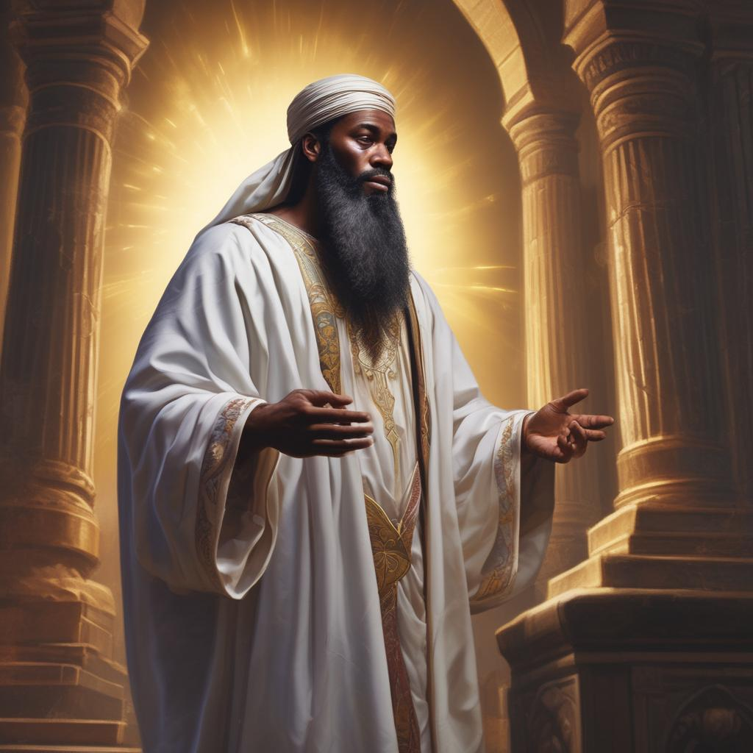
Isaiah Sees God
A Sermon By
Bishop Andy C. Lewter, D. Min.

Slide 2
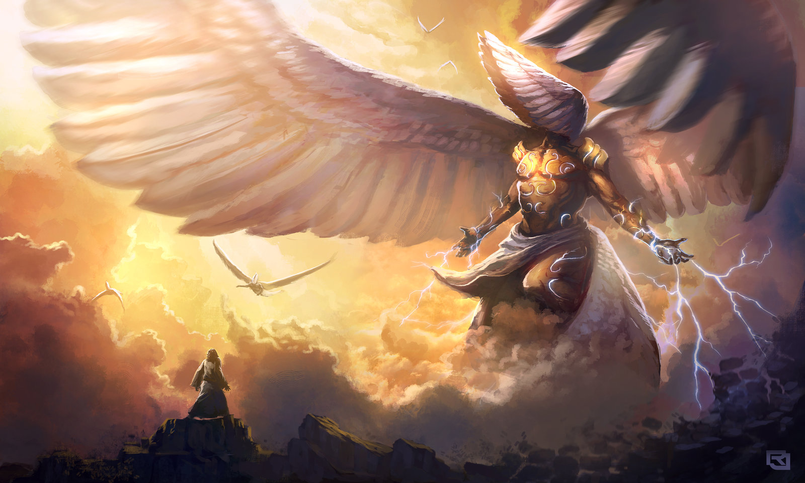
Isaiah 6:1
6 In the year that King Uzziah died, I saw the Lord, high and exalted, seated on a throne; and the train of his robe filled the temple. ² Above him were seraphim, each with six wings: With two wings they covered their faces, with two they covered their feet, and with two they were flying.

Slide 3
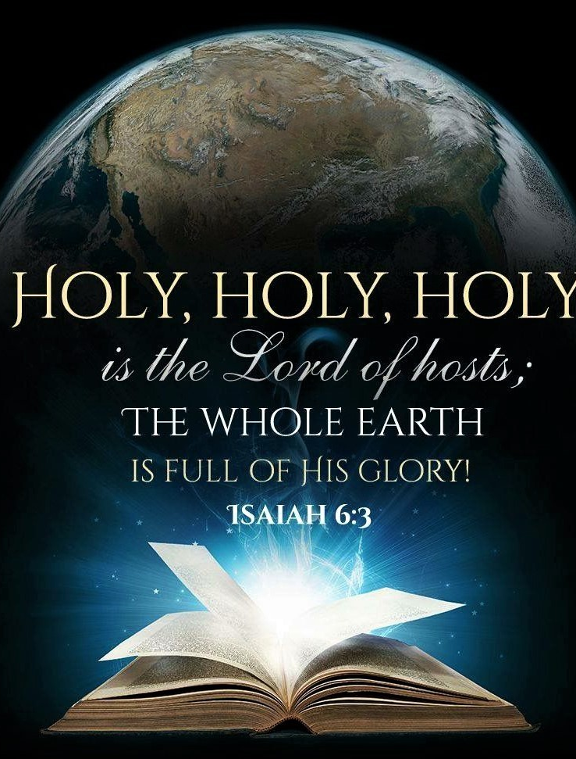
Isaiah 6 Continued
³ And they were calling to one another:
“Holy, holy, holy is the Lord Almighty;
the whole earth is full of his glory.”
⁴ At the sound of their voices the doorposts and thresholds shook and the temple was filled with smoke.

Slide 4

Isaiah 6:8
⁸ Then I heard the voice of the Lord saying, “Whom shall I send? And who will go for us?”
And I said, “Here am I. Send me!”

Slide 5

The Importance of this Election
The consequences of this election is too important for us not to speak truth to power

Slide 6
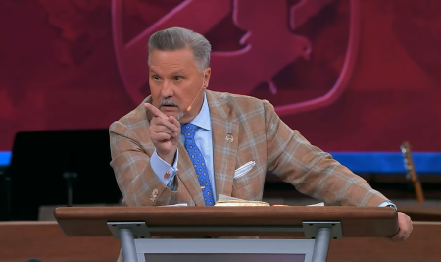
Somebody Needs to Speak
This past week Donnie Swaggert suggested that somebody needed to speak to the Black Church, how about speaking for the Black Church

Slide 7
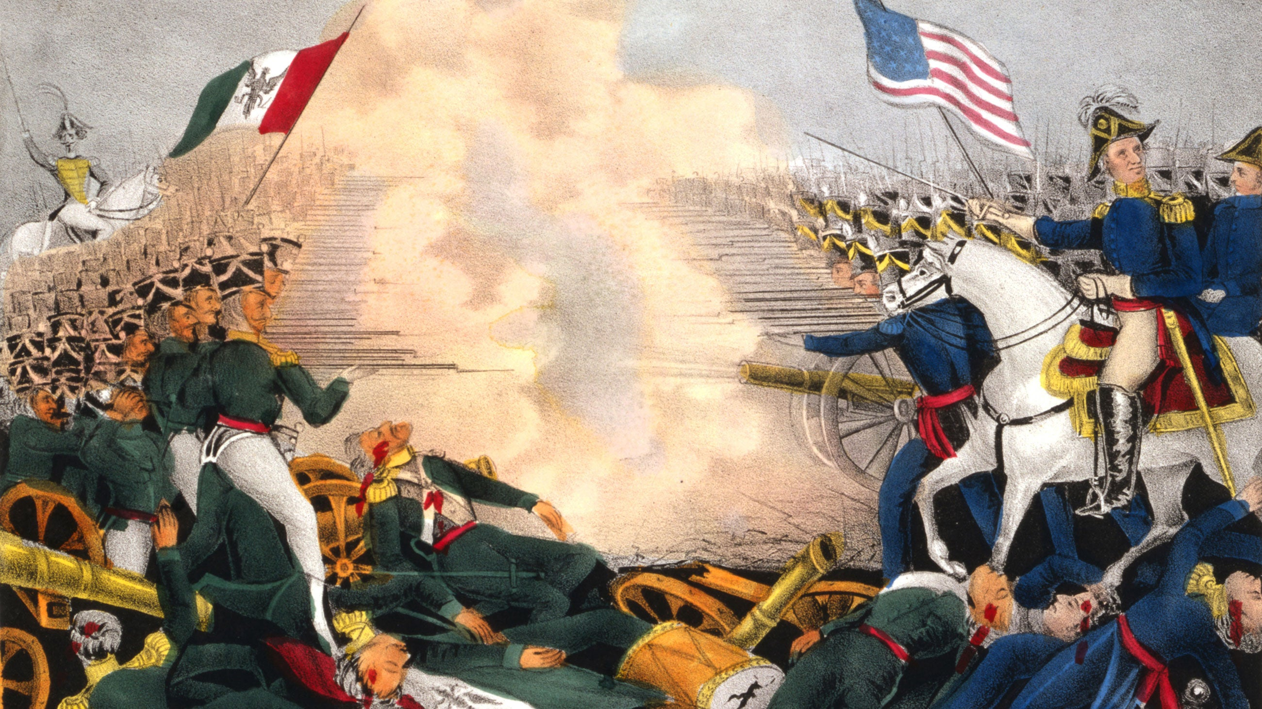
Who Invaded Who?
On February 2, 1848 the "Treaty of Guadalupe Hidalgo was signed bringing to an end the Mexican American War of 1846-1846

Slide 8
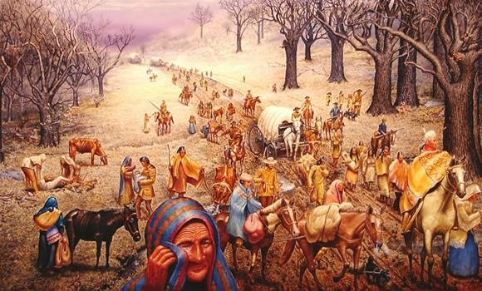
Trail of Tears
From 1830 to 1850 Native Americans were deported from the Southeast to the lands taken in the Mexican-American War

Slide 9
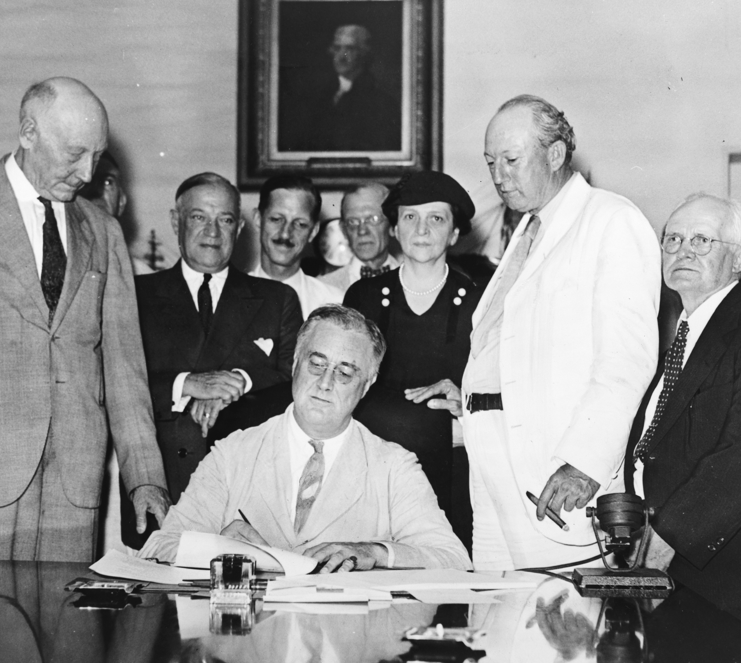
The Social Security Act of 1930
On August 14, 1935 President Franklin D. Roosevelt signed legislation that created Social Security for retirees to insure they would have an income in their latter years. The question is "Who did the act exclude?"

Slide 10
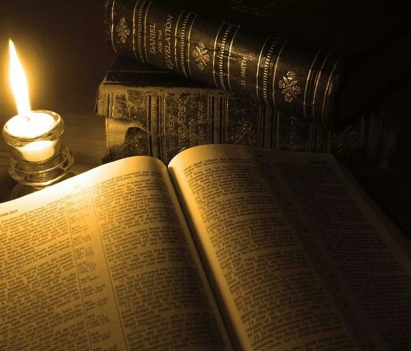
Thank You for Watching

