Slide 1
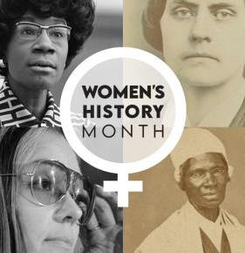
A Salute to Women
A Sermon by
Bishop Andy C. Lewter, D. Min

Slide 2


Introduction
While on Sabbattical, I found myself binging on the 1980’s television series “It’s a Different World” causing me to acknowledge how different is is for women

Slide 3
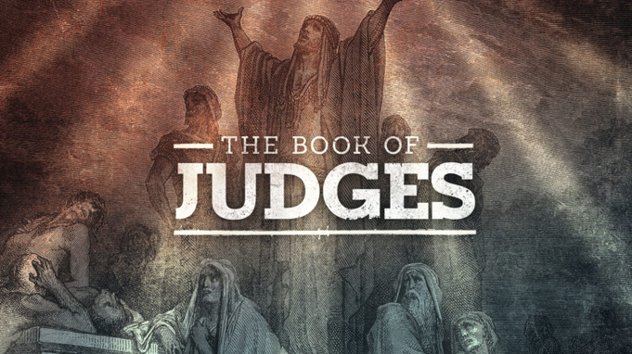
Book of Judges
The second of 12 books of Hebrew History that includes 13 judges starting with Joshua and ending with Samson

Slide 4
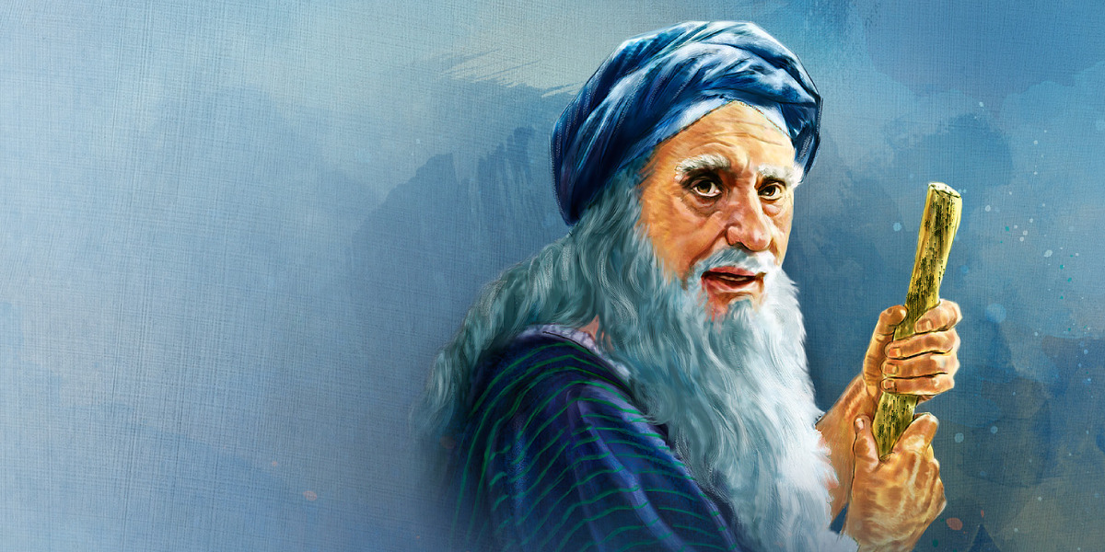
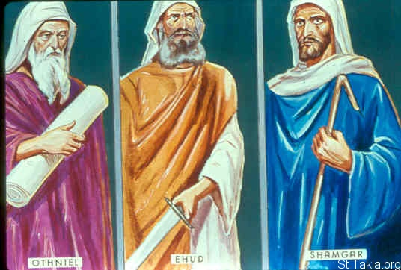
The First Three
The book starts with the stories of Othniel, Ehud and Shamgar and then amazingly pivots to the fourth judge, Deborah, who happens to be a woman

Slide 5

Signifigance
This is a patriarchal society where women were not considered equal to men. For Deborah to be included is to suggest that she must have been both special and powerful

Slide 6
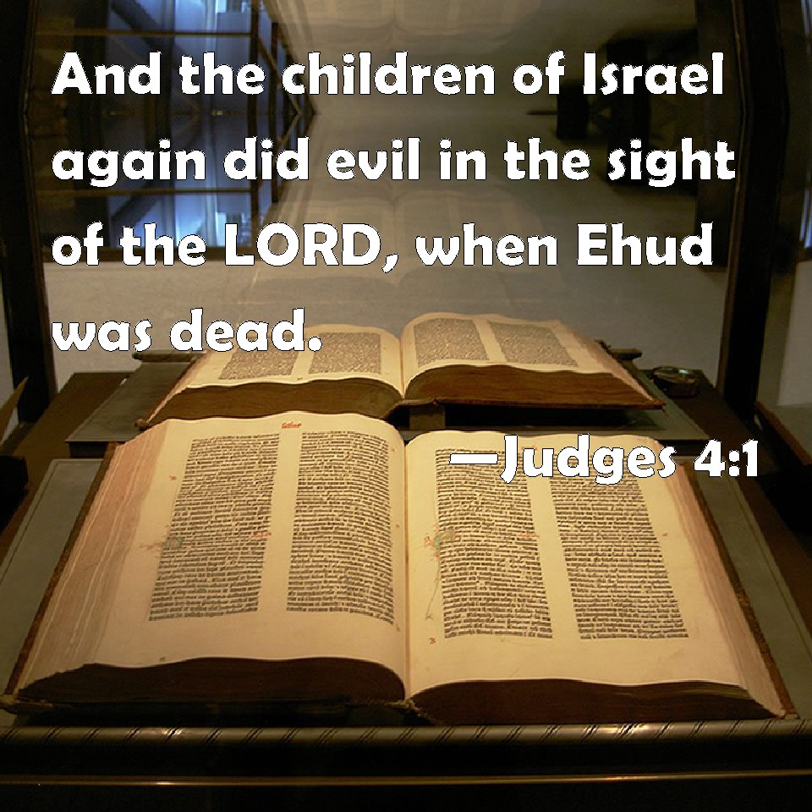
And Again…
The story begins the same way as it does for the male judges. And again, the children of Israel do evil in the eyes of God

Slide 7
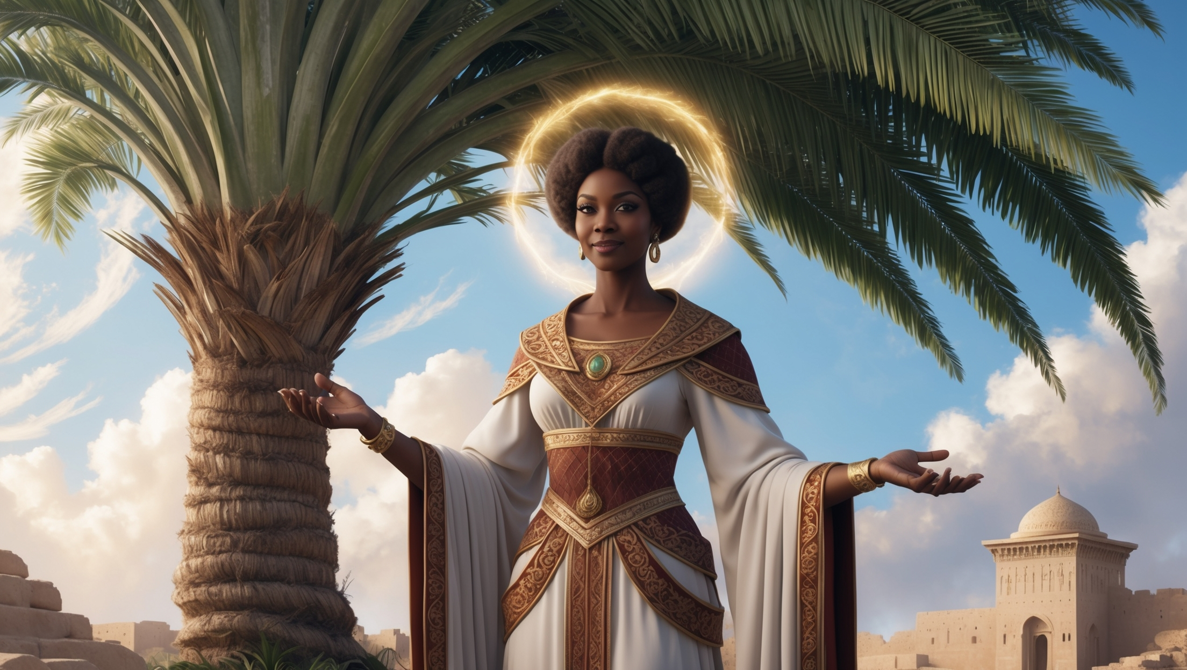
Justice
Chapter 4 says that Deborah distributed justice beneath a palm tree between Ramah and Bethel, where she is approached by the people

Slide 8
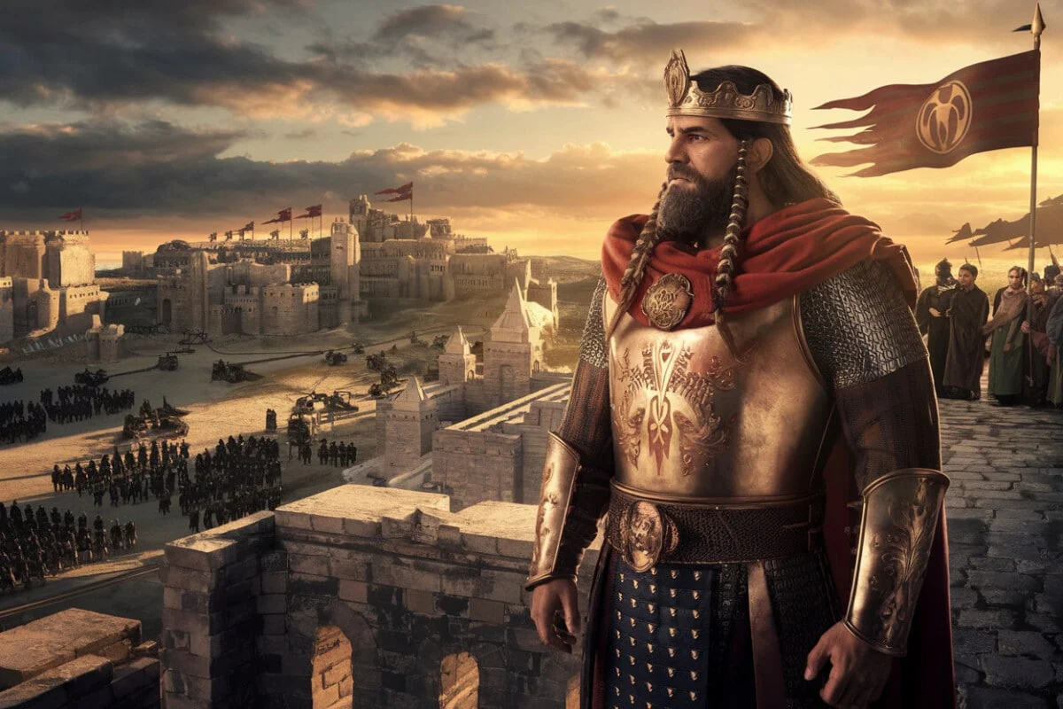
For 20 Years
The children of God suffered under the king Jabin of the Canaanites. Like so many times before, God heard their cries and came to their aid

Slide 9
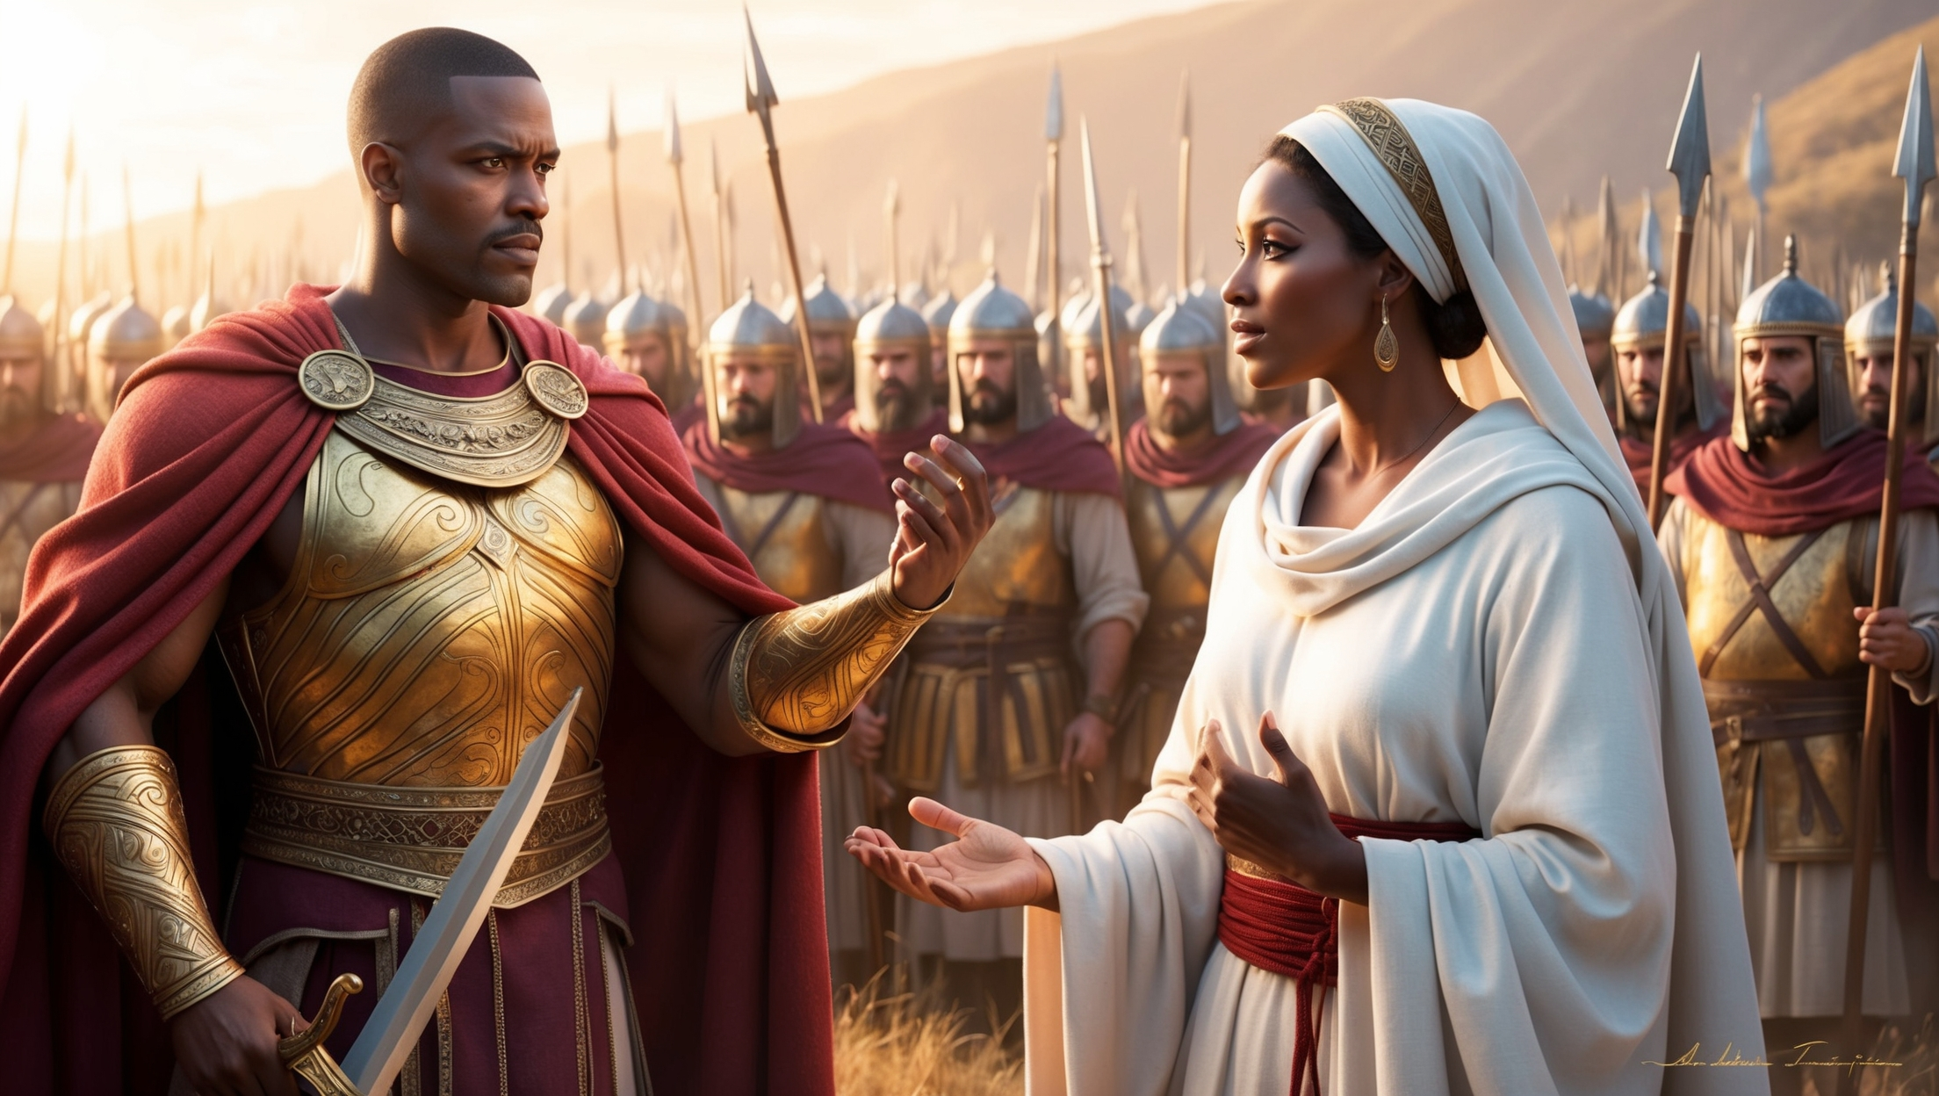
Go Tell Barak
The man after whom the first Black president is named is told by Deborah to take 10,000 men to Mt. Tabor to face Sisera and his army

Slide 10
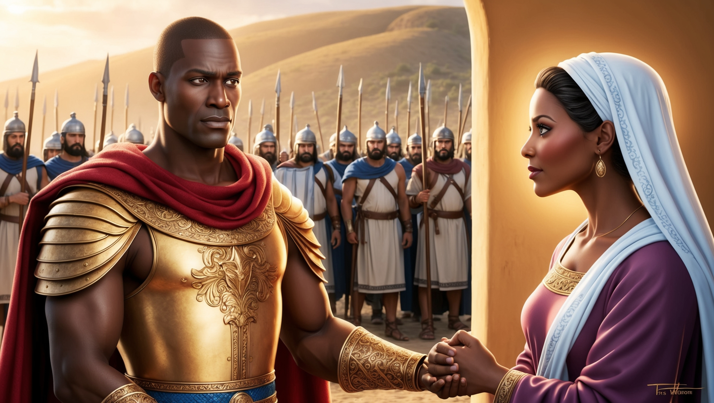
I Won’t Go
Barak refuses to go unless Deborah goes with him. Deborah tells Barak that he won’t get the credit, but God will get the glory at the hands of a woman

Slide 11
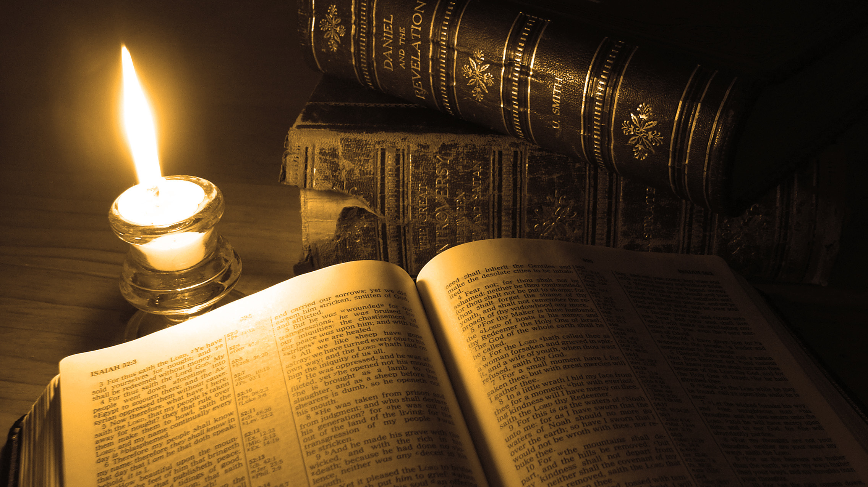
Thank You for Watching

