Slide 1


APPRECIATING
ASH WEDNESDAY
A Bible Webinar By
Bishop Andy C. Lewter, D. Min

Slide 2

ASH WEDNESDAY
In this lesson, we will delve into the rich history, profound symbolism, and contemporary practice of Ash Wednesday among Christians. From its origins to its modern-day observance

Slide 3
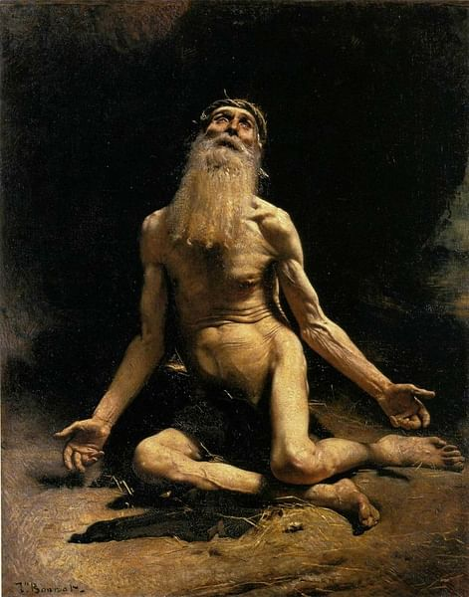
ASH WEDNESDAY
Biblical and Historical Background: The roots of Ash Wednesday can be found in various biblical and historical references. In the Hebrew Bible, ashes are often associated with mourning, repentance, and humility (e.g., Job 42:6, Daniel 9:3, Jonah 3:6). Early Christians adopted these symbolic practices within their own tradition.

Slide 4
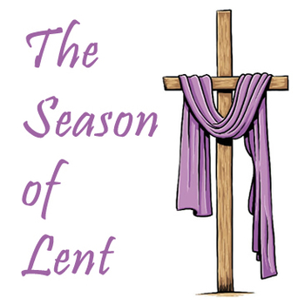
ASH WEDNESDAY
Development of Lenten Observance: The observance of Lent, the forty-day period of fasting and penance leading up to Easter, developed gradually in the early centuries of Christianity. Initially, Lent was a time of preparation for catechumens (those preparing for baptism) and a few days of repentance for those who had committed serious sins.

Slide 5
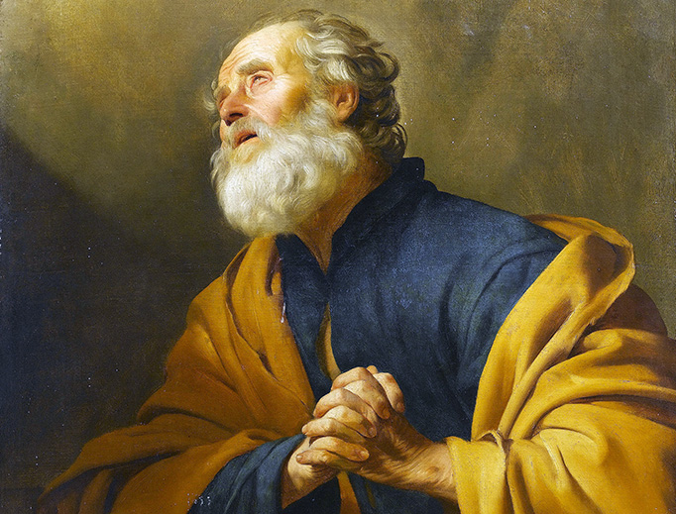
ASH WEDNESDAY
Emergence of Penitential Practices: By the fourth century, penitential practices became more formalized within the Christian community. Public penance for serious sins was common, often involving periods of fasting, prayer, and acts of charity.

Slide 6

ASH WEDNESDAY
Introduction of Ashes: The specific use of ashes on the forehead as a sign of penance likely developed later in the early medieval period. By the eighth century, the imposition of ashes on Ash Wednesday became a widespread practice in Western Christianity.

Slide 7

ASH WEDNESDAY
Liturgical Development: Over time, Ash Wednesday became firmly established within the liturgical calendar of the Church, marking the beginning of Lent. The imposition of ashes symbolizes mortality ("Remember that you are dust, and to dust you shall return") and the need for repentance and spiritual renewal.

Slide 8

ASH WEDNESDAY
Early Observance of Lent: The origins of Lent can be traced back to the early Christian communities, where fasting and penitential practices were observed in preparation for Easter. Initially, Lent was a relatively short period, often lasting only a few days before Easter Sunday.

Slide 9
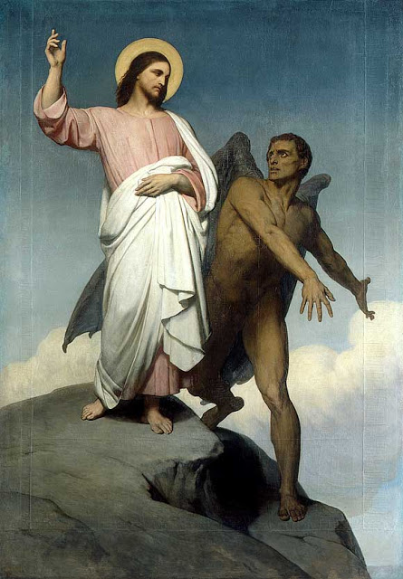
ASH WEDNESDAY
Extension of Lenten Period: Over time, the duration of Lent expanded to encompass forty days, mirroring significant biblical motifs such as the forty days Jesus spent fasting in the wilderness before beginning his public ministry (Matthew 4:1-11, Luke 4:1-13).

Slide 10
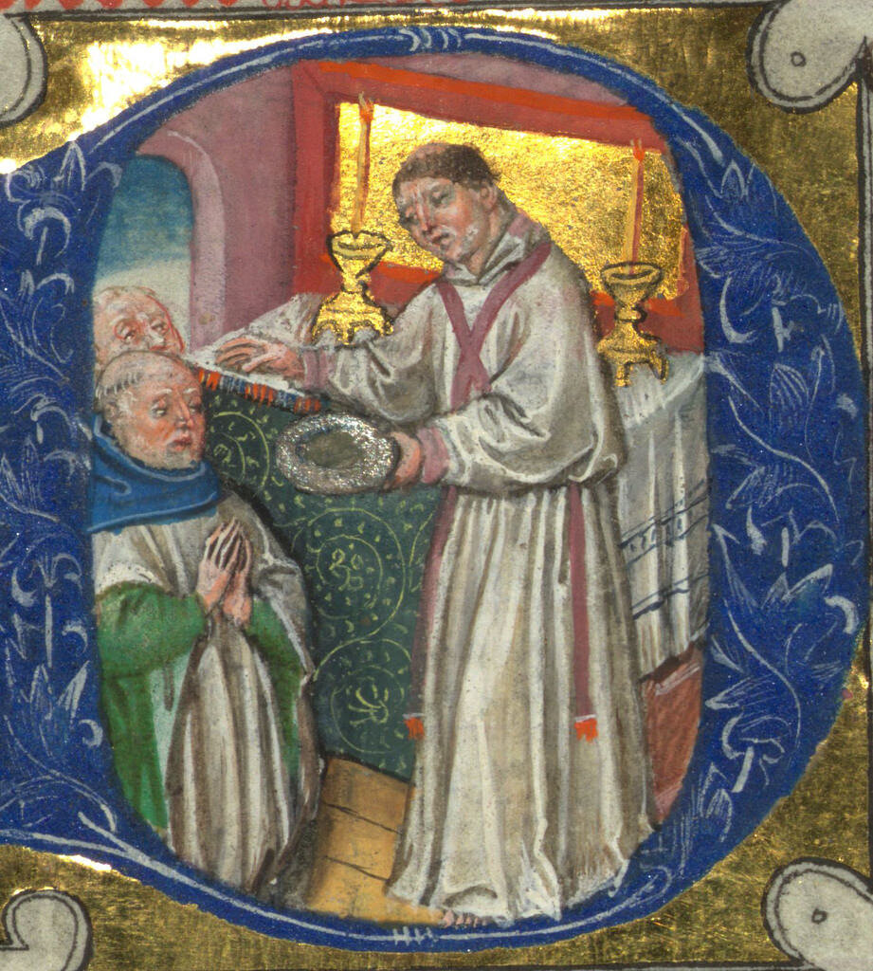
ASH WEDNESDAY
Introduction of Ash Wednesday: Ash Wednesday emerged as the initial day of Lent, marking the beginning of the forty-day period of fasting, prayer, and repentance. The specific observance of Ash Wednesday, with the imposition of ashes on the forehead, likely developed in the medieval period.

Slide 11
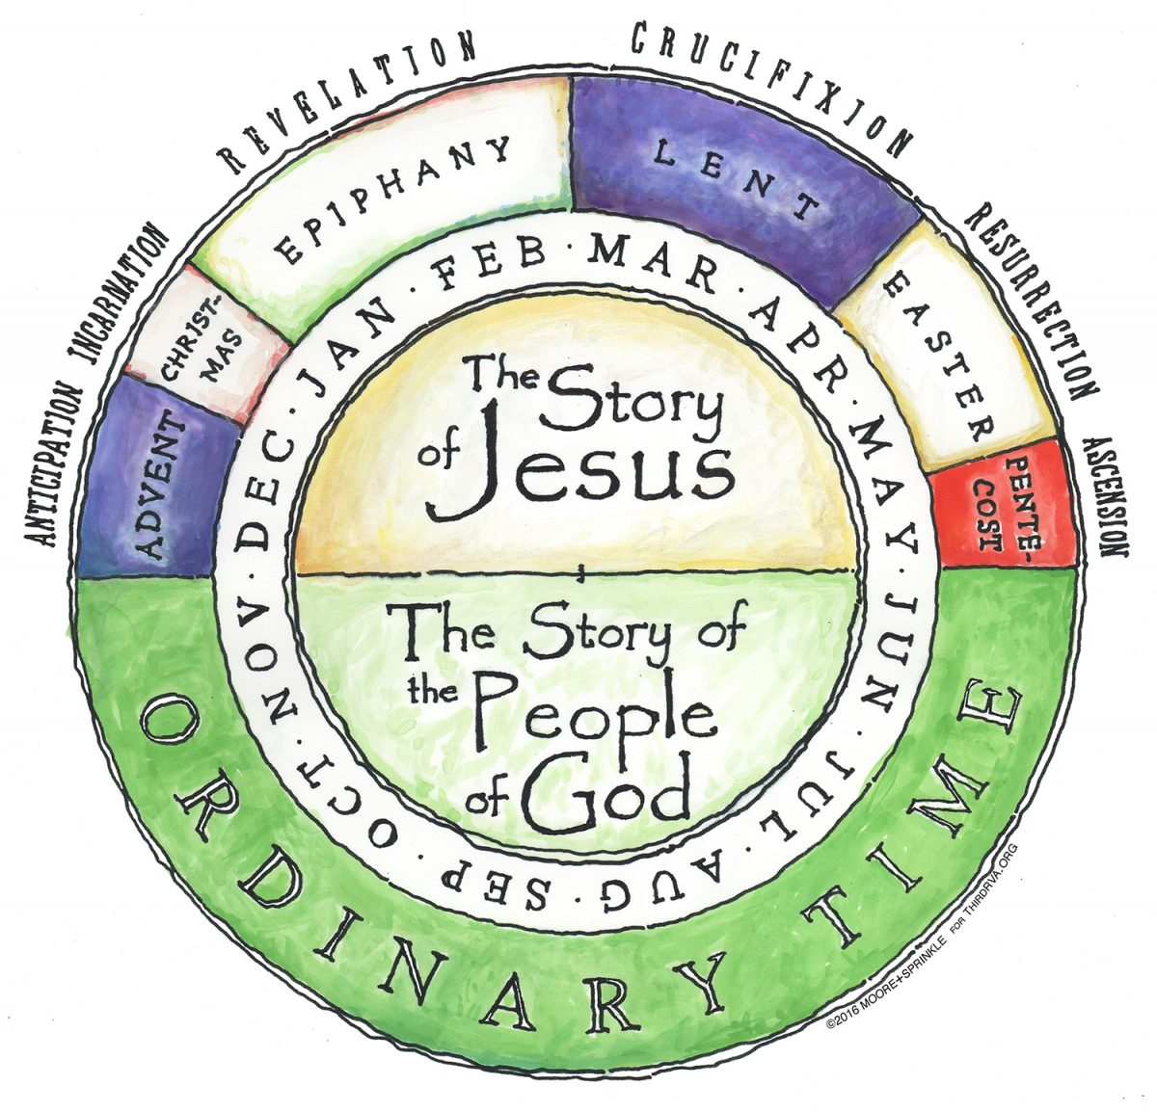
ASH WEDNESDAY
Integration into Liturgical Calendar: Ash Wednesday became firmly established within the liturgical calendar of the Church, serving as a pivotal day that inaugurates the season of Lent.

Slide 12

ASH WEDNESDAY
Old Teachings on Repentance:

Slide 13
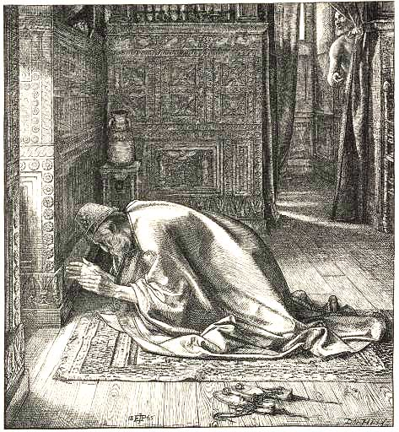
ASH WEDNESDAY
Old Testament: In the Hebrew Bible, ashes are frequently associated with mourning, repentance, and humility. For example, Job, after enduring great suffering, repents "in dust and ashes" (Job 42:6). The prophet Daniel, in seeking forgiveness for his people, humbles himself with fasting and sackcloth (Daniel 9:3).

Slide 14
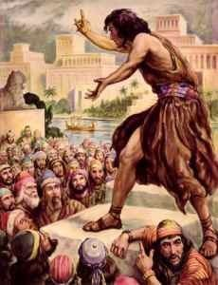
ASH WEDNESDAY
Jonah's Preaching: The city of Nineveh, upon hearing Jonah's preaching, repents and turns to God, expressing their penitence through fasting and wearing sackcloth, which symbolizes humility and repentance (Jonah 3:5-9).

Slide 15
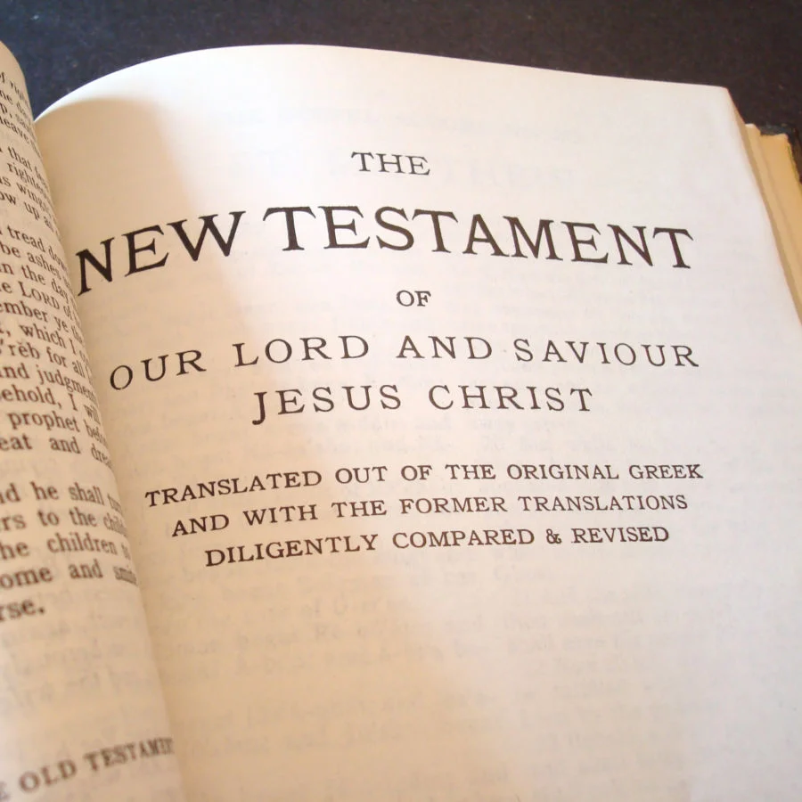
ASH WEDNESDAY
New Testament Teachings on Repentance:

Slide 16

ASH WEDNESDAY
Jesus' Ministry: Throughout his ministry, Jesus emphasizes the importance of repentance and turning towards God's kingdom (Matthew 4:17, Mark 1:15). He calls people to repentance and forgiveness, inviting them to a renewed relationship with God.

Slide 17
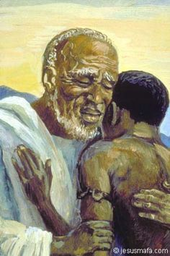
ASH WEDNESDAY
Parables of Repentance: Jesus' parables, such as the Prodigal Son (Luke 15:11-32) and the Pharisee and the Tax Collector (Luke 18:9-14), highlight the significance of repentance and God's mercy.

Slide 18

ASH WEDNESDAY
Historical Development of Penitential Practices:

Slide 19
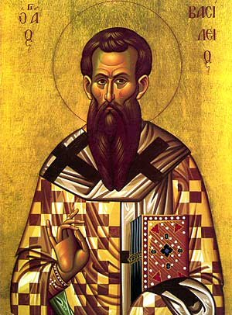
ASH WEDNESDAY
Early Church Fathers: The writings of early Church fathers, such as Tertullian and Origen, attest to the practice of penance and fasting among early Christians.

Slide 20

ASH WEDNESDAY
Summary

Slide 21

ASH WEDNESDAY
Initiation of the Lenten Season: Ash Wednesday marks the beginning of Lent, a period of forty days (excluding Sundays) leading up to Easter Sunday. Lent is a time of spiritual preparation, reflection, and repentance, mirroring Jesus' forty days of fasting in the wilderness.

Slide 22

ASH WEDNESDAY
Symbolism of Ashes: The imposition of ashes on Ash Wednesday carries profound symbolic significance. The ashes, typically made from the burned palm branches of the previous year's Palm Sunday, symbolize human mortality.

Slide 23

ASH WEDNESDAY
Call to Repentance and Renewal: Ash Wednesday serves as a solemn reminder of the Christian call to repentance and renewal. It invites believers to reflect on their lives, acknowledge their shortcomings, and seek reconciliation with God and others.

Slide 24

ASH WEDNESDAY
Preparation for Easter: The observance of Lent, beginning with Ash Wednesday, prepares Christians for the celebration of Easter, the central event of the Christian faith.

Slide 25

ASH WEDNESDAY
Unity in Tradition: Ash Wednesday unites Christians across denominational lines in a shared observance of penitence and preparation for Easter.

