Slide 1
A Sermon By Bishop Andy C. Lewter, D. Min

Slide 2
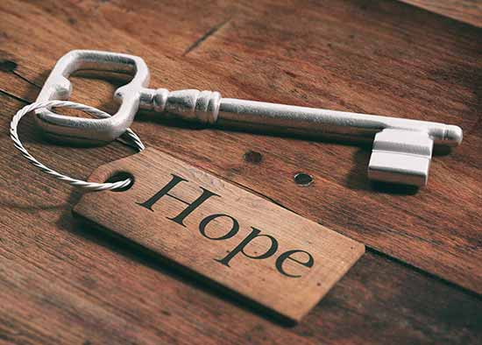
Rebirth of Hope
This week I would like to address you with a sermon that I have entitled “The Re-Birth of Hope”

Slide 3
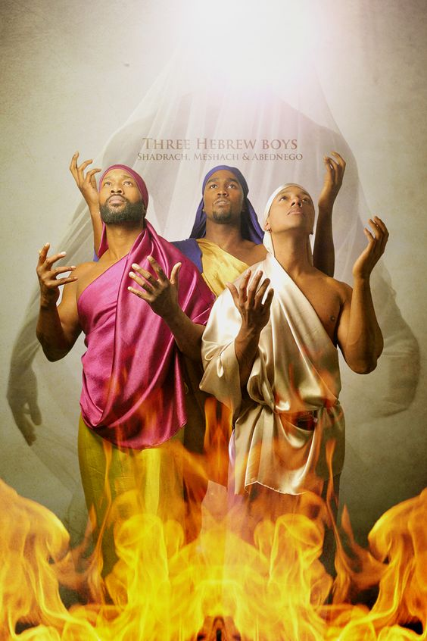
Last Week
Last week we discussed the three Hebrew Boys and their refusal to bow down to the golden image created by the king

Slide 4
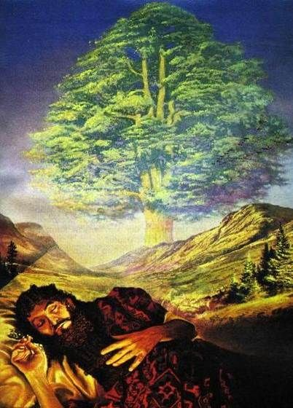
A Second Dream
After the fiery furnace, we are told that king Nebuchanezzar has a second dream that is as puzzling as the first

Slide 5
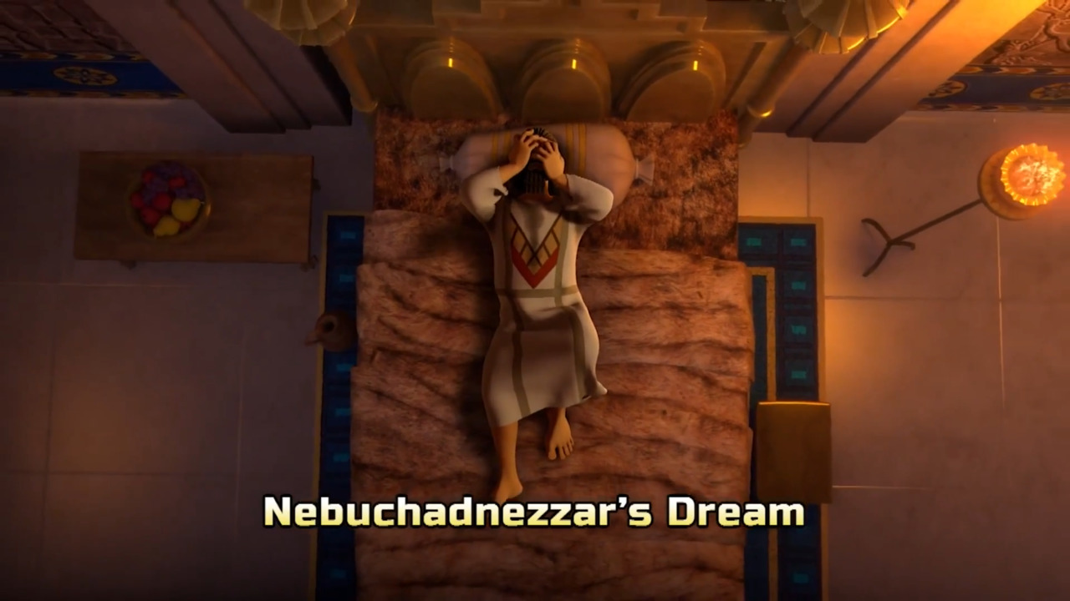
God is Great
In this dream Nebuchanezzar is told that he will be brought low until he acknowledges and recognizes how great God is

Slide 6
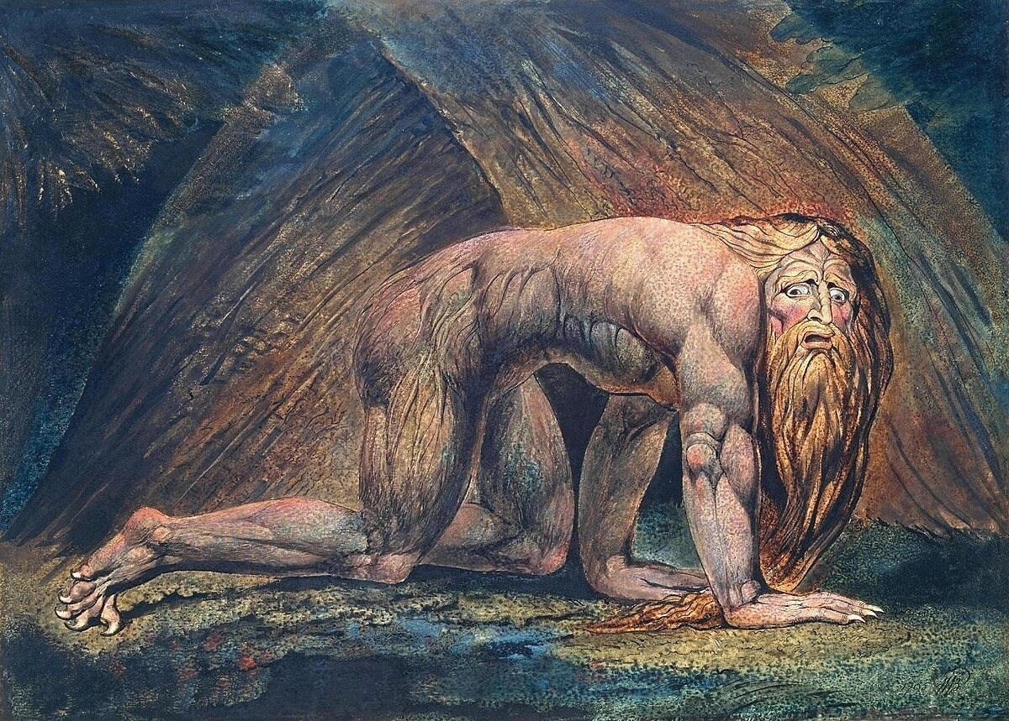
Uncooperative
Because of his refusal, Nebuchanezzar roams the wilderness as a wild animal until he repents and salutes God as the greatest power on the face of the earth

Slide 7
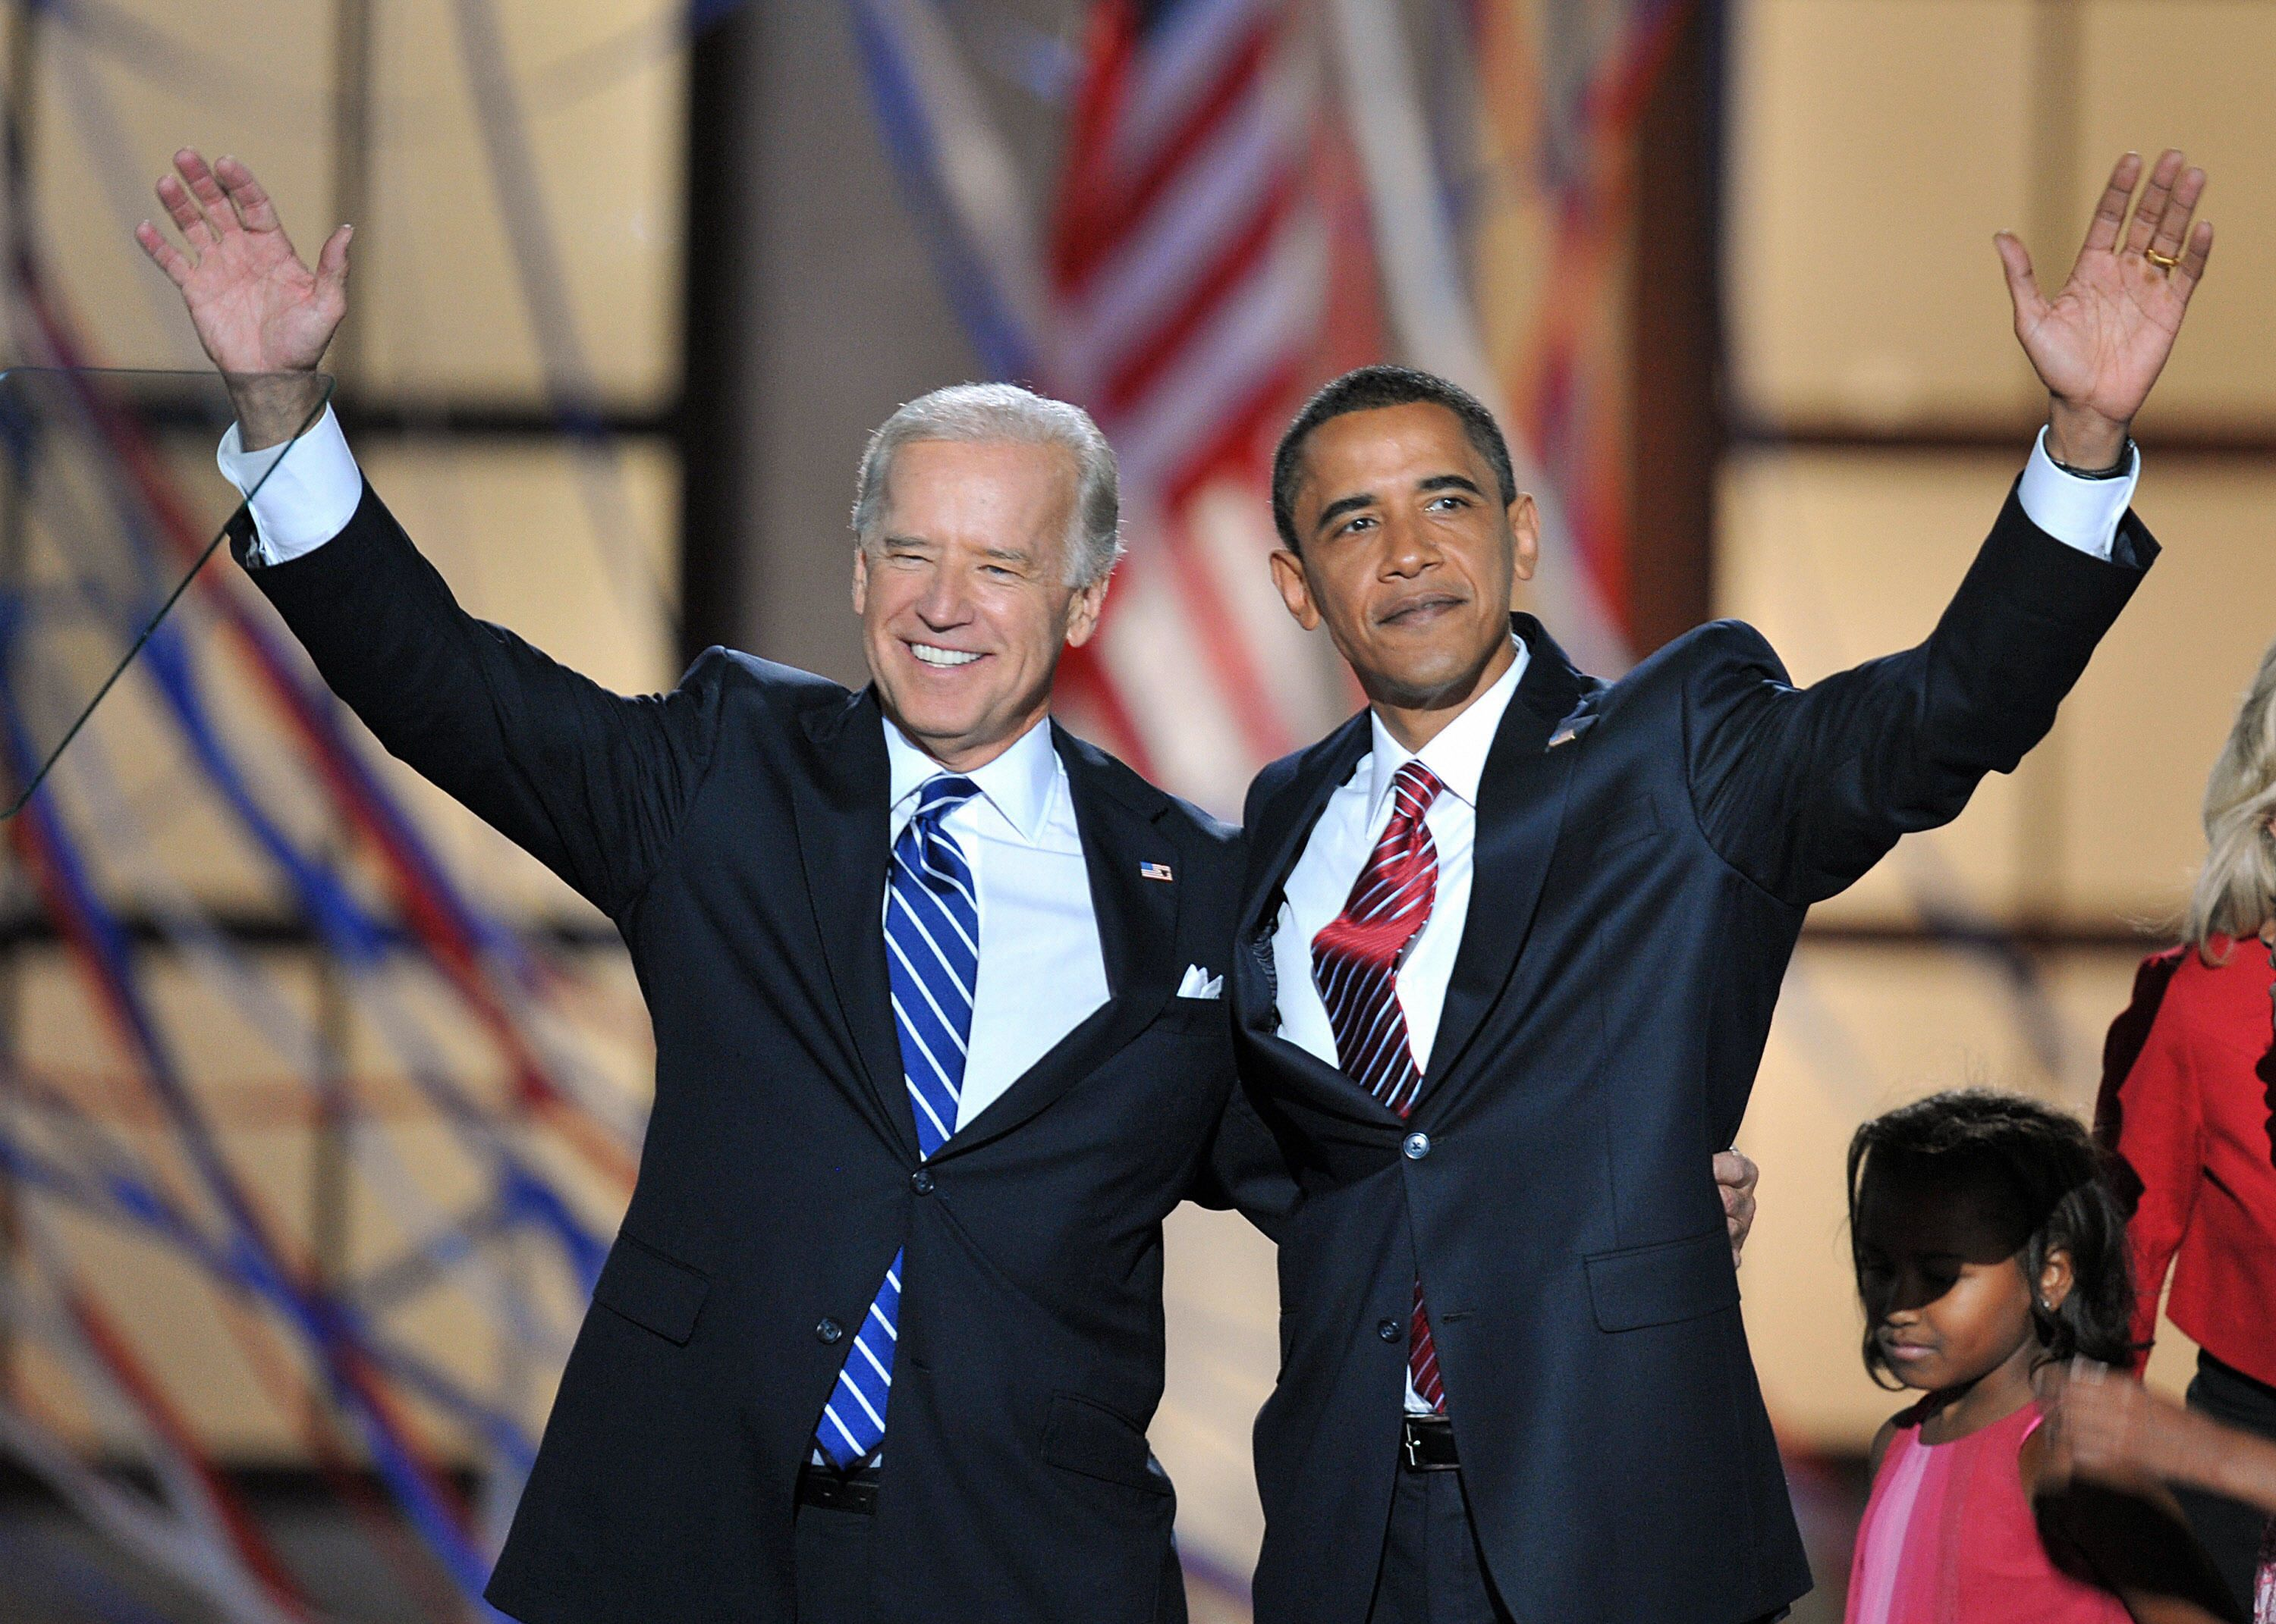
2008
In 2008, America elected two men that gave the country hope rather than despair and optimism rather than complaints

Slide 8
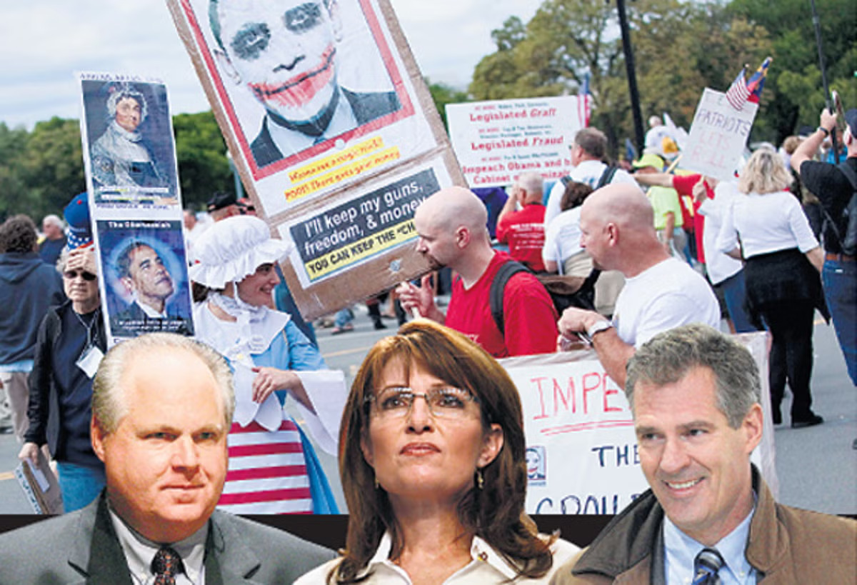
Backlash
Beginning with the “Tea Party” we began to see a fierce backlash from some in the country who regretted that the country had made so much progress

Slide 9
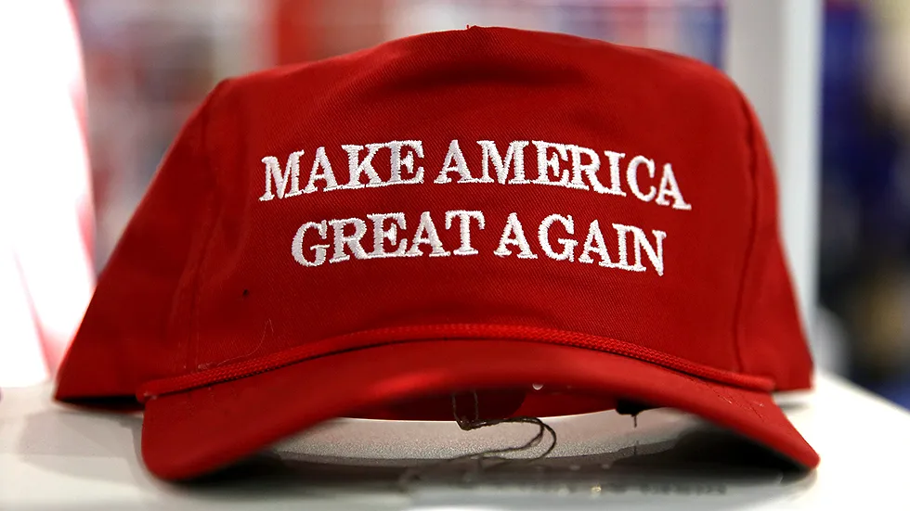
MAGA
Let’s be clear that when we hear “Make America Great Again” that is a reference to a time when all people in this country were not seen as equal

Slide 10
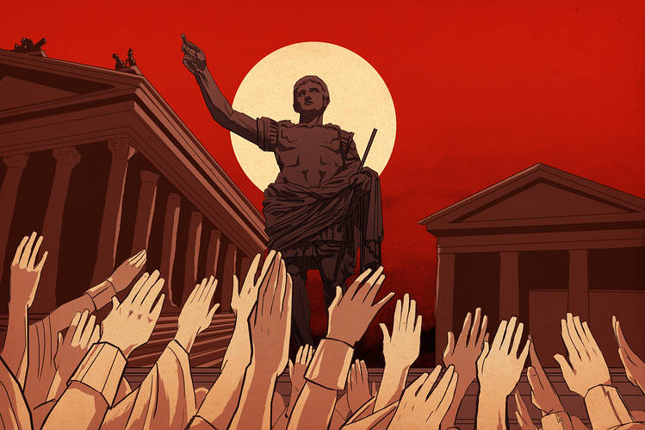
Last Night
Last night I saw a quote made to Christians that if they vote this time things will be fixed in such a way that they would not have to vote again

Slide 11
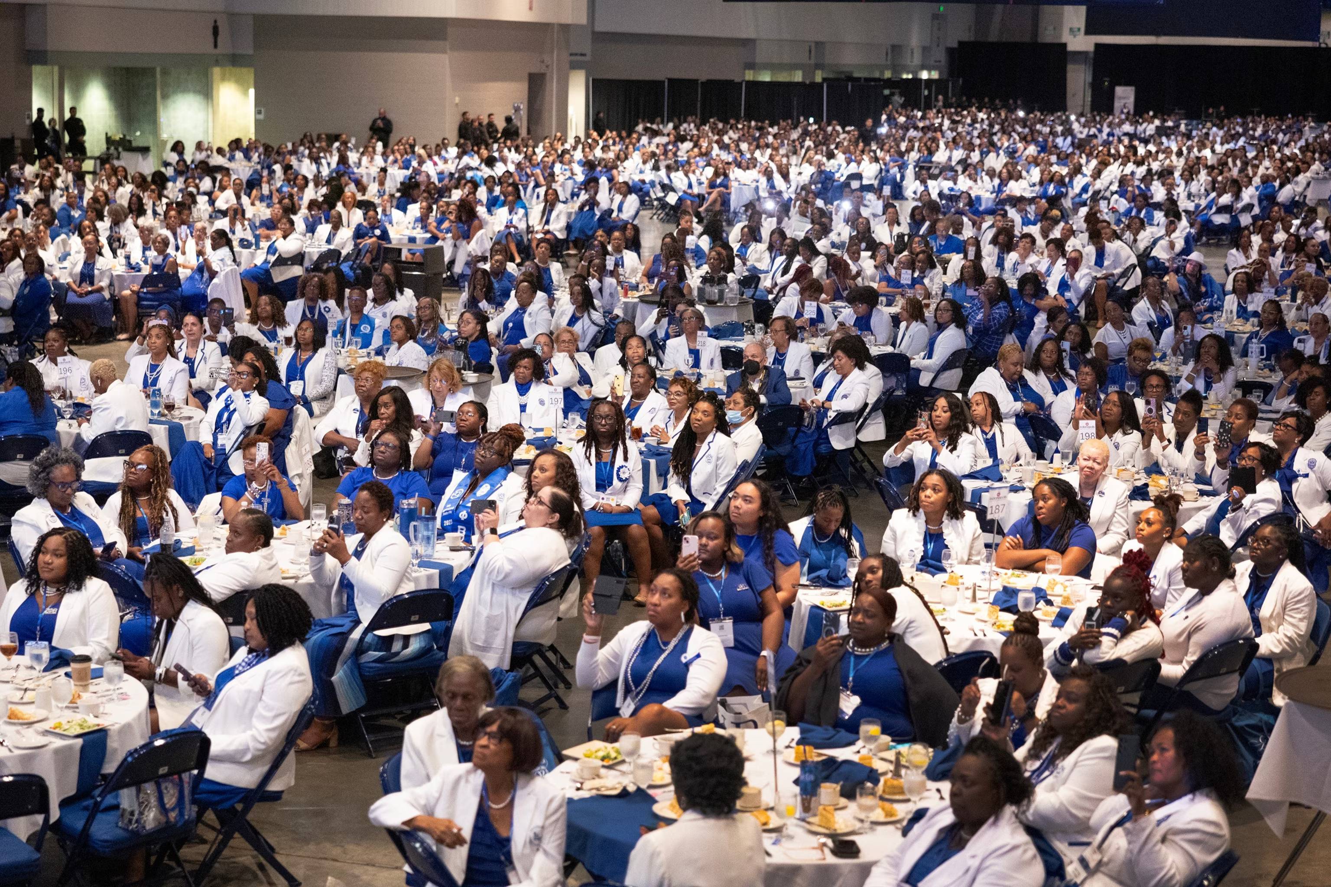
Enthusiasm
I have not seen our country with so much enthusiasm and excitement since the presidential election of 2008

Slide 12
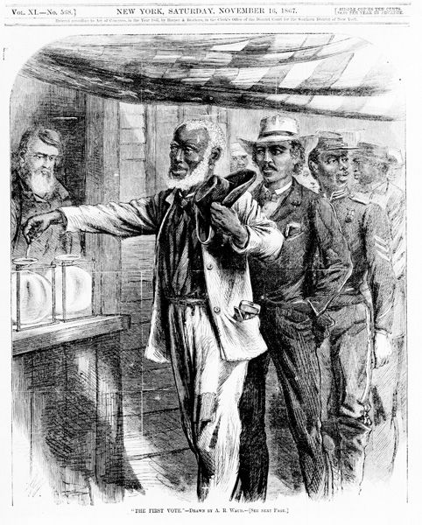
Not Going Back
I admonish and encourage all of us to exercise our right to vote that was paid for with the blood and tears of our ancestors

Slide 13
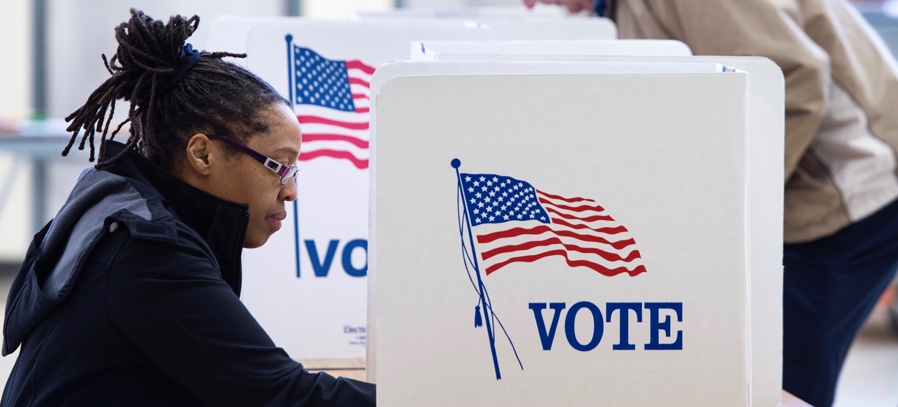
Democracy
The only guarantee that we have that democracy will continue in the future is if we refuse to stay home and make sure that we do whatever it takes to perform our civic duty and vote

Slide 14
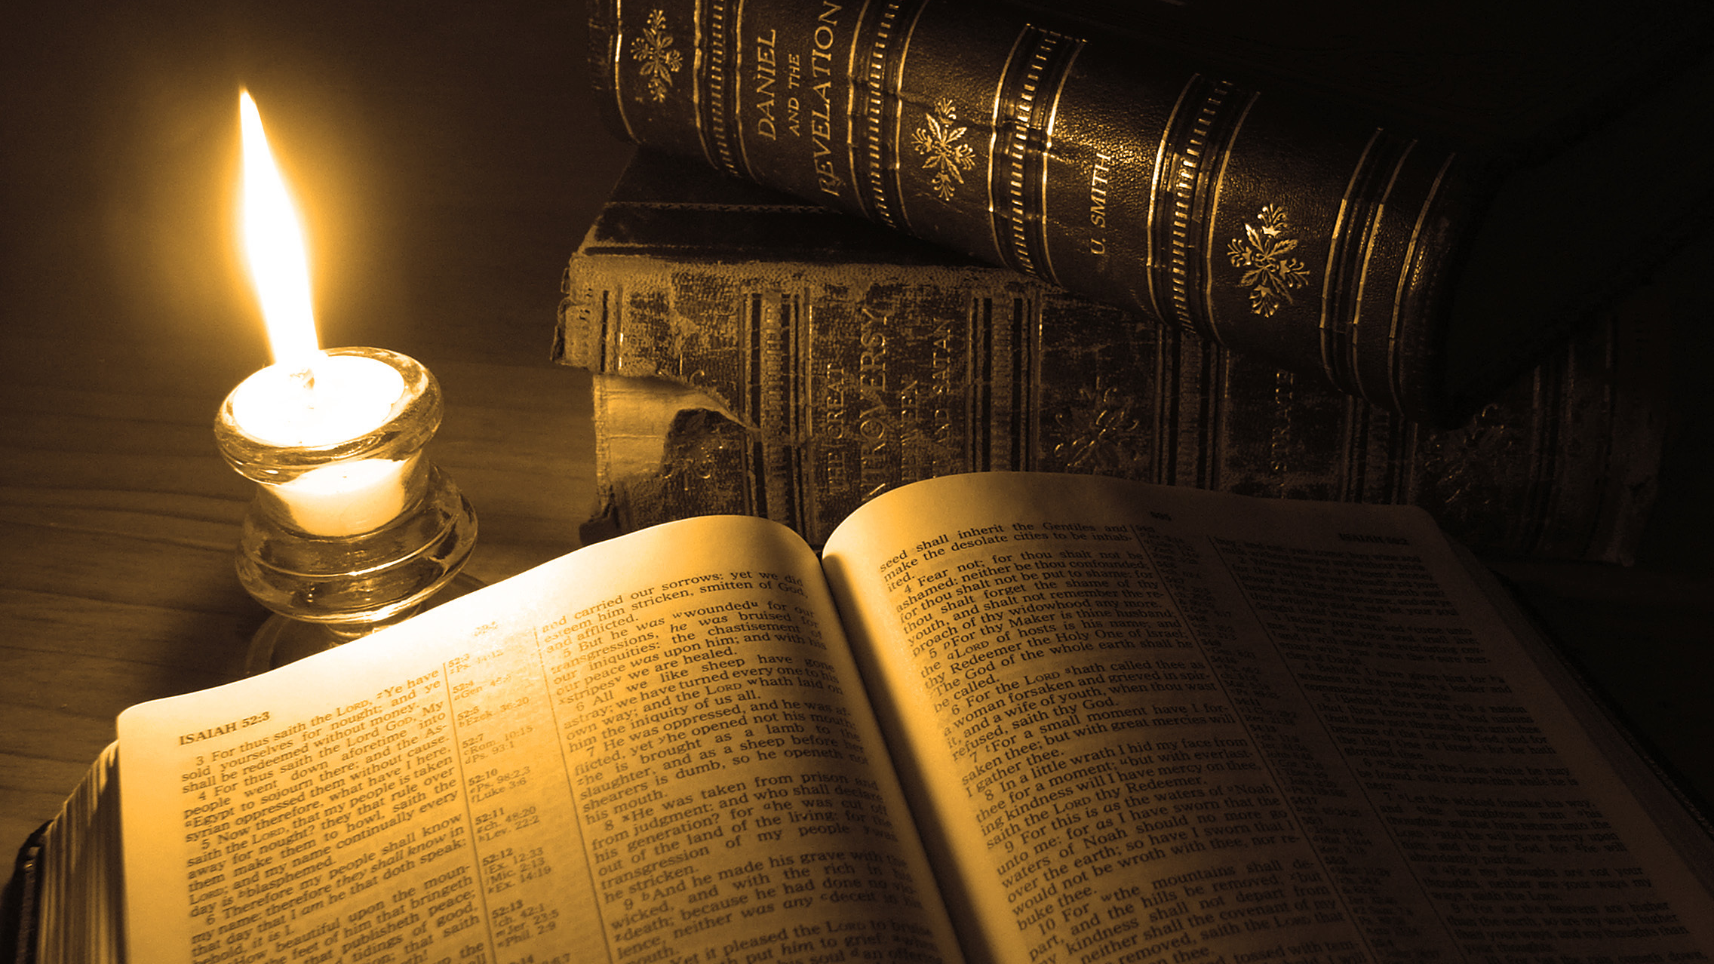
Thank You for Watching

