Slide 1
A Lecture By Bishop Andy C. Lewter, D. Min

Slide 2
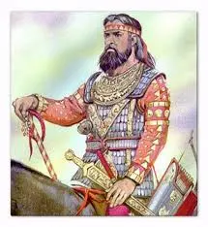
Darius
Last week we saw Daniel survival the Lion’s Den and the deceipt of those who were jealous of him

Slide 3
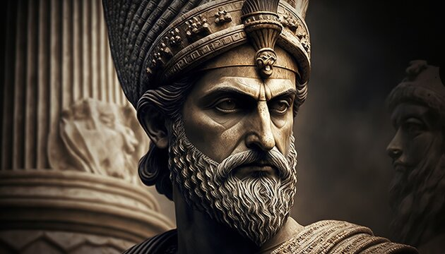
Cyrus
When Darius moves off the scene he is replaced by Cyrus the Great

Slide 4
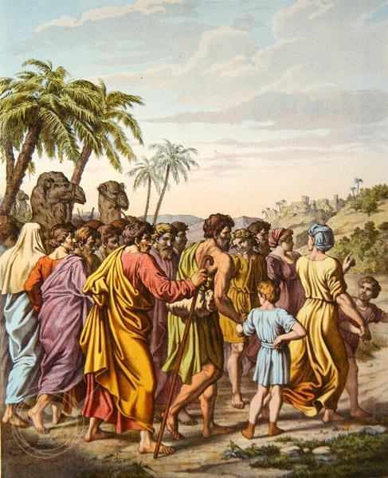
The Return
It is this Cyrus that permits the Children of Israel to return to Jerusalem and resume their relationship with God

Slide 5
Nehemiah
After Daniel the story of the Bible picks up with the story of Nehemiah and Ezra along with the return to Jerusalem from captivity

Slide 6
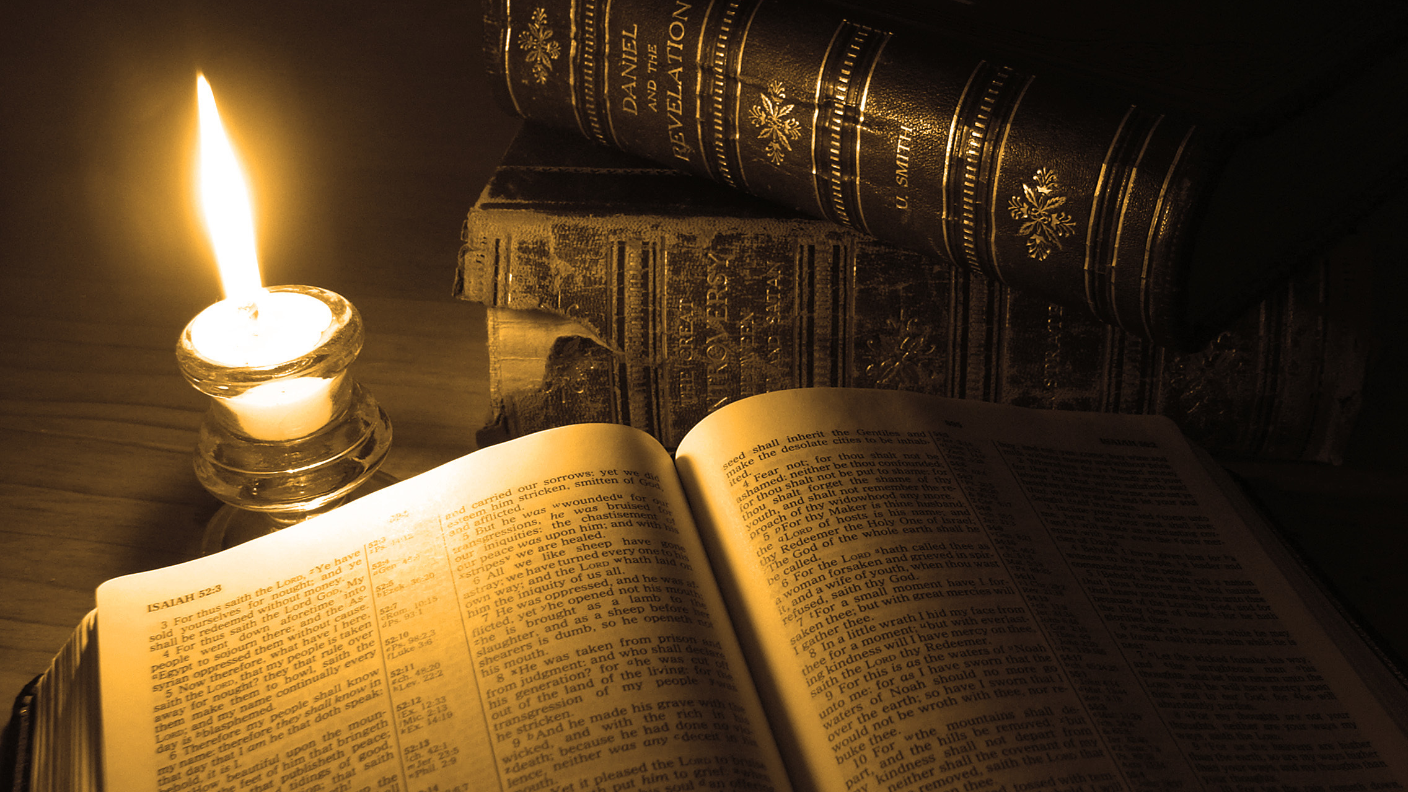
Thank You for Watching

