Slide 1
A Sermon By Bishop Andy C. Lewter, D. Min

Slide 2
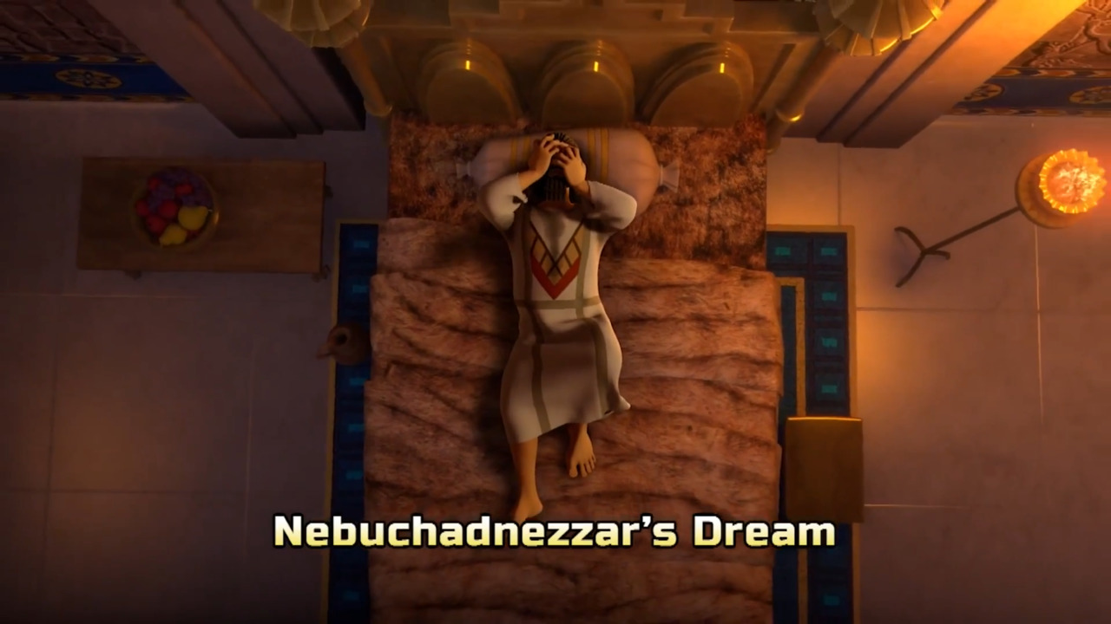
2. The Dream
We begin this week with the dream that the king had that nobody could interpret except Daniel

Slide 3
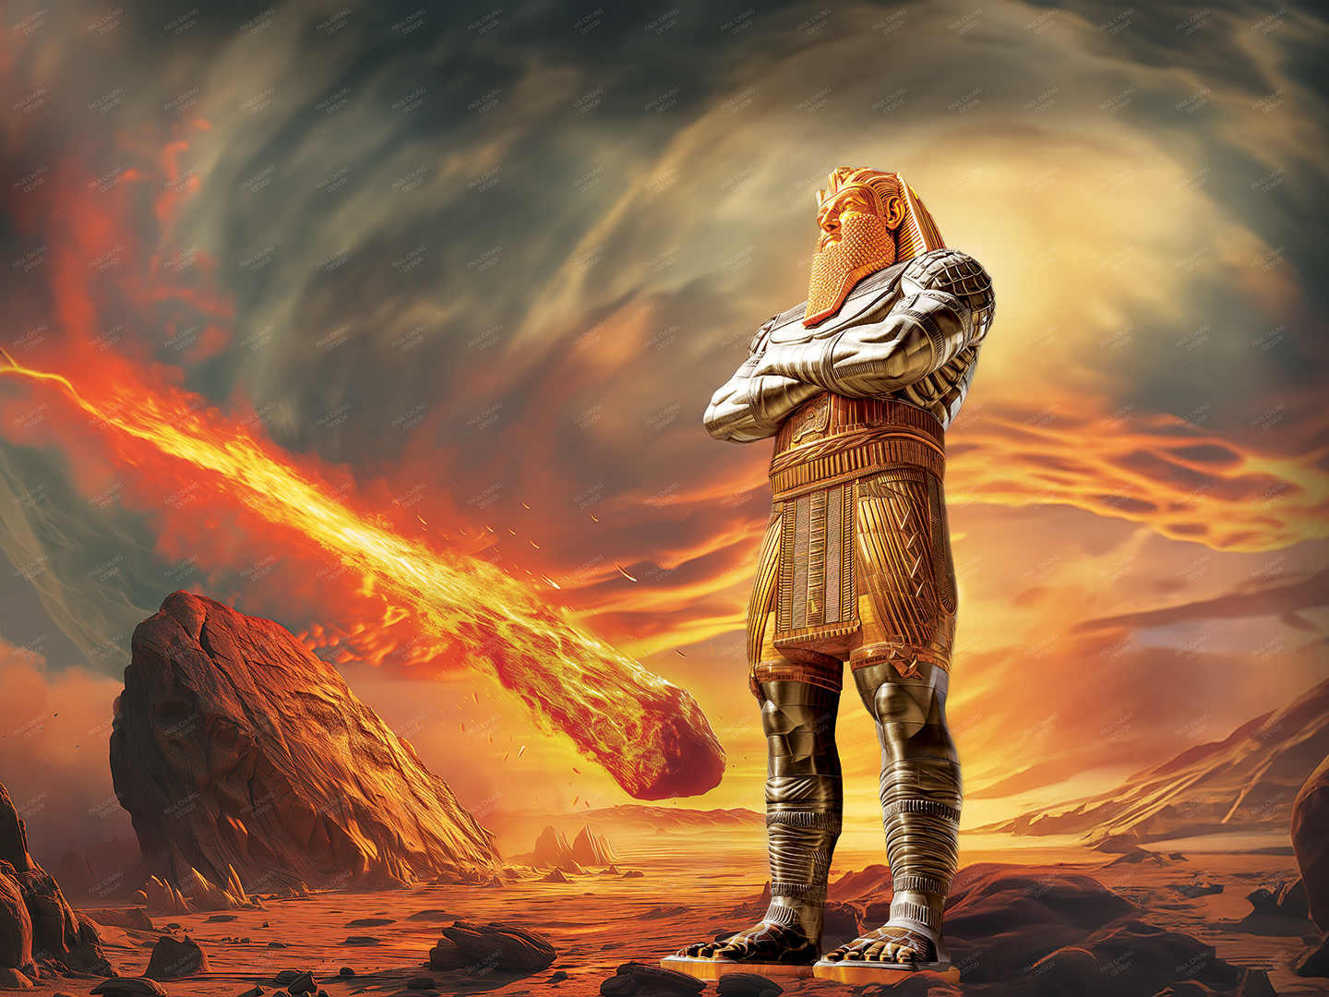
The Statue
Daniel tells the king that the statue he dreamed about represented various empires of which he and Babylon would be the head (gold)

Slide 4
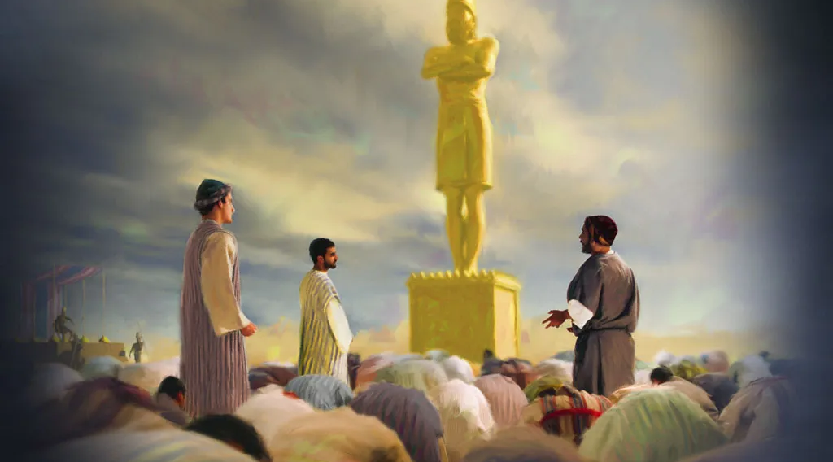
Golden Image
In response, the king builds a golden image and instructs everyone to bow down to the image and worship it

Slide 5
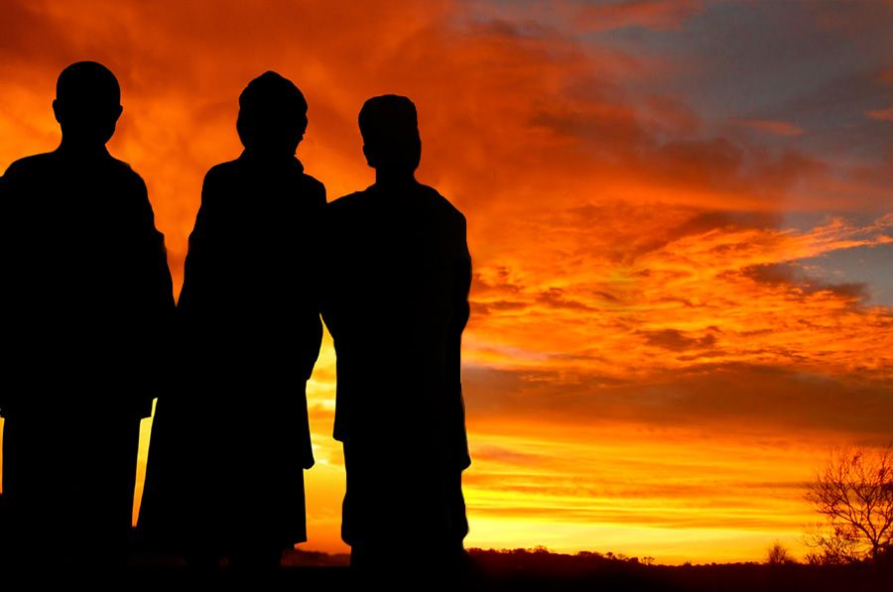
Refusing to Bow
The three Hebrew boys refuse to bow and are pointed out to the king by those who were already jealous of them and the favor they had from God

Slide 6
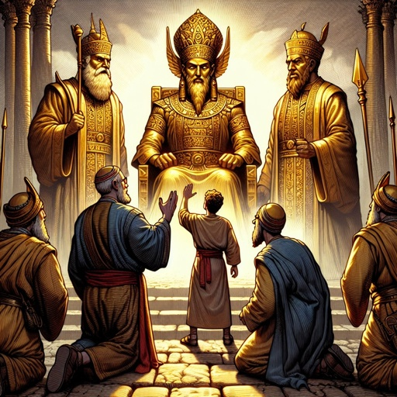
Jealous Ones
The only way others could have told on the three Hebrew Boys would have been if they were being as dis-obedient as what they were accusing the Hebrew boys of

Slide 7
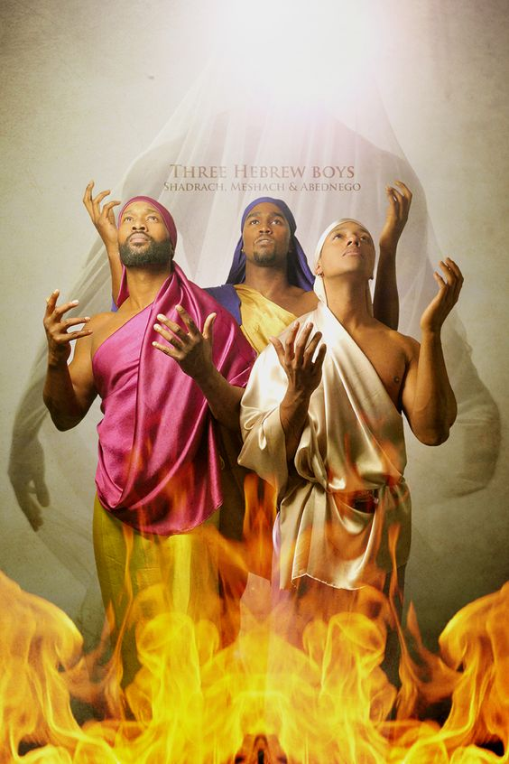
Hebrew Boys
The three Hebrew Boys refuse to bow to the statue of the king and is placed in the fiery furnace

Slide 8
The Results
After surviving the furnace the Bible says that they do not even smell like moke. We do not look like what we have been through

Slide 9
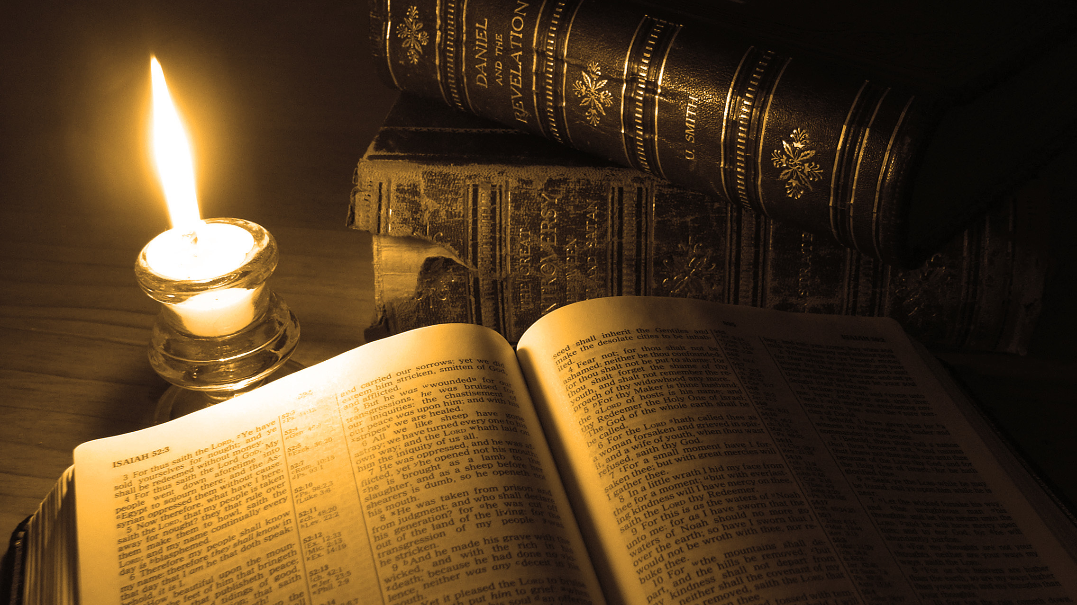
Thank You for Watching

