Slide 1

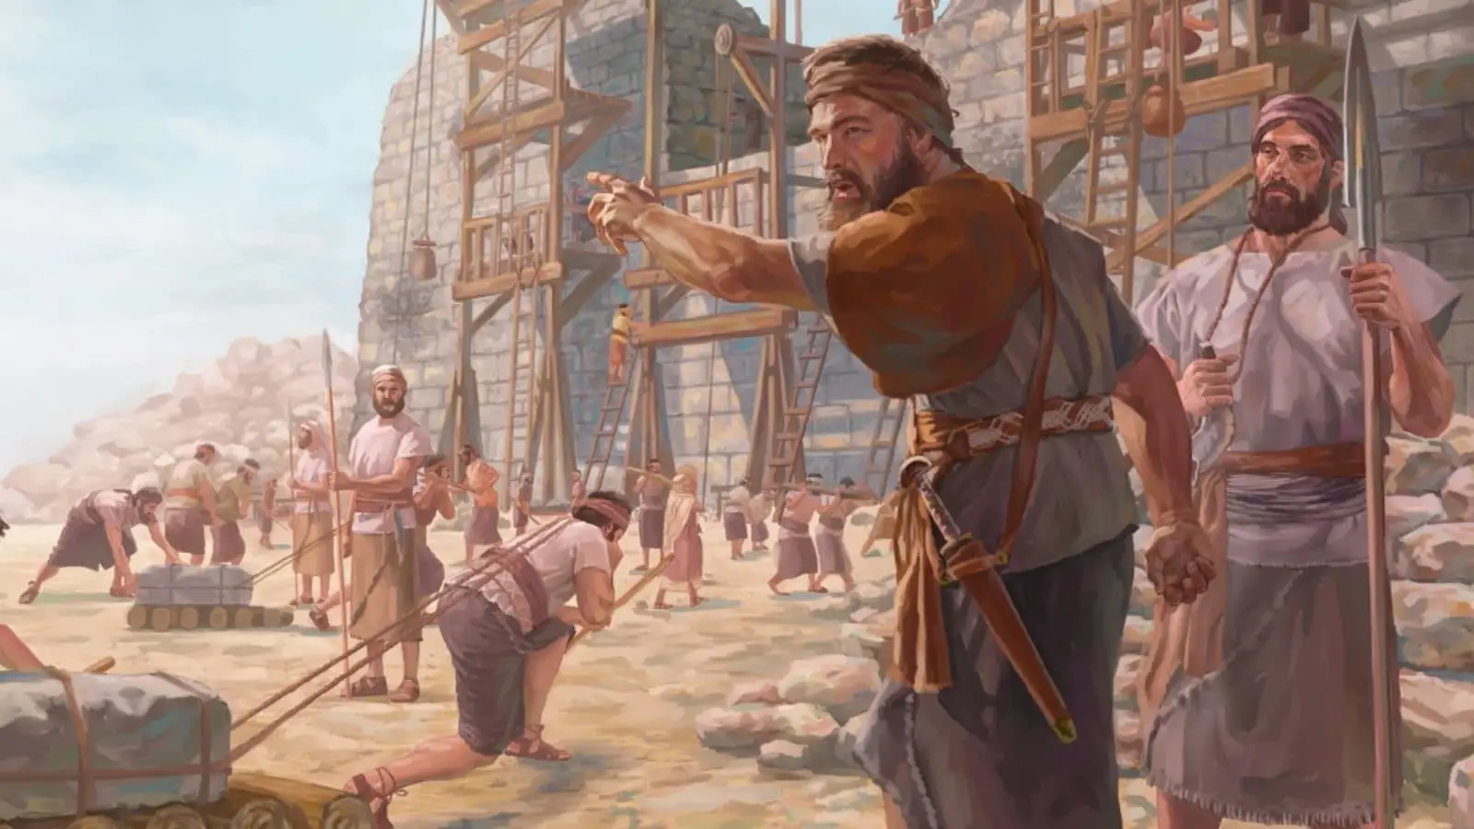

I Won't Come Down
Part 2
A Bible Webinar By,
Bishop Andy C. Lewter, D. Min.

Slide 2
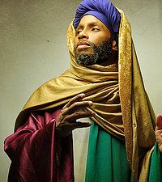

This completes my series on Nehemiah from the Old Testament

Slide 3
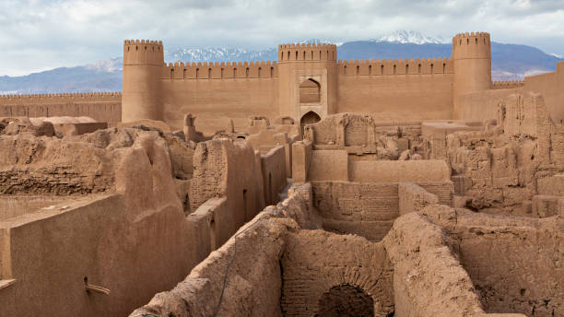
By way of Review, Nehemiah escapes to Persia, returns to Jerusalem, rebuilds the walls of the city and refuses to meet with Sanballet and Tobias

Slide 4
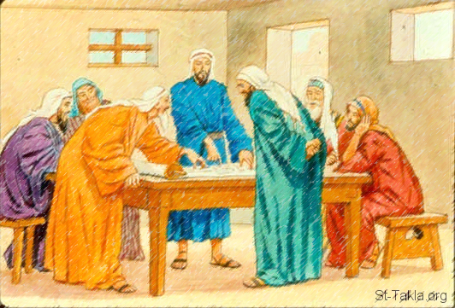

Opposition to Nehemiah came from the Philistines, Arabs (descendents of Ishmael), Ammonites and Samaritans

Slide 5
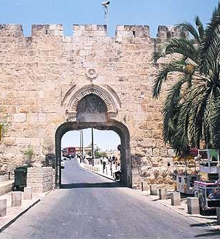
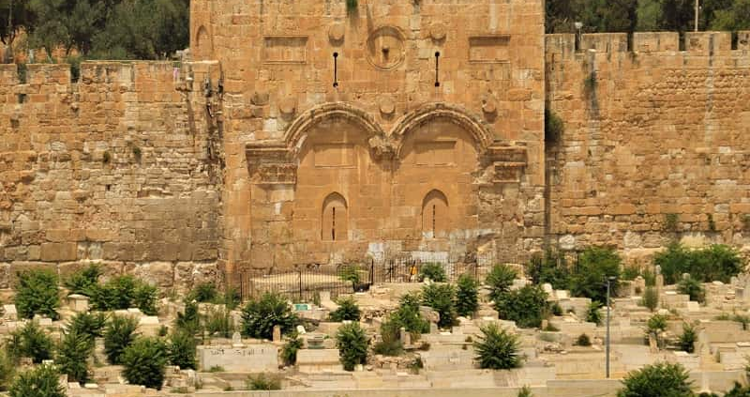
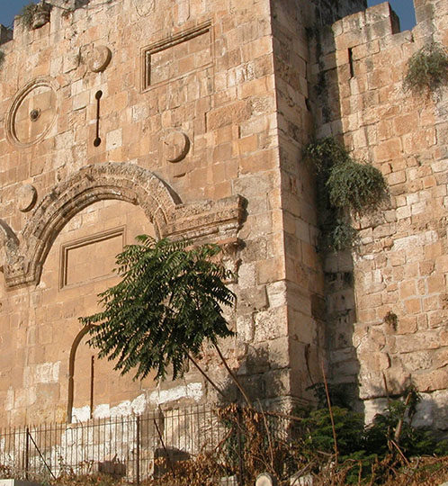
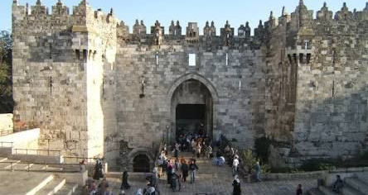
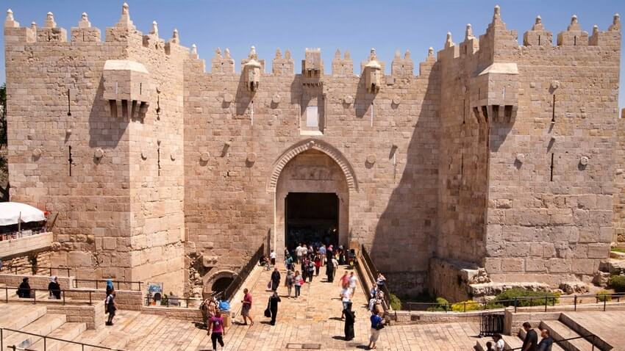
The gates of the city included: Golden, Fish, Sheep, Dung, East gates, all built within 52 days.

Slide 6
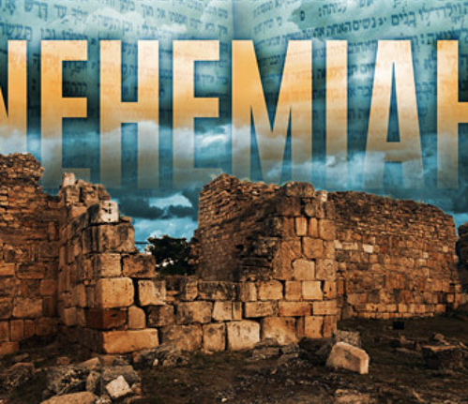
The reforms of Nehemiah included the cancellation of debt, promulgation of the Laws of Moses and the enforcement of divorce of Jewish men from non-Jewish women

Slide 7
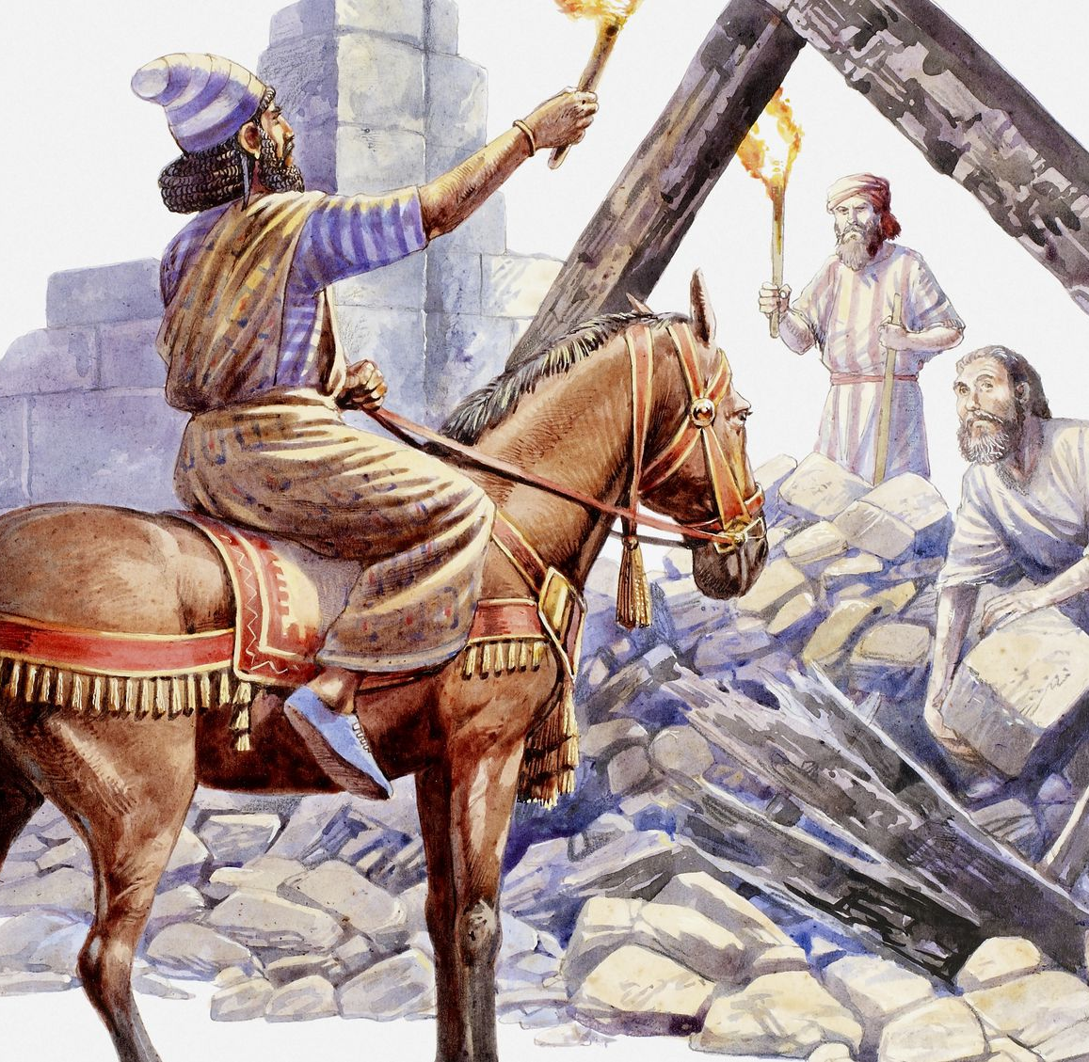
After 12 years as governor, Nehemiah returns to Susa for a short period of time. When he returns he finds that the people had fallen back into their old ways
Notes:
BBC

Slide 8
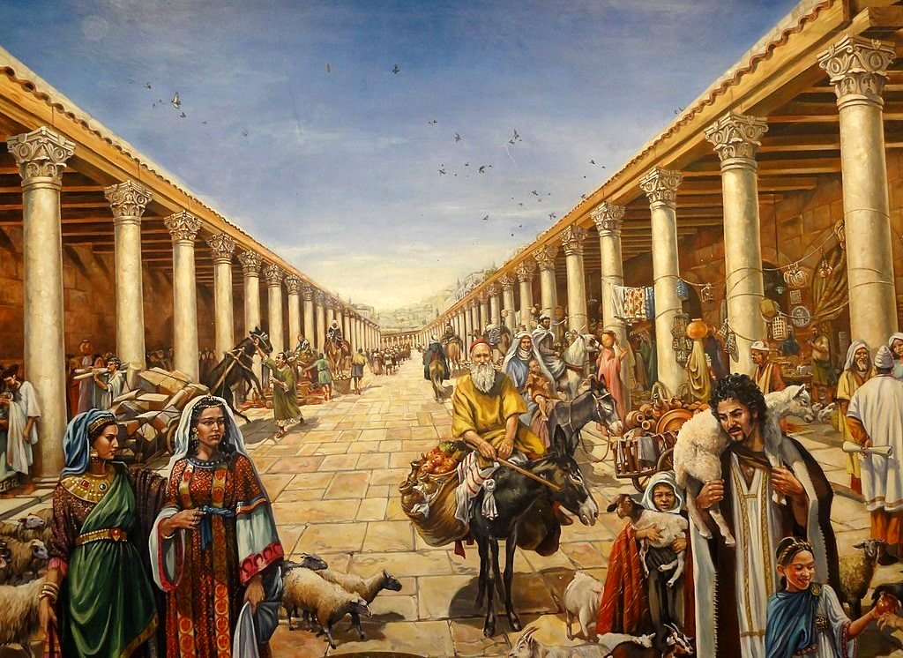
Among the infractions of the people were the allowance of non-jews to set up and do business on the Sabbath and to keep rooms inside the Great Temple

Slide 9
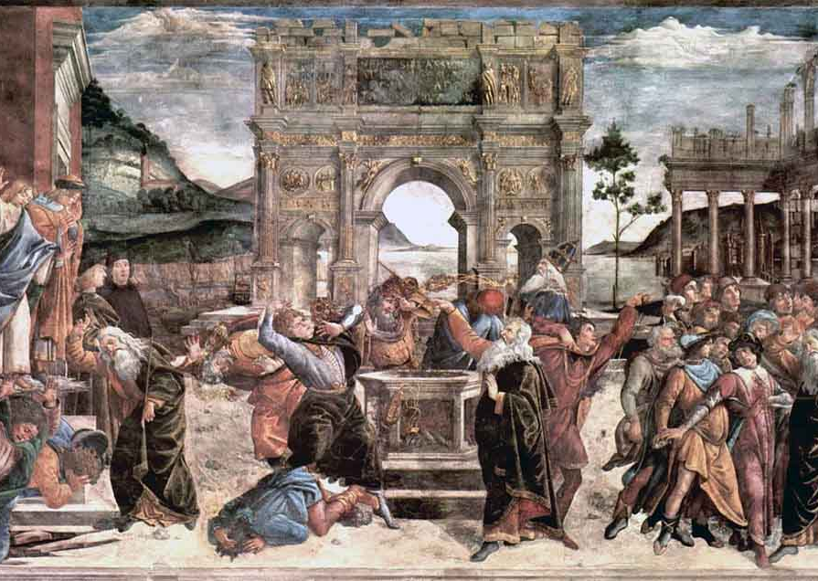
In response, he rids the temple of its priests and Levites and restores again the Laws of Moses

Slide 10
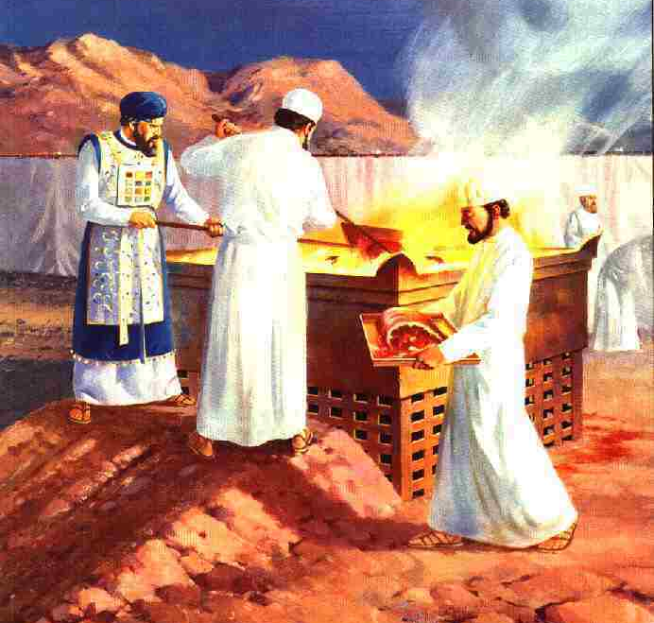
According to II Maccabees, Nehemiah is credited for returning the Holy fire back to the altar of the temple and building a library to hold the Holy Scriptures

Slide 11
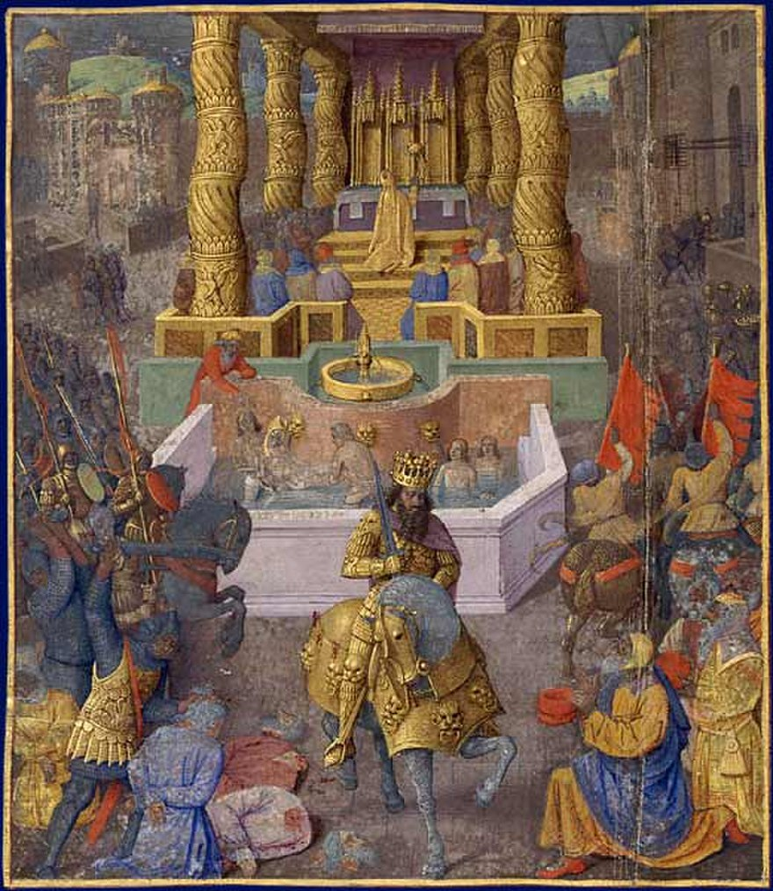
His role as leader becomes the basis for the "Hasmonean Dynasty" that is crucial during the Inter-Testamental Period

Slide 12
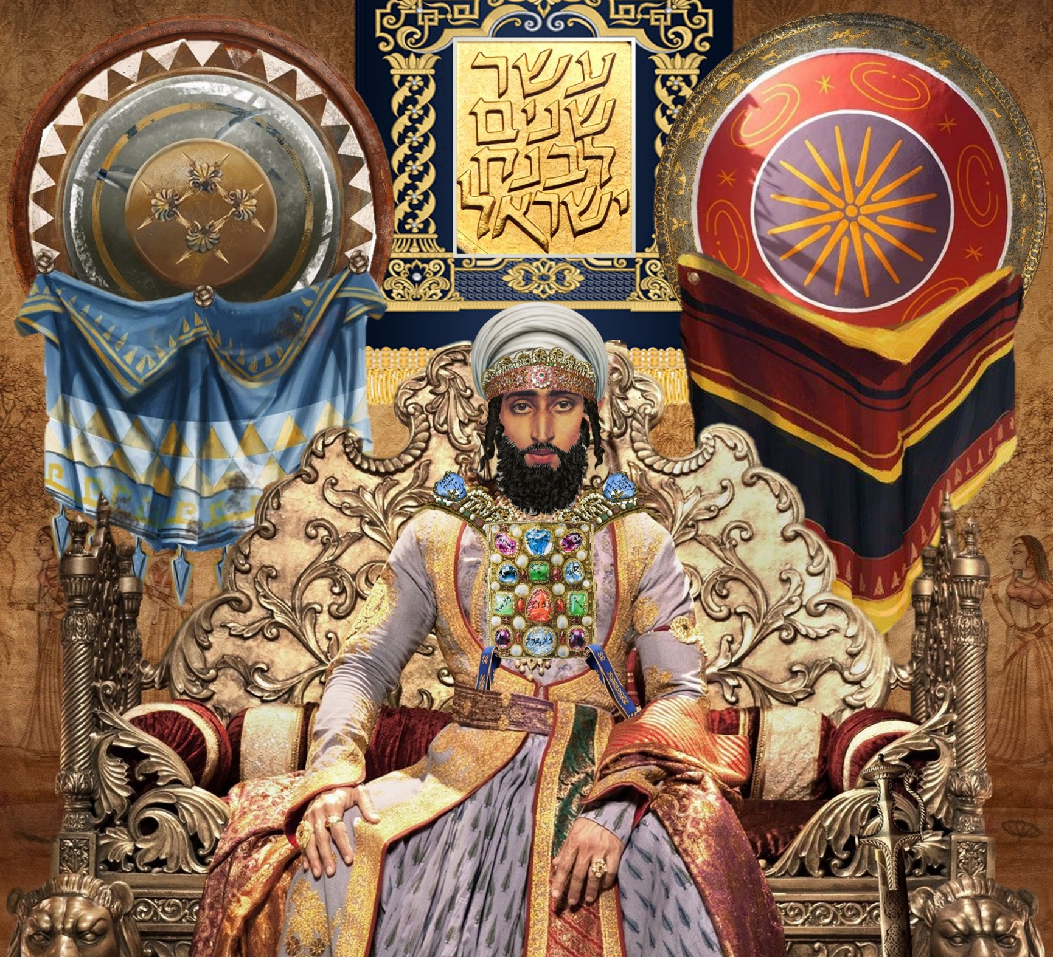
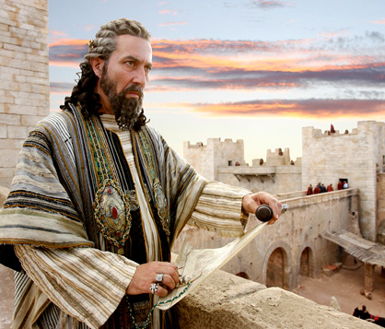
The Hasmoneans began with John Hyrcanus and ended with Herod

Slide 13

The description of worship in Nehemiah 8 becomes the example for worship in the synagogues that remains until this day

Slide 14
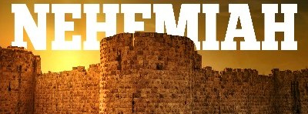
The importance of Nehemiah in Jewish, and subsequently Christian worship can not be overstated

Slide 15
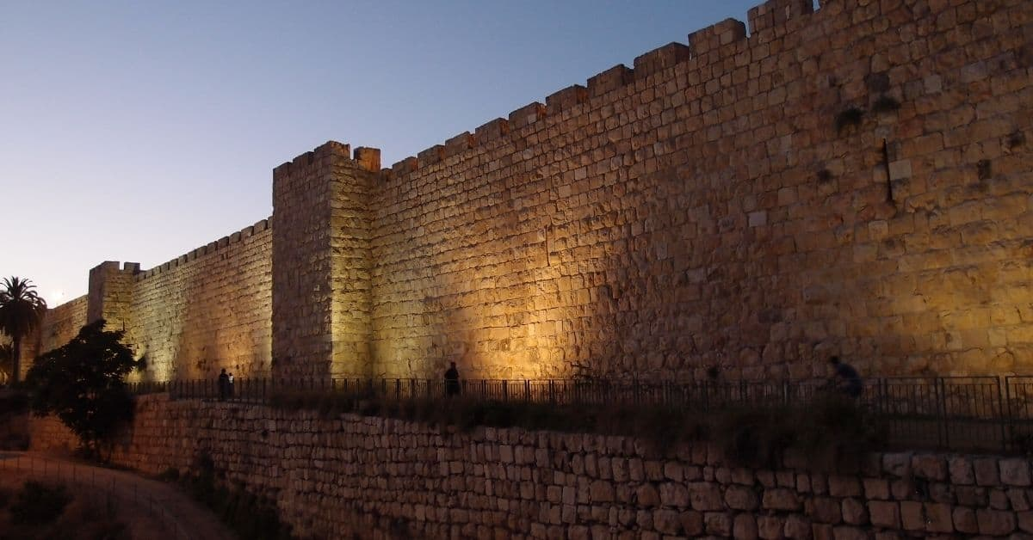
THANK YOU
FOR WATCHING

