Slide 1
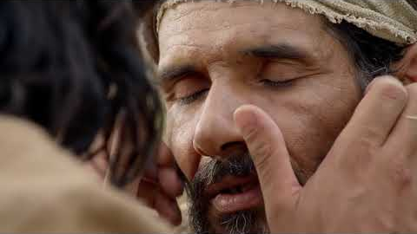
The Blind Man at Bethsaida, Sermon Review
A Bible Webinar by Andy C. Lewter, D. Min.

Slide 2
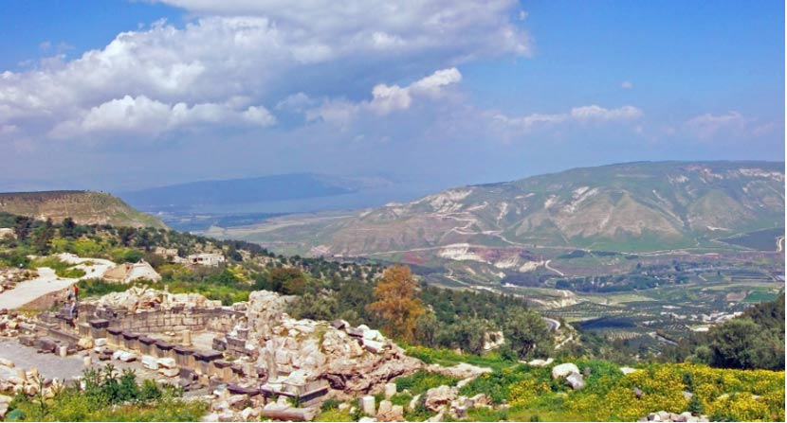
Ancient Bethsaida is in a section of the Holy Land called Galilee.

Slide 3
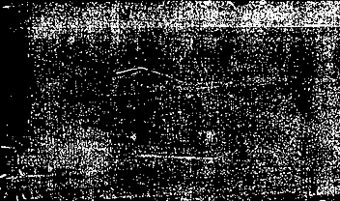
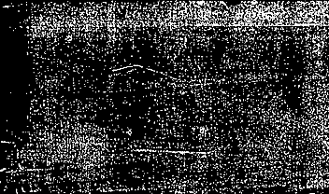
It is north of Jerusalem and considered rather remote.

Slide 4
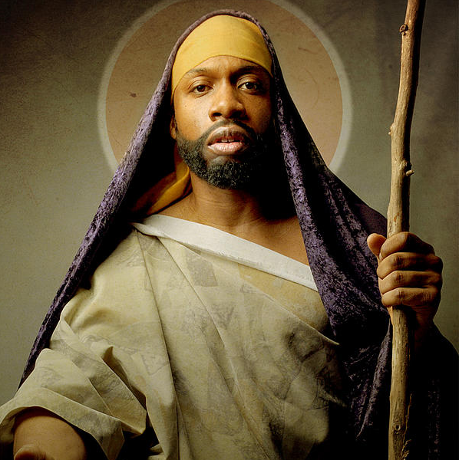
IT IS ALSO WHERE THE DISCIPLE PHILIP IS REPORTEDLY FROM.

Slide 5
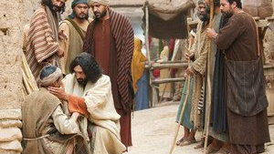
The fact that the blind man is brought to Jesus suggests he is not there by his own volition.

Slide 6
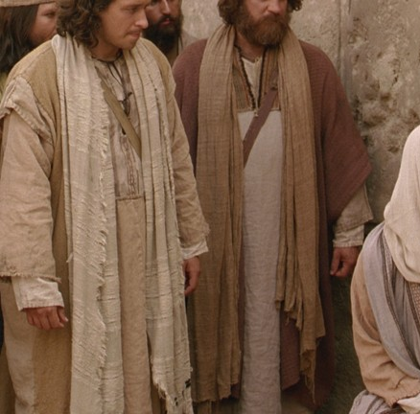
“Brought by some of the people” indicates that all of the people we not in favor of his healing.

Slide 7

In separating him from the people, Jesus has his complete attention, without distraction.

Slide 8
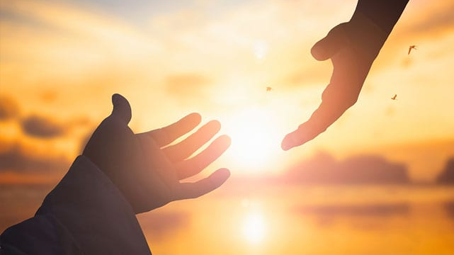
Sometimes our blessings come in stages and phases.

Slide 9
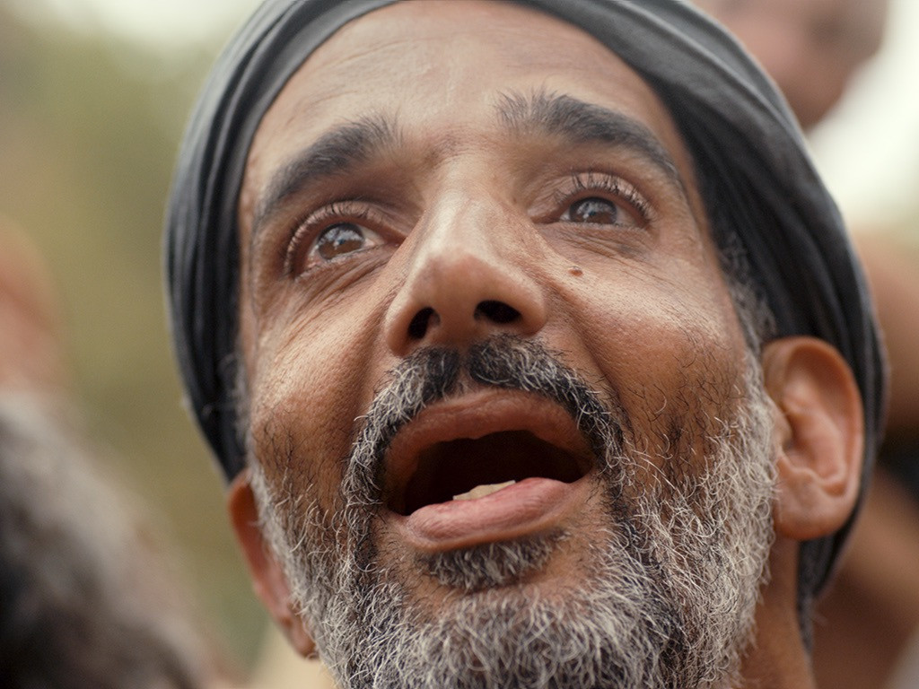
His eyes are not only opened but he sees clearly.

Slide 10

WITH CLEAR VISON WE ARE NOT TO GO BACK WHERE WE CAME FROM.

Slide 11
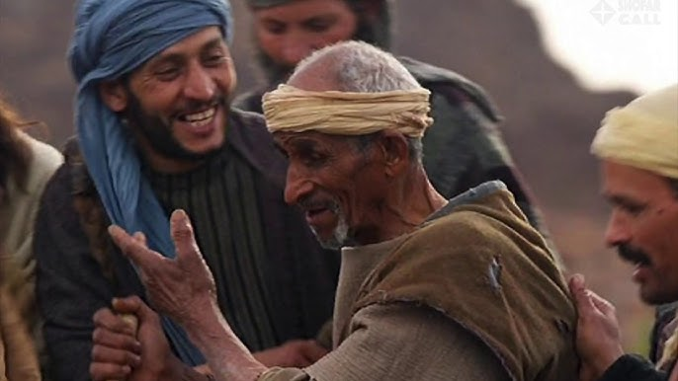
Equipped with a testimony the man returns home.

Slide 12
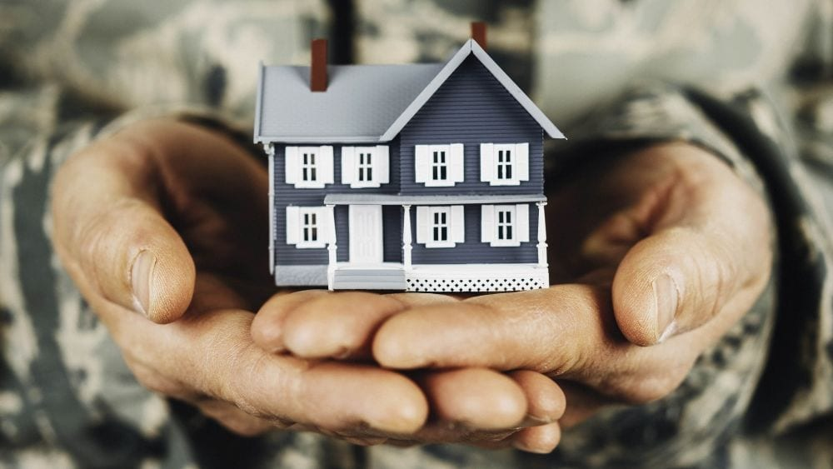
It is home where people will most appreciate what he had then (blind) and what he was now.

Slide 13
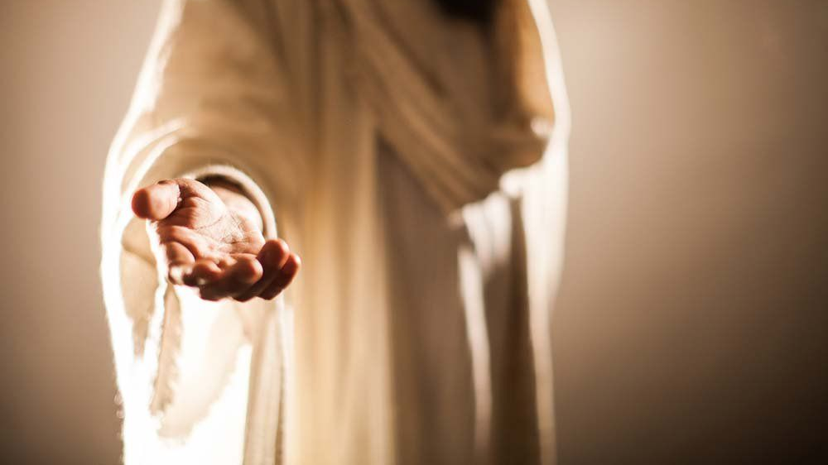
The last time you saw me I did not look like this.

Slide 14

But look at me now.

Slide 15
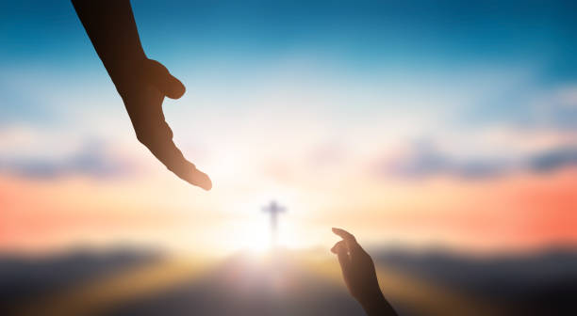
THANK YOU FOR WATCHING

