Slide 1
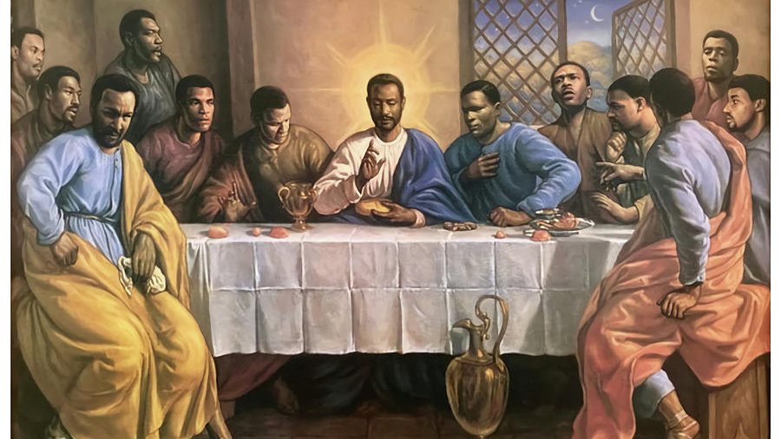
The Meaning of the Lord's Supper
A Sermon by
Bishop Andy C. Lewter, D. Min.

Slide 2
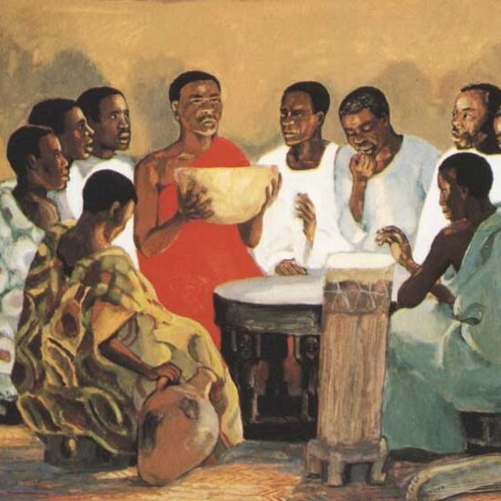
Our gathering today commemorates the final time that Jesus would assemble with his disciples prior to him being arrested in the Garden of Gethsemane

Slide 3
While this meal and fellowship would be the last time that the disciples would gather prior to the crucifixion it was not the only time Jesus shared a meal with his disciples

Slide 4
The symbolic meaning of a meal has always been identified as fellowship

Slide 5
The very core of Jesus' ministry was to bring fellowship to people who under other circumstances would not gather together

Slide 6
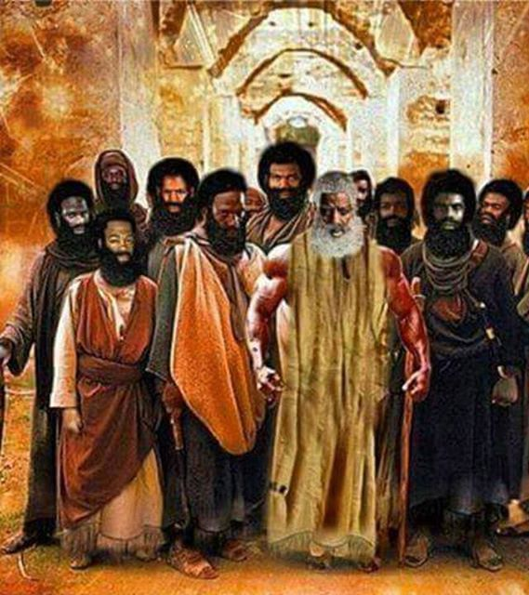
WHEN WE REMEMBER THAT AT LEAST HALF OF JESUS' DISCIPLES WERE "ZEALOTS" AND THAT AT LEAST ONE OF HIS DISCIPLES WAS A BUREAUCRAT THAT HAD WORKED FOR THE ROMAN EMPIRE IT IS HARD TO IGNORE THE TREMENDOUS POWER OF JESUS

Slide 7
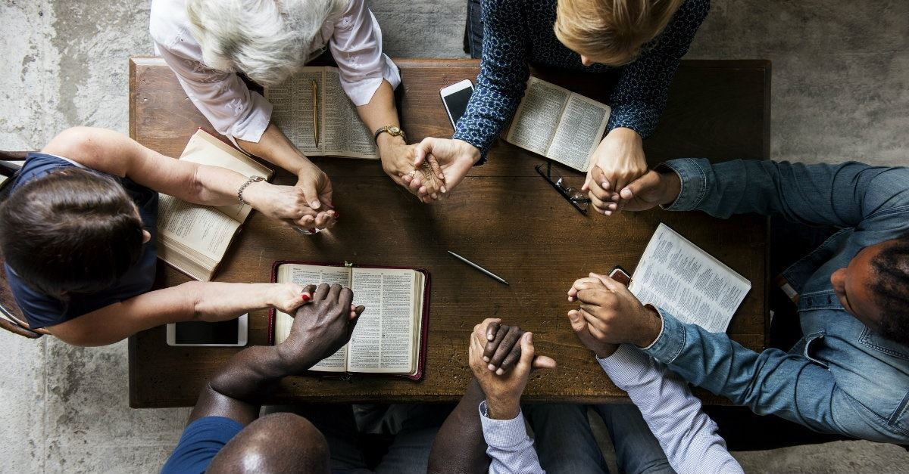
I am convinced that part of our mission as Christians is to offer fellowship to those who would not probably have fellowship with each other

Slide 8
On the heels of Jesus' appearance to the disciples on the road to Emmaus, they return to the other 11 original disciples

Slide 9
It is there that Luke records that Jesus appears to the original 11 back in Jerusalem

Slide 10
37 They were startled and frightened, thinking they saw a ghost. 38 He said to them, “Why are you troubled, and why do doubts rise in your minds? 39 Look at my hands and my feet. It is I myself! Touch me and see; a ghost does not have flesh and bones, as you see I have.”

Slide 11
The very next verse says that they still did not believe. I would argue that if seeing Jesus was not enough to believe, what was enough

Slide 12
I closed my sermon last week by asking what is it going to take for you to recognize Jesus in your life

Slide 13
The story of Joseph HAROUTUNIAN

Slide 14
Thank You for Watching

