Slide 1
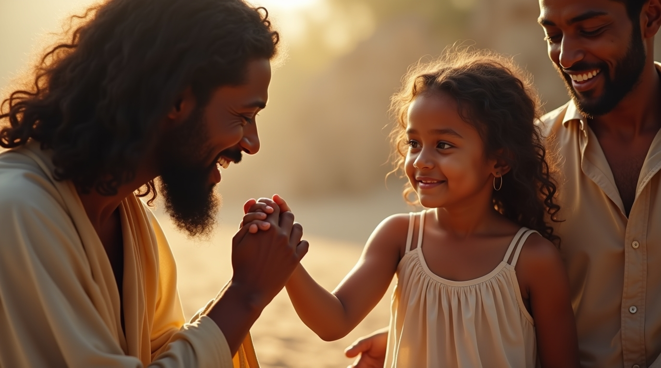
Faith in the Face of a Crisis: The Healing of Jairus’ Daughter
A Webinar By
Bishop Andy C. Lewter, D. Min

Slide 2


What We’ll Cover
The Antecedent
Jairus
The Commotion
The Healing

Slide 3

Mark 5
Begins with a return from the Sea of Galilee to a crowd where a woman who had suffered 12 years pressed through the crowd to see Jesus

Slide 4
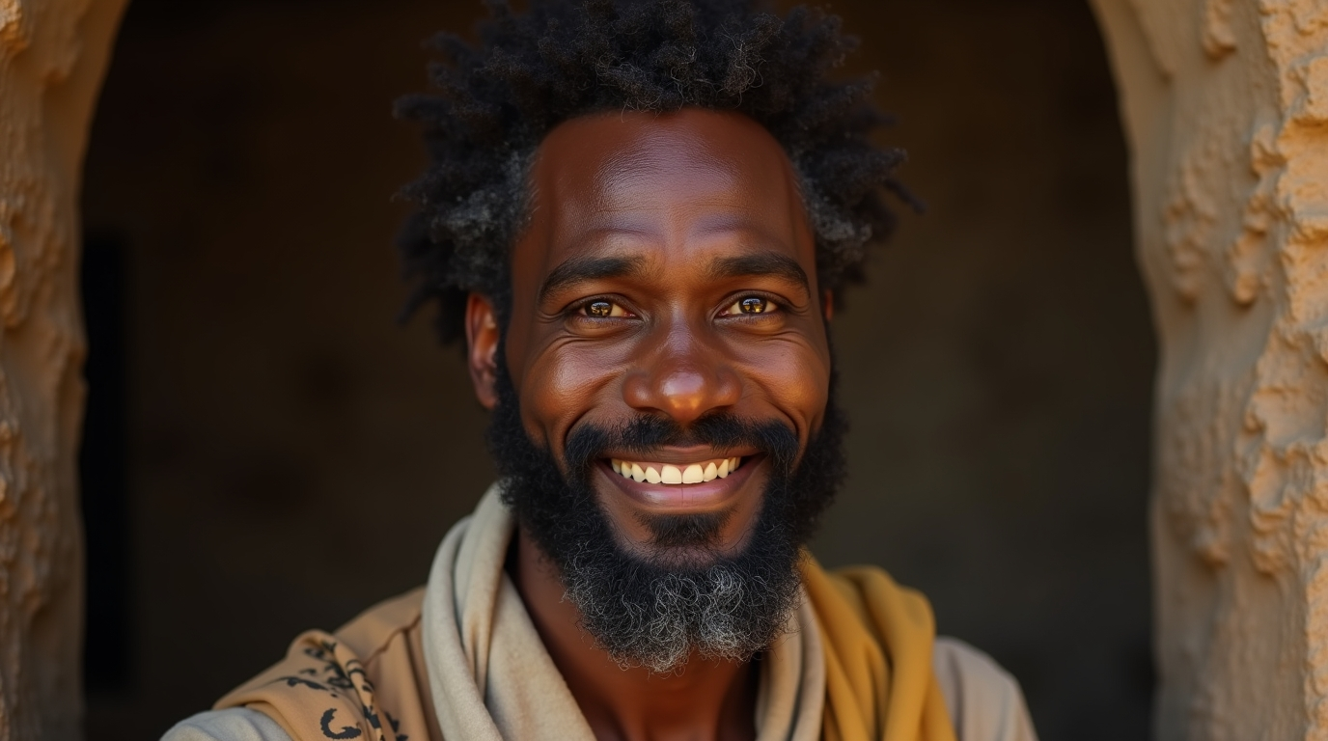
Jairus
Was a religious leader with a name with meaning, God Enlightens, like that of Nicodemus. The fact that he was a synagogue leader meant he was more a teacher than a governing official

Slide 5
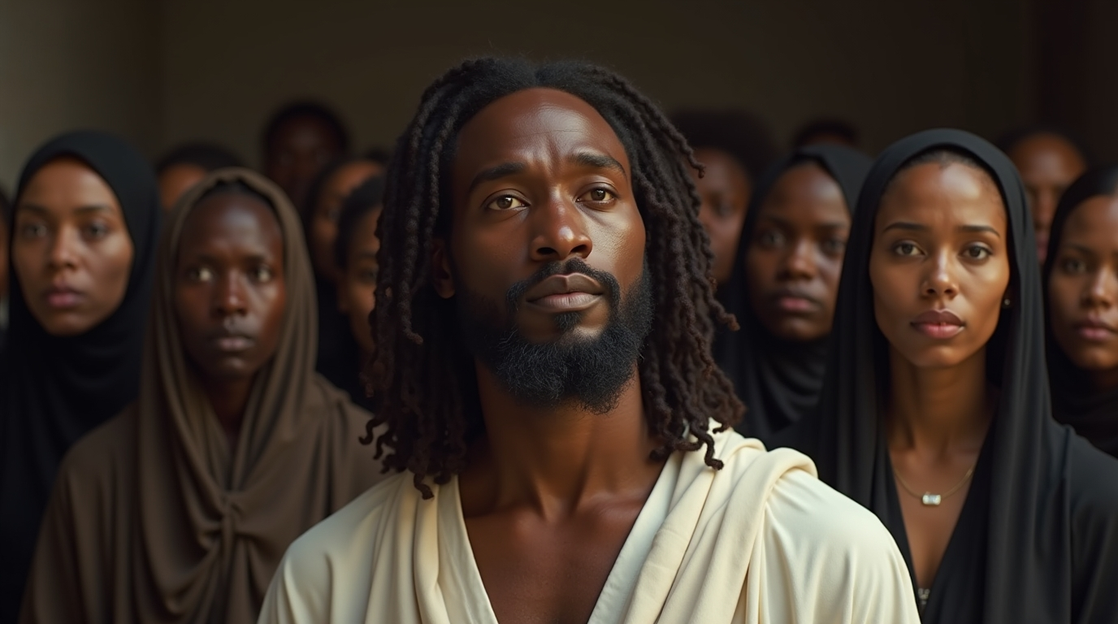
Arrival
Upon his arrival, Jesus encounters professional mourners who he removes with the exception of Peter, James and John. Mourners were hired and not sincere with their emotions or beliefs which is why Jesus needed them removed

Slide 6
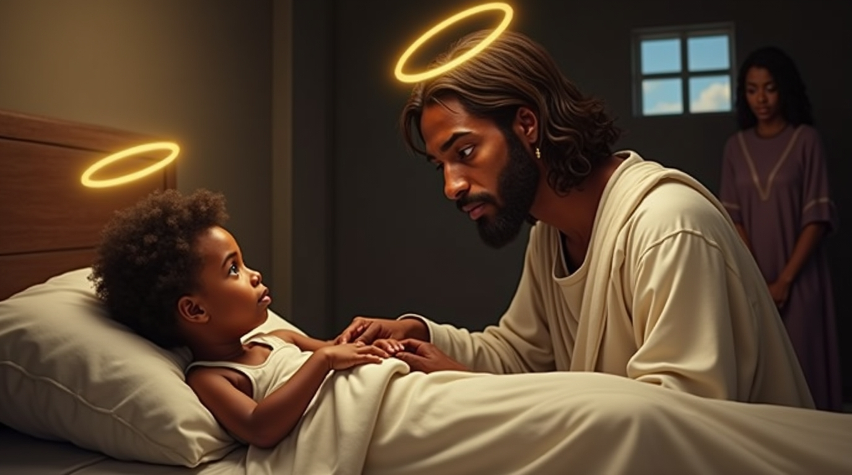
The Healing
Jesus took her by the hand, according to Levitical law it may one unclean to touch a dead corpse. Notice that Mark switches from Greek to Aramaic in the text

Slide 7
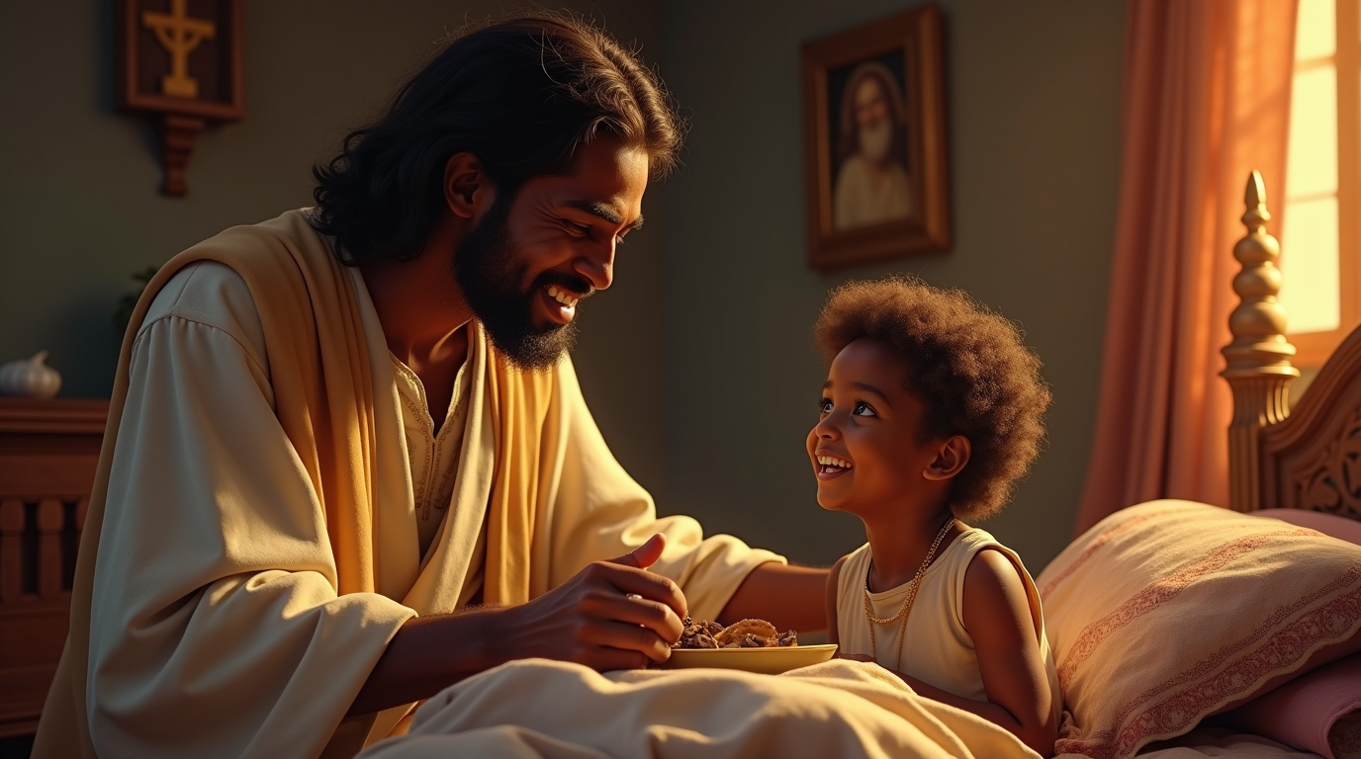
The Miracle
Jesus announces that she is asleep and not dead, re-defining her situation. She immediately walks showing the return of life and eats which proved she was not a ghost or illusion

Slide 8

Thank You for Watching
A Sermon By
Bishop Andy C. Lewter, D. Min

