Slide 1
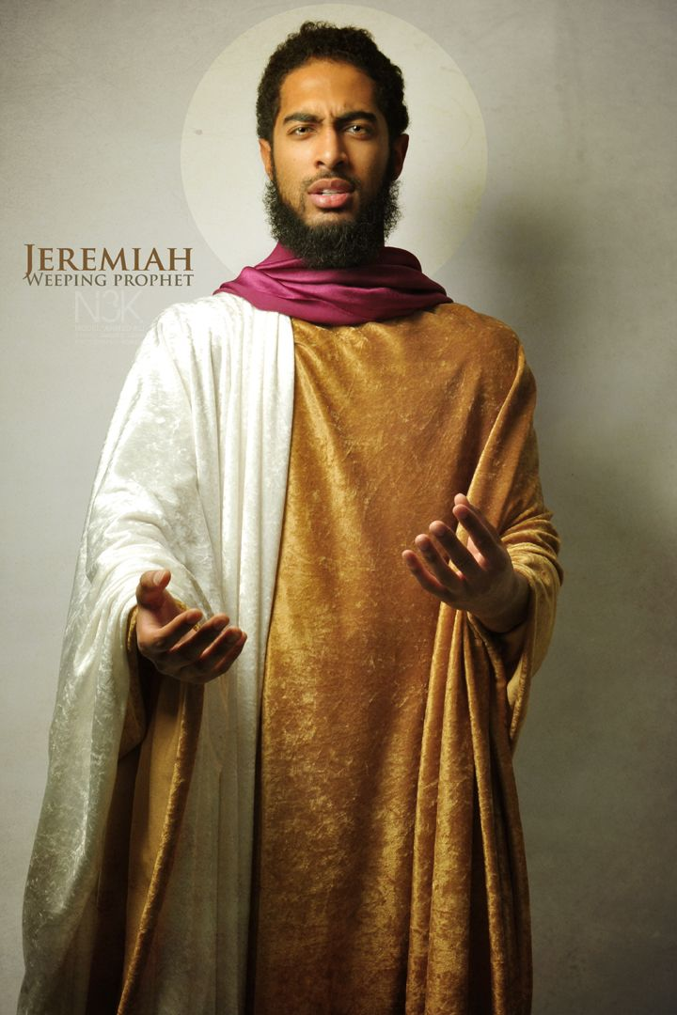
Jeremiah 6
A Sermon By
Bishop Andy C. Lewter, D. Min.

Slide 2
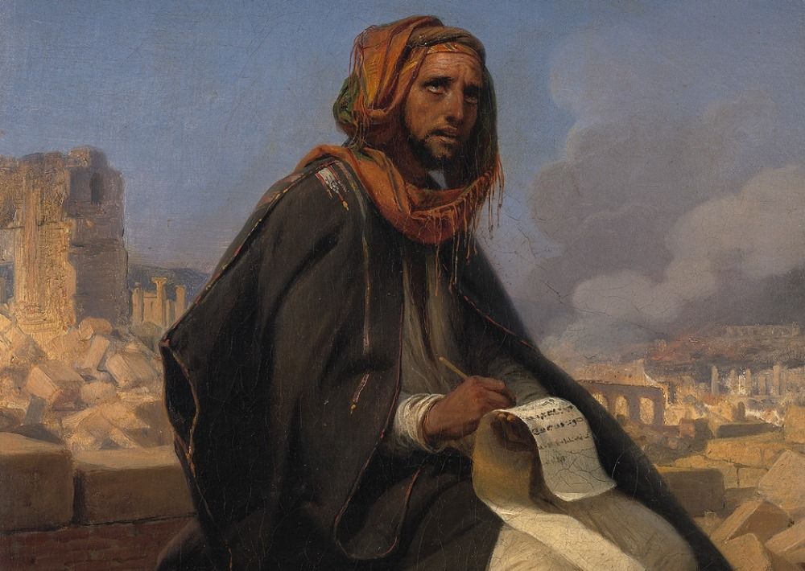

In This Series
In this series we have taken a fresh look at the Prophet Jeremiah, his life, his work and his ministry. Today we conclude with perhaps his greatest testimmony

Slide 3
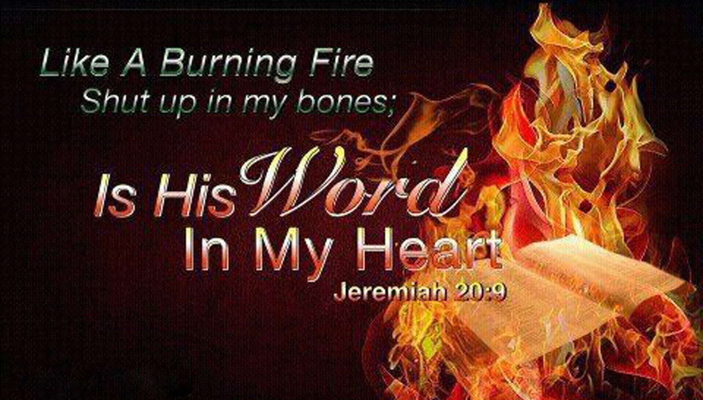
Jeremiah 20:9
Then I said, I will not make mention of him, nor speak any more in his name

Slide 4
Scripture Cont’d
But his word was in mine heart as a burning fire shut up in my bones, and I was weary with forbearing, and I could not stay.

Slide 5
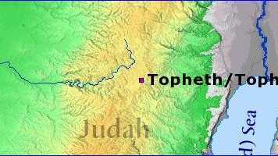
Tophet
Jeremiah had gone to the town of Tophet where he had prophesied doom and destruction upon that city because of their worship of other gods

Slide 6
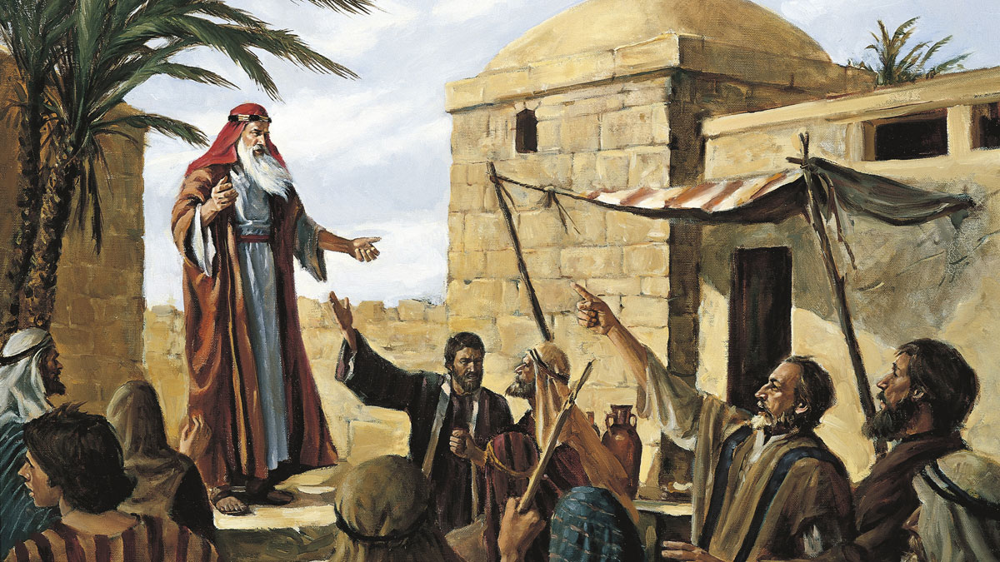
Jerusalem
Jeremiah returns to Jerusalem and pronounces the same word to them because they had behaved in the same way as Tophet

Slide 7
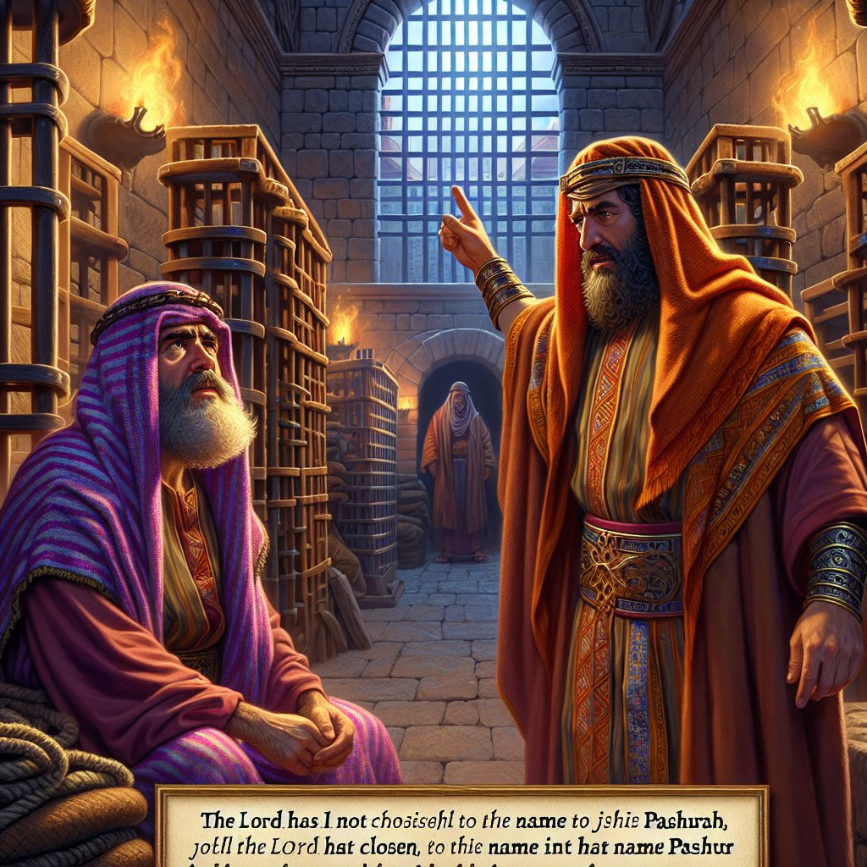
Pashur
When the head priest, Pashur, hears of Jeremiah’s prophecy against Jerusalem he beats him and places Jeremiah in stocks next to the temple

Slide 8
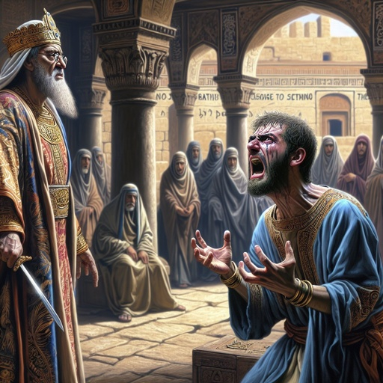
The Next Day
The following day when he is released, he calls Pashur a terror and resumes his prophecy against his house and the city of Jerusalem

Slide 9
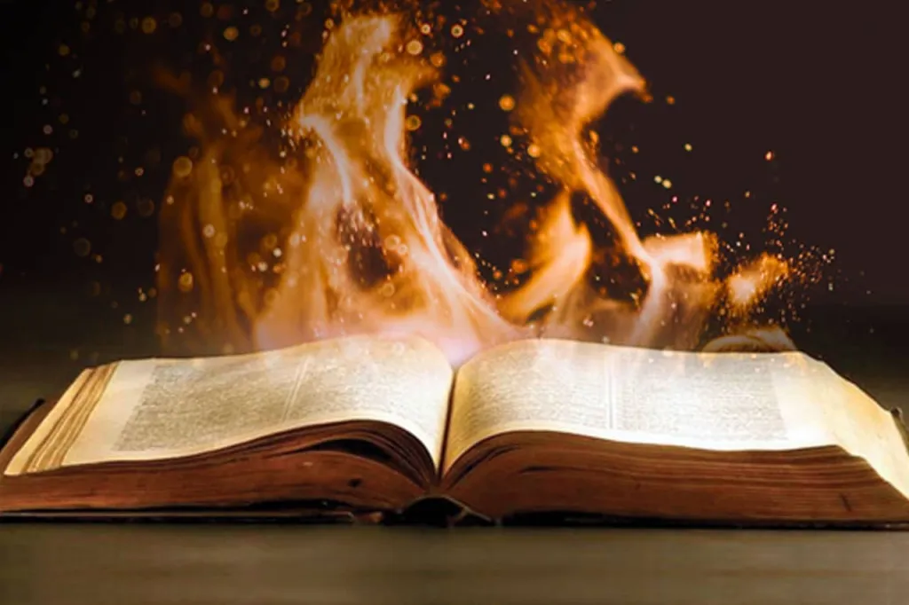
Tries to be Quiet
Knowing that his words mean trouble he tries to remain quiet and not prophesy in the name of the Lord. However, he describes it as fire shut up in his bones

Slide 10
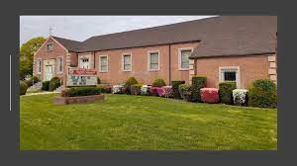
John Sample
Years ago, the Gospel Chorus, under Constance Adams, sang a song led by John Sample entitled “I said I Wasn’t Going to Tell Nobody, But I Couldn’t keep it to Myself

Slide 11
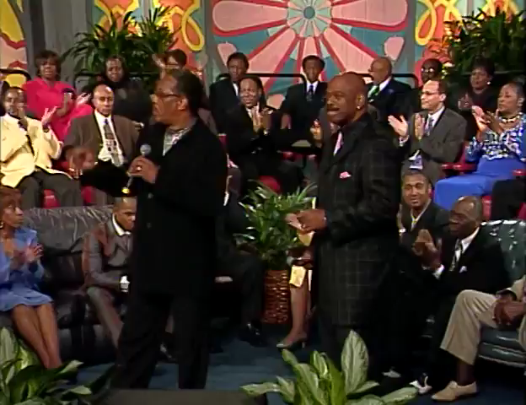

Slide 12
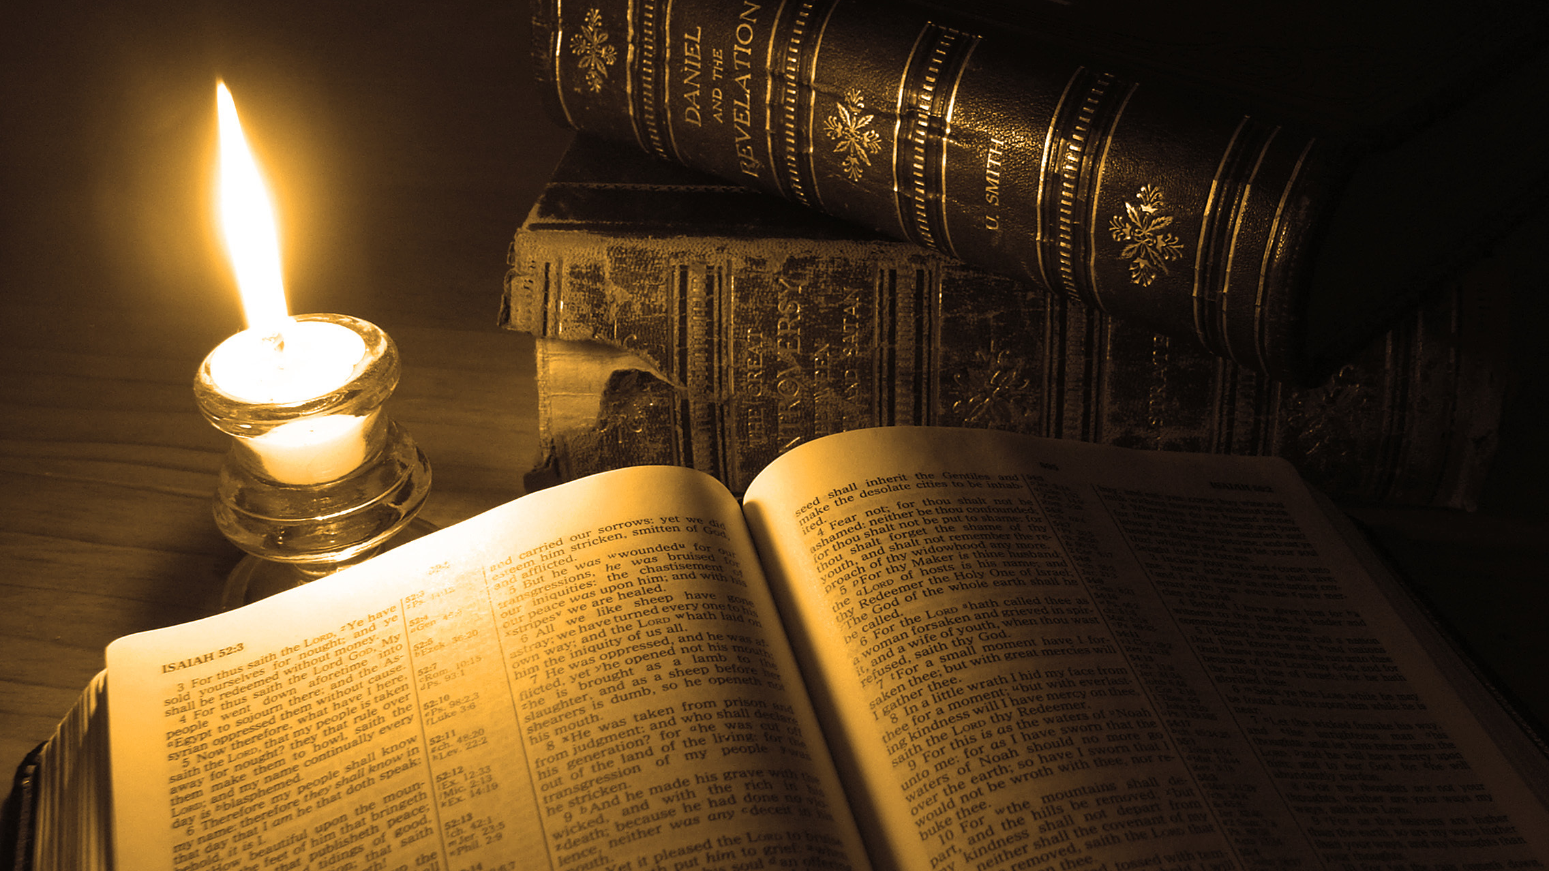
Thank You for Watching

