Slide 1

Living Water for a Thirsty Soul
John 4:1-42

Slide 2
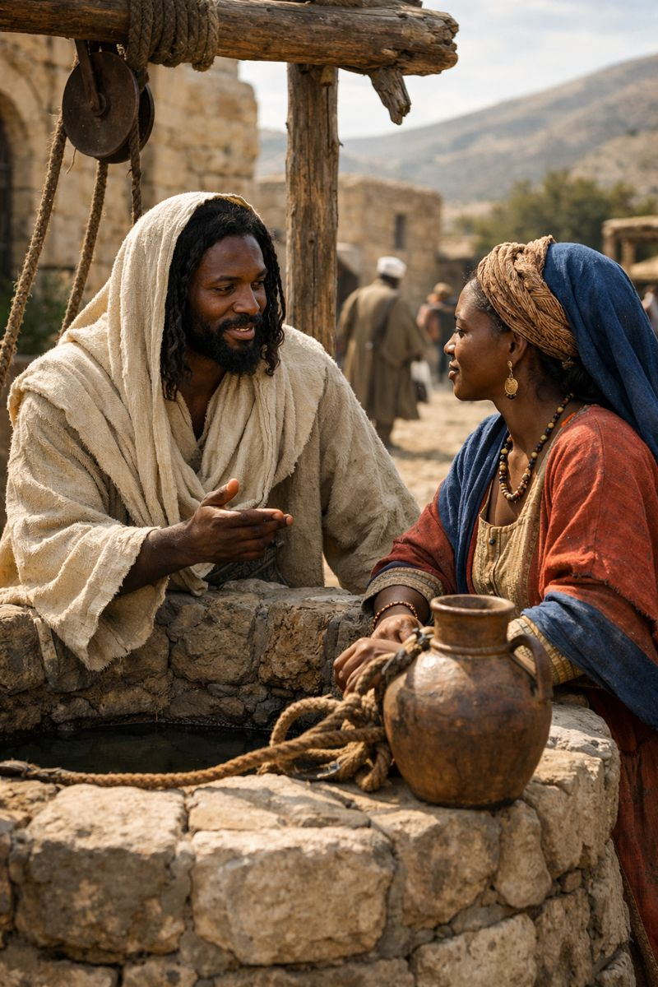
Scripture
Historical Context
¹³ Jesus answered, “Everyone who drinks this water will be thirsty again, ¹⁴ but whoever drinks the water I give them will never thirst. Indeed, the water I give them will become in them a spring of water welling up to eternal life.”
¹⁵ The woman said to him, “Sir, give me this water so that I won’t get thirsty and have to keep coming here to draw water.”

Slide 3
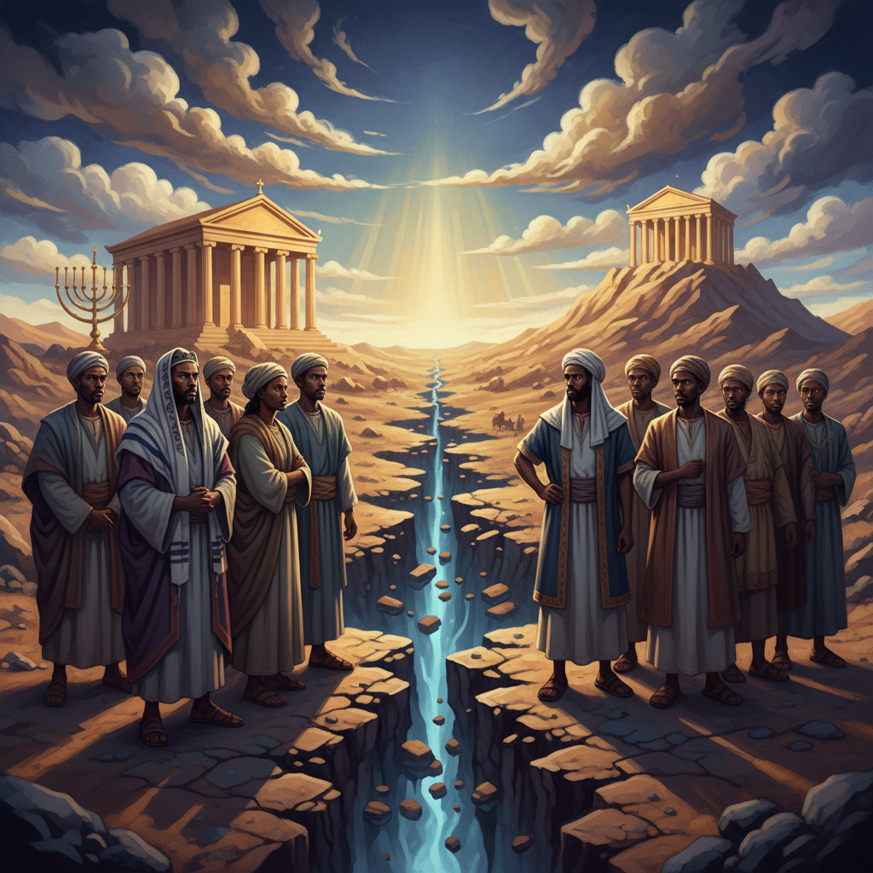
Exegesis 1/3
Historical Context
In the first century, the animosity between Jews and Samaritans was deeply rooted in centuries of religious and ethnic conflict. By traveling through Samaria and speaking to a woman, Jesus intentionally shattered societal norms regarding gender, race, and religious purity.

Slide 4
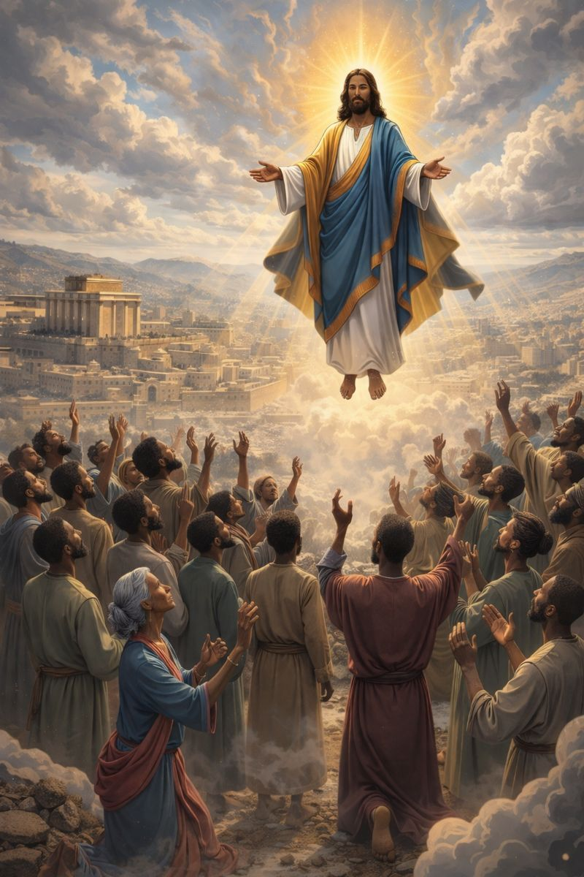
Exegesis 2/3
The Author's Intent
John presents this encounter as a pivotal moment revealing Jesus as the Messiah who transcends human barriers. The author emphasizes that the 'living water' Jesus offers is a spiritual reality that fulfills the deepest human longings which physical rituals cannot satisfy.

Slide 5
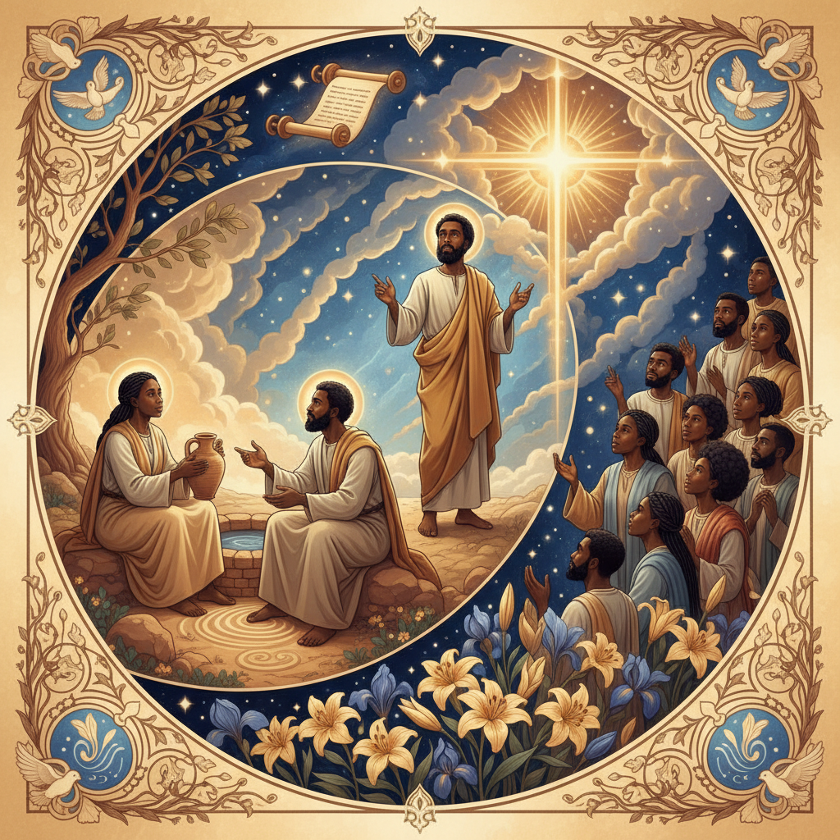
Exegesis 3/3
The Narrative Arc
The story progresses from a simple request for physical water to a profound theological discussion and finally to a city-wide revival. It highlights a transformation where a woman defined by her past becomes the first evangelist to the Samaritans through her encounter with Christ.

Slide 6
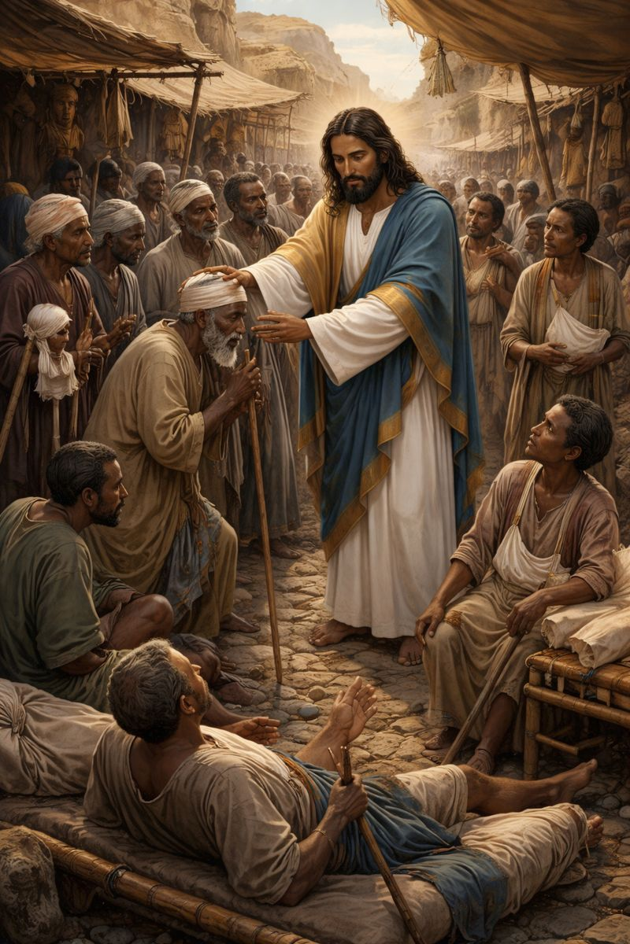
Life Lessons 1/4
Grace Beyond Boundaries
Jesus seeks out those whom society has marginalized or deemed unworthy. This lesson reminds us that no one is beyond the reach of God's grace, and we are called to cross our own 'Samarias' to share the Gospel.

Slide 7

Life Lessons 2/4
Honesty as the Path to Healing
The woman’s transformation began when she confronted the truth about her life in front of Jesus. Real spiritual growth requires us to stop hiding our scars and bring our authentic, broken selves into the light of God’s presence.

Slide 8

Life Lessons 3/4
The Search for Satisfaction
This narrative teaches us that we often try to fill our spiritual thirst with temporary relationships, status, or possessions. Only the 'living water' of a relationship with Christ provides the permanent internal peace we are searching for.

Slide 9
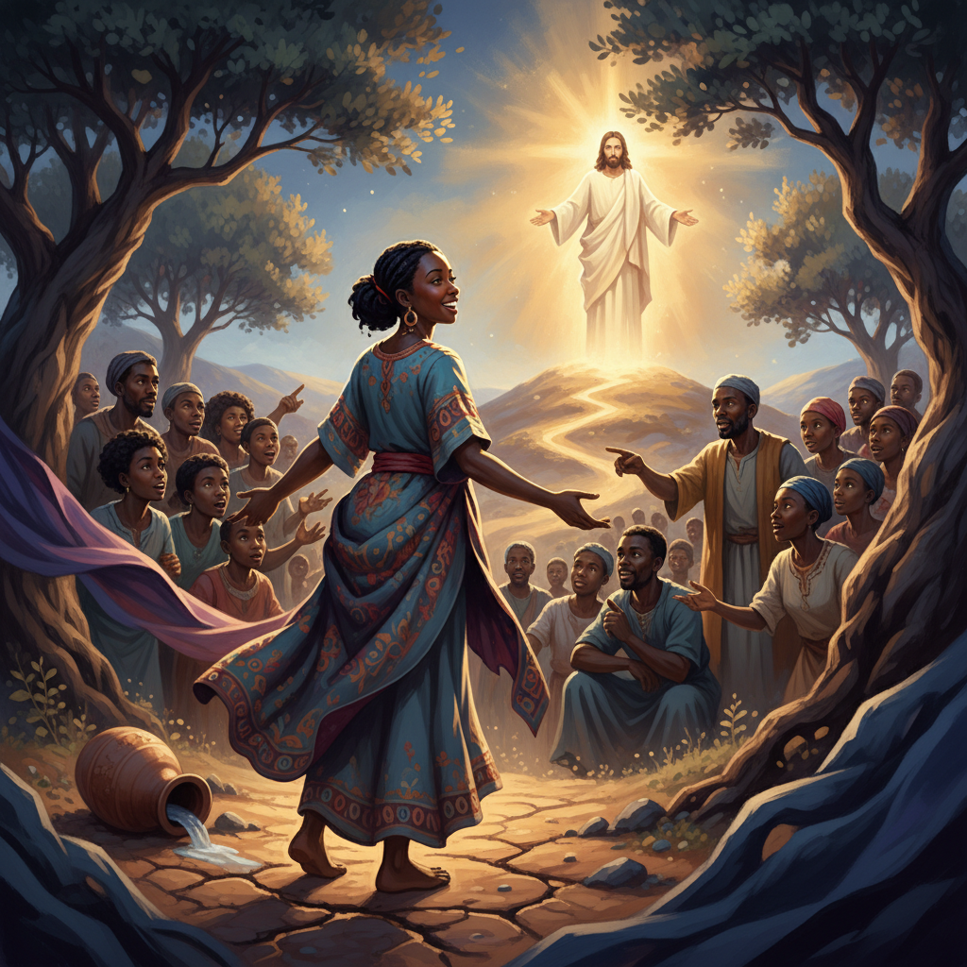
Life Lessons 4/4
Your Testimony is a Tool
The woman left her water jar behind to tell others about Jesus, showing that our past encounters with God are meant to be shared. You do not need a theology degree to lead others to Christ; you only need to share what He has done for you.

Slide 10
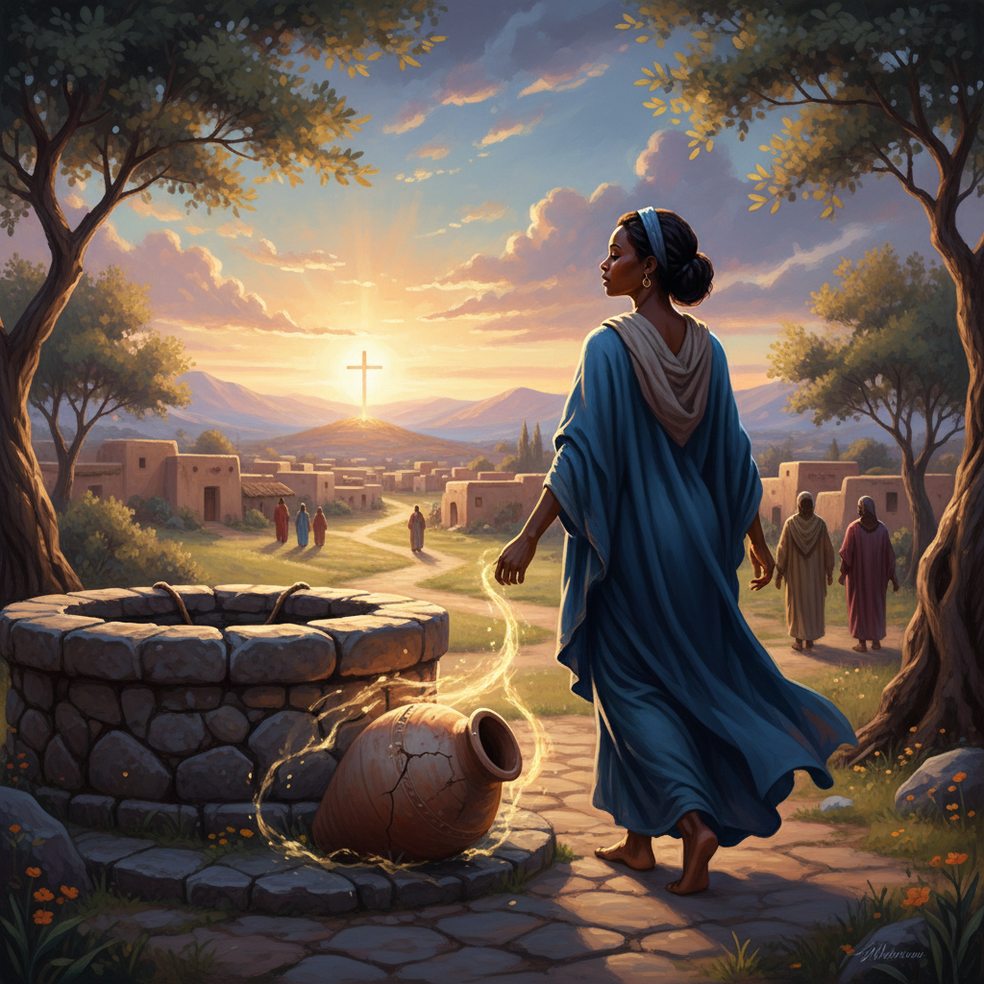
Illustrations 1/3
The Abandoned Water Jar
Imagine the woman leaving her heavy jar at the well; it represents the weight of her old life and her futile cycles of seeking satisfaction. When she found Christ, the very thing she thought she needed most became secondary to her new mission.

Slide 11

Illustrations 2/3
The Mirror of the Well
In ancient times, a well was the center of community, yet this woman came at noon to avoid being seen. Jesus turned the well into a mirror where she finally saw her true value not as a social outcast, but as a child of God.

Slide 12
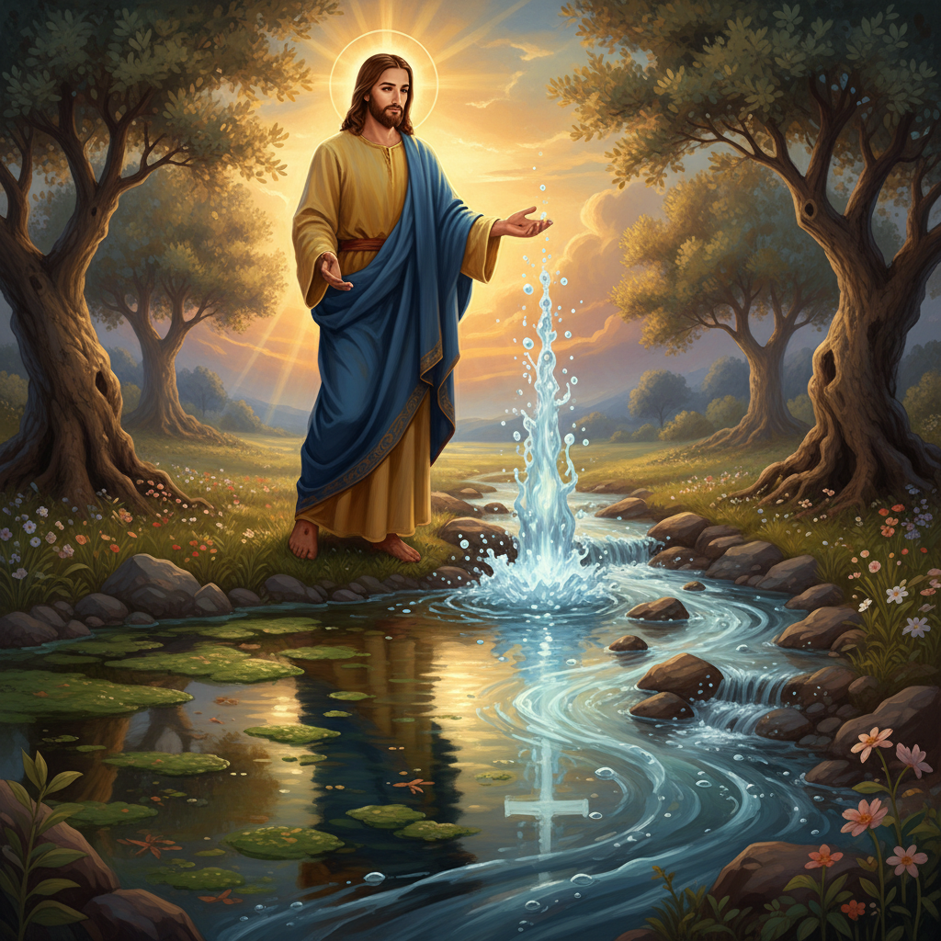
Illustrations 3/3
The Artesian Spring
Think of a stagnant pond versus a bubbling artesian spring that cleanses itself. Jesus offers a faith that isn't a stagnant list of rules, but a self-sustaining source of life that flows outward to impact everyone around us.

Slide 13
Go in Peace
"Your word is a lamp to my feet and a light to my path." - Psalm 119:105

