Slide 1
Designed by biologists, for turtle researchers
Data collection and presentation is designed to simplify and streamline turtle research.
Access all of the most-commonly used functions directly from a user-based Home page.
Specific functions only available to certain user roles.
Custom-defined “Welcome” message, easily changed for “daily message” or notifications.
Designed by Axe Inc Technologies
http://www.axeinc.com
(941) 359-1507

Slide 2
Login
Log into the site, and your assigned Roles are used to determine which data you have access to:
Modify records
Add records
Modify data from previous years
Administer data

Slide 3
Activity log
See everything that has ever happened, for each Activity:
Every time the data changes
Every time the Activity is loaded
Date/Time and User Name logged with each entry

Slide 4
Administration
Define how the site will function for your users:
Each user can be configured to only view data for a specific year, current year, or all years.
Define “Welcome” message the all users will see on the Home page.
Admin functions
Manage Users and Roles
Create Users
Manage Addresses
Manage FDEP Projects
Manage Uploads
Manage Turtles
Manage Tags
Approve All Activities

Slide 5
Fool-proof your data!
Add all of the activity associated data from a single page:
Add Nests, False Crawls, Unmarked Nests, etc.
Different data-collection based on the selected Activity Type (i.e.: different fields are collected based on the Type and other selections).
Validation process ensures that all of the data being saved to the database is valid.
User defined required fields.
User selections are all data-driven (choices defined in the database).
Streamlined data (i.e.: available Zone selections based on selected Key, FDEP based on Zone, etc.)

Slide 6
Activity Map
Quickly view the Activity’s geolocation (using the entered latitude and longitude):
Admin-defined FDEP and Address markers are also displayed
Drag/Drop the Activity icon, and click “Save Activity GPS” to update the latitude and longitude (useful to visually verify the Activity is in the correct location).

Slide 7
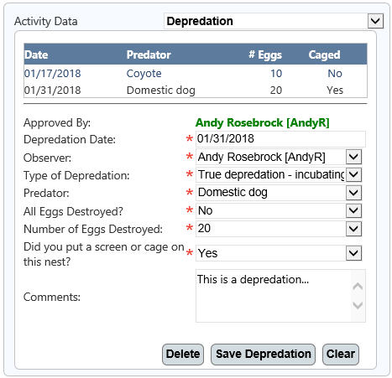
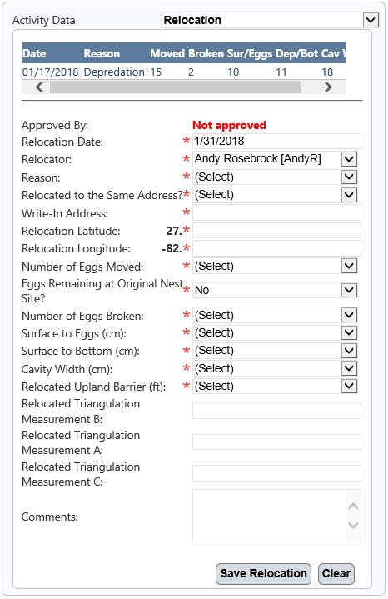
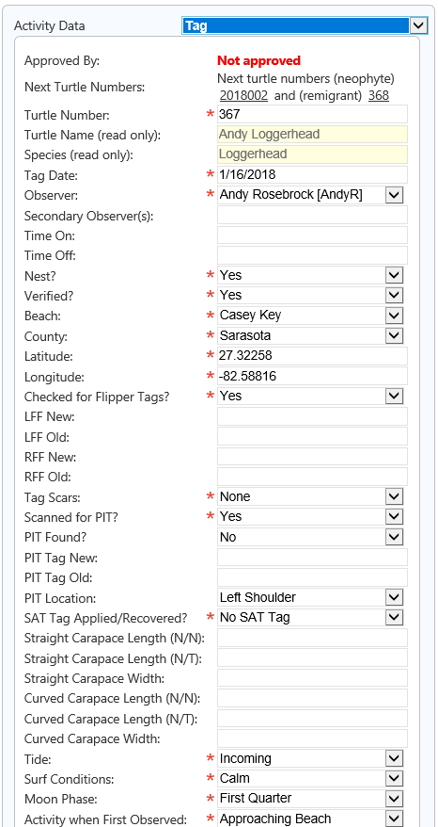
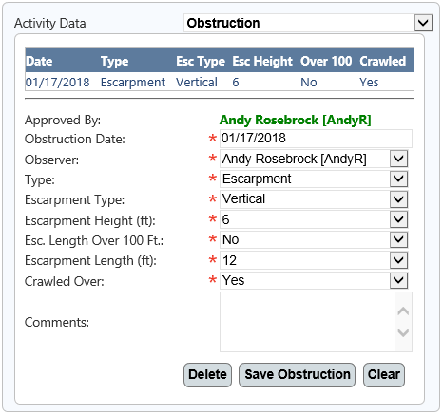
Activity Data
Collect all associated data for the current Activity on a single page:
Multiple (one-to-many) associations
Obstructions
Relocations
Depredations
Cages/Screens
Fire Ants
Water Damages
Human Damages
Drops and/or Hatches
Disorientations
Samples
Uploads
Damage to Other Nests
Single (one-to-one) associations
Activity Details
Excavations
Tags

Slide 8
Manage addresses
Define all addresses (including latitude and longitude) for your area:
Each address can be defined for a specific year, or all years.
Easily copy previous annual addresses to another year.
Addresses defined here displayed as a special icon on the various map screens.
Addresses are defined for a specific Key, Zone, and FDEP. Only the addresses defined for a specific FDEP and year are displayed for selection during Activity entry.

Slide 9
Manage projects
Define all Projects in your area, on an annual basis:
Projects can be defined for specific days only (Monday – Sunday).

Slide 10
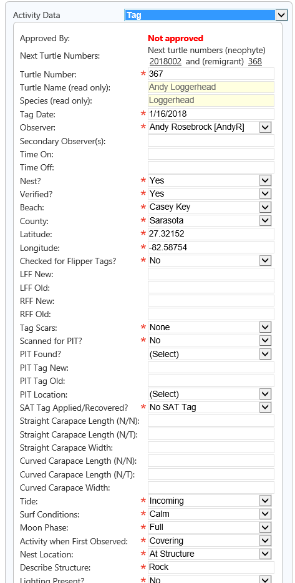
Manage Tags
Easily display all Activities associated with a specific, tagged turtle:
Collect important data for all of your Tagging Events.
Tag records can be added/associated to Activities.
Refine searches to display specifically the Activities you are looking for.

Slide 11
Manage Turtles
Assign each tagged turtle with a unique Turtle Number:
The Turtle Number is used to track all Activities associated with the defined turtle.

Slide 12
Manage Users
Manage all Users, and what they have access to:
Assign Users to Roles
Admins
Administrators can manage all records for all years, as well as modify the admin-level data (Addresses, Projects, Turtles, etc.)
Interns
Interns can add and modify Activities for the current year. They can view prior Activities, but cannot make any modifications – nor can they modify records that have been approved by an Admin.
Volunteers
Volunteers can only view activities.
Test Account
Users assigned to the Test Account Role can add and modify records (like an Intern), but the records are flagged as “test”, and are not included in searches, reports, etc. This Role is helpful for training users on the new system.
Enable, disable, and remove specific Users.

Slide 13
Approve activities
Administrators can easily approve Activities:
Once an Activity has been approved, it cannot be modified (except by Admins).
Search for a specific subset of unapproved Activities (i.e.: a specific Key, Zone, or Date-Range).
Quickly see all details for each Activity, including map/location and all associated data.
Approve multiple Activities with a single action with “Approve All Selected”.

Slide 14
View and Modify Activities
View all associated data with any Activity on a single page:
Using the “Activity Data” dropdown, you can select any of the defined data (Depredations, Drops/Hatches, Water Damages, etc.)
View an embedded map using geolocation based on the entered latitude and longitude to see exactly where the Activity is located.
The Info Panel (bottom left area) displays read-only data that is calculated “on-the-fly” for each Activity (Days Since Observed, Assigned Project, Samples Collected, etc.).
Record “status” is automatically calculated each time any Activity is loaded (based on numerous factors – i.e. “Excavated” changes the status from “Active” to “Inactive”).

Slide 15
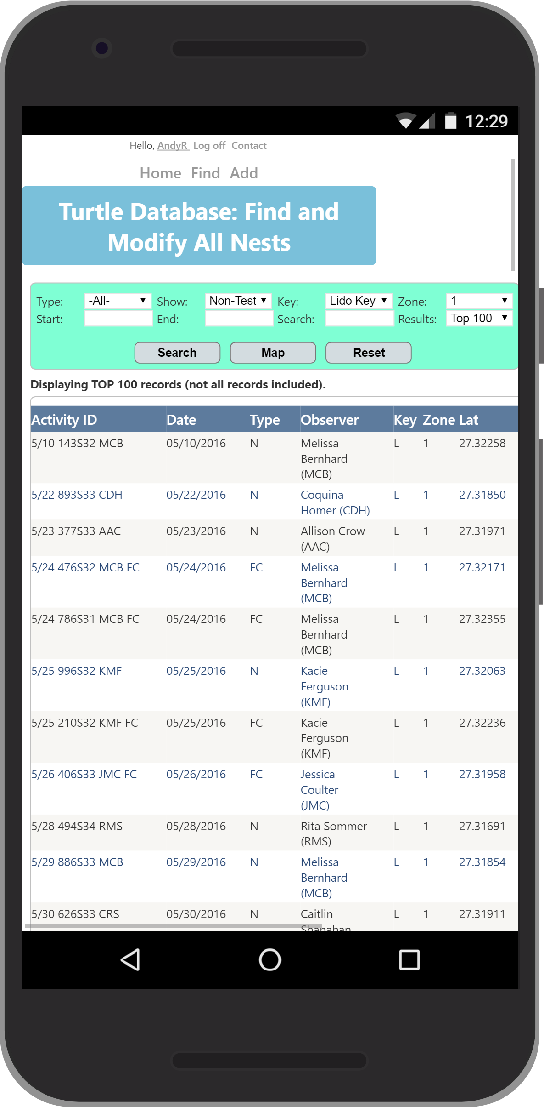
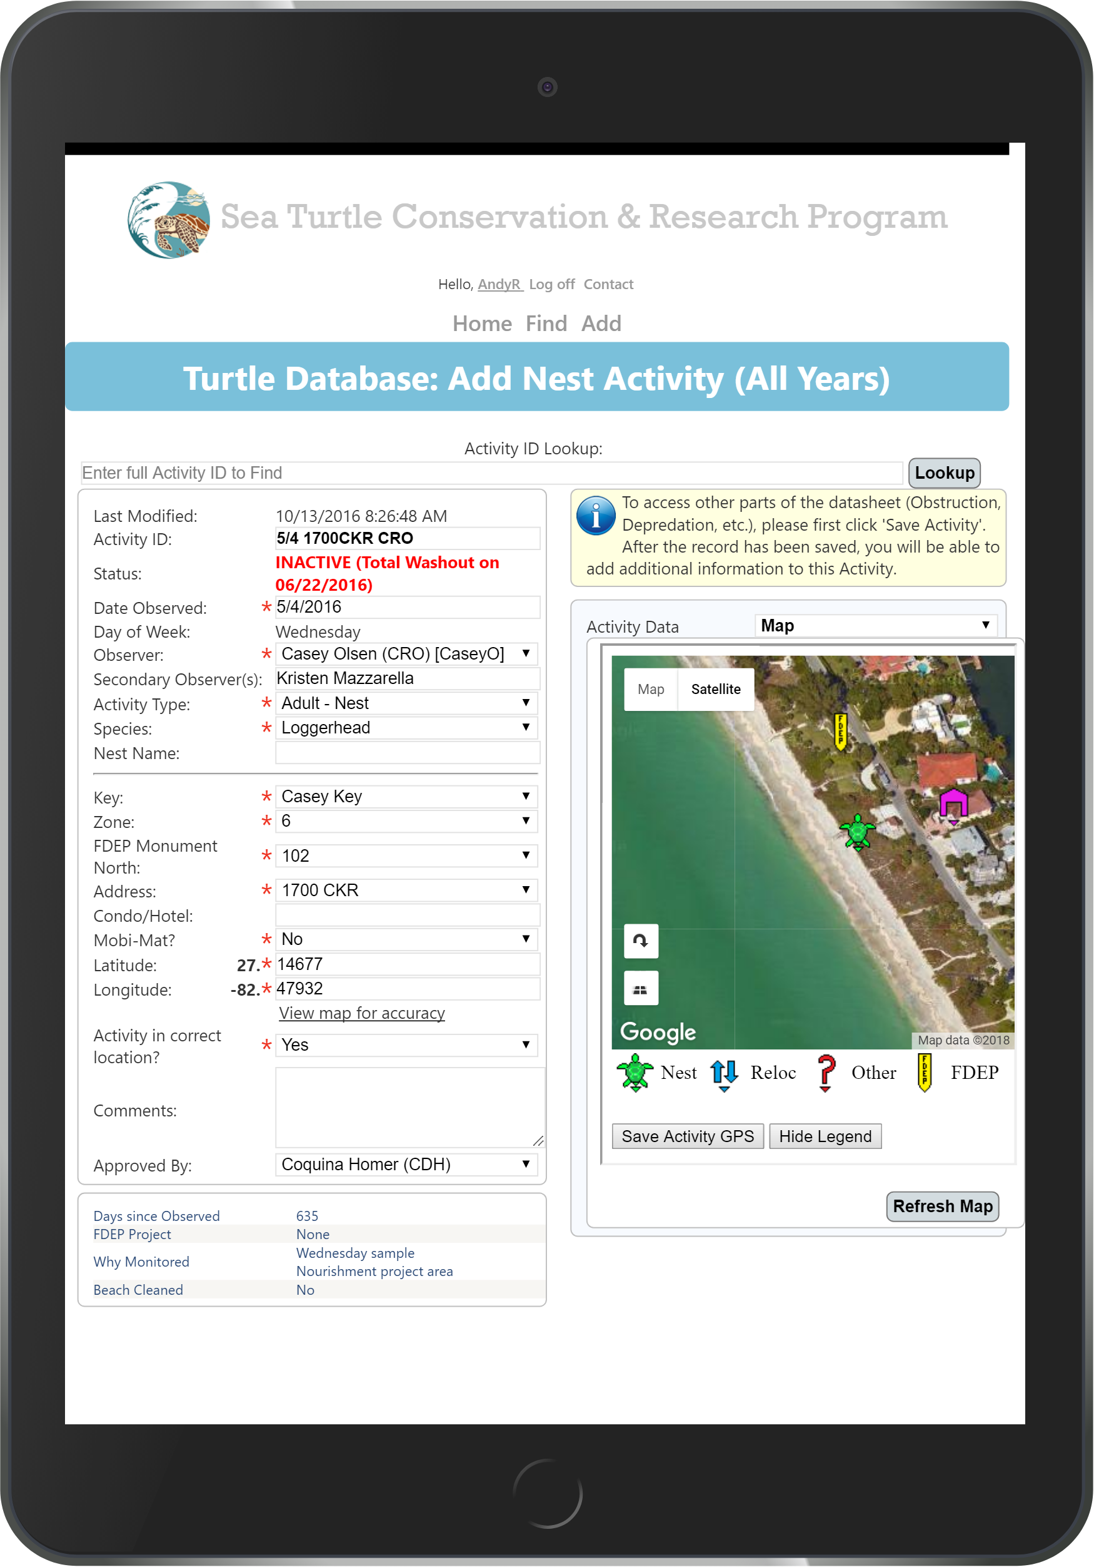
Mobile Access
View and enter data directly from the field:
Access all functionality and data with any mobile device (iPhone, iPad, Android, etc.)
Lookup Activity details, enter new Activities, view reports, verify GPS coordinates – all from your mobile device.
Mobile-friendly versions of the most-used pages

Slide 16
Quickly Find Your Data
Simple, streamlined search page to quickly find the Activities you are looking for:
Search for specific data:
Activity Type (Nest, False Crawl, etc.)
Key and/or Zone
Date Range
Easily search for text in numerous fields with a single entry:
Activity ID
Observer
Key Name
Address
Hotel
Latitude/Longitude
Turtle Name/Number
Nest Name
Display a map of all Activities matching your search.

Slide 17
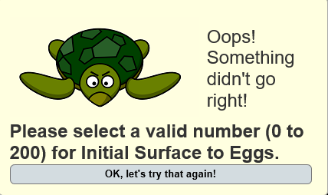
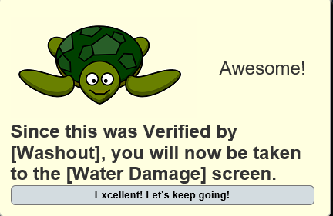
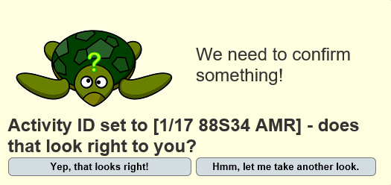
Validation
Automatically validate all data to ensure only accurate data is saved to your database:
Popup messages let you know if a save was successful (passed validation) or unsuccessful (failed validation).
Automatically display the “next step” based on the saved data.
Prompt for confirmations when the user needs to verify data.

Slide 18
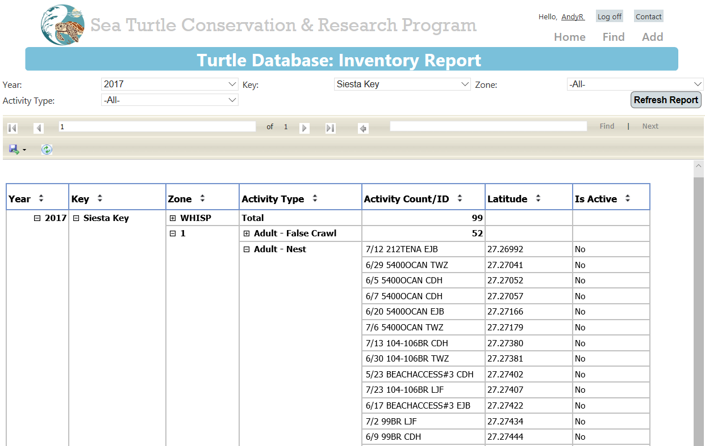
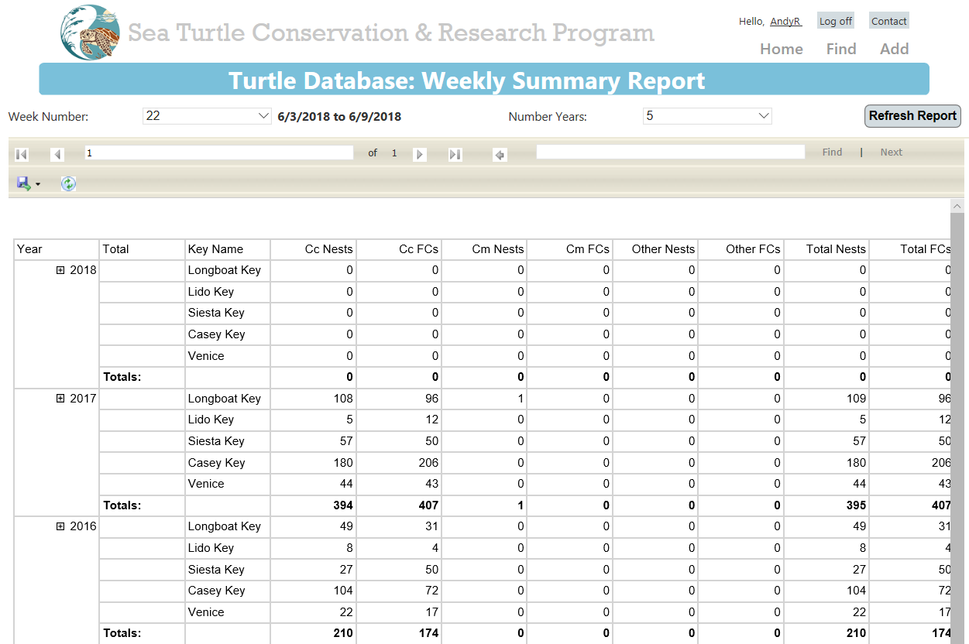
Reports
Quickly generate, print, and export reports for your data:
Monitored Report
This report shows the Activity Count for each Year, Key, Zone, and Activity Type - and includes sub-counts for those activities that are Monitored.
Inventory Report
This report shows the Activity Count for each Year, Key, Zone, and Activity Type. You are able to drill down to the specific Activity, and sort by any of the columns (including Latitude). The status for each activity is also displayed. You can click on an Activity to view the associated record data.
Zone Inventory Report
This report shows active Activities for the selected Year, Key, Zone, and Activity Type. The results also include if the address is Beach Cleaned, as well as the Verified Type, and Triangulation A and B measurements.
Daily Excavation Log
This report shows which activities are due to be excavated for the following day, based on Observed and Hatch Dates.
Weekly Summary
This report shows the weekly totals for each Key, Species, and Activity Type. You may select multiple years for comparison.

Slide 19
Mass editor
Quickly add data for multiple Activities:
Water Damage (useful when a storm or hurricane affects numerous Activities).
Drop/Hatch (useful near the end of the season when there are multiple drops/hatches each day).
Inactivate (useful to inactivate multiple Activities due to washouts, etc.).

Slide 20
Summary
Quickly view all data associated with any Activity:
All associated data (Depredations, Disorientations, Drops/Hatches, etc.) are displayed in chronological order.
Easily see which data has been approved (green) and not approved (orange).
Print all summary data for any Activity.

Slide 21
Uploads
Upload various file formats (pictures, PDFs, etc.) to associate with the current Activity:
Uploaded files are stored on the server, and are viewable by all validated users.
Click any upload to view the file directly from the browser.
Easily see all uploads from the Manage Uploads administration page.

