Slide 1
Scratch Building Experiences to share with you
Jeff Lee MMR
jefflee393@gmail.com

Slide 2
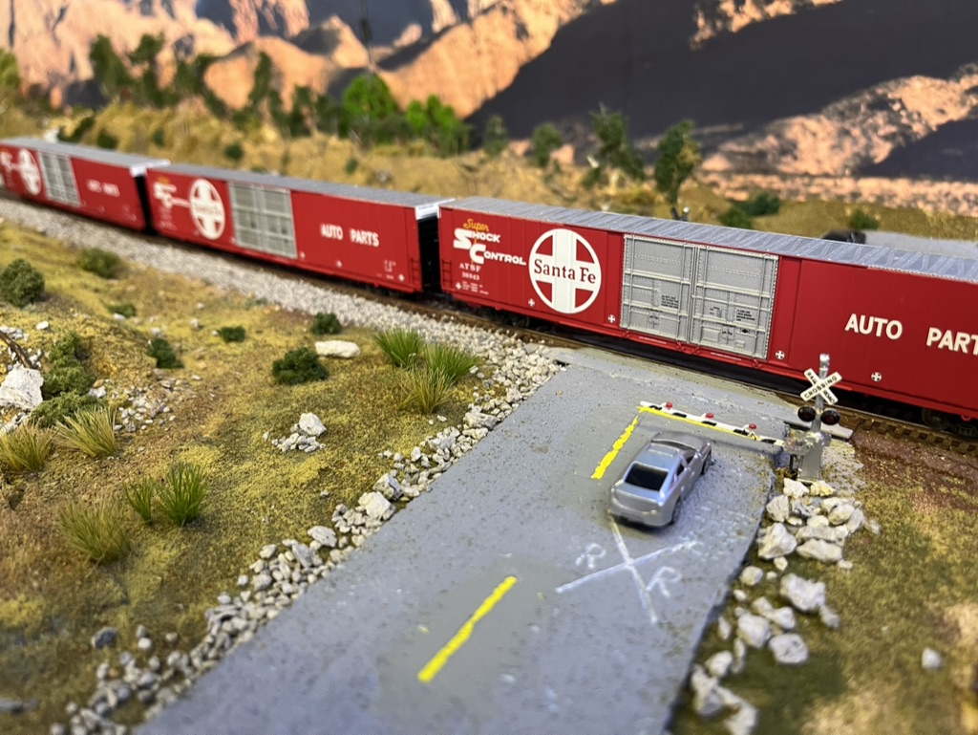
What we will cover:
Creating the Scene: - Research - Design challenges
Mock Ups - scratch and kit bashing
Building Process: - my experiences – ideas.
Do’s and Don’ts
Notes:
We will cover the roadmap / journey from identifying the need to scratch build to planning and execution.
We won’t cover details like making tar paper roofs etc. We will go from a design to a completed scene.
I have some samples here to share as well.
This is a story of building a module / scene and a majority of the structures are scratchbuilt.

Slide 3
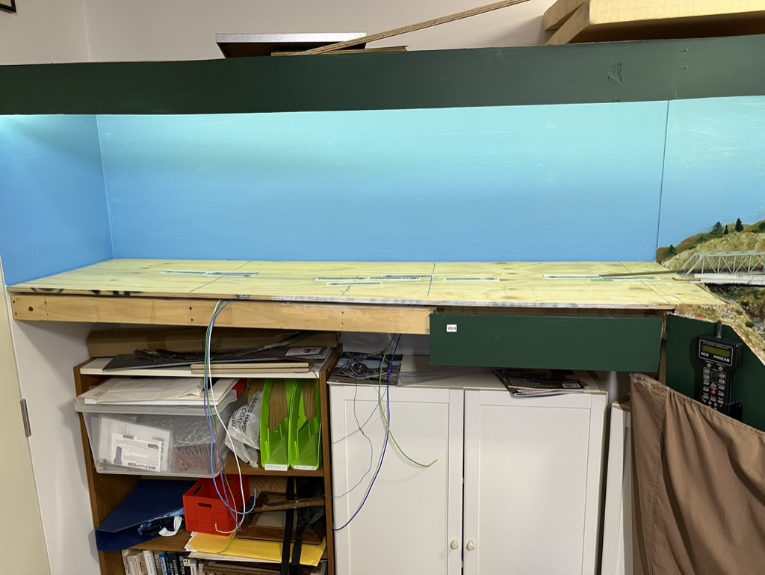
My Opportunity: 1800x500mm. (6x2ft)
Notes:
So here was my challenge.
I have a 22x20 ft room with a double deck N Scale layout – largely fully sceniced.
This section was behind the entrance door, but sub consciously I always knew I would build something here.
I built the base using 1x3inch frame that is attached to the wals.
The top is 12mm (1/2inch) plywood sheet with 12mm strengthening pieces around the perimeter.
The top sits on the frame so it is a portable / modular section.
It could have been a frame with 1 or 2 inch foam, but I chose plywood.

Slide 4
What will it be?
Obviously, a stub-end terminal.
“modern era” so industrial, small industry, engine facility?????
Let’s go for one industry rather than clutter!
Ethanol Plant suits layout.
Notes:
I took ages to decide on the theme.
Eventually an ethanol plant seemed to make sense.

Slide 5
Ethanol Plant
Notes:
Googling ethanol plant brings up a number of sites. This is a good representation of the buildings at such a plant.
The forfront building could be built out of Evergreen metal siding styrene?
The tanks and piping look complicated but can be dissected into simple steps.

Slide 6
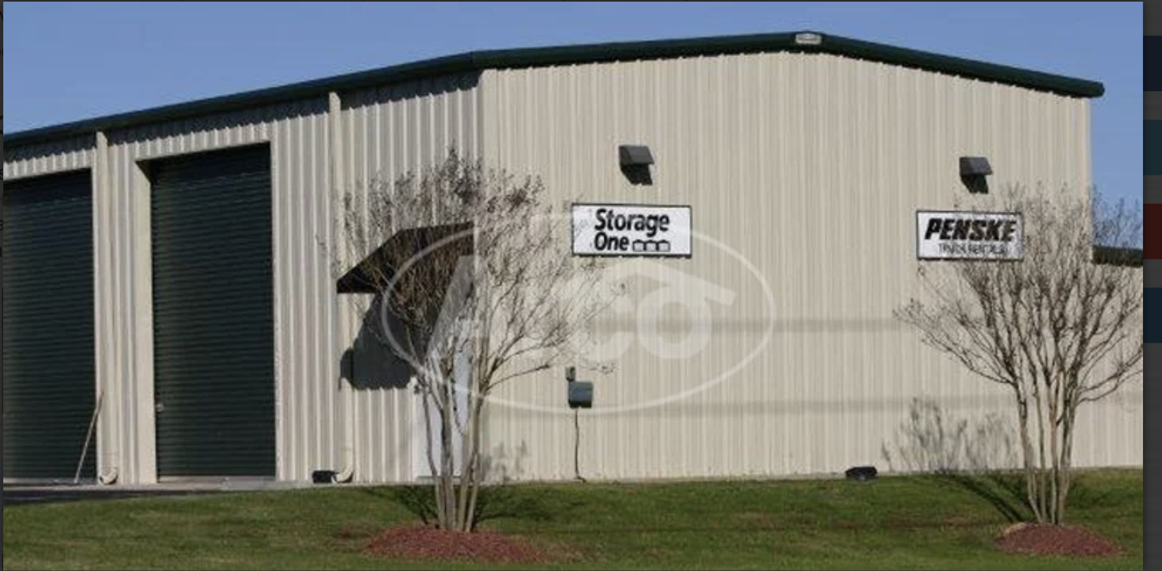
Google Arco Buildings

Slide 7
Ethanol Plant:
Lack of kits in N Scale
Some structures maybe with modifications? - Pike’s warehouses, sheds? - Oil pipelines, tanks?
However, the main structures are not that complicated so let’s scratch build.
But what is the 1st step?

Slide 8
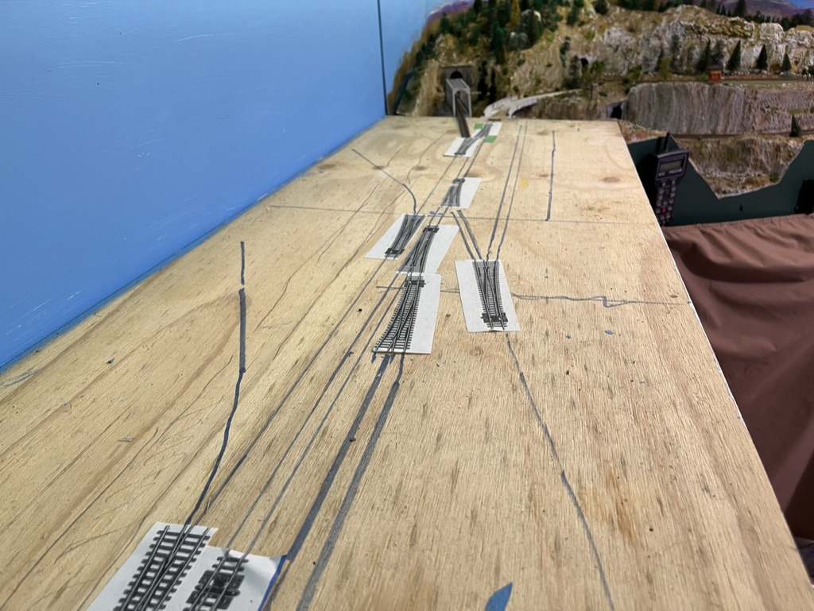
First Steps:
Plan: - track layout (room for locos, xxx tank cars, assembling train etc. - Buildings – key structures, where to fit, size. - layout plan.
Use templates for switches
Use pencil then pen for tracks, buildings
Test with loco, cars.
Notes:
This is key to a good outcome.
The track has to work for switching.
Storage of cars is important.
Laying out the track plan ensured I could bring in a double loco train and reverse the engines out on the run a round track
There was also plenty of options to switch and several locations to build the next train exiting the plant.

Slide 9
First Steps ctd.
“Rough positioning” of buildings to test
Notes:
Once the track plan was finalized I started to lay out where possible buildings could go.
This first step we built boxes to represent buildings, and tubes to represent fuel tanks and silos.
It is quick and will give you a picture.
Of course if you have structures they can be positioned now to test fit in the scene.

Slide 10
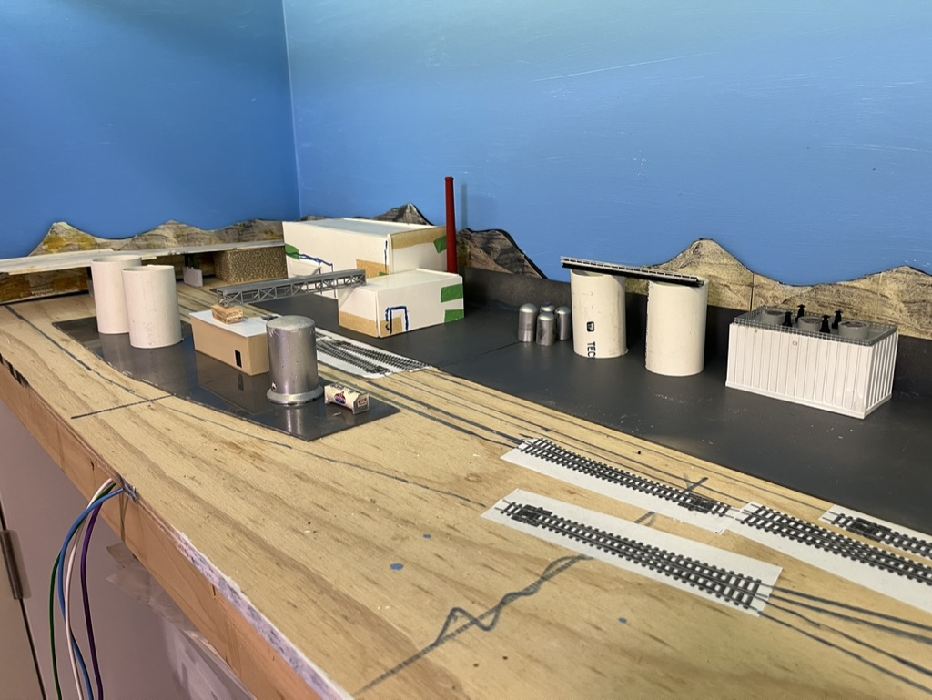
Building Mock-Ups
Aim is flexibility – able to change shape and size of buildings to fit.
Material: Balsa, Foamboard, Heavy cardboard
Glue (PVA, tacky glue) or tape together.
Draw potential windows and doors.
Cut bases for mini scenes so they can be constructed at the workbench.
NOTE: Water pipe for silos. Cigar tubes , toothpaste tubes for tanks.
Notes:
Once a first plan was in place I cut persplex bases for sections of the structures.
Styrene could also be used as a base.
This base can be moved to the work bench so that a diorama can be created.

Slide 11
Simple Mock-Up: A shed / office.
Foam board
Use tool to ensure sides are square.
PVA glue and clamp
Notes:
Here is a simple mock up.
If this is part of the solution make sure the sides are verical using a square.
Cut out the windows and doors.
PVA white glue works fine with foam board.
Balsa wood, cardboard, etc also works.

Slide 12
Mock-Up sidings: Evergreen “metal” sidings. Spare Parts from “bin” Windows, doors from “bin” Tools: Knibbler sharp knife File sandpaper Square Level surface – glass sheet to assemble and make square.
Notes:
Once the foam board model is set it can be used as a base for the structure.
Here I used ”Evergreen” siding.
I had spare doors and windows in my spare parts bin.

Slide 13
Attach sidings to Mock-Up
Glue sides and let dry.
Use angles for corners.
Insert widows and doors
Glue on level surface.
Next Steps:
Roof
Lights
Painting
Interior details?
Notes:
Note: the angles at the corners are not attached initially
Glue the doors and windows to the siding and then glue the sidings to the foam board structure.
90 degree Evergreen angle is used to hide the corners.

Slide 14
Another Mock-Up
Magnetic clamps for alignment
Notes:
Here is another plant storage building.
The truck shed is a section from the parts bin but could have been scratch built.

Slide 15
Mock-Ups
Layout mock-ups for fit.
Cut base for several structures to create
Mini scene and build at workbench
Identify where wires may go for lighting
Now we can take it to the workbench
Notes:
So now we have the roughed out main buildings and we can take the buildings and their base to the workbench.

Slide 16
Workbench
Basic structures “complete”
Identify details like pipes
Storage tanks positioned
Structures glued to base.
Complete as much as possible at workbench
Move to layout to check
Alignment / wires etc:
Notes:
Here is the first base and buildings at the work bench.
The base is painted a light sealer colour.

Slide 17
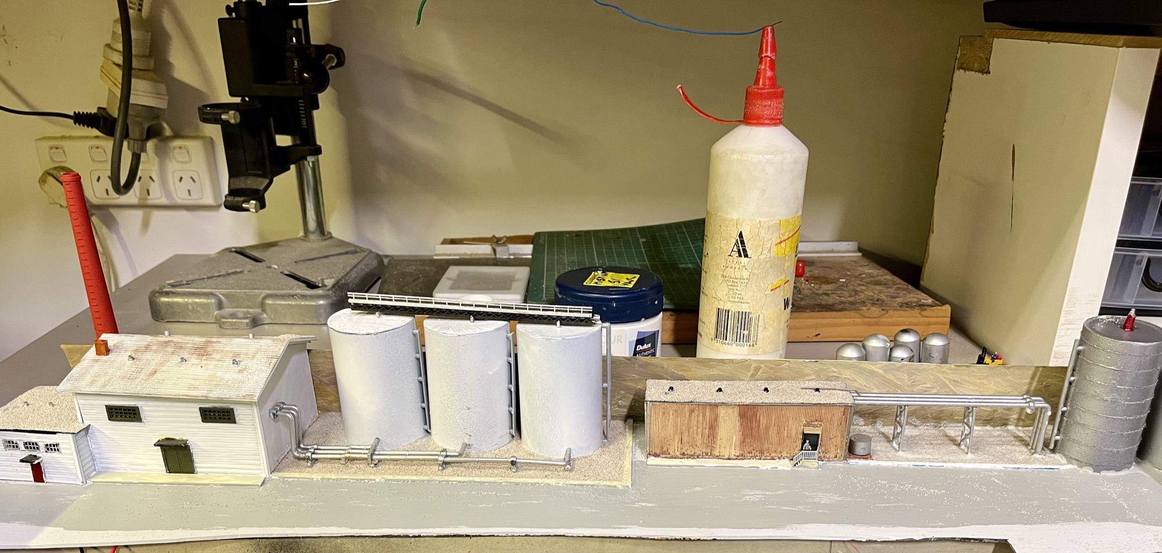
Mock Up’s at Workbench
Notes:
Here are some scratch built buildings at the workbench.
The oil tank is water pipe with cotton thread added.
The pipes at the side of the tank is a spline from a plastic kit – a sprue.

Slide 18
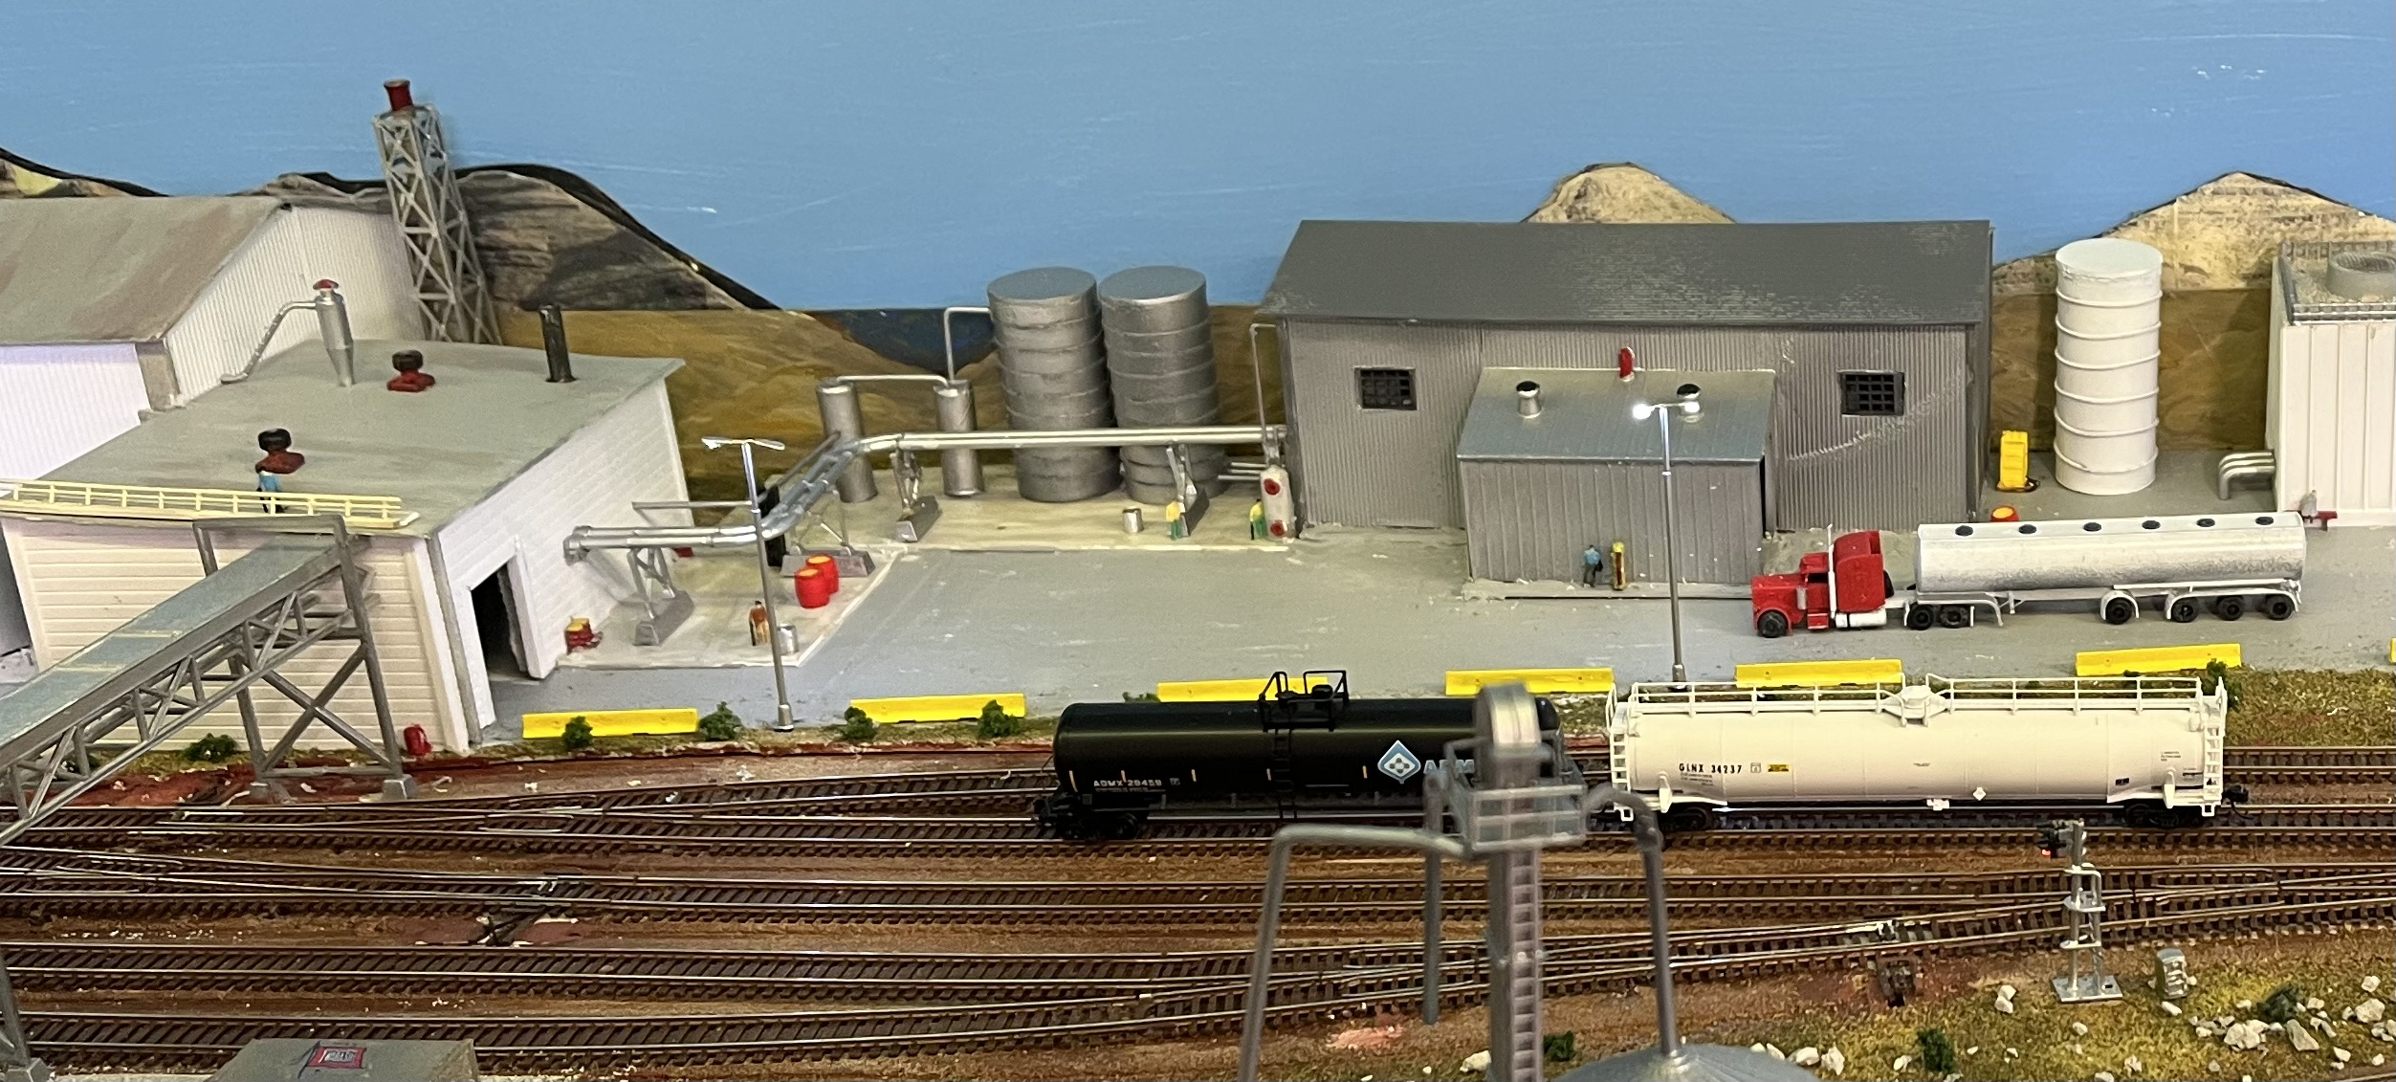
Diorama installed on layout - scenery hides edges of base
Notes:
Note the pipes, footpaths and some details in this scene.

Slide 19
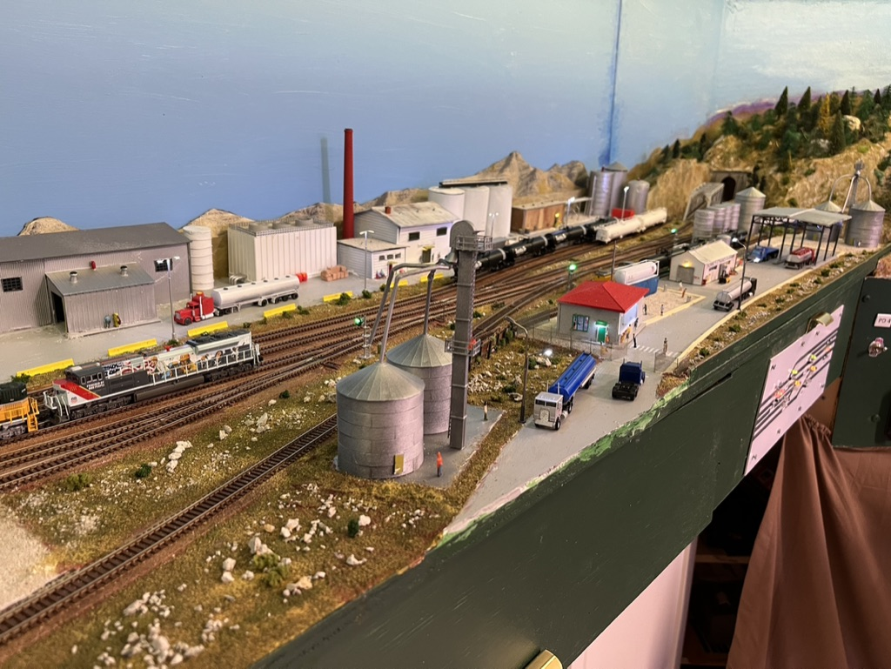
Building the Gatehouse
Front of layout structure: - interior detail so no foam board once design made.
Activity: people, trucks, gates etc.
Notes:
Here is another look at the southern end of the module with several more scratch built structures.
I needed to build a gate house and as this is at the front of the layout it needed to have more detail.

Slide 20
Gatehouse construction:
Evergreen “metal” sidings.
Clear Perspex for window
Interior: desk, shelves, people, lights.
Strengthen sides with interior braces – hidden from view.
Primer paint: Rustoleum grey primer - then off white.
Hand paint doors / windows frames, awnings, roof.
Interior LEDs from roof – wires hidden in small tube.
Notes:
Construction is as per any kit except we cut the pieces from sheets.

Slide 21
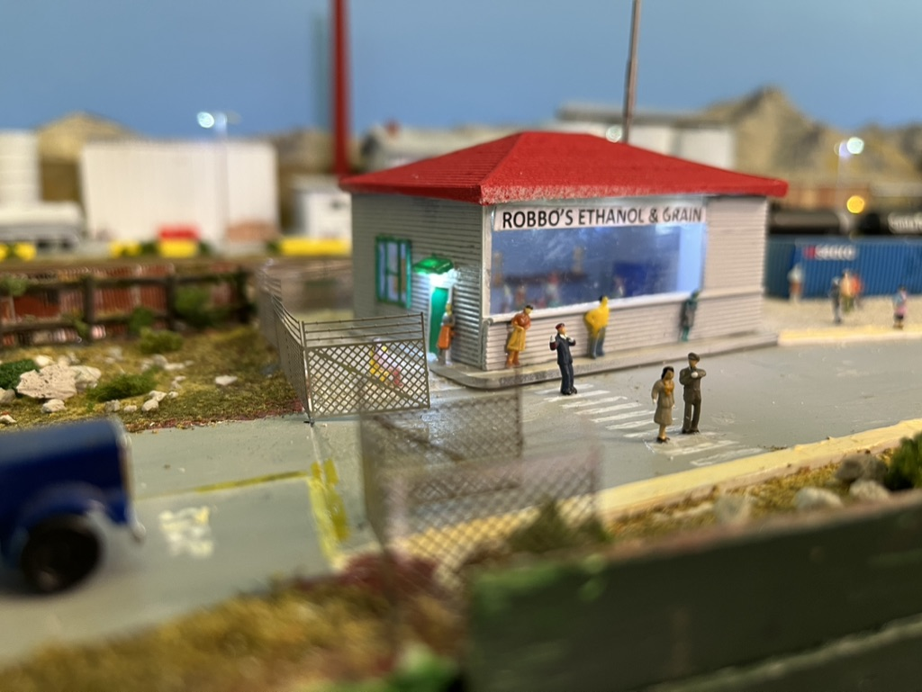
Notes:
Here is the finished gate house.
There are internal details plus ceiling lights.

Slide 22
Add Detail:
People: walking, sitting, lifting
Road barriers / Bollards
Lights – interior, exterior, and street lights
Garbage tins (use tops of DPDT switches)
Gardens: colored flowers, trees, shrubs
Cars, trucks.
Road signs
Scraps – rubbish, construction materials
Look at photos for examples of real scenes

Slide 23
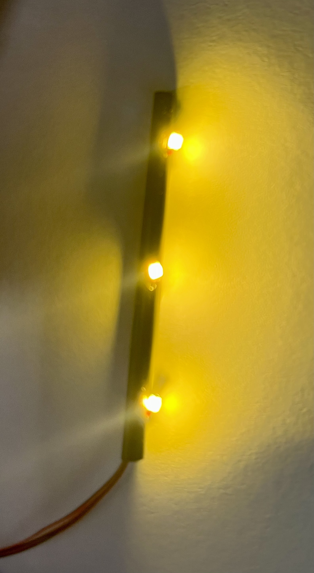
Uniform Roof Lighting

Slide 24
Lessons:
Do - Use very sharp knife - Use square - Use 90 degree clamps - Plan next steps – how will it work? - use workbench to assemble. - use flat base to assemble – eg glass sheet
Don’t: - Fail to plan. - Use blunt knife - glue outside sections – glue inside of walls - rush – wait until right.(paint, glue, lights, building size etc) - underestimate what you can do
Have Fun!!!!

Slide 25
“Finished” module:

Slide 26
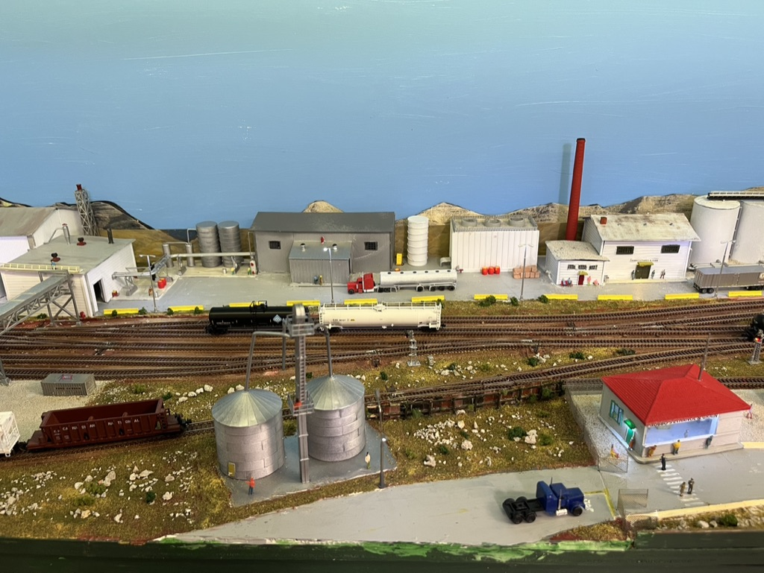

Slide 27
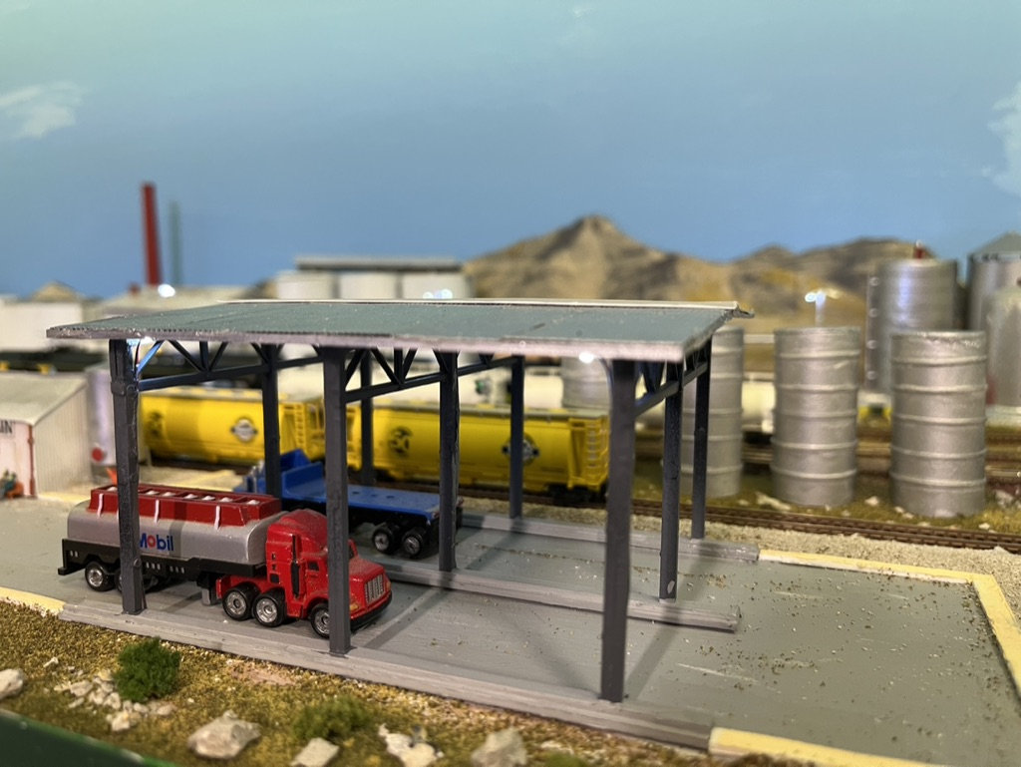
Truck Transfer station

Slide 28
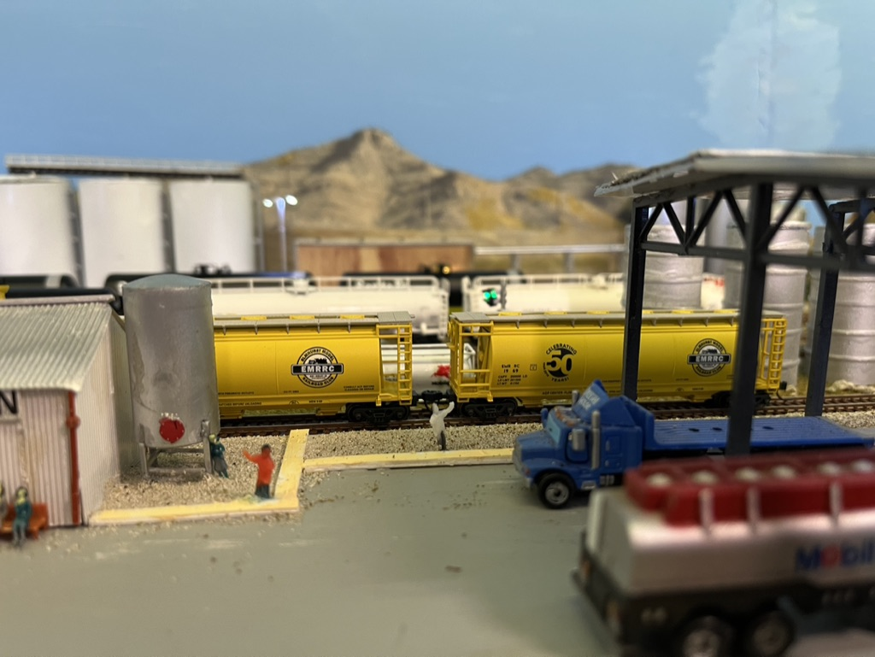
Truck Transfer

Slide 29
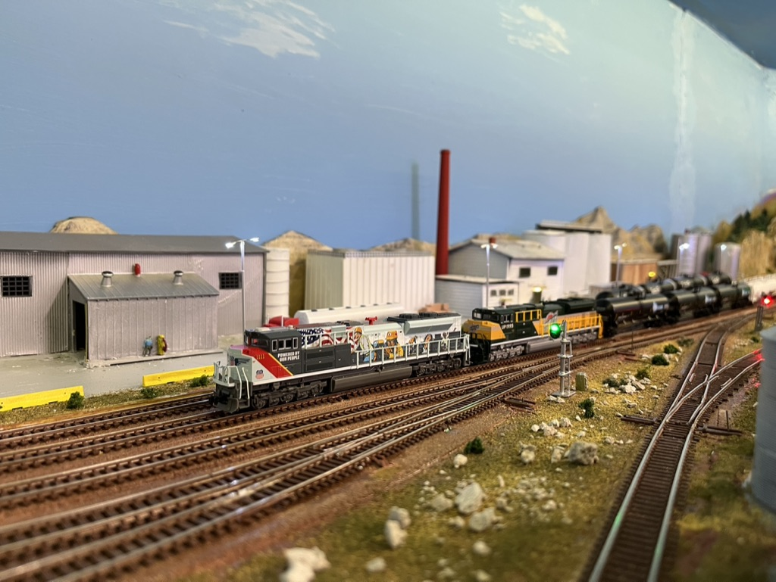
New Delivery

Slide 30
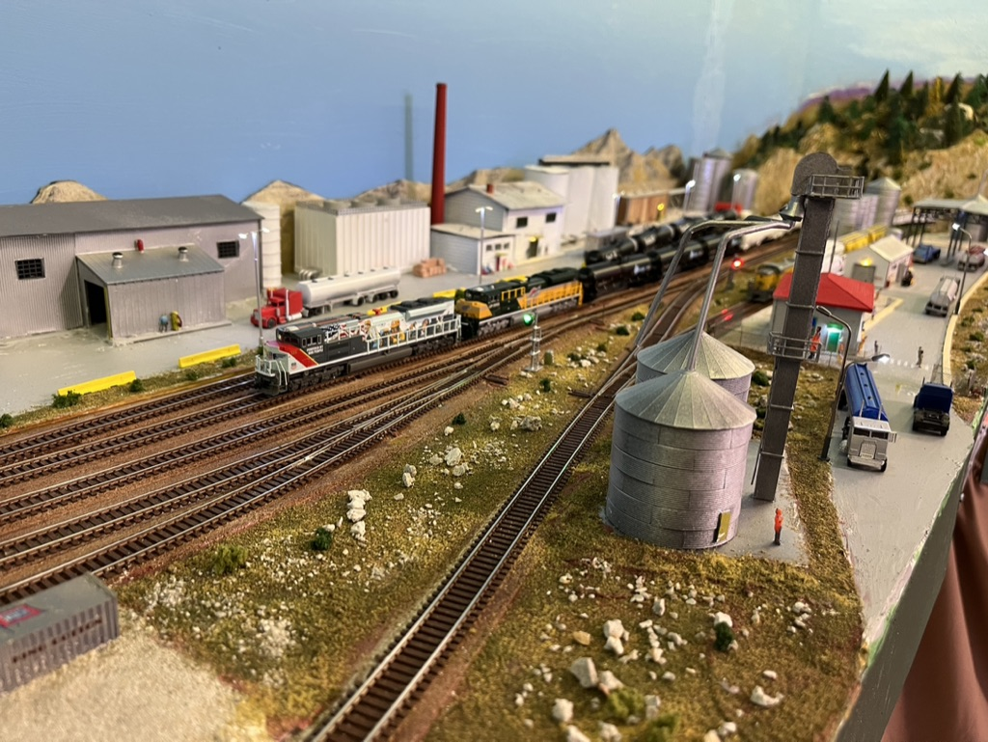

Slide 31
Basic Rules
Better models at front.
Ensure logical positioning of buildings, paths, roads etc.
Use lights to highlight people work areas.
Study prototype photos for scenery details. - fuel tanks, rubbish, materials, maintenance works etc
Vegetation: Grass?, soil?, rocks?, gravel?, shrubs?, trees?

Slide 32
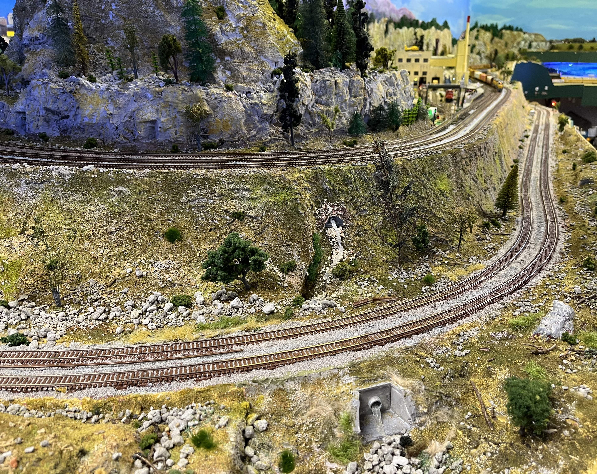
Notes:
Peninsular enabling rise between 2 levels. Maximum grade is 1.5%

Slide 33
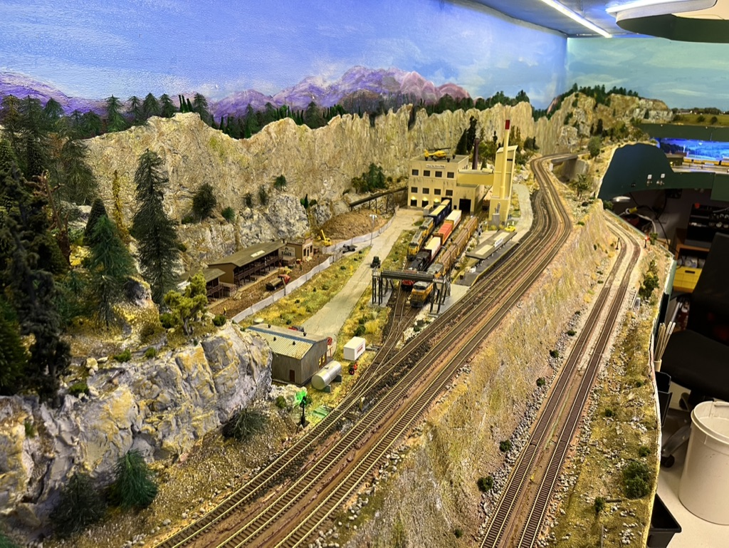

Slide 34
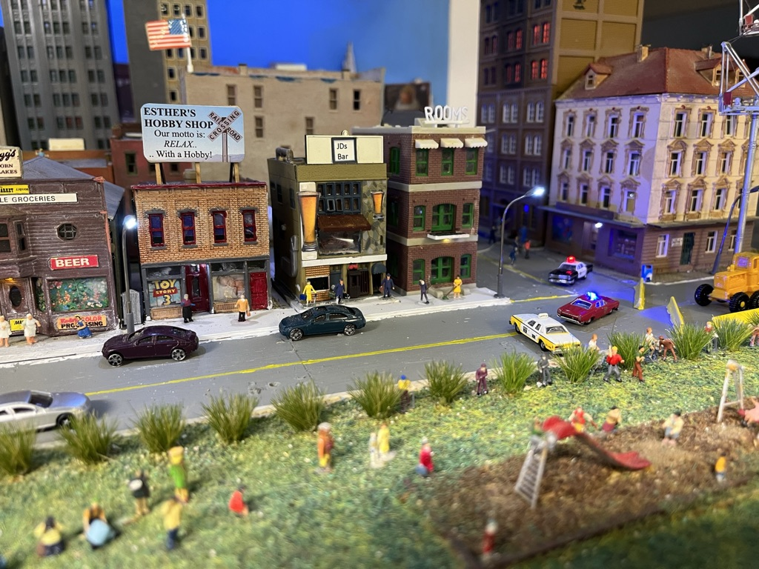

Slide 35
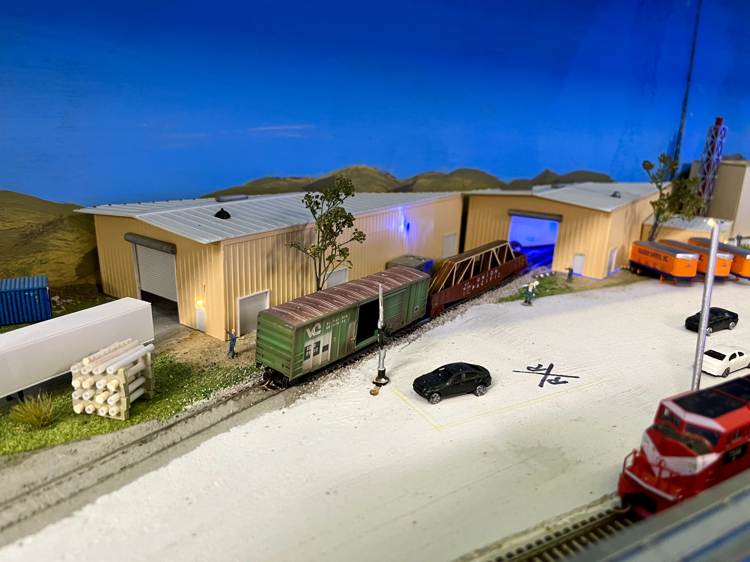
Welder at Work

Slide 36
Thank You
Questions?

