Slide 1
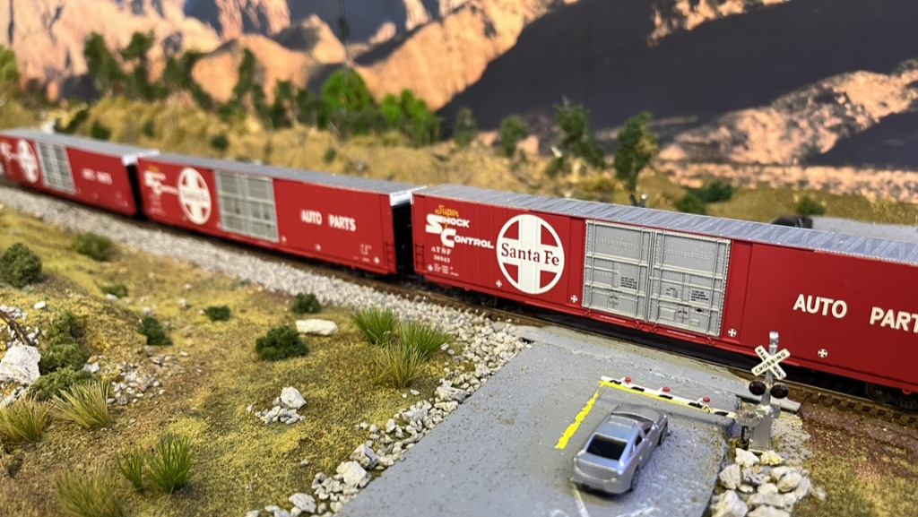
Moving Forward
Jeff Lee MMR

Slide 2
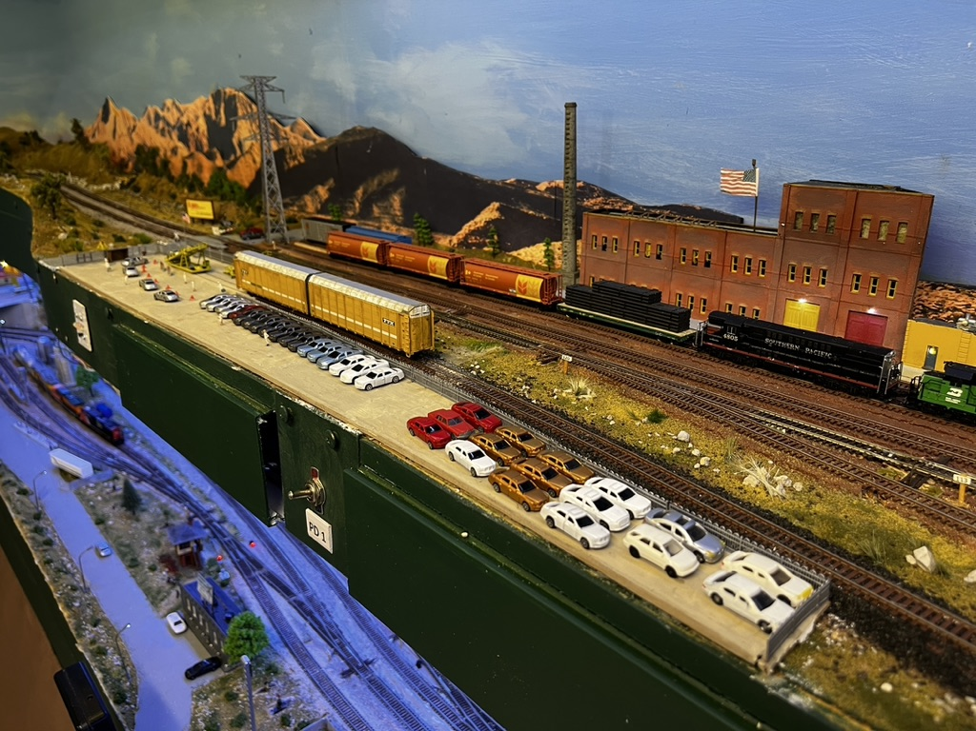
We will cover:
2019/24 Layout
Strengths and Weaknesses
Why Change?
New Plan
Elements of new layout
Note: These are my views – they may not
Work in all cases!
Notes:
Last month I had an almost finished dual level N Scale layout in its own 6x6.5 meter room.
It was started in 2019 after an NMRA convention that encouraged me to re-build and go dual level.
The layout ran well and reliably.
However trends have moved on and there were challenges for me.

Slide 3
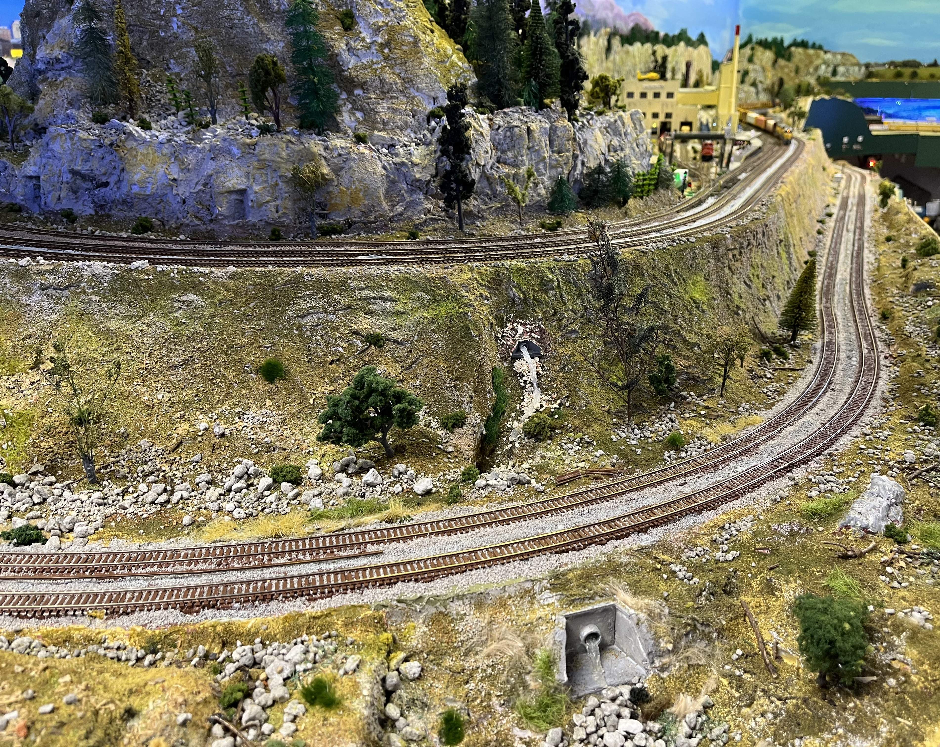
Latest Layout
2 Levels: - No Helix - Max Grade 1.75%
Atlas Code 55 N Scale
Pacific Northwest – Contemporary Era
Tam Valley Servos
NCE – Wireless Plus
Signals – Atlas and Azatrak
”Fully” sceniced
Walk in – around the wall plus peninsular (noelix)
Mostly Kato, Scale Trains, Micro Trains, Atlas.
Mostly metal wheels
Woodland Scenics Light Hubs
Notes:
This is a picture of the “Noelix” where the trains move from one level to the other at less than 2% grade.
The room is walk in and there are no duck unders.
Except for the peninsular the layout is attached to the walls and benches are 50-70cm deep.
The upper level is shorter averaging from 25/30 cm to 60cm.

Slide 4
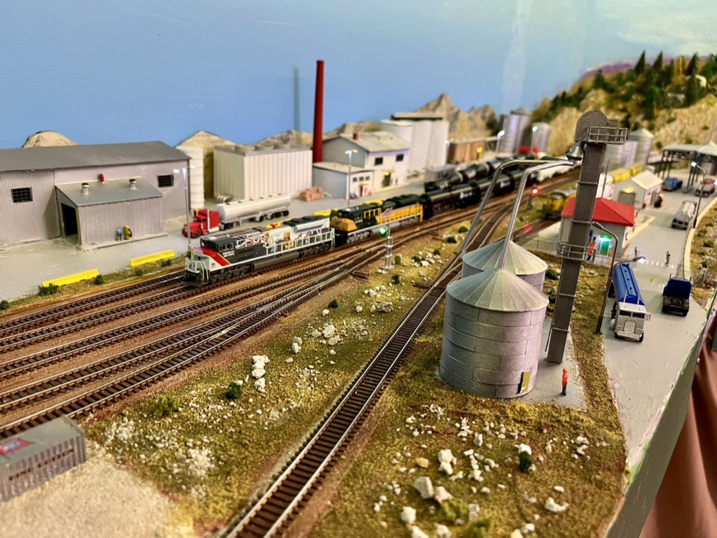
Strengths of Current Layout
Runs Reliably
Long Run – 25 minutes for Amtrak, Fast freights
Signals and animation (signs, welder, Building fire, emergency vehicles etc)
Visible staging
Servos with dwarf signals (via Tam Valley relays)
Wiring robust.
NCE and 8 Power districts
Large radius – 18inch minimum
Drop down fascia for access to wiring.
Wide aisles – no pinch points
Limited hidden track

Slide 5
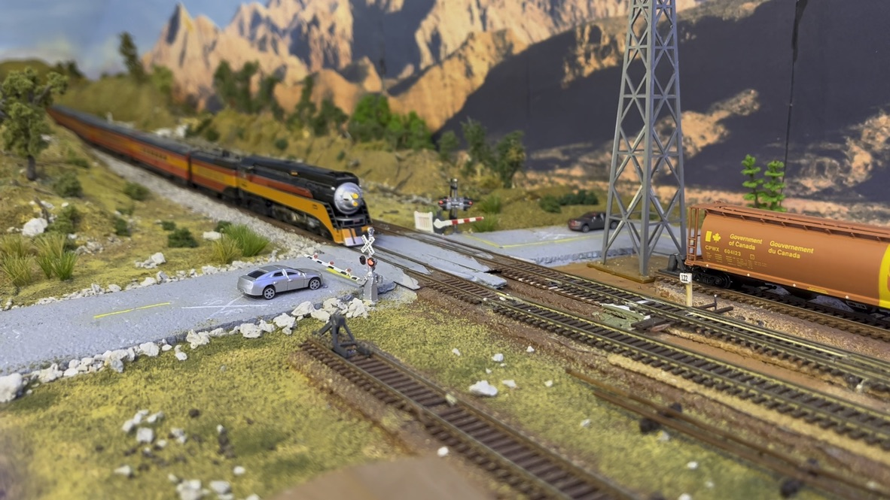
Challenges of Current Layout
Dual level creates tight areas for maintenance
Lower level “low” – not easy to work under.
Wiring with all servos, signals and live frogs etc is busy.
Peninsular divides room – scene divider down the middle.
Drop down fascia area is busy with circuits, terminal boards, wires.
Notes:
Wiring on the upper level became very busy once the signals were added to the servos controlling all switches.
I installed drop down panels on the fasci for the lower level.
The upper level had many electrical boxes with sliding covers that formed part of the fascia.

Slide 6
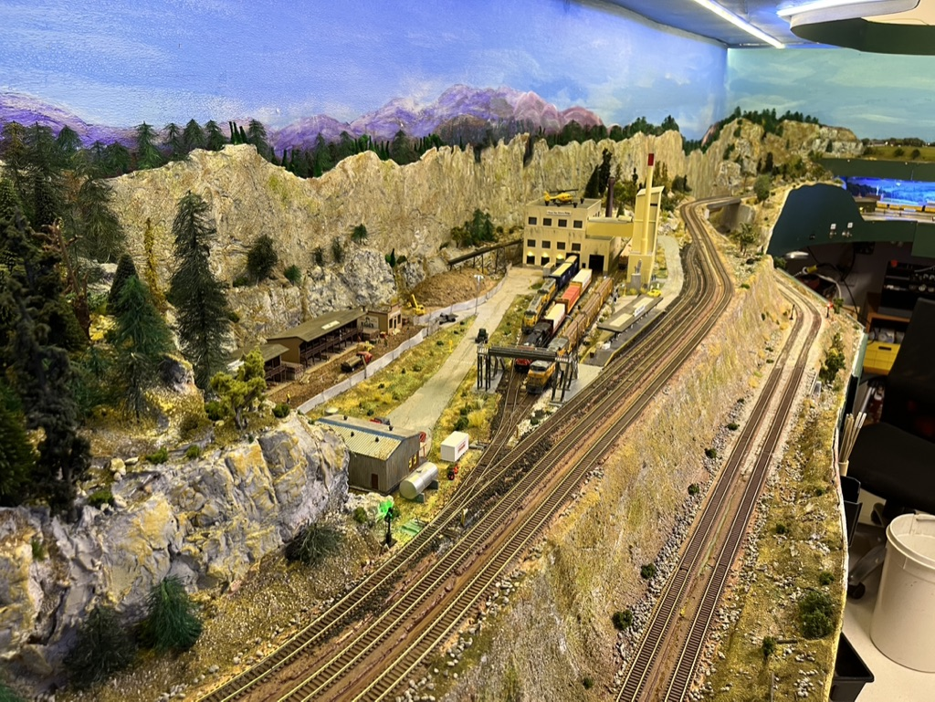
Decision to build new layout
Created my “Druthers”
Planned to review with LDSIG at Long Beach convention. - Byron Henderson
Asked local N Scalers and other NMRA members
Began documenting my new standards - wire colours, Bus and Power district wiring etc.
Aim: Easier to maintain.
Simpler
Even better
Notes:
Looking forward I realized I needed (or wanted) a large layout but one that was simpler and easier to maintain.
I liked the idea of FreemoN but realized I was not going to move modules across the country.
Maybe I could use the ideas of FreeMoN to build my sections (modiules) so they could be “portable” if required or form the basis
of an even smaller layout if conditions in the future required that.

Slide 7
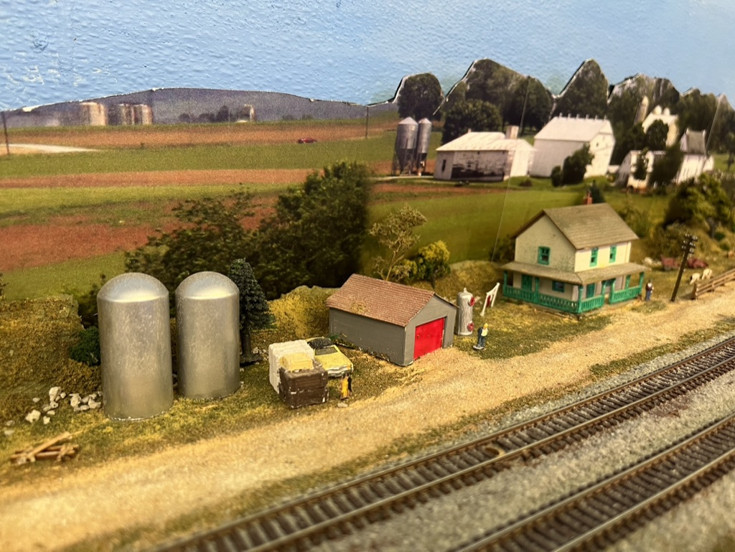
“Druthers”
Single deck – 138cm height
California scenery – contemporary era
Peco Code 55 track – mainly dead frogs. - manual throw
18 inch minimum radius
Long trains – up to 30 cars
“No” grades
Tortoise for mainline switches - switches on fascia in line with turnout
“1.5M” aisles minimum
Develop as modules – build in garage.
Signals
Operations – long runs, industrial switching
Photo Backdrops
Dioramas built at workbench
No hidden staging tunnels. (scenery / hills as view blocks
Notes:
Making the layout 138cm tall is a good height for me. It enables me to work underneath easily.
It also allows a work bench underneath.
I have step up platforms for shorter folks.

Slide 8
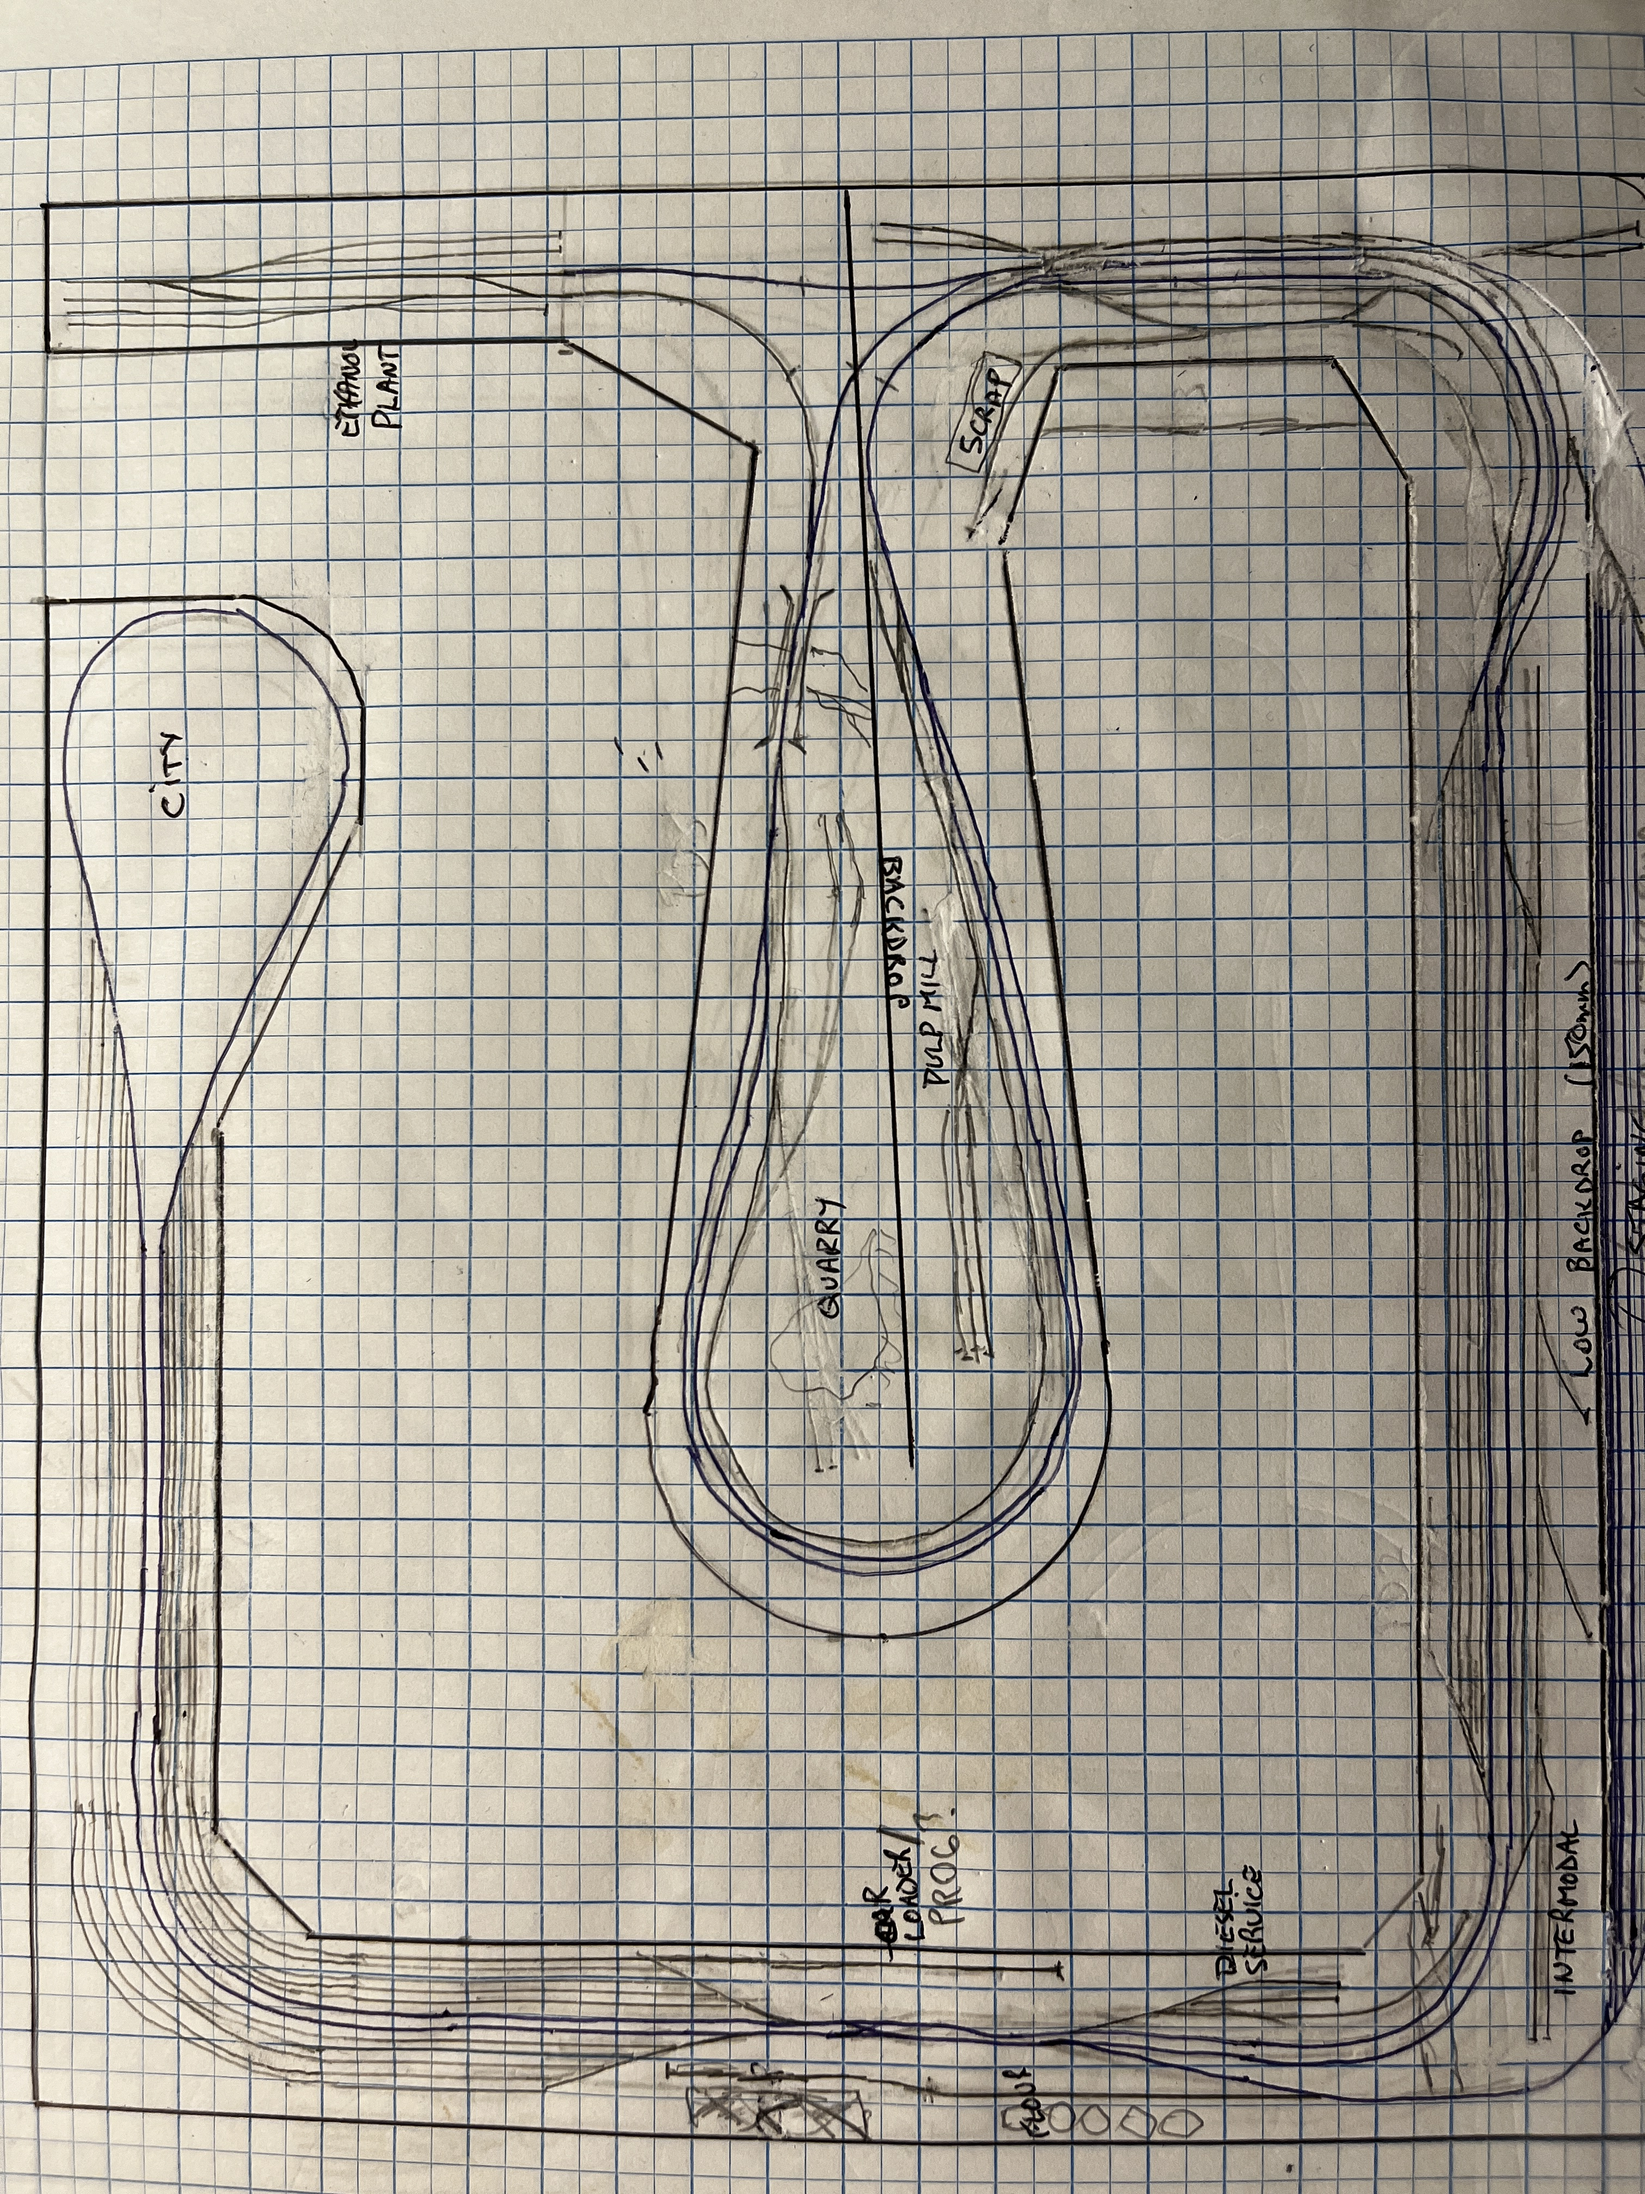
BUSY – many tracks
Train swaps sides – Operations?
Notes:
I scribbled many designs but realized I was caught in a rut.
My gut told me this was not right but I needed to be told by people I respected.
Some N Scalers attended the last operating session and suggested I may not need the scenery divider on the peninsular.
It was becoming obvious that I was putting in tracks to service my too large collection of locomotives and cars.

Slide 9
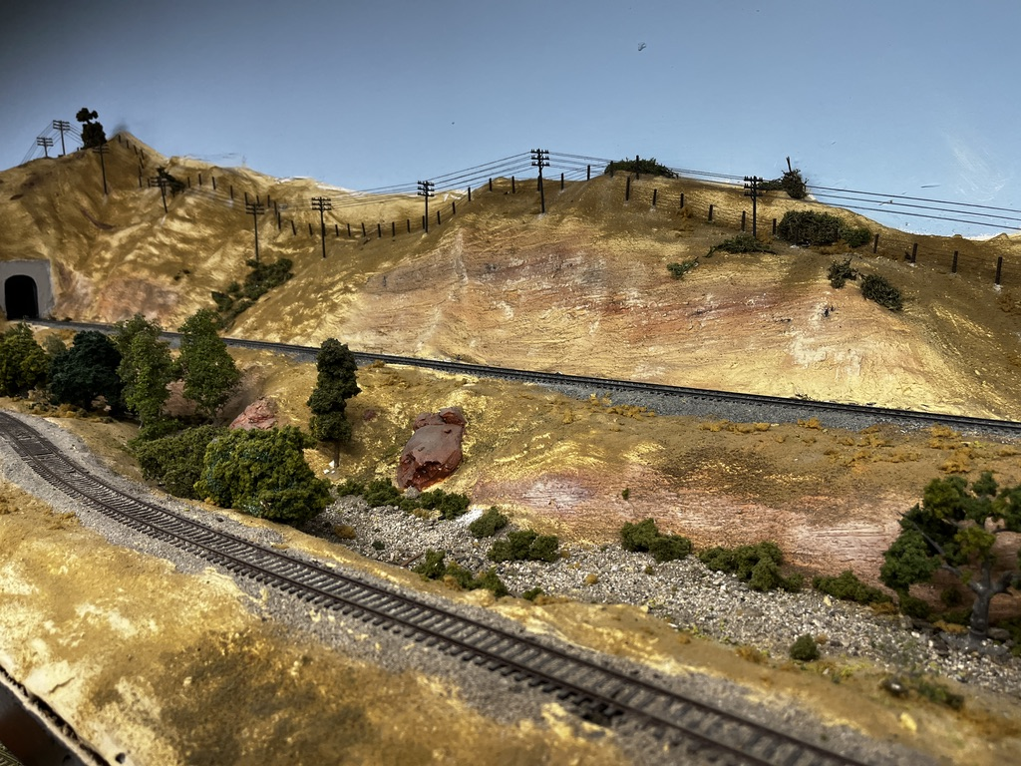
Comments on Plan- LDSIG
Too busy – a lot of staging
How many trains will you run?
Peninsular not ideal for operations – View block?
More industry needed.
Countryside?
Good luck – keep me updated.
Notes:
Byron Henderson heads up the LDSIG.
I have worked with them as a consultant at previous conventions.
Byron helped me with 2 previous layouts.
He is an excellent consultant, and there are several in the LDSIG

Slide 10
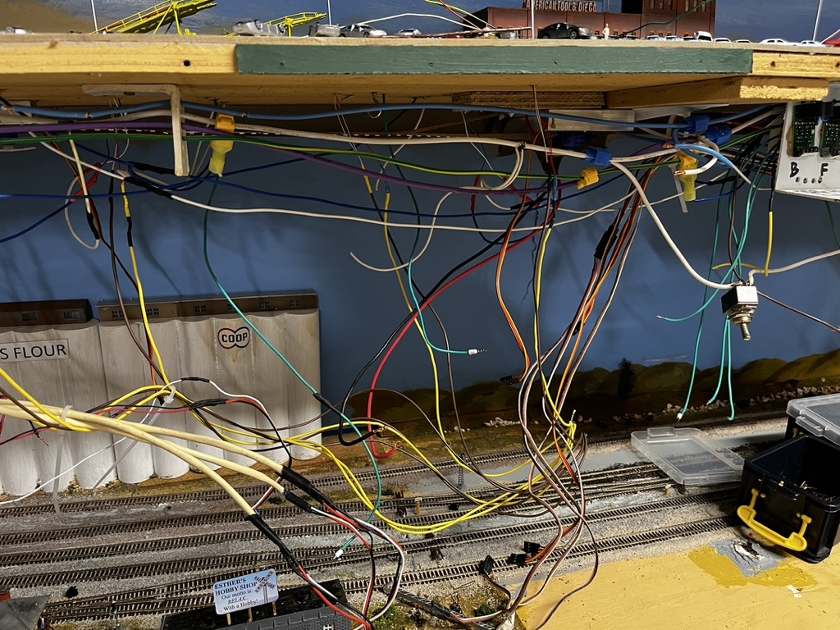
Other Will Do’S based on Experience
NCE plus WIFI and wireless (wifiTrax)
PVA white glue to hold cork roadbed / track
Seal and paint all timber – white for visibility
Fascia painted an earth colour to match scenery
Accessory Bus – heavy (10 amp) to carry loads.
Recessed switches on fascia for Power Districts, Tortoise: Light Hubs?
Light weight modules – 3mm ply + 30mm EPS Foam - 12mm x 100mm frame – 40mm holes for Bus etc
3mm cork roadbed – sanded and sealed
Curtains (black) on spring wire support.
Scenery / Buildings as dioramas built at workbench
Notes:
Cork roadbed carefully sanded and then sealed with a water based earth colour paint.
Recessed switches – in water pipe caps.

Slide 11
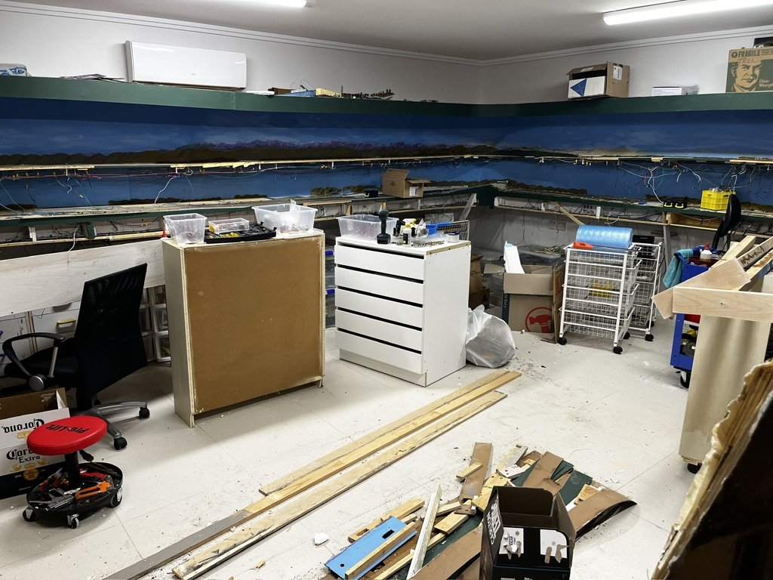
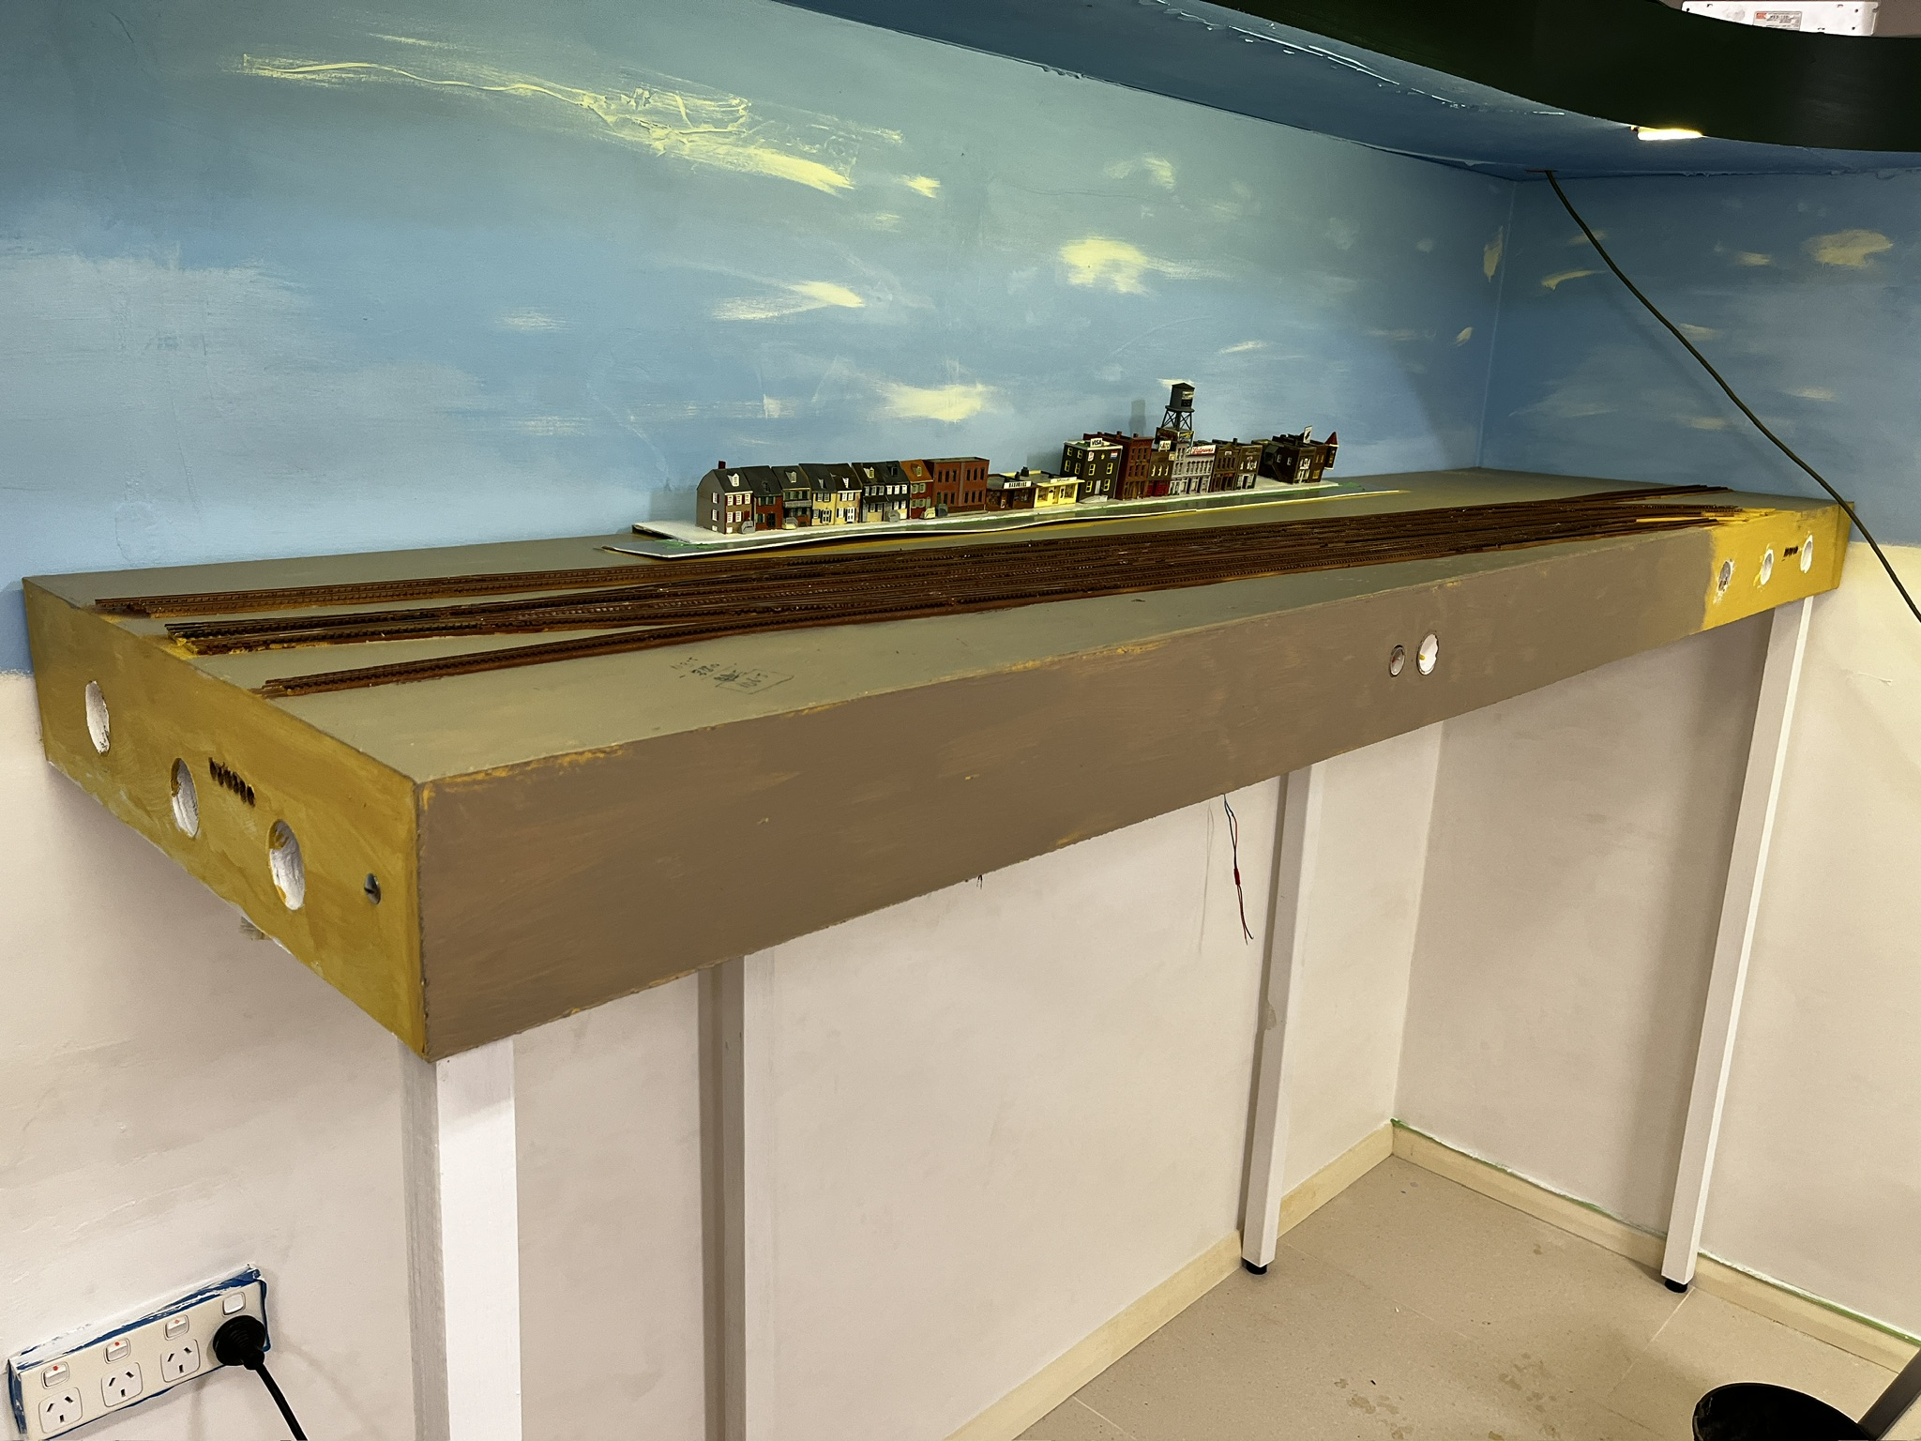
It has started!
Demolition
1ST Module in place

Slide 12
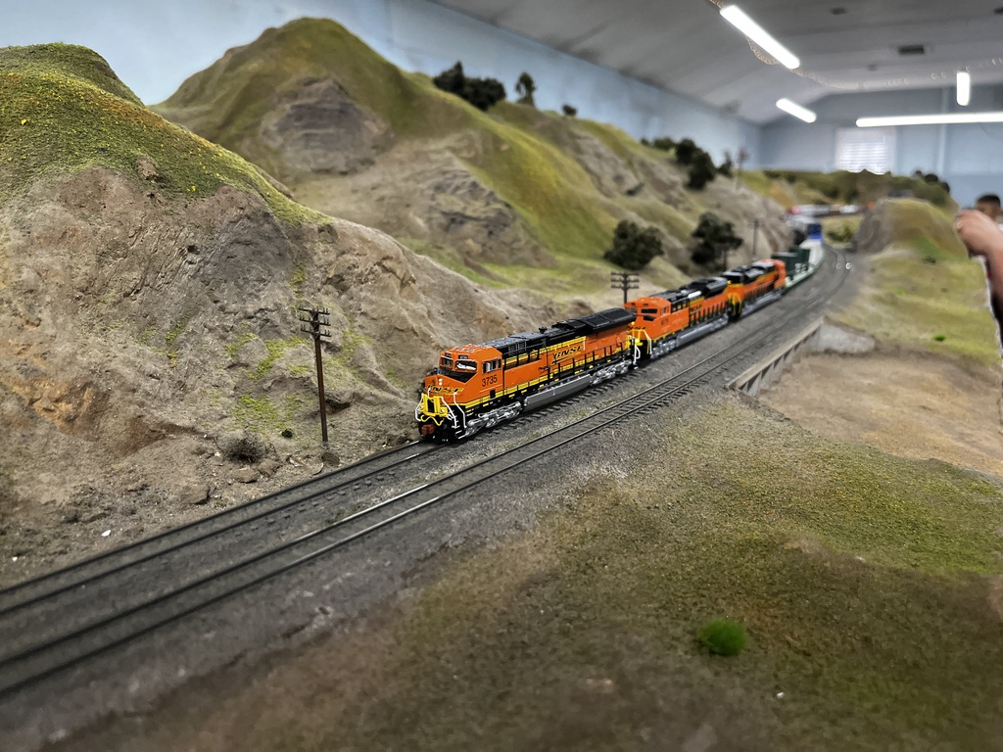
Value of NMRA
Belmont Shores Model Railroad Club
Networking: - members and their guidance / advice
Resources: - LDSIG, OPSIG, Member’s web pages
Conventions: - Local, “National”, NSE and other asscociations
Magazine. (don’t start me on Digital)
Notes:
SIGs cost US$10 per year – great value.
NSE and NMRA getting much closer and supportive of each other.
Magazine has great articles and guidance
Once a new plan is created there is a wealth of expertise to add value to any plans.

Slide 13
Thank You
Happy modelling
More Questions?
jefflee393@gmail.com

