Slide 1
Enhance your nitrogen.

Slide 2
N
Adding CarbonWorks CetaiN to your nitrogen keeps your nutrients in the soil until your crop is able to use them. At the same time, it stimulates microbial activity in saturated soils by delivering a timely supply of molecular oxygen to the root zone.
STABILIZE
NUTRIENTS
CLEANSE THE SOIL OF SALTS & OTHER TOXINS
STIMULATE SOIL MICROBES
INCREASE ROOT GROWTH
© CarbonWorks 2021

Slide 3
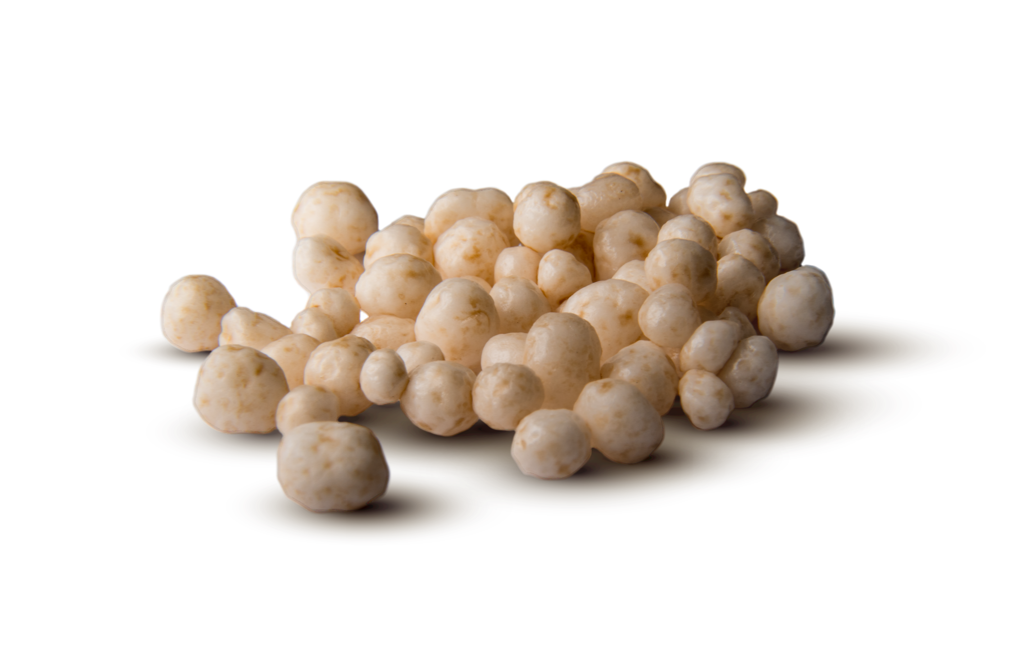
Net Profit
+$34/AC*
+$19/AC*
*Base on the 3-year average yield increase of 10.4 bu/ac when added to urea at corn price of $3.72/bu.
*Base on the 3-year average yield increase of 6.6 bu/ac when added to UAN at corn price of $3.72/bu.
© CarbonWorks 2021

Slide 4
A nitrogen additive that
does more for your soil.
The carbon, hydrogen energy, and oxygen compounds of CarbonWorks CetaiN work together to stabilize nutrients, feed soil microbes, cleanse the soil of salts and harmful heavy metals, and promote increased root growth. We’re doing more than stabilize your nitrogen. We’re transforming your soil into a corn-producing workhorse.
STABILIZE
NUTRIENTS
STIMULATE SOIL MICROBES
CLEANSE THE SOIL OF SALTS & OTHER TOXINS
INCREASE ROOT GROWTH
© CarbonWorks 2021

Slide 5
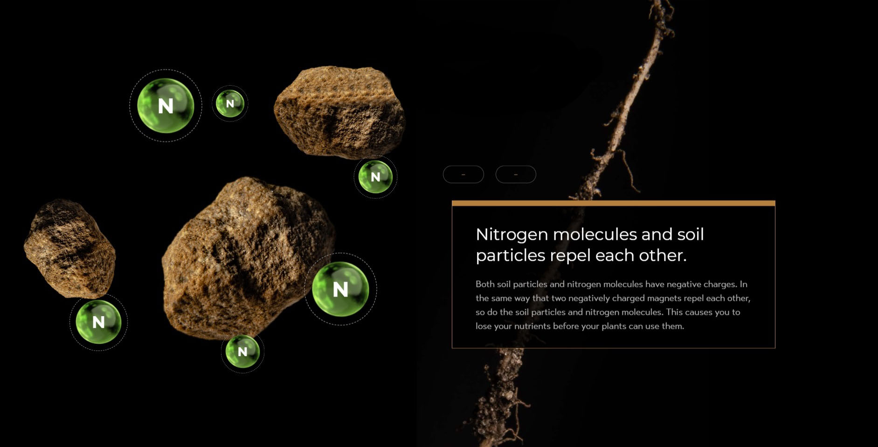
How It Works
Nitrogen molecules and soil particles repel each other
Both soil particles and nitrogen molecules have negative charges. In the same way that two negatively charged magnets repel each other, so do the soil and nitrogen molecules. This causes you to lose your nutrients before your plants can use them.
© CarbonWorks 2021

Slide 6
Carbon creates a link that holds your nitrogen to the soil.
Carbon’s unique ability to hold positive and negatively charged elements enables it to act as a middle link between soil and nitrogen molecules. This prevents you from losing a costly nitrogen application before your plants can use it.
© CarbonWorks 2021

Slide 7
Delivering a timely supply of oxygen for your microbes.
Overly saturated soils are often the culprit behind yellow corn fields. Like us, the aerobic bacteria responsible for making nutrients available for your crop cannot survive without air. CarbonWorks Certain delivers a timely supply of oxygen that gives those crucial microbes a boost and greens up your corn fields faster.
© CarbonWorks 2021

Slide 8
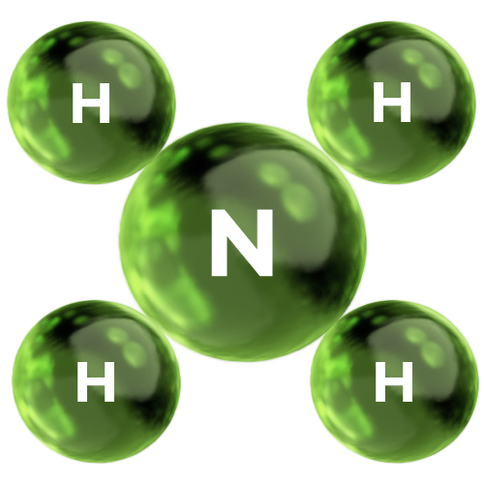
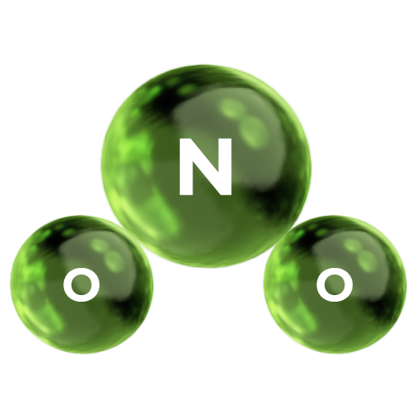
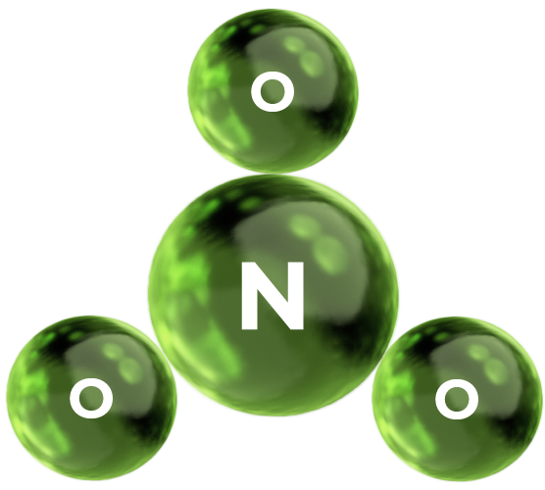
Enhancing all 3 forms of nitrogen.
AMMONIUM
NITRITE
NITRATE
Initial form of many fertilizers. Readily converts to the nitrate form of nitrogen which can be easily lost.
An intermediate step in the nitrogen conversion process that is NOT plant available but can be lost through leaching
A readily available form of nitrogen for plants but is the most easily lost through leaching and denitrification
CarbonWorks CetaiN
Bactericides (Instinct)
Urease Inhibitors (Agrotain)
Ammonium Thiosulfate
© CarbonWorks 2021

Slide 9
Your UAN nitrogen is
100% in need of protection.
CarbonWorks CetaiN protects all of your UAN.
NH
SUBJECT TO VOLATILIZATION
3
50%
UREA
UAN 28% and 32% contains 3 forms of nitrogen so it is subject to all 3 forms of nitrogen loss. CarbonWorks CetaiN gives you the most complete protection by holding all 3 forms of nitrogen in the soil.
NH
STABLE BUT WILL CONVERT TO NITRITE & NITRATE FORMS
AMMONIUM
4
25%
NO
3
SUBJECT TO VOLATILIZATION
BROADCAST
INJECTION
DROP HOSES
NITRATE
25%
© CarbonWorks 2021

Slide 10
Enhancing every nitrogen application.
CarbonWorks CetaiN enhances both pre-plant and in-season nitrogen applications when added to urea, UAN 28%, or UAN 32%. For optimal application rates based on timing and application method, contact us or your nearest authorized CarbonWorks Distributor.
© CarbonWorks 2021

Slide 11
Enhancing your nitrogen.
www.carbonworks.com

