Slide 1
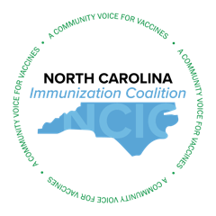
March 2025 NCIC Membership Meeting
March 11th, 2025
Rachael Baartmans, MPH
Brandon Young, Ph. D.

Slide 2

Welcome Members
Rachael Baartmans, MPH
NCIC Executive Committee Member

Slide 3
Agenda
Welcome | Rachael Baartmans
NCIC Update | Nadja Vielot
HPV Task Force Update | Lacie Mckamey and Nadja Vielot
DHHS Immunization Updates | Juliette Pailin Education, Outreach, and Communications Unit Manager
Consequences of Low Immunization Rates | Christoph Diasio, MD, FAAP Pediatrician Sandhills Pediatrics
H5 Influenza Update | Brandon Young PhD MSL CSL Seqirus
Manufacturer Updates | One minute time slots
Closing and Adjourn | Brandon Young

Slide 4
NCIC Update
Dr. Nadja Vielot
NCIC Executive Committee

Slide 5
HPV Task Force Update
Lacie Mckamey & Dr. Nadja Vielot
NCIC HPV Task Force

Slide 6
DHHS Immunization Update
Juliette Pailin
Education, Outreach, and Communications Unit Manager

Slide 7

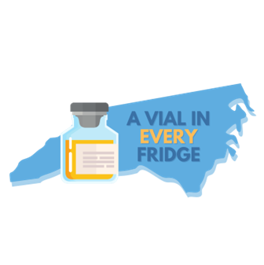
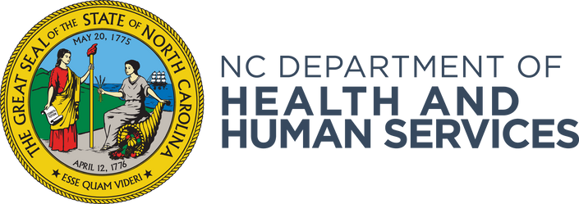
North Carolina Immunization Coalition
March 11, 2025

Slide 8

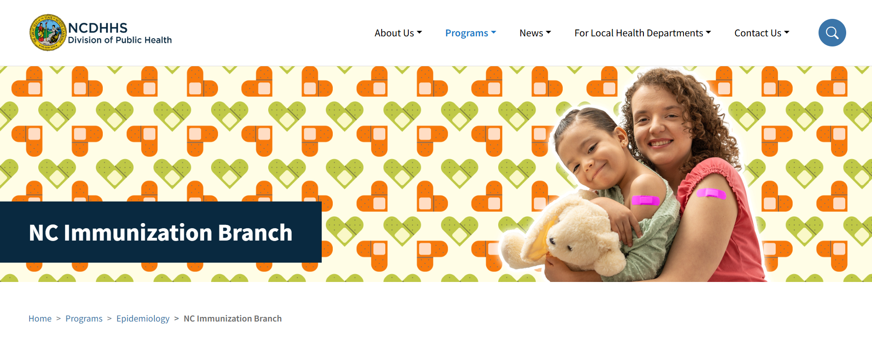
Newly Designed Website!
A New Look and Improved Navigation: We’ve transformed several pages with updated design features, making it easier to find the information and tools you need.
Resources for Providers: All the essential information for providers is now conveniently located on the Immunization Information for Providers page, including your most accessed resources.
What’s Next: The next phase of our design focuses on updating the website content to ensure you have access to accurate and up-to-date information.
Visit our site today! NC Immunization Branch | Division of Public Health
March 7, 2025, Newly Designed Website: Communication

Slide 9

2024-2025 Respiratory Season Vaccine Numbers
Thanks to your dedication, we’ve seen substantial progress in vaccination efforts.
As of March 3, 2025, we are proud to share the following vaccination totals:
• 1,024,379 COVID-19 doses have been administered
• 2,359,598 flu doses administered*
• 131,391 adult RSV doses administered
• 46,823 pediatric RSV doses administered
*Note that NC pharmacies are not required to report flu doses to the NC Immunization Registry (NCIR), so these totals reflect only those reported into the registry.
Notes:
As the respiratory season draws to a close, we want to take a moment to highlight the extraordinary work of our providers in ensuring that North Carolinians are protected. Thanks to your dedication, we’ve seen substantial progress in vaccination efforts. As of March 3, 2025, we are proud to share the following vaccination totals:
• 1,024,379 COVID-19 doses have been administered
• 2,359,598 flu doses administered*
• 131,391 adult RSV doses administered
• 46,823 pediatric RSV doses administered
Your ongoing commitment to administering these vaccines plays a vital role in protecting our communities, and we appreciate the incredible work you've done throughout this season.

Slide 10
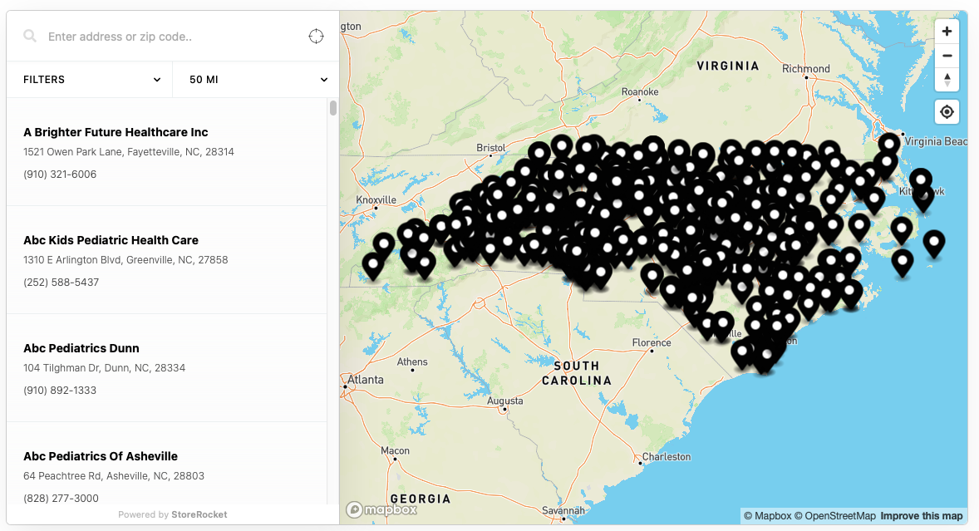
VFC Provider Finder: Coming Soon!
We are developing a provider finder for the VFC program on our NCIP website.
This provider finder will be a searchable, online map of all enrolled VFC providers in North Carolina.
Designed for families and community health workers, it will make it easier to find local VFC providers.
Expected launch: Early May.

Slide 11
Relaunching the North Carolina Immunization Advisory Committee (NCIAC)
Purpose: The North Carolina Immunization Advisory Committee (NCIAC) will provide expert advice and guidance on immunization policies and practices within the state.
The committee will play a crucial role in shaping the future of immunization strategies and ensuring the health and safety of North Carolinians.
Stay tuned for more updates on the NCIAC and how it will support immunization efforts across North Carolina!

Slide 12
Consequences of Low Immunization Rates
Christoph Diasio, MD, FAAP

Slide 13
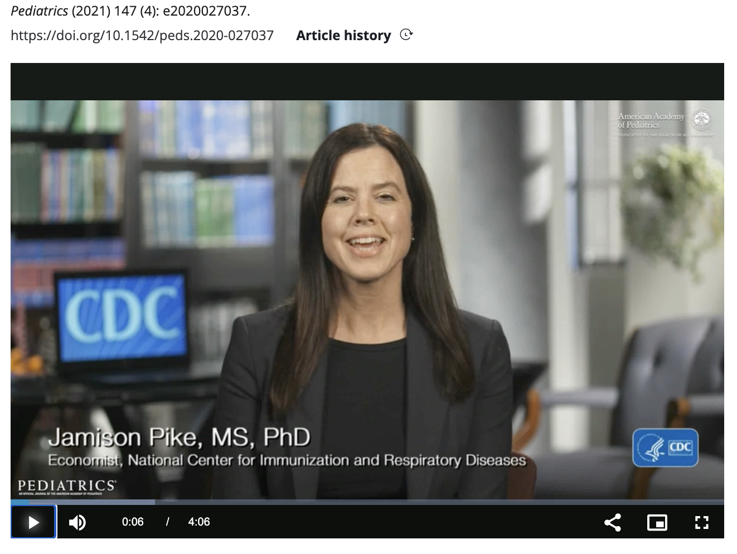

Slide 14
H5 Influenza Update
Brandon Young PhD MSL
CSL Seqirus

Slide 15
H5N1: RESERVOIRS AND TRANSMISSION
Primary Hosts
Transmission to Humans
Human infections occur through direct contact with infected animals or contaminated environments. As of March 2025, there is no evidence of sustained human-to-human transmission.
  Wild birds are natural reservoirs for H5N1. The virus has also been detected in poultry and, more recently, in dairy cows. There are also cases involving domestic cats.

Slide 16
DETECTIONS IN ANIMALS
12,467 wild birds detected as of 3/4/2025
52 jurisdictions with bird flu in wild birds
166,414,821 poultry affected as of 3/4/2025
51 jurisdictions with outbreaks in poultry
983 dairy herds affected as of 3/10/2025
17 states with outbreaks in dairy cows
https://www.cdc.gov/bird-flu/situation-summary/?CDC_AAref_Val=https://www.cdc.gov/flu/avianflu/avian-flu-summary.htm

Slide 17
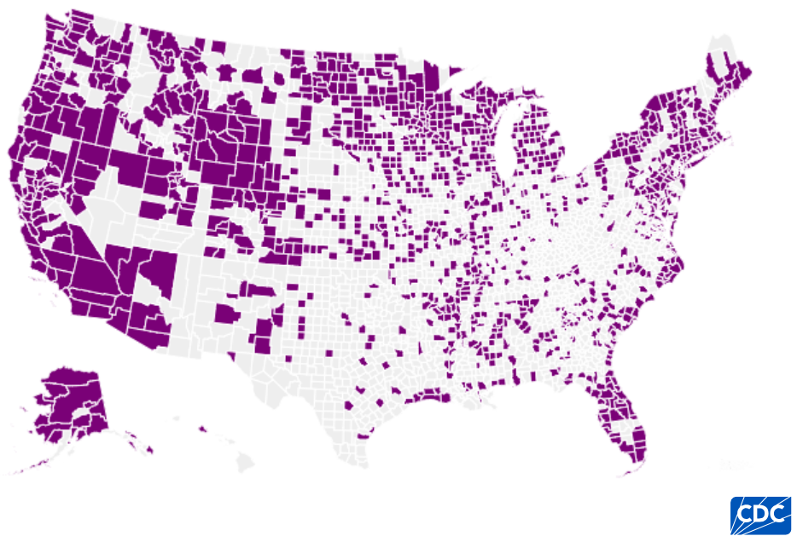
H5N1 Distribution in Wild Birds
https://www.cdc.gov/bird-flu/situation-summary/data-map-wild-birds.html

Slide 18
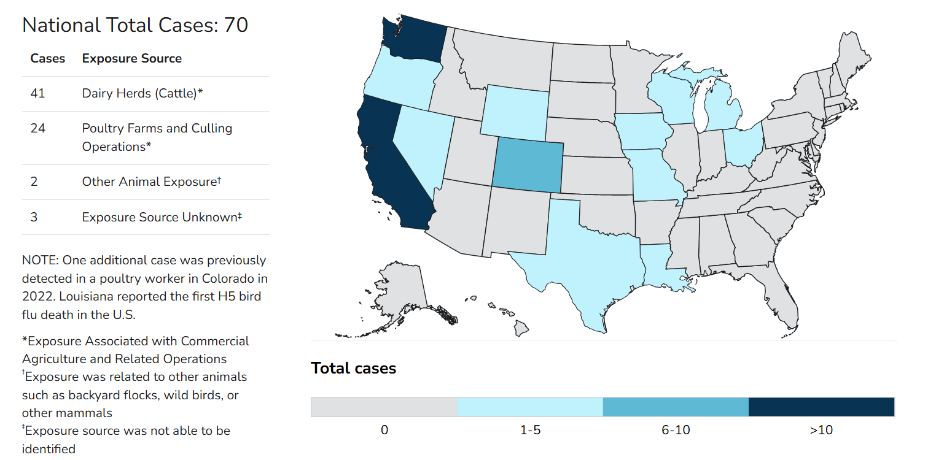
H5N1 Confirmed Human Cases
https://www.cdc.gov/bird-flu/situation-summary/?CDC_AAref_Val=https://www.cdc.gov/flu/avianflu/avian-flu-summary.htm

Slide 19
Manufacturer Updates

Slide 20
Closing
Upcoming NCIC Meetings
  May 13th, 2025 (virtual)
  August 12th, 2025 (hybrid)
  November 18th, 2025 (virtual)
Check our website for updates!
https://letsimmunizenc.org
To join NCIC please email: director@letsimmunizenc.org
Brandon Young

