Slide 1

Health Equity IQIP Strategy:
Address Health Disparities in Immunization Coverage
North Carolina Immunization Coalition
August 20th, 2024

Slide 2
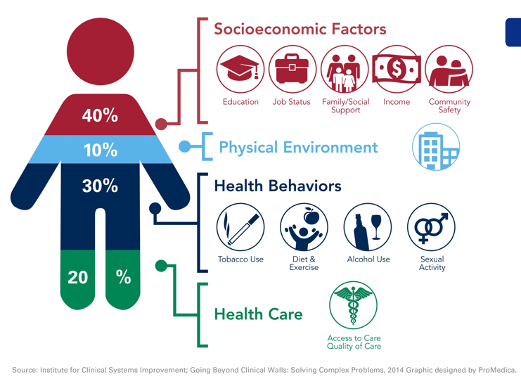
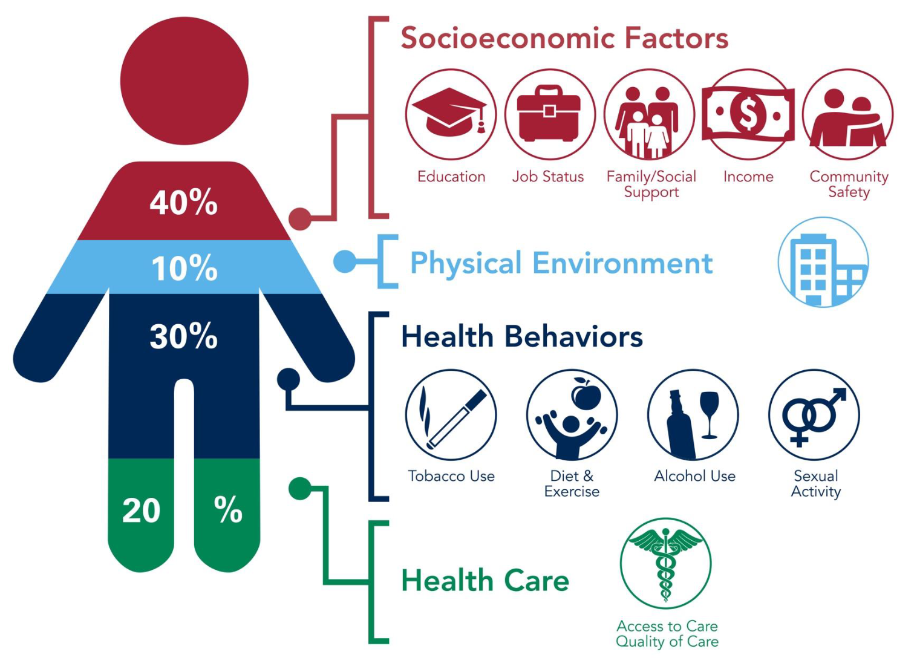
Social Determinants of Health

Slide 3
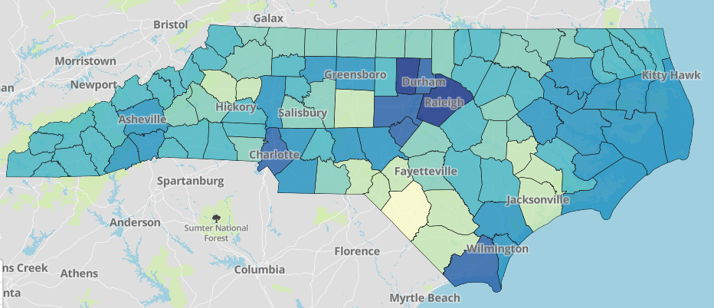
Disparities in COVID-19 Vaccination
NC COVID Vaccination Coverage by Race
Estimated COVID-19 Vaccine Hesitancy
CDC Estimates of Vaccine Hesitancy for COVID-19 Vaccine; https://data.cdc.gov/stories/s/Vaccine-Hesitancy-for-COVID-19/cnd2-a6zw

Slide 4
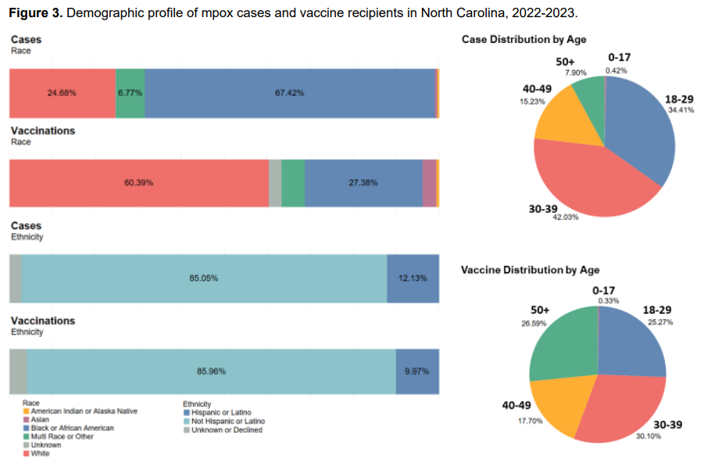
Disparities in mpox vaccination coverage
NCDHHS Mpox Equity Update Report: https://www.ncdhhs.gov/mpox-equity-report-update/download?attachment
Notes:
Add source

Slide 5
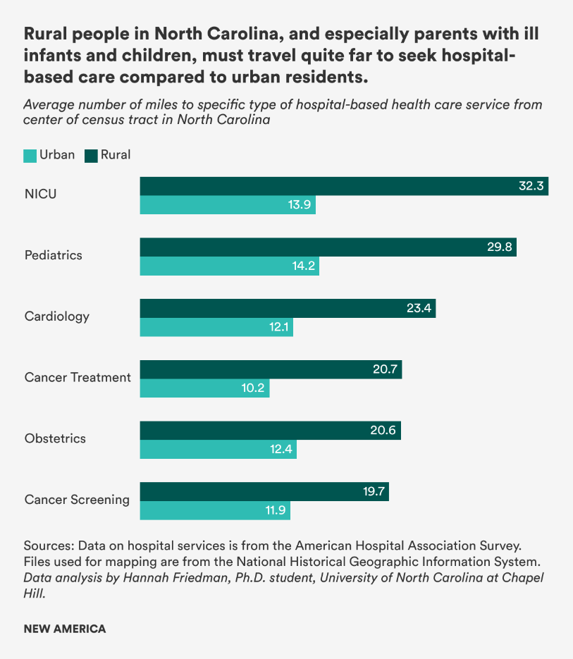
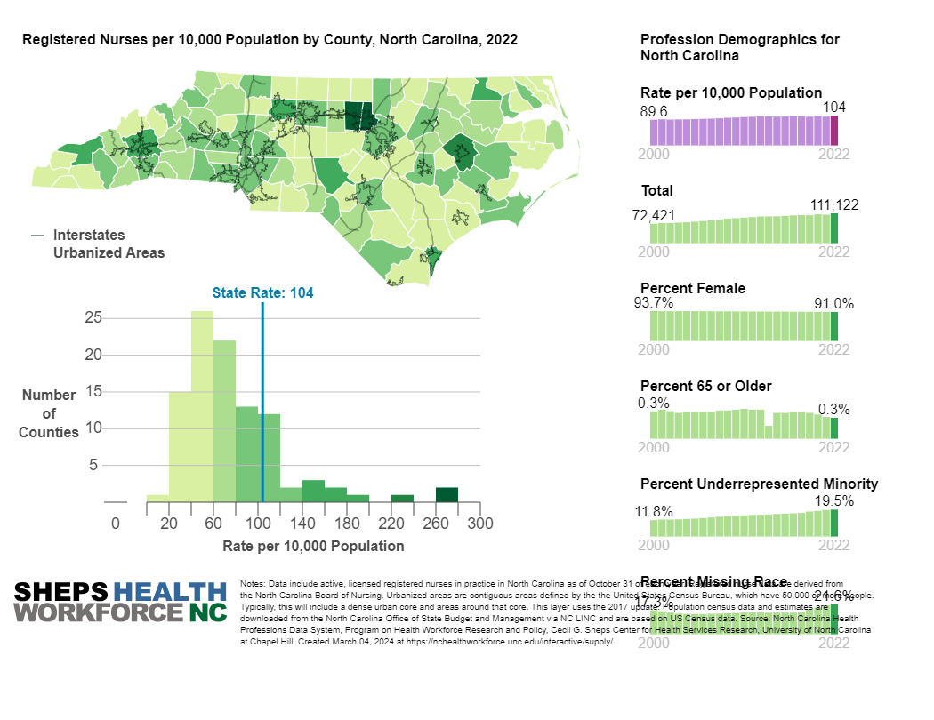
Where you live and work matters
https://www.newamerica.org/better-life-lab/blog/rural-north-carolinians-face-disproportionately-long-travel-distances-to-health-care/
https://nchealthworkforce.unc.edu/interactive/supply/
Notes:
https://www.newamerica.org/better-life-lab/blog/rural-north-carolinians-face-disproportionately-long-travel-distances-to-health-care/

Slide 6
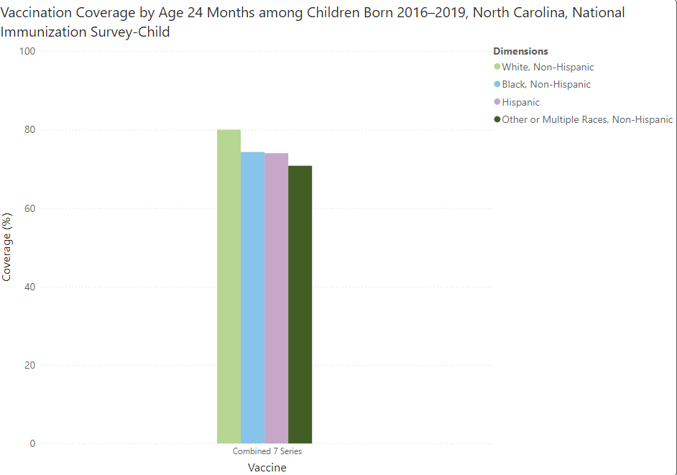
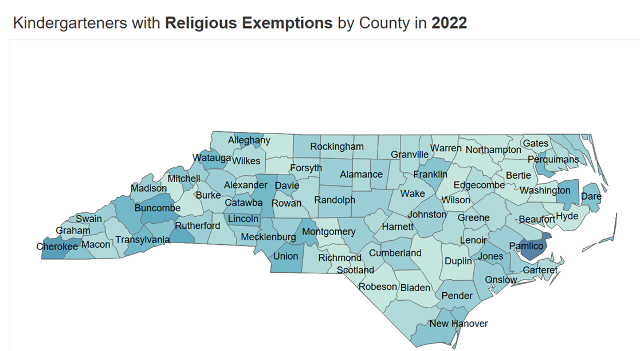
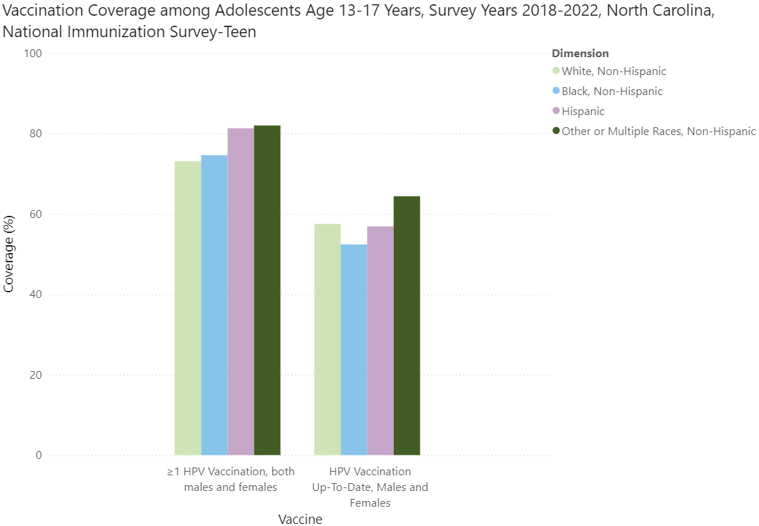
Disparities in Routine Immunization Coverage
CDC ChildVaxView and TeenVaxView - https://www.cdc.gov/vaccines/vaxview/index.html / NC Kindergarten Immunization Dashboard: https://immunization.dph.ncdhhs.gov/schools/kindergartendashboard.htm
Notes:
National Immunization Survey continues to observe disparities in coverage by race, ethnicity, socioeconomic status, insurance status, education level, etc.

Slide 7

Lessons Learned
Data-driven outreach and communication is a vital component of a vaccine strategy
Identifying and engaging populations with lower rates of vaccination coverage is a critical step in eliminating health disparities
Demographic surveillance data:
  Shines light on susceptible populations and communities
  Draws attention to health disparities
  Mobilizes action to inform and protect those most at risk
  Creates ongoing accountability
State-level data is not sufficient for driving action. Availability of more granular data is critical.
The most successful public health interventions happen at the local level.
Advancing health equity is now the first goal of NCDHHS’ 2024-2026 Strategic Plan.

Slide 8
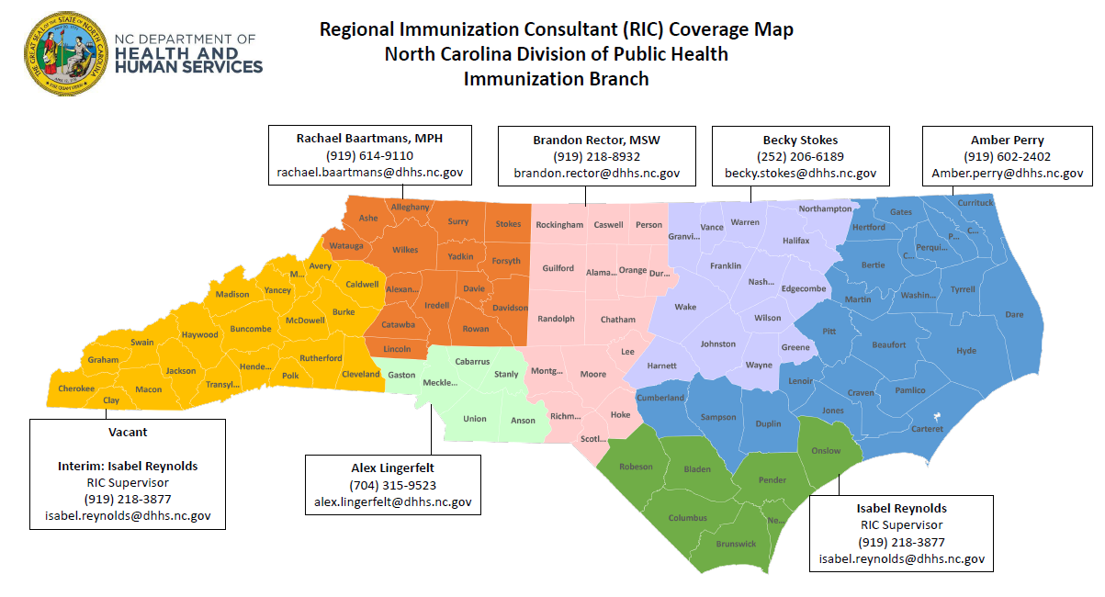
IQIP in North Carolina
Immunization Quality Improvement for Providers (IQIP) is CDC’s national, Vaccines for Children (VFC) provider-level QI program. IQIP serves to assist and support health care providers by identifying opportunities to improve vaccine uptake. Providers select at least two strategies to implement over the course of 12 months. Four CDC-defined core strategies include:
  Facilitate return for vaccination
  Leverage IIS functionality to improve immunization practice
  Give a strong vaccine recommendation
  Strengthen vaccination communications
Notes:
100 counties spanning from the coast to the mountains
86 local health departments (several districts covering multiple counties)
Very diverse state geographically and culturally
Large urban counties and many rural counties, some in between
A lot of variation in coverage, vaccine hesitant and anti-vax populations, politics, etc.
Different messaging is needed in different areas – root causes for low coverage tend to vary. In some areas it may be access (hours of operation, lower provider county), other areas it may be higher rates of vaccine hesitancy, etc.

Slide 9
Custom Strategy Development
Collaborative Effort – Branch Director, IQIP Coordinator, Immunization Equity lead, MPH student intern, IQIP Consultant Supervisor
Development Efforts:
Cross-referenced lessons learned from COVID and mpox vaccine response efforts, CDC NIS MMWRs, and IQIP core strategies and action steps
Conducted an in-depth literature review and gap analysis
Creation of custom county-level vaccine coverage reports by demographic
Creation of vaccine equity toolkit to train IQIP consultants and provider staff
Custom strategy proposal to CDC IQIP Team
Formally approved by CDC for implementation in NC IQIP Program in Spring 2023.
Extensive training with IQIP consultants on health equity concepts and SOG for implementing this custom strategy
Strategy Title:
Address Health Disparities in Immunization Coverage

Slide 10
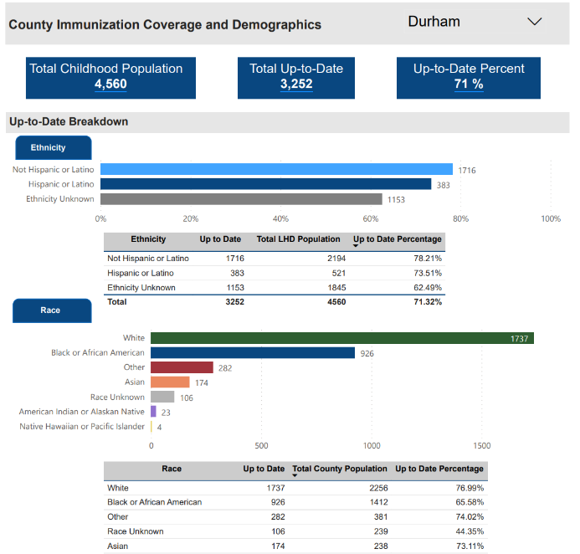
County-specific Vaccine Coverage Reports
County-specific coverage reports are used to guide discussion with providers around health equity in their practice and community.
Notes:
To operationalize this strategy, custom county-specific coverage reports were created for each county to guide discussion around immunization equity

Slide 11
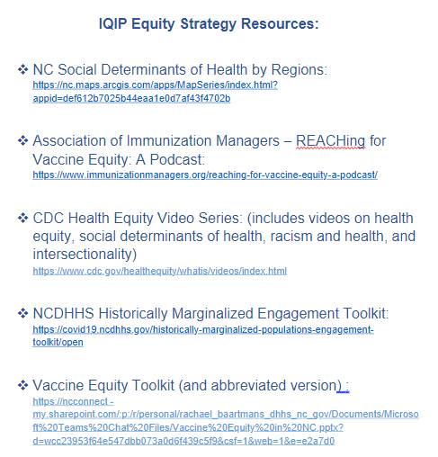

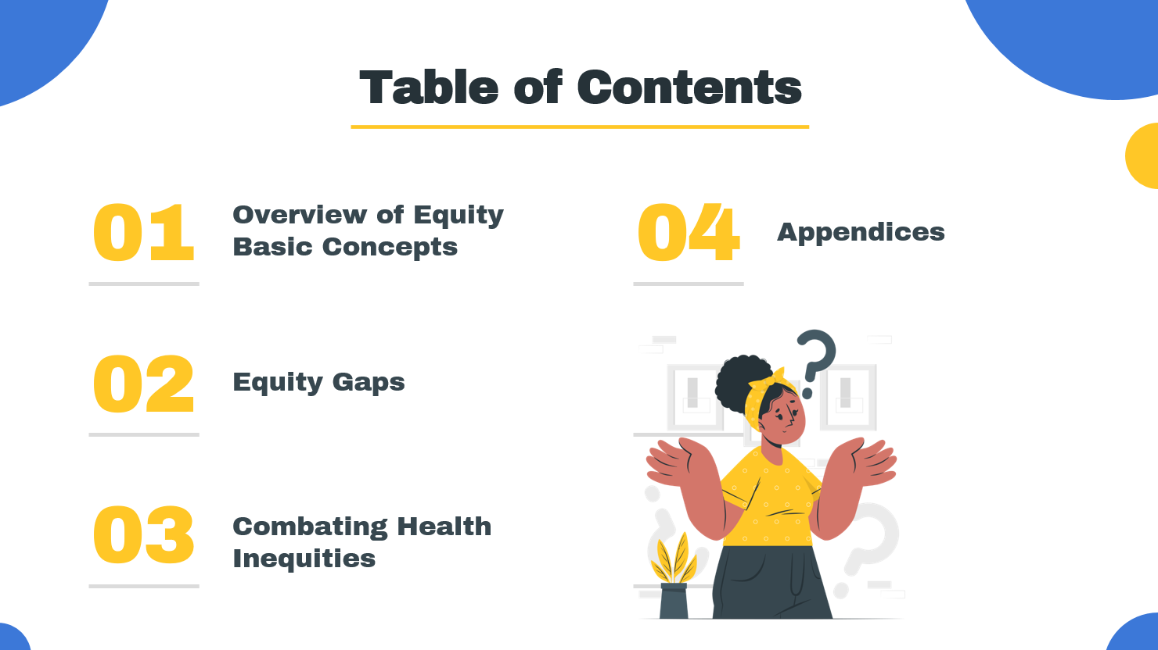
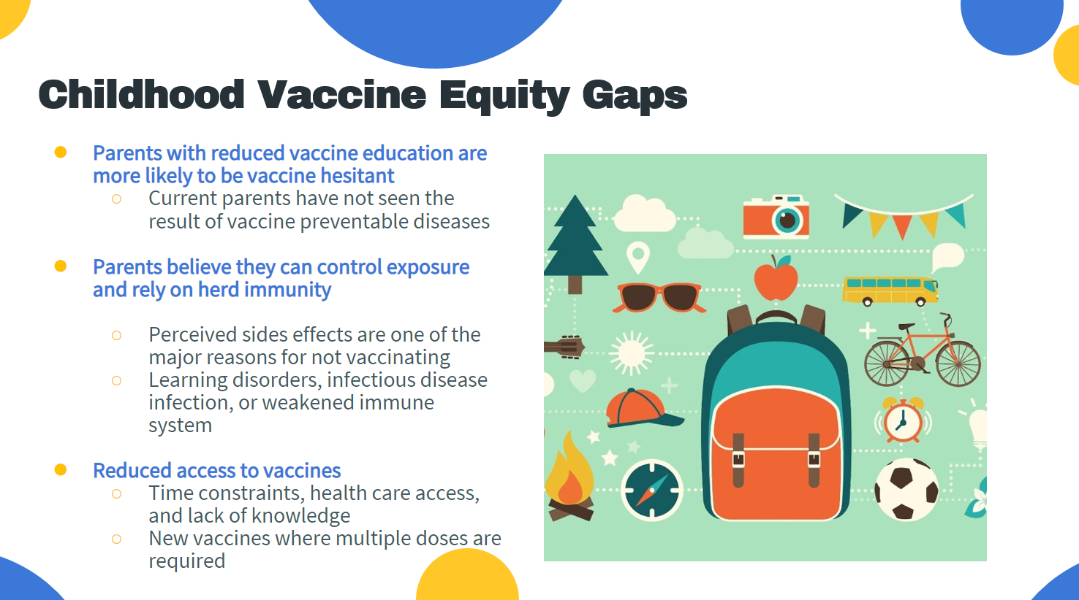
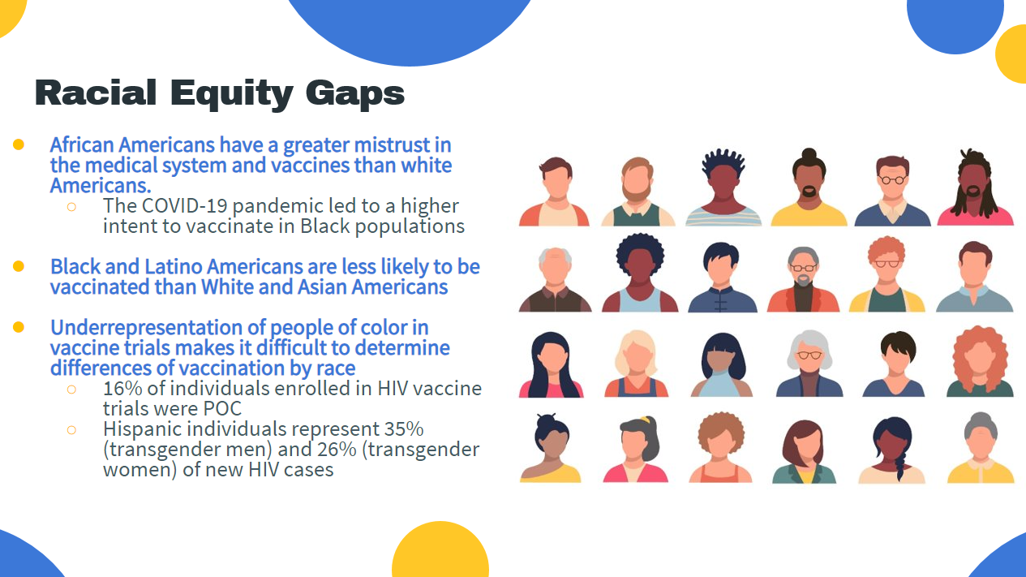
Vaccine Equity Toolkit and Resources
Notes:
Comprehensive vaccine equity toolkit was developed to train IQIP consultants and provider staff.

Slide 12

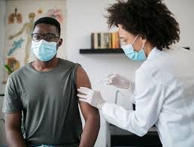
Custom Strategy Action Items:
Educate staff on the principles of health equity and raise awareness of county-specific disparities in immunization coverage
Implement processes to routinely and uniformly collect race and ethnicity data from patients and document in the NCIR
Actively explore barriers to immunization with patients and provide resources if available
Ensure that resources available to patients represent demographics of your patient population
Partner with community organizations (including your LHD) to recruit unvaccinated patients in underserved populations
Seek to have an inclusive workforce representative of your patient’s community (build trust, understanding of target population)
Other

Slide 13
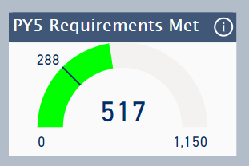
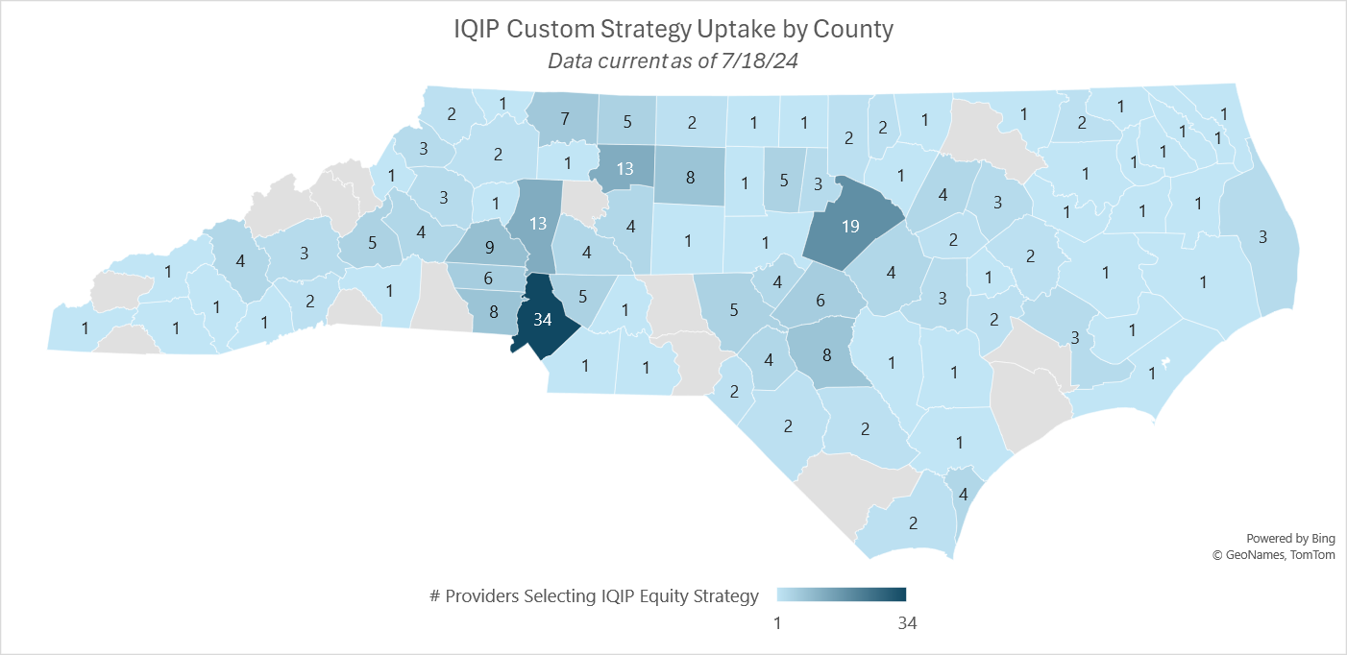
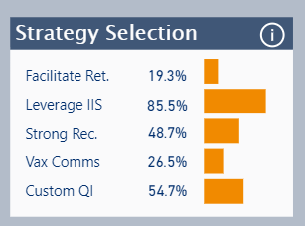
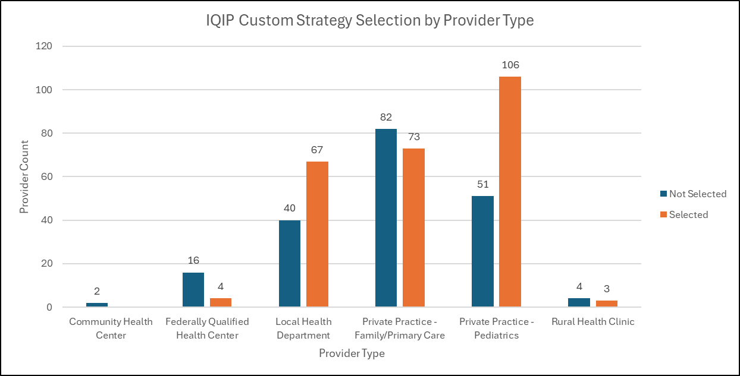
PY5 Custom Strategy Uptake
PY5 Highlights:
~283 NC Providers (55%) selected the custom strategy as part of their IQIP QI Plan.
Custom strategy is most frequently selected strategy after “Leverage IIS”.
At least one provider in 86 counties selected the custom strategy as part of their QI Plan.
Representation in 5/6 provider types visited for IQIP (exception is CHCs)
High uptake among LHDs and private pediatric and family/primary care practices

Slide 14
Provider Survey
Administered to all PY5 and PY6 providers, regardless of custom strategy selection
Pre and post QI plan implementation responses collected (initial visit vs. 12-month follow-up visit)
Survey Questions
How familiar is your practice with the term “health equity” and how it relates to immunization services and coverage levels?
How comfortable is your practice discussing health equity with staff and colleagues?
How knowledgeable is your practice about existing health disparities in your community and their contributing factors?
How equipped is your practice at locating resources to support underserved populations in your community?
How motivated/willing is your practice to address health disparities in your practice and community?
Legend:
1 | Very unfamiliar/uncomfortable/unknowledgeable/unequipped/unmotivated
2 | Slightly unfamiliar/uncomfortable/unknowledgeable/uneqipped/unmotivated
3 | Neutral
4 | Slightly familiar/comfortable/knowledgeable/equipped/motivated
5 | Very familiar/comfortable/knowledgeable/equipped/motivated

Slide 15
Evaluation Metrics and Next Steps
Evaluation Metrics (through July 2025):
Provider familiarity/comfort/knowledge/motivation/capacity around health equity and ability to operationalize efforts to address health equity (via survey)
Custom strategy uptake and distribution
Operational/Implementation details
Coverage levels (long-term; beyond two-year timeline)
Next Steps
Expand evaluation to include PY6 data
Expand the list of action items to include others based on feedback from consultants and providers
Develop process for monitoring coverage levels by race/ethnicity long-term
Engage with CDC and other immunization partners on evaluation methodology and potential collaborations

Slide 16


Contact Information:
Rachael Baartmans, MPH
Regional Immunization Consultant
NC Immunization Brach
Rachael.baartmans@dhhs.nc.gov
Isabel Reynolds
Regional Immunization Consultant Supervisor
NC Immunization Branch
Isabel.reynolds@dhhs.nc.gov
Acknowledgements:
Carrie Blanchard, PharmD, MPH - NC Immunization Branch Director
Catherine Guerrero, MPA - NC Immunization Branch Equity Lead
Isabel Reynolds – Regional Immunization Consultant Supervisor
Rachael Baartmans, MPH – Intern

