Slide 1

Slide Library for presentation of expert testimony on friction ridge comparison evidence
Version 4.0
Notes:
NOTES:
The members of CanFRWG (see slide #50 for represented Agencies) have developed this slide library to assist forensic identification members when presenting expert testimony on fingerprint evidence in court. It is recommended that this slide library be used in conjunction with the Guidance Document for the Slide Library and the Roadmap for Court Acceptance of Fingerprint Evidence. (Both CanFRWG documents are listed on the CanFRWG website which can be accessed by typing CanFRWG into Google).

Slide 2

Slide Colour | Key | Slide #
Green | Mandatory slides that form an essential component of expert testimony | 3-5, 9-18, 31-33, 35-36, 43, 45-46, 53-55.
Yellow | Choose slide from a group, that relates directly to your case For example: For a latent fingerprint case (#6 from 6 to 8) For agencies that trace ridges on their charts (#41 from 40 & 41) When CA was used to develop the latent (#20 from 19 to 29) | 6-8, 19-29, 34, 40-42, 44
Red | Optional slides that are presumptively not included unless at the request of the Crown and have been reviewed by both Crown and the fingerprint expert to determine if they are relevant and admissible. Will blood reagents only react with human blood (#30) When AFIS was used in a case (#37 and perhaps #38 from 37 to 39) Age of fingerprint (#46) How many points required (#47) Probability of people having the same fingerprint (#48) What are the types of potential errors in your discipline (#49) Have errors occurred in your discipline (#50) Are you aware of controversial errors (#51) | 30, 37-39, 47-52
Consult the Guidance Document for the Slide Library. Provide Crown with the Roadmap for Court Acceptance of Expert Fingerprint Testimony.
Notes:
NOTES:
Key describing the colour coding of the slides. Examples of the possible selections, in addition to the mandatory slides, have been given.
The header colours of the remaining slides should be removed by the following process:
click on the header, then click on Shape Fill located in the upper right of the Tool Bar and select No Fill. The text should remain and the slide background seen.

Slide 3
Case File
Introduce your case file impression.
Single picture of latent and overall.
Analysis
NOTE: Provide your crown prosecutor with the testimony roadmap to help them guide you through your testimony.
Notes:
NOTES:
Mandatory slide should be included to provide a comprehensive description of friction ridge evidence.
Reference roadmap for court testimony and slide library guidance document.

Slide 4
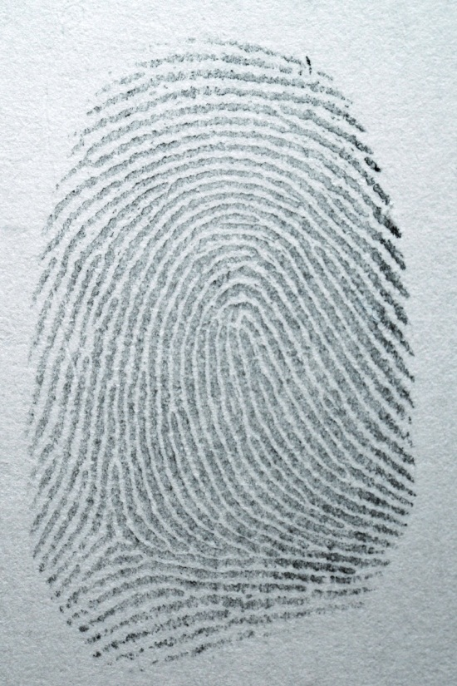
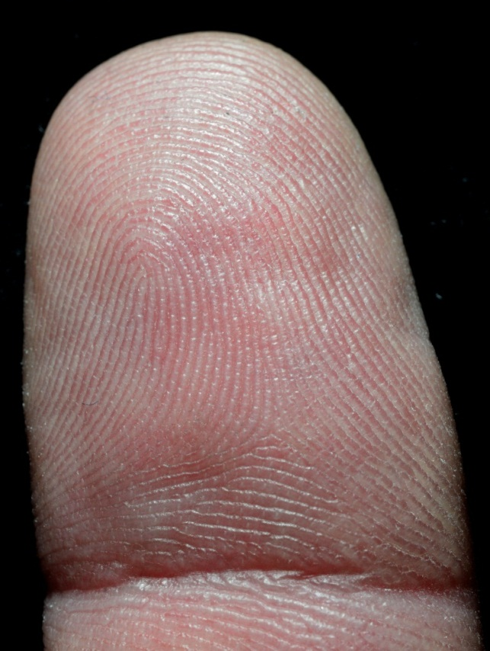
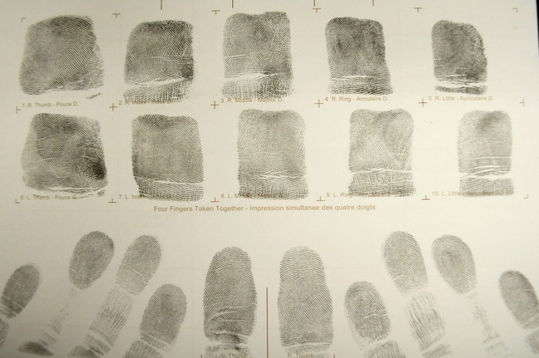
What is a fingerprint?
A fingerprint is an impression made by the ridges of the skin on a finger or thumb on a surface. These ridges assist in gripping or obtaining traction. These areas are referred to as friction skin and are found on our hands and feet.
Images provided by Canadian Police College Forensic Identification Services
Quantitative-Qualitative Friction Ridge Analysis: An Introduction to Basic and Advanced Ridgeology, Ashbaugh, DR. CRC Press, 1999.
Notes:
NOTES:
Mandatory slide should be included to provide a comprehensive description of friction ridge evidence.

Slide 5
Types of fingerprints
Known:
Fingerprint impressions that are lawfully obtained for identification or comparison purposes (inked or digitized).
Image provided by Edmonton Police Services Forensic Identification Services
Notes:
NOTES:
Mandatory slide should be included to provide a comprehensive description of friction ridge evidence.

Slide 6

Types of fingerprints
Latent:
Fingerprint impressions that are not easily seen by the naked eye and require development to be visualized.
Image provided by Integrated Forensic Identification Services
Notes:
NOTES:
Select the appropriate slide(s) from slides 6 to 8 that best describes the type of fingerprint(s) that you are presenting to the court.

Slide 7
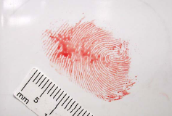
Types of fingerprints
Visible:
Fingerprint impressions that are plainly visible usually due to transfer of foreign material by the finger onto a surface e.g. blood, grease etc.
Image provided by Ottawa Police Services Forensic Identification Services
Notes:
NOTES:
Select the appropriate slide(s) from slides 6 to 8 that best describes the type of fingerprint(s) that you are presenting to the court.

Slide 8
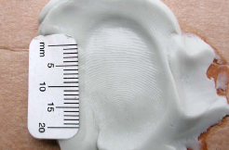
Types of fingerprints
Moulded:
Fingerprint impressions that retain the 3D shape of the ridge detail within the surface e.g. wax, clay, chewing gum, etc.
Image provided by Ottawa Police Services Forensic Identification Services
Notes:
NOTES:
Select the appropriate slide(s) from slides 6 to 8 that best describes the type of fingerprint(s) that you are presenting to the court.

Slide 9
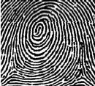
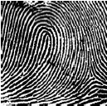
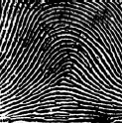
Premises of friction ridge identification
Develop prior to birth: Friction ridges develop on the fetus in their definitive form prior to birth
Persistent: Friction ridges persist throughout life, except for permanent injury or disease
Unique: Random stresses that influence the development of friction ridges in utero result in friction ridge characteristics that are unique
Patterns vary allowing for classification: 3 common pattern types
Whorl
Loop
Arch
Quantitative-Qualitative Friction Ridge Analysis: An Introduction to Basic and Advanced Ridgeology, Ashbaugh, DR.CRC Press, 1999.
Notes:
NOTES:
Mandatory slide should be included to provide a comprehensive description of friction ridge evidence.
The word "premises" is used to indicate that these statements are not necessarily proven, but are inferred.
Fingerprint patterns are used to communicate information about the impression between forensic identification members but are no longer used to classify fingerprints in AFIS.

Slide 10
Philosophy of friction ridge identification
Friction ridge identification is established through the agreement of sufficient friction ridge formations, in sequence.
Based on Quantitative-Qualitative Friction Ridge Analysis: An Introduction to Basic and Advanced Ridgeology, Ashbaugh, DR.CRC Press, 1999.
Notes:
NOTES:
Mandatory slide should be included to provide a comprehensive description of friction ridge evidence.
See CanFRWG position paper on use of the term identification (posted 2018-09-21).

Slide 11
ACE-V Methodology
ACE-V methodology is used for friction ridge analysis and consists of:
  Analysis (Latent Known)
  Comparison Latent
  Evaluation Known
  Verification / Quality Control
“Appropriate documentation of the analysis of the latent is required prior to viewing the known.
During Comparison and Evaluation the examiner looks back and forth between the latent and the known to form an opinion.”
SWGFAST Document #10 (2013), Standards for Examining Friction Ridge Impressions and Resulting Conclusions (Latent/Tenprint Ver 2.0).
Notes:
NOTES:
Mandatory slide should be included to provide a comprehensive description of friction ridge evidence.

Slide 12
Analysis
To determine if the impression is suitable for comparison by assessing if there is sufficient quantity and quality of detail in the impression.
If the impression is not suitable the examination stops at the analysis phase.
SWGFAST Document #10 (2013), Standards for Examining Friction Ridge Impressions and Resulting Conclusions (Latent/Tenprint Ver 2.0).
Notes:
NOTES:
Mandatory slide should be included to provide a comprehensive description of friction ridge evidence.
Slides 11 to 16 show factors that may cause an apparent dissimilarity between impressions from the same source and these factors must be considered during analysis.

Slide 13
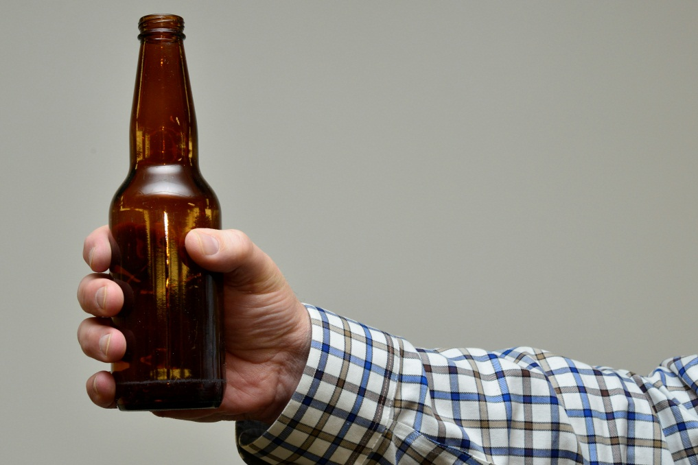
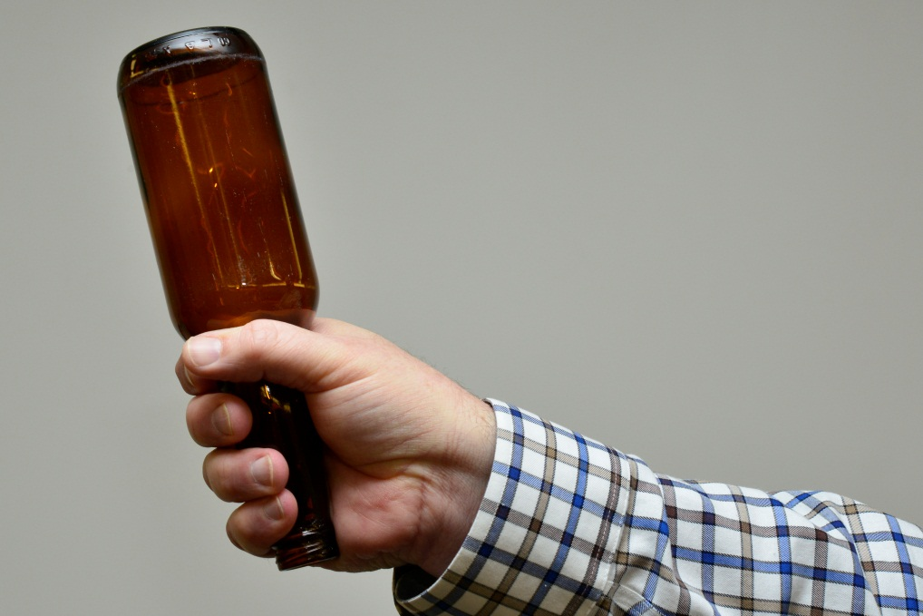
Analysis continued…
Anatomical Aspects: how the object was handled and the way the print was deposited.
Insert image relating to your case here.
Images provided by Canadian Police College Forensic Identification Services.
SWGFAST Document #10 (2013), Standards for Examining Friction Ridge Impressions and Resulting Conclusions (Latent/Tenprint Ver 2.0).
Notes:
NOTES:
Mandatory slide should be included to provide a comprehensive description of friction ridge evidence.

Slide 14
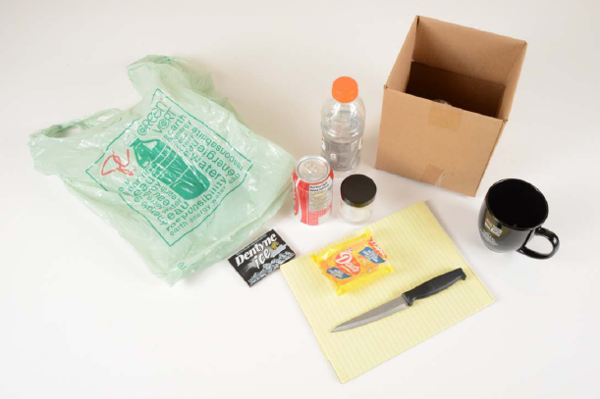
Analysis continued…
Substrate: the type of surface on which the impression was located and how it impacts the appearance of the fingerprint.
Insert image relating to your case here.
Image provided by Ottawa Police Services Forensic Identification Services.
SWGFAST Document #10 (2013), Standards for Examining Friction Ridge Impressions and Resulting Conclusions (Latent/Tenprint Ver 2.0).
Notes:
NOTES:
Mandatory slide should be included to provide a comprehensive description of friction ridge evidence.
SWGFAST reference, section 3. “Factors Affecting Examinations” also includes reference to texture of surface e.g. smooth, rough, corrugated, pliable or textured surfaces.

Slide 15
Analysis continued…
Matrix: what material or medium was deposited on the substrate by the finger e.g. sweat in combination with sebaceous oil, dirt, blood, grease etc.
Insert image relating to your case here.
SWGFAST Document #10 (2013), Standards for Examining Friction Ridge Impressions and Resulting Conclusions (Latent/Tenprint Ver 2.0).
Notes:
NOTES:
Mandatory slide should be included to provide a comprehensive description of friction ridge evidence.

Slide 16
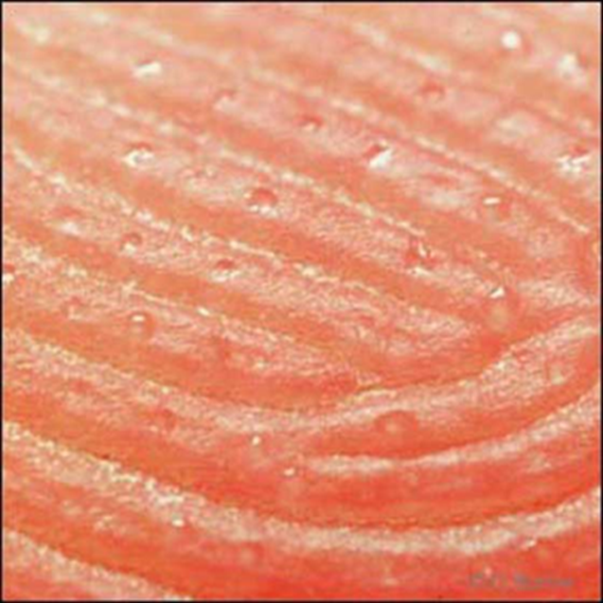
Composition of latent fingerprints
Latent fingerprints are typically comprised of sweat from the eccrine glands and oils from the sebaceous glands.
The Fingerprint Sourcebook, National Institute of Justice, 2010.
Notes:
NOTES:
Mandatory slide should be included to provide a comprehensive description of friction ridge evidence.

Slide 17
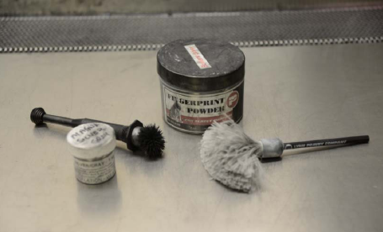
Analysis continued…
Development techniques: what method was used to make the latent impression visible e.g. fingerprint powders, chemicals, etc.
Insert image relating to your case here.
SWGFAST Document #10 (2013), Standards for Examining Friction Ridge Impressions and Resulting Conclusions (Latent/Tenprint Ver 2.0).
Notes:
NOTES:
Mandatory slide should be included to provide a comprehensive description of friction ridge evidence.
SWGFAST uses the term “Detection Techniques” rather than “Development Medium” as the former includes optical (light sources and illumination techniques), as well as physical (powders) and chemical processing. Development Medium implies only the physical or chemical means of detecting latent fingerprints.

Slide 18
Development of latent fingerprints
Latent fingerprint development may be achieved by a wide array of optical, physical or chemical techniques.
Certain fingerprint reagents can be used in sequence but the choice of technique(s) will be made based upon factors such as; type of residue suspected, texture, type and condition of substrate, environmental conditions, subsequent forensic examinations etc.
The Fingerprint Sourcebook, National Institute of Justice, 2010.
Notes:
NOTES:
Mandatory slide should be included to provide a comprehensive description of friction ridge evidence.
The choice of technique depends on the substrate upon which the latent impression is located:
- porous e.g. paper, cardboard, wood etc.
- non-porous e.g. glass, metal, plastics etc.
- semi-porous e.g. glossy cardboard, some wood finishes.

Slide 19
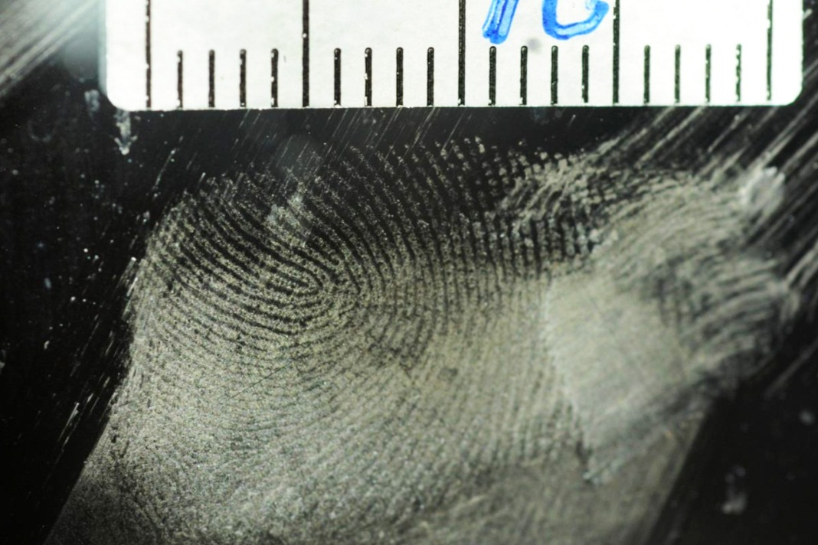
Fingerprint reagents for nonporous surfaces
Fingerprint powders: Application of fine particles that physically adhere to the sweat and oil components in latent fingerprints.
Choice of powder will depend on adhesion quality and contrast to the substrate.
Image provided by Edmonton Police Services Forensic Identification Services
Notes:
NOTES:
Select the appropriate slide from slides 19 to 29 that describes the development technique(s) used to detect the latent fingerprint.

Slide 20
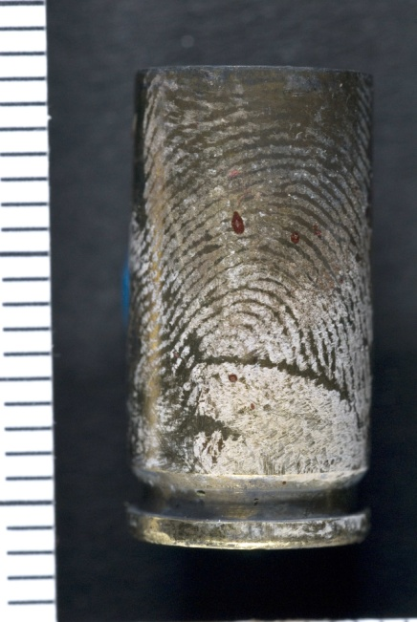
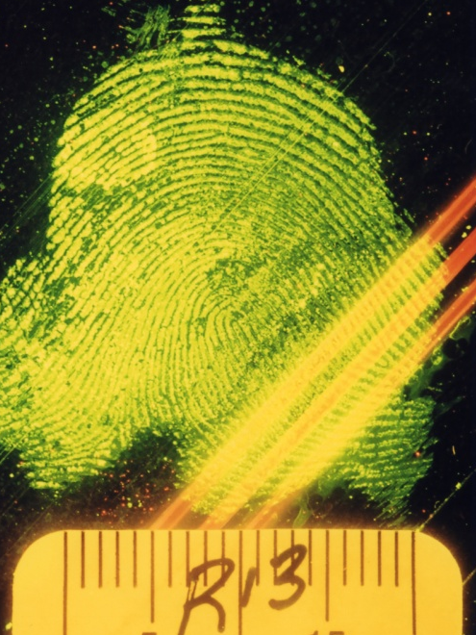
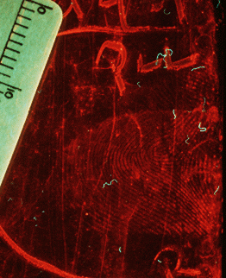
Fingerprint reagents for nonporous surfaces
Cyanoacrylate Fuming: The fumes of cyanoacrylate (CA) bond with components within the fingerprint residue forming a white layer on the ridges which can be further enhanced by powders or fluorescent dye stains.
CA on cartridge
CA/ BY40 dyestain on Ziploc bag
CA/ R6G dyestain on cellophane
Images provided by RCMP Forensic Identification Services.
Notes:
NOTES:
Select the appropriate slide from slides 19 to 29 that describes the development technique(s) used to detect the latent fingerprint.
Once developed with CA (superglue), fingerprints have a white appearance that can be difficult to see against lighter backgrounds. The CA-developed fingerprint can be treated with fingerprint powders or fluorescent dyestains such as Brilliant Yellow 40 (BY40), Ardrox or Rhodamine 6G (R6G).

Slide 21
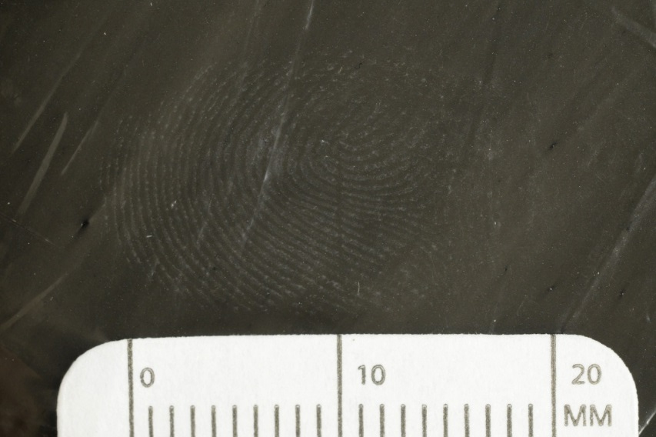
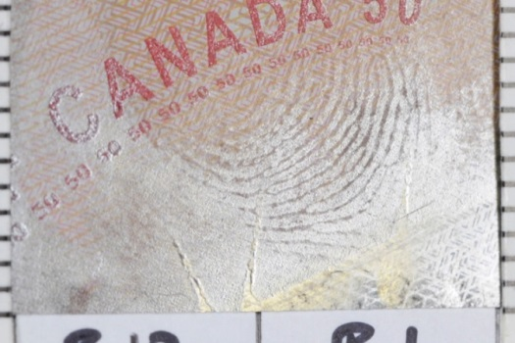
Fingerprint reagents for nonporous surfaces
Vacuum Metal Deposition: Under vacuum gold vapour deposits onto the surface being examined. Gold forms a thin coating on the surface but is absorbed by the oily residue of the fingerprint. Zinc vapour condenses onto the exposed gold layer creating contrast.
CA/VMD on polymer banknote
VMD on garbage bag
Insert image relating to your case HERE
Images provided by RCMP Forensic Identification Services
Notes:
NOTES:
Select the appropriate slide from slides 19 to 29 that describes the development technique(s) used to detect the latent fingerprint.

Slide 22
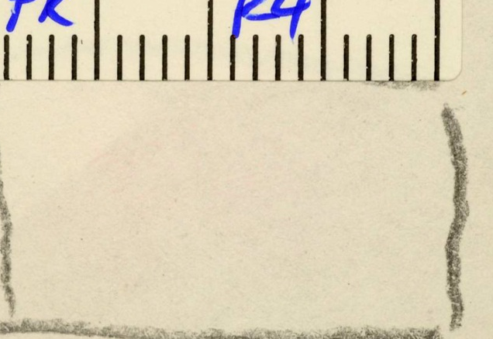
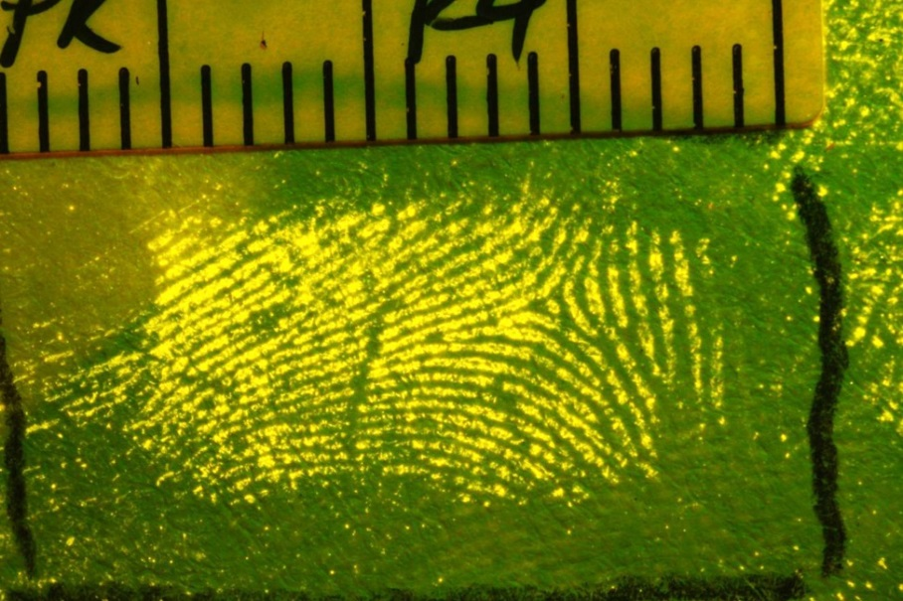
Fingerprint reagents for porous surfaces
Amino Acid Reagents: Pores on the friction ridges of the skin secrete amino acids in sweat which can be detected by a variety of reagents such as ninhydrin, DFO or IND-Zinc.
IND-Zn on paper (ambient light)
IND-Zinc on paper (fluorescence)
Insert image relating to your case HERE
Images provided by Edmonton Police Services Forensic Identification Services
Notes:
NOTES:
Select the appropriate slide from slides 19 to 29 that describes the development technique(s) used to detect the latent fingerprint.

Slide 23
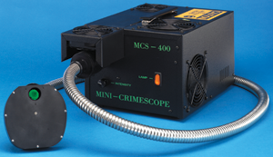
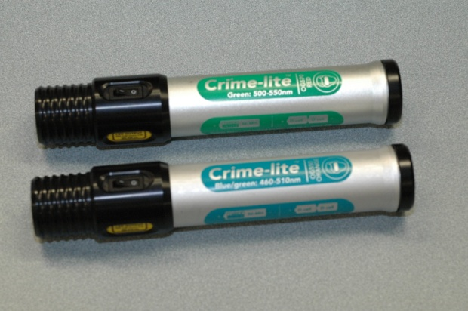
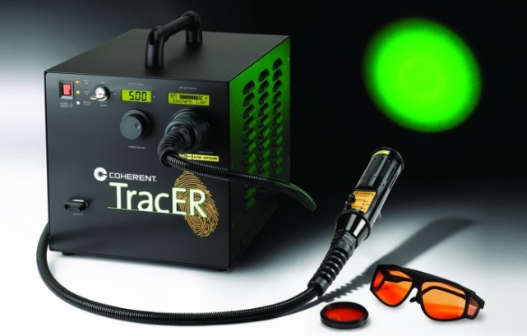
Forensic Examination
Forensic Light Sources: Forensic Light Sources (FLS) generate coloured light that can be used to visualize fingerprints treated with fluorescent chemicals. Examples of FLS are shown below:
Lamp with filters
Hand-held LED
Laser
Images obtained from manufactures websites.
Hand-held LED image provided by RCMP Forensic Identification Services
Notes:
NOTES:
Select the appropriate slide from slides 19 to 29 that describes the development technique(s) used to detect the latent fingerprint.

Slide 24
Fluorescence Examination
Fluorescent materials absorb specific colours of light and emit different coloured light.
Observers eye
Viewing filter
Light source
Fluorescence
(longer wavelength) - transmitted by filter
Incident light (shorter wavelength)
Reflected/scattered
light
Surface under examination
Fingerprint ridges
(containing fluorescent material)
Based on a Diagram from The Source Book, CAST, Home Office, UK, 2012.
Notes:
NOTES:
Select the appropriate slide from slides 19 to 29 that describes the development technique(s) used to detect the latent fingerprint.

Slide 25
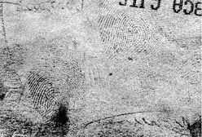
Fingerprint reagents for porous surfaces
Physical Developer: Physical developer is a water-based solution which deposits silver onto the fingerprint ridges.
Insert image relating to your case HERE
Image provided by RCMP Forensic Identification Services.
Notes:
NOTES:
Select the appropriate slide from slides 19 to 29 that describes the development technique(s) used to detect the latent fingerprint.

Slide 26
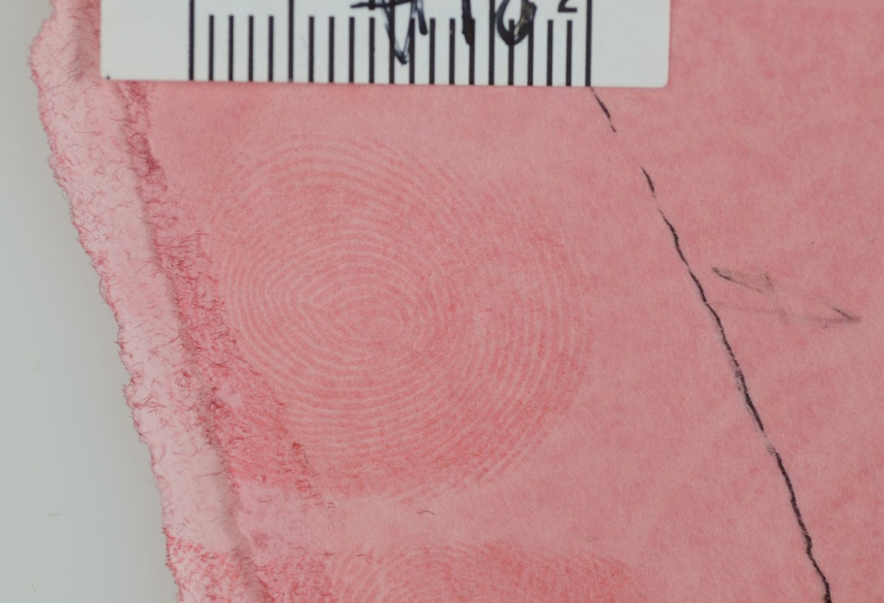
Fingerprint reagents for porous surfaces
Oil Red O: Oil Red O is a water-based solution that stains the fingerprint ridges red.
Insert image relating to your case HERE
Image provided by OPP Forensic Identification Services
Notes:
NOTES:
Select the appropriate slide from slides 19 to 29 that describes the development technique(s) used to detect the latent fingerprint. Oil Red O stains the oils within the fingerprint residue.

Slide 27
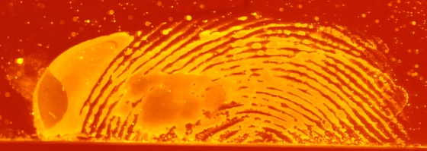
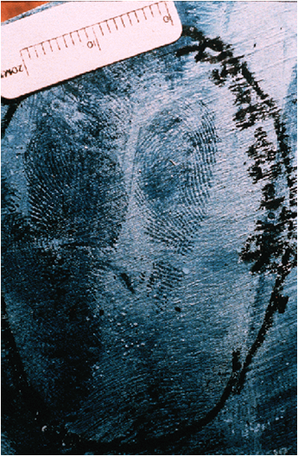
Blood enhancement reagents
Blood enhancement reagents are chemicals that react with, or stain, bloodstains in order to make latent blood visible, or weak bloodstains easier to observe.
All presumptive blood tests have the potential for false positive reactions and do not confirm the presence of blood.
Acid Yellow 7
Amido Black on wood
Insert image relating to your case HERE
Images provided by RCMP Forensic Identification Services.
Notes:
NOTES:
Select the appropriate slide from slides 19 to 29 that describes the development technique(s) used to detect the latent fingerprint.
Dyestains like Amido Black stain the proteins in blood to give it a blue-black colour. Other stains can produce different colours, or fluorescent reaction products. The choice of stain will depend on the colour of the substrate being examined.
Amino acid reagents like ninhydrin and DFO may react with blood, but they are usually not the first choice for enhancing bloody impressions or stains.

Slide 28
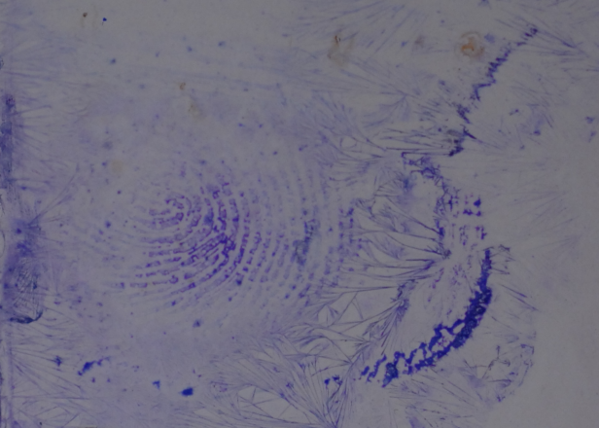
Blood enhancement reagents
Other reagents react with the heme portion of a red blood cell to produce a coloured or luminescent product. Leuco dyes will go from colourless to coloured when they react with blood.
All presumptive blood tests have the potential for false positive reactions and do not confirm the presence of blood.
Leuco Crystal Violet
Insert image relating to your case HERE
Images provided by RCMP Forensic Identification Services.
Notes:
NOTES:
Select the appropriate slide from slides 19 to 29 that describes the development technique(s) used to detect the latent fingerprint.
Dyestains like Amido Black stain the proteins in blood to give it a blue-black colour. Other stains can produce different colours, or fluorescent reaction products. The choice of stain will depend on the colour of the substrate being examined.
Amino acid reagents like ninhydrin and DFO may react with blood, but they are usually not the first choice for enhancing bloody impressions or stains.

Slide 29
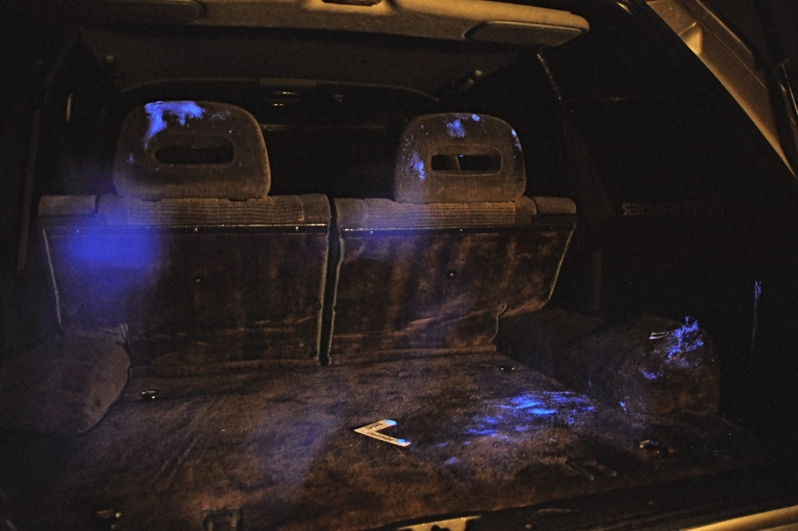
Blood enhancement reagents
Luminol will glow in a darkened room when it reacts with blood. Luminol is a good search tool for discovering blood trails or evidence of clean-up.
Luminol used in a vehicle
Insert image relating to your case HERE
Image provided by RCMP Forensic Identification Services
Notes:
NOTES:
Select the appropriate slide from slides 19 to 29 that describes the development technique(s) used to detect the latent fingerprint.

Slide 30
Frequently Asked Questions
Will blood enhancement reagents only react with human blood?
No. Blood enhancement reagents are not specific for human blood. Treatment of exhibits may produce “false positive” results due to some common household products. Friction ridges can still be compared, but the forensic laboratory will have to be consulted to confirm that it is human blood and, through DNA analysis, whose blood it is.
Notes:
NOTES:
Optional slide that should be reviewed by Crown and the fingerprint expert to determine if they are relevant and admissible. Can be included to help explain aspects of fingerprint evidence that may be raised by defence.

Slide 31

Analysis continued…
Deposition pressure:
Assessment of downward pressure exerted by the finger on contact with the substrate.
Insert video showing
3D rotation of skin
Lateral pressure distortion:
Assessment of movement of the finger while in contact with the substrate e.g. twisting motion or slipping.
SWGFAST Document #10 (2013), Standards for Examining Friction Ridge Impressions and Resulting Conclusions (Latent/Tenprint Ver 2.0).
Notes:
NOTES:
Mandatory slide should be included to provide a comprehensive description of friction ridge evidence.

Slide 32
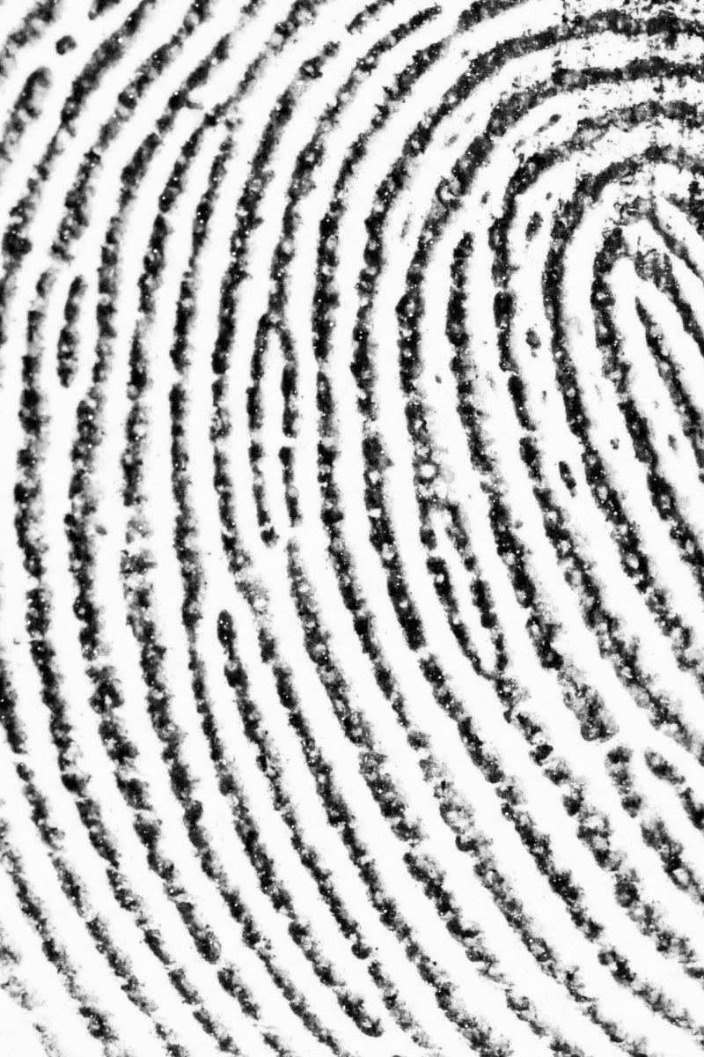
Analysis continued…
Levels of Detail
Level 1: overall ridge flow or pattern type (cannot identify, but can exclude)
Level 2: specific ridge paths, major ridge path deviations (e.g. ridge events, characteristics or minutiae)
-islands
-bifurcations
-ridge endings
-lakes
(can identify and exclude)
Image provided by Canadian Police College Forensic Identification Services.
SWGFAST Document #10 (2013), Standards for Examining Friction Ridge Impressions and Resulting Conclusions (Latent/Tenprint Ver 2.0).
Notes:
NOTES:
Mandatory slide should be included to provide a comprehensive description of friction ridge evidence.

Slide 33
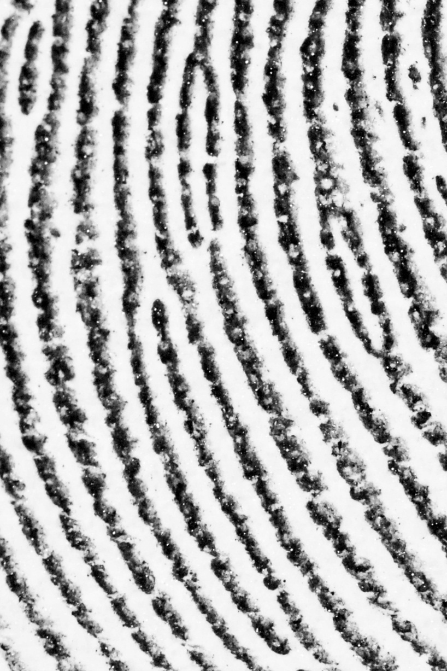
Analysis continued…
Levels of Detail
Level 3: ridge structures and their relative arrangements e.g. ridge shapes, sizes, edges, pore locations and sizes
(cannot exclusively identify or exclude)
Image provided by Canadian Police College Forensic Identification Services.
SWGFAST Document #10 (2013), Standards for Examining Friction Ridge Impressions and Resulting Conclusions (Latent/Tenprint Ver 2.0).
Notes:
NOTES:
Mandatory slide should be included to provide a comprehensive description of friction ridge evidence.

Slide 34
Quality
Quality
High | Level 1 detail is distinct Level 2 details are distinct There are abundant distinct Level 3 details
Medium High | Level 1 detail is distinct Most of the Level 2 details are distinct There are minimal distinct Level 3 details
Medium Low | Level 1 is distinct Few of the Level 2 details are distinct There are minimal distinct Level 3 details
Low | Level 1 may not be distinct Most of the Level 2 details are indistinct There are no distinct Level 3 details
SWGFAST Document #10 (2013), Standards for Examining Friction Ridge Impressions and Resulting Conclusions (Latent/Tenprint Ver 2.0).
Notes:
NOTES:
Optional slide.
SWGFASTs quality table defines the demonstrable data upon which to form an opinion as to the quality of a latent friction ridge impression. These quality terms are used in SWGFAST’s sufficiency graph (see slide 44).

Slide 35
Analysis continued…
Clarity: the visual quality of the friction ridge detail.
Tolerance for dissimilarities: The examiner assesses the friction ridge features in the impression to determine how much variation is reasonable in appearance and spatial relationships between the known and latent impression.
High Quality = Lower tolerance for dissimilarities
Low Quality = Higher tolerance for dissimilarities
SWGFAST Document #10 (2013), Standards for Examining Friction Ridge Impressions and Resulting Conclusions (Latent/Tenprint Ver 2.0).
Notes:
NOTES:
Mandatory slide should be included to provide a comprehensive description of friction ridge evidence.
SWGFAST’s definition of “Tolerance is the allowance of variation in appearance of friction ridge features (due to factors listed previously) that will be accepted during comparison…” SWGFAST uses four terms to categorize quality (see Slide 34).

Slide 36
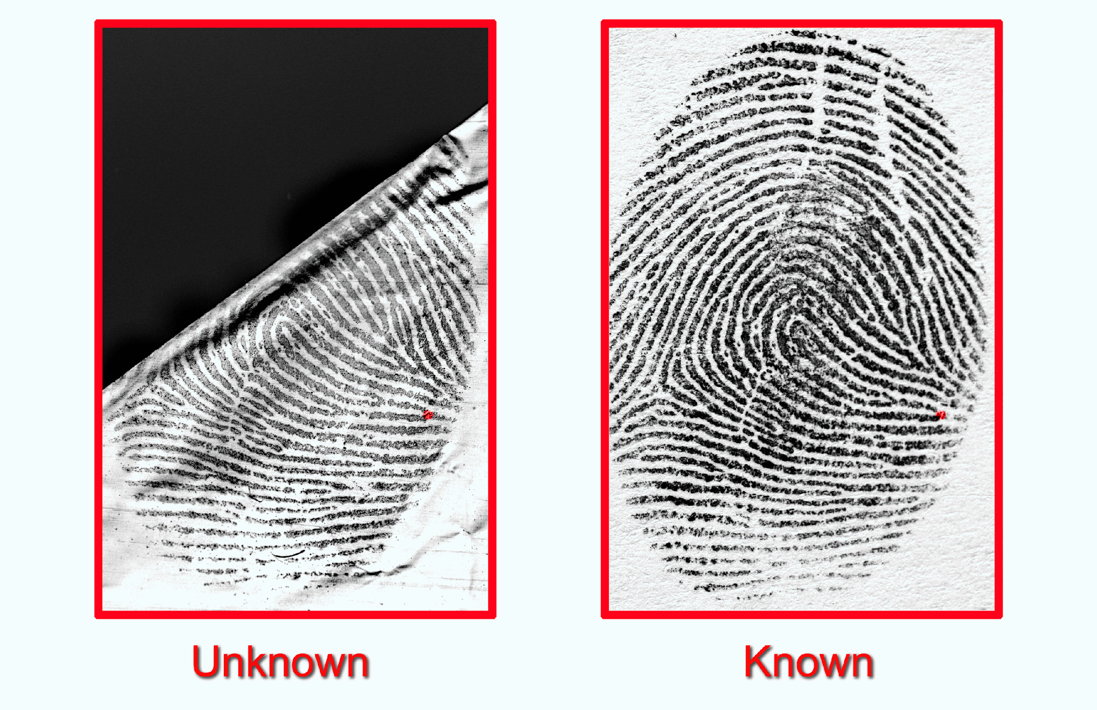
Comparison
Introduces the known impression. The comparison is accomplished through side-by-side observations of all available levels of details.
SWGFAST Document #10 (2013), Standards for Examining Friction Ridge Impressions and Resulting Conclusions (Latent/Tenprint Ver 2.0).
Notes:
NOTES:
Mandatory slide should be included to provide a comprehensive description of friction ridge evidence.
If there is sufficient quantity and quality in the known impression a comparison can be made to the unknown. Analysis of the known should be completed at this time.
The comparison is accomplished through side-by-side observations of all available levels of details. It determines if the two impressions are in agreement or not based upon the features, in sequence and their spatial relationship within the tolerance of clarity and distortion.

Slide 37
Frequently Asked Questions
How is the Automated Fingerprint Identification System (AFIS) used for fingerprint searches?
A fingerprint is uploaded into an AFIS computer system for search against an database of known impressions.
AFIS only provides a list of possible candidates.
An AFIS technician will return the results of the evaluation to the submitting officer/ agency.
A forensic identification examiner, using a new set of known impressions taken at the time of arrest, does a manual comparison of the latent to the known impression(s) and forms an opinion.
Notes:
NOTES:
These AFIS slides (slide #37-39) are presumptively irrelevant and inadmissible for court purposes but should be provided to and discussed with Crown as they can become relevant and admissible if the role of AFIS is raised by defence.

Slide 38
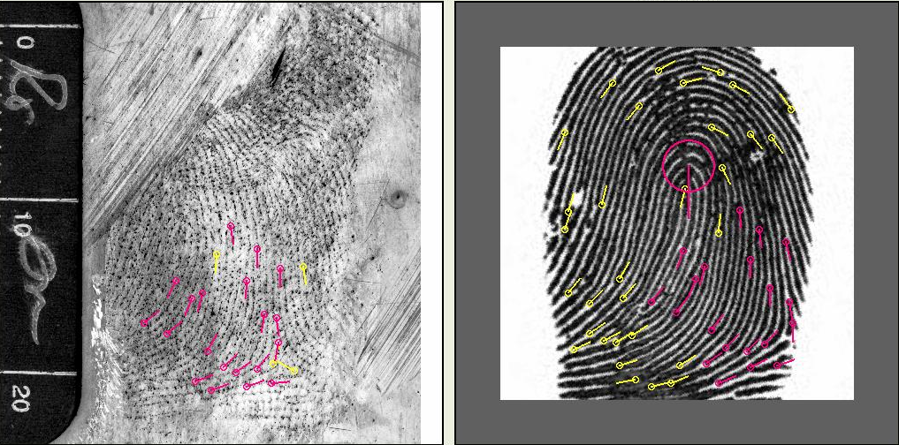
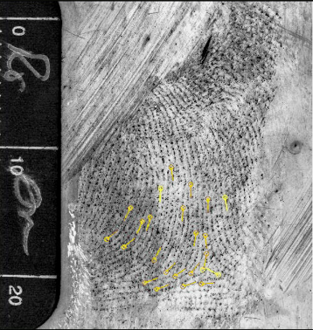
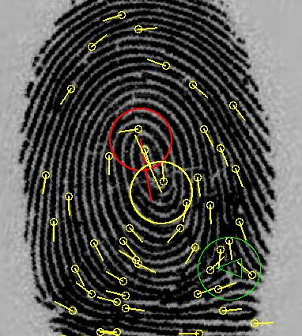


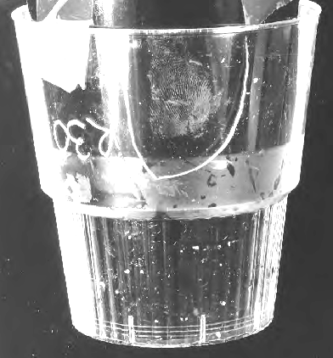
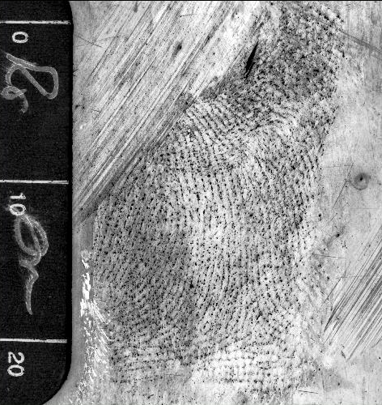


Frequently Asked Questions
How does AFIS work?
Latent fingerprint uploaded & correct orientation determined
Encoding of level 2 details recorded & searched against database
Results ranked
AFIS technician compares images
AFIS Ranking
Comparison
Location &
Orientation
Latent
Analysis
Detail
Encoding
Images provided by the Canadian Criminal Real Time Identification Services (CCRTIS), Training Section.
Notes:
NOTES:
These AFIS slides (slide #37-39) are presumptively irrelevant and inadmissible for court purposes but should be provided to and discussed with Crown as they can become relevant and admissible if the role of AFIS is raised by defence.

Slide 39
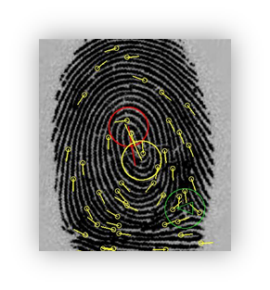

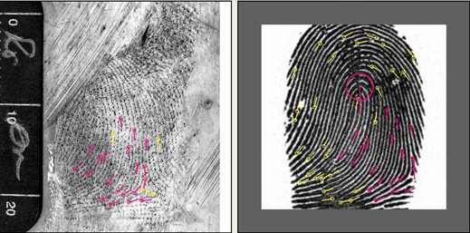
Frequently Asked Questions
How are AFIS results assessed by humans?
Latent (left) & Known (right)
Visually assessed as
Not same source
Latent (left) & Known (right)
Visually assessed as
Possibly the same source
Images provided by the Canadian Criminal Real Time Identification Services (CCRTIS), Training Section.
Notes:
NOTES:
These AFIS slides (slide #37-39) are presumptively irrelevant and inadmissible for court purposes but should be provided to and discussed with Crown for inclusion in the disclosure package as they may become relevant and admissible if the role of AFIS is raised by defence.

Slide 40
Known Suspect
If a known suspect is available then a forensic identification officer, using a new set of known impressions taken at the time of arrest, does a manual comparison of the latent to the known impression(s) and forms an opinion.
Notes:
NOTES:
Optional slide if this best describes how you obtained the known impressions to compare.

Slide 41
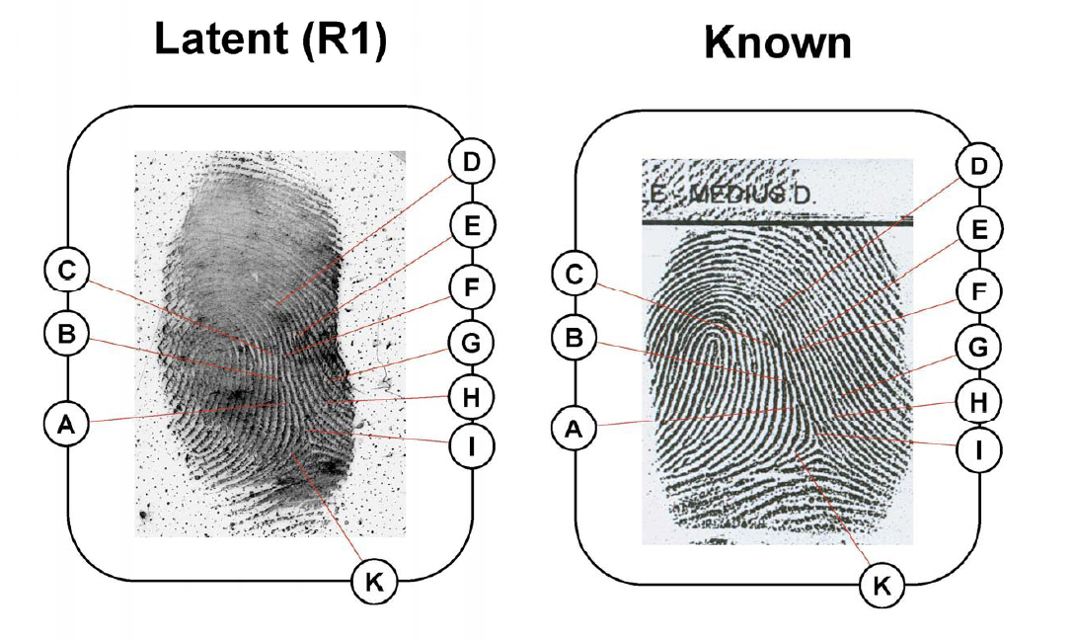
Demonstrative aids for court - Charts
Insert image relating to your case HERE
Chart provided by Ottawa Police Services Forensic Identification Services
Notes:
NOTES:
Select the appropriate slide from slides 41 and 42 that introduces the chart style used by your agency.

Slide 42
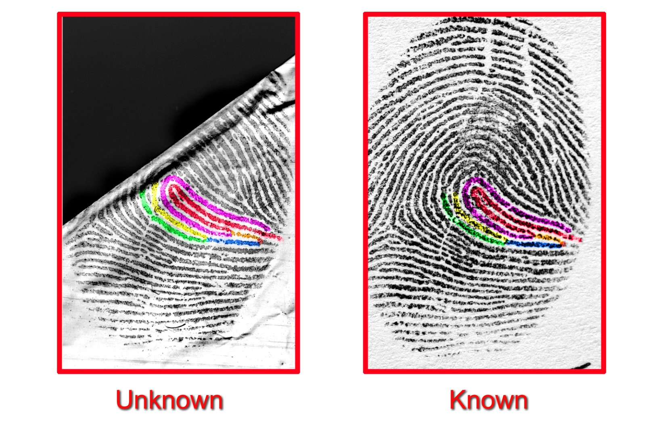
Demonstrative aids for court - Charts
Insert image relating to your case HERE
Chart provided by Canadian Police College Forensic Identification Services
Notes:
NOTES:
Select the appropriate slide from slides 41 and 42 that introduces the chart style used by your agency.
Highlight agreement beginning with level 1 detail progressing through levels 2 and 3, explaining any distortions, presence of creases or wrinkles (white lines) and discrepancies as you proceed.

Slide 43
Evaluation
A quantitative and qualitative evaluation to determine if there is agreement of sufficient friction ridge formations, in sequence.
The outcome of the evaluation is one of the following standard opinions:
  Identification: same source.
  Exclusion: not the same source.
  Inconclusive: unable to identify or exclude as being from the same source.
SWGFAST Document #10 (2013), Standards for Examining Friction Ridge Impressions and Resulting Conclusions (Latent/Tenprint Ver 2.0).
Notes:
NOTES:
Mandatory slide should be included to provide a comprehensive description of friction ridge evidence.
SWGFAST reference section 5.3.2.3. discusses the subtleties of inconclusive as quoted below:
“5.3.2.3. Inconclusive
Inconclusive is the opinion by an examiner that an unknown impression of comparison value cannot be excluded or identified. The reason for each inconclusive opinion must be documented and reported. Inconclusive opinions do not apply to impressions determined to be of no value (see section 5.1.1). Reasons for inconclusive may include but not limited to:
5.3.2.3.1. Lack of Comparable Areas (LCA)
This inconclusive opinion results from a lack of complete and legible known prints. This means comparisons were made to the extent possible, however additional clear and completely recorded exemplars, to include the required anatomical areas, are needed for re-examination.
5.3.2.3.2. Lack of Sufficiency for Individualization (LSI)
Corresponding features are observed but not sufficient to individualize. No substantive dissimilar features are observed.
5.3.2.3.3. Lack of Sufficiency for Exclusion (LSE)
Dissimilar features are observed but not sufficient to exclude. No substantive correspondence is observed.
5.3.2.3.4. There may be other instances where agencies have adopted procedures to report inconclusive opinions. These are left to the administrative policies and procedures of the individual agency. However, these policies and reporting procedures must be clearly defined by the agency.”
Whatever your agency policy you will need to justify the reasons why an inconclusive decisions has been reached.

Slide 44
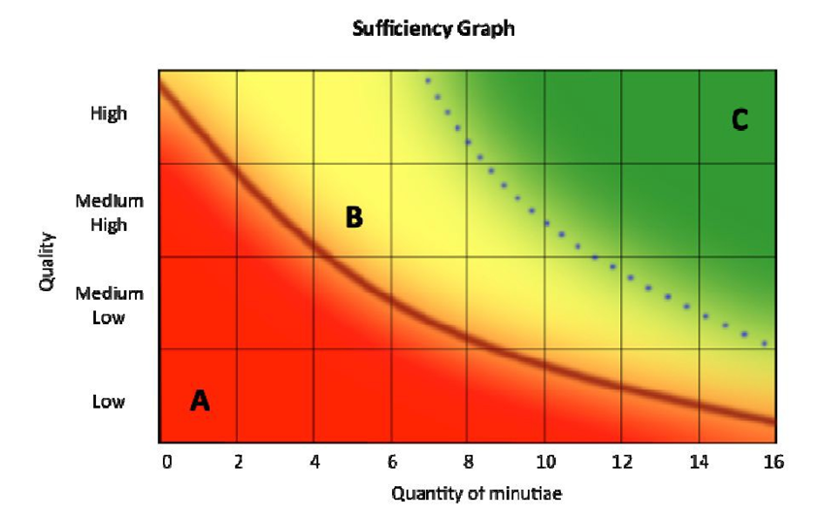
Sufficiency
The quality and the quantity of Level 2 details observed in the latent friction ridge impression are indicated on the vertical and horizontal axis, respectively.
Minutiae counts are not the sole criteria upon which to base an opinion.
A – identification not warranted
B – complex comparison, identification may be warranted.
C – non-complex comparison, identification warranted
SWGFAST Document #10 (2013), Standards for Examining Friction Ridge Impressions and Resulting Conclusions (Latent/Tenprint Ver 2.0).
Notes:
NOTES:
Optional slide.
SWGFAST’s sufficiency graph visually demonstrates the interplay of quality and quantity when reaching an opinion during the evaluation of a fingerprint comparison.
Whatever your agency policy you will need to justify the reasons why an inconclusive decisions has been reached.

Slide 45
Identification
“Identification is the opinion by the examiner, based on training, knowledge, and experience, that the friction ridge impressions originated from the same source.”
CanFRWG position paper on use of the term “identification”, https://sites.google.com/site/canfrwg/home, posted 2018.
Notes:
NOTES:
Mandatory slide should be included to provide a comprehensive description of friction ridge evidence.

Slide 46
Verification
The verification stage requires an independent examination by a qualified examiner.
Verification of findings is part of the quality assurance protocol.
SWGFAST Document #10 (2013), Standards for Examining Friction Ridge Impressions and Resulting Conclusions (Latent/Tenprint Ver 2.0).
Notes:
NOTES:
Mandatory slide should be included to provide a comprehensive description of friction ridge evidence.

Slide 47
Frequently Asked Questions
Can the age of a fingerprint be determined?
No. Currently, fingerprints can only be aged circumstantially e.g. when the surface was last known to be cleaned.
Notes:
NOTES:
Optional slide that should be reviewed by Crown and the fingerprint expert to determine if they are relevant and admissible. Can be included to help explain aspects of fingerprint evidence that may be raised by defence.

Slide 48
Frequently Asked Questions
How many “points” are required to make an identification?
International Association for Identification (IAI), Jackson, Wyoming –August 1st, 1973. Standardization Committee stated:
“no valid basis exists at this time for requiring that a pre-determined minimum number of friction ridge characteristics must be present in two impressions in order to establish positive identification.”
International Symposium, Ne’urim, Israel –June 1995
“No scientific basis exists for requiring that a predetermined minimum number of friction ridge features must be present in two impressions in order to establish a positive identification.”
A Review of the Sixteen Points Fingerprint Standard in England and Wales. Evett, IW., Williams RL. Journal of forensic Identification. 1996;46(1):49-73.
Notes:
NOTES:
Optional slide that should be reviewed by Crown and the fingerprint expert to determine if they are relevant and admissible. Can be included to help explain aspects of fingerprint evidence that may be raised by defence.
Some agencies/ countries use a minimum number of “points” as a threshold or safeguard against the possibility of false identifications being made.
Evett & Williams reference describes a review of the 16 point rule (England and Wales) which required that a fingerprint identification should be based on 16 points of comparison before evidence could go to court.

Slide 49
Frequently Asked Questions
Can you give the probability of another person having the same fingerprint?
No. There are quantitative methods being developed for assessing the strength of association between a latent and an exemplar.
For example, the Defense Forensic Science Center (DFSC), US Army have implemented a software application (FRStat) to report the statistical strength of friction ridge skin comparisons.
Swofford HJ. Information paper, on “Modification of Latent Print Technical Reports to Include Statistical Calculations’. Department of the Army, Defense Forensic Science Center, 2017-03-09.
Notes:
NOTES:
Optional slide that should be reviewed by Crown and the fingerprint expert to determine if they are relevant and admissible. Can be included to help explain aspects of fingerprint evidence that may be raised by defence.
Quotes from the IAI, Spokane, Washington – July 18th, 2010.
“models may not be used as the sole determinant when concluding that friction ridge impressions share a common source.”
“does not relieve the examiner of responsibility for their expert opinion.”

Slide 50
Frequently Asked Questions
What are the types of potential errors in your discipline?
False positive error (erroneous identification) –the incorrect opinion that two areas of friction ridge impressions originated from the same source.
False negative (erroneous exclusion) –the incorrect opinion that two areas of friction ridge impressions did not originate from the same source.
SWGFAST Document #19 (2013), Standard Terminology of Friction Ridge Examination (Latent/Tenprint Ver. 4.1).
Notes:
NOTES:
Optional slide that should be reviewed by Crown and the fingerprint expert to determine if they are relevant and admissible. Can be included to help explain aspects of fingerprint evidence that may be raised by defence.

Slide 51
Frequently Asked Questions
Have errors occurred in your discipline?
Yes. We do not claim a zero error rate.
According to a study published in the Proceedings of the National Academy of Sciences involving mainly US experts the rates of error:
  False positive rate of 0.1% without verification.
  False negative rate of 7.5% without verification.
Ulery BT, Hicklin RA, Buscaglia J, Roberts MA. Accuracy and reliability of forensic latent fingerprint decisions. Proceedings of the National Academy of Sciences. 108(19);2011:7733-8
Notes:
NOTES:
Optional slide that should be reviewed by Crown and the fingerprint expert to determine if they are relevant and admissible. Can be included to help explain aspects of fingerprint evidence that may be raised by defence.

Slide 52
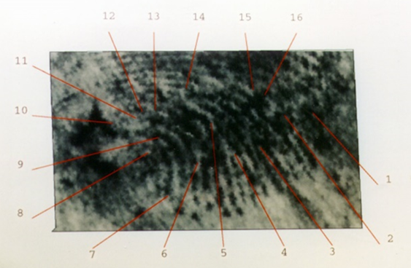
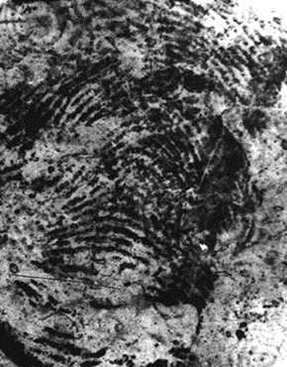
Frequently Asked Questions
Are you aware of controversial errors?
Yes.
Scottish Criminal Records Office
Madrid Bombing
Notes:
NOTES:
Optional slide that should be reviewed by Crown and the fingerprint expert to determine if they are relevant and admissible. Can be included to help explain aspects of fingerprint evidence that may be raised by defence.

Slide 53
Certification
Certification in fingerprint examination is available through the International Association for Identification (IAI) and the RCMP.
A candidate who successfully completes the testing process is certified for a 5-year period.
The Ontario Police College has a 3-year certification process for Forensic Investigators.
Certification is not mandatory outside of the RCMP and Ontario-based Police Services.
Notes:
NOTES:
Mandatory slide should be included to provide a comprehensive description of friction ridge evidence.
If your organization has an internal certification process, add it to the slide.

Slide 54
Professional Affiliations
The largest and most well known professional organizations that fingerprint examiners may belong to include:
Canadian Identification Society (Canada)
    International Association for Identification (USA)
    Fingerprint Division of The Chartered Society of Forensic Sciences (UK)
    Ontario Forensic Investigators Association (ON)
    Associations Québécoise de Criminalistique(QC)
Notes:
NOTES:
Mandatory slide should be included to provide a comprehensive description of friction ridge evidence.
Each organisation is open to international members and has different categories of members i.e. student, associate and regular.

Slide 55


Established in 1995 as one of several SWGs.
Replaced by the Organization of Scientific Area Committees (OSAC) Friction Ridge Subcommittee in 2014.
Up to 50 members who were experts in the area of latent & tenprint examination.
Establishes consensus guidelines & standards for the forensic examination of fingerprints, palm prints and barefoot prints.
Established in 2011 to assist members of the forensic identification community in preparation for court testimony.
Comprised of the following members/ organizations:
CPC; OPC; Chair of the CIS Friction Ridge Certification Committee; RCMP IFIS; Canadian OSAC rep; research scientist; Crown Prosecutors; RCMP ‘E’ Division; OPP; SQ; Edmonton PS; Ottawa PS; York Regional PS; and Vancouver PD.
Notes:
NOTES:
Mandatory slide should be included to provide a comprehensive description of friction ridge evidence.
Currently funded by National Institute of Standards and Technology (NIST) in the USA and are being reconfigured into Scientific Area Committees.

Slide 56











Contributors
The following organizations are gratefully acknowledged for contributing to this slide catalogue:

Slide 57
Record of Amendments
Date | Version | Actions
2014-10-31 | 1.0 | Posted on CanFRWG website
2017-07-20 | 2.0 | Added version # and page #’s to all slides; Slide#2 – changed “Yellow” to “Green” for mandatory slides and “Green” to “Yellow” for choose from a group. The colour of the header was amended to reflect this in all subsequent slides. Moved AFIS slides 37-39 from “Yellow” to “Red” to reflect concerns about prejudicial content. Changed wording for optional slides from “…that could be used to clarify an anticipated issue” to “that are presumptively not included unless at the request of the Crown and have been reviewed by both Crown and the fingerprint expert to determine if they are relevant and admissible.” Changed slide numbers to reflect the following additions. Slide#10 - changed wording from “Friction ridge identification is established through the agreement of friction ridge formations, in sequence, having sufficient uniqueness to individualize” to “Friction ridge identification is established through the agreement of sufficient friction ridge formations, in sequence.” To avoid using ‘uniqueness’ with respect to latent fingerprints. Removed quotation marks and italics. Added “Based on” to reference; Slide#11 – added graphics to demonstrate linear A and circular CE and changed wording from “ACE is not generally applied as a strictly linear process because it may include a return to any previous phase” to “Appropriate documentation of the analysis of the latent is required prior to viewing the known. During Comparison and Evaluation the examiner looks back and forth between the latent and the known to reach a decision.” Added / Quality Control to Verification; Additional Slide#34 – Quality Table (referenced to SWGFAST Document #10); Slide#35 – replaced ‘discrepancies’ with ‘dissimilarities’ to be consistent with SWGFAST Terminology (dissimilarity = difference in appearance; discrepancy = friction ridge detail that appears in one impression but not the other); Slide#37 – changed wording from “forensic identification officer” to “forensic identification examiner”. Changed slide to “Red” FAQ format as content is evidence of other discreditable conduct. If AFIS topic is raised by defence during cross examination then Crown can include presenting the AFIS slides in re-examination. Title is formatted as a question “How is the Automated Fingerprint Information System (AFIS) used for fingerprint searches?” Additional Slide#38 – FAQ format – How does AFIS work?; Additional Slide#39 – FAQ format – How are AFIS results assessed by humans? (enlargement of images from slide#38); Additional Slide#44 – Sufficiency (SWGFAST Document #10); Continued…

Slide 58
Record of Amendments continued
Date | Version | Actions
2017-07-20 | 2.0 | Slide#49 – changed wording from “Mathematically based models are in the early stages of development” to “There are quantitative methods being developed for assessing the strength of association between a latent and an exemplar.” added “For example, the Defence Forensic Science Center (DFSC), US Army have implemented a software application (FRStat) to report the statistical strength of friction ridge skin comparisons.” and the reference “Swofford HJ. Information paper on ‘Modification of Latent Print Technical Reports to Include Statistical Calculations’. Department of the Army, Defense Forensic Science Center, 2017-03-09.”; Additional Slide#50 – Frequently Asked Questions – “What are the types of potential errors in your discipline? False positive error (erroneous identification) – the incorrect determination that two areas of friction ridge impressions originated from the same source. False negative (erroneous exclusion) – the incorrect determination that two areas of friction ridge impressions did not originate from the same source.” Referenced to SWGFAST Document #19 (2013), Standard Terminology of Friction Ridge Examination (Latent/Tenprint Ver. 4.1).” Additional Slide#51 – Frequently Asked Questions – “Have errors occurred in your discipline? Yes. We do not claim a zero error rate. According to a study published in the Proceedings of the National Academy of Sciences involving mainly US experts the rates of error: False positive rate of 0.1% without verification. False negative rate of 7.5% without verification.“ Referenced to Ulery, BT. Hicklin RA, Buscaglia J, Roberts MA. Accuracy and reliability of forensic latent fingerprint decisions. Proceedings of the National Academy of Sciences. 109;2011:7733-8.” Additional Slide#52 – Frequently Asked Questions – “Are you aware of controversial errors? Yes.” Images of Madrid Bombing and Scottish Criminal Records Office erroneous identifications are shown. Slide#53 – changed wording from “Certification in fingerprint examination is available through the Canadian Identification Society (CIS) and the International Association for Identification (IAI).” to “Certification in fingerprint examination is available through the Canadian Identification Society (CIS), the International Association for Identification (IAI) and the RCMP.” Changed wording from “Certification is not mandatory for fingerprint examiners.” to “Certification is not mandatory outside of the RCMP and Ontario-based Police Services.” Added “The Ontario Police College has a 3-year certification process for Forensic Investigators.” Slide#54 – added “Ontario Forensic Investigators Association (ON) and ``Association Québécoise de Criminalistique (QC).” As of April 2017, The Fingerprint Society is now the Fingerprint Division of The Chartered Society of Forensic Sciences (CSFS) and the slide was changed to reflect this. Slide#55 – added wording under SWGFAST “Replaced by the Organizational of Scientific Area Committees (OSAC) Friction Ridge Subcommittee in 2014.” Added wording under CanFRWG “RCMP ‘E’ Division; OPP; SQ; Edmonton PS; Ottawa PS; and, York Regional PS.” Slide#56 – added Police shield for SQ and York Regional to contributors.

Slide 59
Record of Amendments continued
Date | Version | Actions
2018-07-12 | 3.0 | Slide#32 – replaced ‘individualize’ with ‘identify’ as CanFRWG support use of the term ‘identification’ for the Canadian forensic identification practice as explained in the CanFRWG Position Paper on use of the term ‘Identification’. Slide#33 – replaced ‘individualize’ with ‘identify’ as CanFRWG support use of the term ‘identification’ for the Canadian forensic identification practice as explained in the CanFRWG Position Paper on use of the term ‘Identification’. Removed ‘verified’ Slide#37 – changed ‘…submitted into a computer system for search against an AFIS database…’ to ‘…uploaded into an AFIS computer system for search against a database...’. Changed ‘…return the veriied results to…’ to ‘return the results of the evaluation to…’ to reflect that not all agencies verify the AFIS result. Slide#38 – replaced ‘submitted’ with ‘uploaded’ and ‘analyst’ with ‘technician’ to be consistent with slide #33. Slide#39 – replaced ‘visibly’ to ‘visually’ since this is grammatically correct. Slide#43 – removed ‘individualization’ and ‘individualize’ as CanFRWG support use of the term ‘identification’ for the Canadian forensic identification practice as explained in the CanFRWG Position Paper on use of the term ‘Identification’. Slide45 – removed the terms ‘individualization’ and ‘individualize’ and redefined ‘identification’ as “Identification is the opinion by the examiner, based on training, knowledge and experience, that the friction ridge impressions originated from the same source.” Slide#53 – removed “the Canadian Identification Society (CIS),” from the first sentence as the CIS is no longer offering certification exams.
2019-11-04 | 3.1 | Slide#27 – added “All presumptive blood tests have the potential for false positive reactions and do not confirm the presence of blood.” Slide#28 – added “All presumptive blood tests have the potential for false positive reactions and do not confirm the presence of blood.” Slide#56 – added logos for Service de police de la ville de Montréal and MRC des Collines.
2020-12-31 | 4.0 | Updated CanFRWG Logo – all slides Slide#1 – added “Version 4.0” and removed version number from other slides.
Notes:
Update OPS crest

Slide 60
Record of Amendments continued
Date | Version | Actions
2020-12-31 | 4.0 | Slide#11 – Capitalized ACE Slide#37 – In point 4. “reaches a conclusion” changed to “forms an opinion” Slide#40 – “reaches a conclusion” changes to “forms an opinion” Slide#43 – “standard conclusions” changed to “standard opinions” Slide#11 – “reach a conclusion” changed to “form an opinion” Slide#44 – “sole criteria for a decision” changed to “sole criteria upon which to base an opinion” Slide#50 – “determination” changed to “opinion”
Notes:
Update OPS crest

