Slide 1


Accelerated and Sustainable Improvement
Brett Lane, INSTLL
June 7, 2021

Slide 2

Today’s Goals
Session Purpose
Our goal today is to introduce a Framework and explore key Practices for accelerating schoolwide improvement efforts…and to gather your input and thinking about how to improve.
We aim to engage you in thinking about and offering ideas regarding:
  How can City View leverage existing teaming structures and practices?
  What do we (as a school) need to improve or change to accelerate improvement?
Worcester Public Schools: Sustainable Improvement
June 7, 2021

Slide 3
Input and Activities
What does it mean to engage in accelerated improvement?
Why is professional learning important and how do schools foster collaboration and sustainable professional learning?
Exploring Practices #1 and #2
Leadership, Shared Responsibility and Professional Collaboration
Intentional Practices for Improving Instruction
Exploring Practices #3 and #4
Providing student-specific instruction and support to all students
Culture and Climate
For each topic, we will provide content, read, and engage in an activity.
Worcester Public Schools: Sustainable Improvement
June 7, 2021

Slide 4
What do we aim to accomplish?
Design and Planning – begins by identifying what we want to accomplish.
Why are we doing this?
What is the primary goal/aim - what we want to accomplish?
What do we need to do to accomplish our goal?
Worcester Public Schools: Sustainable Improvement
June 7, 2021

Slide 5
Shifting our perspective
to guide thinking around improvement efforts next year
Design vs. Planning
Considering how to DESIGN your school so that it can best function to support professional learning and dramatically improve student achievement, in 2 to 3 years.
Structures
Processes
Resources and Materials
A deliberate design provides the foundation for a PLAN (actions, strategies, PD) for achieving what you want to accomplish (goal/aim/objective).
Actions
Timelines
Measures and Benchmarks
Worcester Public Schools: Sustainable Improvement
June 7, 2021

Slide 6
Shifting our perspective
to guide thinking around improvement efforts next year
Accelerated Improvement vs. Continuous Improvement
What is the difference between
Accelerated and Continuous Improvement?
Accelerated Improvement often involves significant changes (yes, improvements) in school culture, teacher practice, school structures and ways of working, and use of time and resources.
Worcester Public Schools: Sustainable Improvement
June 7, 2021

Slide 7
Activity #1
How do you, as teachers and staff at City View, distinguish between Design and Planning classroom instruction?
What and how do you design instruction?
How do you plan instruction?
Jamboard: https://tinyurl.com/jzabaj5t
Worcester Public Schools: Sustainable Improvement
June 7, 2021

Slide 8

Mean mathematics performance, by school location, after accounting for socio-economic status
8
8
Fig II.3.3
Policy levers to teacher professionalism
Autonomy: Teachers’ decision-making power over their work (teaching content, course offerings, discipline practices)
Professionalism is the level of autonomy and internal regulation exercised by members of an occupation in providing services to society
Teacher
professionalism
Peer networks: Opportunities for exchange and support needed to maintain high standards of teaching (participation in induction, mentoring, networks, feedback from direct observations)
Knowledge base for teaching (initial education and incentives for professional development)
Notes:
There are different models of teacher professionalism across the TALIS systems, these figures present an example of the five most frequent models:
High peer networks/low autonomy
High autonomy
Knowledge emphasis
Balance domains/high support for professionalism
Balance domains/ low support for professionalism

Slide 9
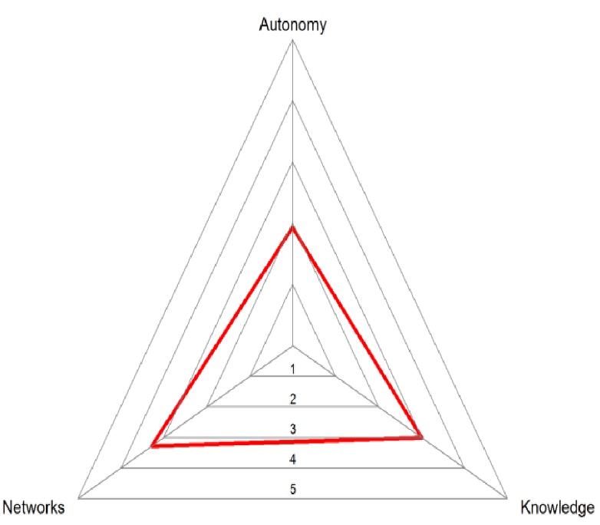
Mean mathematics performance, by school location, after accounting for socio-economic status
9
9
Fig II.3.3
Teacher professionalism
Autonomy: Teachers’ decision-making power over their work (teaching content, course offerings, discipline practices)
Professionalism is the level of autonomy and internal regulation exercised by members of an occupation in providing services to society
Peer networks: Opportunities for exchange and support needed to maintain high standards of teaching (participation in induction, mentoring, networks, feedback from direct observations)
Knowledge base for teaching (initial education and incentives for professional development)
Notes:
There are different models of teacher professionalism across the TALIS systems, these figures present an example of the five most frequent models:
High peer networks/low autonomy
High autonomy
Knowledge emphasis
Balance domains/high support for professionalism
Balance domains/ low support for professionalism

Slide 10



Teacher co-operation
10
Percentage of lower secondary teachers who report doing the following activities at least once per month
Exchange and co-ordination
Notes:
So if collaboration is important, how frequently do teachers engage in it?
The pictures is actually mixed. When it comes to informal exchange and co-ordination, teachers are generally very active.
And Alberta, here marked in red, is no exception to this.
However, the kind of deep professional collaboration I referred to in the preceding chart is actually quite rare, as you can see on the right panel. Only one in 5 teachers pursues team teaching, that you saw closely related to job satisfaction, at least one per month. In countries such as Japan, Denmark or Italy it is a bit more common, but still not as frequent as you hope it might be. And the picture is similar for collaborative professional development. Even in Alberta, which together with Singapore, Australia and Israel does best on this you still find only a third of teachers doing this at least once per months. And least frequent is classroom observation that you also saw closely related to job satisfaction.

Slide 11
Collaboration and Professionalism
How often do teachers….
 | Never | Once a year or less | 2 to 4 times a year | 5 to 10 times a year | 1-3 times a month | Once a week or more
Teach jointly as a team in the same classroom
Observe other teachers’ classes and provide feedback
Engage in joint activities across different classes
Take part in collaborative professional learning
Worcester Public Schools: Sustainable Improvement
June 7, 2021

Slide 12
Mean mathematics performance, by school location, after accounting for socio-economic status
Teachers Self-Efficacy and Professional Collaboration
12
12
Fig II.3.3
Less
frequently
More
frequently
Notes:
Here is some data on this.
Teachers who teach more often jointly as a team consistently report higher levels of job satisfaction.
The same is true for observing other teachers classes
Or engaging in joint activities across different classes
Or to take part in collaborative professional learning

Slide 13
Quick Read
Program Coherence
The instructional guidance systems begins with a curriculum framework that details the subject matter to be taught. Encapsulated here are the scope and sequence of instruction, which coordinate learning objectives among classrooms both within and across grades. Accompanying this is a common pedagogy: the core practices and social routines that teachers use to engage students in the subject matter. Key here is that the practices and routines of instruction are shared across a faculty, rather than being purely matters of individual choice. This is essential if social learning regarding instructional improvement is to occur. Effecting this collective cognition requires a common language for instruction accompanied by a reservoir of teacher experiences in confronting the same work tasks in their classroom. Minus this resource, improvement conversations would resemble a Tower of Babel.
Direct quote from Organizing Schools for Improvement: Lessons from Chicago (p. 205; Bryk, A.S. et al. 2010)
Worcester Public Schools: Sustainable Improvement
June 7, 2021

Slide 14
Activity #2
We will now go into breakout groups (4-5 per group).
Individually read pgs. 6-7 in the Field Guide (Theme 2 and Theme 3).
In your group, share and reflect upon the content on professional learning and the readings AND respond to the following question:
What are some examples of effective and collaborative professional learning at City View?
What was the activity and how did it support professional learning?
POST your responses on Jamboard (activity #2 – second sheet):
Jamboard: https://tinyurl.com/jzabaj5t
Worcester Public Schools: Sustainable Improvement
June 7, 2021

Slide 15
  Successful Turnaround in Action
Turnaround Practices
Leadership, Shared Responsibility, and Professional Collaboration
The school has established a community of practice through leadership, shared responsibility, and professional collaboration
Intentional Practices for Improving Instruction
The school employs intentional practices for improving teacher-specific and student-responsive instruction.
Providing Student-Specific Instruction and Supports to All Students
The school is able to provide student-specific supports and interventions informed by data and the identification of student-specific needs.
Grounded in a safe, orderly and respectful environment for students and a collegial, collaborative, and professional culture among teachers.
Worcester Public Schools: Sustainable Improvement
June 7, 2021
Notes:
Point out that these practices work together in tandem. They are reinforcing practices – system practices. Give examples that focus on the instructional core (common and shared understanding of high quality instruction)
That many schools have pieces of each or even have well developed practices in one, but not the others. That all three need to be in place, built upon a foundation of a safe, orderly and respectful environment.
Without the the foundation, success is not possible.
Finding the right leaders and teachers is crucial, to develop a collegial, collaborative and professional culture
Then, active use of teams, focus on instructional practice, mechanism in each can begin to be developed and refined.
Key distinction is the sophistication and precision of the use of these practices.

Slide 16
  Successful Turnaround in Action
Turnaround Practices
What does this look like in practice?
Leadership, Shared Responsibility, and Professional Collaboration
The school has established a community of practice through leadership, shared responsibility, and professional collaboration
Collaborative Teaming and Practices to Improve Instruction
Principals have established and support distributive leadership teaming structures throughout the school:
Evidence of teaming structures (an ILT, grade-level and/or vertical teams) that work in tandem to support turnaround strategies.
A school leadership team that is representative of each grade, content area, and student area of need.
Commitment and Action to Improve all aspects of the schools
Teams, and the leaders and teachers in the teams, exhibit a strong commitment to high expectations for all students and a willingness to work together to improve instruction.
Evidence of leaders and teachers actively using teaming structures to share and improve classroom instruction, and to monitor turnaround strategies.
Worcester Public Schools: Sustainable Improvement
June 7, 2021
Notes:
This starts with having an instruction and improvement oriented leader – a transformational leader.
Significant amount of Teaming, Sharing of Students (e.g., through tiered instruction), Sharing of Instructional strategies

Slide 17
  Successful Turnaround in Action
Turnaround Practices
What does this look like in practice?
Intentional Practices for Improving Instruction
The school employs intentional practices for improving teacher-specific and student-responsive instruction.
Defined Expectations for High Quality Instruction
School leadership has set explicit expectations regarding the provision of standards-based lessons that include high quality instructional practices, strategies, and academic language…which is EVIDENT in written and taught instruction and instructional practices.
Targeted and Welcomed Feedback and Support to Teachers
The principal (or administrators or coaches) spend significant time in classrooms, observing teachers’ instruction and providing teachers with constructive and useful formal and informal feedback on instructional practices.
Teacher-driven instructional improvement
Teachers (and teacher team) use a variety of standards-based assessments to assess and revise lessons (e.g., core instruction).
Worcester Public Schools: Sustainable Improvement
June 7, 2021
Notes:
There must be a clear and explicit understanding of high quality instruction and instructional interventions
Systems are in place for teachers to frequently examine the effectiveness of their own instruction (e.g., teacher teams)
Systems are in place for administrators to regularly visit classrooms and observe instruction and student work
Administrators have the skill to provide precise and useful feedback
Teachers welcome and value feedback from administrators and from peers
This is a tiered system of support for TEACHERS – Coaching and other PD is targeted, immediate, and focused on improving instruction.

Slide 18
Activity #3
We will now return to the same breakout groups.
Individually read pgs. 24 to 26 in the Field Guide (beginning with “Using common planning time to drive turnaround efforts).
In your group, spend 5 minutes exploring the following question:
  What practices did the school use and how did they promote professional learning?
As a group and to record on Jamboard, please explore the following questions:
How can we leverage existing teaming structures or practices to more directly support instructional improvement? (What structures and How?)
What may we need to Improve or Change?
POST your responses on Jamboard (activity #3 – third sheet):
Jamboard: https://tinyurl.com/jzabaj5t
Worcester Public Schools: Sustainable Improvement
June 7, 2021

Slide 19
  Successful Turnaround in Action
Turnaround Practices
What does this look like in practice?
Providing Student-Specific Instruction and Supports to All Students
The school is able to provide student-specific supports and interventions informed by data and the identification of student-specific needs.
Data Driven Targeting and Monitoring of Intervention
The principal, coaches, and teachers use a variety of ongoing assessments to identify students’ academic and non-academic needs.
Tiered and Targeted Interventions for Students
Students are provided with instruction and student-specific interventions in direct response to their academic areas of need, identified through formative assessments and analyses of student work.
Autonomy and Flexibility
Leadership and teachers have the autonomy and flexibility to quickly adapt and modify time (e.g., schedules,) resources (e.g., people and interventionists,) and interventions to directly and immediately meet student-specific needs.
Worcester Public Schools: Sustainable Improvement
June 7, 2021
Notes:
If your school was DESIGNED to do this…

Slide 20
  Successful Turnaround in Action
Turnaround Practices
What does this look like in practice?
School Culture and Climate
The School has established a climate and culture that provides a safe, orderly and respectful environment for students and a collegial, collaborative, and professional culture among teachers that supports the school’s focus on increasing student achievement.
Shared Behavioral Expectations that support Student Learning
Administrators and teachers have clearly established and actively pursue a set of shared behavioral expectations that support student learning.
Targeted and effective social-emotional supports
The school has identified, established, and proactively provides effective social-emotional resources and supports for students in need of such supports and assistance.
Establishing a collegial, respectful, and trusting professional environment
The school is promoting a respectful and collegial professional environment (e.g., that teachers like to work together) that contributes to a collective effort to increase student achievement.
Worcester Public Schools: Sustainable Improvement
June 7, 2021

Slide 21
Activity #4
We will now return to the same breakout groups.
Individually read pgs. 18 to 20 in the Field Guide (begin with “Connery’s Journey and end prior to “Decoding standards-based lesson objectives).
In your group, spend 5 minutes exploring the following question:
  How did the school use its teaming structures to address a specific need?
As a group and to record on Jamboard, please explore the following questions:
How can we leverage existing practices, staffing, resources or teaming practices to provide student-specific support to all students? (What and How?)
What may we need to Improve or Change?
POST your responses on Jamboard (activity #4 – fourth sheet):
Jamboard: https://tinyurl.com/jzabaj5t
Worcester Public Schools: Sustainable Improvement
June 7, 2021

Slide 22
  Successful Turnaround in Action
Turnaround Practices
What does this look like in practice?
Instructional Coherence
The school is using tightly aligned and consistent curricula, assessments, and common instructional practices within and across grades and content areas that will ensure that all students have access to content, instruction, and learning tools necessary to ultimately take and succeed in advanced and college-level coursework.
Vertical and horizontal planning time
Formal meeting structures are established for teachers to develop and maintain vertical and horizontal alignment of curriculum and instruction within and across
Instructional Coherence and Focus
Vertically aligned and standards-based curricula (e.g., course scope and sequence and common assessment) have been developed and are referenced and used by teachers.
Vertically and horizontally aligned instructional strategies, language, and other learning tools are evident in shared lessons and in teachers’ instructional practice, to enable students to access content.
Worcester Public Schools: Sustainable Improvement
June 7, 2021

