Slide 1
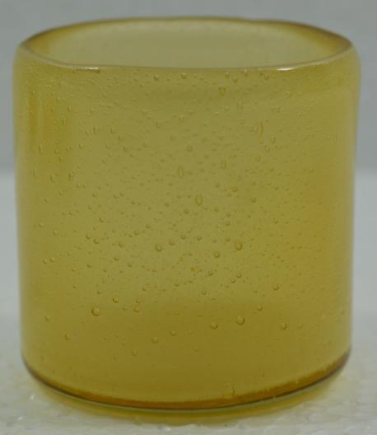

Slide 2
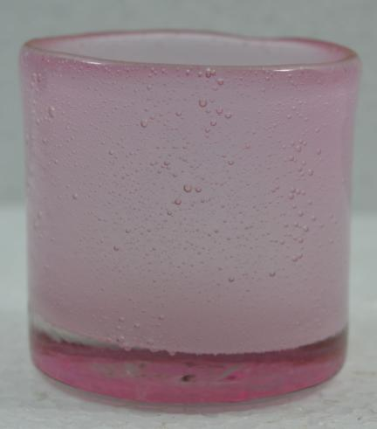
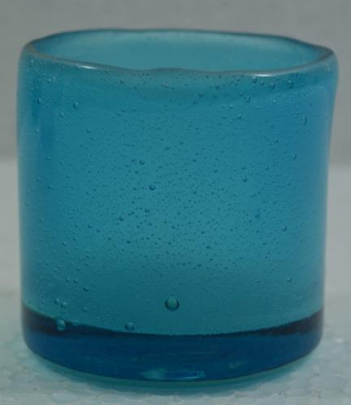

Slide 3
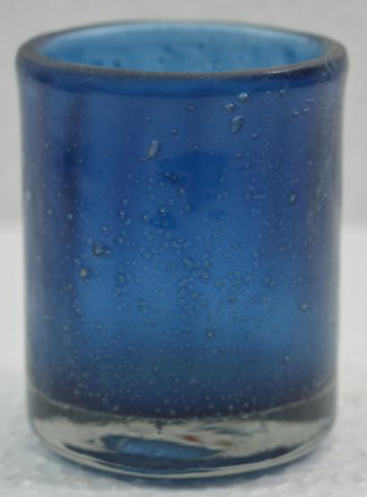
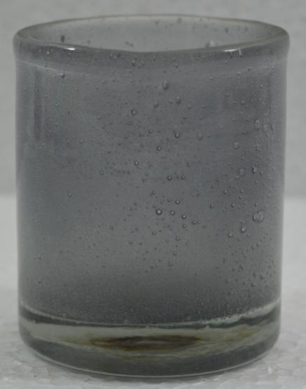

Slide 4
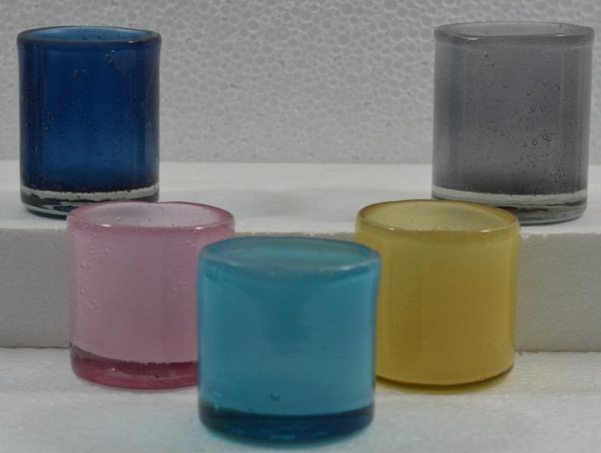
Item No. : Group

Slide 5
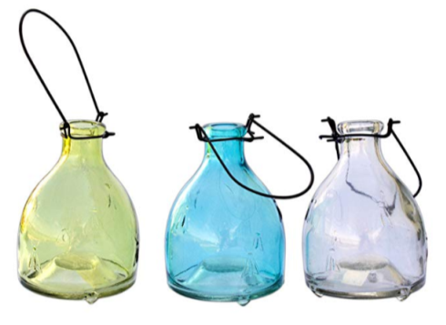
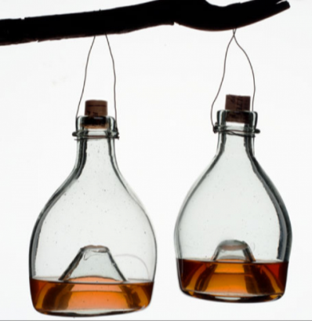
UG-1001
UG-1002

Slide 6
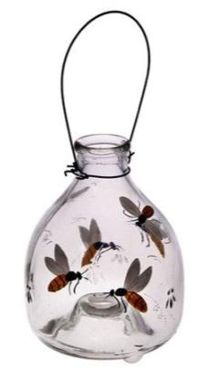
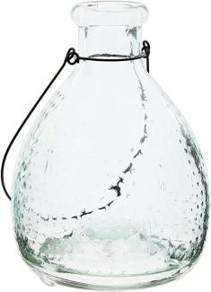
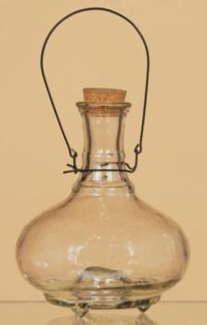
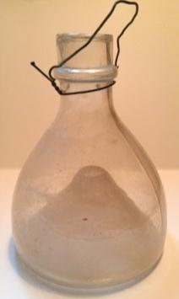
UG-1017
UG-1018
UG-1019
UG-1020

Slide 7
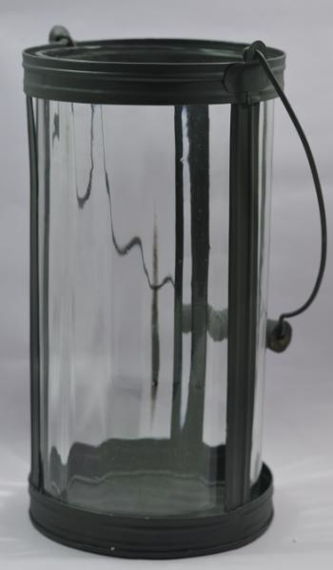
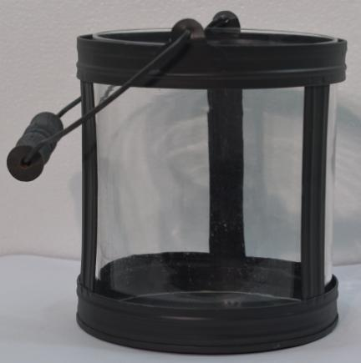

Slide 8
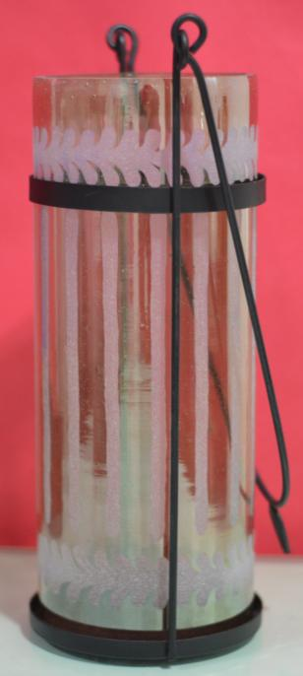

Slide 9
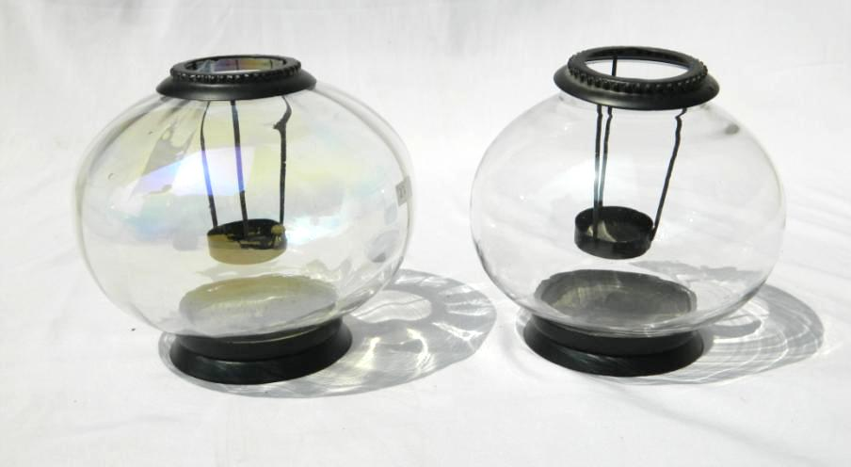
A
B
Itme No. UG 4169
Desc. Tea Light Holder
Size (Cm.) A - Dai 17 x Ht 14.5 , B – Dia 15.5 x Ht 14.5
Price (USD) A B

Slide 10
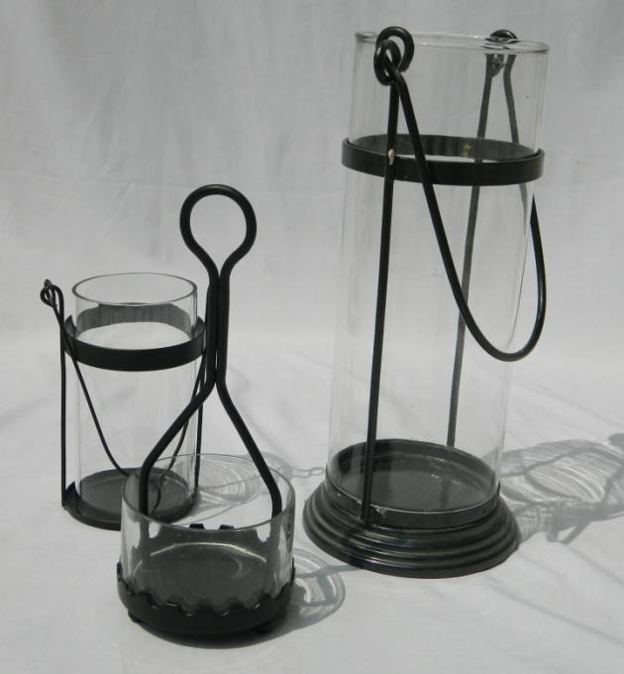
B
A
Itme No. UG 4171
Desc. Lantern
Size (Cm.)
A - Dai 11.5 x Ht 14.5
B – Dia 13 x Ht 26
C – 9 x Ht 12.5
Price (USD)
A
B
C
C

Slide 11
B
A
Itme No. UG 4171
Desc. Lantern
Size (Cm.)
A - Dai 11.5 x Ht 14.5
B – Dia 13 x Ht 26
C – 9 x Ht 12.5
Price (USD)
A
B
C
C

Slide 12
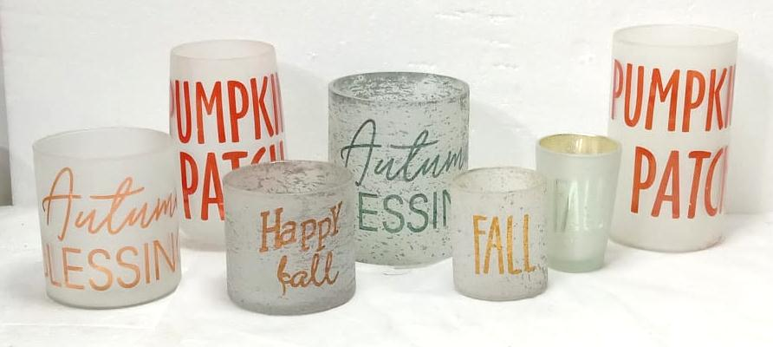
GROUP PICTURE

Slide 13
ITEM NO--1001
SIZE (INCH)- D-3X H-3

Slide 14
ITEM NO--1002
SIZE (INCH)- D-2.5X H-5

Slide 15
ITEM NO--1003
SIZE (INCH)- D-4X H-4

Slide 16
ITEM NO--1004
SIZE (INCH)- D-3.5X H-5

Slide 17
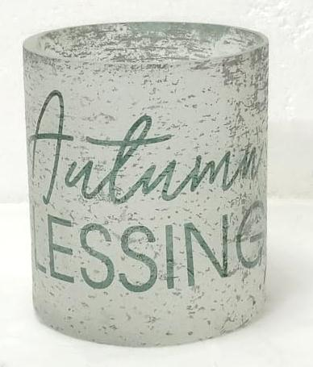
ITEM NO--1005
SIZE (INCH)- D-4X H-4

Slide 18
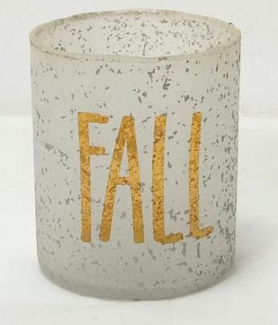
ITEM NO--1006
SIZE (INCH)- D-3X H-4

Slide 19
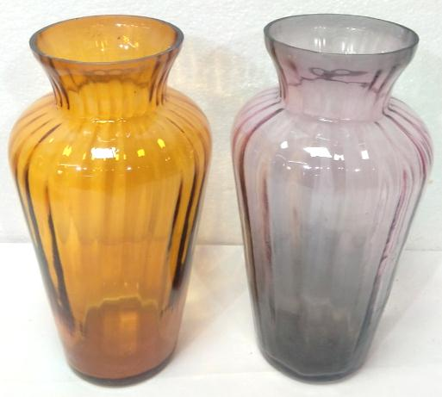
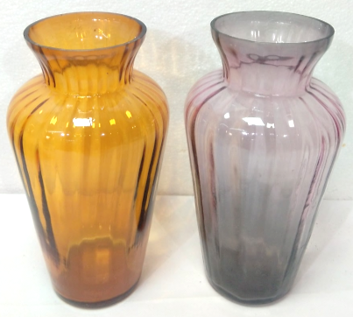
Item no :- Ul-1089
Size ( INCH ) :- H 8/D 4

Slide 20
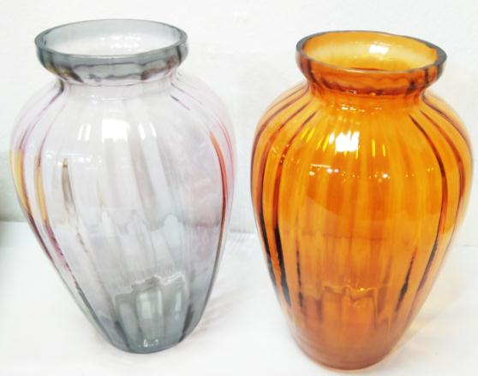
Item no :- Ul-1090
Size ( INCH ) :- H 10/D 6.5

Slide 21
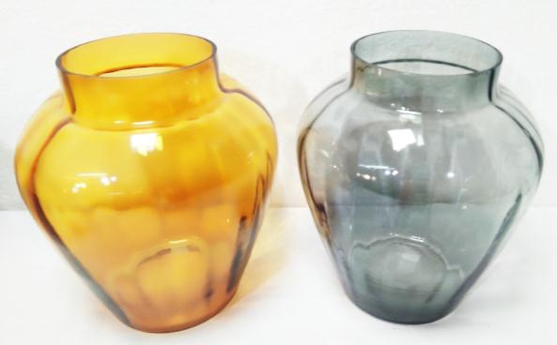
Item no :- Ul-1091
Size ( INCH ) :- H 8 /D 7

Slide 22
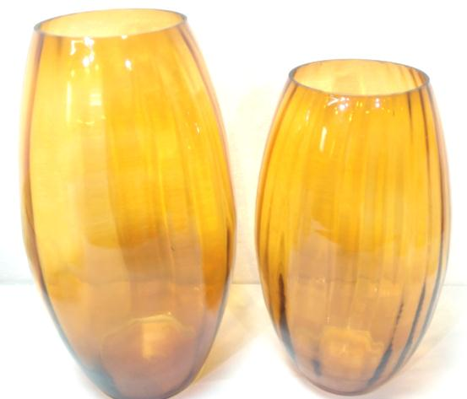
Item no :- Ul-1092
Size ( INCH ) :- H 11.25/D 6
Item no :- Ul-1093
Size ( INCH ) :- H 9.8/D 6

Slide 23
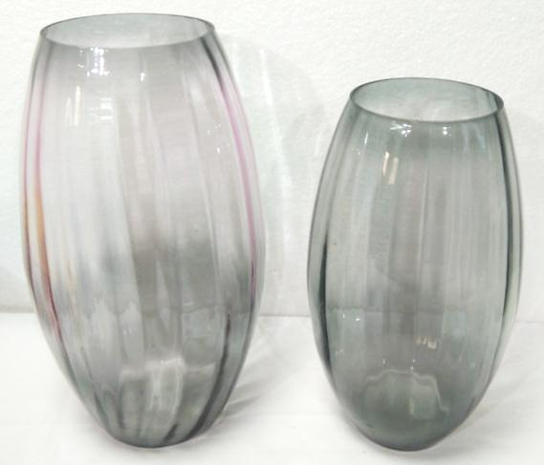
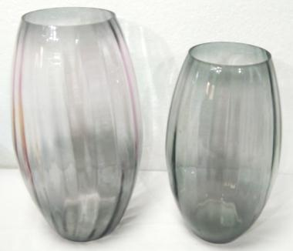
Item no :- Ul-1094
Size ( INCH ) :- H 11.25/D 6
Item no :- Ul-1095
Size ( INCH ) :- H 9.8/D 6

Slide 24
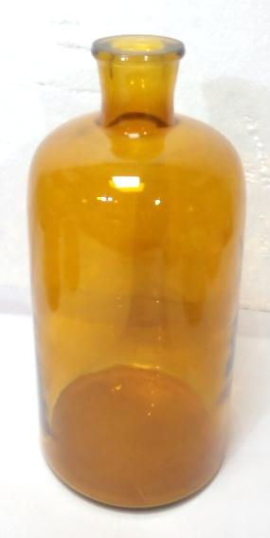
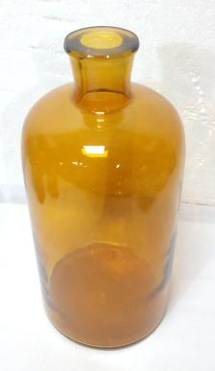
Item no :- Ul-0112
Size ( INCH ) :- H 11.41/D 5.31

Slide 25
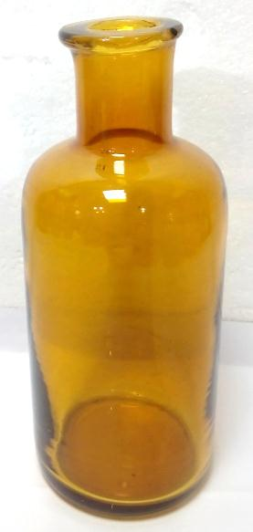
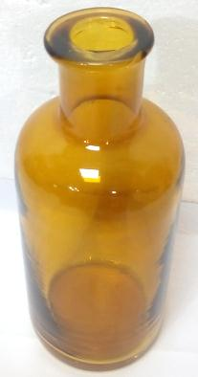
Item no :- Ul-0113
Size ( INCH ) :- H 7.87/D 3.14

Slide 26
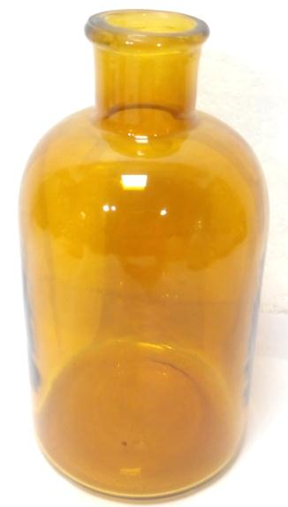
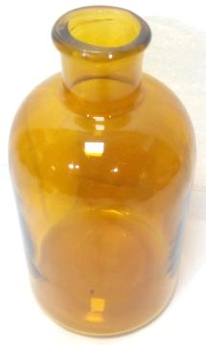
Item no :- Ul-0114
Size ( INCH ) :- H 7.28/D 3.93

Slide 27
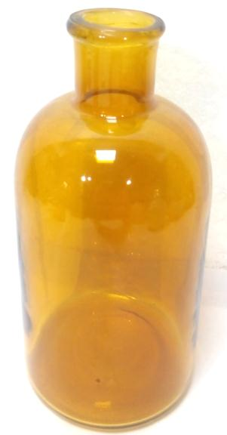
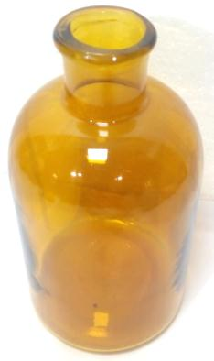
Item no :- Ul-0115
Size ( INCH ) :- H 5.90/D 3.14

Slide 28
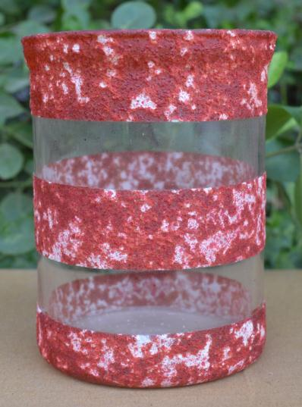
ITEM NO- UG-VT-0363
SIZE(INCH)-H -5.3”/D- 4”
WT--------0.336 KG

Slide 29
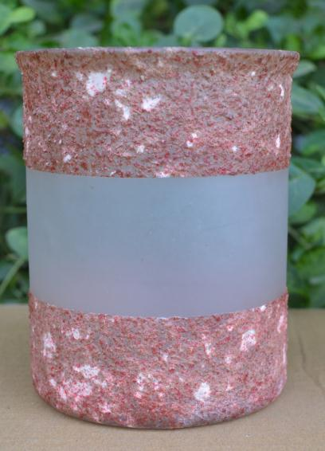
ITEM NO- UG-VT-0363
SIZE(INCH)-H -5.1”/D-4.1”
WT--------0.285 KG

Slide 30
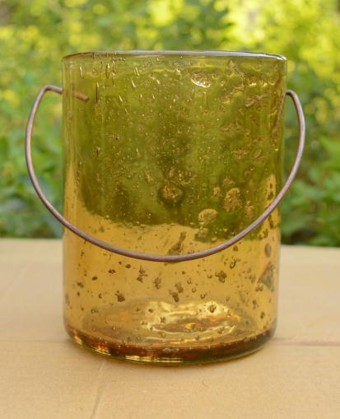
ITEM NO-UG-VT-0013
SIZE(INCH)-H-5”/D-3.8”
WT-0.624 kg

Slide 31
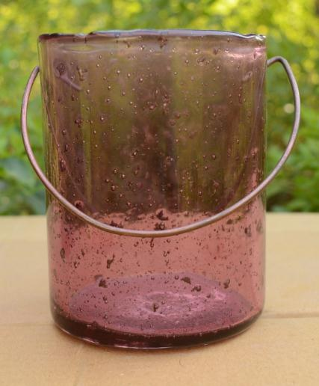
ITEM NO-UG-VT-0013
SIZE(INCH)-H-5”/D-3.8”
WT-0.624 kg

Slide 32
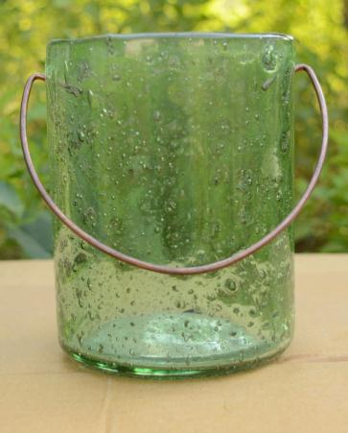
ITEM NO-UG-VT-0013
SIZE(INCH)-H-5”/D-3.8”
WT-0.624 kg

Slide 33
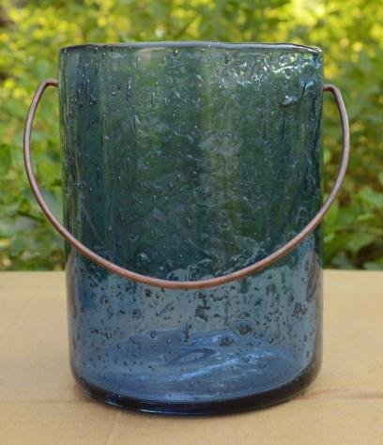
ITEM NO-UG-VT-0013
SIZE(INCH)-H-5”/D-3.8”
WT-0.624 kg

Slide 34
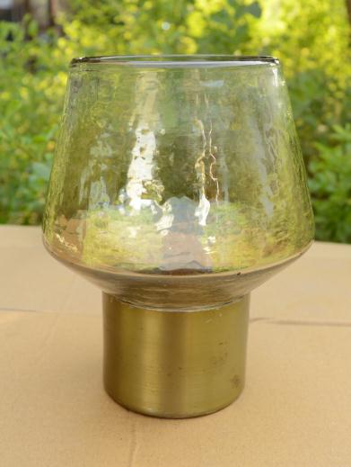
ITEM NO-UG-VS-0543
SIZE(INCH)-H-6.5”/D-5”
WT-0.691kg

Slide 35
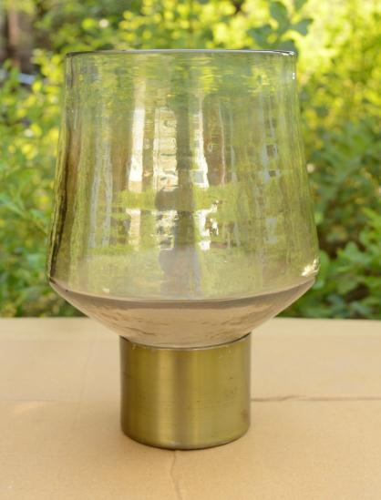
ITEM NO-VS-0541
SIZE(INCH)-H-8.55.75”/D-”
WT-1.126 kg

Slide 36
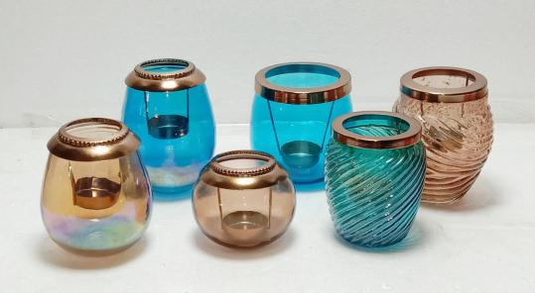
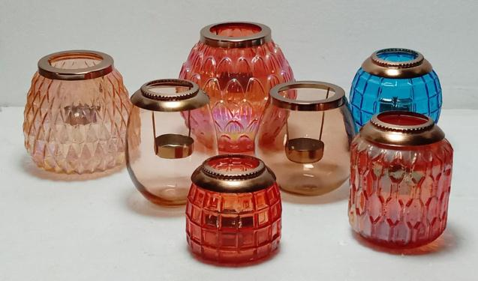
UMA GLASS WORKS PVT. LTD.
T - LIGHT VOTIVE
WITH FITTING

Slide 37
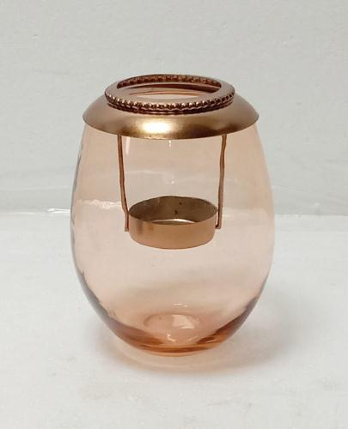
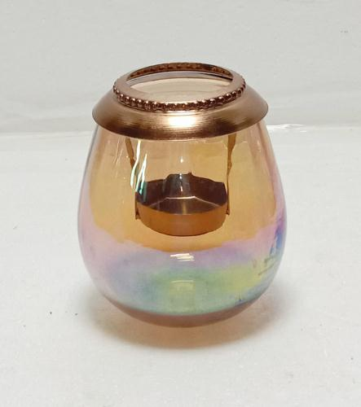
Item No. UG 611
Desc. T – Light Votive
Size Cm. Dia 9.5 x Ht 12.5
Item No. UG 612
Desc. T – Light Votive
Size Cm. Dia 9.5 x Ht 11

Slide 38
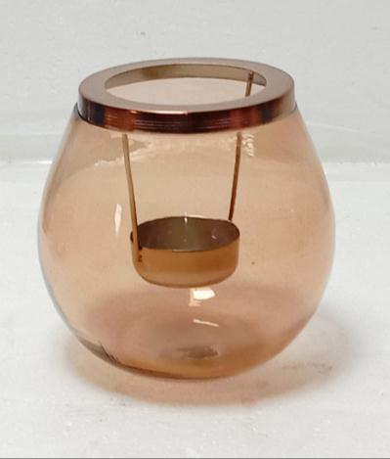
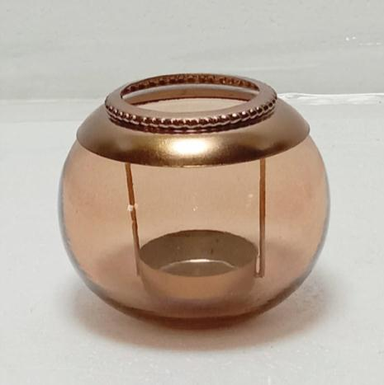
Item No. UG 613
Desc. T – Light Votive
Size Cm. Dia 11.5 x Ht 11.5
Item No. UG 614
Desc. T – Light Votive
Size Cm. Dia 9.5 x Ht 8

Slide 39
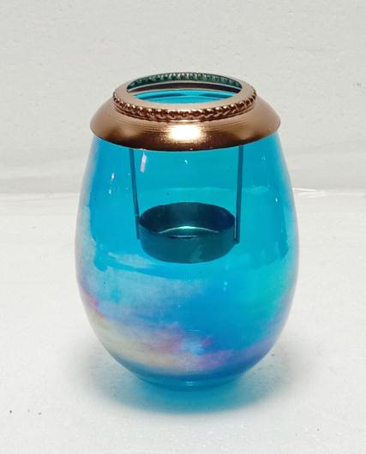
Item No. UG 615
Desc. T – Light Votive
Size Cm. Dia 9.5 x Ht 12.5
Item No. UG 616
Desc. T – Light Votive
Size Cm. Dia 11 x Ht 11

Slide 40
Item No. UG 617
Desc. T – Light Votive
Size Cm. Dia 9 x Ht 11
Item No. UG 618
Desc. T – Light Votive
Size Cm. Dia 10.5 x Ht 12

Slide 41
Item No. UG 619
Desc. T – Light Votive
Size Cm. Dia 10. x Ht 12
Item No. UG620
Desc. T – Light Votive
Size Cm. Dia 12.5 x Ht 13

Slide 42
Item No. UG 621
Desc. T – Light Votive
Size Cm. Dia 14 x Ht 15
Item No. UG 622
Desc. T – Light Votive
Size Cm. Dia 9.5 x Ht 11

Slide 43
Item No. UG 623
Desc. T – Light Votive
Size Cm. Dia 9 x Ht 9

Slide 44
Group picture

Slide 45
ITEM NO-UG-001
SIZE (INCH)- DAI-4” X H-4”

Slide 46
ITEM NO-UG-002
SIZE (INCH)- DAI-6” X H-7”

Slide 47
ITEM NO-UG-003
SIZE (INCH)- DAI-3” X H-3.25”

Slide 48
ITEM NO-UG-004
SIZE (INCH)- DAI-3.25” X H-5.5”

Slide 49
ITEM NO-UG-005
SIZE (INCH)- DAI-4” X H-5”

Slide 50
ITEM NO-UG-006
SIZE (INCH)- DAI-6” X H-10”

Slide 51
ITEM NO-UG-007
SIZE (INCH)- DAI-4.5” X H-6.5”

Slide 52
Item no. UP3084
Desc. Votive
Size Inch Dia 4 x Ht 4
Item no. UP3085
Desc. Votive
Size Inch Dia 3.25 x Ht 5

Slide 53
Item no. UP 3086
Desc. Votive
Size Inch Dia 5.25 x Ht 5.5
Item no. UP 3087
Desc. Votive
Size Inch Dia 4.25 x Ht 4

Slide 54
Item no. UP3088
Desc. Votive
Size Inch Dia 3 x Ht 3.5
Item no. UP 3089
Desc. Votive
Size Inch Dia 3 x Ht 4

Slide 55
Item no. UP 3090
Desc. Votive
Size Inch Dia 3 x Ht 5.25
Item no. UP3091
Desc. Votive
Size Inch Dia 2.5 x Ht 2

Slide 56
Item no. UP 3092
Desc. Votive
Size Inch Dia 2.5 x Ht 4
Item no. UP 3093
Desc. Votive
Size Inch Dia 3 x Ht 7

Slide 57
Item no. UP3094
Desc. Votive
Size Inch Dia 2.25 x Ht 4
Item no. UP3095
Desc. Votive
Size Inch Dia 2.5 x Ht 3.25

Slide 58
Item no. UP3096
Desc. Votive
Size Inch Dia 5 x Ht 6.25

Slide 59
Item no. UG 3042
Desc. Hurricane
Size Inch Dia 6 x Ht 9 , Dia 5x Ht 7.5 , Dia 4.75 x Ht 5.75

Slide 60
Uma Glass Works Pvt. Ltd.
Item no. UG 3043
Desc. Hurricane
Size Inch Dia 6 x Ht 9 , Dia 5x Ht 7.5 , Dia 4.75 x Ht 5.75

Slide 61
Item no.: SG-17989
Size (Inch) : 8X8X6.5

Slide 62
Item no.: SG-17990
Size (Inch) : 6X6X5

Slide 63
Item no.: SG-17991
Size (Inch) : 5.5X5.5X4.5

Slide 64
Item no.: SG-17992
Size (Inch) : 4.25X4.25X4

Slide 65
Item no.: SG-17993
Size (Inch) : 5X5X7.5

Slide 66
Item no.: SG-17994
Size (Inch) : 4X4X8

Slide 67
Item no.: SG-17995
Size (Inch) : 8X8X10

Slide 68
Item no.: SG-17996
Size (Inch) : 5X5X8

Slide 69
Item no.: SG-17997
Size (Inch) : 5X5X7

Slide 70
Item no.: SG-17998
Size (Inch) : 6X6X6

Slide 71
Item no.: SG-17999
Size (Inch) : 4.5X4.5X6

Slide 72
Item no.: SG-18000
Size (Inch) : 4X4X5

Slide 73
Uma Glass Works Pvt. Ltd.
Item No. UG – 3258
Desc. - Glass hurricane candle holder
Size Inch A - Dia 7.5 x Ht 14 PRICE
B - Dia 6.5 x Ht 11.5 PRICE

Slide 74
Uma Glass Works Pvt. Ltd.
Item No. UG – 3259
Desc. - Glass hurricane candle holder
Size Inch A - Dia 7.5 x Ht 14 PRICE
B - Dia 6.5 x Ht 11.5 PRICE

Slide 75
Uma Glass Works Pvt. Ltd.
Item No. UG – 3260
Desc. - Glass hurricane candle holder
Size Inch A - Dia 7.5 x Ht 14 PRICE
B - Dia 6.5 x Ht 11.5 PRICE

Slide 76
GROUP PICTURE

Slide 77
ITEM NO- UG-JR-100283
SIZE(INCH)-HT3.75 ”/DIA4.75 ”
WT--------0.303 KG

Slide 78
ITEM NO- UG-JR-0365
SIZE(INCH)-HT3.25 ”/DIA4 ”
WT--------0.247 KG

Slide 79
ITEM NO- UG-JR-100284
SIZE(INCH)-HT 2.4”/DIA 3.2”
WT--------0.100 KG

Slide 80
ITEM NO- UG-CL-0444
SIZE(INCH)-HT 6.25”/DIA4.25 ”
WT--------0.475 KG

Slide 81
ITEM NO- UG-CL-0446
SIZE(INCH)-HT 7”/DIA 5.25”
WT--------0.799 KG

