Slide 1
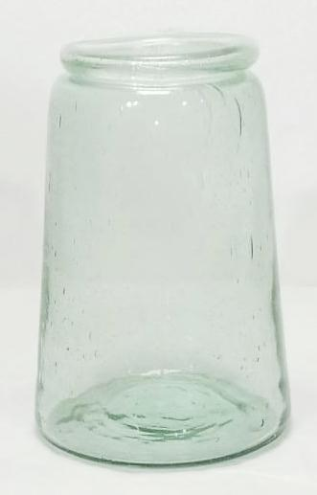
ITEM NO-G-021
SIZE (INCH)-H-9.5X BD-6

Slide 2
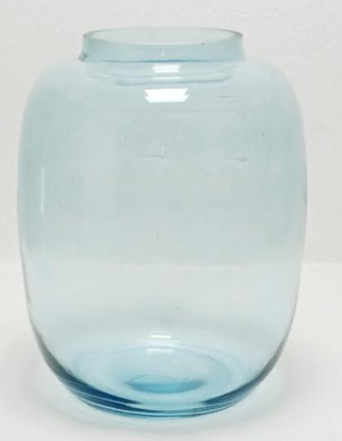
ITEM NO-G-022
SIZE (INCH)-H-10.8X BD-6“

Slide 3
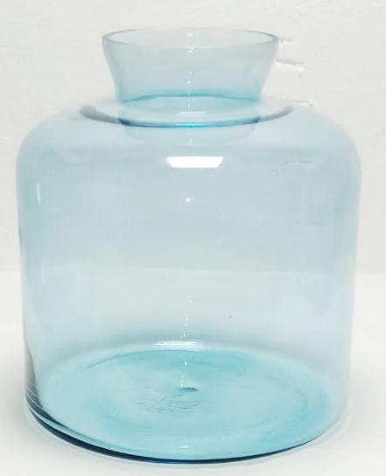
ITEM NO-UG-025
SIZE (INCH)-H-9.75X BD-6

Slide 4
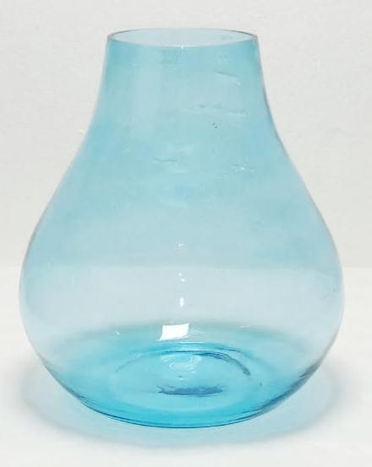
ITEM NO-G-029
SIZE (INCH)-H-9X BD-6.5“

Slide 5
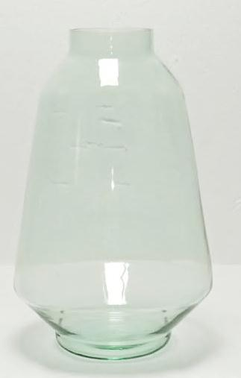
ITEM NO-G-016
SIZE (INCH)-H-12X BD-8“

Slide 6
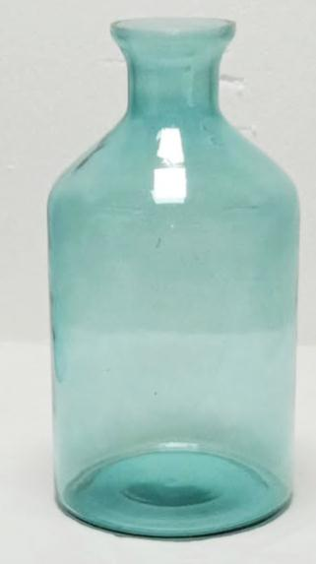
ITEM NO-G-015
SIZE (INCH)-H-10X BD-5“
Size (inch) 6d*12ht
Size (inch) 7d*14hT

Slide 7
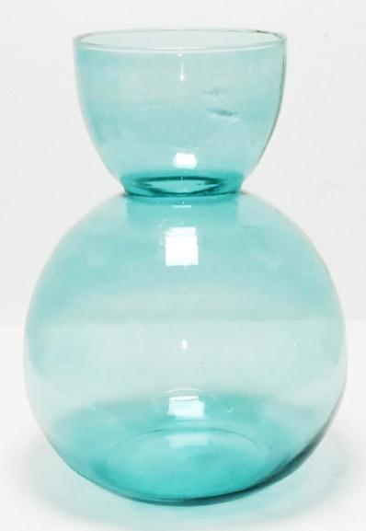
ITEM NO-G-019
SIZE (INCH)-H-12X BD-9“
Size (inch) 7d*14ht-

Slide 8
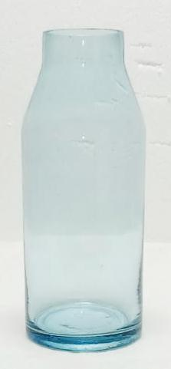
ITEM NO-G-023
SIZE (INCH)-H-9.5X BD-3.75“ –
Size (inch) 6d*12ht-
Size (inch) 7d*14ht-

Slide 9
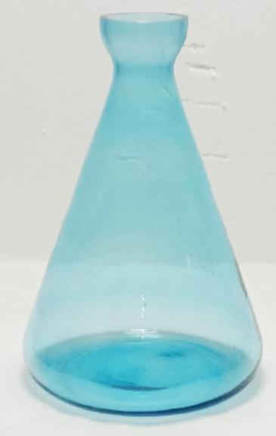
ITEM NO-G-026
SIZE (INCH)-H-10X BD-7“-5.34
Size (inch) 6d*12ht- 5.77$
Size (inch) 7d*14ht-6.21$

Slide 10
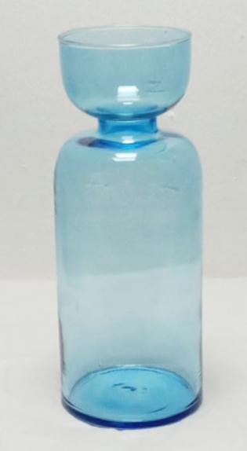
ITEM NO-G-028
SIZE (INCH)-H-12X BD-4.5“-5.6$
Size (inch) 7d*14ht- 6.44$

Slide 11
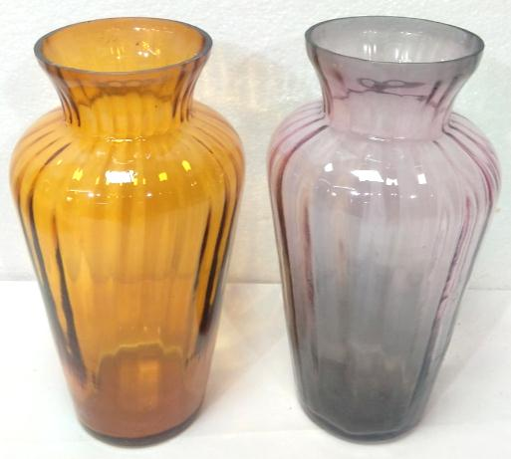
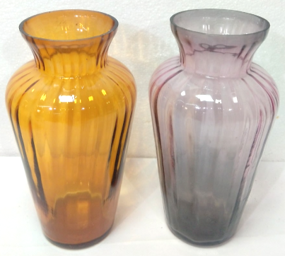
Item no :- Ul-1089
Size ( INCH ) :- H 8/D 4

Slide 12
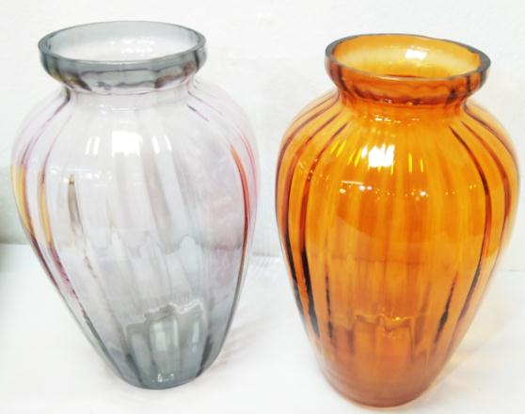
Item no :- Ul-1090
Size ( INCH ) :- H 10/D 6.5

Slide 13
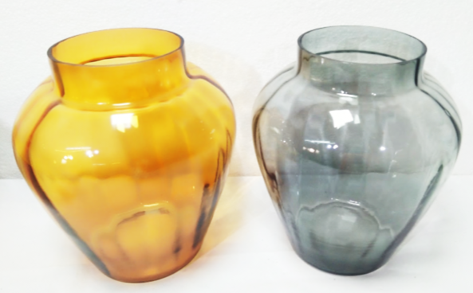
Item no :- Ul-1091
Size ( INCH ) :- H 8 /D 7

Slide 14
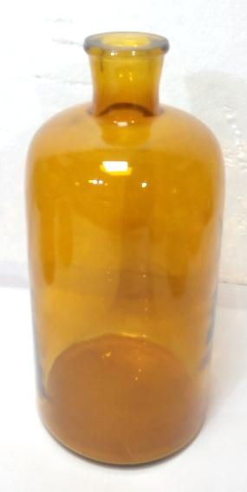
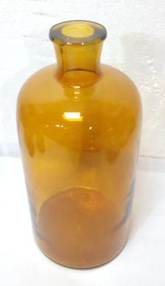
Item no :- Ul-0112
Size ( INCH ) :- H 11.41/D 5.31

Slide 15
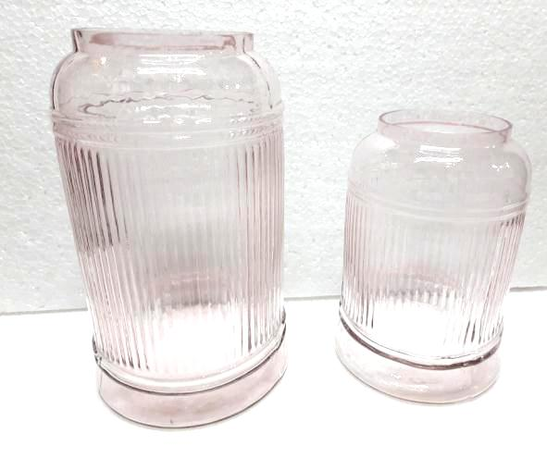
Item No. G 6621 Big
Desc. Vase
Size Inch Dia 6.5 x Ht 11
Wt. Kg.
Item No. G 6621 Small
Desc. Vase
Size Inch Dia 6x Ht 8.5
Wt. Kg.

Slide 16
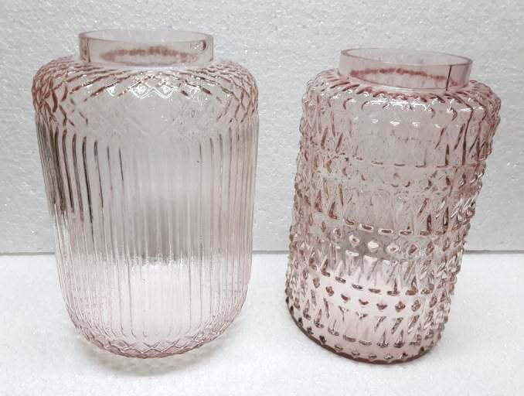
Item No. G 6622
Desc. Vase
Size Inch Dia 7 x Ht 10.25
Wt. Kg.
Item No. G 6622
Desc. Vase
Size Inch Dia 6.5x Ht 10
Wt. Kg.

Slide 17
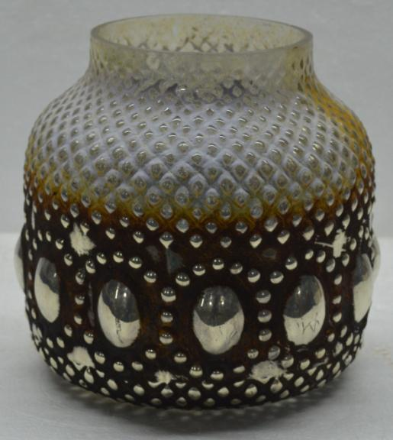
Item No. : G-20121
Size (CM) : Dia 15 x Ht. 15
Wt. : 0.700 Kg.

Slide 18
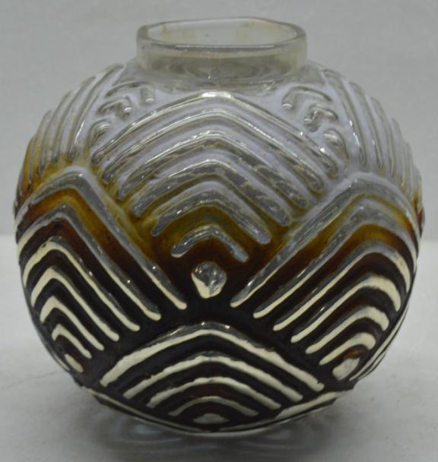
Item No. : G-20123
Size (CM) : Dia 15 x Ht. 15
Wt. : 0.650 Kg.

Slide 19
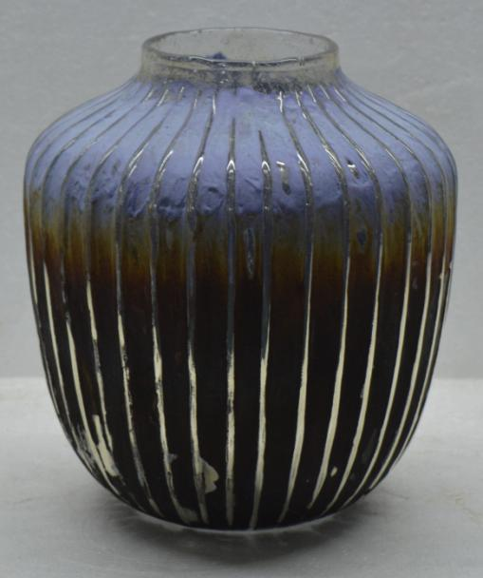
Item No. : G-20126
Size (CM) : Dia 17 x Ht. 20
Wt. : 1.050 Kg.

Slide 20
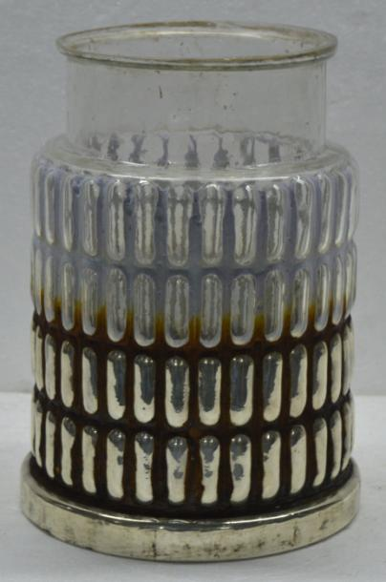
Item No. : G-20133
Size (CM) : Dia 16 x Ht. 23
Wt. : 1.500 Kg.

Slide 21
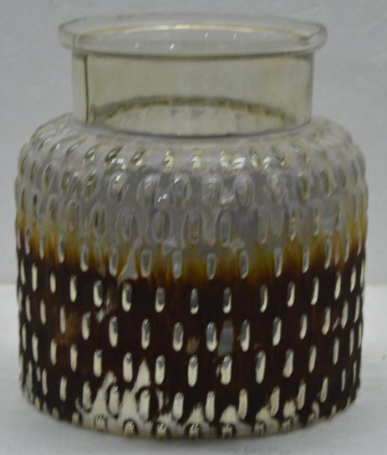
Item No. : G-20134
Size (CM) : Dia 17 x Ht. 18
Wt. : 1.000 Kg.

Slide 22
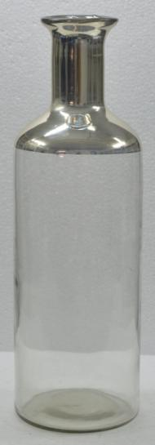
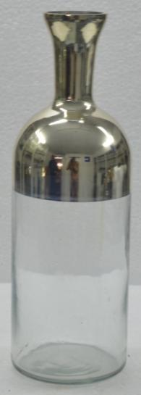
Item No. : G-20892
Size (CM) : Dia 15 x Ht. 45
Wt. : 1.920 Kg.
Item No. : G-20893
Size (CM) : Dia 10 x Ht. 32
Wt. : 0.770 Kg.

Slide 23
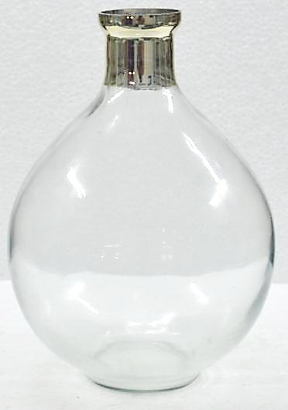
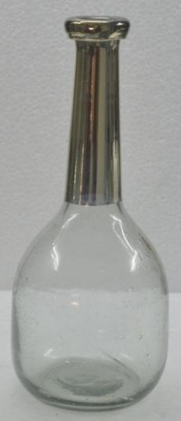
Item No. : G-20894
Size (CM) : Dia 22 x Ht. 28.5
Wt. : 1.420 Kg.
Item No. : G-20895
Size (CM) : Dia 13 x Ht. 29.5
Wt. : 0.748 Kg.

Slide 24
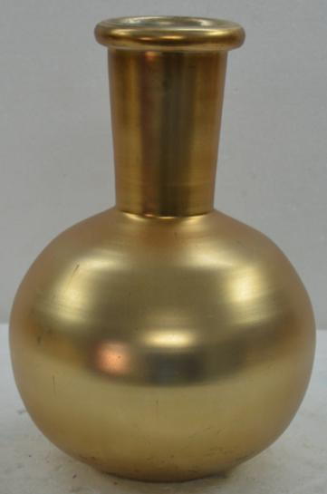
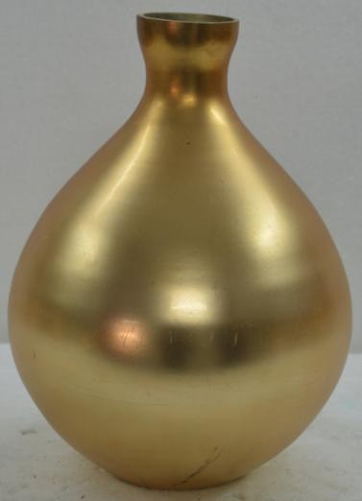
Item No. : G-20501
Size (CM) : Dia 16 x Ht. 23.5
Wt. : 0.588 Kg.
Item No. : G-20502
Size (CM) : Dia 17 x Ht. 23.5
Wt. : 0.728 Kg.

Slide 25
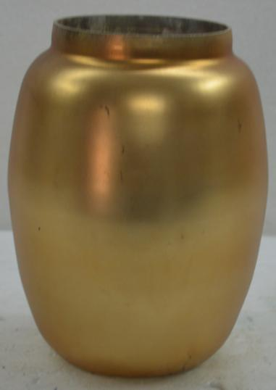
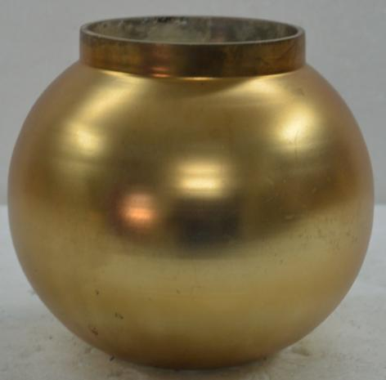
Item No. : G-20503
Size (CM) : Dia 15 x Ht. 13.5
Wt. : 0.514 Kg.
Item No. : G-20504
Size (CM) : Dia 13 x Ht. 16.5
Wt. : 0.350 Kg.

Slide 26
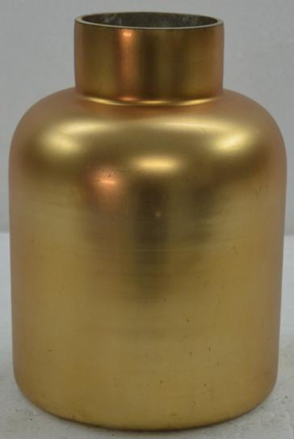
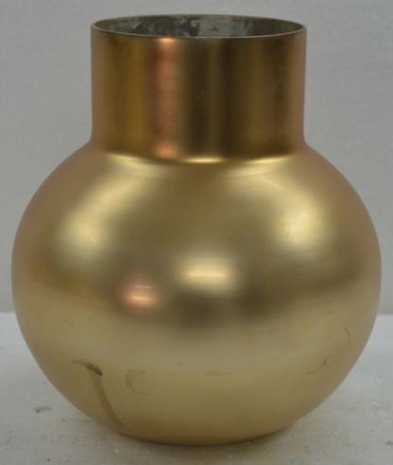
Item No. : G-20505
Size (CM) : Dia 12 x Ht. 16.5
Wt. : 0.400 Kg.
Item No. : G-20500
Size (CM) : Dia 19.5 x Ht. 21.5
Wt. : 0.646 Kg.

