Slide 1
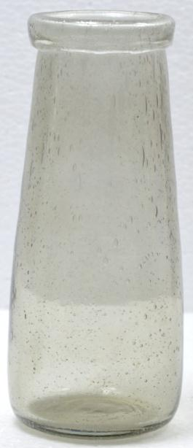
Item No. : VS091
Size (CM) : Dia 9 x Ht. 15

Slide 2
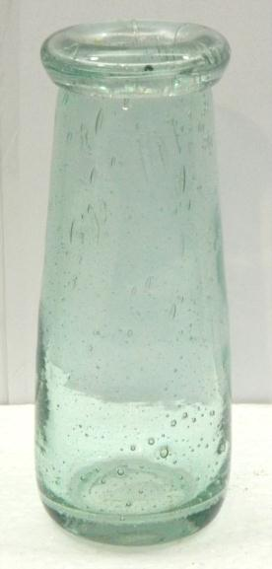
Item No. : VS092
Size (cm) : Dia 9 x Ht19

Slide 3
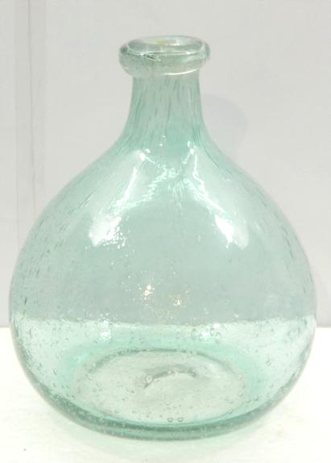
Item No. : VS093
Size (cm) : Dia 18 x Ht 22

Slide 4
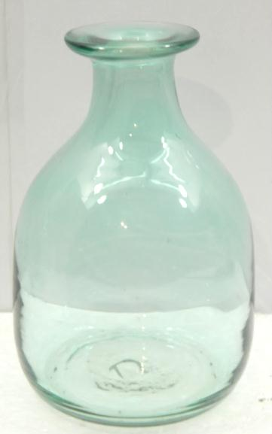
Item No. : VS094
Size (cm) : Dia 8 x Ht 12

Slide 5
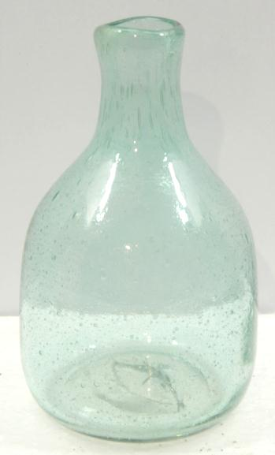
Item No. : VS095
Size (cm) : Dia 12 x Ht20.5

Slide 6
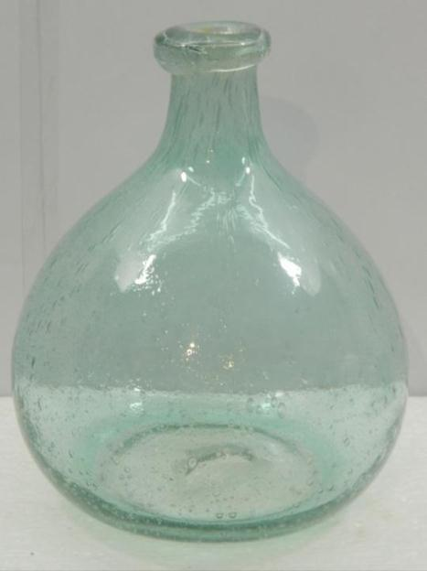
Item No. : VS096
Size (cm) : Dia 18 x Ht 22

Slide 7
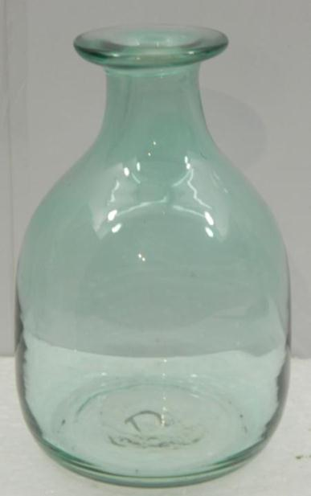
Item No. : VS097
Size (cm) : Dia 8 x Ht 12

Slide 8
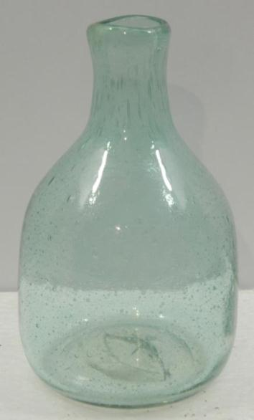
Item No. : VS098
Size (cm) : Dia 8 x Ht12

Slide 9
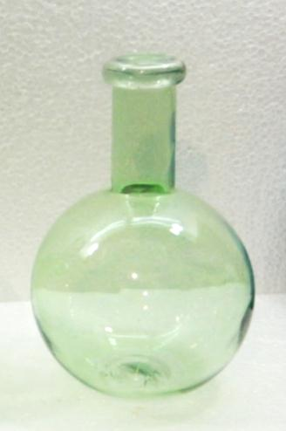
Item No. : VS099
Size (cm) : Dia 15 x Ht 22

Slide 10
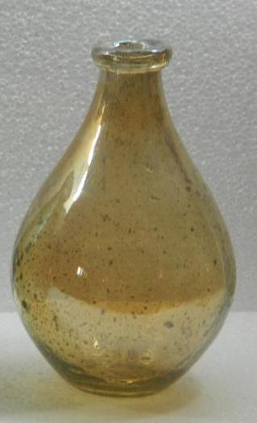
Item No. : VS100
Size (CM) : Dia 17 x Ht 22

Slide 11
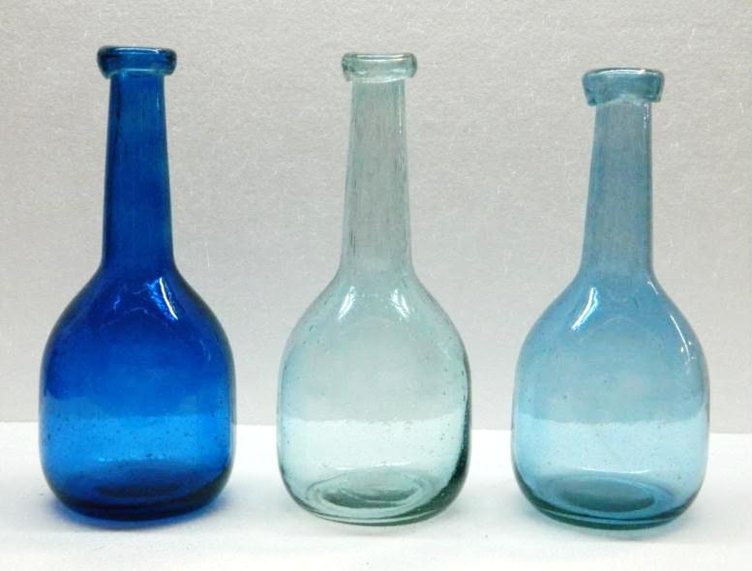
Item No. VS101
Size cm Dia12 x Ht27.5

Slide 12
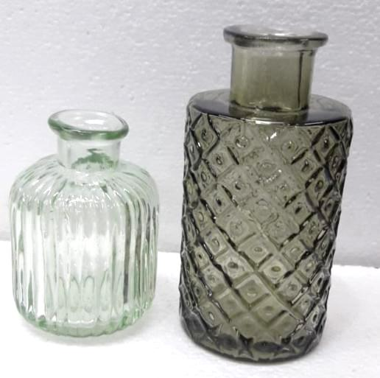
Item No. VS101B
Size cm Dia12 x Ht27.5

Slide 13
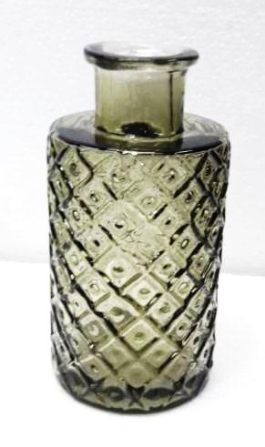
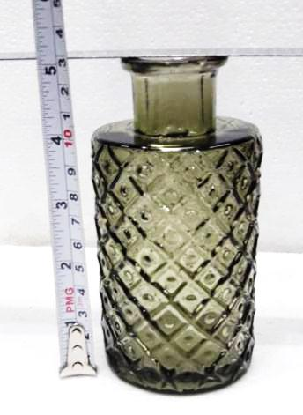
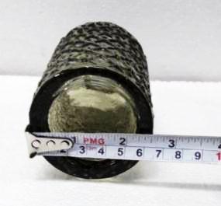
Item No. VS102
Size cm Dia6.25 x Ht12.5

Slide 14
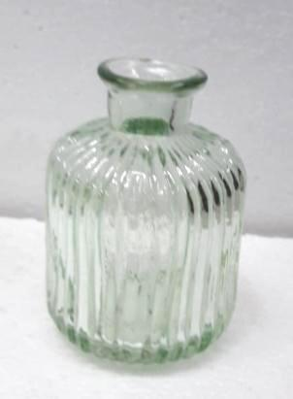
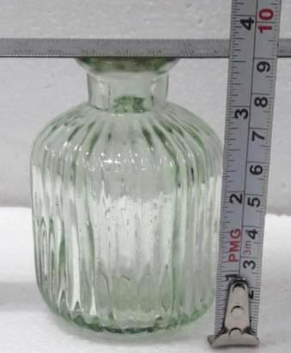
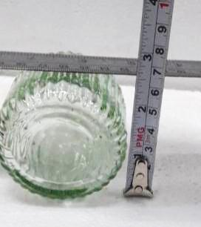
Item No. VS103
Size cm Dia6.87 x Ht8.7

Slide 15
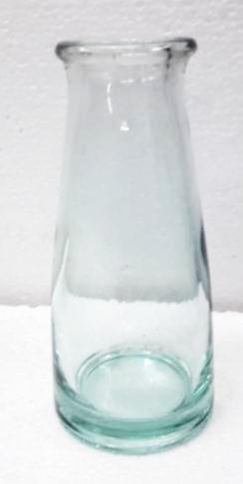
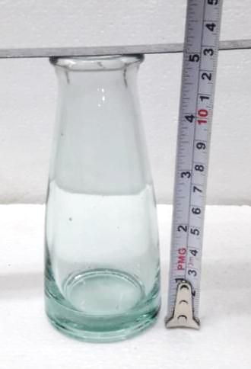
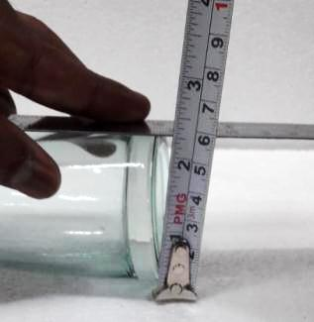
ITEM NO –VS104
SIZE (CM)D-5.6 H-12.5

