Slide 1
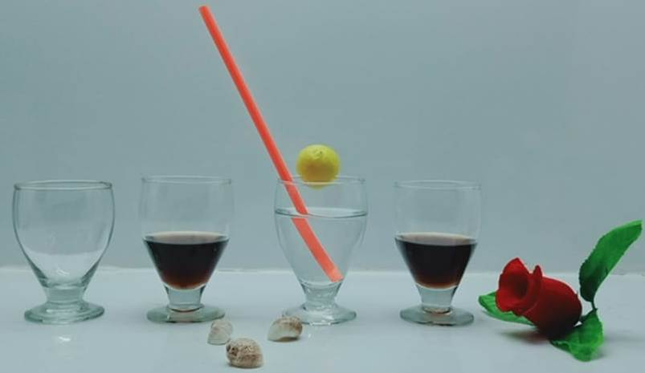
ITEM NO- G4012
SIZE(INCH)-HT4.25 ” /D2.5 “
ITEM NO- G4013
SIZE(INCH)-HT 4.25 ” /D2.5 “
ITEM NO- G4011
SIZE(INCH)-HT4 ” /D “2.5
ITEM NO- G4014
SIZE(INCH)-HT 4.25 ” /D2.5 “

Slide 2
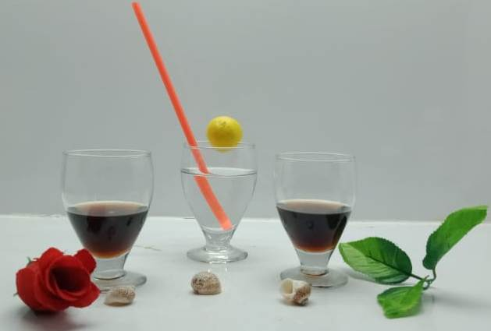
Item no-G4015
Size(inch):h4.25 /d2.5
Item no-G4016
Size(inch):h4.25 /d2.5
Item no-G4017
Size(inch):h 4.25/d2.5

Slide 3
ITEM NO- G4018
SIZE(INCH)-HT4.5 ” /D2.5 “
ITEM NO- G4019
SIZE(INCH)-HT4.5 ” /D2.5 “
ITEM NO- G4019
SIZE(INCH)-HT4.5 ” /D2.5 “

Slide 4
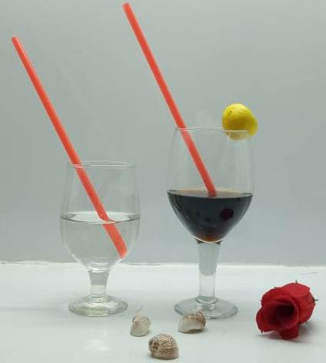
ITEM NO- G4020
SIZE(INCH)-HT 7 ” /D2.75 “
ITEM NO- G4021
SIZE(INCH)-HT 5.5 ” /D2.5 “

Slide 5
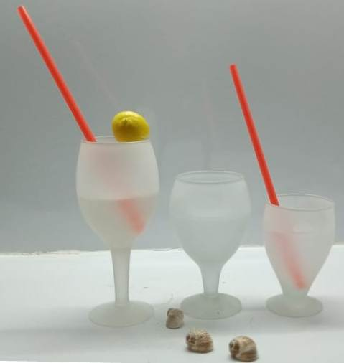
ITEM NO- G4022
SIZE(INCH)-HT6.75 ” /D2.75 “
ITEM NO- G4023
SIZE(INCH)-HT 5.25 ” /D3 “
ITEM NO- G4024
SIZE(INCH)-HT 4.25 ” /D2.75 “

Slide 6
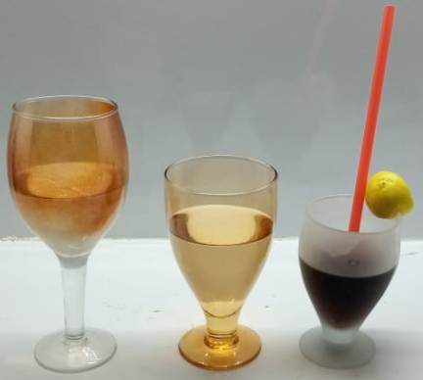
ITEM NO- G4025
SIZE(INCH)-HT 7 ” /D3 “
ITEM NO- G4026
SIZE(INCH)-HT5.75 ” /D 2.75“
ITEM NO- G4027
SIZE(INCH)-HT4.25 ” /D2.75 “

Slide 7
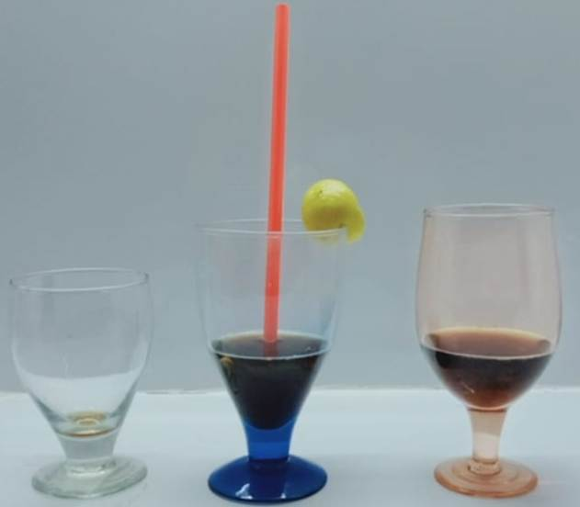
ITEM NO- G4028
SIZE(INCH)-HT4.252.5 ” /D “
ITEM NO- G4029
SIZE(INCH)-HT 5.25 ” /D3 “
ITEM NO- G4030
SIZE(INCH)-HT5.5 ” /D2.75 “

Slide 8
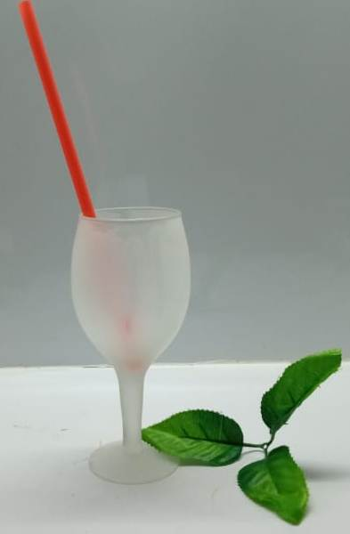
ITEM NO- G4031
SIZE(INCH)-HT 6.75 ” /D 2.75 “

Slide 9
ITEM NO- G4032
SIZE(INCH)-HT 4.25 ” /D 2.75 “

Slide 10
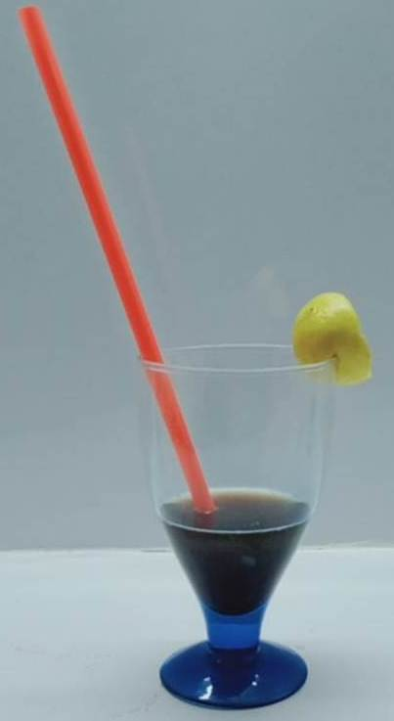
ITEM NO- G4033
SIZE(INCH)-HT 5.25” /D 3“

Slide 11
ITEM NO- G4034
SIZE(INCH)-HT7.25”/DIA 3.25 ”
Cm - HT /DIA
WT--------0.229 KG
ITEM NO- G4035
SIZE(INCH)-HT5.8 ”/DIA 3.1 ”
Cm - HT /DIA
WT--------0.136 KG

Slide 12
ITEM NO- G4036
SIZE(INCH)-HT 6.5”/DIA 2.1 ”
Cm - HT /DIA
WT--------0.119 KG
ITEM NO- G4037
SIZE(INCH)-HT5.75 ”/DIA 3 ”
Cm - HT /DIA
WT--------0 .144 KG

Slide 13
ITEM NO- G4038
SIZE(INCH)-HT5.75 ”/DIA 3.25 ”
Cm - HT /DIA
WT--------0.136 KG
ITEM NO- G4039
SIZE(INCH)-HT5.5 ”/DIA 3.25 ”
Cm - HT /DIA
WT--------0.136 KG

Slide 14
ITEM NO- G4040
SIZE(INCH)-HT 4.8”/DIA 2.5 ”
Cm - HT /DIA
WT--------0.098 KG
ITEM NO- G4041
SIZE(INCH)-HT 4.5”/DIA 3.5 ”
Cm - HT /DIA
WT--------0 .135 KG

Slide 15
ITEM NO- G4042
SIZE(INCH)-HT 4.1”/DIA 2.75 ”
Cm - HT /DIA
WT--------0.106 KG

Slide 16
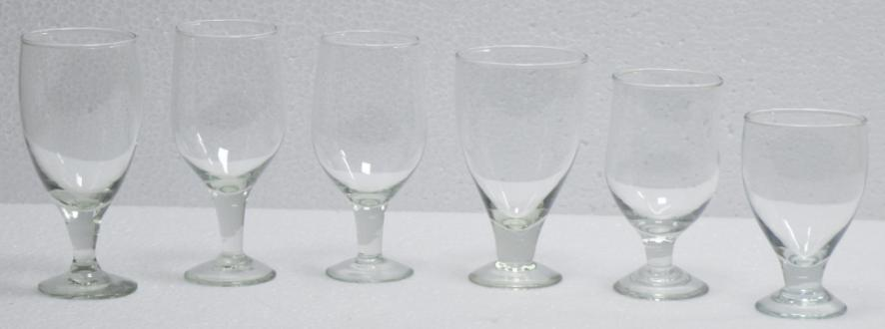
Item No. : Group

Slide 17
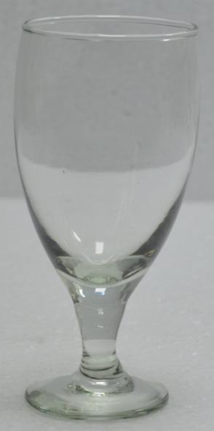
Item No. : G-18297
Size (CM) : Dia 7 x Ht. 14.5
Wt. : 0.146 Kg.

Slide 18
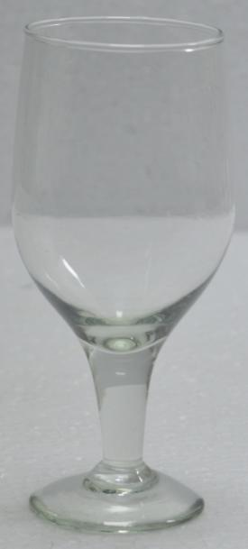
Item No. : G-18298
Size (CM) : Dia 6.5 x Ht. 14.5
Wt. : 0.095 Kg.

Slide 19
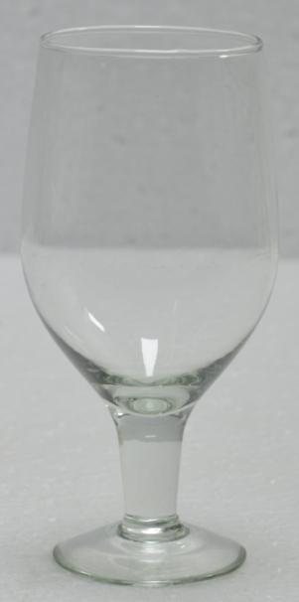
Item No. : G-18299
Size (CM) : Dia 6.5 x Ht. 14
Wt. : 0.085 Kg.

Slide 20
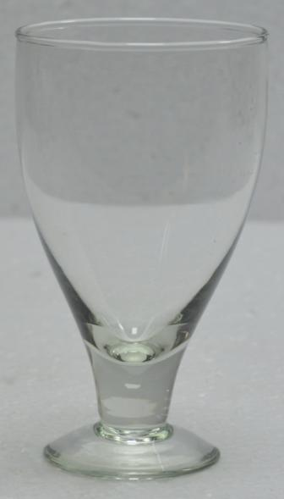
Item No. : G-18300
Size (CM) : Dia 7.5 x Ht. 13
Wt. : 0.134 Kg.

Slide 21
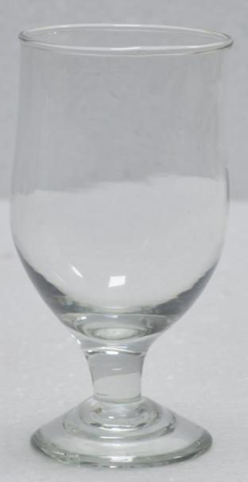
Item No. : G-18301
Size (CM) : Dia 6.5 x Ht. 12
Wt. : 0.121 Kg.

Slide 22
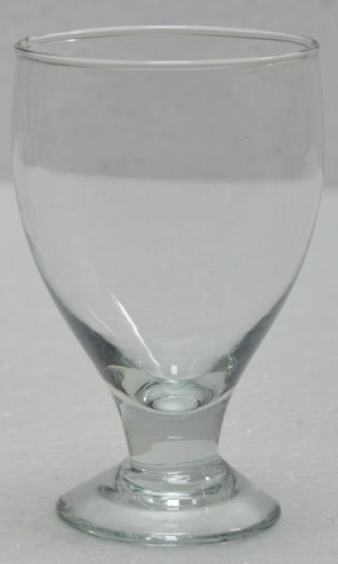
Item No. : G-18302
Size (CM) : Dia 7 x Ht. 11
Wt. : 0.098 Kg.

Slide 23
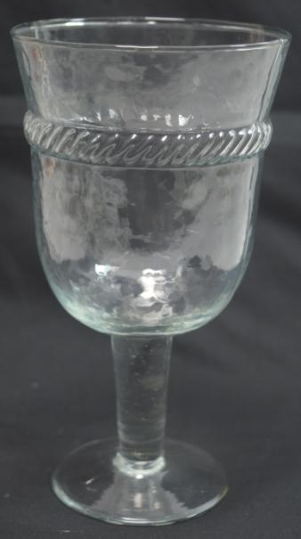
Item No. : G-19675
Size Inch Dia 3.75 h 8.25”
.

Slide 24
ITEM NO : MG 2119 SIZE(INCH)-H-9”/D-5”

Slide 25
ITEM NO : MG 2121 SIZE(INCH)-H-10”/D-5.75”

