Slide 1
Church Women United – Milwaukee Unit
100th Anniversary
1921 - 2021

Slide 2
Church Women United – Milwaukee Unit
Agreed to Differ,
Resolved to Love,
United to Serve

Slide 3
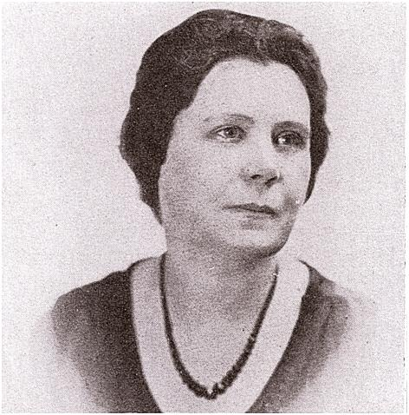
Church Women United – Milwaukee Unit
100th Anniversary Celebration
Past Presidents
Mrs. Clinton M. Barr
1921 – 1922

Slide 4
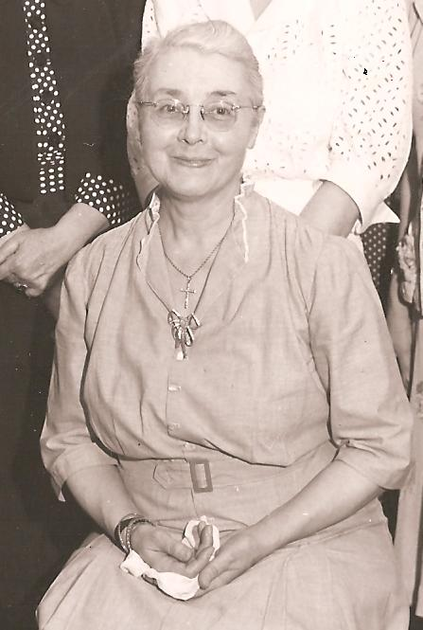
Church Women United – Milwaukee Unit
100th Anniversary Celebration
Past Presidents
Miss Mary Clarkson
1922 – 1927

Slide 5
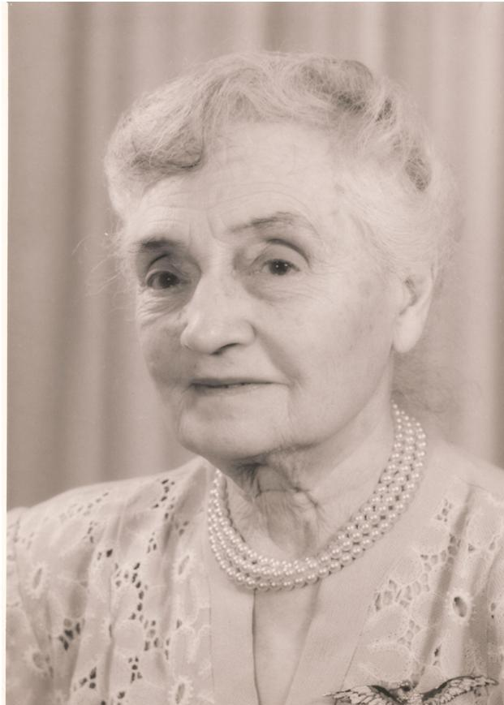
Church Women United – Milwaukee Unit
100th Anniversary Celebration
Past Presidents
Mrs. C. G. Junkermann
1927 – 1930

Slide 6
Church Women United – Milwaukee Unit
100th Anniversary Celebration
Past Presidents
Mrs. Abram LeGrand
1930 – 1934

Slide 7
Church Women United – Milwaukee Unit
100th Anniversary Celebration
Past Presidents
Rev. Ada L. Forster
1934 –1935

Slide 8
Church Women United – Milwaukee Unit
100th Anniversary Celebration
Past Presidents
Mrs. Sylvia DeGelleke
1935 - 1939

Slide 9
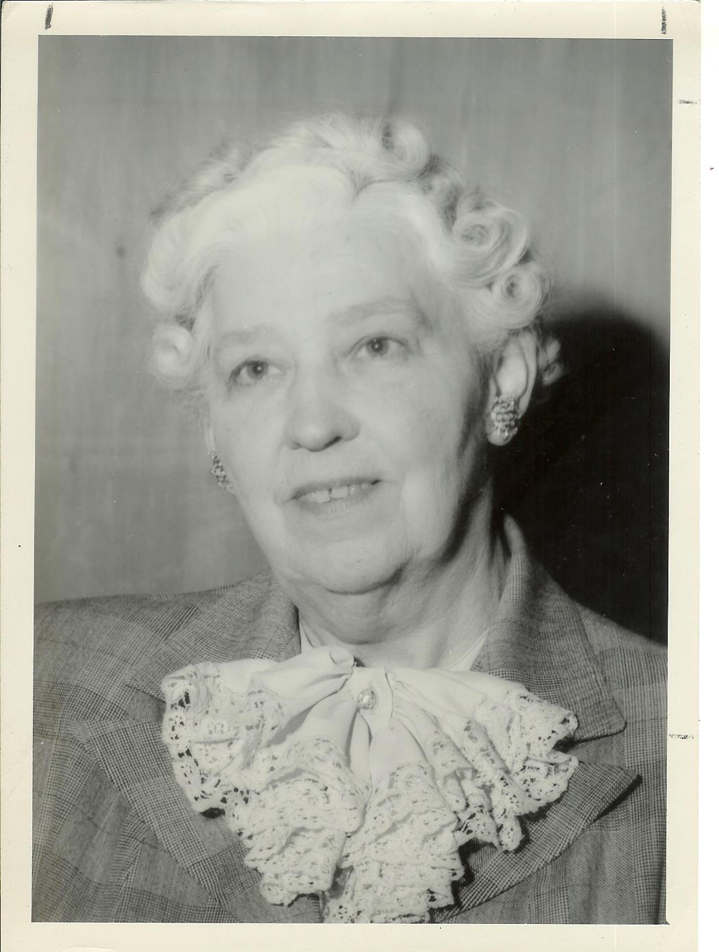
Church Women United – Milwaukee Unit
100th Anniversary Celebration
Past Presidents
Mrs. B. R. Dennis
1939 - 1943

Slide 10
Church Women United – Milwaukee Unit
100th Anniversary Celebration
Past Presidents
Mrs. William Tonkin
1943 - 1947

Slide 11
Church Women United – Milwaukee Unit
100th Anniversary Celebration
Past Presidents
Mrs. Luella Rilling
1947 - 1951

Slide 12
Church Women United – Milwaukee Unit
100th Anniversary Celebration
NO PHOTOS AVAILABLE
Mrs. Stanley Brown 1951 – 1953
Mrs. Nola Frick 1953 – 1955
Mrs. Bertha J. Candy 1955 – 1959
Mrs. Irma E.. Estes 1959 – 1961
Past Presidents

Slide 13
Church Women United – Milwaukee Unit
100th Anniversary Celebration
Past Presidents
Mrs. Margaret Jean Bond
1961 - 1964

Slide 14
Church Women United – Milwaukee Unit
100th Anniversary Celebration
Past Presidents
Mrs. Mary E. Williams 1964 –1966
Mrs. Grace Abramson 1966 –1969
NO PHOTOS AVAILABLE

Slide 15
Church Women United – Milwaukee Unit
100th Anniversary Celebration
Past Presidents
Mrs. George Wayman
1969 – 1972

Slide 16
Church Women United – Milwaukee Unit
100th Anniversary Celebration
Past Presidents
Mrs. Lois Tice
1972 - 1975

Slide 17
Church Women United – Milwaukee Unit
100th Anniversary Celebration
NO
PHOTO
AVAILABLE
Past Presidents
Mrs. Dorothy Henrich
1975 - 1978

Slide 18
Church Women United – Milwaukee Unit
100th Anniversary Celebration
Past Presidents
Mrs. Sophia Shane
1978 - 1981

Slide 19
Church Women United – Milwaukee Unit
100th Anniversary Celebration
Past Presidents
Mrs. Alice Simpkins 1981 – 1984
Mrs. Grace Abramson 1984 – 1988
NO PHOTOS AVAILABLE

Slide 20
Church Women United – Milwaukee Unit
100th Anniversary Celebration
Past Presidents
Mrs. Mabel Blackmon
1988 - 1991

Slide 21
Church Women United – Milwaukee Unit
100th Anniversary Celebration
Past Presidents
Mrs. Lois Tice
1991 - 1994

Slide 22
Church Women United – Milwaukee Unit
100th Anniversary Celebration
Past Presidents
Mrs. Dorothy Brand
1994 - 1997

Slide 23
Church Women United – Milwaukee Unit
100th Anniversary Celebration
Past Presidents
Mrs. Willodine H. Carter
1997 - 2003

Slide 24
Church Women United – Milwaukee Unit
100th Anniversary Celebration
Past Presidents
NO PHOTO
Mrs. Eleanor Ford
2004 - 2005
AVAILABLE

Slide 25
Church Women United – Milwaukee Unit
100th Anniversary Celebration
Past Presidents
Ms. Lois Olsen
2006 - 2013

Slide 26
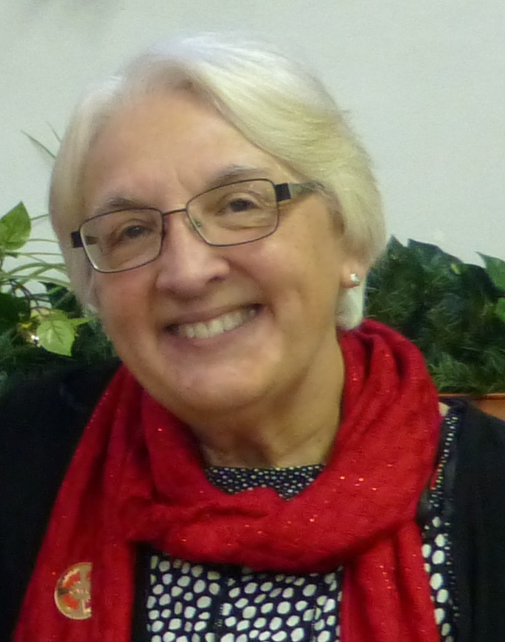
Church Women United – Milwaukee Unit
100th Anniversary Celebration
Past Presidents
Ms. Marilyn Stone
2014 - 2017

Slide 27
Church Women United – Milwaukee Unit
100th Anniversary Celebration
Past Presidents
Dr. Wilma Spann
2017 - 2020

Slide 28
Church Women United – Milwaukee Unit
100th Anniversary Celebration
Name Changes
1921 - Federated Church Women of Milwaukee County
1939 - Milwaukee County Council of Church Women
1951 - United Church Women of the Milwaukee Area
1967 - Church Women United in the Milwaukee Area
Currently – Church Women United – Milwaukee Unit

Slide 29
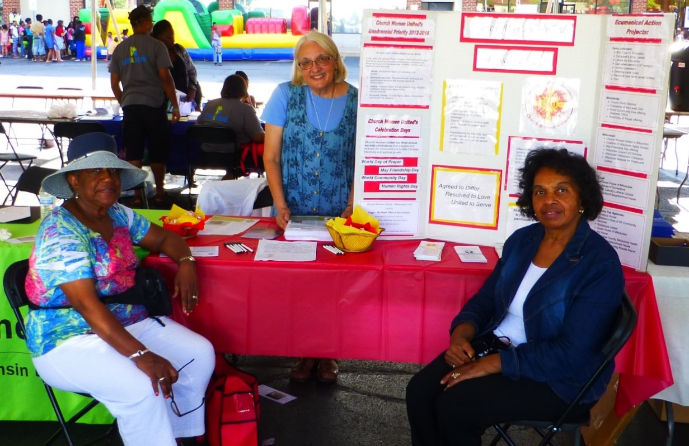
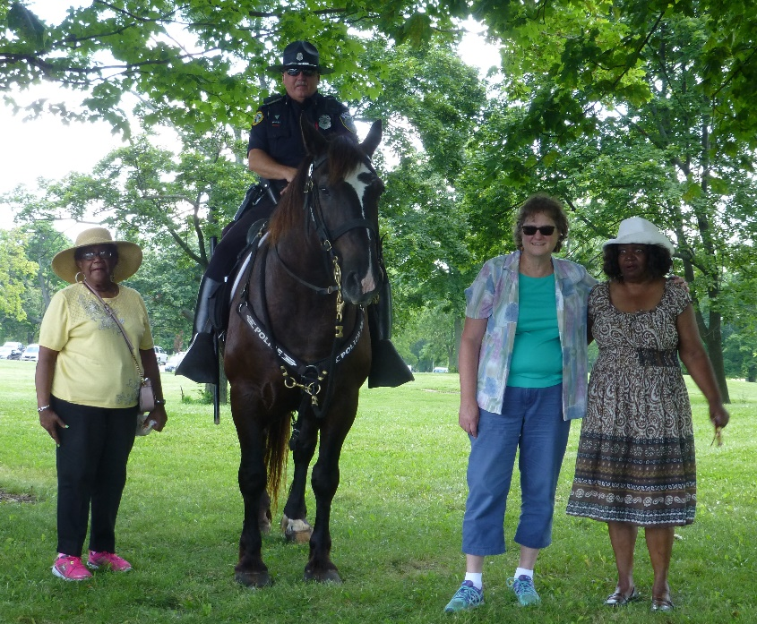
Church Women United – Milwaukee Unit
100th Anniversary Celebration
National Night Out Police District #3

Slide 30
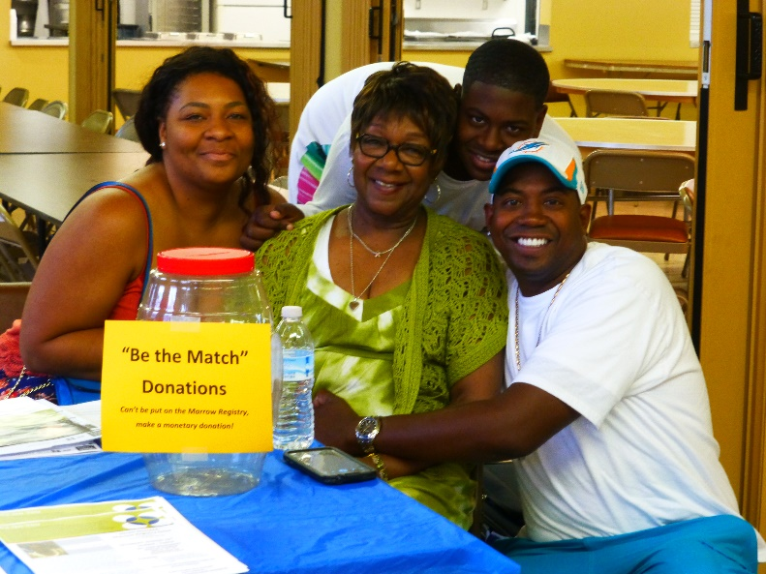
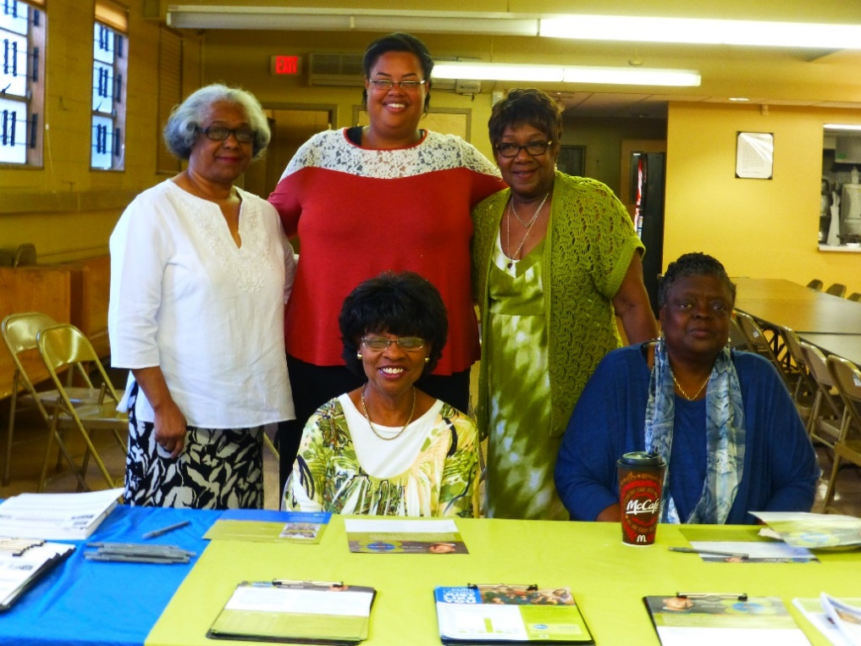
Church Women United – Milwaukee Unit
100th Anniversary Celebration
“Be the Match”
Donor Registry
Bone Marrow Drive

Slide 31
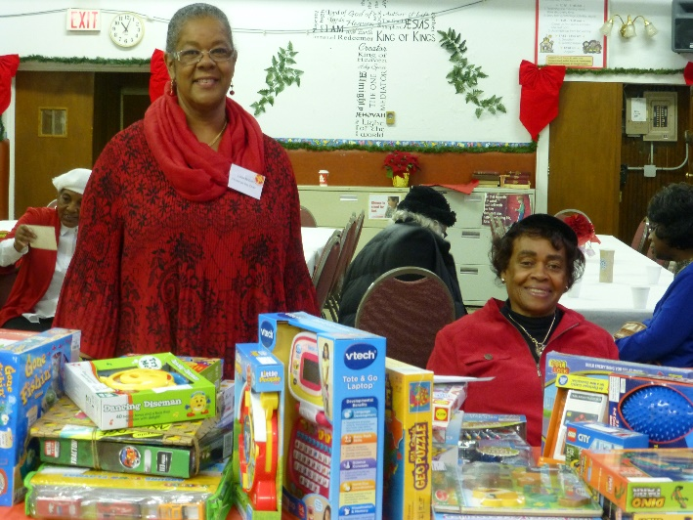
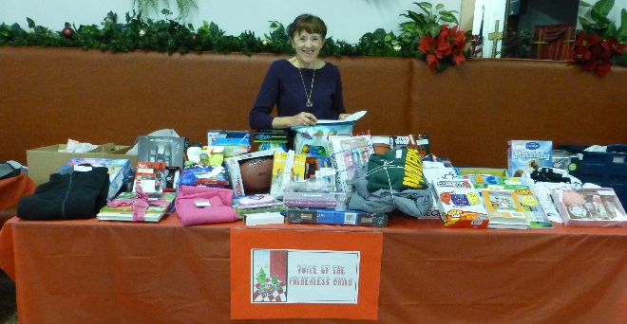
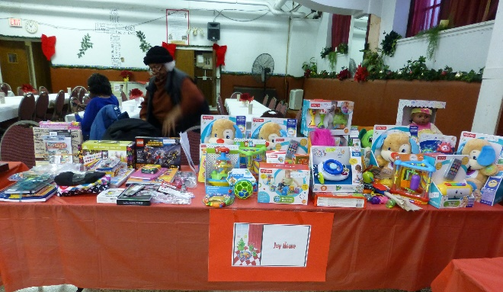
Church Women United – Milwaukee Unit
100th Anniversary Celebration
= Annual Christmas Tea =
Outreach to ten
local agencies

Slide 32
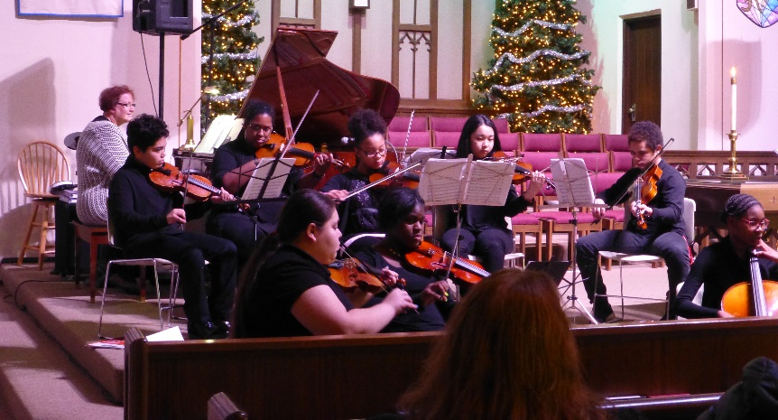
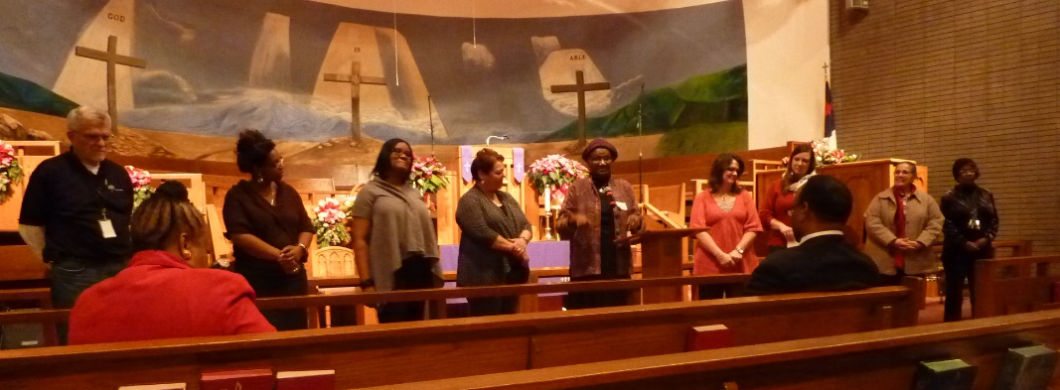
Church Women United – Milwaukee Unit
100th Anniversary Celebration
Christmas Tea Entertainment
Christmas Tea Agency Representatives

Slide 33
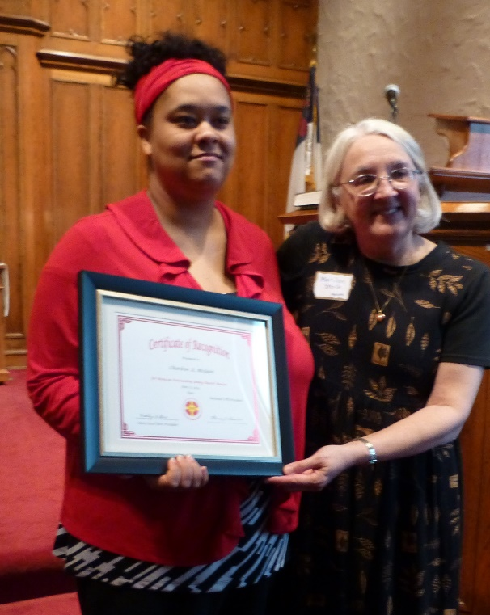
Church Women United – Milwaukee Unit
100th Anniversary Celebration
Young Church Women Award
Charlene McGuin
2014

Slide 34
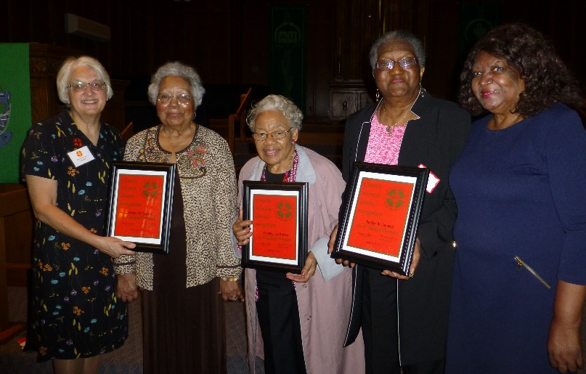
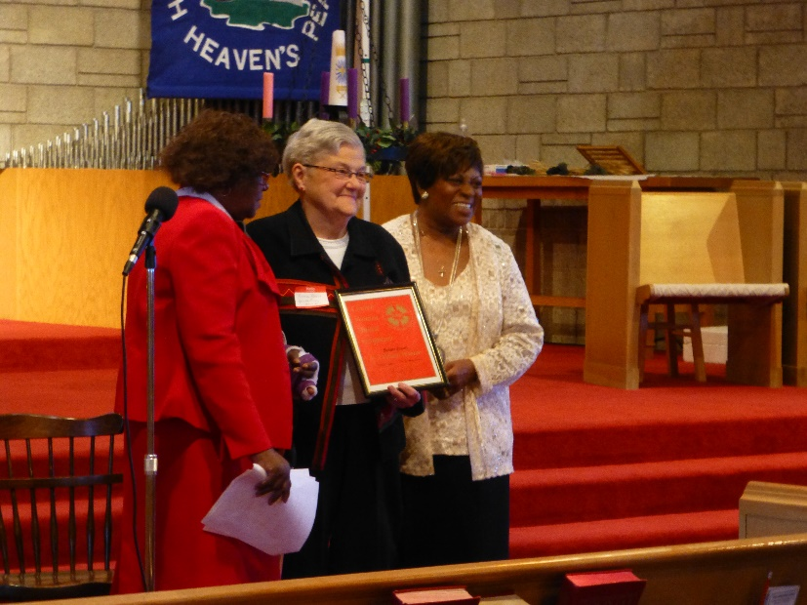
Church Women United – Milwaukee Unit
100th Anniversary Celebration
Valent Woman Awards
Ms. Lois Olsen
2006 - 2013

Slide 35
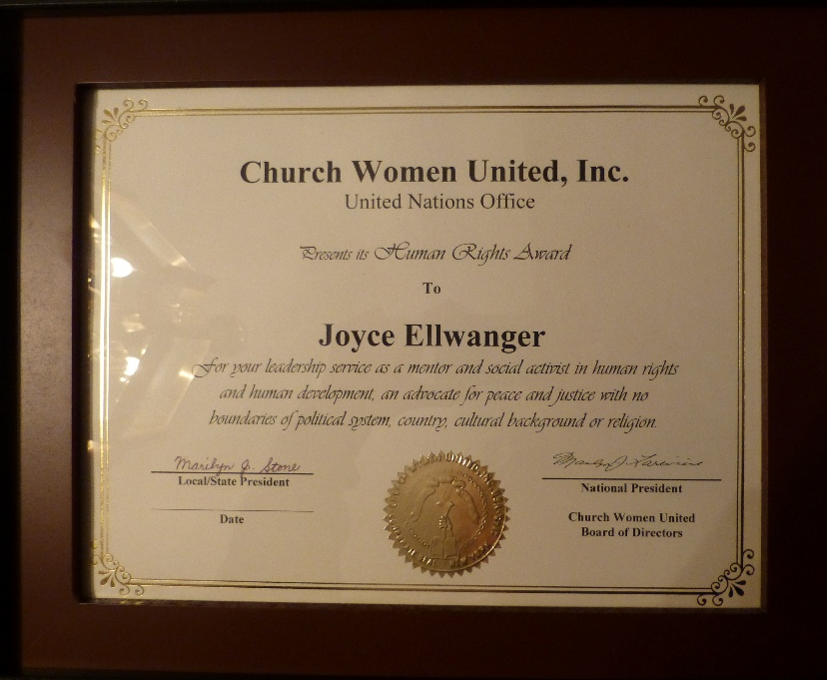
Church Women United – Milwaukee Unit
100th Anniversary Celebration
Joyce Ellwanger
2015
Human Rights
Award

Slide 36
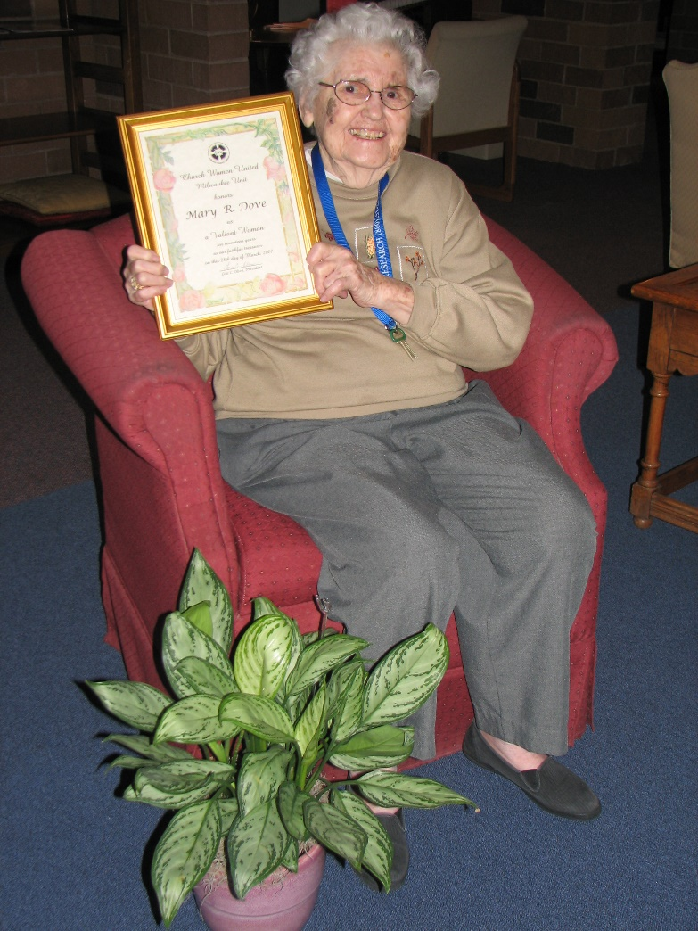
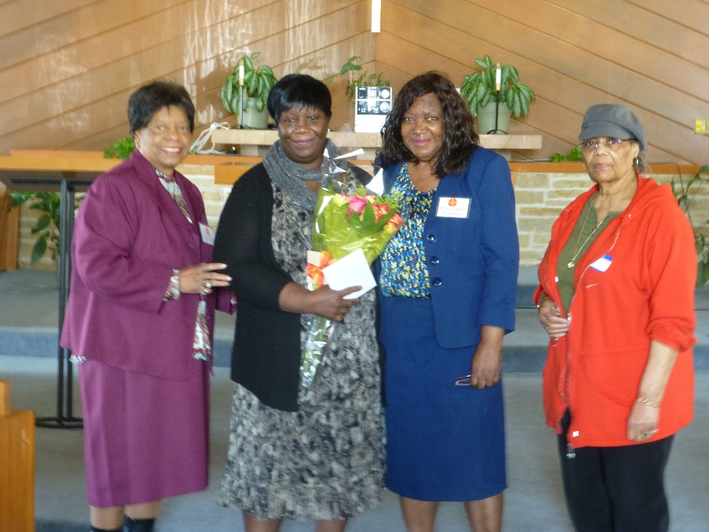
Church Women United – Milwaukee Unit
100th Anniversary Celebration
Della Ware – 2017
Retiring Secretary
Mary Dove – 2006
Retiring Treasurer

Slide 37
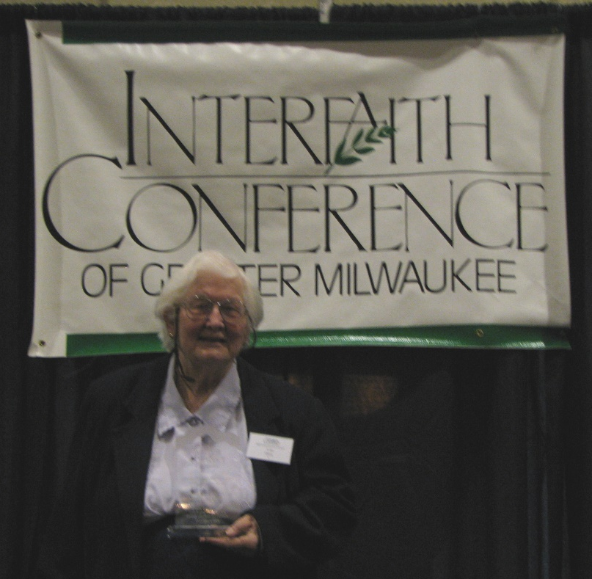
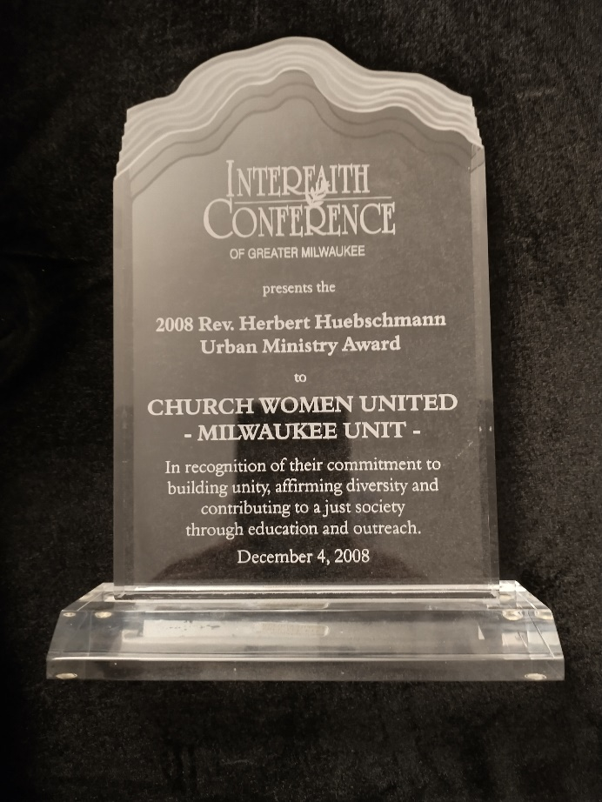
Church Women United – Milwaukee Unit
100th Anniversary Celebration
Interfaith Conference of Greater Milwaukee - 2008
Rev. Herbert Huebschmann
Urban Ministry Award
In recognition of their commitment to building unity, affirming diversity and contributing to a just society through education and outreach.
December 4, 2008

Slide 38
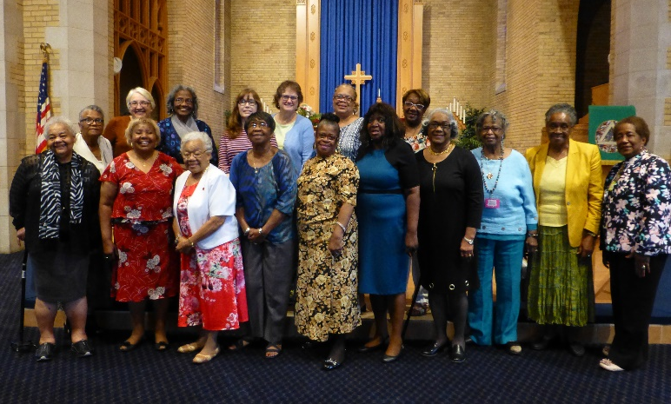
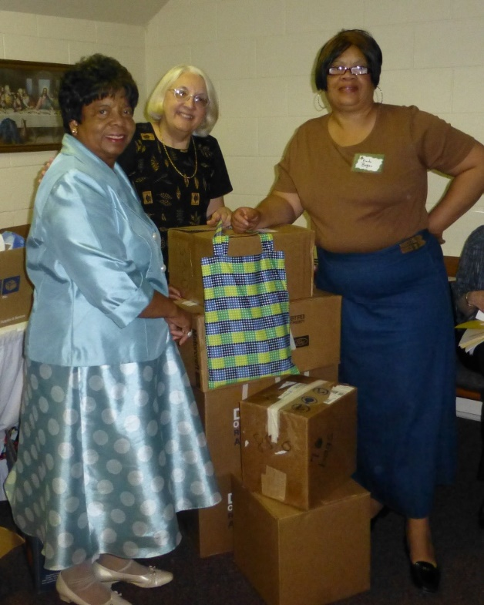
Church Women United – Milwaukee Unit
100th Anniversary Celebration
Attended CWU State Assembly Meetings
Collected Hygiene Kits for Church World Service
for CWU State Project

Slide 39
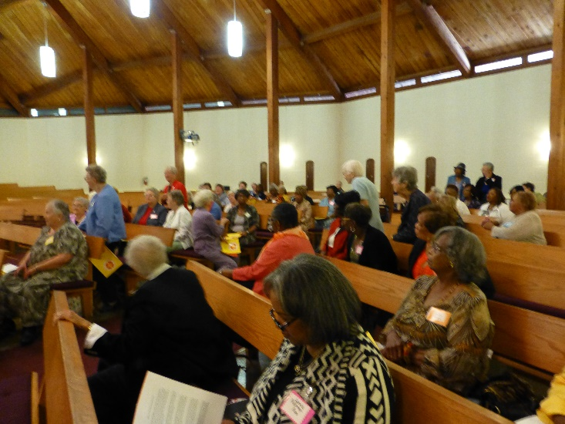
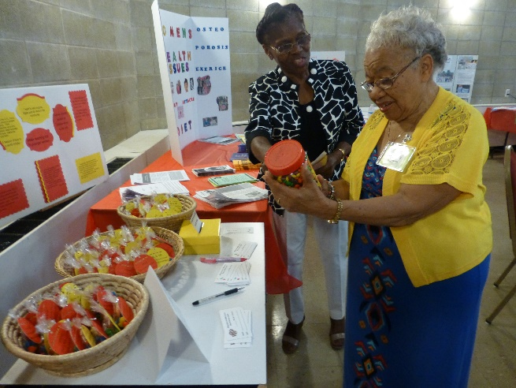
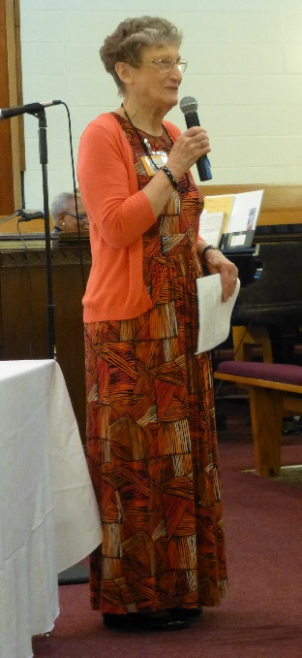
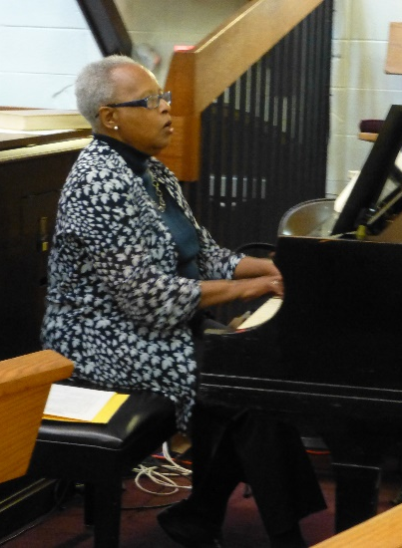
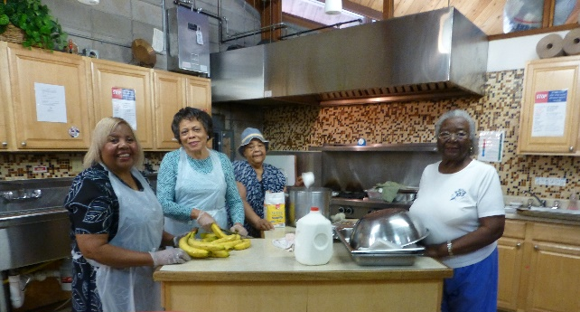
Church Women United – Milwaukee Unit
100th Anniversary Celebration
Hosted
CWU in Wisconsin
State Assembly
September 2016

Slide 40
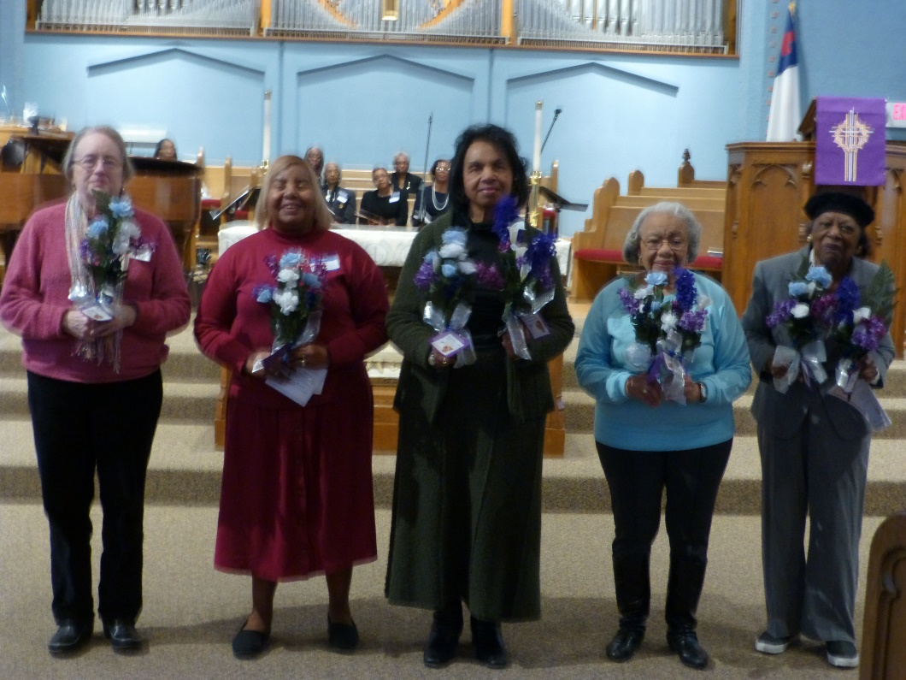
Church Women United – Milwaukee Unit
100th Anniversary Celebration
Remembering our CWU Sisters
with annual Services of Remembrance

Slide 41
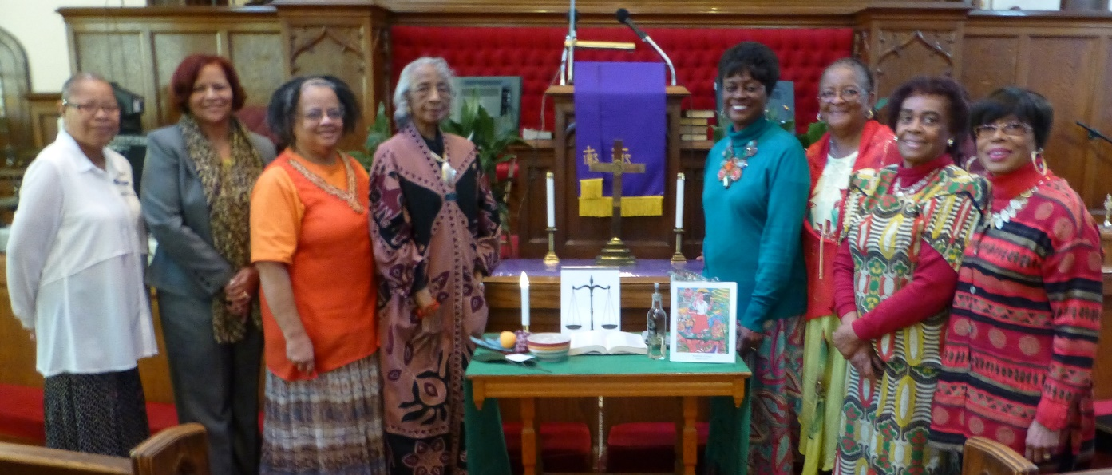
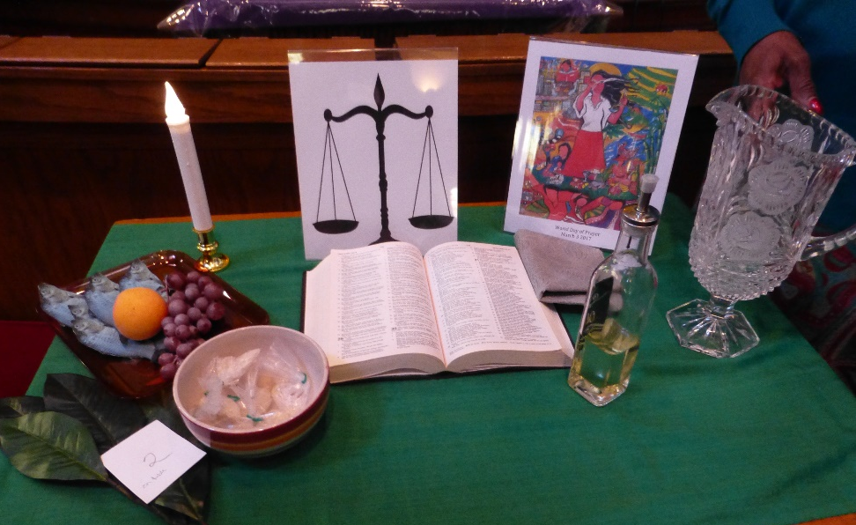
Church Women United – Milwaukee Unit
100th Anniversary Celebration
Celebrations
and
World Day of Prayer

Slide 42
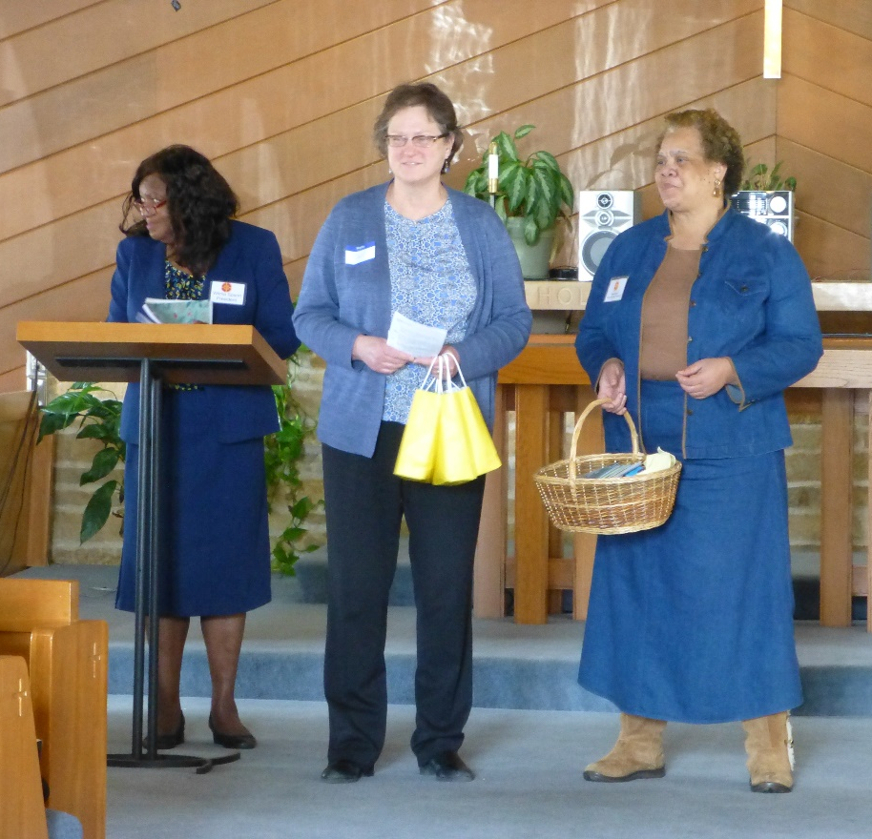
Church Women United – Milwaukee Unit
100th Anniversary Celebration
Celebrate monthly birthdays

Slide 43
Church Women United – Milwaukee Unit
100th Anniversary Celebration
Looking forward to the
next 100 years. . .

Slide 44
Church Women United – Milwaukee Unit
100th Anniversary Celebration
Looking forward to the next 100 years. . .

Slide 45
Church Women United – Milwaukee Unit
100th Anniversary Celebration
Current President
Ms. Marilyn Stone
2020 - Present

Slide 46
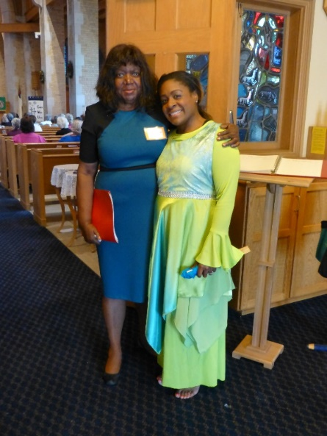
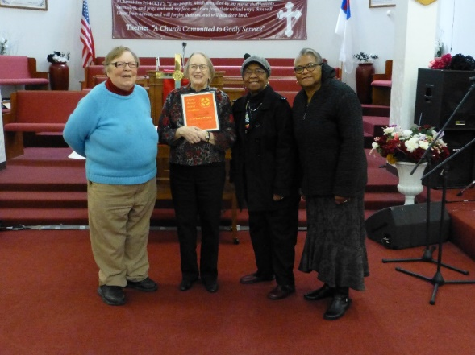
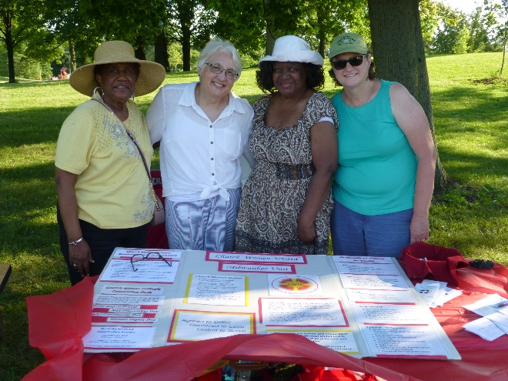

Slide 47
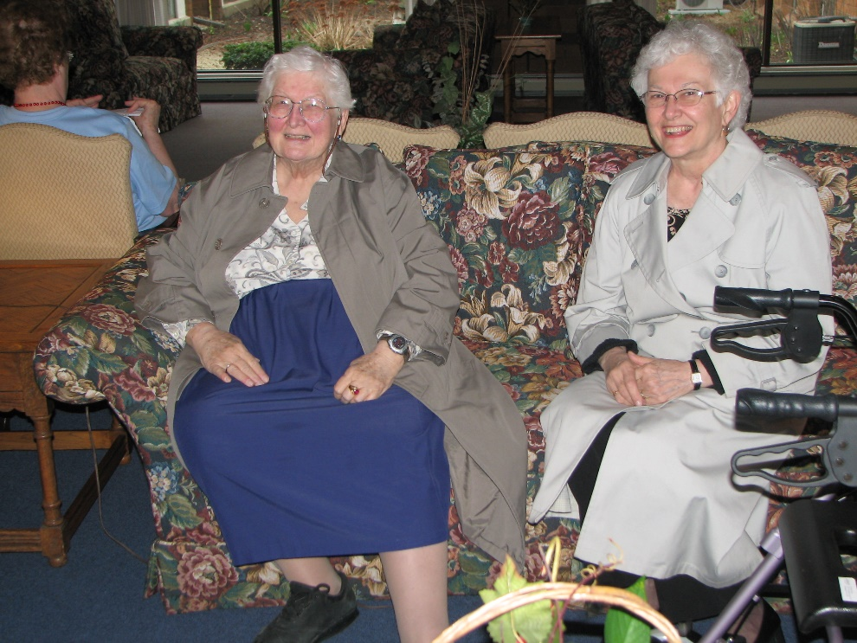
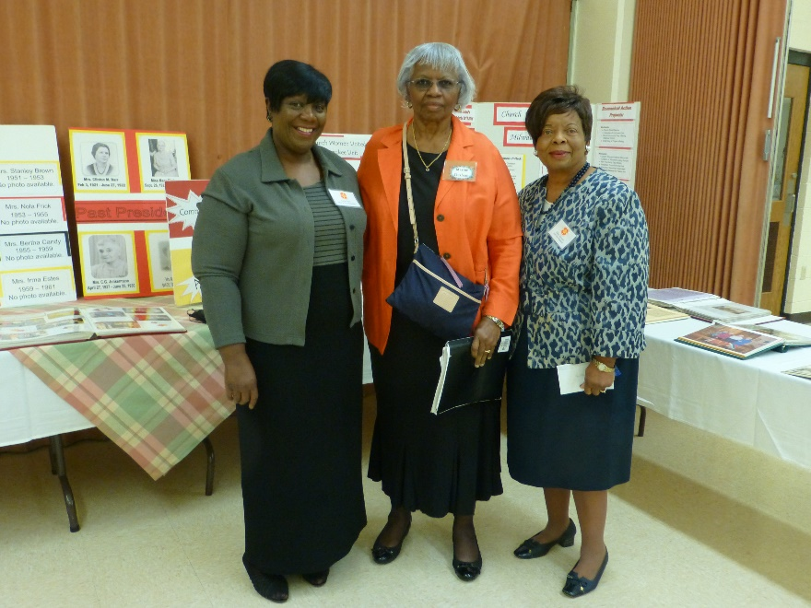
Church Women United – Milwaukee Unit
95th Anniversary Celebration
Past Presidents
Ms. Lois Olsen
2006 - 2013

Slide 48
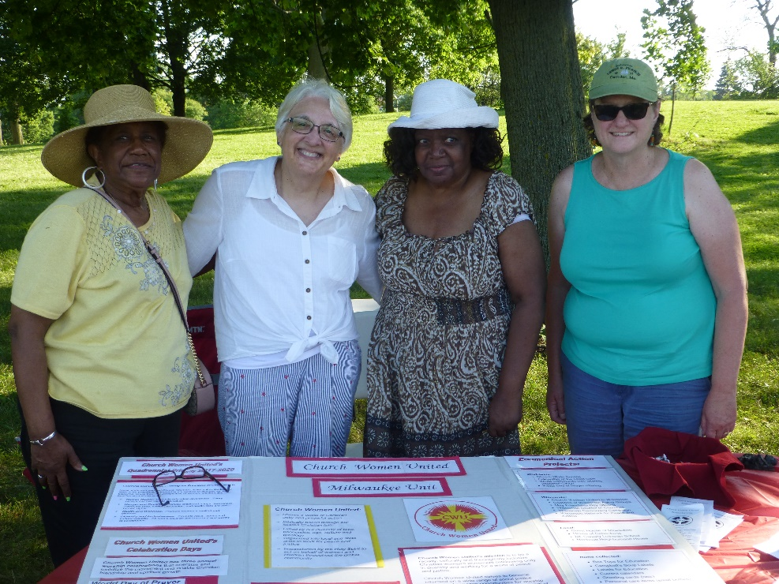
National Night Out
Police Districe #3

Slide 49
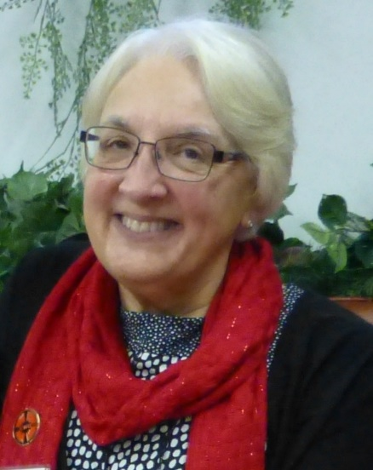
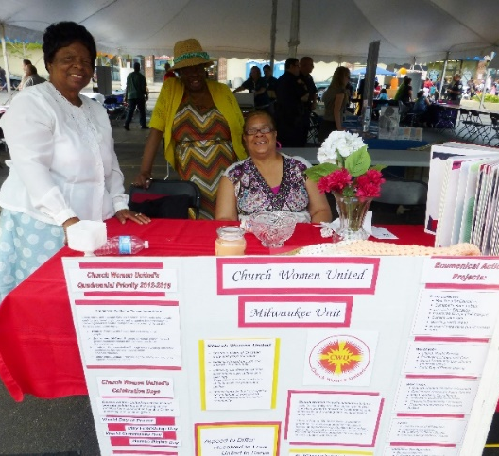

Slide 51
Church Women United – Milwaukee Unit
100th Anniversary Celebration

Slide 52
Church Women United – Milwaukee Unit
100th Anniversary Celebration

Slide 53
Church Women United – Milwaukee Unit

