Slide 1
WASHINGTON STATE Working Families
Tax Credit

Slide 2
About the program What is the credit?
A new tax credit for low-to-moderate income individuals and families enacted by EHB 1297.
Payments are based on income level and the number of qualifying children.
Applications open on February 1, 2023.

Slide 3
About the program Who qualifies?
Applicants must have:
Filed a federal income tax return as an individual or joint filer.
A valid Social Security Number (SSN) or Individual Taxpayer Identification Number (ITIN).
Qualified for the federal Earned Income Tax Credit.
Lived in Washington State for more than 183 days of the year.
Must be at least 25 years old and less than 65.

Slide 4
About the program Who qualifies?
Number of qualifying children | Applicant must make less than the following |  | Maximum credit amount
 | Single | Married (filing jointly)
0 | $16,480 | $22,610 | $300
1 | $43,492 | $49,622 | $600
2 | $49,399 | $55,529 | $900
3 or more | $53,057 | $59,187 | $1,200

Slide 5
Applications open in 2023
Three options:
Online at WorkingFamilesCredit.wa.gov
Paper Applications will be available at:
Website: WorkingFamiliesCredit.wa.gov
Local DOR field office.
Through external tax preparation software and providers.

Slide 6
Outreach & communication
Website: WorkingFamiliesCredit.wa.gov
Eligibility checker
Partner toolkit and training materials
Sign up for updates and notifications
Request a speaker
Marketing & media campaign
Partnering with community-based organizations
Outreach Advisory Committee
Community outreach grants

Slide 7
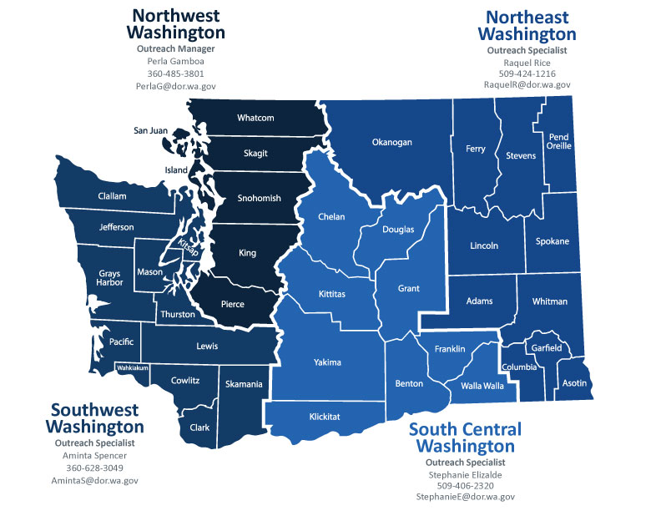
Outreach Team
Perla Gamboa
Outreach & Community Partnerships Manager
PerlaG@dor.wa.gov

Slide 8
Get involved
Help promote WFTC and drive awareness
DOR would love to partner with you on WFTC outreach!
We can provide speaking engagements & attend events
Training materials and resources will be available

Slide 9
Questions & more information
Email any follow-up questions to DORWFTC@dor.wa.gov
Outreach team: DORWorkingFamiliesOutreach@dor.wa.gov
Bilingual Website: WorkingFamiliesCredit.wa.gov
Request a speaker: WorkingFamiliesCredit.wa.gov/invite-us-speak

Slide 10
Contact information
Aminta Spencer
amintas@dor.wa.gov | 360-628-3049
Perla Gamboa
perlag@dor.wa.gov | 360-763-7130

