Slide 1




Rose of Sharon Church
The Stories We Sing
“Victory in Jesus”

Slide 2


What line from this hymn stands out to you?

Slide 3
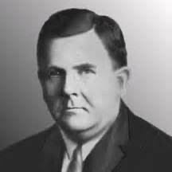
Eugene M. Bartlett
1885-1941
Gospel Songwriter
Music Publisher
Loved helping churches sing
Wrote over 800 gospel songs

Slide 4
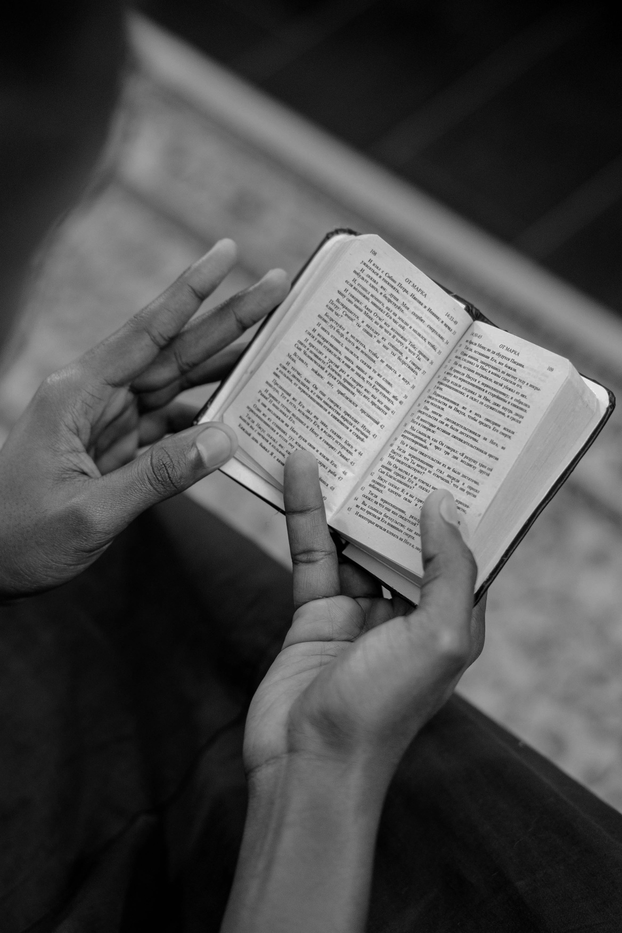
  “Can anything ever separate us from Christ’s love? Does it mean he no longer loves us if we have trouble or calamity, or are persecuted, or hungry, or destitute, or in danger, or threatened with death? 36 (As the Scriptures say, “For your sake we are killed every day; we are being slaughtered like sheep.”[o]) 37 No, despite all these things, overwhelming victory is ours through Christ, who loved us.”
Romans 8:35-37

Slide 5
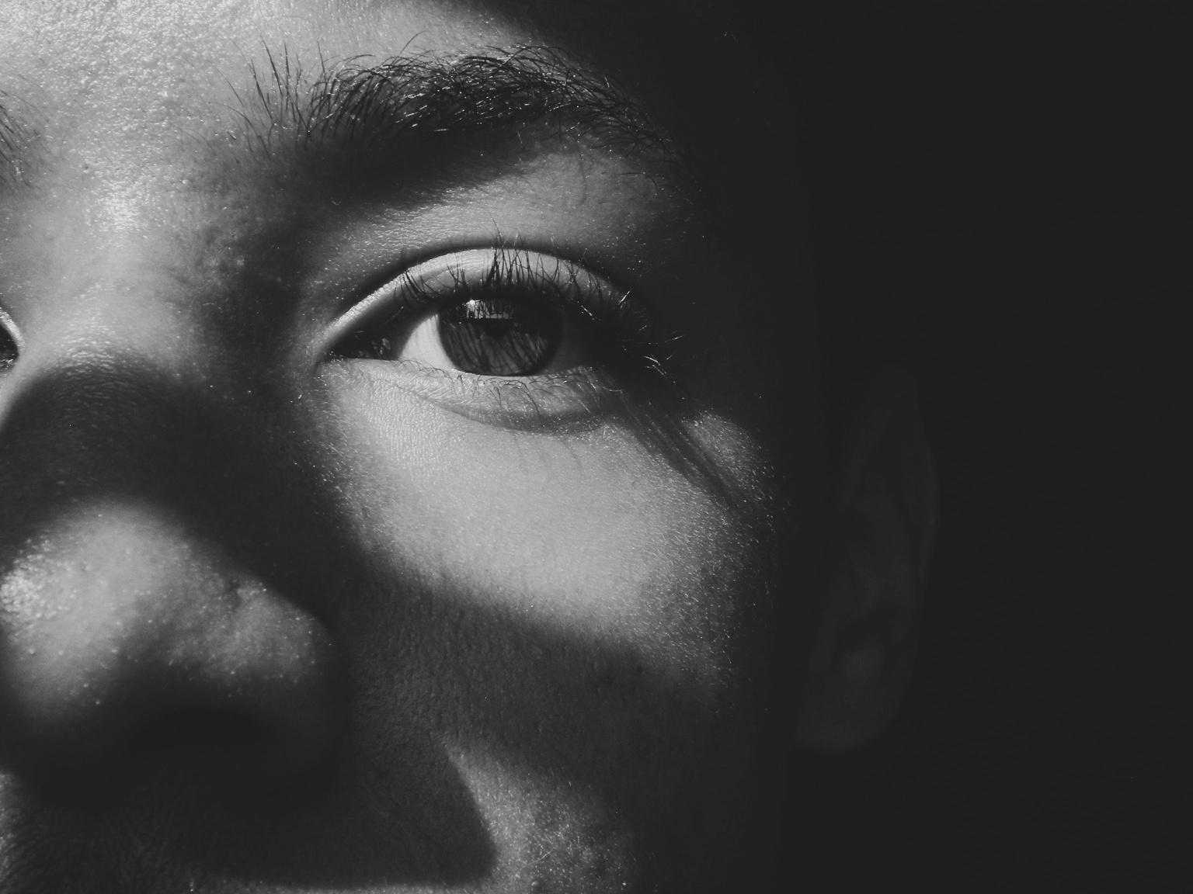

Victory isn’t the absence of suffering...
Victory is the presence of Jesus IN the suffering

Slide 6

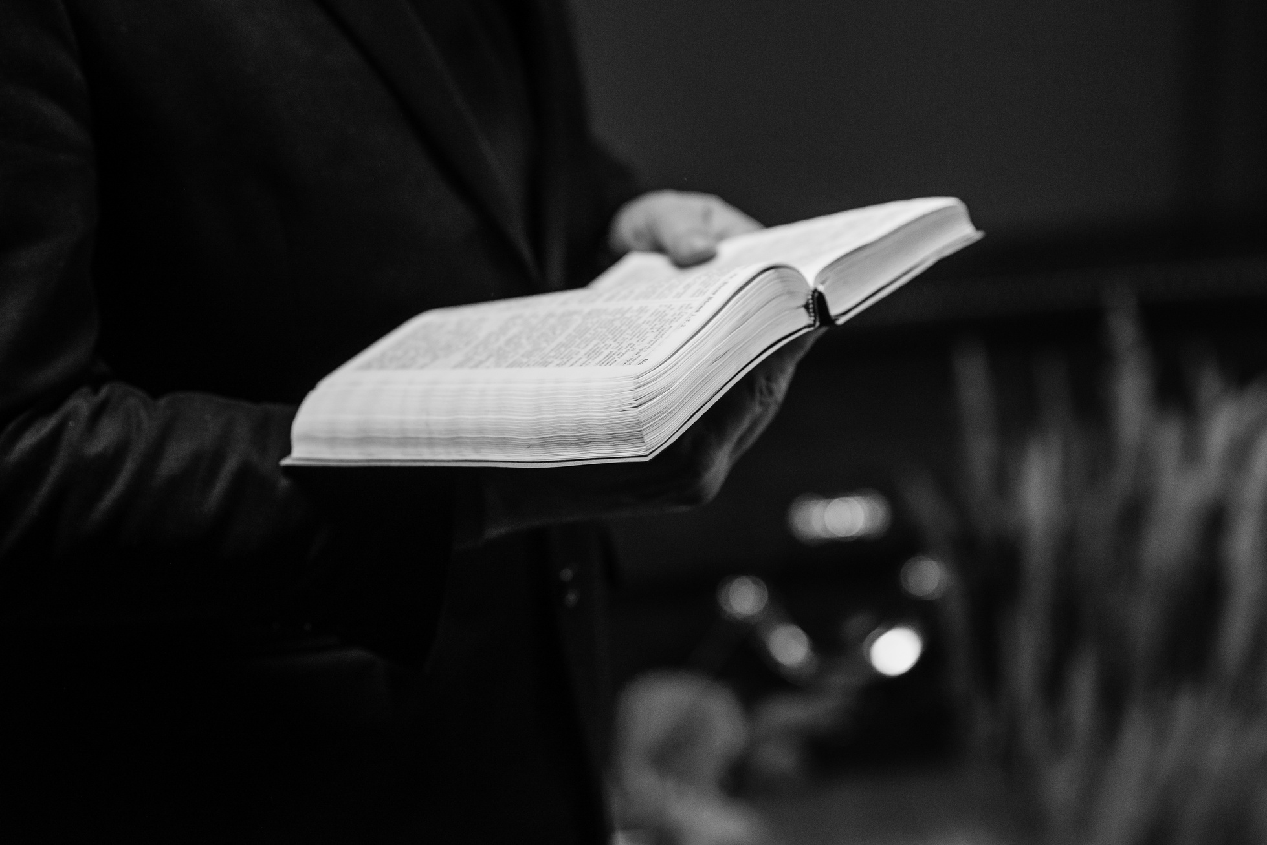
I heard an old, old story
How a Savior came from glory
How He gave His life on calvary
To save a wretch like me
I heard about His groaning
Of His precious blood’s atoning
Then I repented of my sins
And won the victory

Slide 7
Though he was God,[a]
he did not think of equality with God
as something to cling to.
7 Instead, he gave up his divine privileges[b];
he took the humble position of a slave[c]
and was born as a human being.
When he appeared in human form,[d]
8 he humbled himself in obedience to God
and died a criminal’s death on a cross.
9 Therefore, God elevated him to the place of highest honor
and gave him the name above all other names,
10 that at the name of Jesus every knee should bow,
in heaven and on earth and under the earth,
11 and every tongue declare that Jesus Christ is Lord,
to the glory of God the Father.
Philippians 2:6-11

Slide 8
I heard an old, old story
How a Savior came from glory
How He gave His life on calvary
To save a wretch like me
I heard about His groaning
Of His precious blood’s atoning
Then I repented of my sins
And won the victory

Slide 9
Yet it was our weaknesses he carried;
it was our sorrows[a] that weighed him down.
And we thought his troubles were a punishment from God,
a punishment for his own sins!
5 But he was pierced for our rebellion,
crushed for our sins.
He was beaten so we could be whole.
He was whipped so we could be healed.
Isaiah 53:4-5

Slide 10
I heard an old, old story
How a Savior came from glory
How He gave His life on calvary
To save a wretch like me
I heard about His groaning
Of His precious blood’s atoning
Then I repented of my sins
And won the victory

Slide 11
1 Peter 1:18-19
For you know that God paid a ransom to save you from the empty life you inherited from your ancestors. And it was not paid with mere gold or silver, which lose their value.19 It was the precious blood of Christ, the sinless, spotless Lamb of God. 20 God chose him as your ransom long before the world began, but now in these last days he has been revealed for your sake.

Slide 12
I heard an old, old story
How a Savior came from glory
How He gave His life on calvary
To save a wretch like me
I heard about His groaning
Of His precious blood’s atoning
Then I repented of my sins
And won the victory

Slide 13
Acts 3:19
“Now repent of your sins and turn to God, so that your sins may be wiped away.”

Slide 14
O victory in Jesus
My Savior, forever
He sought me and bought me
With His redeeming blood
He loved me ere I knew Him
And all my love is due Him
He plunged me to victory
Beneath the cleansing flood

Slide 15
“If a man has a hundred sheep and one of them gets lost, what will he do? Won’t he leave the ninety-nine others in the wilderness and go to search for the one that is lost until he finds it? 5 And when he has found it, he will joyfully carry it home on his shoulders. 6 When he arrives, he will call together his friends and neighbors, saying, ‘Rejoice with me because I have found my lost sheep.’ 7 In the same way, there is more joy in heaven over one lost sinner who repents and returns to God than over ninety-nine others who are righteous and haven’t strayed away!”
Luke 15:4-7

Slide 16
O victory in Jesus
My Savior, forever
He sought me and bought me
With His redeeming blood
He loved me ere I knew Him
And all my love is due Him
He plunged me to victory
Beneath the cleansing flood

Slide 17
Ephesians 1:7
“He is so rich in kindness and grace that he purchased our freedom with the blood of his Son and forgave our sins.”

Slide 18
O victory in Jesus
My Savior, forever
He sought me and bought me
With His redeeming blood
He loved me ere I knew Him
And all my love is due Him
He plunged me to victory
Beneath the cleansing flood

Slide 19
Romans 5:8
“But God showed his great love for us by sending Christ to die for us while we were still sinners.”

Slide 20
O victory in Jesus
My Savior, forever
He sought me and bought me
With His redeeming blood
He loved me ere I knew Him
And all my love is due Him
He plunged me to victory
Beneath the cleansing flood

Slide 21
“Or have you forgotten that when we were joined with Christ Jesus in baptism, we joined him in his death? 4 For we died and were buried with Christ by baptism. And just as Christ was raised from the dead by the glorious power of the Father, now we also may live new lives.”
Romans 6:3-4

Slide 22
I heard about His healing
Of His cleansing power revealing
How He made the lame
To walk again
And caused the blind to see
And then I cried, Dear Jesus
Come and heal my broken spirit
And somehow Jesus came and brought to me the victory

Slide 23
Isaiah 53:5
“But he was pierced for our rebellion,
crushed for our sins.
He was beaten so we could be whole.
He was whipped so we could be healed.”

Slide 24
I heard about His healing
Of His cleansing power revealing
How He made the lame
To walk again
And caused the blind to see
And then I cried, Dear Jesus
Come and heal my broken spirit
And somehow Jesus came and brought to me the victory

Slide 25
1 John 1:9
“But if we confess our sins to him, he is faithful and just to forgive us our sins and to cleanse us from all wickedness.”

Slide 26
I heard about His healing
Of His cleansing power revealing
How He made the lame
To walk again
And caused the blind to see
And then I cried, Dear Jesus
Come and heal my broken spirit
And somehow Jesus came and brought to me the victory

Slide 27
I heard about a mansion
He has built for me in glory
And I heard about the streets of Gold beyond the crystal sea
About the angels singing
And the old redemption story
And some sweet day I’ll sing up there the song of victory

Slide 28
“Don’t let your hearts be troubled. Trust in God, and trust also in me. 2 There is more than enough room in my Father’s home.[a] If this were not so, would I have told you that I am going to prepare a place for you?[b] 3 When everything is ready, I will come and get you, so that you will always be with me where I am.”
John 14:1-3

Slide 29
I heard about a mansion
He has built for me in glory
And I heard about the streets of Gold beyond the crystal sea
About the angels singing
And the old redemption story
And some sweet day I’ll sing up there the song of victory

Slide 30
“I heard a loud shout from the throne, saying, “Look, God’s home is now among his people! He will live with them, and they will be his people. God himself will be with them.[a] 4 He will wipe every tear from their eyes, and there will be no more death or sorrow or crying or pain. All these things are gone forever.”
Revelation 21:3-4

Slide 31
I heard about a mansion
He has built for me in glory
And I heard about the streets of Gold beyond the crystal sea
About the angels singing
And the old redemption story
And some sweet day I’ll sing up there the song of victory

Slide 32
“And they sang a new song with these words:
“You are worthy to take the scroll
and break its seals and open it.
For you were slaughtered, and your blood has ransomed people for God
from every tribe and language and people and nation.“
Revelation 5:9

Slide 33
  Our Reflection
  Where have you experienced victory in Jesus?

