Slide 1
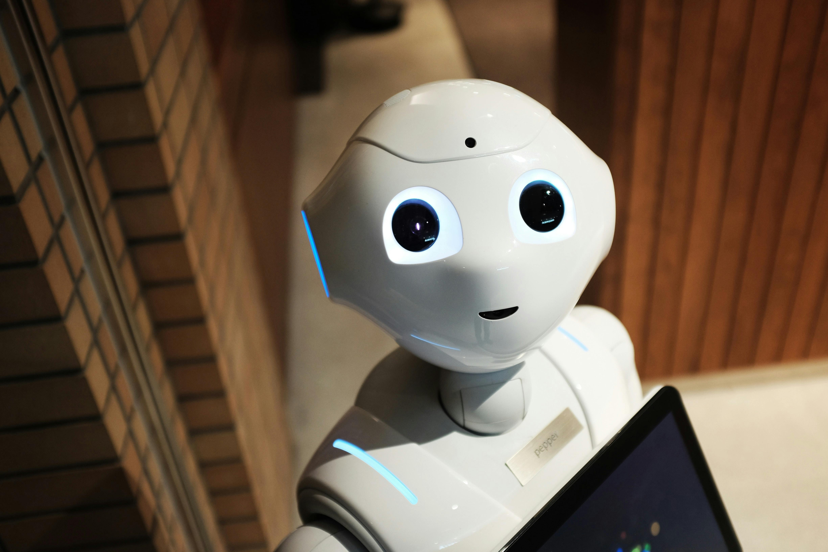

AI in the
Classroom:
What EVERY Teacher NEEDS to Know
Presenter: Geoff Kullman

Slide 2

Who Am I?
(…and Why You Might Care!)

Slide 3

Geoff Kullman
High-level copywriter for a decade
Worked with some amazing clients
…until 2023!
But I WON in 2010…

Slide 4
Our Outline
Welcome
What is AI (in plain English)
What’s changing in education because of AI
Practical classroom uses for teachers
Student use: what teachers are already facing
Risks, limitations, and red flags
Assessments, academic integrity, and more
Talking to students (and parents) about AI
What every teacher should do next…
Q&A
← you are HERE
← you are HERE

Slide 5

WHAT IS AI (IN PLAIN ENGLISH)

Slide 6

What is AI?
Before we decide what to do with AI, we need a clear picture of what it actually is.
AI is a tool that predicts, generates, sorts, and suggests
Text
Images
Summaries
Recommendations
Classifications
December 2022, podcast episode of my conversation w/ Austin Distel @ Jarvis (Jasper)*
Bots scraped the entire internet to learn language patterns, phrases, facts, etc.
In many ways, early AI is simply a parrot
AI is NOT magic… trained on data, trained to organize effectively, sophisticated “telephone”

Slide 7

What is AI?
AI isn’t new… we’ve seen it for decades
Autocomplete in emails or texts
Grammar and spell check on documents
Netflix/YouTube recommendations
Spam filters
Voice assistants
Playing against the “computer” (since the 80’s)
What AI tools do you already use?
Generative AI creates new content
Writes text – “write me a 500-word essay about X”
Creates images – “show me an image of me standing next to Gretzky as a rookie”
Summarizes text – “what does this paragraph mean?”
Suggests activities – “what should my family do this weekend?”
Generates examples – “create a sample shopping list (or weekly family menu)”
Generative (discriminative) AI doesn’t just repeat info, it uses what it knows to create new responses
Opposite is called “predictive AI” – analyzes & learns to predict future outcomes w/ high accuracy
← ANSWER!

Slide 8
What is AI?
What AI is not
It is not a human brain
It is not always accurate
It is not always truthful or ethical on its own
It does not know your students, your classroom, or your context
AI often sounds confident and polished (but polished is not the same as correct)
Lawyers getting caught citing case law that doesn’t exist
Students getting caught citing references that don’t exist
Hallucinations – not from bad information, but because it’s looking to create plausible language
AI is trying to produce the most likely answer, not a verified one
Newer models (GPT 5.4) are less likely to hallucinate, but still not perfect
These hallucinations can still…
Spread misinformation
Create false confidence
Waste teacher time
Mislead students who trust too much

Slide 9

WHAT’S CHANGING BECAUSE OF AI?

Slide 10

What’s Changing?
AI is changing more than student work
Teaching
Assessment
Student behaviour
Digital literacy
A lot of the early conversation focused on cheating. But AI is affecting much more than assignments. It’s changing how teachers plan, how students approach work, how we assess learning, and what it now means to be digitally literate.

Slide 11
What’s Changing?
Students now have a thinking shortcut
AI can now generate…
Outlines
Summaries
Paragraphs
Complete essays
Math equations
Problem-solving steps
The problem is no longer access to ANSWERS
The challenge is now EVIDENCE of UNDERSTANDING
In the past, students mostly searched for information. Now they can generate polished responses in seconds. That changes the teacher’s question from ‘Can they provide the answer?’ to ‘Can they think, explain, apply, and defend the answer?’

Slide 12
What’s Changing?
We need to assess the PROCESS more than the final PRODUCT
Outlines
Brainstorms
Drafts
Checkpoints
Revision notes
In-class reflections
Oral explanations
explain their reasoning
walk through how they got their answer
answer follow-up questions
reflect on choices they made
Personal or local applications
their class discussion
A local issue
a recent lab or activity
a specific text discussed in class

Slide 13
What’s Changing?
AI raises the value of human judgment
critical thinking
discernment
creativity
ethical judgment
In an AI-rich world, students need more than answers. They need judgment.
One of the paradoxes of AI is that as machine-generated content becomes easier to produce, deeply human skills become more important.
Teachers and schools are being pushed to answer new questions
When is AI use appropriate?
What counts as cheating now?
What should students still do on their own?
How do we protect privacy and trust?
What does responsible AI use look like in class?
AI is not only giving us new tools. It’s forcing schools to make new judgment calls. And many educators are being asked to make those calls before policy has fully caught up.

Slide 14
What’s Changing?
The BIG Shift
Before AI: Can students find information?
After AI: Can students think, evaluate, apply, and explain?
In an AI-rich world, students need to learn how to learn
One of the paradoxes of AI is that as machine-generated content becomes easier to produce, deeply human skills become more important.
← REFLECTION
Previously, education was meant to prepare students for their future career (learning how to learn)
Today, we are preparing students for jobs that don’t even exist… yet
Education is no longer just about preparing students for known careers. It must also prepare them for change, uncertainty, and work that has yet to be invented.

Slide 15
What’s Changing?
So… if AI is changing the classroom this much, where can it actually be useful in the classroom?
THOUGHTS?

Slide 16
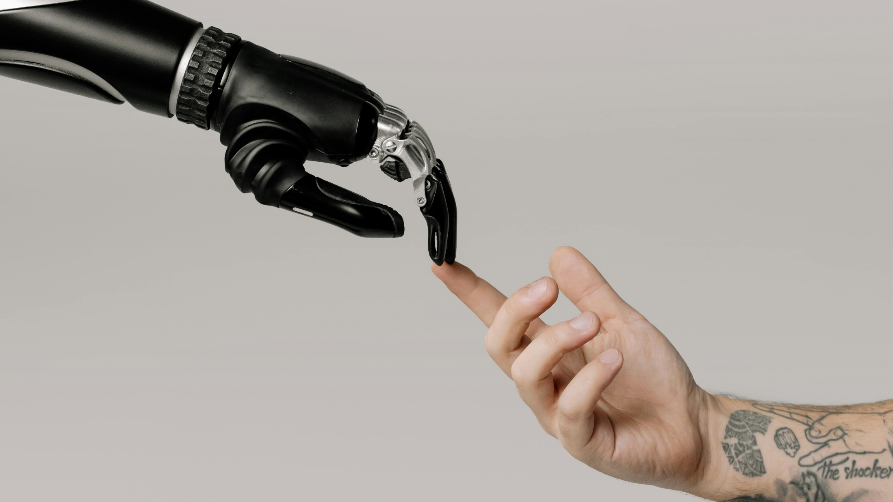
PRACTICAL CLASSROOM USES FOR TEACHERS

Slide 17
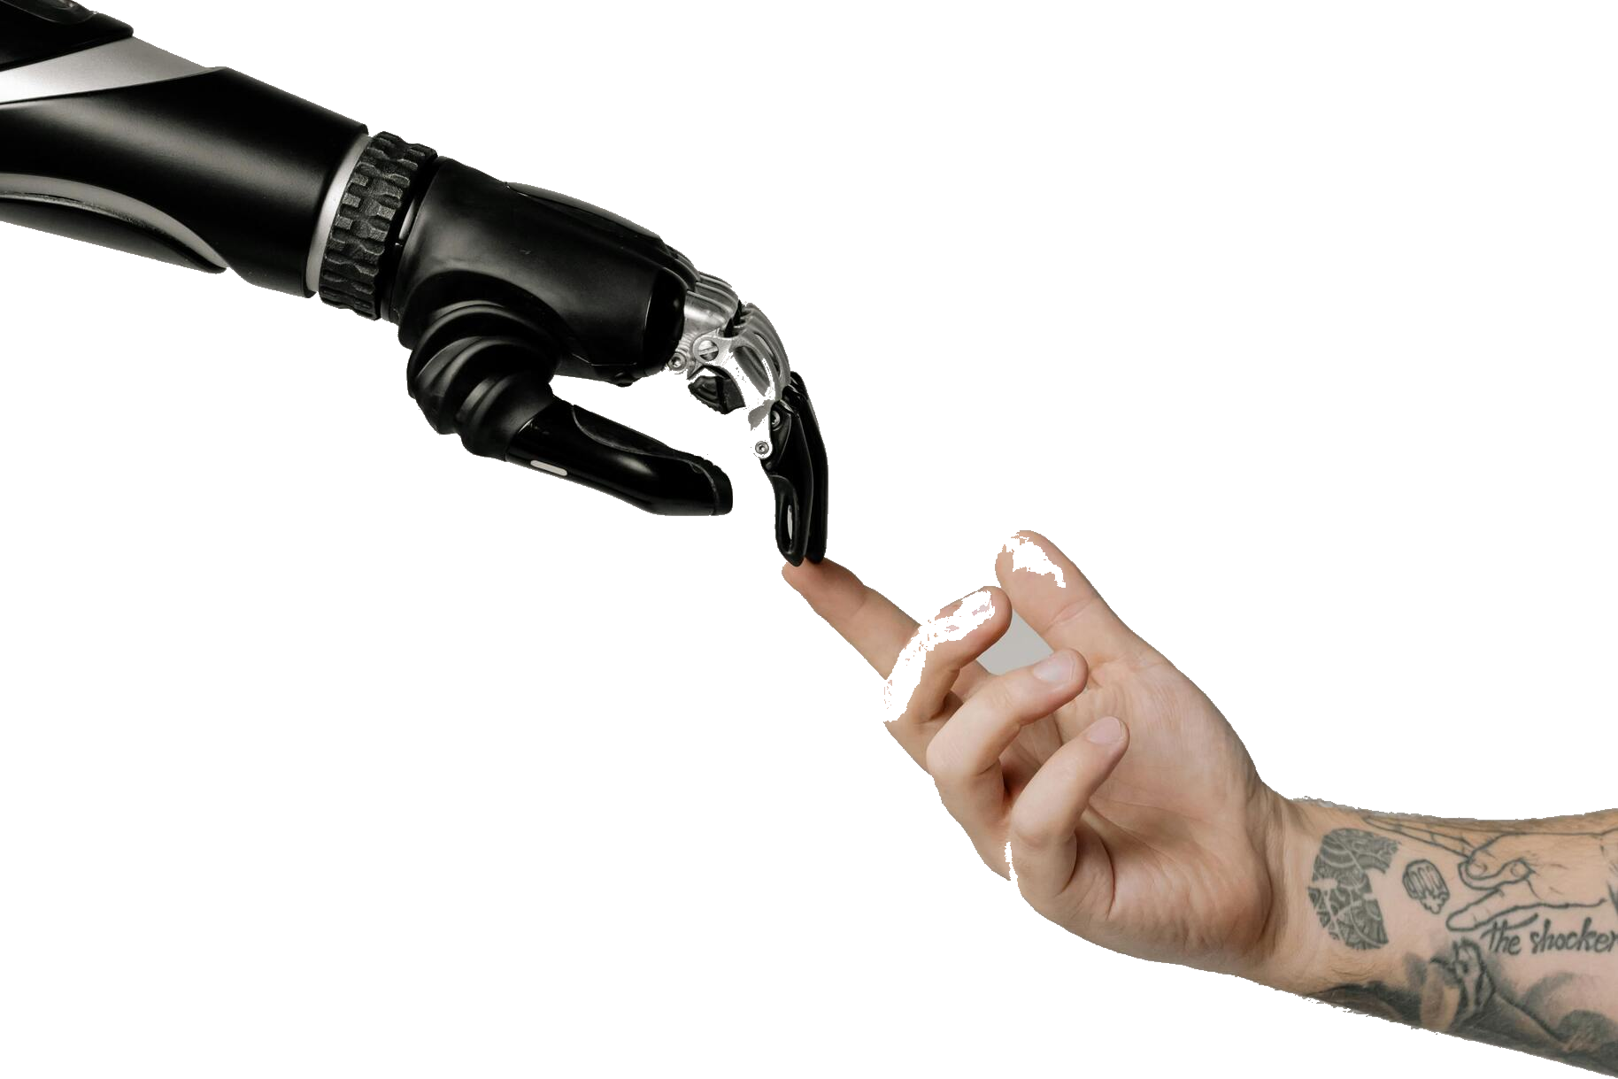
Practical Uses
Where AI can actually help…
AI is best used as a support tool, not a substitute teacher
Helpful for:
Drafting
Brainstorming / organizing
Adapting
generating options / ideas
Not a replacement for:
professional judgment
student relationships
classroom context
ethical decisions
final approval
The sweet spot for AI is not replacing teachers. It’s reducing friction around repetitive or first-draft work.

Slide 18
Practical Uses
We’re going to look at practical AI uses in 3 primary BUCKETS
BUCKET 1: Planning Support
AI can help teachers get past the “blank page” faster…
brainstorm lesson ideas
generate hooks or warm-ups
create discussion questions
draft rubrics
suggest examples at different levels
simplify or extend a concept
One of the easiest ways teachers can use AI is in planning. Not to hand over lesson design entirely, but to generate a strong starting point.
We’ve already done this for years; we just called them “Lesson Plan books”

Slide 19
Practical Uses
BUCKET 2: Differentiation & Accessibility
AI can help make content accessible… without starting from scratch every time:
rewriting directions more simply
creating sentence starters
generating exemplars
offering alternative explanations
supporting translation or vocabulary scaffolds
This is one of the most promising areas. Teachers already know differentiation matters, but it takes time. AI can help produce multiple versions of the same material much faster.
Copy/paste your lesson plan into an AI tool and have it translate it to Korean or simpler English, or a side-by-side translated version*

Slide 20
Practical Uses
BUCKET 3: Communication & admin support
AI can draft… teacher needs to always review!
parent emails*
weekly updates
newsletter blurbs
TTOC plans
quiz questions
feedback comment banks – you’re already buying them on TPT anyway!
checklists and templates
This is often where teachers feel the most immediate time savings — not because AI is doing the hard relational work, but because it helps with first drafts and repetitive wording.
*Remember to leave out student names and use district-approved tools where possible

Slide 21
Practical Uses
What this can look like in real life…
Instead of: spending 45 minutes drafting a parent email Try: asking AI for a warm, clear first draft
Instead of: building 3 reading levels from scratch Try: adapting one teacher-created version for support and extension
Instead of: staring at a blank planning page for hours Try: generating a lesson outline to revise and personalize
The biggest gain is often not that AI does everything. It’s that it gets you moving faster.
Again, remember to use district-approved AI tools & follow district AI rules where possible
Use AI where the risk is low and the time savings are real
Lower risk uses:
Brainstorming
Rewording
Summarizing
Generating options
Crafting drafts
Higher risk uses:
grading complex student thinking alone
sensitive parent communication
behaviour/discipline decisions
IEP-related wording
mental health concerns

Slide 22

STUDENT USE: TOMORROW’S CLASSROOM… TODAY!

Slide 23

Student Uses
What teachers are already facing
How students are using AI & why it matters
Students may use AI to…
Brainstorm ideas
Summarize readings
Generate outlines
Check grammar
Solve problems (math and otherwise)
Write paragraphs
Avoid doing the thinking
Some use supports learning. Some replaces it.
One of the biggest mistakes we can make is treating all student AI use as the same. It isn’t.

Slide 24
Student Uses
Not all student AI use is the same
The key question: Did the student do the thinking?
Supportive
Helps a student get unstuck
Examples:
explain a concept more simply
define vocabulary
translate instructions
Collaborative
Helps a student develop or refine ideas
Examples:
brainstorm possible topics
suggest stronger wording
help organize an outline
Substitutive
Does the thinking or writing for the student
Examples:
writes the paragraph
solves the problem
generates the response
Deceptive
Hides authorship or bypasses learning entirely
Examples:
submits AI work as original
uses AI without disclosure
pretends the thinking was theirs

Slide 25
Student Uses
Some student AI use bypasses learning
Examples…
submitting AI-written paragraphs as original work
generating a full essay from one prompt
solving problems without understanding them
creating discussion responses without reading
using AI to imitate effort rather than do the work
The issue is not just authorship. It’s lost thinking.
ASK: “Did the student do the thinking?”

Slide 26
Student Uses
Why is this hard to navigate?
AI outputs can sound polished (and keeps getting better)
student use may be invisible
detectors are unreliable (ZeroGPT / GPT Zero / TurnItIn)
school policies are still evolving
Teachers are being asked to make judgment calls in a moving landscape.
What teachers need is clarity, not panic
Avoid:
assuming all AI use is cheating
relying on detection tools alone
trying to ban what cannot really be banned
The question is NOT “Did AI help?”
The better question is: “Did the student do the thinking?”
Focus on:
clear expectations
visible thinking
transparent use
better task design
professional judgment

Slide 27

RISKS, LIMITATIONS & RED FLAGS

Slide 28

RISKS vs. REWARDS
So far, we’ve talked about what AI is, what’s changing, and where it can be useful.
BUT if we stop there, the picture is incomplete.
Teachers also need to understand where AI can mislead, oversimplify, or create new problems.
Remember: not all AI usage is bad, harmful, or cheating.

Slide 29
RISKS vs. REWARDS
AI can sound confident and still be wrong
AI might…
give inaccurate information
invent quotes or citations
misstate facts
oversimplify complex ideas
present guesses as answers
BOTTOM LINE: Fluent does not always mean factual.
True for BOTH students and teachers!

Slide 30
RISKS vs. REWARDS
AI hallucinations
A hallucination happens when AI generates information that is:
False
Fabricated
Misleading
...while presenting it as if it were true.
Examples:
a fake quote
an invented citation
the wrong answer stated confidently
a source or study that does not exist
An AI hallucination is not just a typo or a small mistake. It’s when the AI creates something that sounds real but isn’t.

Slide 31
RISKS vs. REWARDS
AI can reflect bias and blind spots
AI outputs may reflect:
Cultural bias — assumes one cultural norm is “normal”
Incomplete perspectives — leaves out important voices or viewpoints
Stereotypes — repeats familiar gender, racial, or social assumptions
Dominant-language assumptions — sounds fluent but may not be accessible for multilingual learners
Hidden bias in training data — reflects patterns and imbalances in the material AI learned from
Neutral-sounding output is not always neutral.
Privacy matters
Teachers should be cautious about entering:
student names
behavioural incidents
IEP details
medical or mental health information
sensitive family situations
confidential school information

Slide 32
RISKS vs. REWARDS
Convenience can come at a cost
Overuse of AI can lead to:
reduced original thinking
weaker problem-solving stamina
shortcut habits
less careful reading
overconfidence in weak answers
Easy is not always educational!
This is true for students, but also for teachers. When a tool makes thinking easier to skip, we have to be intentional about what still needs human effort.

Slide 33
RISKS vs. REWARDS
Red flags to watch for...
Be cautious when AI output is:
too polished for the student
vague but impressive-sounding
unsupported by real sources
oddly generic
inconsistent with what the student can explain
correct in tone, but thin in reasoning
Warning: Polished work is not always authentic work.
These are some of the practical things that signal teachers may notice. None of them proves anything on their own, but the pattern should prompt closer attention.

Slide 34
RISKS vs. REWARDS
What thoughtful caution looks like…
Instead of:
trusting AI too quickly
banning everything automatically
relying on detectors
assuming polished means true
Focus on:
teacher review
source checking
visible thinking
privacy awareness
sound professional judgment
Teachers do not need to panic. They need to discern.
The goal here is not fear. It’s wise caution. Teachers don’t need to know everything about AI, but they do need some practical filters.

Slide 35

ASSESSMENT, ACADEMIC INTEGRITY & REDESIGNING STUDENT WORK

Slide 36

ACADEMIC INTEGRITY
The challenge is not just cheating…
AI raises deeper questions:
What counts as authentic work now?
What does academic integrity look like with AI?
How do we know what a student understands?
What kinds of tasks still reveal thinking?
This is not only a discipline issue. It is a design issue.
One of the biggest ways AI is changing education is through assessment. It is forcing us to ask what really counts as evidence of learning — and what kinds of tasks still show student thinking clearly.

Slide 37

ACADEMIC INTEGRITY
A better question…
Instead of asking: “Is this AI-proof?”
Ask: “What would actually show me that the student did the thinking?”
Explanation
Application
Reasoning
Process
Reflection
There may not be many truly AI-proof tasks anymore. But there are still many ways to design for stronger evidence of learning.

Slide 38
ACADEMIC INTEGRITY
Some tasks are easier to outsource
Examples:
generic essay prompts
simple summaries
predictable short-answer questions
basic discussion posts
definition-based homework
formulaic reflection tasks
If AI can do it easily, the task may need stronger evidence of learning built in.
oral explanation or defense
process journals and drafts
in-class checkpoints
personalized or local application
performance tasks
reflection on choices and reasoning
Design for evidence, not just output.

Slide 39
ACADEMIC INTEGRITY
How teachers can redesign familiar tasks
Instead of:
a generic essay
a simple summary
a take-home response with no process
a polished final product only
The goal is not to throw out everything teachers already do. It is to add design features that make student thinking more visible.
Consider this:
oral follow-up questions
class-specific application
draft checkpoints
reflection on how the work was developed
explanation of choices made
in-class planning or retrieval

Slide 40
ACADEMIC INTEGRITY
Academic integrity still matters
Students still need to:
be honest about what they did
represent their own thinking accurately
follow class expectations
take responsibility for final work
explain and defend their learning
AI does not remove the need for honesty, responsibility, or authorship.
AI changes the tools available, but it does NOT cancel academic integrity. If anything, it makes clear expectations even more important.

Slide 41

TALKING TO STUDENTS (AND PARENTS) ABOUT AI

Slide 42
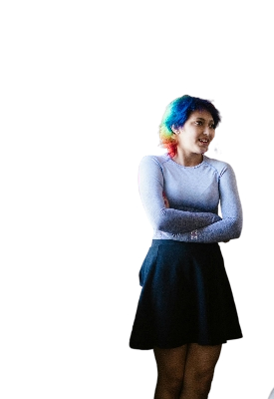
TALKING TO STUDENTS
Students need clarity, not vague warnings
Instead of saying:
“Don’t use AI”
“Just don’t cheat”
“You should know better”
Be clearer:
what AI may be used for
what AI may not be used for
what students are still responsible for
what tools (or category of tools) are allowable
what honesty/integrity looks like in this class
Clear expectations work better than vague fear.
Students often hear broad warnings, but broad warnings don’t always help them make better decisions. Clear boundaries are more useful.

Slide 43
TALKING TO STUDENTS
A simple classroom message
“In this class, AI may be used for…
brainstorming
feedback on clarity
vocabulary support
practice or review
AI may not be used for:
doing the assignment for you
replacing your own thinking
submitting work you cannot explain
hiding where your ideas came from”
Students are still responsible for their final work.
This kind of message is simple, direct, and easy to adapt by grade level or subject.

Slide 44
TALKING TO STUDENTS
A key message for students
Students should understand:
AI can support learning, but not replace it
integrity still matters
accuracy still matters
honesty still matters
using AI does not remove responsibility
“If you use it, you still own it!”
If a student uses AI in any form, they are still responsible for the truth, quality, and integrity of what they submit.

Slide 45
TALKING TO STUDENTS
Parents need clarity, too
Parents often want to know:
What is AI?
How are students using it?
Is it allowed?
Is it helping or harming learning?
How is the school responding?
Most families do not need hype or fear. They need clear, practical information.
Parents often hear mixed messages in the media, online, or from other families. Teachers can be a calming voice by staying practical and clear.

Slide 46
TALKING TO STUDENTS
A simple parent-facing explanation:
AI tools are becoming more common in education and in students’ lives. In our classroom, we are focusing on responsible use. That means students may use AI for limited support in some situations, but not as a replacement for their own thinking, learning, or honesty. Students are always responsible for the work they submit.
Responsible use is a better frame than total panic or total freedom.
This gives parents a balanced message: neither “we’re banning everything” nor “anything goes.”

Slide 47
TALKING TO STUDENTS
Questions teachers might hear…
From students:
“Is this cheating?”
“Can I use AI to help me start?”
“What if I only used it for ideas?”
“How will you know?”
From parents:
“Should my child be using AI at all?”
“How do I know if they’re relying on it too much?”
“Is the school teaching responsible use?”
“What counts as acceptable?”
This helps normalize the kinds of questions teachers are already likely to hear — and shows that confusion is understandable.

Slide 48
TALKING TO STUDENTS
A simple response framework:
When responding, come back to 4 ideas…
This framework gives teachers a way to talk about AI use without reducing everything to yes or no.
Purpose
What was AI used for?
Example:
brainstorming ideas vs writing the whole response
Transparency
Was the use honest and disclosed?
Example:
“I used AI to help me organize my outline”
Responsibility
Can the student still explain and stand behind the work?
Example:
explaining their argument in their own words
Learning
Did the AI support learning or replace it?
Example:
clarifying vocabulary vs answering every question for them

Slide 49
TALKING TO STUDENTS
The conversation matters!
Teachers do not need to have every answer.
But students and families do need:
clear expectations
consistent language
calm communication
a focus on honesty, learning, and responsibility
Clear communication builds trust.
This may be one of the most important practical takeaways in the seminar: the way we talk about AI can either increase confusion or build confidence.

Slide 50

WHAT EVERY TEACHER SHOULD DO NEXT…

Slide 51

WHAT TO DO NEXT
You do not need to know everything about AI
You do not need to:
become an AI expert
use/know every tool
rewrite every lesson plan
solve every policy question on your own… today!
instead, focus on:
understanding the basics
using sound judgment
trying one or two practical moves
staying clear about learning goals
The goal is not mastery. It’s readiness.
The expectation should not be “know everything.” It should be “be prepared enough to respond wisely.”

Slide 52
WHAT TO DO NEXT
Learn the basics…
Start by understanding:
what generative AI does
where it helps
where it can mislead
how students may already be using it
You do not need deep technical knowledge to make good classroom decisions
Teachers don’t need to become AI engineers. But they do need a basic mental model of what these tools can and cannot do.

Slide 53
WHAT TO DO NEXT
Try one low-risk teacher use
Start small:
Draft a parent email
brainstorm lesson ideas
simplify directions
create sentence starters
generate a first draft of a quiz or rubric
Start where the risk is low and the time savings are real
One of the best ways to reduce fear is to try one practical, low-stakes use and see what it actually feels like.

Slide 54
WHAT TO DO NEXT
Set clear expectations for students
Students need to know:
what AI may be used for
what AI may not be used for
what they are still responsible for
what honesty looks like in your class
Clarity works better than vague warnings
This does not need to be a long policy document. Even a simple classroom statement is better than leaving expectations unclear.

Slide 55
WHAT TO DO NEXT
Review one assignment through your new AI lens
Ask:
Can AI do this easily?
Does this task make thinking visible?
Would I know if the student understood the work?
What could I add to strengthen evidence of learning?
You do not need to redesign everything at once.
This is one of the most realistic next steps. Pick one assignment and look at it through the lens of visible thinking.

Slide 56
WHAT TO DO NEXT
Keep human judgment at the center
AI can help with:
drafting
organizing
generating options
reducing routine workload
But teachers still bring:
relationships
context
ethics
discernment
professional judgment
AI can assist teaching. It should not replace teacher judgment.
Teachers are not being replaced in the work that matters most.

Slide 57
WHAT TO DO NEXT
A simple starting point:
Learn the basics
Try one low-risk use
Set clear expectations
Review one assignment
Keep human judgment central
Small steps are better than overwhelmed inaction
If you leave with these 5 steps, you’re taking a strong step forward!

Slide 58
WHAT TO DO NEXT
Teachers do not need panic. They need confidence, clarity, and judgment.
AI is already changing education.
But teachers can respond with:
calm
clarity
practical boundaries
thoughtful experimentation
a strong focus on real learning
You do not have to know everything. You do need to know what matters most.
MAIN TAKEAWAY: no pressure, no fear, but clearer judgment and a workable next step.

Slide 59

Q&A

