Slide 1



Smarter, Not Harder:
Using AI to Save Teachers Time
Smarter-Not-Harder.ai
Presenter: Geoff Kullman

Slide 2
Seminar Promise:
By the end of this session, you’ll be able to use AI to reduce your workload with simple, reliable frameworks and methods that support great teaching — without compromising your professional judgment or student learning.
Core Throughline:
AI helps teachers work smarter, not harder — by handling the drafting, so you can focus on the teaching.
Workshop title:
Smarter, Not Harder

Slide 3

Who Am I?
(…and Why You Might Care!)
Workshop title:
Smarter, Not Harder

Slide 4

Geoff Kullman
High-level copywriter for a decade
Worked with some amazing clients
…until everything changed in 2023!
Recognize my last name?
That’s how I know the heavy workload teachers face!
Workshop title:
Smarter, Not Harder

Slide 5
Who Am I?
(…and Why This Conversation Matters!)
Workshop title:
Smarter, Not Harder

Slide 6

Why This Matters?
Teachers are being asked to do more than ever
AI is already changing the kinds of tasks that can be drafted, adapted, and streamlined*
The goal today is not to add more… but to reduce the friction in the work you already do
The real question isn’t “Should teachers use AI for everything?” but “How do teachers use AI without compromising judgement, learning, or integrity?”
Workshop title:
Smarter, Not Harder

Slide 7
What This Session IS
(…and is NOT!)
Workshop title:
Smarter, Not Harder

Slide 8
What This IS?
Practical & hands-on
if you have a laptop, get Co-Pilot ready!
Real-world & classroom-focused
Dedicated to real teachers (you)
Designed to save time, not add more work
Grounded in good teaching, professional judgement, and academic integrity
Workshop title:
Smarter, Not Harder

Slide 9
What This Is NOT?
Push to use AI for everything
Replacement for your expertise and skill
Deep dive into AI theory
Promise that AI will solve every problem in your classroom
Workshop title:
Smarter, Not Harder

Slide 10
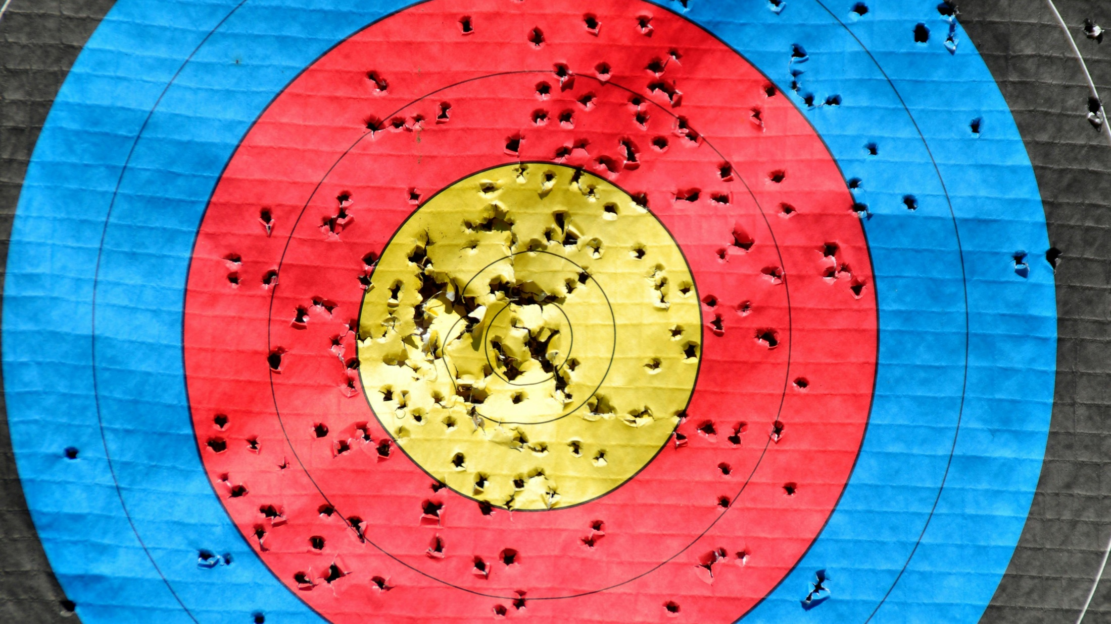
WHAT THIS SESSION WILL HELP YOU DO…
Workshop title:
Smarter, Not Harder

Slide 11
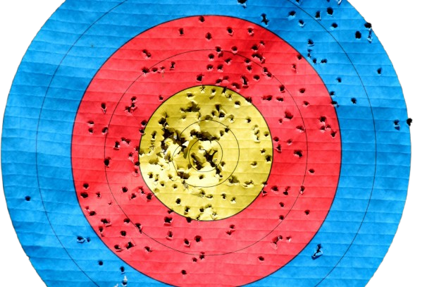
Why This Session Matters
Teachers are being asked to do more than ever
AI can lighten the load (especially when used effectively)
We’ll focus on real classroom scenarios (elementary, HS, IST, ELL)
No tech jargon, no hype
…but we will learn to write great/better/effective prompts
Remember the Goal + Throughline?
Workshop title:
Smarter, Not Harder

Slide 12
Seminar Promise:
By the end of this session, you’ll be able to use AI to reduce your workload with simple, reliable frameworks and methods that support great teaching — without compromising your professional judgment or student learning.
Core Throughline:
AI helps teachers work smarter, not harder — by handling the drafting, so you can focus on the teaching.
Workshop title:
Smarter, Not Harder

Slide 13
What Today Is / Is Not
IS:
Practical framework
Time‑saving methodologies
Hands‑on practice
Templates you can reuse
IS NOT:
Tech theory
AI hype
Abstract futurism
“One more thing on your plate.”
Workshop title:
Smarter, Not Harder

Slide 14
Today’s Roadmap
AI Workflow Mindset
Teaching Block 1 - How to Write an Effective Prompt (framework)
Demo Block 1
Hands‑On Cycle 1
Teaching Block 2 - Practical AI Workflows
Demo Block 2
Hands‑On Cycle 2
Templates + Q&A
Questions before we begin..?
Workshop title:
Smarter, Not Harder

Slide 15

QUESTION:
WHAT’S YOUR “AI LEVEL”?
BEGINNER | INTERMEDIATE | EXPERT
Workshop title:
Smarter, Not Harder

Slide 16

WHAT’S AI GOOD AT (& BAD AT…)?
Workshop title:
Smarter, Not Harder

Slide 17

What’s AI Good At?
AI is often useful for:
Drafting
Rewriting
Simplifying
Generating ideas
Pattern recognition
Best use: getting past the blank page faster.
What’s your favorite USE of AI tools for the classroom?
Workshop title:
Smarter, Not Harder

Slide 18
What’s AI Bad At?
AI is often weak at:
Context
Nuance
Judgment
Understanding your students
AI can support teachers. It shouldn’t replace teacher judgment.
What do you think AI is not good at (yet)?
Are you worried about AI robots replacing teacher jobs?
Workshop title:
Smarter, Not Harder

Slide 19
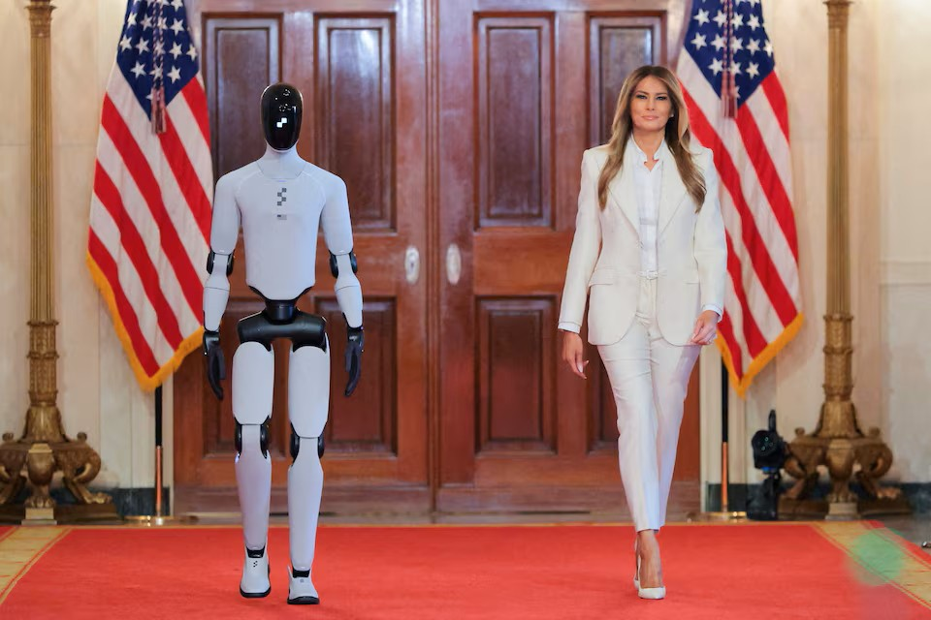
What’s AI Bad At?
Workshop title:
Smarter, Not Harder

Slide 20
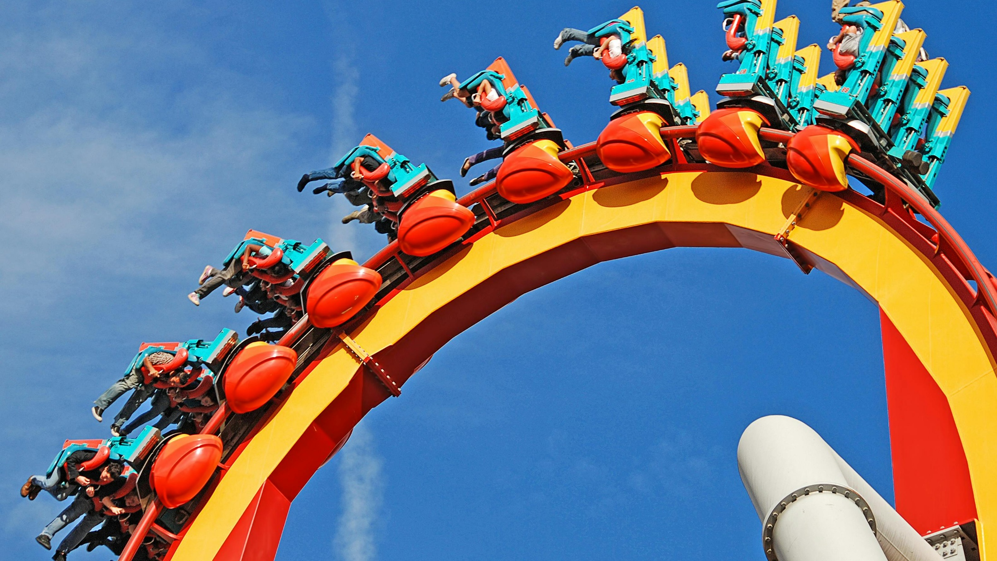
THE RIDE FRAMEWORK
Workshop title:
Smarter, Not Harder

Slide 21
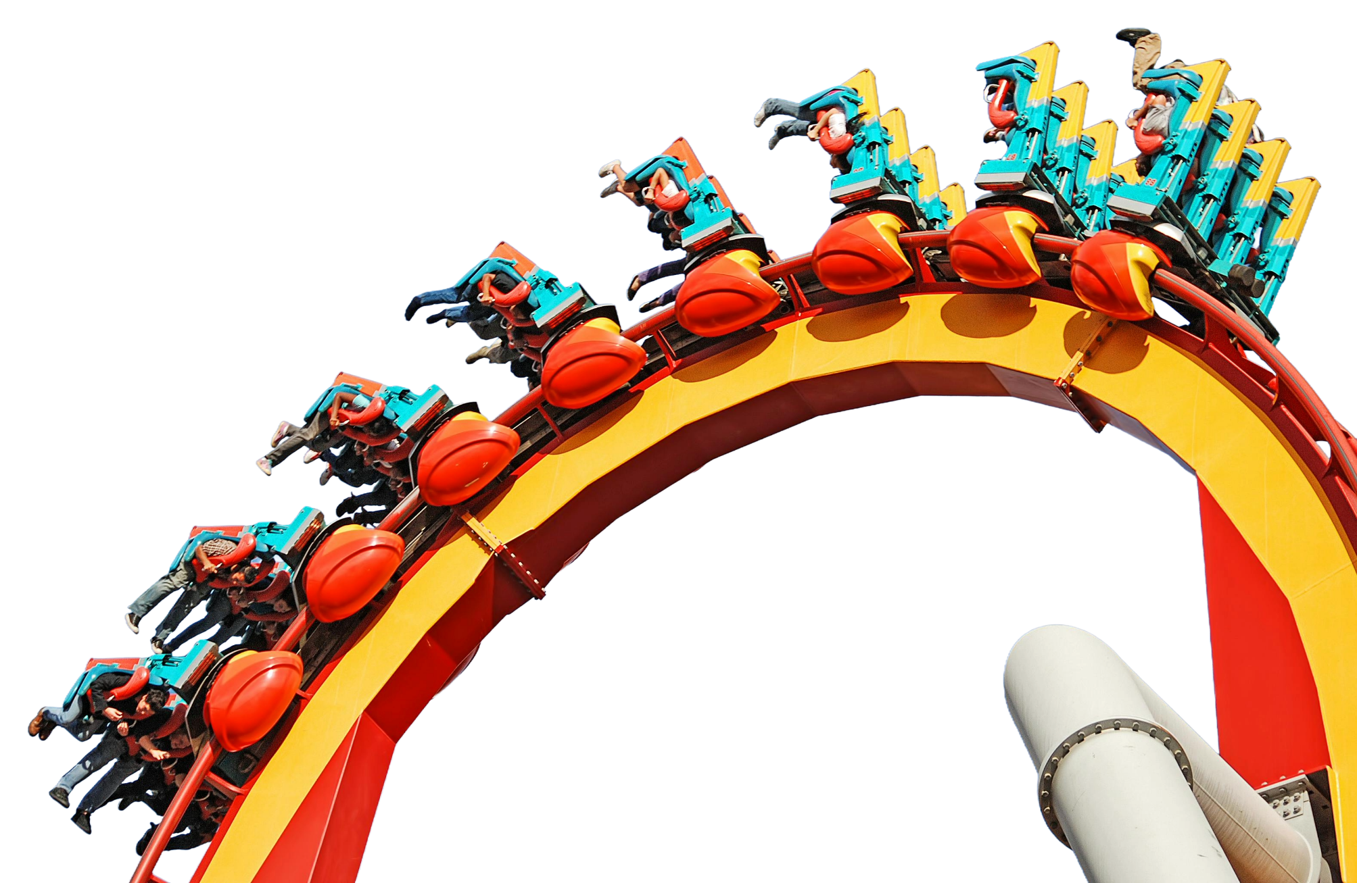
The RIDE Framework
The RIDE Framework: A Simple Way to Get Great AI Outputs
Any generative AI tool, include these four elements in your prompt:
R — Role Who should the AI act as? “Act as a Grade 4 teacher…”
I — Instructions What do you want it to do? “Create a leveled reading passage…”
D — Details What information does it need? Topic, tone, targeted supports, constraints
E — Expected Output How should the result be presented? Bullets, table, three versions, step‑by‑step
Workshop title:
Smarter, Not Harder

Slide 22
The RIDE Framework
The GOLDEN rule of prompting…
“AI is only as good as the instructions you give it.”
R — Role Who should the AI act as? “Act as a Grade 4 teacher…”
I — Instructions What do you want it to do? “Create a leveled reading passage…”
D — Details What information does it need? Topic, tone, targeted supports, constraints
E — Expected Output How should the result be presented? Bullets, table, three versions, step‑by‑step
Workshop title:
Smarter, Not Harder

Slide 23
The RIDE Framework
RIDE in Action: Weak Prompt vs. Strong Prompt
Weak Prompt:
“Make a worksheet”
Strong Prompt (using RIDE):
Role
Instructions
Details
Expected Output
Role: You are an experienced Grade 4 literacy teacher.
Instructions: Create a reading‑comprehension worksheet based on a short informational text about salmon life cycles.
Details: – Include a 120–150 word passage written at a Grade 4 reading level. – Include 5 comprehension questions: 2 factual, 2 inferential, 1 vocabulary-in-context. Format the worksheet clearly with headings and space for student answers. Align tone and structure with typical BC Grade 4 literacy tasks.
Expected Output: A ready‑to‑use worksheet with the passage and questions.
Workshop title:
Smarter, Not Harder

Slide 24
The RIDE Framework
WEAK PROMPT:
Worksheet
Name: _______________________
Answer the questions.
Write your responses in full sentences.
Complete all parts.
Questions:
What did you learn today?
Why is learning important?
Write three facts about something you studied.
Draw a picture of something related to your learning.
Workshop title:
Smarter, Not Harder

Slide 25
The RIDE Framework
STRONG PROMPT:
Grade 4 Reading Comprehension Worksheet
Name: __________________________
Salmon Life Cycles
Salmon are fish that begin their lives in freshwater streams. After hatching, tiny salmon called fry spend several months hiding among rocks and plants. As they grow, they swim toward the ocean, where they spend most of their adult lives. Salmon travel long distances in the ocean to find food. When they are fully grown, they return to the same stream where they were born. Scientists believe they use the Earth’s magnetic field and their strong sense of smell to find their way back. Once they return, salmon lay eggs, and the cycle begins again.
Questions
Factual: Where do salmon begin their lives
Factual: What are young salmon called
Inferential: Why do you think salmon hide among rocks and plants when they are fry
Inferential: What might make returning to their home stream difficult for salmon
Vocabulary in Context: What does the word cycle mean in the passage
Workshop title:
Smarter, Not Harder

Slide 26
Grab A Copy NOW
Remember the golden rule of prompting…
“AI is only as good as the instructions you give it.”
PDF includes
RIDE framework
this slide deck
contact info
Workshop title:
Smarter, Not Harder
Smarter-Not-Harder.ai

Slide 27

Demonstration Time (1.0)
Workshop title:
Smarter, Not Harder

Slide 28

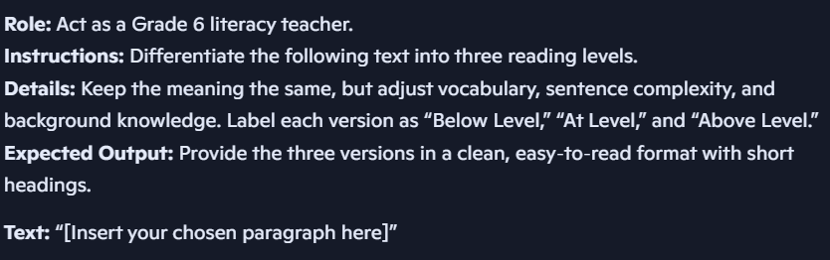
DEMO: Elementary
Free Use sample from Holes by Louis Sachar
Workshop title:
Smarter, Not Harder

Slide 29
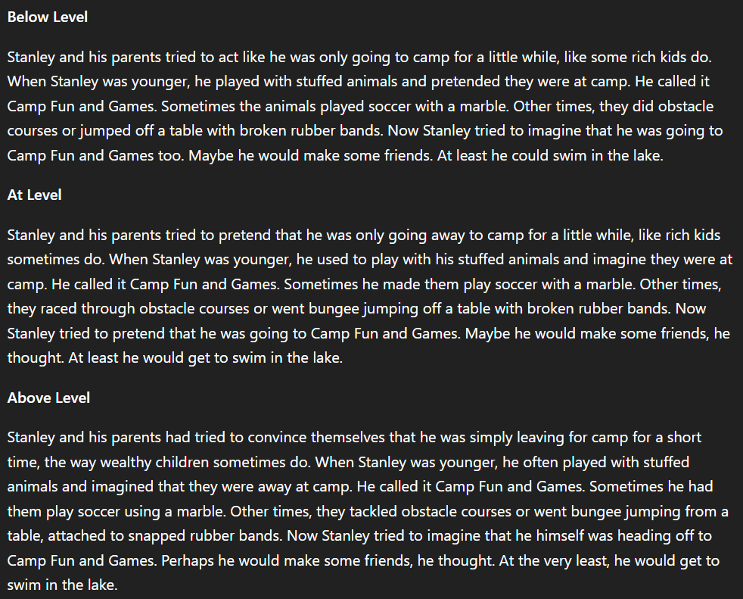
DEMO: Elementary
ChatGPT
Workshop title:
Smarter, Not Harder

Slide 30
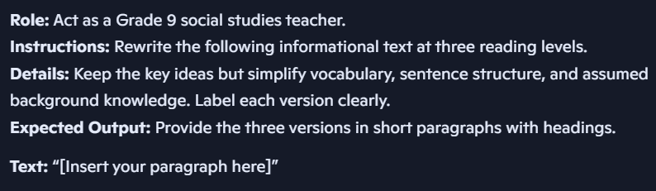
DEMO: Secondary
Free Use sample from Grade 9 socials textbook in Manitoba
Workshop title:
Smarter, Not Harder

Slide 31
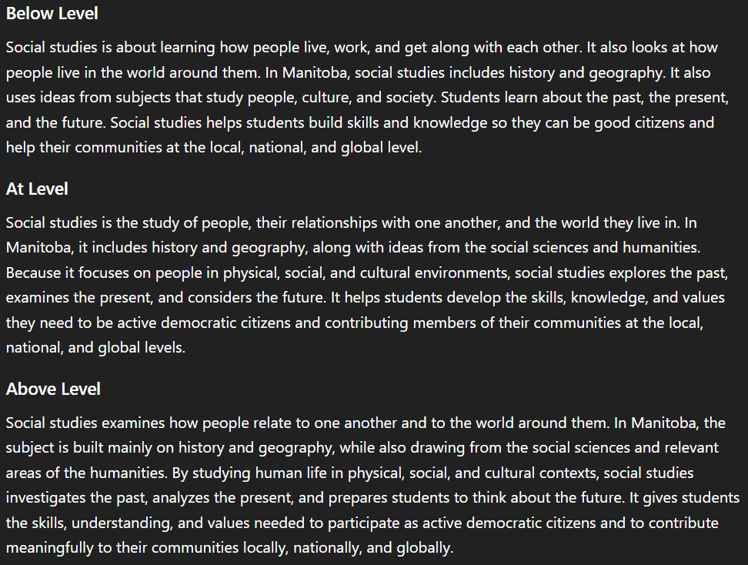
DEMO: Secondary
ChatGPT
Workshop title:
Smarter, Not Harder

Slide 32
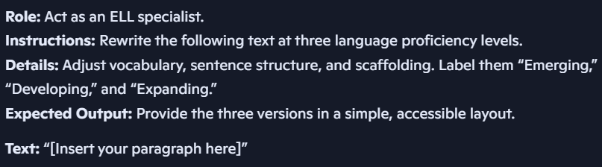
DEMO: Specialist
Free Use sample from ReadingUniverse.org
Workshop title:
Smarter, Not Harder

Slide 33
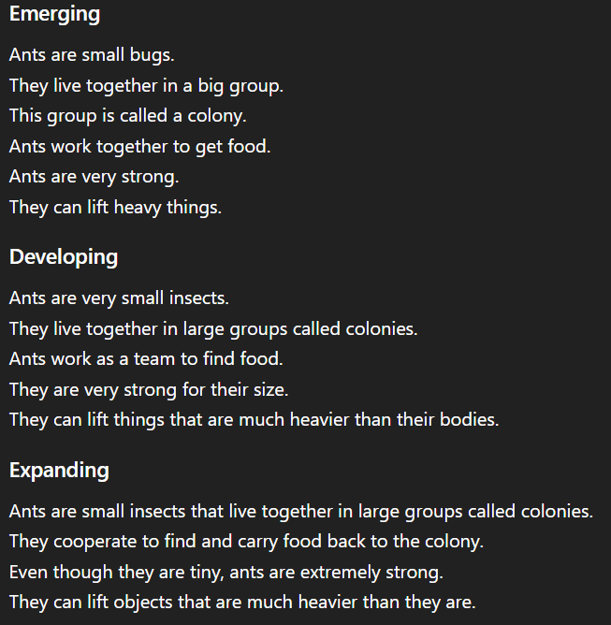
DEMO: Specialist
ChatGPT
Workshop title:
Smarter, Not Harder

Slide 34
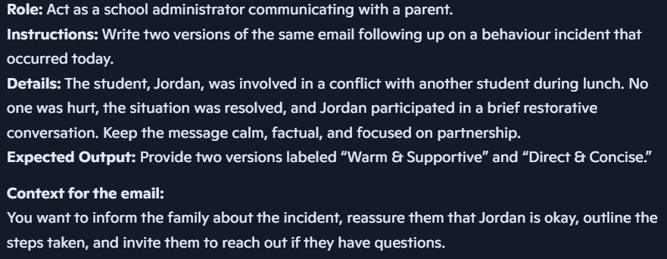
DEMO: Admin
Note the extra “context” added as well
Workshop title:
Smarter, Not Harder

Slide 35
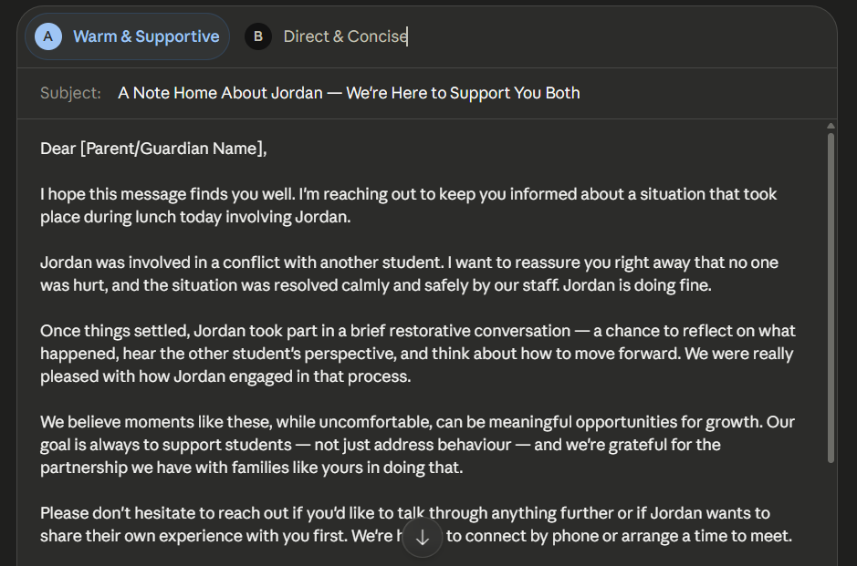
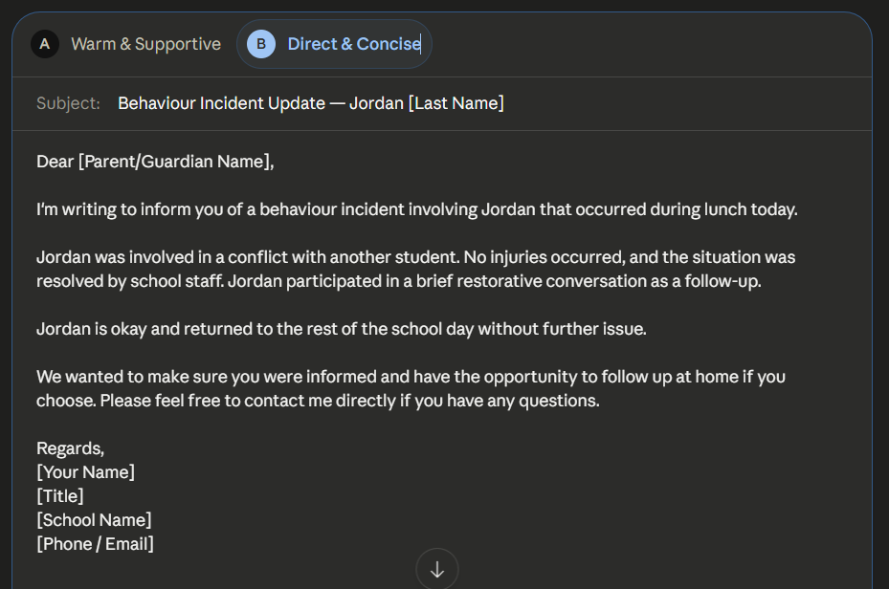
DEMO: Admin
Claude
Workshop title:
Smarter, Not Harder

Slide 36

HANDS-ON TIME
Workshop title:
Smarter, Not Harder

Slide 37


Hands On Activity 1
Choose your lane:
Elementary
Secondary
IST
ELL
Open your phone/laptop to Co-Pilot (copilot.microsoft.com)
Use the RIDE framework to create something you need this week.
Smarter-Not-Harder.ai
Workshop title:
Smarter, Not Harder

Slide 38

REAL WORLD AI WORKFLOWS
Workshop title:
Smarter, Not Harder

Slide 39

REAL WORLD WORKFLOW
Now that you know HOW TO prompt effectively, let’s discuss what AI is great ai doing…
lesson planning
assessment
accommodation supports
communication
Workshop title:
Smarter, Not Harder

Slide 40
LESSON PLANNING
Don’t just use the RIDE framework to create lesson plans, but also…
lesson ideas
unit outlines
essential questions
grade-level adaptions
Workshop title:
Smarter, Not Harder

Slide 41
ASSESSMENT & RUBRICS
Don’t just use the RIDE framework to create lesson plans, but also…
rubric drafts
exemplars
practice questions
Workshop title:
Smarter, Not Harder

Slide 42
ACCOMMODATION-FRIENDLY MATERIALS
Don’t just use the RIDE framework to create lesson plans, but also…
ELL scaffolds
IST modifications
Visual supports
Sentence frames
Workshop title:
Smarter, Not Harder

Slide 43
COMMUNICATION & DOCUMENTATION
Don’t just use the RIDE framework to create lesson plans, but also…
parent emails
progress notes
meeting summaries
Workshop title:
Smarter, Not Harder

Slide 44

Demonstration Time (2.0)
Workshop title:
Smarter, Not Harder

Slide 45
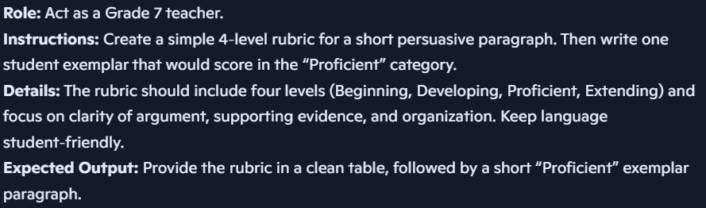
DEMO: Elementary
Workshop title:
Smarter, Not Harder

Slide 46
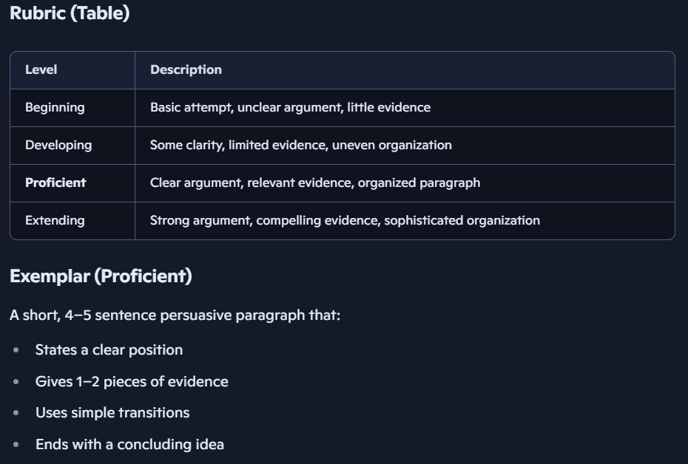
DEMO: Elementary
Co-Pilot
Workshop title:
Smarter, Not Harder

Slide 47
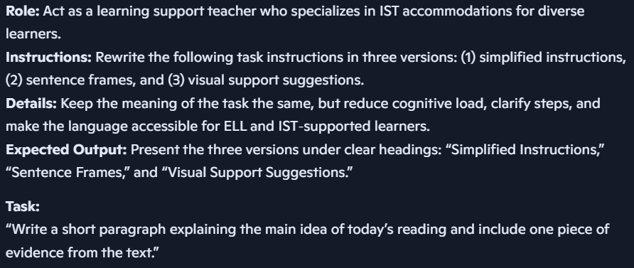
DEMO: Specialist
Workshop title:
Smarter, Not Harder

Slide 48
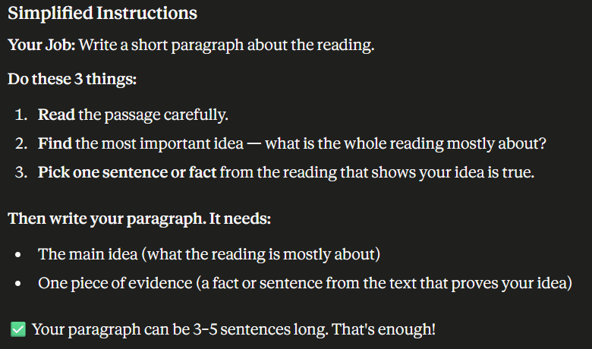
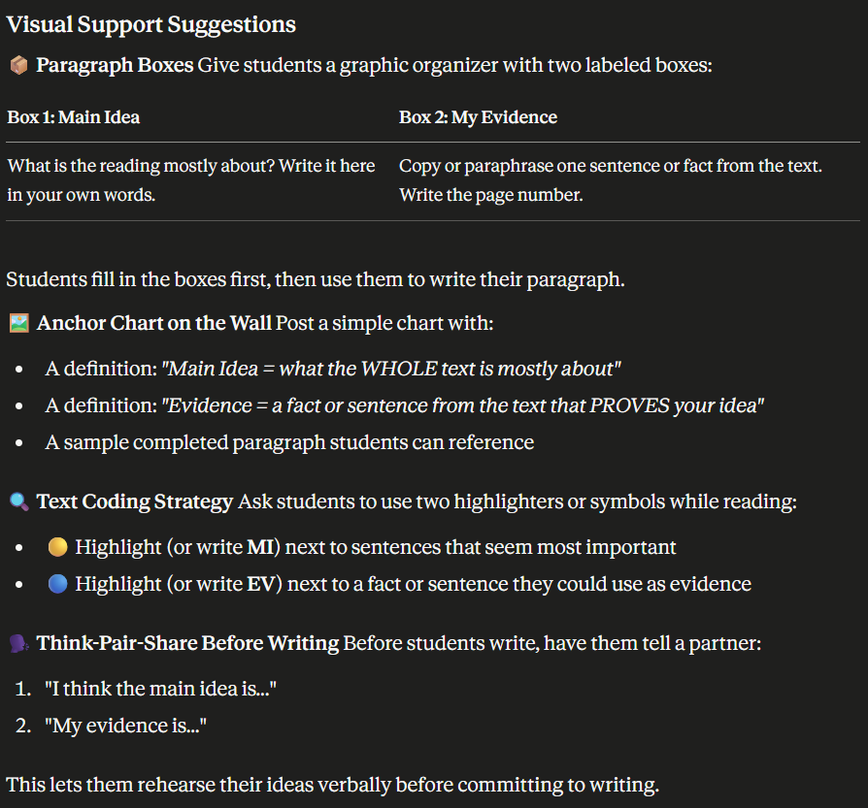
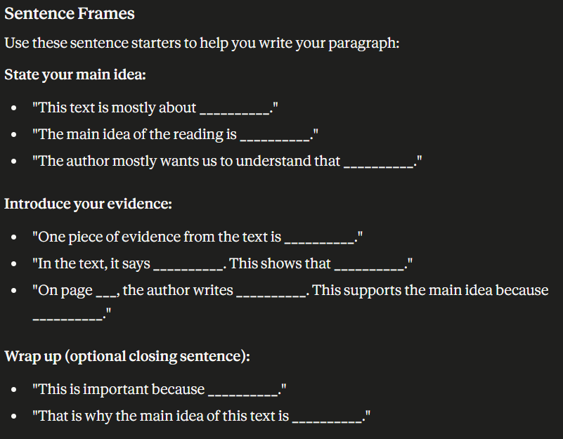
DEMO: Specialist
Claude
Workshop title:
Smarter, Not Harder

Slide 49

DISCUSSION
Discuss: where does AI fit into your workflow?
Turn to someone near you and share one workflow where AI could save you time this week.
2–3 minutes, quick share.
Smarter-Not-Harder.ai
Workshop title:
Smarter, Not Harder

Slide 50
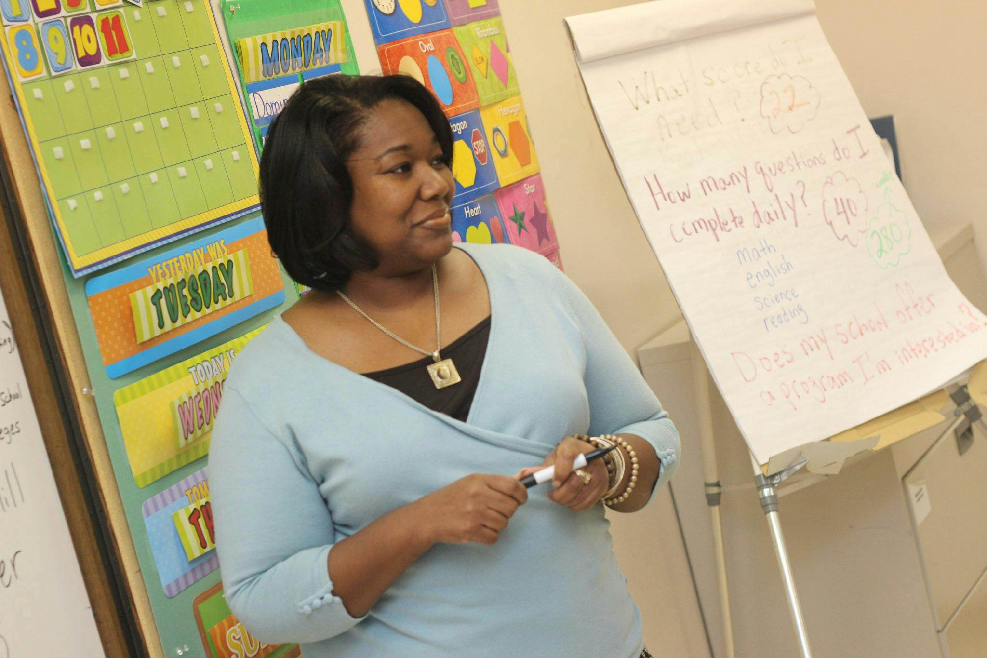
Hands On Activity 2
Choose your lane:
Elementary
Secondary
Specialist
Admin
Open your phone/laptop to Co-Pilot (copilot.microsoft.com)
Use the RIDE framework to create something you need this week.
Stretch challenge: Ask AI to generate multiple versions
Smarter-Not-Harder.ai
Workshop title:
Smarter, Not Harder

Slide 51

Smarter-Not-Harder.ai
REMEMBER… GRAB THE RESOURCES
Workshop title:
Smarter, Not Harder

Slide 52

DISCUSSION + Q&A
Workshop title:
Smarter, Not Harder

Slide 53
Ethics: “Where is the line between support and over‑reliance?”
Integrity: “How do we design assignments that encourage thinking?”
Equity: “How can AI help close gaps?”
Policy: “What guardrails help you feel confident?”
Future: “What tasks do you hope AI takes off your plate next?”
Workshop title:
Smarter, Not Harder
Smarter-Not-Harder.ai

Slide 54
THANK YOU!
Try one workflow this week
Use RIDE as your starting point
Reach out for templates or support
Workshop title:
Smarter, Not Harder

