Slide 1

Module: Listening Comprehension Slide No. 1
Audio Narration
Slide Mockup
Welcome to the Language Learning thru Immersion & Context Module, Listening Comprehension.
Interactivity & Programming Notes
In picture live camera of instructor narrating at bottom right of screen

Slide 2
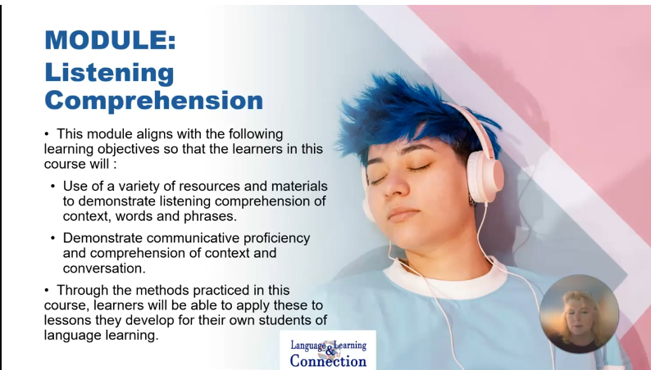
Module: Listening Comprehension Slide No. 2
Audio Narration
Slide Mockup
In this module you will learn how to use a variety of resources and materials to demonstrate listening comprehension of context, words and phrases and demonstrate communicative proficiency and comprehension of context and conversation. These are learning objectives that will help you develop methods to develop lessons for your students of language learning.
Interactivity & Programming Notes
In picture live camera of instructor narrating at bottom right of screen

Slide 3
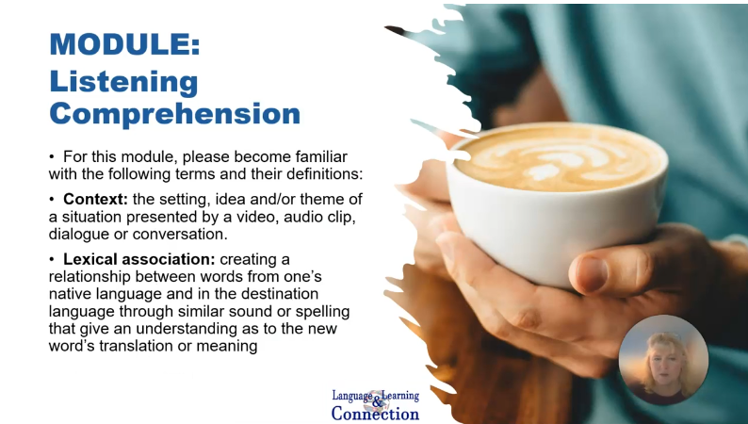
Module: Listening Comprehension Slide No. 3
Audio Narration
Slide Mockup
For this module as well as developing lessons for your students, you must become familiar with these terms….
Interactivity & Programming Notes
In picture live camera of instructor narrating at bottom right of screen

Slide 4
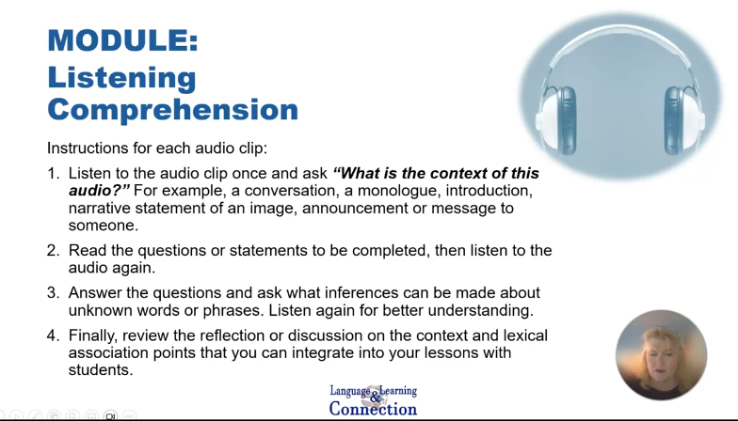
Module: Listening Comprehension Slide No. 5
Audio Narration
Slide Mockup
There are instructions for each exercise, but the general instructions are to listen first to the audio clip to understand the context before reviewing the questions. Then….
Interactivity & Programming Notes
In picture live camera of instructor narrating at bottom right of screen

Slide 5
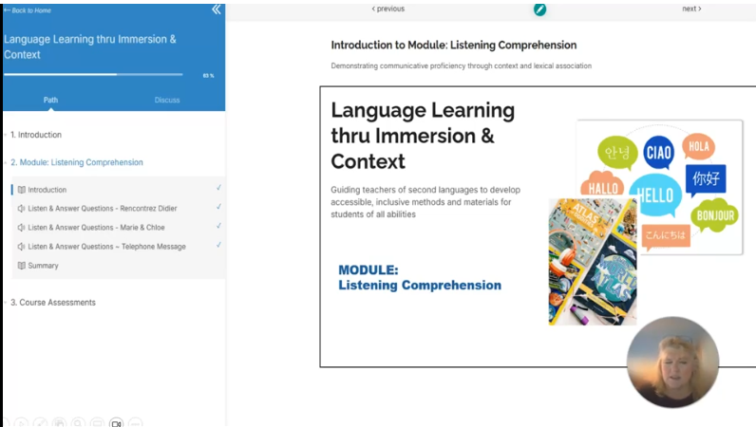
Module: Listening Comprehension Slide No. 5
Audio Narration
Slide Mockup
Here is a walkthrough of the Course path player. Note the components of the course and module on the left, including the introduction which is this video you are viewing along with its transcript. Next, we will go the first listening exercise.
Interactivity & Programming Notes
In picture live camera of instructor narrating at bottom right of screen.
Click on the “Path” and see the list of module components and then click on “Listen” exercise one to go to next slide

Slide 6
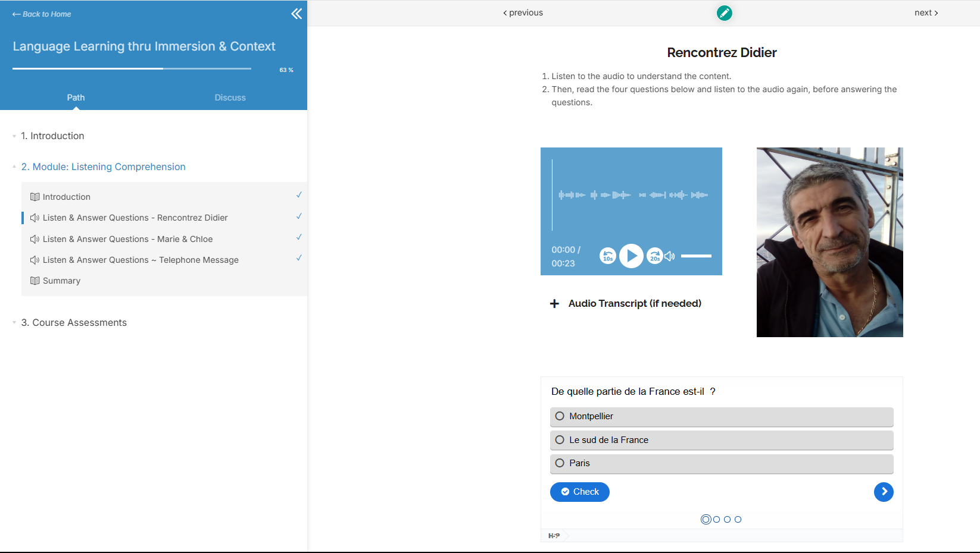
Module: Listening Comprehension Slide No. 6
Audio Narration
Slide Mockup
This is an example of one of the listening exercises. Notice the audio clip with optional transcript (if needed) and the visual image to help with context. See how we can advance through the four or five questions to read them before listening to the audio a second time and then coming back to answer them and move onto the reflection or discussion questions.
Interactivity & Programming Notes
In picture live camera of instructor narrating at bottom right of screen.
Click on sound bar to hear video clip.
Click on Accordion + for audio transcript
Click on embedded quiz to demonstrate how to advance through the questions.

Slide 7
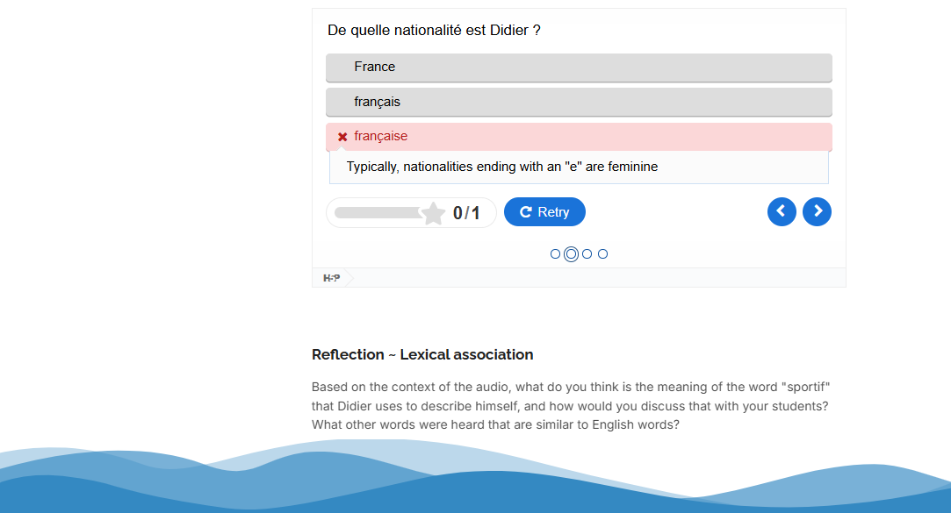
Module: Listening Comprehension Slide No. 7
Audio Narration
Slide Mockup
After completing each question you can “check” your answer and receive feedback as to whether it is right or wrong. Once you have completed all questions, move onto the reflection or discussion section at the bottom.
Interactivity & Programming Notes
In picture live camera of instructor narrating at bottom right of screen.
Scroll down to see “Reflection ~ Lexical Association” prompt.
Click on the “Discuss” tab on the course player to go to next slide

Slide 8
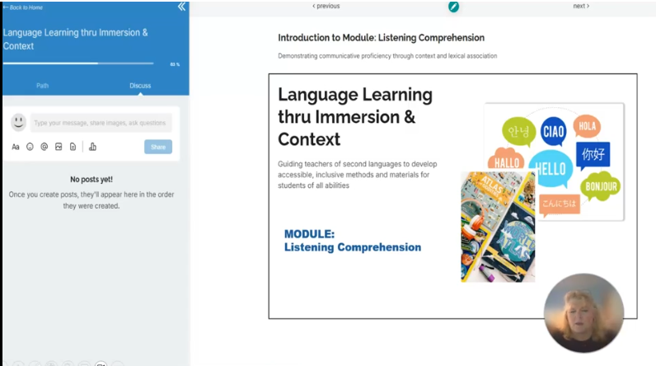
Module: Listening Comprehension Slide No. 8
Audio Narration
Slide Mockup
Finally, this is the course discussion tab. Now this is a discussion area for all participants in the course and specific to any subject. Please refer to any assignments that have specific discussion prompt areas for them.
If you have any questions about this module or course, please reach out to your instructor. Thank you and enjoy!
Interactivity & Programming Notes
In picture live camera of instructor narrating at bottom right of screen.

