Slide 1
What’s Next presentation
So . . . I took this Fire and EMS class; now where do I go from here?

Slide 2
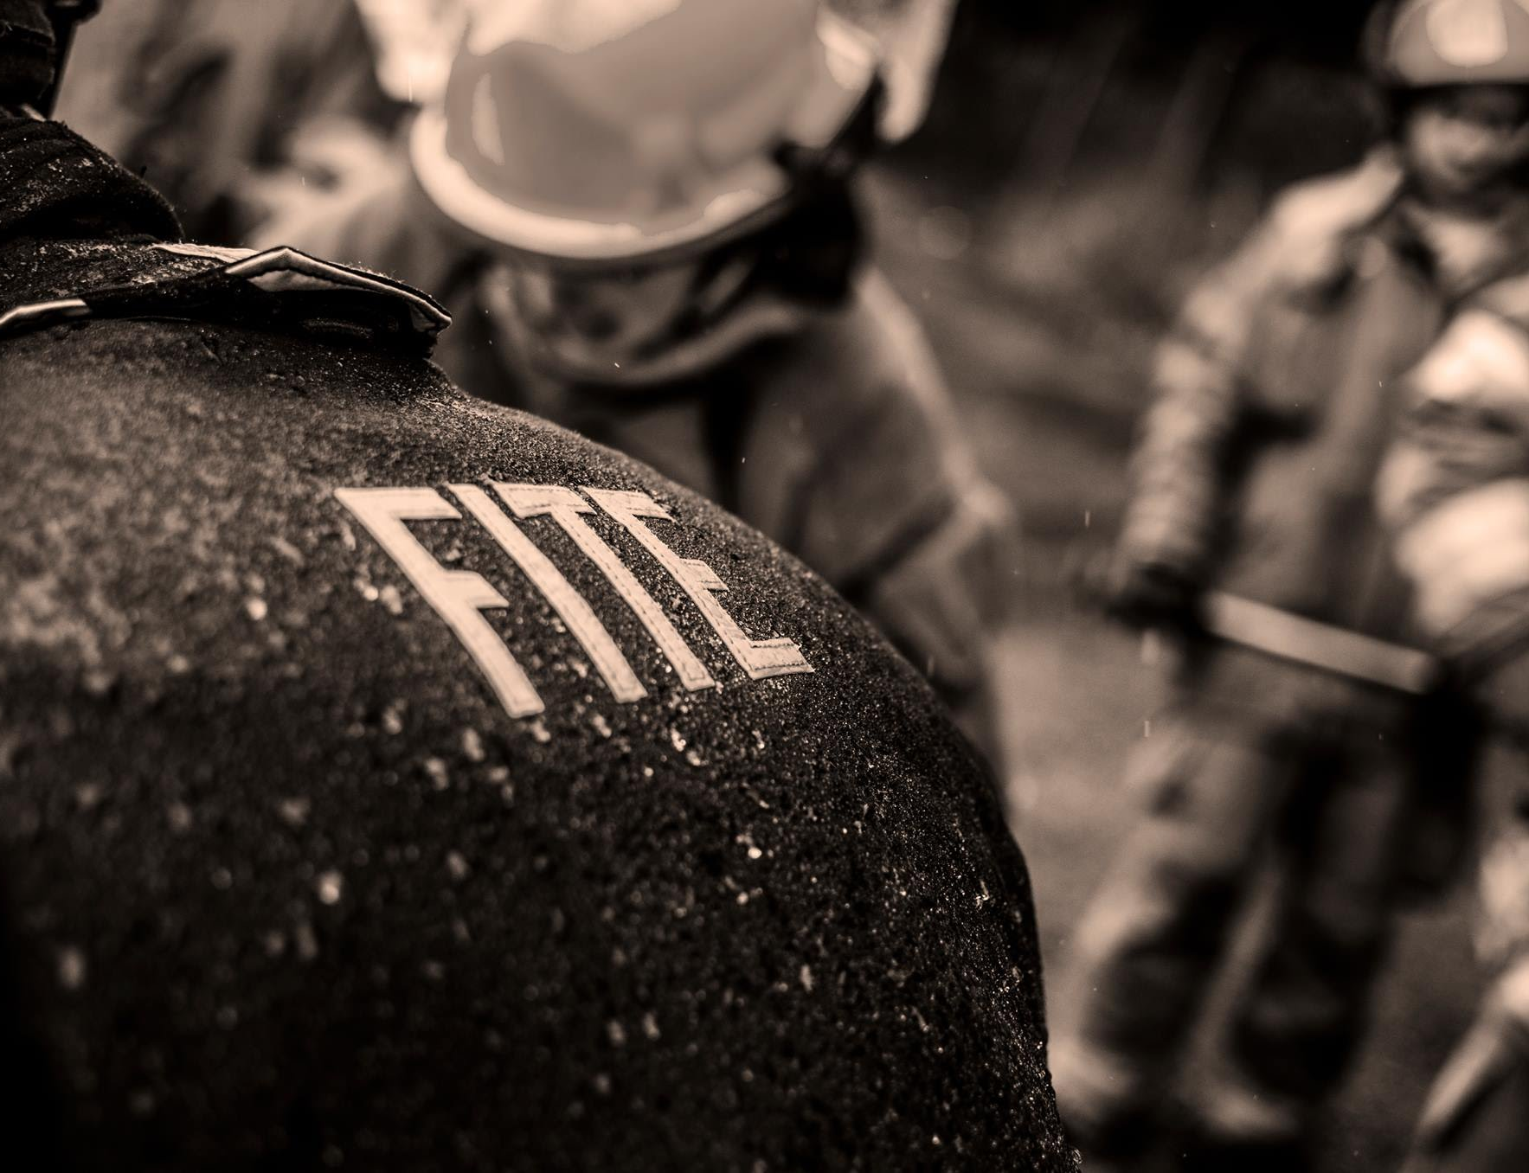
The fite class
Mission - We exist to raise up a generation of young people that live to serve their communities.
About our Instructors
Students Earn Professional Certificates
Fire Service Advisory Board
FITE Website: www.fitefire.org
Clothing Store:
Not mandatory
https://firetechacademy.com/storefront/

Slide 3
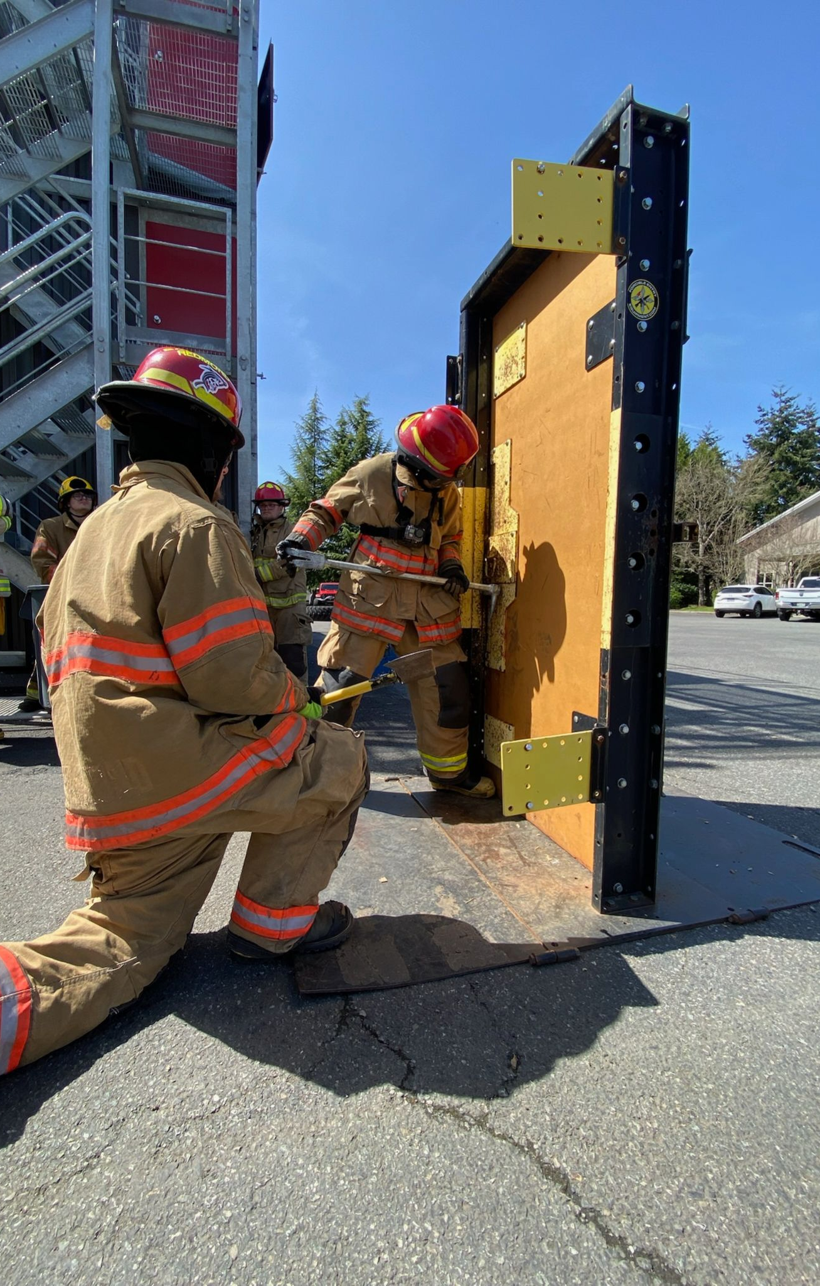
WHAT DOES IT TAKE TO MOVE TO THE NEXT LEVEL? . . . And the next . . . And the next?
FITE’s Belief: If you can physically do the job AND are willing to sacrifice, there IS a place for you in the fire service.
Secret to Success: Hard work IS the shortcut!
Reverse engineer the PLAN.
Do I HAVE to go to college to be a firefighter?
So where do I start if I want to go to college?
Create a Plan A . . . Plan B . . . Plan C
Apply for Financial Aid “FAFSA” & Scholarships
Even if you think you will not qualify or you might not go to college, fill it out
Go visit and check it out!

Slide 4
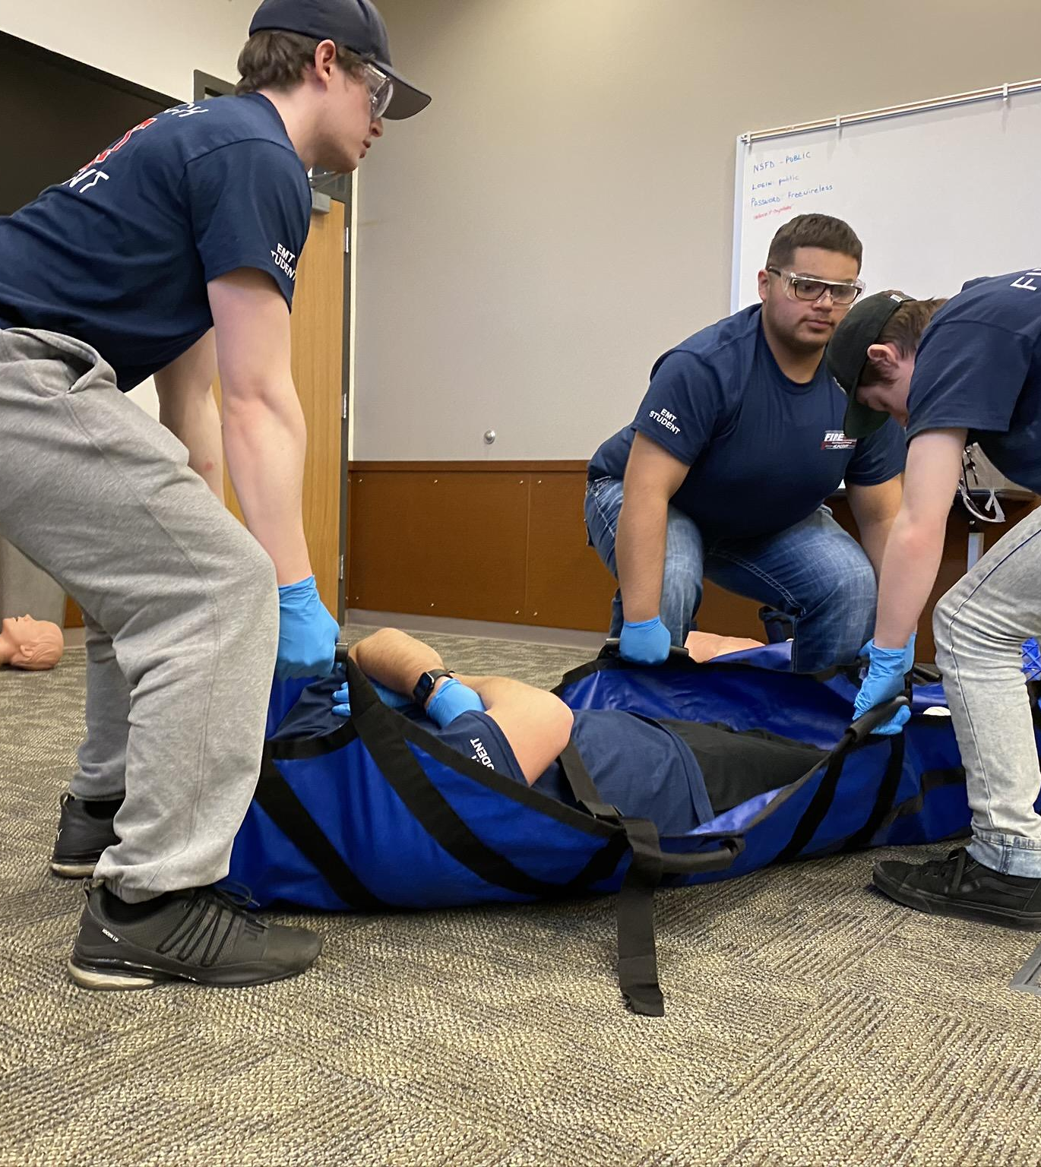
What’s Next . . . Fire tech academy
EMT Training Class:
Class Schedule (12 weeks):
Tuesday / Thursday 5:30 – 9:30 PM
Saturdays 8:00 AM – 4:00 PM
Qualifies students to take the NREMT test
3 classes offered each year (Winter, Spring, Fall).
Seniors can take this class with approval in the Spring (must be 18 by final test date)
Tuition: $2300 for all students
Includes 1 test voucher, t-shirt, fees, and equipment

Slide 5
What’s next . . . College (in state)
Washington State Fire & EMS Colleges:
Skagit Valley Community College
Everett Community College
North Seattle Community College
Bates Technical College (Tacoma)
Central Washington University (Ellensburg)
Spokane Community College

Slide 6
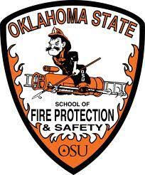
What’s next . . . College (out of state)
Notable Out-of-State Fire & EMS Colleges:
University of Alaska (Fairbanks, Ak)
Chemeketa Community College (Salem, Or)
University of Montana (Helena, MT)
Oklahoma State University (Stillwater, OK)
Eastern Kentucky University (Richmond, KY)
University of Maryland (College Park, MD)
Pennsylvania College of Technology (Williamsport, PA)

Slide 7
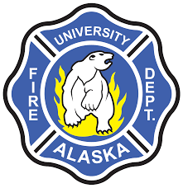
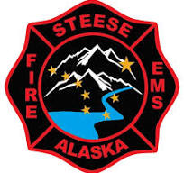
What’s next . . . College & Fire experience
University of Alaska – Fairbanks:
Steese FD, University FD, Chena-Goldstream FD, North Star
2-year Fire Science Degree
4-year Emergency Management or Paramedicine Degree
Chemeketa Community College:
Salem, Oregon area.
2-year Fire Science
College Fire Department Internship

Slide 8
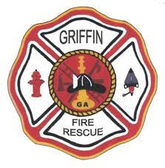
What’s next . . . Fire experience
Residencies:
Sky Valley-Goldbar / Index / Snoqualmie
Mountain View
Eastern Washington:
Leavenworth, Douglas County #2, Cheney
Sedro Woolley
East Olympia
Volunteer/Part-paid:
Griffin (full-time open now)
West Thurston
Riverside
Getchell
To apply, visit the department’s website

Slide 9
What’s next . . . military
Pros:
Testing point bonus
Followership opportunities
Leadership opportunities
Life experience
Education…paid
Keep in mind:
You don’t always get to do “the job” in the military
Years on a contract

Slide 10
Upcoming Events to talk to your Student about!
Interview Prep Project
Scholarship Interview Assignment
Auto Extrication
North Bend Parent Nights (In person…6PM)
Kirkland 4/23
Tumwater 4/28
Mount Vernon 5/5
Seattle 5/7
North Bend Fire Experience- Tumwater 5/21, Kirkland 5/22, Mount Vernon/Seattle 5/23

Slide 11
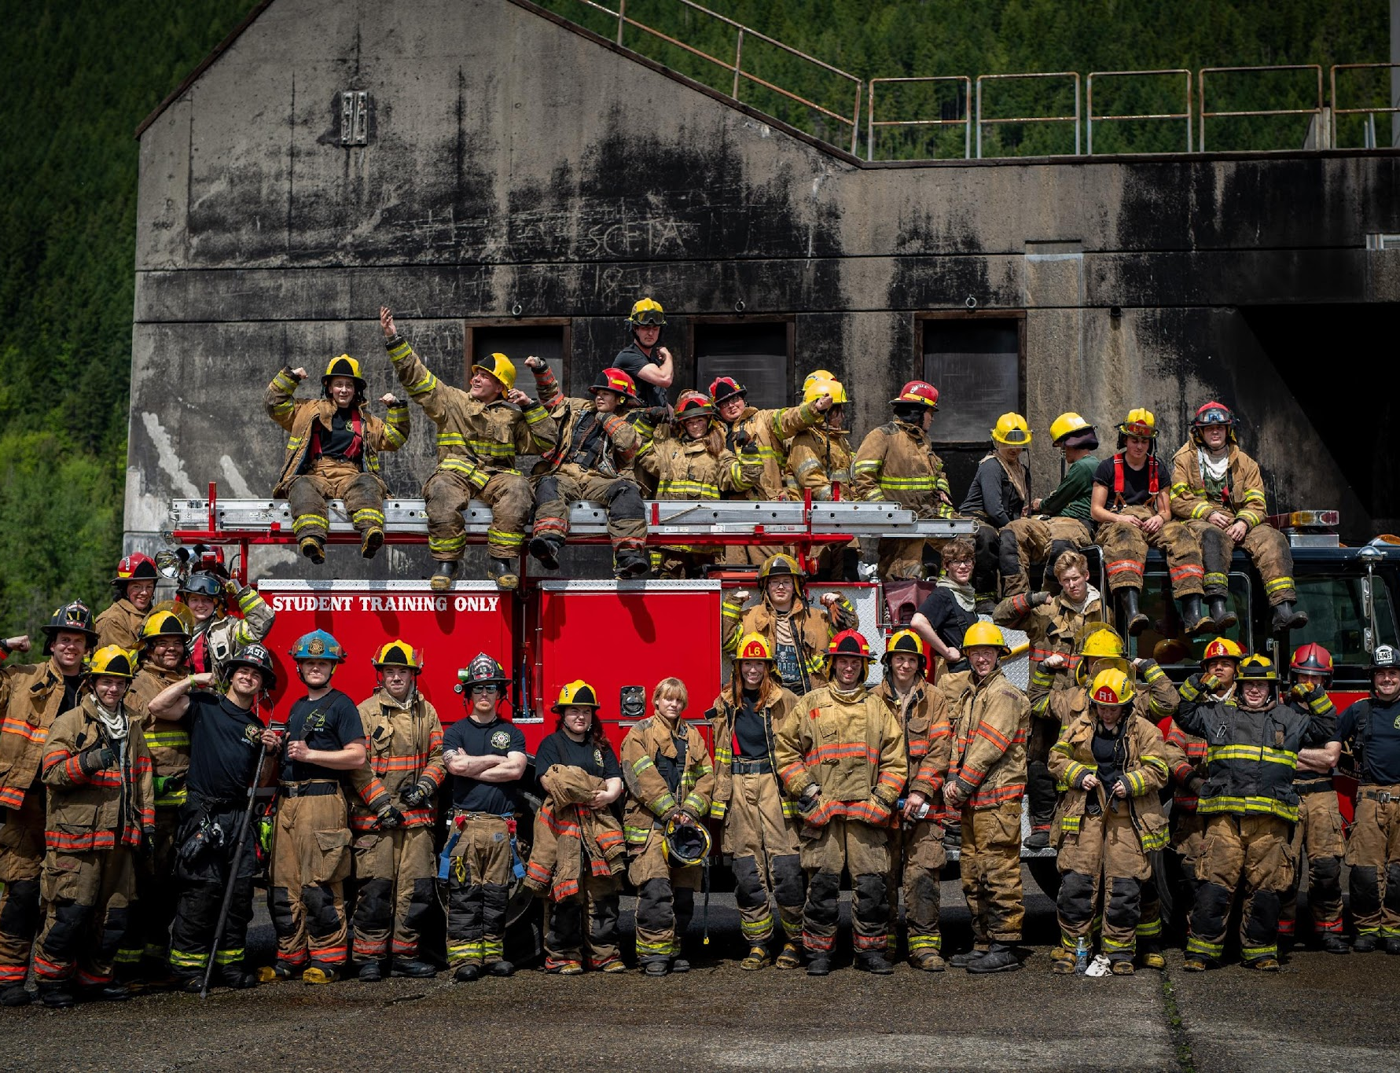
Explore all the options!
Please feel free to contact us with any questions!
FITE Director: Jack Greaves
jgreaves@fitefire.org
FITE Administrators:
Cameron Means cmeans@fitefire.org
Austin Allen aallen@fitefire.org
https://fitefire.org/whats-next
Thanks for joining!!!

