Slide 1
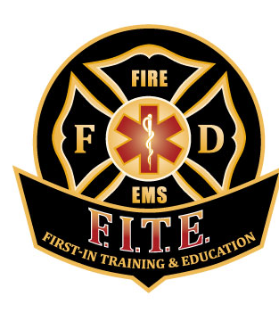
WANIC-F.I.T.E. Fire and Ems
Open house and informational session
March 9, 2021

Slide 2
First-In Training and Education- F.i.t.e.
A 501(c)3 public charity formed in 2011 at WANIC
We contract with high schools and skills centers to provide fire and EMS preparatory training to high school juniors and seniors
Taught by full-time fire service professionals
Currently has 5 programs in Washington serving over 300 students per year (New Market-Thurston/Mason/Lewis Counties, Meridian-Whatcom County, Mt. Vernon-Skagit/Snohomish Counties, Seattle-Seattle School District, WANIC-NE King County)

Slide 3
Why WANIC/FITE??
Firefighting and EMS is a high demand, high wage, highly competitive field
FITE gives students the opportunity to gain valuable experience prior to jumping into the hiring/training process
Early experience gives multiple advantages:
Build a network of support and expertise
“Test Drive” the career before investing more resources (college, tech school, time, etc.)
Find your niche…multiple facets to the fire service and emergency medicine

Slide 4
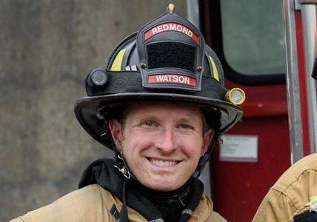
Meet the fite team!
FITE Director
Jack Greaves
FITE WANIC Lead Instructor
Dave Watson
FITE Instructor/Advisor
Austin Allen
FITE Instructor
Jayden Petro
FITE Instructor
Anthony Casanas
FITE Instructor
Parker McKinnon
FITE Instructor
Cody Carlson

Slide 5
What does my student get out of this class?
High school credit- 1.0 Lab Science, 1.0 PE, 1.0 Occupational Ed
Inexpensive (or free) College Credit (with a qualifying grade): Up to 8 credits at Everett CC and 12 credits at Bellevue College
Exposure: Our industry relevant Advisory Board is made up of local fire department Chiefs, Deputy Chiefs, and training staff that are included in hiring and decision-making for their individual communities.
The strength of the FITE FAMILY! We have had students go to almost any fire (and non-fire related) programs in the country and can utilize that experience

Slide 6
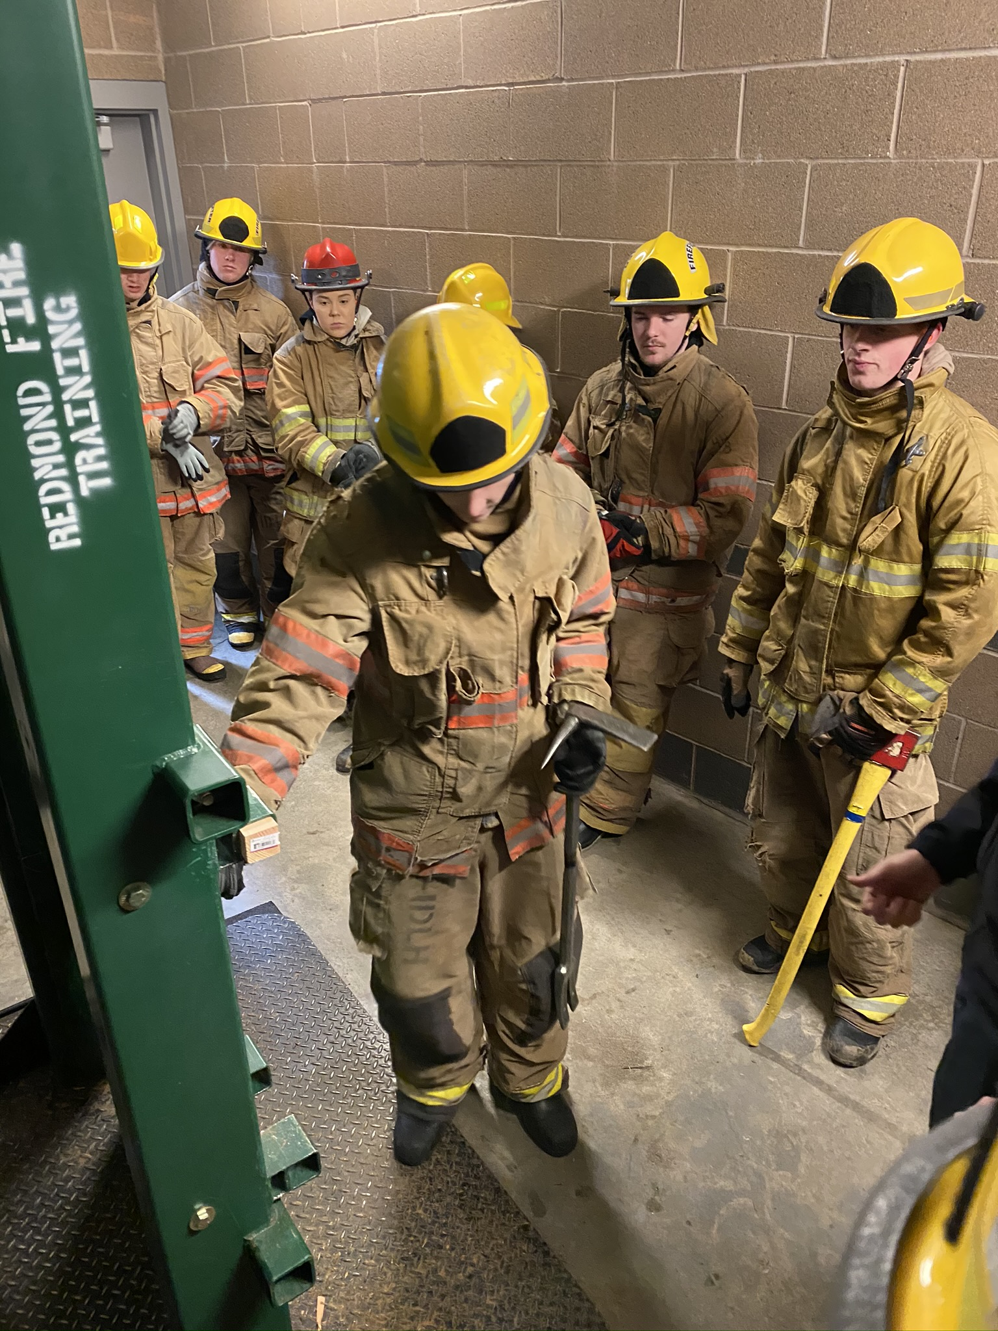
Schedule
AM class-7:15-9:45
PM class-12:00-2:30
Outside of COVID restrictions, class would be at Lake Washington Tech Mon-Tue-Wed and at various local fire departments Thur-Fri.
When ”in-person”, students receive their own set of bunker gear and 40% of our class time is dedicated to drill ground training

Slide 7
Outside Opportunities
Seniors have additional opportunities to earn certificates:
Wildland Certification - 5 online course and an in-person Field Day prepares them to earn a job fighting wildfires as a seasonal employee of state, federal, or private contractors
Offered in Fall and Spring
EMT - Spring EMT class prepares motivated students for the National Registry Emergency Medical Technician test and qualifies them for State Certification application
Both courses are outside of WANIC and incur additional out of pocket expenses and significant time commitment

Slide 8
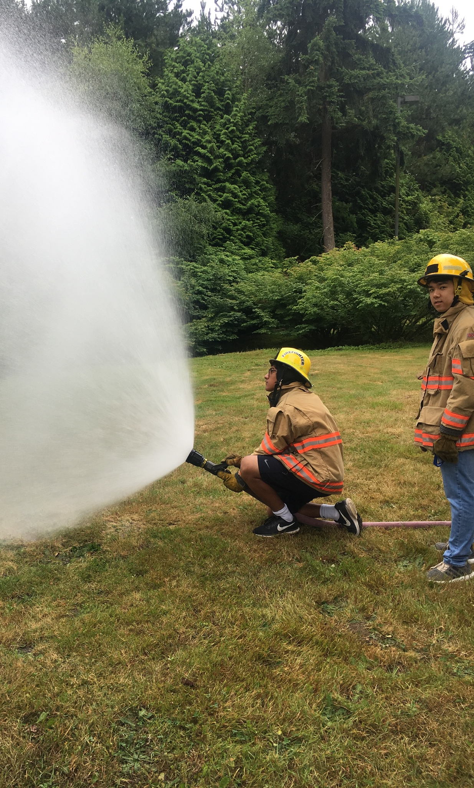
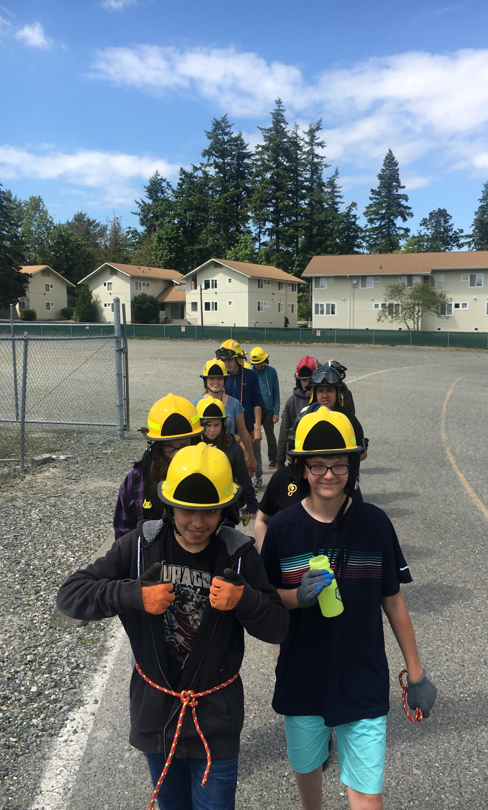
Summer Opportunities
FITE offers a 3-week Summer session
Intro to Firefighting and Emergency Medicine
Open to incoming Freshmen-incoming Seniors

Slide 9
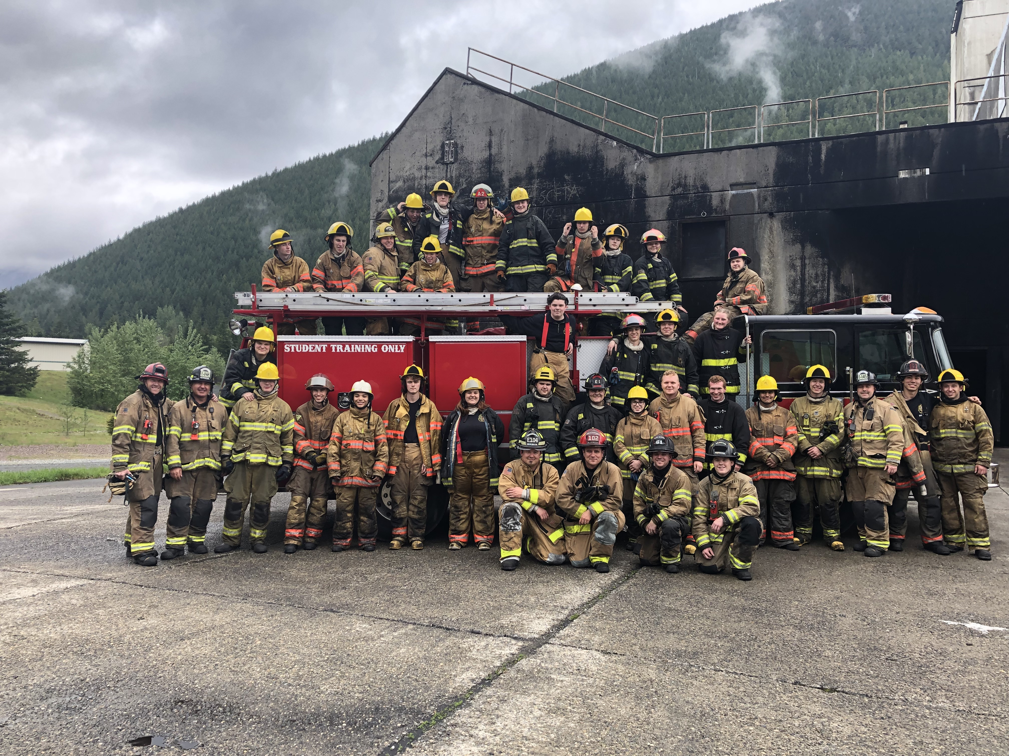
Questions?
Jack Greaves – FITE Director
jgreaves@fitefire.org
Dave Watson – FITE WANIC Lead Instructor
dwatson@fitefire.org
Austin Allen – FITE Instructor/Advisor
aallen@fitefire.org
FITE Website: fitefire.org
Facebook: @fitefire
Instagram: @fitefire_ems

