Slide 1

What SEND Support is Available in Schools?
Parent Assembly Session
Tuesday 8th September 2026

Slide 2

Ordinarily Available Inclusive Provision Myth-Busting Quiz
Type True or False into the chat for each statement
OAIP strategies are only for pupils with EHCPs.
Adaptive practice means creating separate worksheets for every pupil.
Visual aids and task planners are examples of OAIP.
You need a TA to implement inclusive adaptations.
Flexible starts and movement breaks are part of OAIP.
Inclusive planning should be reactive, based on pupil behaviour.
OAIP is about anticipating barriers and planning for them.
Using pupil passports can help embed OAIP in weekly planning.
OAIP is the same in every school.
OAIP strategies are just good teaching.
Notes:
1. False – OAIP is for all pupils, not just those with EHCPs.
2. False – Differentiation can be about outcomes, support, or resources, not just worksheets.
3. True – These are practical OAIP tools.
4. False – Teachers can implement OAIP independently.
5. True – These support regulation and access.
6. False – OAIP is proactive, not reactive (but you should be aware of how to made in-the-moment adaptations based on pupil behaviour)
7. True – Planning ahead is key to inclusion.
8. True – Pupil passports guide personalised support.
9. False – OAIP varies based on school context and resources (hopefully the guidance will make provision more consistent across settings though)
10. True – OAIP aligns with quality first teaching.

Slide 3
OAIP Myth-Busting Quiz
OAIP strategies are only for pupils with EHCPs.
Adaptive practice means creating separate worksheets for every pupil.
Visual aids and task planners are examples of OAIP.
You need a TA to implement inclusive adaptations.
Flexible starts and movement breaks are part of OAIP.
Inclusive planning should be reactive, based on pupil behaviour.
OAIP is about anticipating barriers and planning for them.
Using pupil passports can help embed OAIP in weekly planning.
OAIP is the same in every school.
OAIP strategies are just good teaching.
Notes:
1. False – OAIP is for all pupils, not just those with EHCPs.
2. False – Differentiation can be about outcomes, support, or resources, not just worksheets.
3. True – These are practical OAIP tools.
4. False – Teachers can implement OAIP independently.
5. True – These support regulation and access.
6. False – OAIP is proactive, not reactive (but you should be aware of how to made in-the-moment adaptations based on pupil behaviour)
7. True – Planning ahead is key to inclusion.
8. True – Pupil passports guide personalised support.
9. False – OAIP varies based on school context and resources (hopefully the guidance will make provision more consistent across settings though)
10. True – OAIP aligns with quality first teaching.

Slide 4
Notes:
We are a School Improvement Service with a SEND Focus. There are 8 of us in the team, all previous SENCOs and school leaders that work across all age phases. Our role is to work with Leadership Teams and SENCOs in settings to improve their systems, procedures and practice to get better outcomes for the young people with SEND. Whilst we do not work directly with families and young people, we are part of the wider system, providing guidance and support to setting staff and wider professionals.

Slide 5

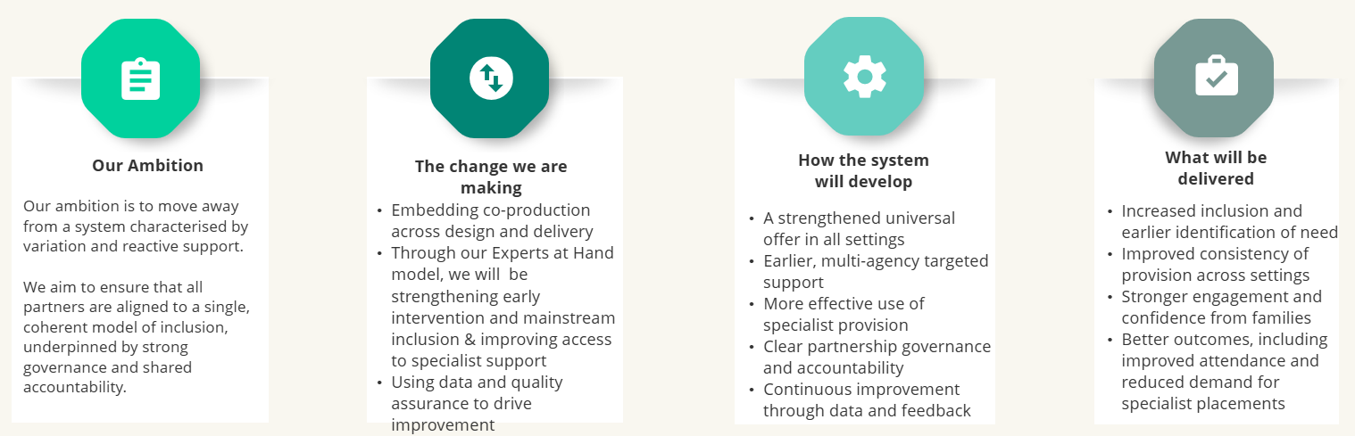
SEND Reforms: Salford’s Plan
Salford’s vision is to create a fully inclusive, partnership-led SEND system in which children and young people with additional needs achieve positive outcomes, attend their local settings wherever possible, and are supported early, consistently and effectively.
This means a system where:
  Inclusion is the default across all education settings
  Families experience a joined-up and responsive pathway of support
  Services work seamlessly together across education, health and care
  Decisions are transparent, co-produced and focused on outcomes

Slide 6
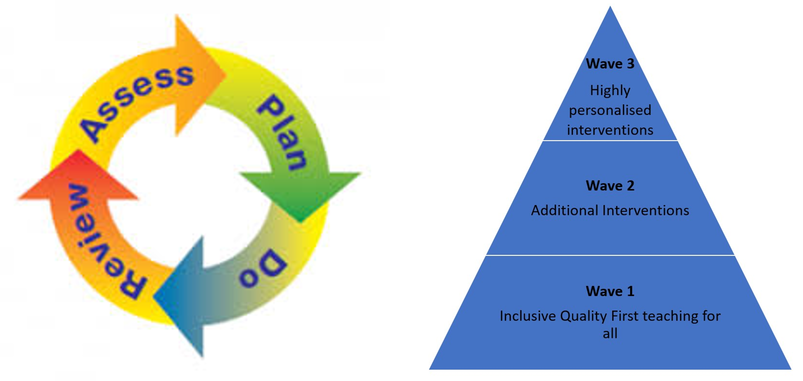

The Graduated Approach
Lack of clarity and consistency, even when the model is applied well.

Slide 7
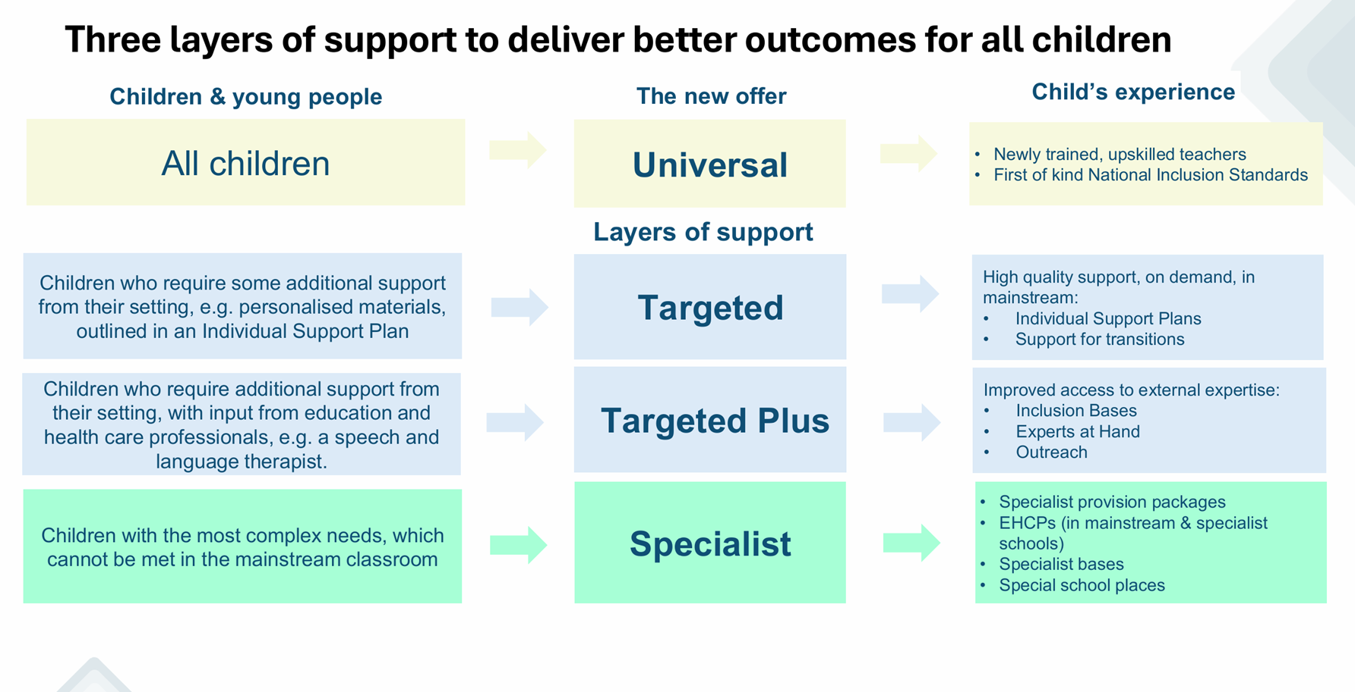
Notes:
The new Graduated Approach Model / Use old model first

Slide 8
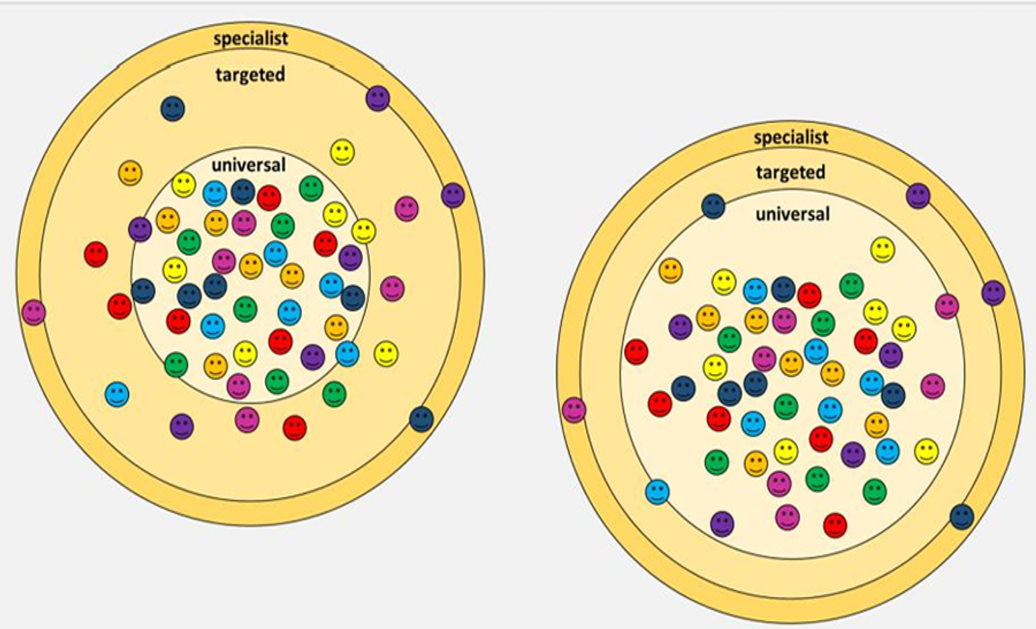
The Universal Offer
Over the next few months, a co-produced Salford Universal Offer Agreement will be developed.
All settings across the city will agree to the following:
A shared vision for Inclusion
The use of Ordinarily Available Inclusive Provision (OAIP) as standard practice
Inclusive Classroom & Practices
Partnership Working
Transition & Preparation for Adult Life
Quality Assurance & Accountability
Our first co-production event takes place on Wednesday 16th September at Buile Hill Park Hall (10:00-12:00). All are welcome to attend – book your place by emailing: Chantelle.Marshall@salford.gov.uk

Slide 9
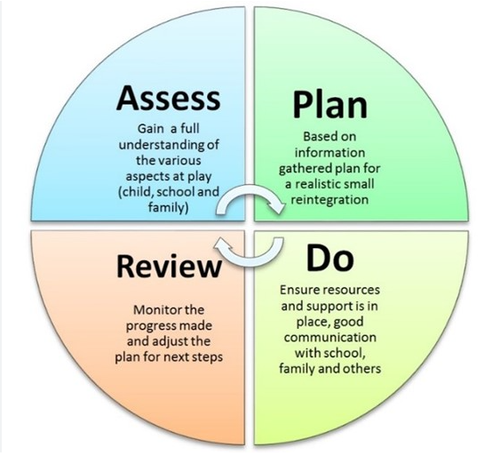
Targeted Support – Individual Support Plans
What is an ISP?
A working document that sets out the additional support your child needs in school, the strategies we will use to help them, and the outcomes we are aiming for. It helps everyone involved with your child to understand what support is in place and how we will work together to help them make progress.
It is individualised to your child.
It focuses on strengths as well as areas of need.
It records agreed support and outcomes.
It is reviewed regularly and can be adapted.
Parents and the child are important partners in shaping it.
Notes:
Make sure you’ve covered:
What is an ISP
When should an ISP be used – APDR cycle
Why – child is presenting with difficulties that OAIP is not solving
Who – co-produced with setting, family and child
Review – targets should be reviewed regularly – this can be done in different ways and parent/carers should remain involved.

Slide 10
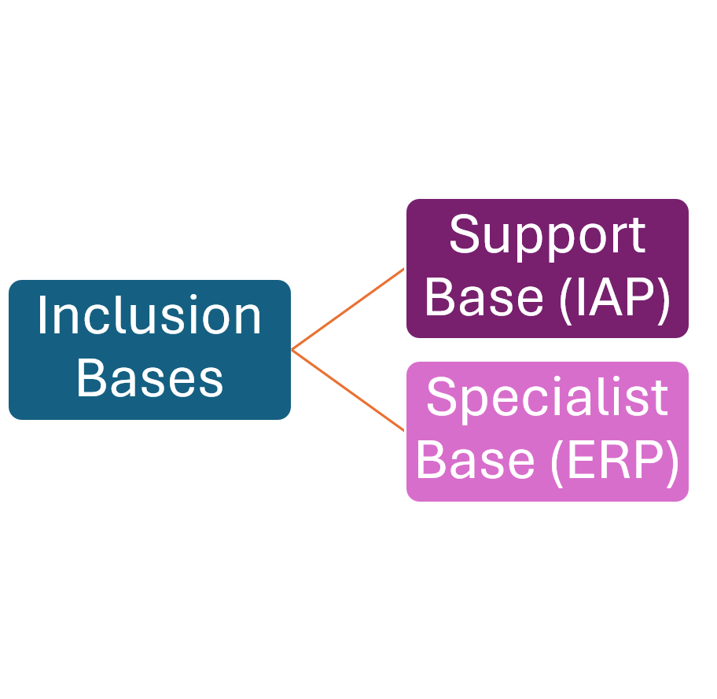
Targeted Plus Support – Inclusion Bases
Support Base
Currently known as Internal Alternative Provision (IAP).
A space outside of the mainstream classroom, where children access additional support for a significant amount of time.
Children will have access to specifically skilled staff and the Experts At Hand model.
Specialist Base
Currently known as Enhanced Resource Provision (ERP).
The children accessing this base are determined by the Local Authority and will have an Education, Health and Care Plan (EHCP).
Children may spend all their time in this base or access some mainstream learning.
Children will receive bespoke support from professionals required to meet their needs.

Slide 11
Key Objectives
Access to specialist SEND expertise.
Advice and guidance tailored to need.
Works alongside school staff.
Builds staff confidence and skills.
Focused on improving outcomes for children and young people.
A collaborative approach involving school, parents, and where appropriate, the child or young person
Myth Busting
Having Experts At Hand in settings does not mean that your child will be receiving 1:1 input.
There could be whole school approaches, class level input, small group interventions and individual observations.
Experts At Hand
Experts at Hand gives schools direct access to SEND specialists who help staff identify effective strategies and support so that children and young people can thrive.

Slide 12
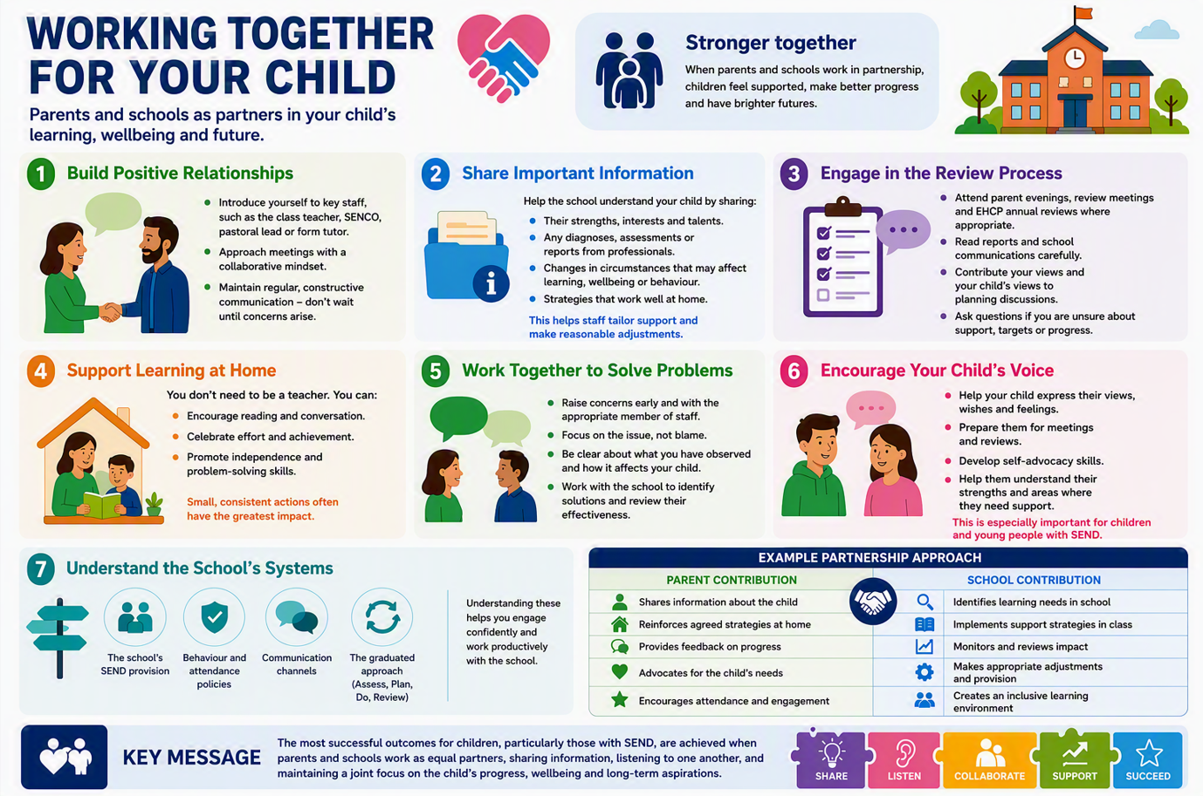

Slide 13
Happy to take Questions

