Slide 1


Welcome
Date: Tuesday 25th August
Time: 6:30pm
Place: Online
SalfordPCF & SEND Local Offer
Guest speaker: Melissa Caslake

Slide 2

Today’s session
Welcome, introductions and housekeeping
Updates from SalfordPCF
Today's guest presenter
Question time
Looking ahead
Further information and support
Close
Notes:
1. Welcome and Introductions
Welcome from Salford Parent Carer Forum
Introductions to facilitators, guest speakers and attendees
Housekeeping
2. Looking After You
A reminder that some topics may be sensitive or emotional.
Please take a break if you need to and speak to a member of the SalfordPCF team if you would like support.
We are here to listen and help signpost you to the right services.
3. Updates from Salford Parent Carer Forum
Recent activities and achievements
Opportunities to get involved
Upcoming events and support groups
4. Today's Topic / Guest Presentation
Presentation from guest speaker(s)
Information, updates or service developments
5. Questions and Discussion
Open discussion
Questions from parent carers
Sharing experiences and ideas
6. Looking Ahead
Upcoming meetings and events
Future Parent Assembly topics
7. Where to Find More Information
Salford Parent Carer Forum website: www.salfordpcf.com
Salford Local Offer
SEND Information Advice and Support Service (SIASS)
Salford Parent Carer Forum Facebook page
8. Thank You and Close
Thank attendees for coming
Evaluation/feedback

Slide 3
Welcome, introductions and housekeeping
Viv Ormrod - Chair, SalfordPCF
Abi McCarthy - SEND Development Officer, Salford City Council
If you want to jump in at any point you can either pop your question in the chat or use the hand raise button
Feel free to keep cameras on or off, we really don’t mind
Grab a brew and let’s get started

Slide 4

The Parent Assembly
The Parent Assembly is a monthly meeting where parent carers and local SEND professionals come together to share information, discuss key issues, influence local services, and work in partnership to improve outcomes for children and young people with SEND.

Slide 5

Updates from SalfordPCF
Changes for SalfordPCF
Expanding our work
Driving co-production

Slide 6
Guest speaker: Melissa Caslake - Executive Director, Children’s Services, Salford City Council

Slide 7



Salford’s Ambitions
 | To co-produce plans with children, young people and families with clear information sharing and communication so that everyone is working together. To promote co-production at the heart of practice so that the voice of the children, young people and their families is at the heart of all we do.
 | For children, young people and their families to have good outcomes through clear pathways and the right support at the right time To co-ordinate clear multi-agency pathways, including planning ahead for smooth transitions to achieve positive outcomes for individual children and their families. To have clear focus on creating opportunities that are fulfilling and meet personal aspirations.
 | That the whole workforce is knowledgeable and skilled ensuring children and young people are accessing the right provision at the right time. Plan sufficient provision to enable children, young people and their families to feel supported and included.
 | That children and young people's needs are identified early, assessed in a timely manner and met through support which is reviewed regularly. Ensure timely information, advice and support is provided and deliver high quality assessments and reviews in a timely manner ensuring children and young people with SEND and their parents/carers are involved at every stage of the process.
Notes:
SEND reforms build on what we are already doing

Slide 8
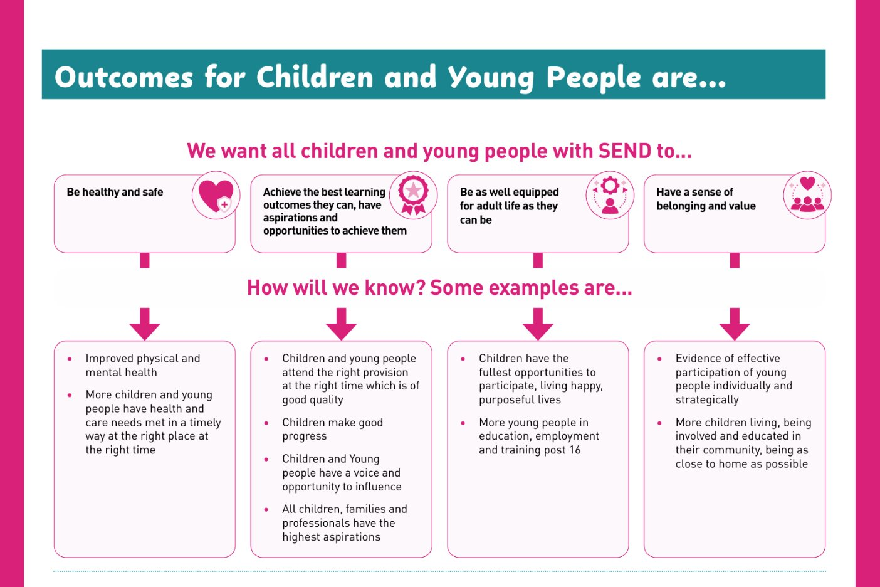

Slide 9
Guest speaker: Melissa Caslake - Executive Director, Children’s Services, Salford City Council
Recent Ofsted/CQC SEND Inspection
What was the inspection for?
The findings and full report should be published in the next few weeks

Slide 10
Guest speaker: Melissa Caslake - Executive Director, Children’s Services, Salford City Council
SEND reforms
February 2026: The Department for Education (DfE) published the schools white paper Every Child Achieving and Thriving. Alongside this they launched a consultation on proposed changes.
Over the following months, Salford were asked to undertake a number of tasks including completing a number of self assessments. We have looked at the DfEs core minimum requirements and complete a draft SEND reform plan.

Slide 11
Guest speaker: Melissa Caslake, Executive Director, Children’s Services, Salford City Council
How your views make a difference
Working with SalfordPCF, we have been including the voice and experiences of Children, Young People and their families in our work.
They have contributed to:
Salford’s SEND Strategy
Salford's SEND Reform Plan
Salford’s SEND Action Plan

Slide 12








Priorities for 26/27
Improve timeliness of annual review process and ensure EHCPs are current and matched to provision
Continue to build on the Neurodevelopmental Approach
Strengthen the range and availability of the Short Break Care offer
Inclusion in mainstream
Embedding co-production within workforce & increasing participation of families
Embed high quality and earlier transitions and preparation for adult life
Develop and implement a streamlined workforce strategy, strengthening workforce knowledge and skills
SEND Provision - Continue to increase capacity within mainstream
Notes:
Melissa

Slide 13
Comment, questions and feedback

Slide 14
Upcoming sessions
8th September: SEND Support in School with Salford SEND Leaders
13th October: Education Rights with SIASS
10th November: Preparation for Adult Life & post 16 Education with Salford’s PFA lead and Skills & Work
8th December: Children’s Mental Health and wellbeing with CAMHS

Slide 15
Further information and support
Salford’s SEND Local Offer website
Salford Parent Carer Forum:
- Facebook and Instagram pages
- Private Facebook group
- WhatsApp Community
- Support group, drop-ins and information sessions
- Organise feedback and listening events
- Website www.salfordpcf.com
Salford’s Neurodiversity Networks:
- 27th August, 10am, Langworthy Cornerstone
Gaddum Carers Service:
- www.gaddum.org.uk
Carers Assessment
- Call the Bridge on 01616034500

Slide 16

Close

