Slide 1
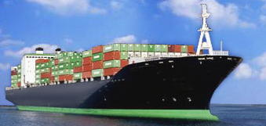
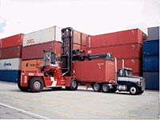
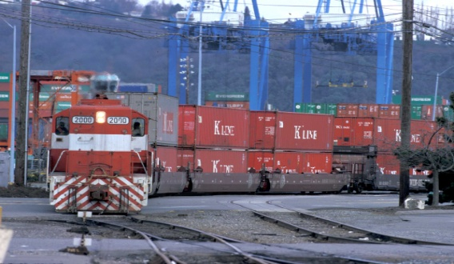

Elaine Nessle, Executive Director
Floridians for Better Transportation
2018 Transportation Summer Camp

Slide 2




















Who is CAGTC?

Slide 3
What Federal Resources Exist for Freight Transportation Infrastructure?
INFRA (2015-2020, authorized)
  Mega projects grant program for freight & highway projects. ~ $1 billion annually, limited funding for non-highway projects.
BUILD/ TIGER (2009–2018, appropriated)
  Competitive grant program for all mobility needs, including freight. Ranges from $500 million to $1.5 billion annually.
Freight Formula Program (2015-2020, authorized)
  Distributed to state departments of transportation using existing formula allocations. ~ $1 billion annually, divided among states and territories, limited funding for non-highway projects.

Slide 4
How Do Federal Resources Stack Up Against Freight Needs?
$19 B
$11.8 in Requests for every $1 Available!

Slide 5
How Do Federal Resources Stack Up Against Needs?
$12.6 in Requests for every $1 Available!

Slide 6
Put in Perspective…
Florida’s INFRA Requests
$1.6 B

Slide 7
Put in Perspective…
Florida’s TIGER Requests
18 applications requested total of $213 million, or 43% of available funding. $13 million was awarded to 1 project.

Slide 8
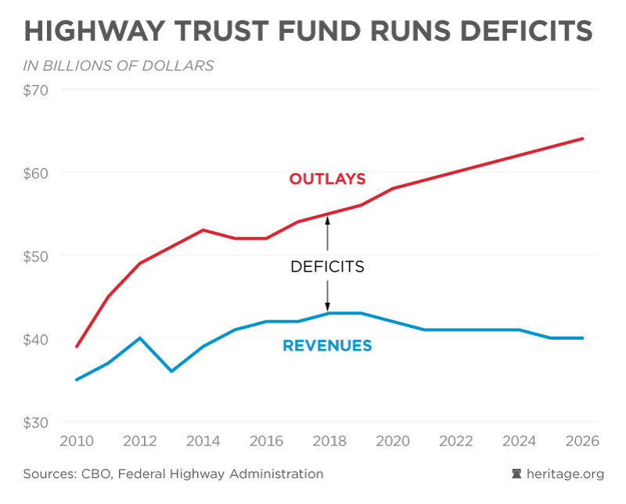
Needs Grow, Resources Decline

Slide 9
How do we avoid the 2021 cliff?
NNNDevolutionNNN
Align spending and receipts
Continue HTF Bailouts
Find Additional Resources
  Increase gas tax
  Vehicle Miles Traveled (VMT)
  Waybill

Slide 10
Freight Can’t Wait.
And Neither Should You!
Meet frequently with your Member of Congress
  Invite them for a site visit during August Recess!
  Visit them in Washington!
  Ask for letters of support on your INFRA and BUILD applications – and ask your Member to place phone calls!
Collaborate regionally
Collaborate nationally

Slide 11
Contact
Elaine Nessle
enessle@blakey-agnew.com
Phone: 202-828-9100
www.tradecorridors.org

