Slide 1
THEA Connected vehicle Pilot Project
Technology for Our Future
Notes:
THEA won a $17.7 M USDOT grant for a pilot CV project. With our $3.8M match and a $500K FDOT contribution it is a $22M project.
THEA’s CV Pilot Project is designed to make transportation safer, smarter and greener.
Safer: According to the National Highway Safety Administration, 94 percent of fatal car accidents in Florida were caused by driver error. Drivers fail to recognize pre-crash conditions, like sudden braking, or reacted inappropriately to the situation. CV technology can help drivers recognize pre-crash events more quickly and respond to them more effectively.
Smarter: V2V and V2I communication technology can give real-time warnings to pedestrians, bicyclists and drivers via Smartphones and Smart car apps.
Greener: V2I technology will be used to monitor traffic conditions and then transmit that information to drivers and signal systems. Instead of stopping at every intersection, you’d see green lights for blocks at a time, thereby improving traffic flow and reducing carbon emissions.

Slide 2
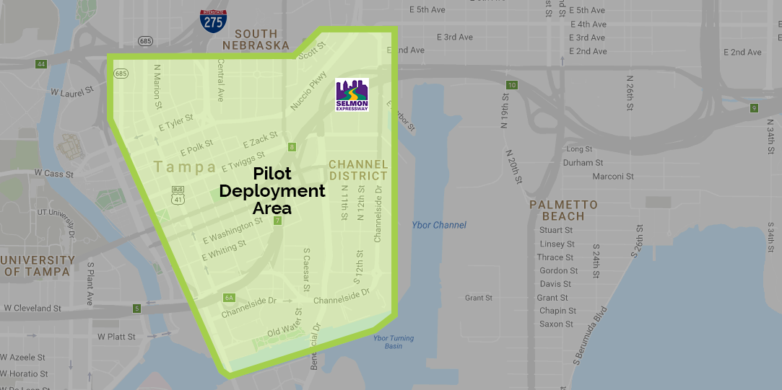
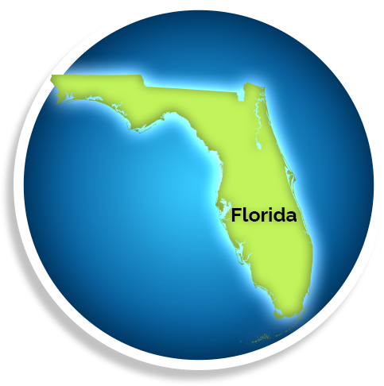
Connected Vehicles in Tampa
MAP: TAMPA HILLSBOROUGH EXPRESSWAY AUTHORITY (THEA)
Notes:
This is a map of our deployment area The area is about one square-mile of the Tampa downtown business district.
Our focus is on technology we can apply now.
We want our customers to see a benefit now. To make this real for our customers it needs to be practical.
We identified baseline conditions and we will monitor and measure the changes the technology provides.
If successful, we want it to be repeatable. Something we can share and grow as a cost effective solution to broader benefit.

Slide 3
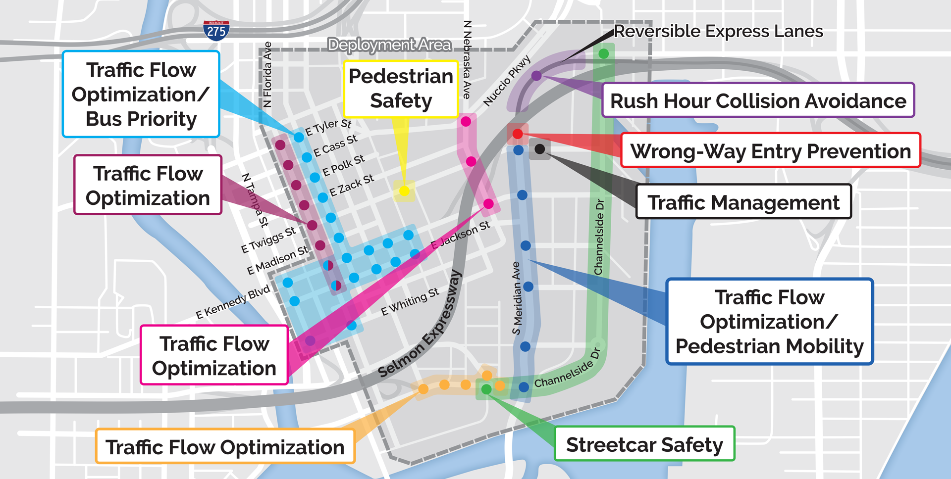
Focused Deployment Area
Notes:
These are the issues we’ll be addressing with the deployment of about a dozen technology applications.
Sample transportation problems to addressed and measured:
Red Light Running
Transit Prioritization
Pedestrian Conflicts
Enhanced Signal Coordination
Crash Avoidance
Queue Prevention
Smart Parking
Wrong way Driving

Slide 4
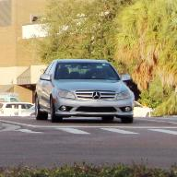
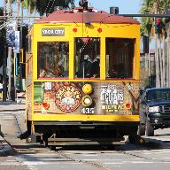
Participants
PHOTO: THEA
PHOTO: NPR
PHOTO: THEA
PHOTO: THEA
1,600
Privately Owned Vehicles
500+
Pedestrian Smartphones (Android devices only)
10
TECO Line
Streetcar Trolleys
10
Hillsborough Area Regional Transit
(HART) buses
Notes:
By the numbers…our goal is to recruit the help of 1,600 commuters in their personal vehicles and 500 or more pedestrians via their cell phones.

Slide 5
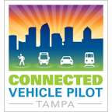
Transit Signal Priority
Applications
I-SIG
Transit Signal Priority (TSP)
IMA
Pedestrian Transit Movement Warning (PTMW)
PHOTO: TAMPA HILLSBOROUGH EXPRESSWAY AUTHORITY (THEA)
Notes:
This will include 10 Hillsborough Area Regional Transit (HART) buses, equipped to enable them to communicate with traffic signals on their routes.
Downtown traffic congestion can prevent buses from reaching their stops on time, causing them to fall behind schedule and frustrate customers.
The signals will prioritize bus movements to keep buses on schedule.

Slide 6
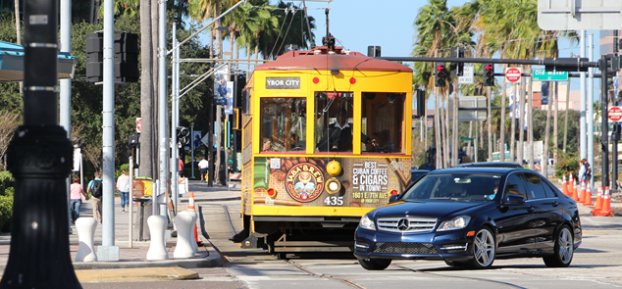
Streetcar Conflicts
Applications
Vehicle Turning Right in Front of Transit Vehicle (VTRFTV)
PTMW
PHOTO: TAMPA HILLSBOROUGH EXPRESSWAY AUTHORITY (THEA)
Notes:
And a trolley system….
The TECO Line Streetcar System is an electric trolley line that roughly follows Channelside Drive between downtown Tampa and Ybor City.
Our project will equip TECO Line streetcars with devices that enable them to communicate wirelessly with other connected vehicles and pedestrians to enhance safety.
Streetcar operators will receive a warning when a connected vehicle or pedestrian is about to cross the track, reducing the risk of a collision.

Slide 7
Transportation in the Future
Connected-Automated-Shared-Electric (CASE) for
Automated-Connected-Electric-Shared (ACES)
The C.A.S.E. for A.C.E.S
Think of the space program. The idea was conceived during President Eisenhower's administration, but it was President Kennedy who set a national goal of "landing a man on the Moon" by the end of the 1960s. He proposed that goal in an address to Congress on May 25, 1961. Just 8 years and two months later on July 20, 1969, a man walked on the moon.
Notes:
I believe we are living in an amazing time, on the verge of a golden age in transportation. We in the tolling industry have lived through one disruptive technology transformation called All Electronic Tolling. 8-years ago THEA converted the
“ACES is transportations moon shot” We may not be landing in the next 8-years, but it will be there in the next 30. And, we - you and I – who work in the transportation industry must play a major role in making that happen.
Selmon Expressway to AET. Today, that transition allows us to carry 70% more transactions than we did 10-years ago – that’s without adding a lane of roadway and actually lowering operating costs. Something that would have been impossible with the old toll plaza approach.
So how will ACES happen – THEA, FDOT and others are looking to the future – This disruption will affect all transportation, including transit agencies. Some transit thinkers and doers have realized their paradigm is going to change radically.
EXAMPLE …

Slide 8
Transit in the Future
CITILAB
The High Cost of Saving Travel Time
LAURA BLISS JUN 25, 2018
https://www.citylab.com/transportation/2018/06/the-high-cost-of-saving-travel-time/563393/
Are commuters changing how they value their minutes? A new study of time/cost trade-offs between transit, Uber, and Lyft is a hint. Time is a precious and nonrenewable resource. Lose it or save it, and you can’t trade it in for something else. But time can be traded off, depending on how you value it. And when it comes to the time we spend traveling, that value is in flux.
For example, it seems that more transit riders in major U.S. cities are making a clear choice with their time and money, as mounting evidence indicates that Uber, Lyft, and other transportation network companies (TNCs) are drawing them off buses and trains and into their backseats. Riders are choosing to shell out more for a speedier TNC journey where they can enjoy not having to drive.
Notes:
CITILAB is a web based news letter discussing the many factors of urban life and how it is changing. There I found an insightful piece talking about the competition between transit agencies and transportation network companies like Uber & Lyft,. The article focuses on the value of time and ‘comfort values” of customers as the reason Uber and Lyft are drawing transit riders off of public transit in our large urban centers.
The tolling business has always been based on time savings, and customer values like trip flexibility and comfort. Today transit finds itself in competition with TNCs for the Ride Share market.
The gist of this article is that the more comfortable, quiet, and predictable a bus or train journey is, the more cost-effective taking transit would be compared to a TNC. In other words, the worse the bus ride gets, the “cheaper” the on-demand car ride becomes. In essence it is a defensive perspective.
What the article leaves out is that as ACES evolves and the TNC “cost per trip” becomes lower with autonomous-connected–electric vehicles, the more competitive TNCs will become to public transit agencies for ride share services. In a signal of the future, some Transit agencies are already partnering with TNCs to supplement their rideshare services.

Slide 9
Transit in the Future
Pinellas Suncoast Transit Authority (PSTA) EXPANDS TRANSIT PARTNERSHIP WITH UBER, LYFT ACROSS PINELLAS COUNTY
St. Petersburg, Fla. – After the success of the first partnership of its kind between Uber and a public transit system, the Pinellas Suncoast Transit Authority (PSTA) is expanding that partnership from the initial small pilot area to span across Pinellas County.
Direct Connect Is Simple
This program makes using the PSTA system easy and saves money. From your first mile to your last, to 24 locations, Direct Connect utilizes the power of innovative partnerships with Uber, United Taxi and Wheelchair Transport to get you where you need to be. Direct Connect is available from 6:00am until 11:00pm, 7 days a week.
PSTA - Direct Connect:
https://www.psta.net/riding-psta/direct-connect/
UBER Blog – Direct Connect:
https://www.uber.com/blog/tampa-bay/uber-psta-dc/
Notes:
The Pinellas Suncoast Transportation Authority contracted with Uber, United Taxi, and Lyft in a program to give low-cost Uber, Lyft, or taxi rides to designated bus stops to provide greater access to PSTA’s primary bus lines. They’ve launched the first true first-mile/last-mile program using private sector Transportation Network Companies.
A quote from PSTA CEO Brad Miller reads “Our real focus continues to be how we can use these new technologies to benefit our thousands of transit customers. By providing $1 rides to and from our bus lines, we hope to attract an even wider customer base to use public transportation as their preferred mode. This is the future of transportation….”
Riders will pay an average of $1 to use the program to travel to the nearest designated bus stop where they’ll continue to their destinations on the bus. PSTA is providing a $5 discount per trip under the program. That is about the same level of per trip subsidy per fare box ticket PSTA now funds for each passenger trip. So as the TNC costs go down for Uber-Pool like service, the opportunity for transit agencies to offer even more subsidized subscription services to TNCs will increase.
The new paradigm is reflected in another quote from the PSTA Board Chair Darden Rice who said ”It’s exciting to work with our partners like Uber and taxis on this innovative program that benefits our customers,”.
Five companies were approved to provide this service: Uber, Lyft, United Taxi, Care Ride and Wheelchair Transport

Slide 10
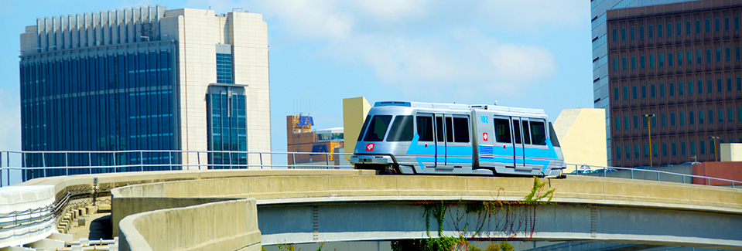
Transit in the Future
Jacksonville Transportation Authority: The Ultimate Urban Circulator (U²C) is a better way to connect people and places around downtown Jacksonville. Transforming and expanding the current Skyway supports the vision of a vibrant, revitalized, and better-connected downtown.
TRANSPORTING JACKSONVILLE
Into the Future:
https://u2c.jtafla.com/
Notes:
And then there is the Jacksonville Transportation Authority’s plan to convert their existing Urban Circulator to one that uses Automated – Electric Vehicles for ride share services.
They propose replacing their current vehicles which are guideway restricted with Autonomous-Electric vehicles that won’t be limited to the fixed guideway. Those vehicles will be able to leave the guideway and operate on at-grade roadways.
When combined with the type of Vehicle to Infrastructure Connective technologies that we are exploring at THEA, a lower cost and more extensive service will be possible.

Slide 11
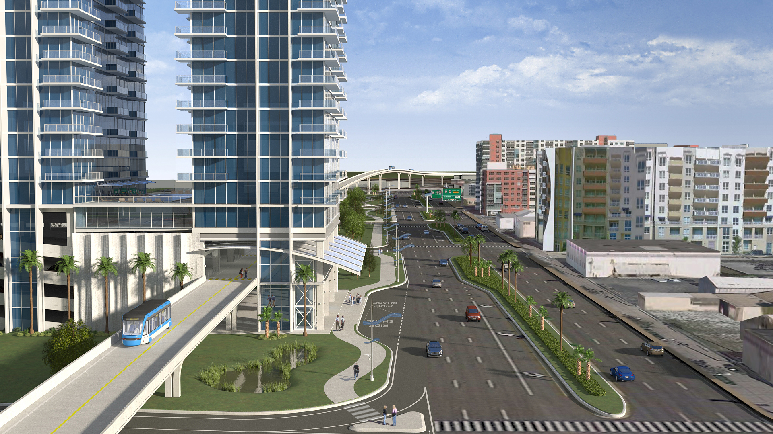
Transit in the Future
Mobility Hub
Notes:
So here’s a picture of what that transportation/transit system might start to look like. It can go through buildings. They don’t require catenaries or heavy duty structures. If you currently have a garage in a building – it can become a mobility center.

Slide 12
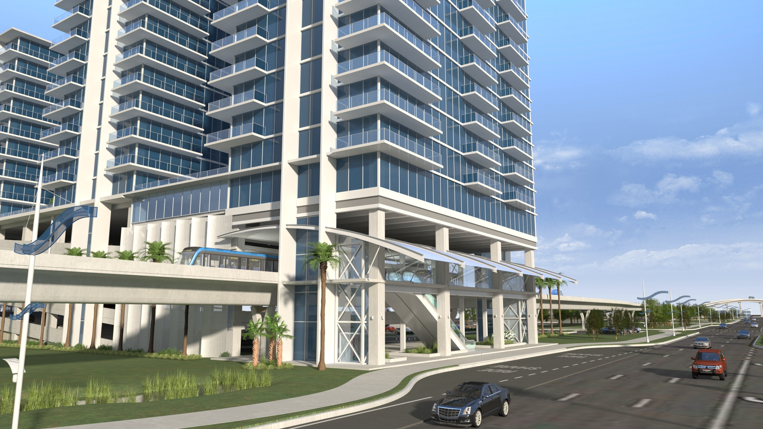
Transit in the Future
Mobility Hub-Option 1
Notes:
When you exit from your rideshared commute at a downtown drop-off zone you either walk into your place of work, or its mobility center to complete your trip via an autonomous Downtown Circulator.
You won’t see parking on the streets, and parking garages will evolve into higher economic uses like office, commercial, and residential space.

Slide 13
Notes:
And then of course there the development of the SunTrax facility. A major component of the CENTRAL FLORIDA AV PARTNERS projects.
Florida agencies are in touch with the technology and each other. We are sharing our learning experiences.

Slide 14
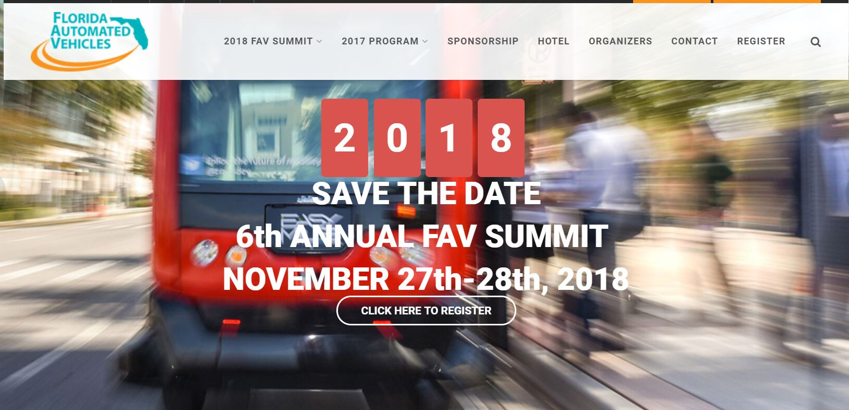
https://favsummit.com/
Notes:
To help you stay in touch and ride the wave of transformative transportation events, you should put this date on your calendar. We need to hone our skills and be responsible agents, innovating and collaborating to advance mobility for our customers. THEA is excited to again host the Annual Florida Automated Vehicle Summit, this November.
Our future is ACES. Few of us would ever have imagined as kids that we would be in this business.
Growing up, I wanted to be a park ranger or a professional athlete. But the low pay of the former, and the lack of talent for the later brought me here instead.
I think this is a great place to be.
You can reserve your spot at the table now. Registration is open.

Slide 15
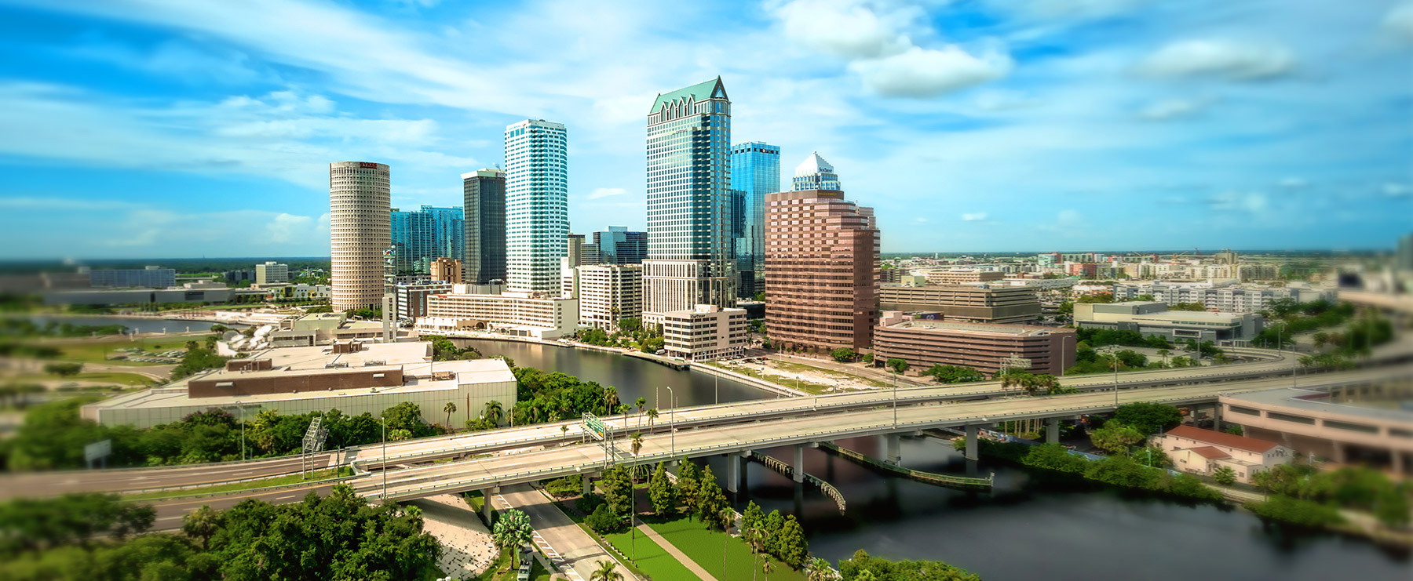
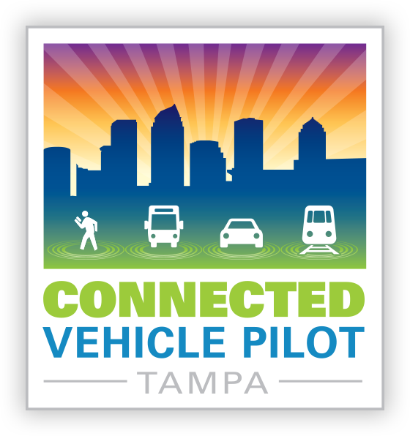
Tampa Connected Vehicle Pilot: https://www.tampacvpilot.com/
Joe Waggoner, Executive Director
Tampa-Hillsborough Expressway Authority

