Slide 1
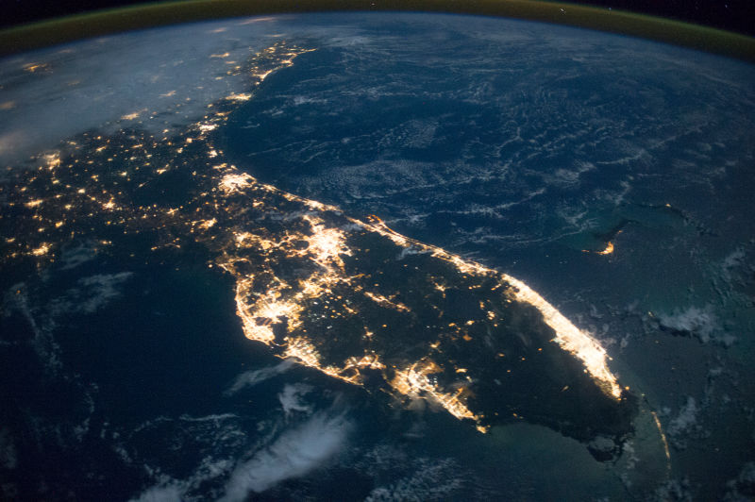
What’s Happening
To Our State?
Florida’s Changing Economic, Demographic & Political Landscape and Why It Matters

Slide 2
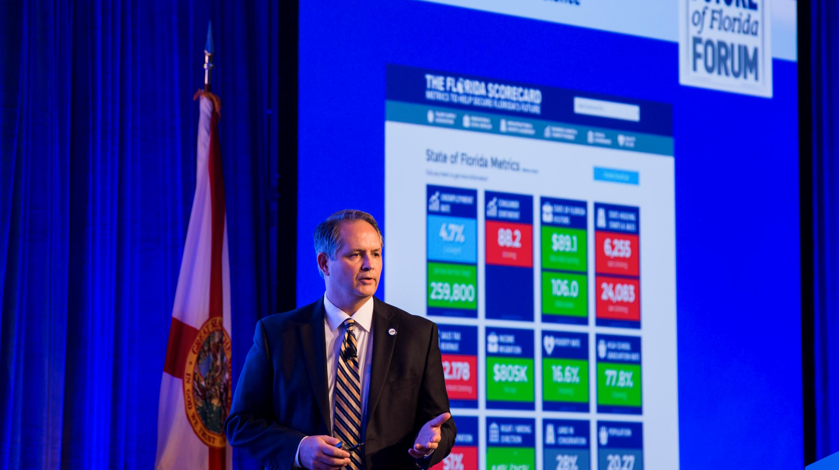
“Florida is changing. Our ECONOMICS, our DEMOGRAPHICS and our POLITICS are all changing and these changes are both opportunities and challenges.” – Mark Wilson
“Our mission is to lead Florida to a new and sustainable economy.”

Slide 3
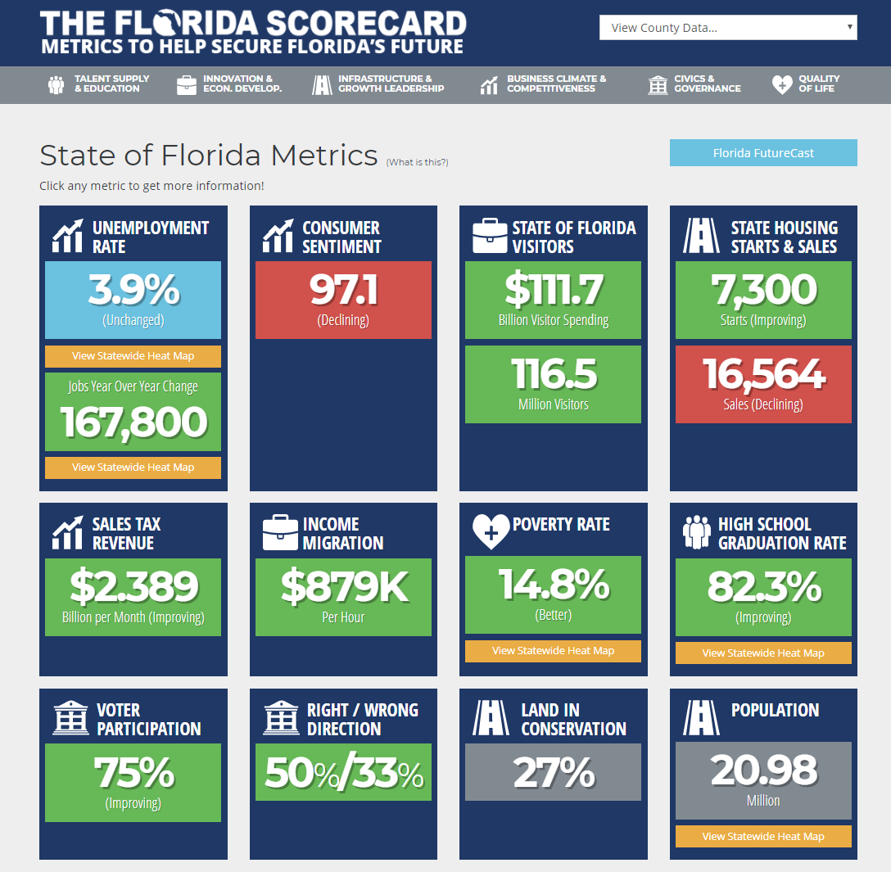
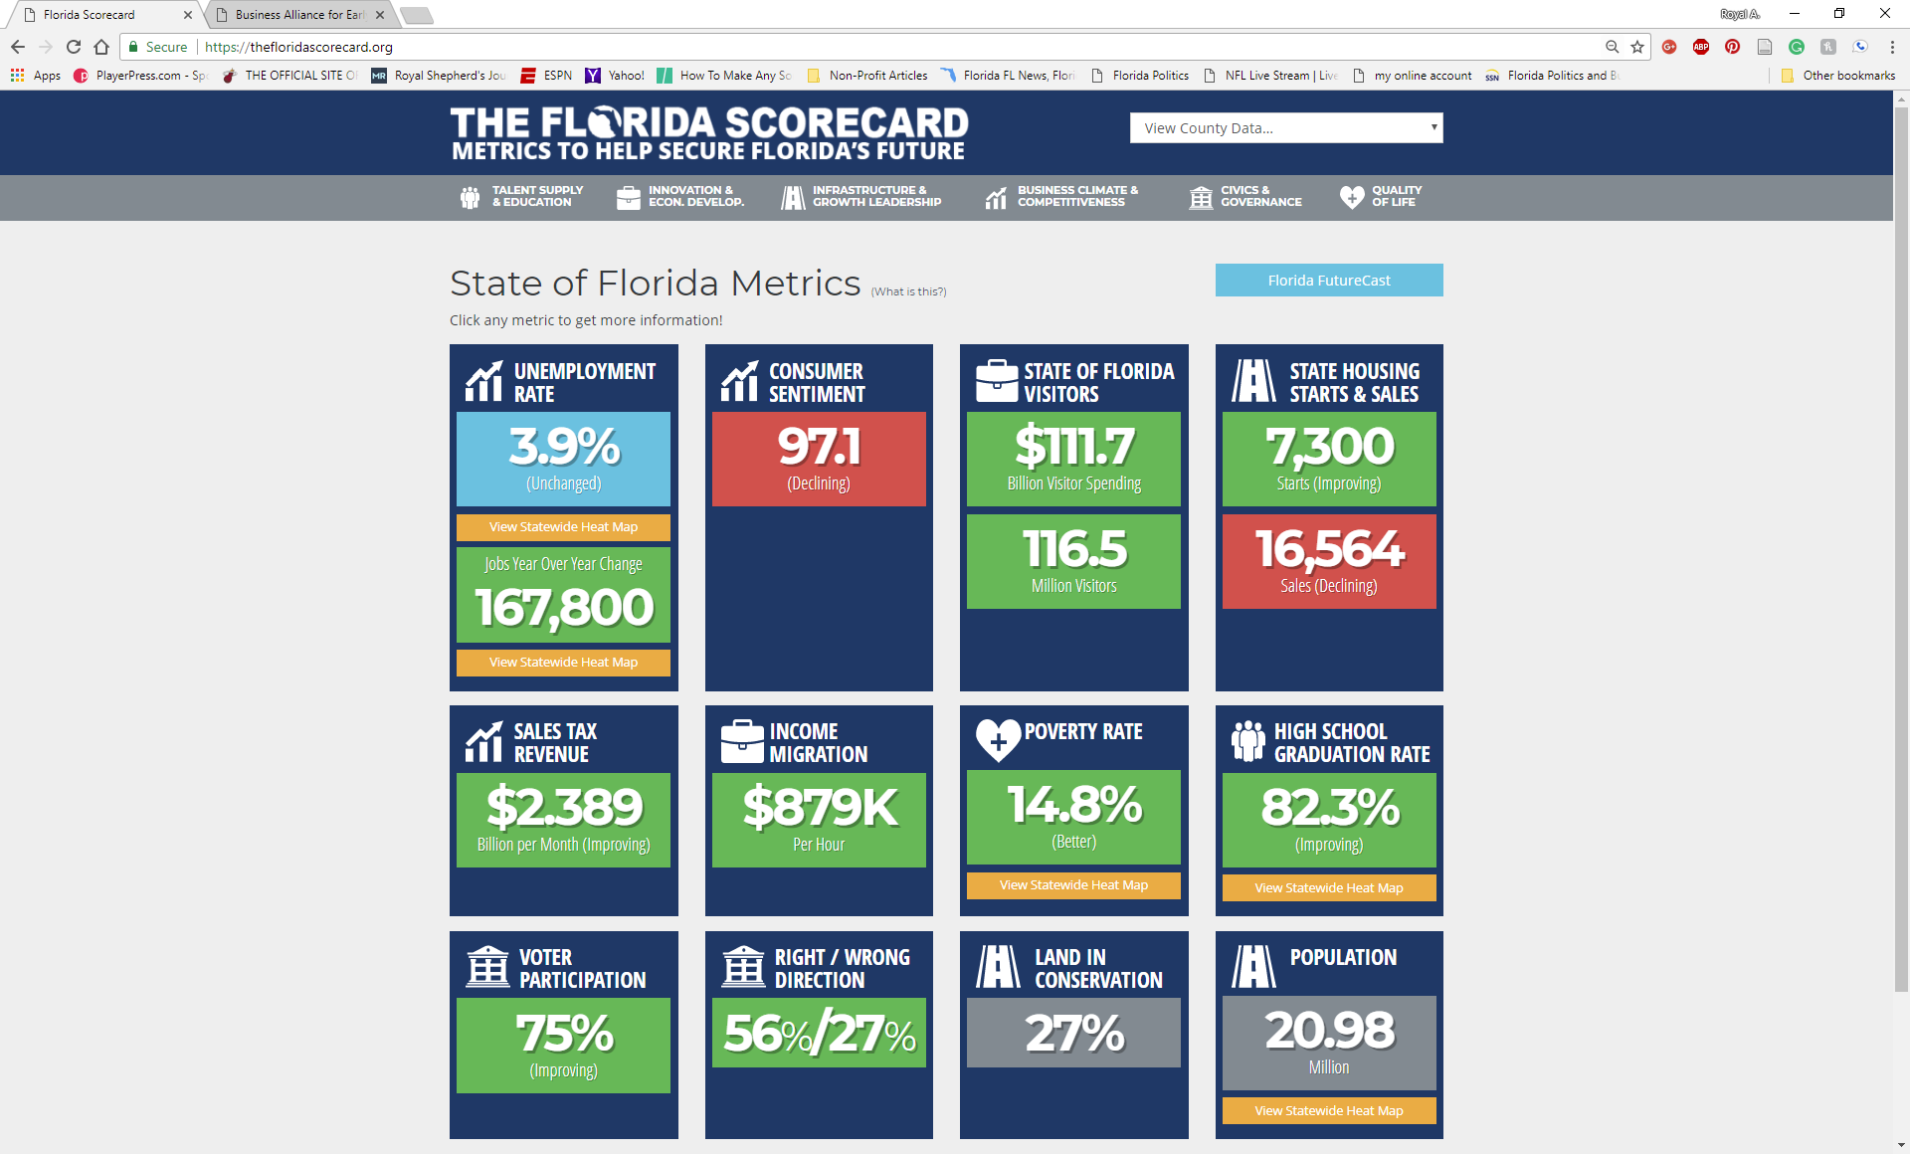
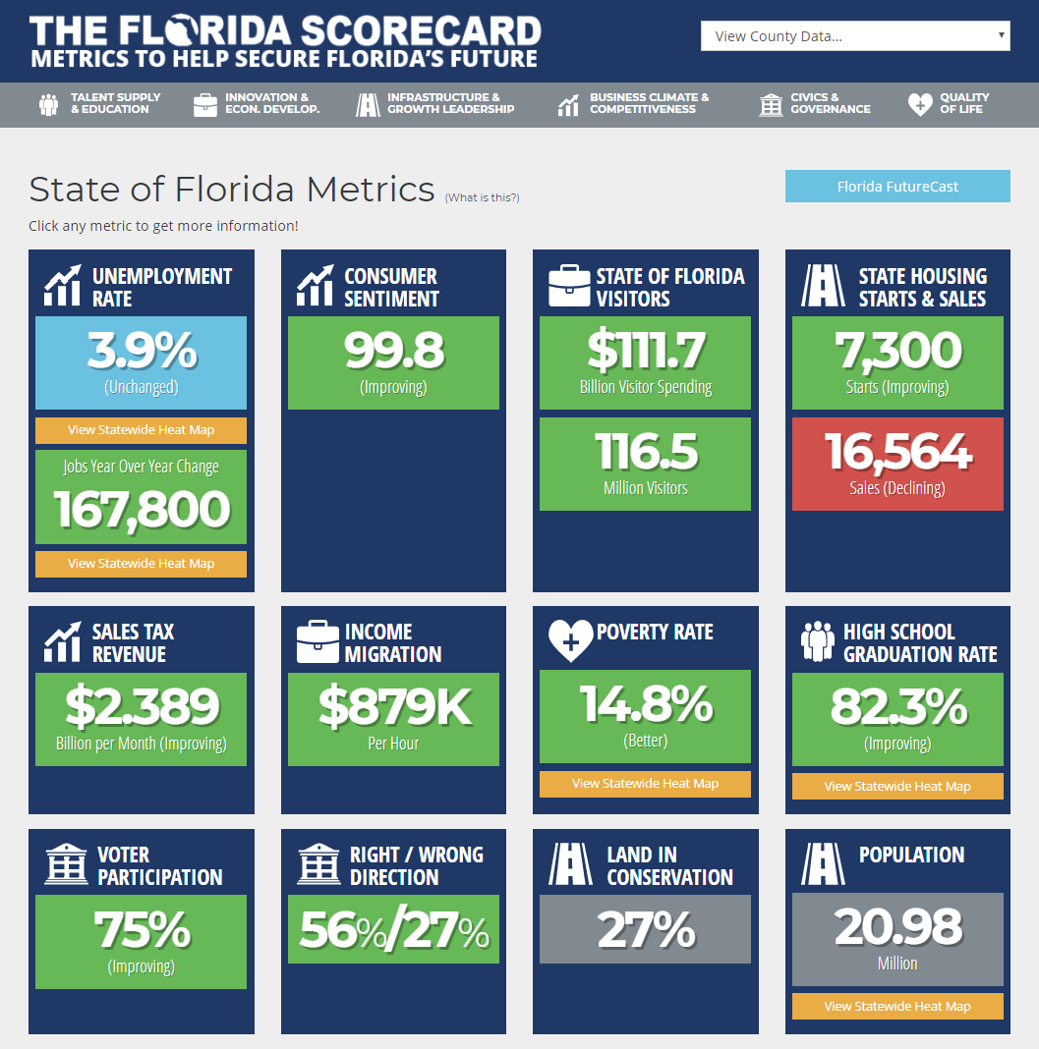
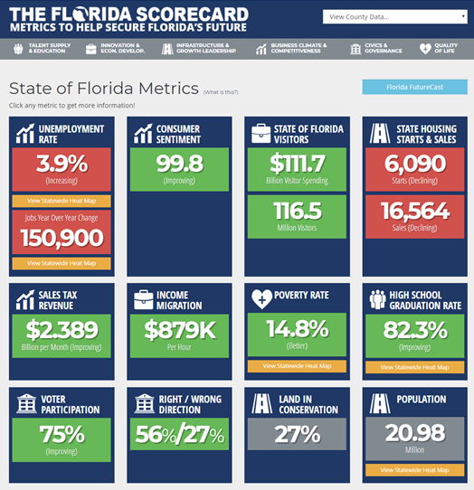
You Can’t Manage What You Don’t Measure
Florida’s Economy $976.7 Billion GDP (16th / $1T in 2018)
20.98 Million Residents (3rd /+5M by 2030 /+898/day)
167,800 Private-Sector Jobs Created in Florida in the Past Year
Florida creates more than 1 out of every 14 jobs in the U.S.
116.5 Million Visitors in 2017
3.9% Unemployment Rate

Slide 4
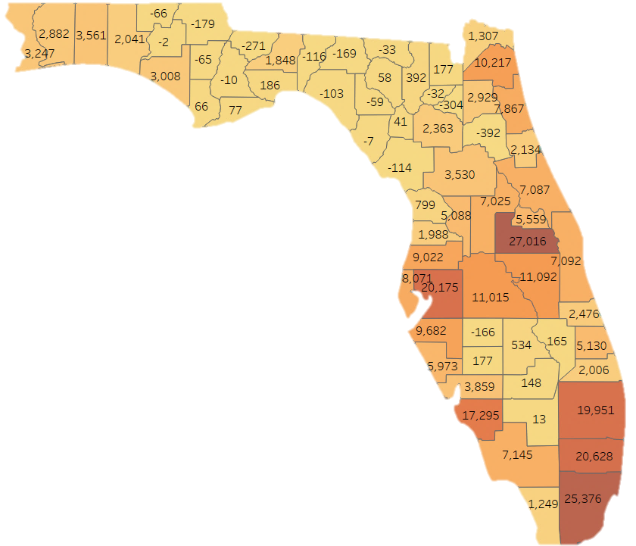
Year-over-Year
Population Changes
2016-2017
Top Counties:
Orange 27,016
Miami-Dade 25,376
Broward 20,628
Hillsborough 20,175
Palm Beach 19,951
Lee 17,295
Osceola 11,092
Polk 11,015
Duval 10,217
Manatee 9,682
17 Florida Counties
Lost Population

Slide 5
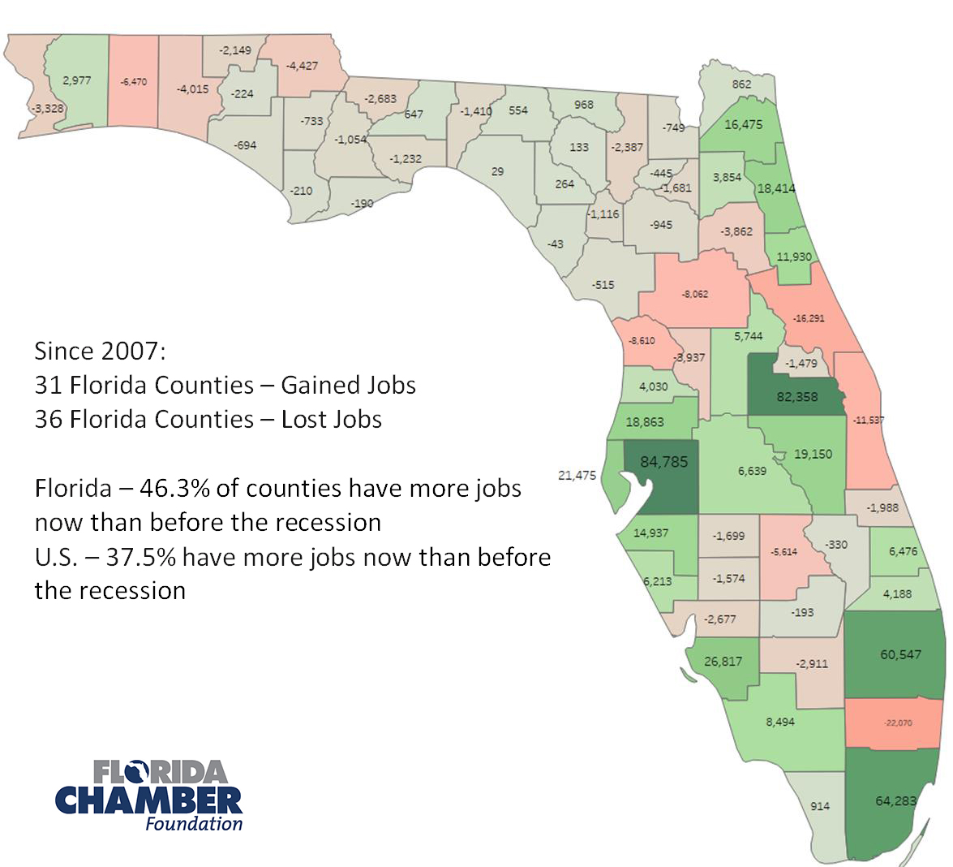
Another Tale Of Two Floridas
Notes:
We need this image with no white background.

Slide 6






Florida’s Game Changers/Headwinds
Term-limits creating Kings and Queens in Leadership – short term vs. long term.
Florida has become a testing ground for national issues and Constitutional Amendments as turnout drivers (The Alliance)
Out-of-state billionaires with their own anti-business agendas, essentially creating their own political machinery to advance their agendas.
State Republican and Democratic parties in states of disarray.
National Politics – Are President Trump and/or Congress a tailwind or headwind?
Proliferation of “paid” and “fake” news creating uncertainty.

Slide 8
Registration Comparisons Over Time
Total State
35% (4,614,467)
37% (4,860,654)
28% (3,593,622)
This Month
26% (12,365)
30% (14,267)
45% (21,567)
Republican
Democratic
NPA/Other
Year to Date
27% (36,907)
28% (38,508)
44% (59,916)
Since Last Election
29% (202,522)
27% (191,857)
44% (307,830)
Notes:
Total state: to find these numbers do not select any criteria for the search! (no dates, no party affiliation, etc.) Literally just scroll to the bottom and click search and it will give you the total numbers and percents for each party
This month: just select the current month’s date range that you are working on. Ex. if it’s Feb voter stats, for the search criteria you would select Feb 1 - Feb 28. Click search and scroll down to find totals for each party affiliation
YTD: just search from the start of this year until present. Ex. Feb voter stats: jan 1st 2018-Feb28th 2018
Since last election: for this search set the criteria to dates from last election (november 7th 2016) until present

Slide 9
New Voters By County
Since Last Election
NPA 44%
Republican 29%
Democrat 27 %
Democratic
NPA/Other
Republican

Slide 10
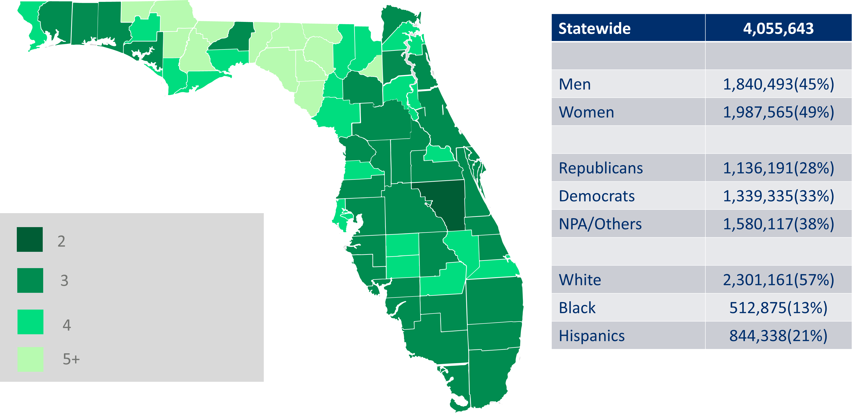
Scott Era: New Voters
Map Shaded by
Total Voters/New Voters

Slide 11
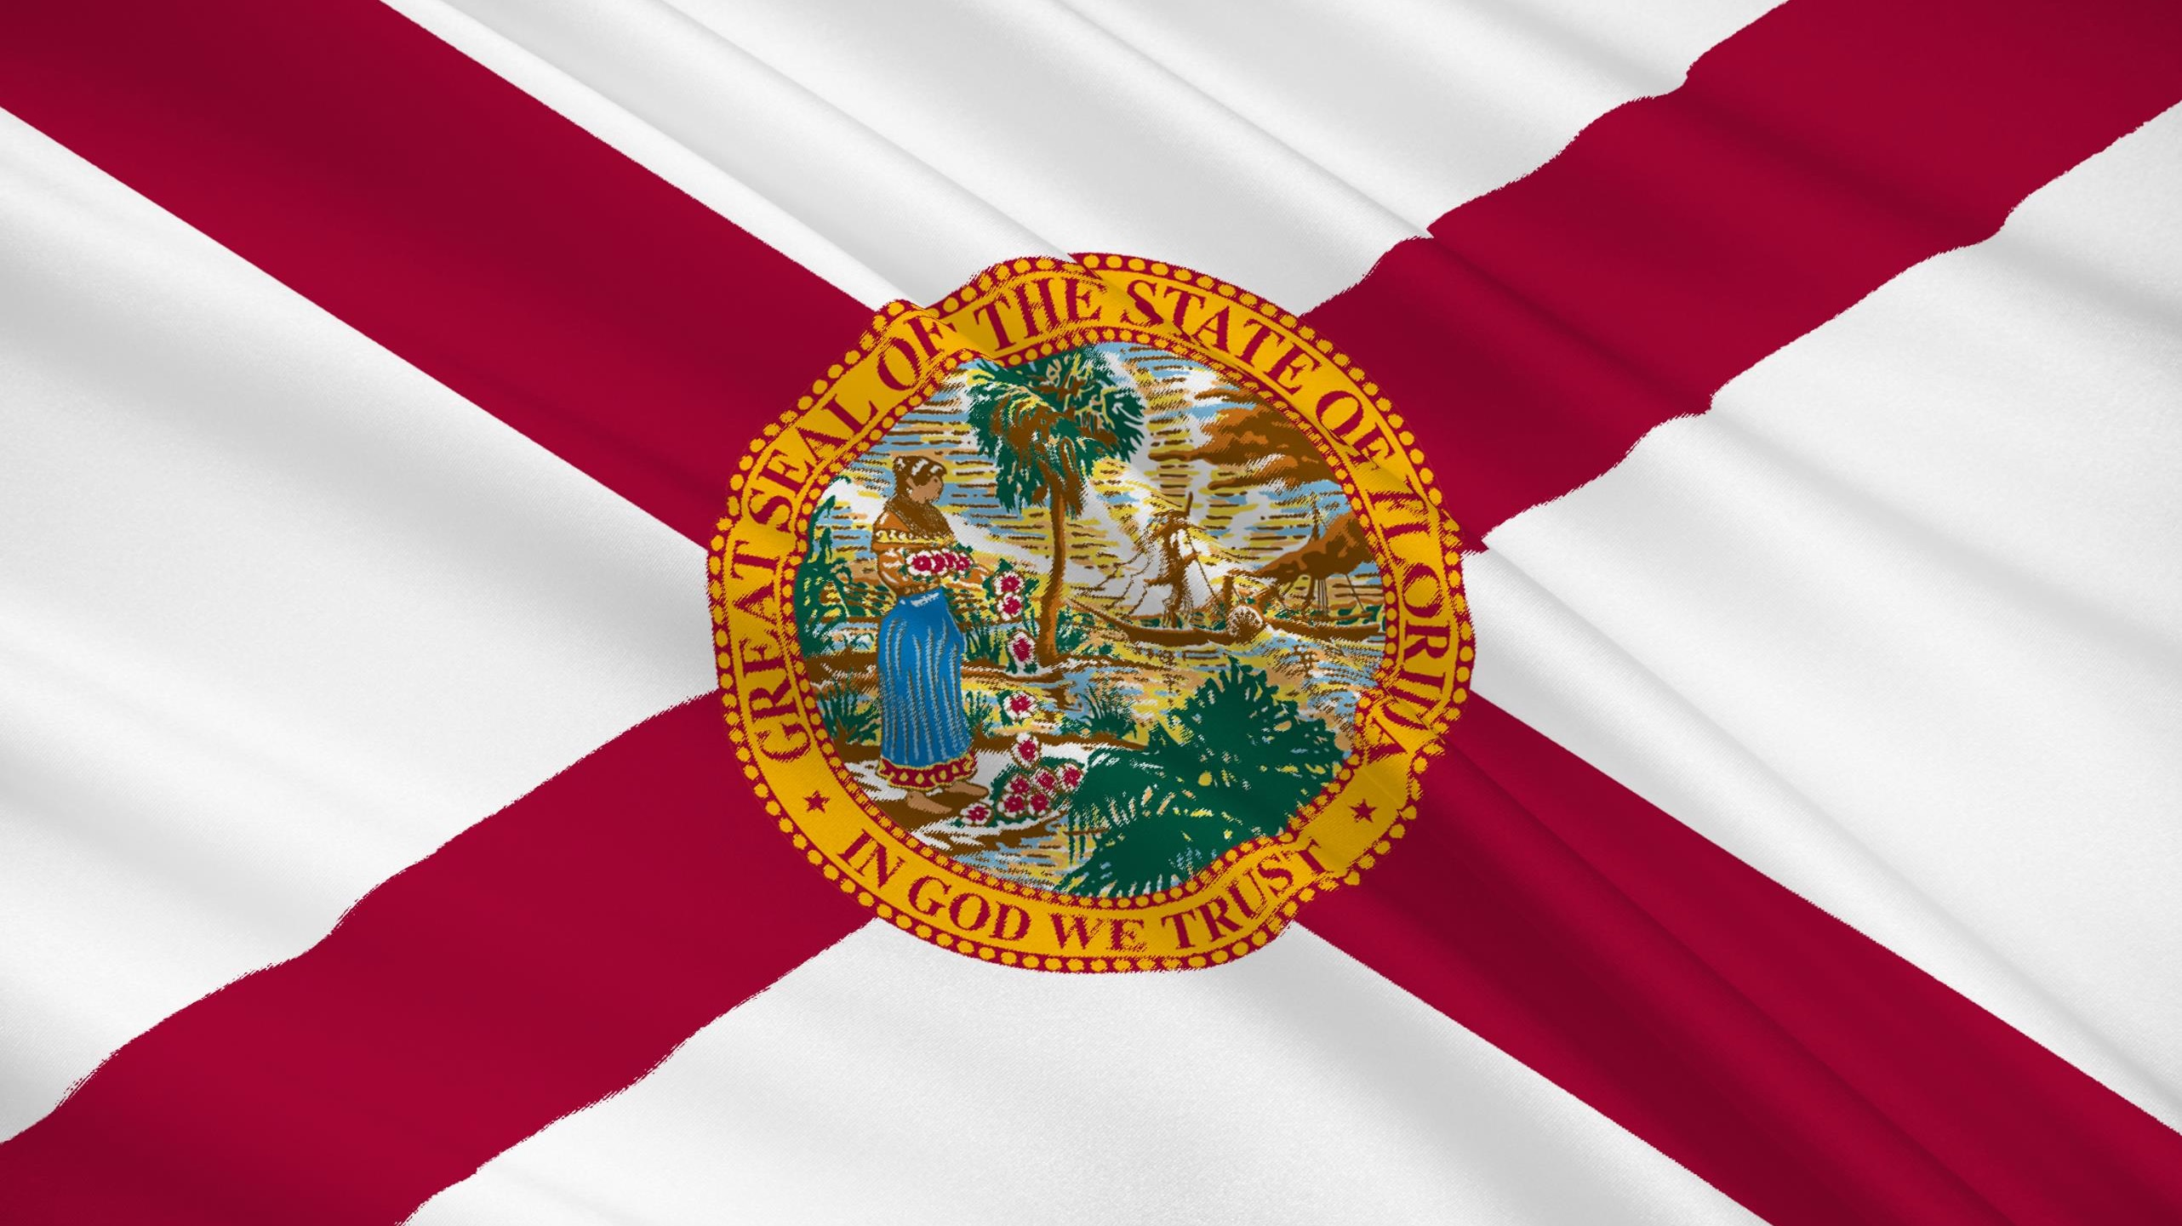
2016 Summary
Trump vs. Clinton
New Florida Political Model

Slide 12
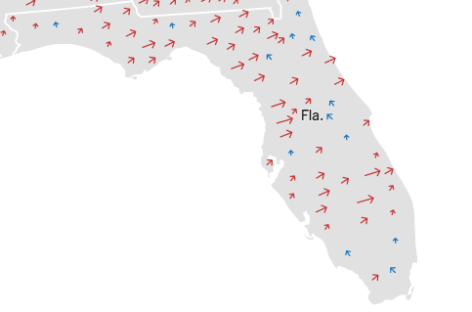
The Trump Map
Florida In 2016

Slide 13
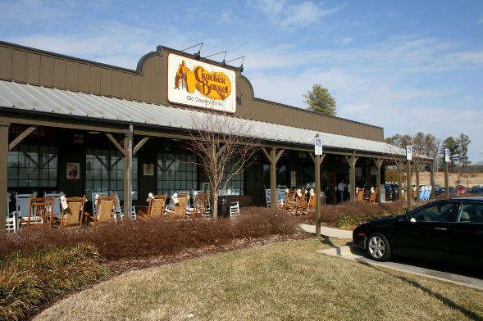
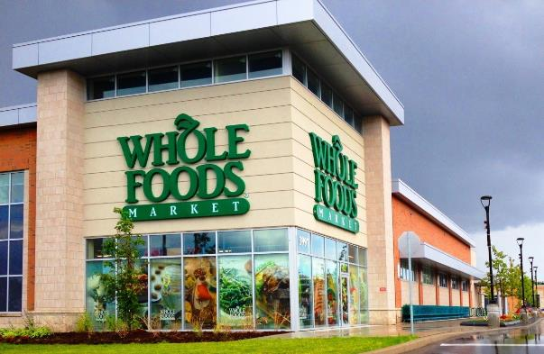
The Trump Map
By County (9 Clinton – 58 Trump)
76%
22%
Notes:
Nationwide, Donald Trump won more than 76 percent of counties with a Cracker Barrel, while winning just 22 percent of counties with a
Whole Foods.

Slide 14
Republican Primary Vote Share
By DMA
6.4%
12.9%
6.2%
3.5%
1.7%
21.2%
Likely Voters
1,327,420
25.5%
8.8%
9.7%
11.3%
Notes:
1.3 Million voters cast ballot in 2010 Gubernatorial. In 2018, we could see 1.8 million ballots cast.

Slide 15
Democrat Primary Vote Share
By DMA
6.7%
8.3%
3.0%
2.5%
2.8%
18.6%
Likely Voters
1,018,866
22.5%
10.9%
4.3%
20.5%
Notes:
864,000 ballots cast in 2010 Dem Gubernatorial. In 2016, could see closer to 1.2 million.

Slide 16
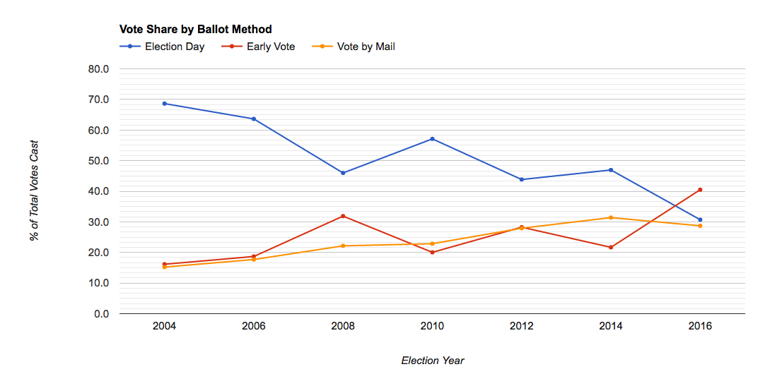
Voting Method
Change Over Time
2016
30.7
40.5
28.7
Notes:
Sent Joe an email to ask he add the percentages to the legend. 1/19/2018

Slide 17
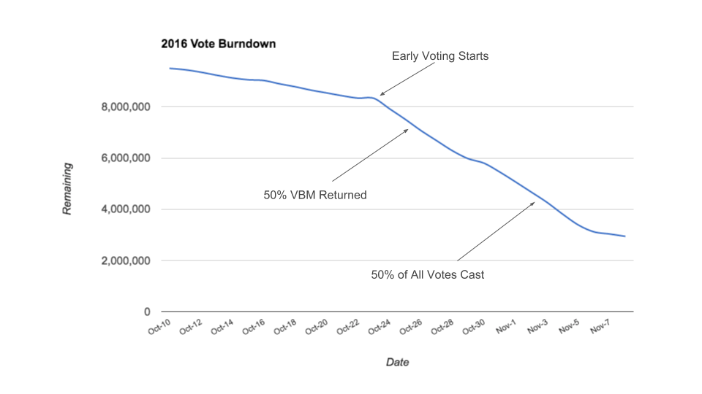

Voting Method
Why It Matters

Slide 18
Freedom Preference: January 2018 – April 2018
Socialism and “About the Same”
Capitalism

Slide 19

In the U.S., Facebook and Google account for 63% of all digital advertising.
http://www.adweek.com/agencies/18-bullish-stats-about-the-state-of-u-s-advertising/

Slide 20
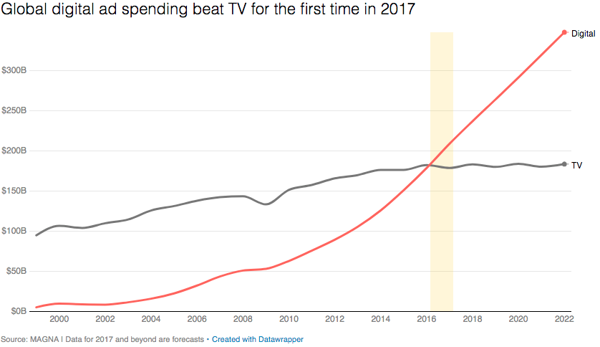

Digital vs. TV

Slide 21

Florida Chamber Poll
Conducted June 2018
N=600

Slide 22
Rick Scott vs. Bill Nelson
January 2018 – June 2018
Bill Nelson
Rick Scott

Slide 23
Jimmy Patronis vs. Jeremy Ring
January 2018 – June 2018
Jeremy Ring (D)
Jimmy Patronis (R)

Slide 24
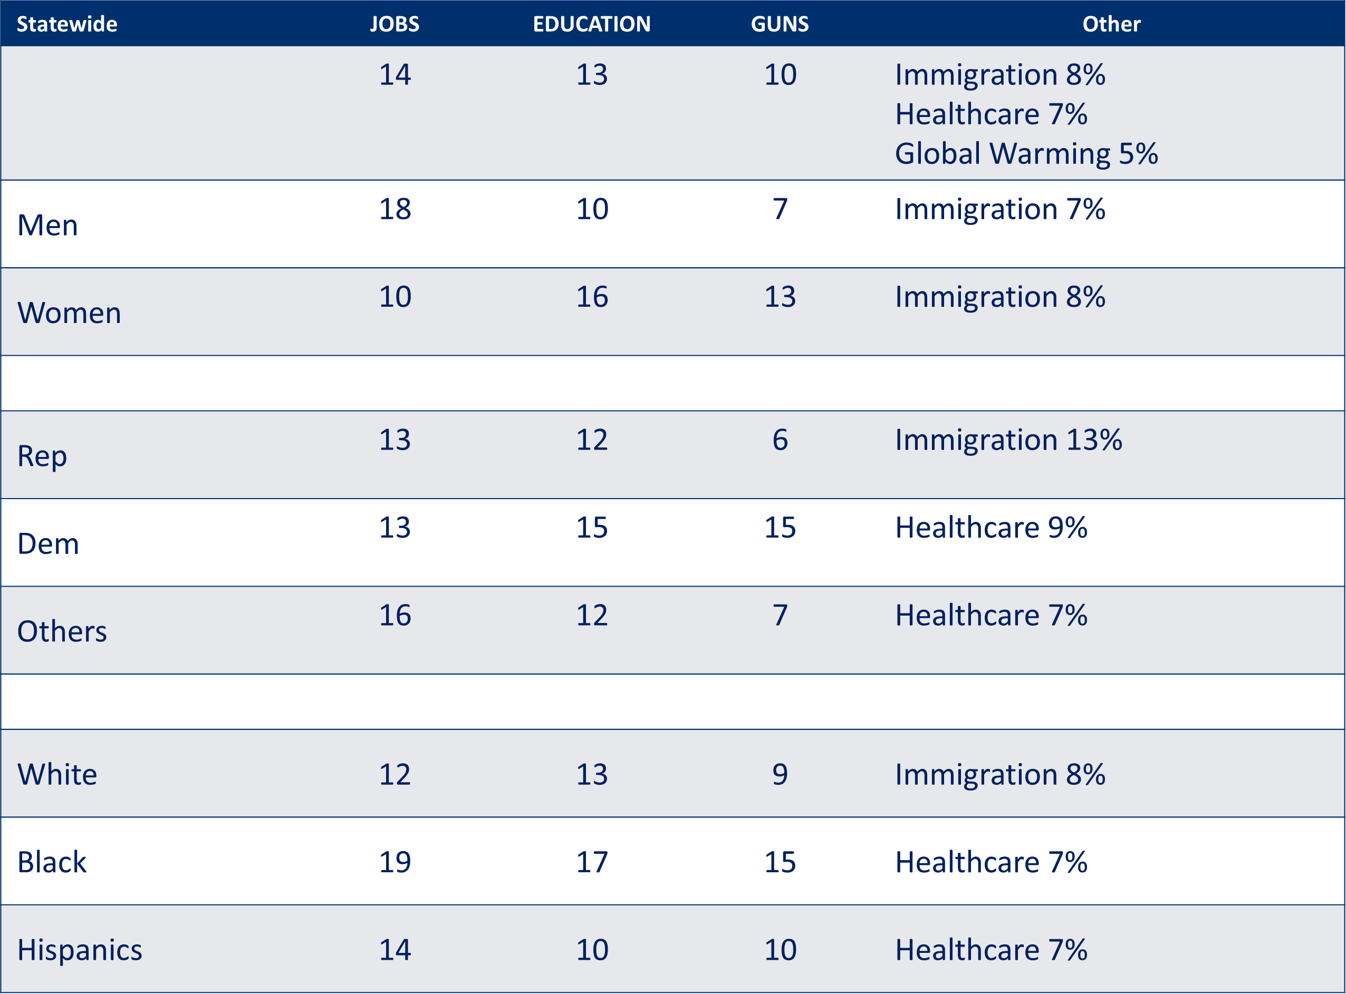
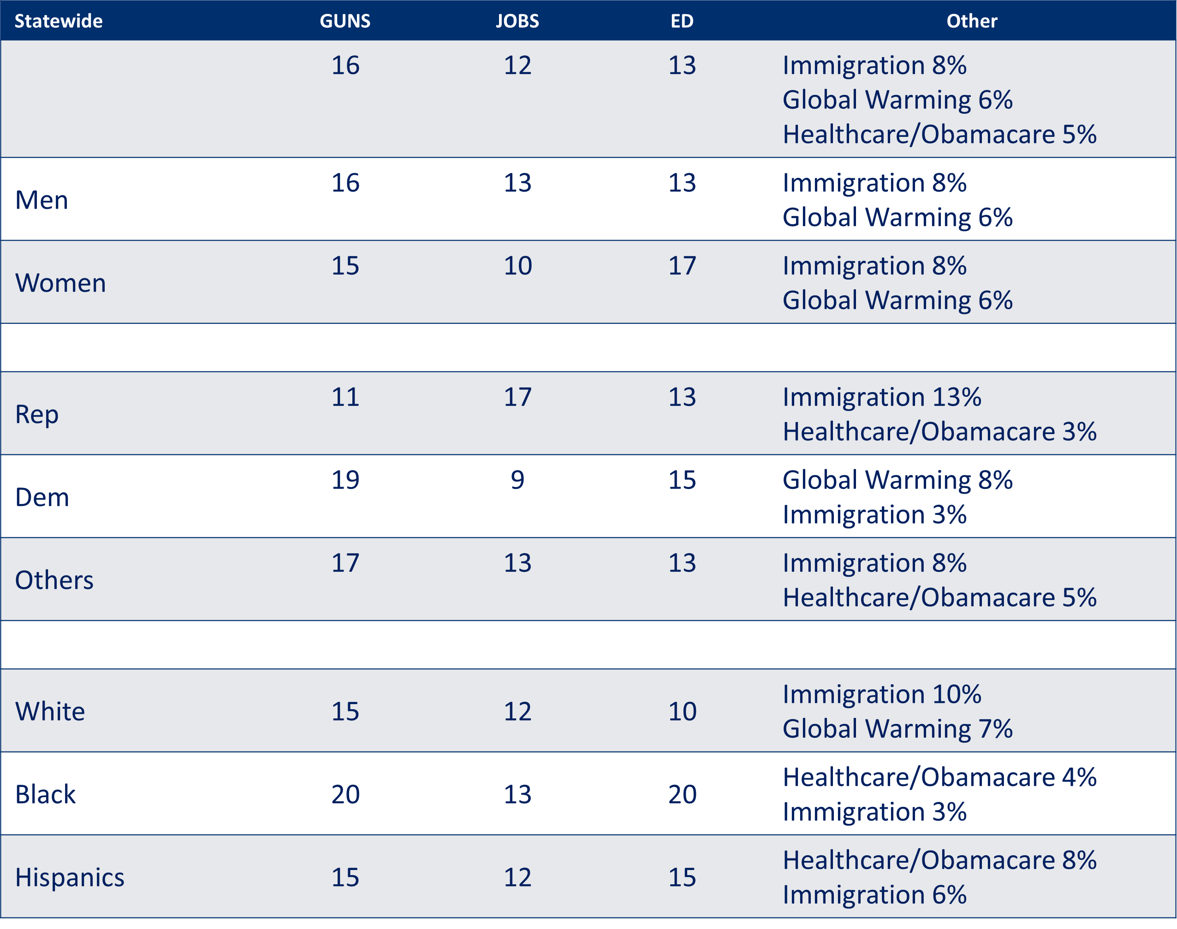
June 2018 Poll
April 2018 Poll

Slide 25
Florida Chamber of Commerce Poll
May 25 – June 4, 2018
Reuters/Ipsos Polls June 1 – 5, 2018

Slide 26
Florida Politics
2018

Slide 27
The 2018 Ballot
Governor
Attorney General
Chief Financial Officer
Agriculture Commissioner
All 27 Seats in Congress
4 Open
(DeSantis; Ross; Rooney; Ros -Lehtinen)
22 State Senate
2 Termed
2 Open
All 120 House Seats
19 Termed
18 Open
Constitutional Amendments
5 Already
8 by the
CRC
One
U.S. Senate (Nelson)
1 Supreme Court Justice
C. Alan Lawson

Slide 28
That’s What is Happening
To Our State
Florida’s Changing Economic, Demographic & Political Landscape and Why It Matters

