Slide 1
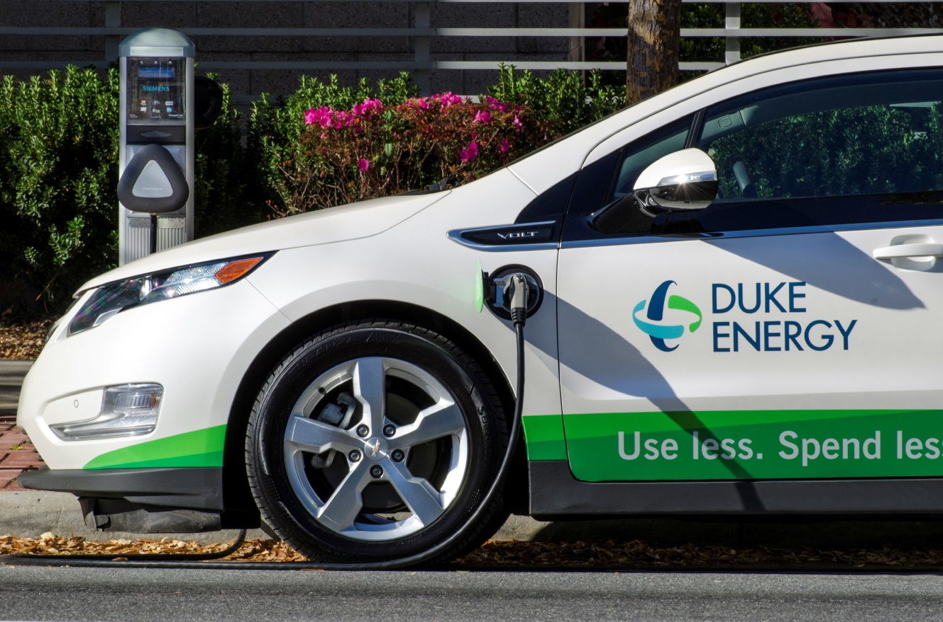
Electric Transportation in Florida
Floridians for Better Transportation
July 18, 2018
Peter King
Chair, Drive Electric Florida
Electric Transportation Mgr – Duke Energy Florida

Slide 2

Mission
Advance the energy, economic and environmental security of the state of Florida by promoting the growth of electric vehicle (EV) ownership and the accompanying infrastructure
Vision
Support and accelerate the adoption of plug-in electric vehicles in Florida by engaging and educating the public, businesses and policy-makers; facilitate collaboration and supporting EV-friendly policy and programs

Slide 3
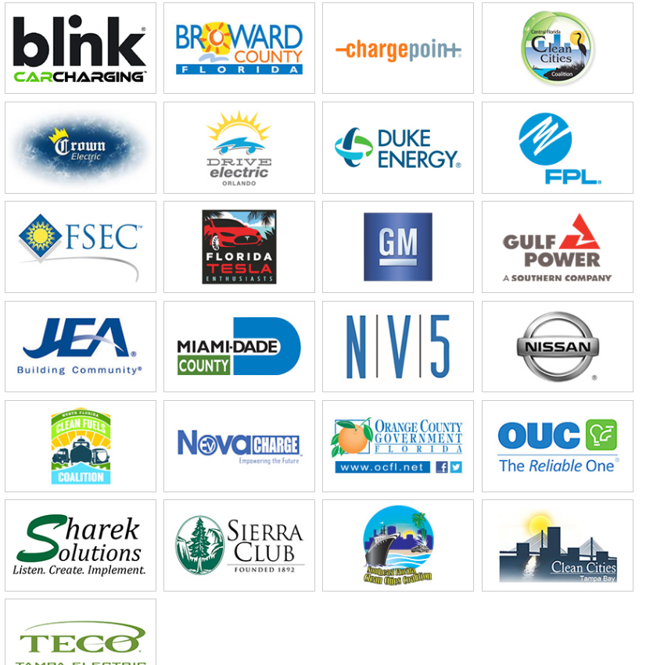



Slide 4

EV Legislative Actions
CS/SB 384 (2018) Electric and Hybrid Vehicles
Requiring the Florida Transportation Commission to review all sources of revenue for transportation infrastructure and maintenance projects and prepare a report to the Governor and the Legislature when the commission determines that electric and hybrid vehicles make up a certain percentage or more of the total number of vehicles registered in this state
SENATE - Indefinitely postponed and withdrawn from consideration
CS/SB 712 (2018) Autonomous Vehicles
Exempting an autonomous vehicle being operated in autonomous mode from a certain prohibition on the operation of a motor vehicle if the vehicle is actively displaying certain content that is visible from the driver’s seat while the vehicle is in motion
SENATE - Indefinitely postponed and withdrawn from consideration
CS/CS/SB 852 (2018) Transportation Infrastructure
Florida Smart City Challenge Grant Program
SENATE - Indefinitely postponed and withdrawn from consideration
CS/CS/CS/HB 841: Community Associations - SENATE – Passed 35 Yeas, 1 Nay House – Passed 100 Yeas, 1 Nay
An association may not prohibit a unit owner from installing an electronic vehicle charging station; providing when the installation of an electronic vehicle charging station may be the basis of a lien.

Slide 5
Current Initiatives
VW Mitigation Trust
  Advocate for 15% EV infrastructure and Electric transit/school buses
  Guidance Document to FL DEP
    Characterize NOx offsets for EV
    Advise on DC Fast network
    Conduct advisory committee for projects
    Provide other support data for electric transportation
Public Comment (May 2018)
Plan to EPA (Pending)
Projects funded (Late 2018)
Mitigation Trust Timeline

Slide 6
EV Adoption Forecast Florida
FL has just over 27,000 PHEVs
4th fastest growing state for EV*
No state incentives
Source: Florida Power & Light

Slide 7
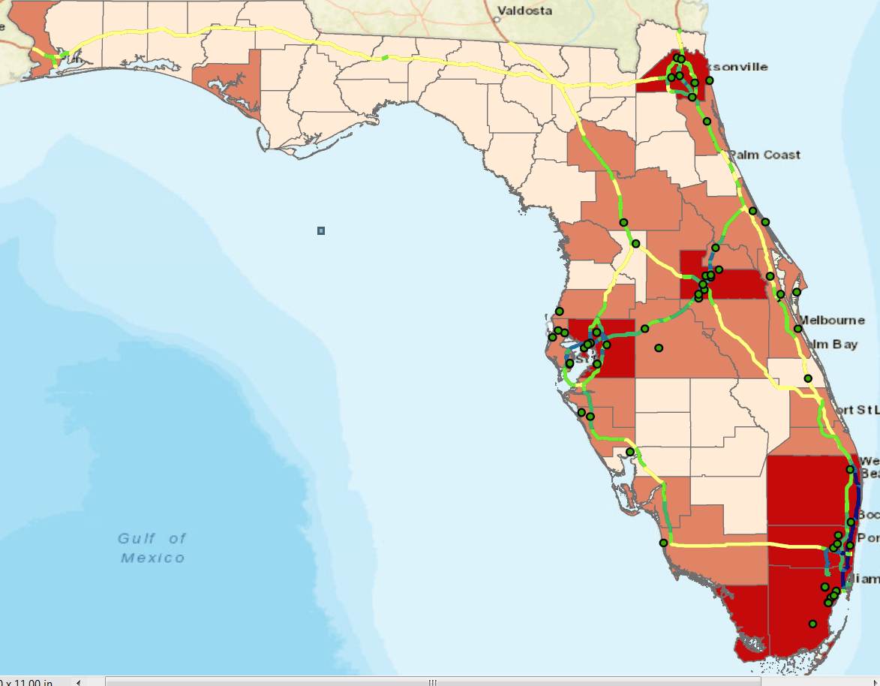
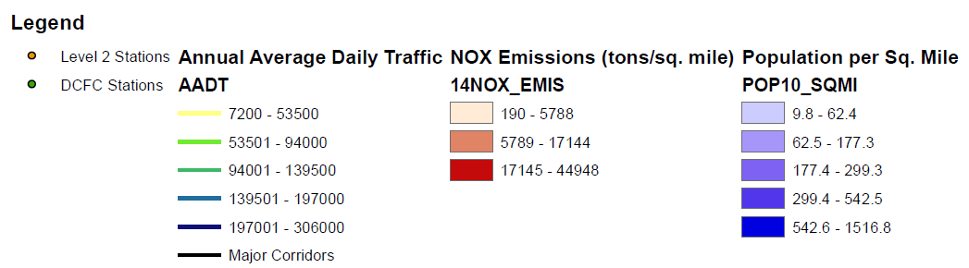

Current Florida Public DC Fast
Dealerships excluded

Slide 8
Duke Energy Territory =
Electrify America =

Slide 9
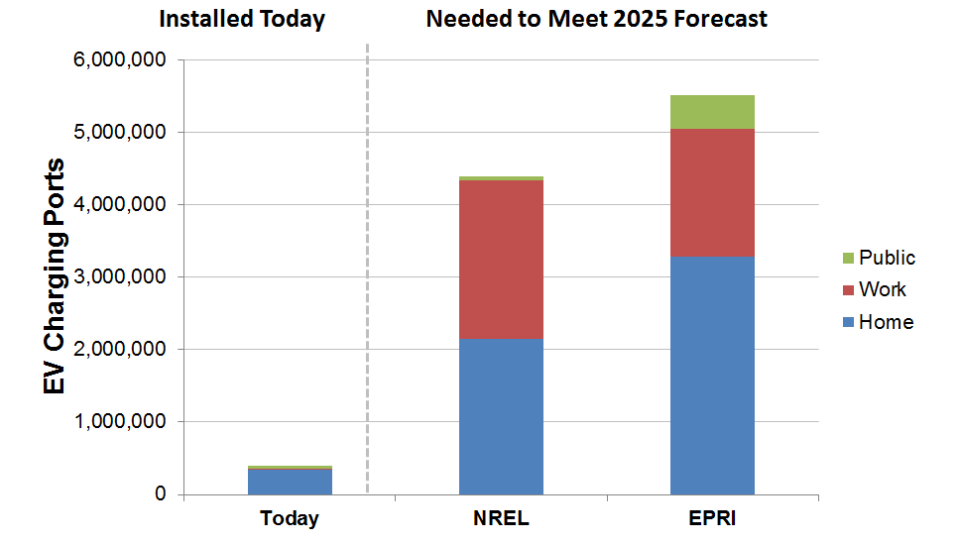
The cars are coming – where will they charge?
EV Infrastructure and future need to match EV growth forecasts
Source: EEI 2017
Notes:
US - Over 16,000 charging units & over 42,000 charging ports
FL – just under 900 stations
Power Gap for forecasted Evs

Slide 10

Florida EV Infrastructure in Progress
Electrify America
-300 sites, each site 1MW to 2MW new load
-Major Corridors
Tesla
-Continues to add to Supercharger network (120KW chargers)
-Urban area in-fill with multiple 70KW chargers to support Model 3
Duke Energy Florida
-535 ports in Florida service territory

Slide 11
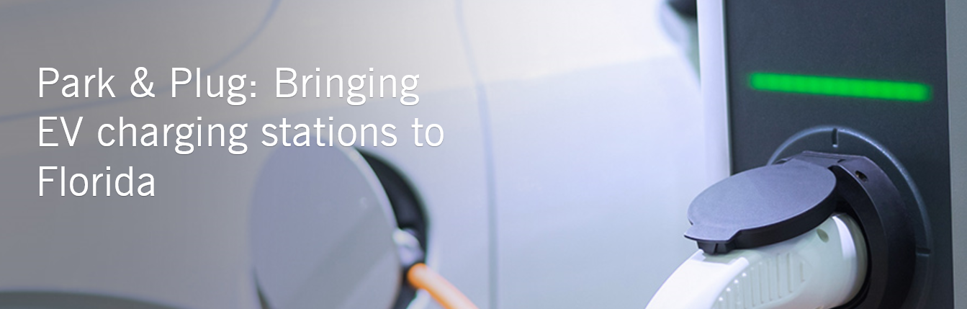
$8MIL agreement with Florida Public Service Commission (FPSC) - $400,000 for outreach/education
Utility owned & operated – Dec 2022
Collect data and report annually to FPSC
Seeking qualified site hosts in Duke Energy Florida service territory

Slide 12
Unique Opportunity to install foundational level of charging infrastructure and gather data for evaluation
  Critical load data for system planning
  Utilization across segment types
  Trends in usage, charging times, segments
  Corridor placement – evacuation routes
  Configurations i.e. DCFC with Level 2 or Single phase “Fast charge”
  Rural vs urban placements

Slide 13
Segment | Multi-unit dwellings (MUD) | Workplaces | “Longer dwell time” public locations | Highway Corridors
EVSE Technology | Level 2 | Level 2 | Level 2 | DC Fast Charging
Minimum EVSE to be deployed (number of plugs or ports) | 325 ports | 100 ports | 75 ports | 30 Units Chademo/CCS Combo
Examples | Apartments Condos - Commons Dorms | Offices Employee Parking Small Fleets | Shopping Centers Museums Restaurants Gas stations Public Parking | Near major corridors Adjacent to Tesla Superchargers
Sample driving ranges provided by charge | 20 to 30 miles/hour dependent on amperage | 20 to 30 miles/hour dependent on amperage | 20 to 30 miles/hour dependent on amperage | 50 to 80 miles/30 minutes at 50KW
**At least ten (10) percent of the charging stations shall be installed in low income communities, as that term is defined in Section 288.9913(3), F.S.

Slide 14
Peter King
Duke Energy Florida peter.king@duke-energy.com

