Slide 1
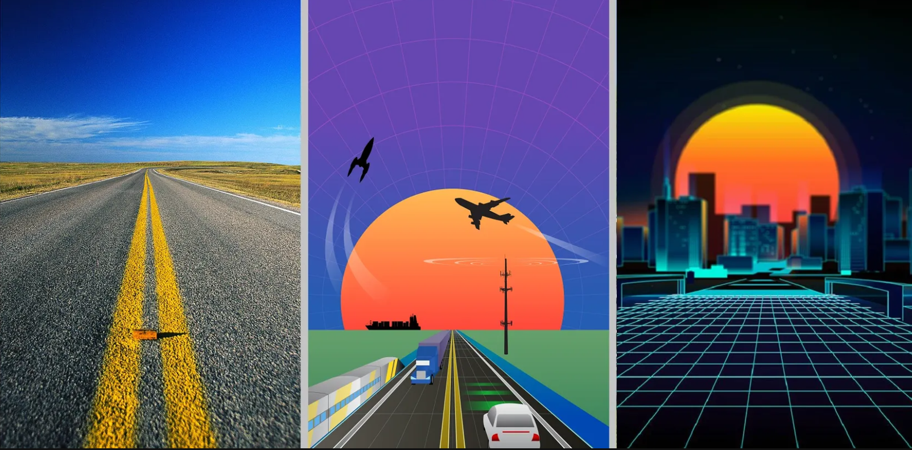
Sally Patrenos
FBT President

Slide 2
Mark your calendars for
FBT Summer Camp 2022…

Slide 3
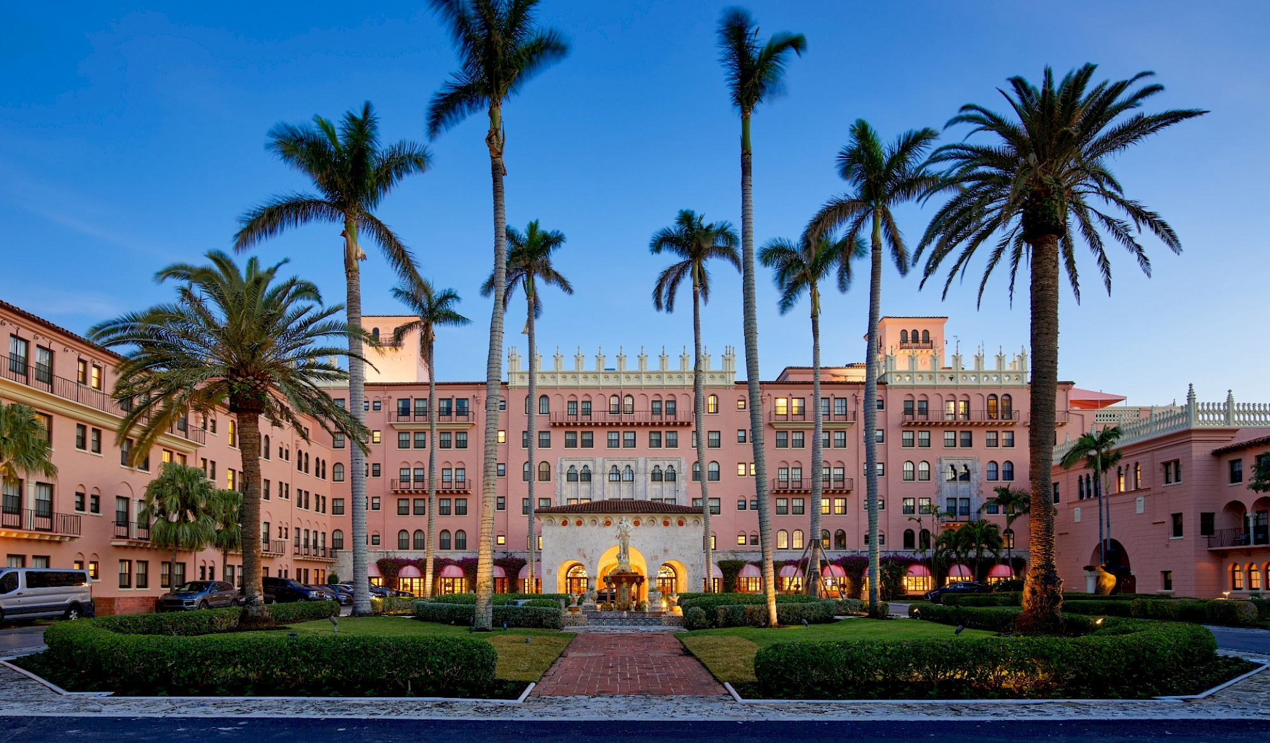
July 7-8, 2022
Boca Resort,
Boca Raton, FL

Slide 4
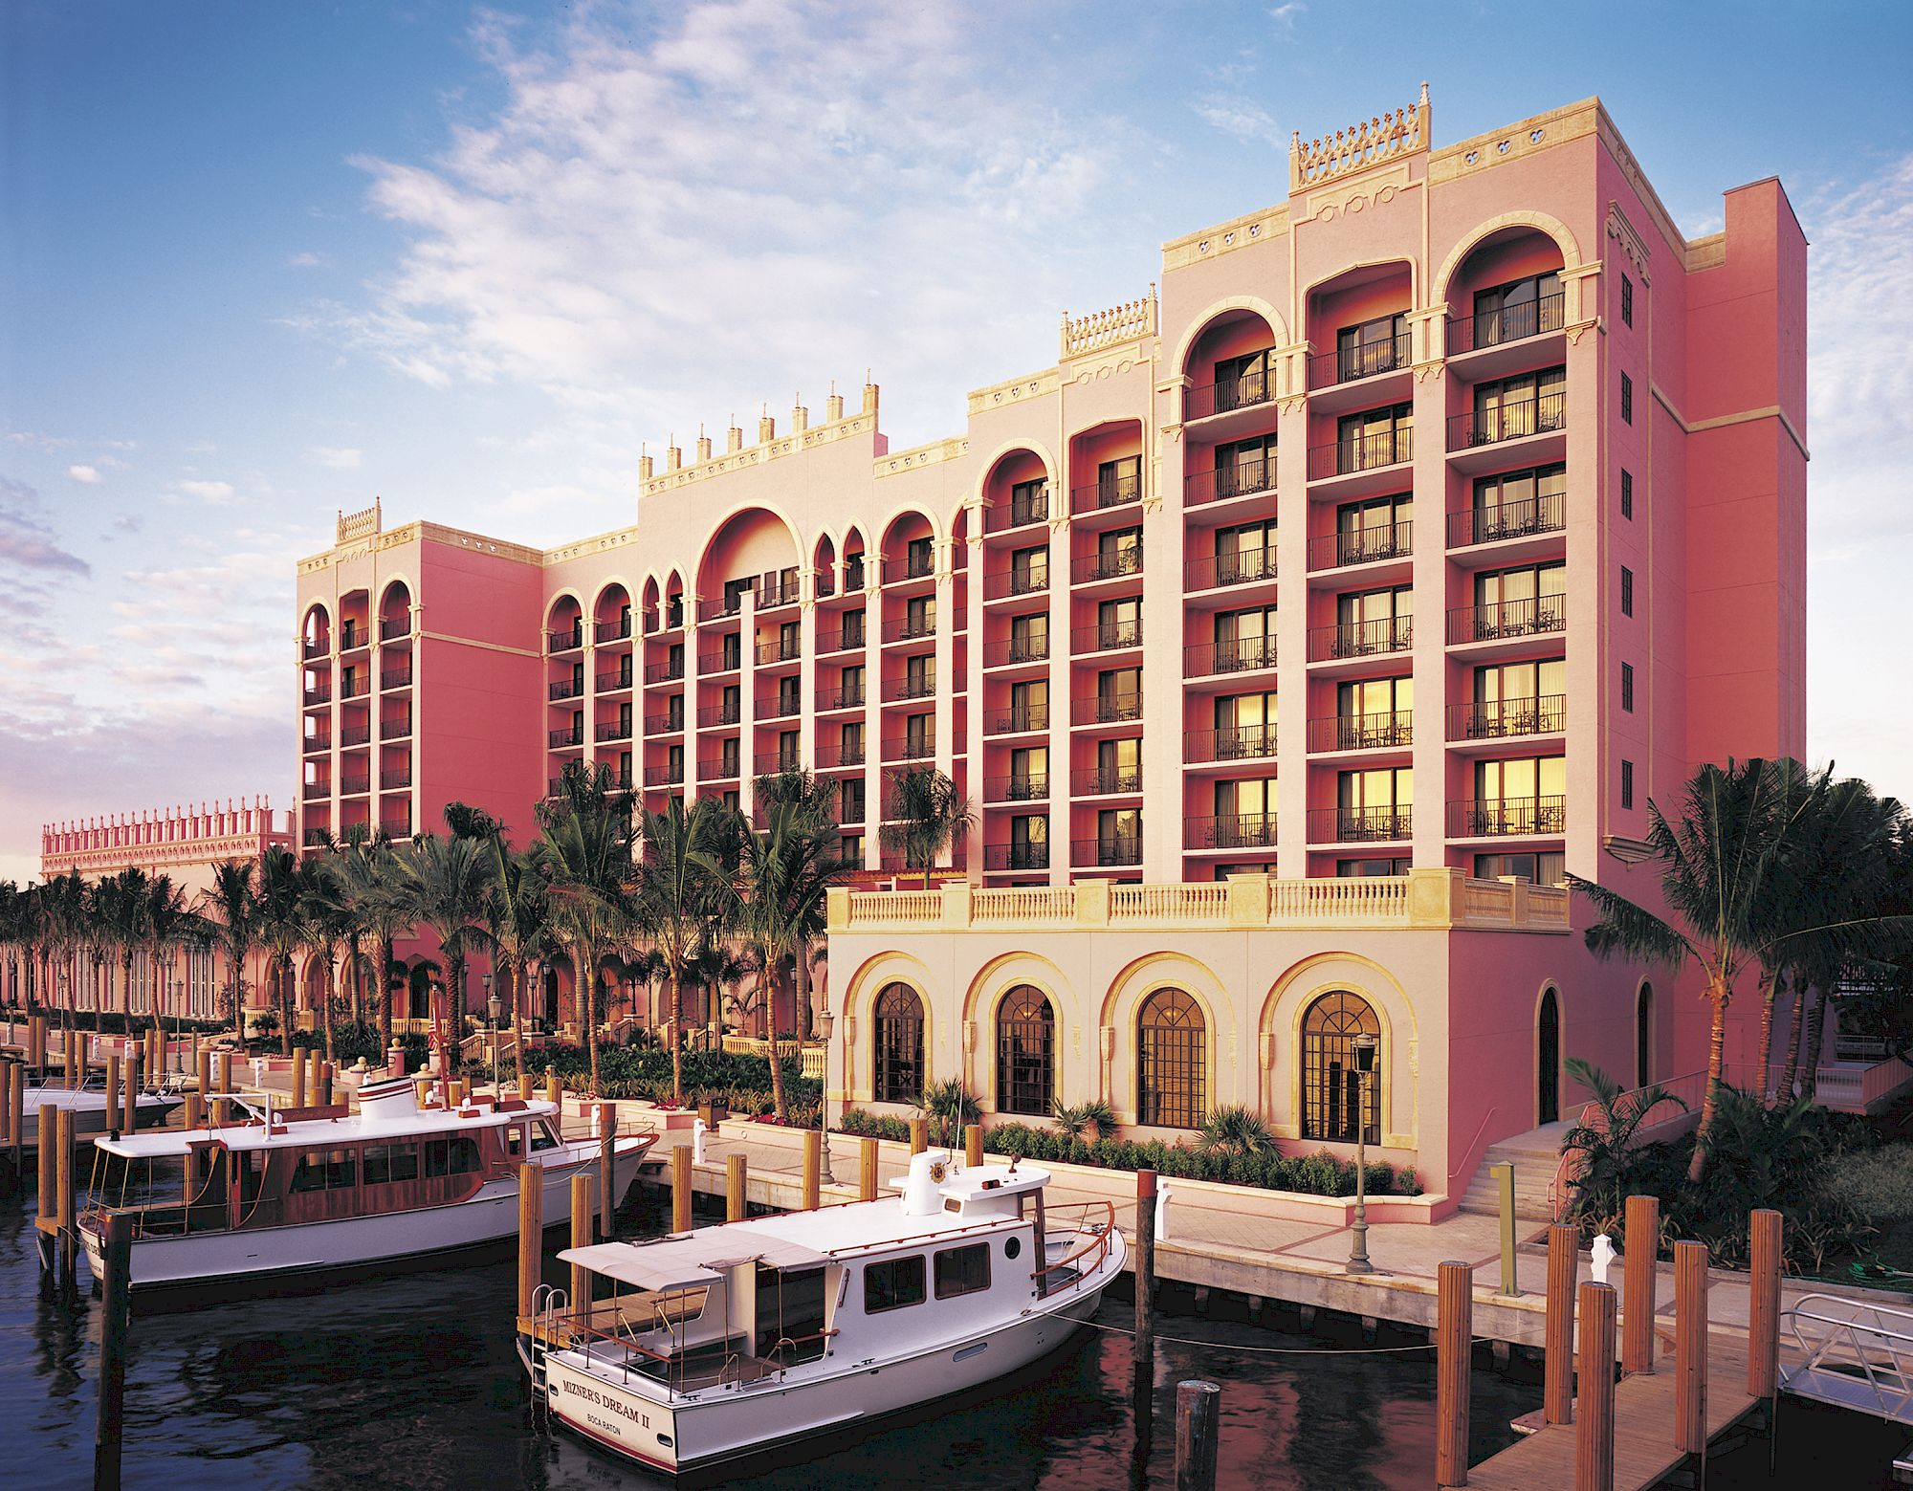
July 7-8, 2022
Boca Resort,
Boca Raton, FL

Slide 5
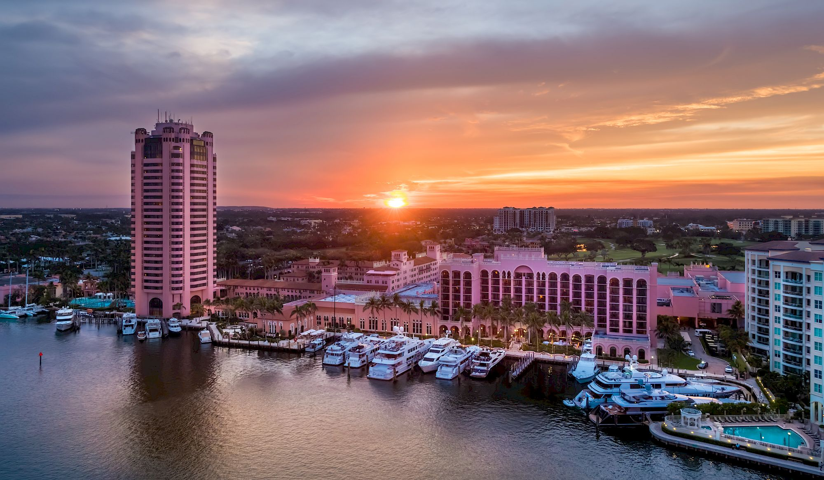
July 7-8, 2022
Boca Resort,
Boca Raton, FL

Slide 6
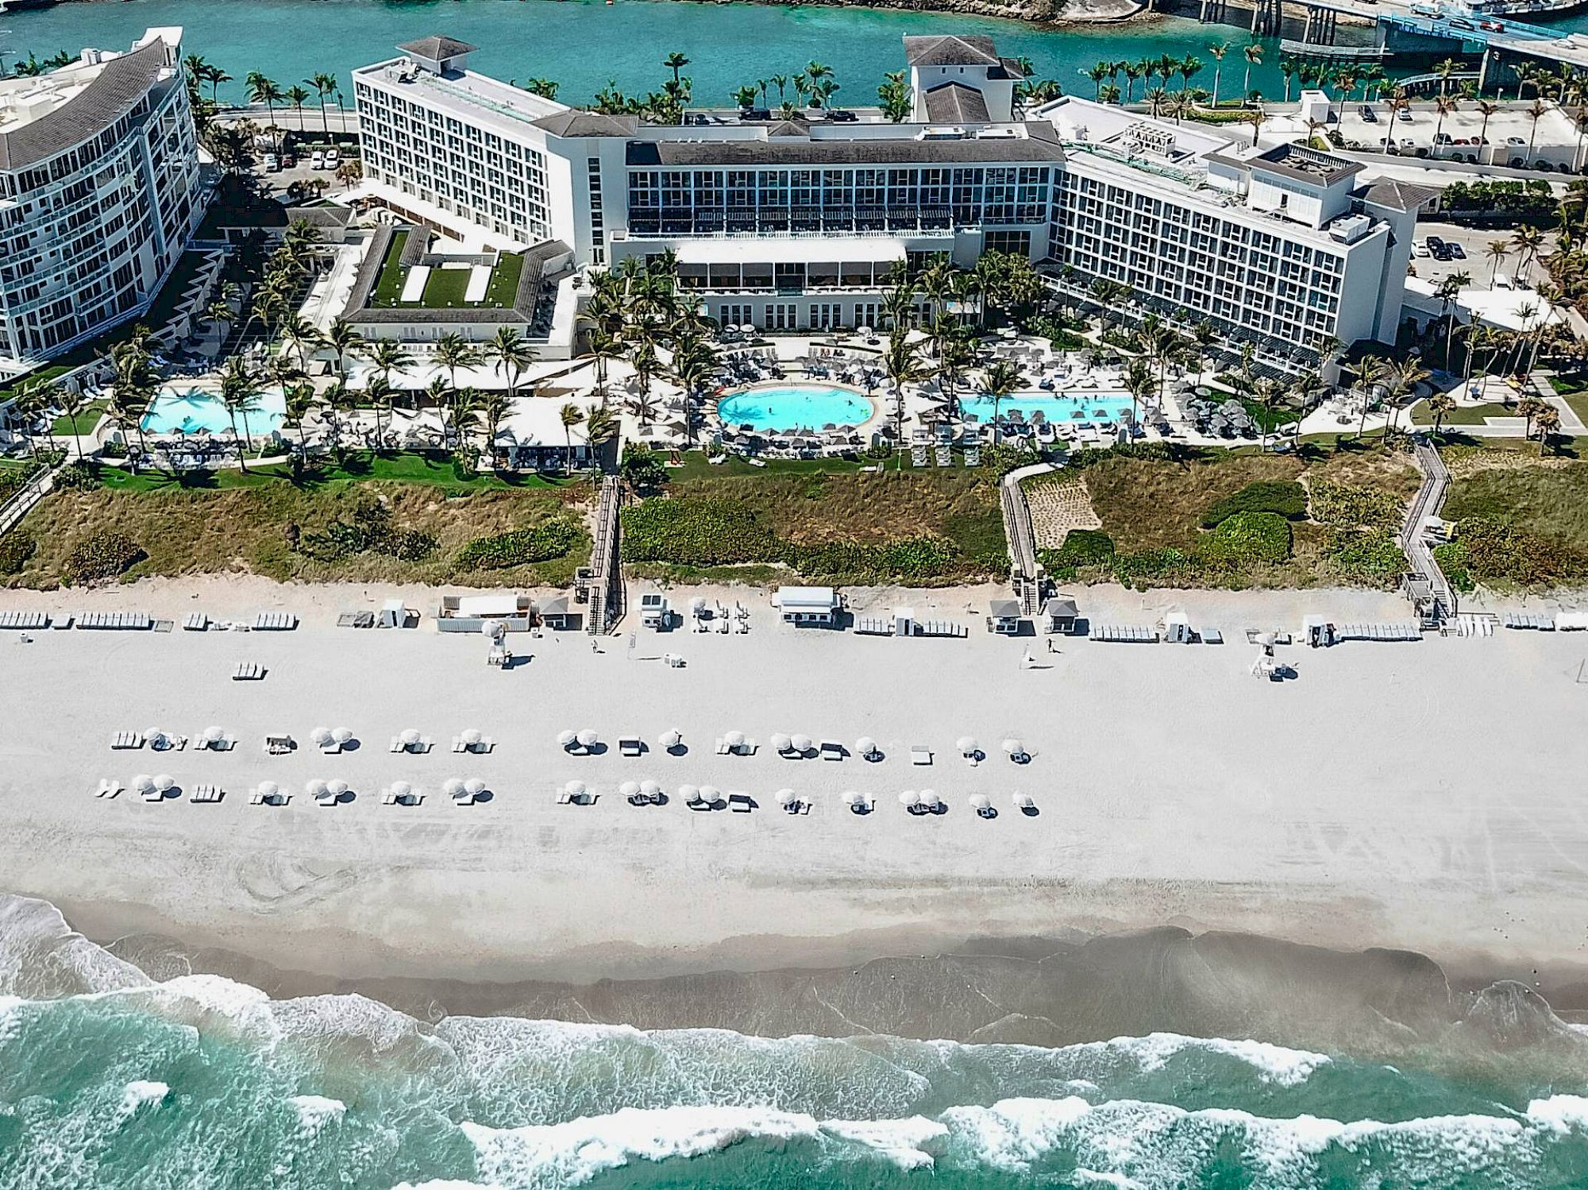
July 7-8, 2022
Boca Resort,
Boca Raton, FL

Slide 7
Thank you for attending the
2021 FBT Summer Camp!

Slide 8
Travel Safely!

