Slide 1


Slide 2

Notes:
[PRESENTER]
This is the new FTP video. In presentation mode, it will automatically link to the website and bring up the play button. Push play from presentation mode. It may take a few seconds to make the connection to the internet. If you do not have an internet connection, you will not be able to plan the video.
In normal mode, double click anywhere in the BLACK and it will take you to the embedded video. From there, click play.

Slide 3
Florida Transportation Plan (FTP)
FBT Board
July 11, 2019

Slide 4
Florida Transportation Plan
Agile, resilient, and quality transportation infrastructure
^{Safety}
^{and security}
^{Efficient and}
^{reliable mobility}
^{More transportation}
^{choices}
^{Global economic}
^{competitiveness}
^{Quality places to live,}
^{learn, work, and play}
^{Environment and}
^{energy conservation}

Slide 5
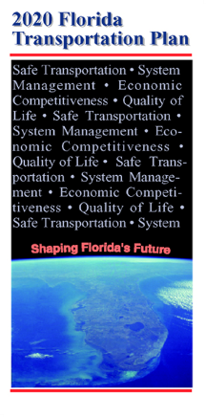
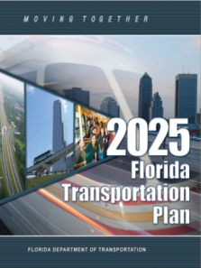
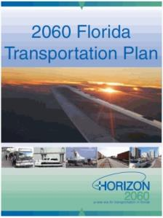
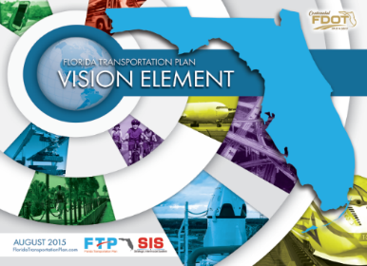
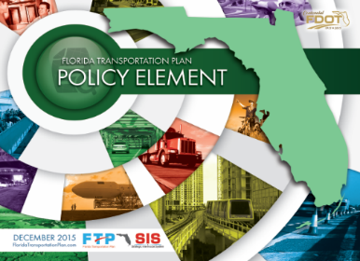

Prior FTPs Have reshaped Florida
2020 FTP (2000)
  Strategic Intermodal System (SIS)
2025 FTP (2005)
  Regional visioning
  Future corridors
2060 FTP (2010)
  Economic Strategic Plan
  Freight Mobility and Trade Plan (FMTP)
  Managed lanes
Current FTP (2015)
  Transportation choices
  Emphasis on safety and alignment with the Strategic Highway Safety Plan (SHSP)
  Workforce development

Slide 6
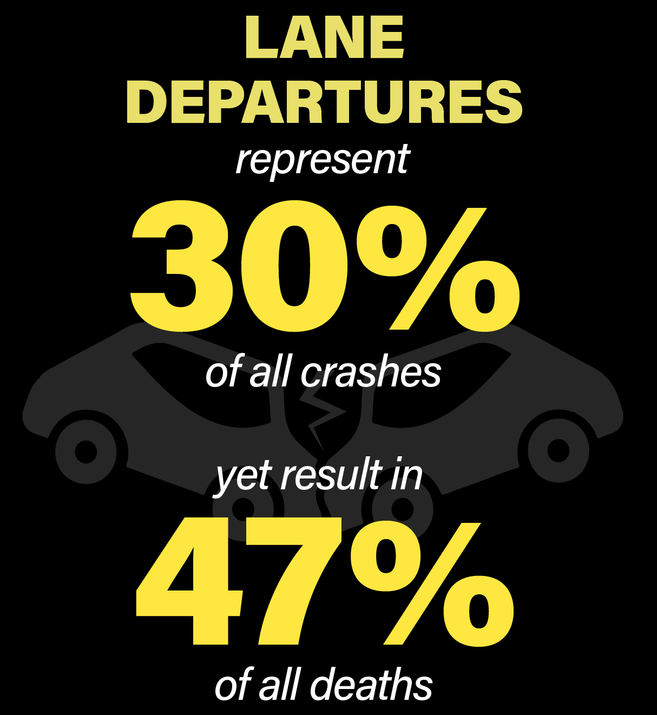
Safety
Speeding
Fatalities
26%
of all Fatalities
10%
of all Fatalities
Bike/Ped
Fatalities
25% of all
Fatalities
involve a bicyclist
or pedestrian
Notes:
Land use and transportation – more than context, partnerships to match and discuss early (before development), relationships with local government.
Use of technologies to address safety – like the FDOT’s CAV program.
Embracing the new FDM – intersection control through roundabouts, diverging diamonds…, speed management (note intersection crashes as % of total crashes)
2017 Daily VMT = 599 Million
From existing SHSP
Lane Departures represent 30% of all crashes and 47% of all deaths (2011-2015)
Intersections account for 23% of all fatalities (2015)

Slide 7
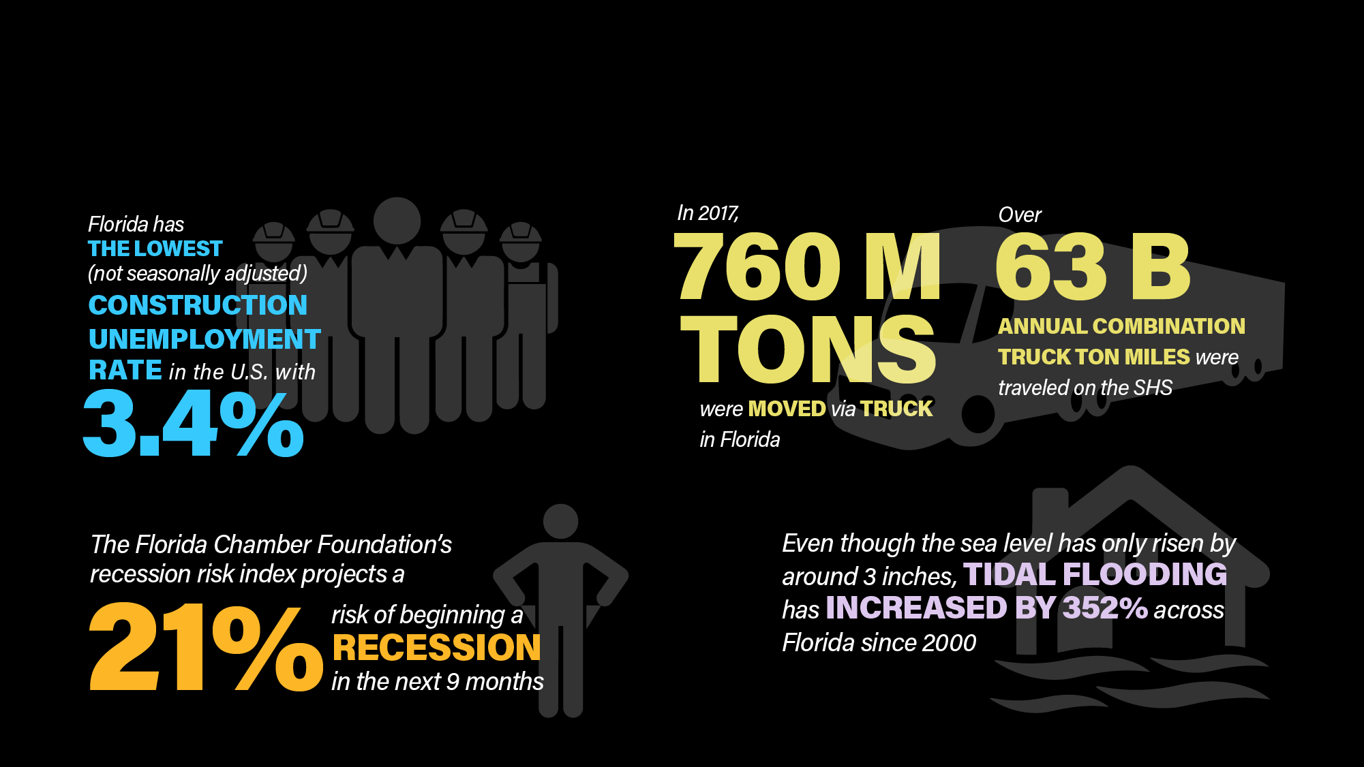
System Preservation
Notes:
Workforce
Funding risks
Resilience – affects of SLR/flooding and other risks, fires, hurricanes stronger than ever
Climate Central. (2017, October). These U.S. Cities Are Most Vulnerable to Major Coastal Flooding and Sea Level Rise. Retrieved from https://www.climatecentral.org/news/us-cities-most-vulnerable-majorcoastal-flooding-sea-level-rise-21748
SeaLevelRise.org. (2019). Florida. Retrieved from https://sealevelrise.org/states/florida/
Importance of SIS as strategic to interregional travel – for freight especially
Source for Construction Statistic - http://www.abc.org/News-Media/News-Releases/entryid/3729/background-on-state-construction-unemployment-rates

Slide 8
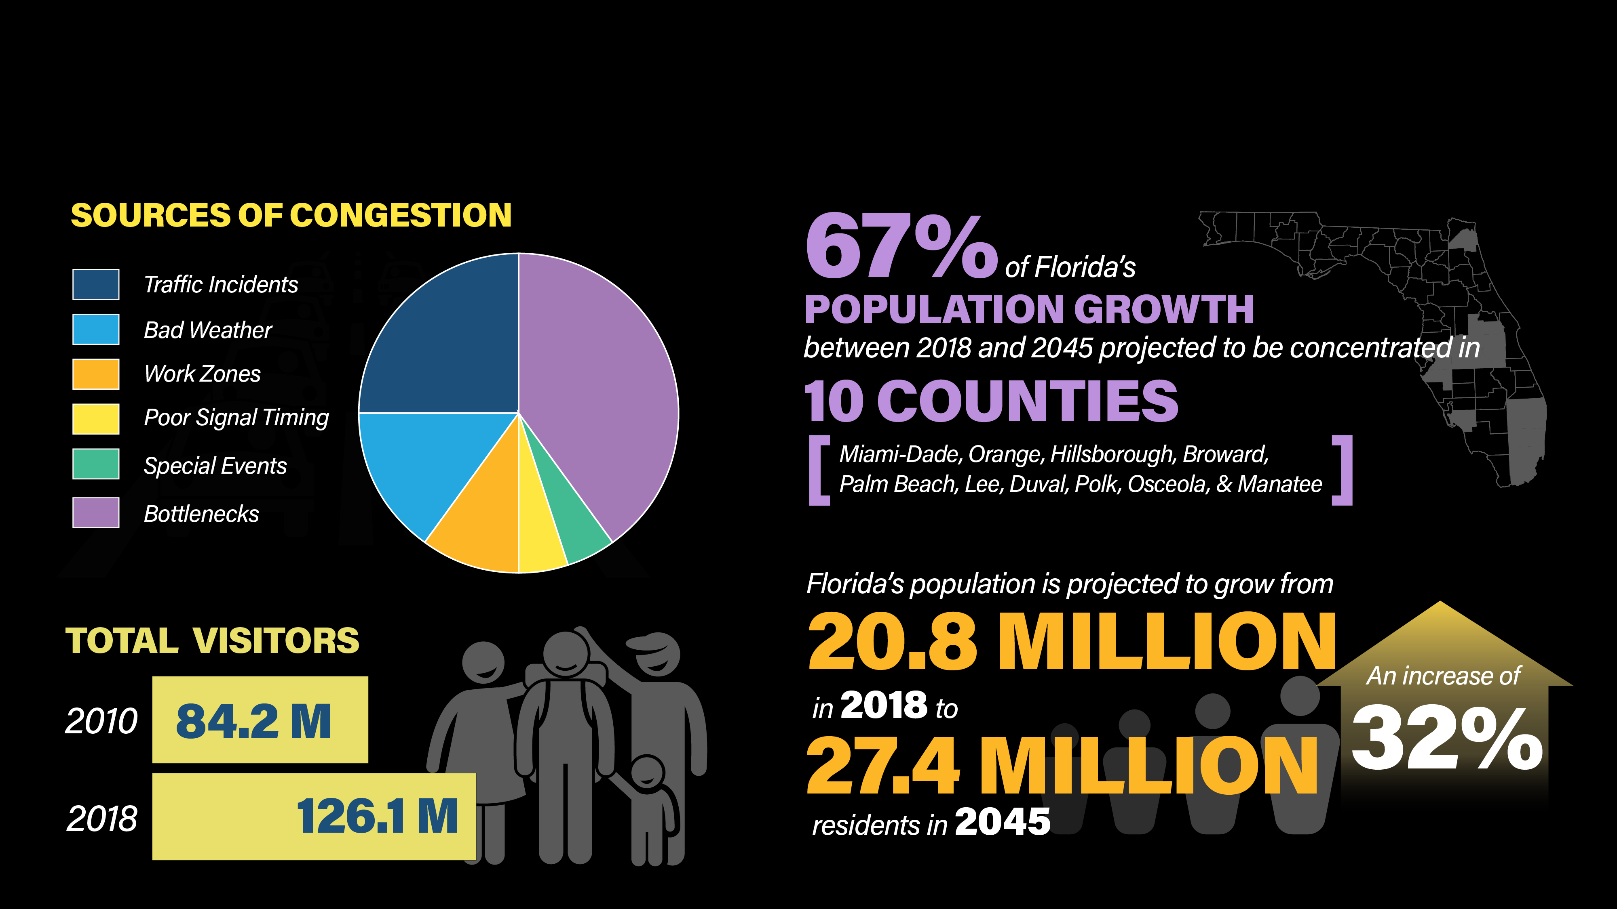
Capacity
Notes:
Cover increase in VMT. Population/Tourism contribute to continued VMT as do new choices like ridesharing, etc.; economy health and fuel costs too
Land use issues and relationship to capacity needs; long-term thinking and relationship with locals. In some cases, it’s ok to have congestion to some degree – having the network is what gives us options. This is another spot where we can bring in ideas from LRV.
Development – cumulative impacts affecting SIS facilities for local needs
Continued urbanization and shifting of freight delivery means more pressures with cities

Slide 9
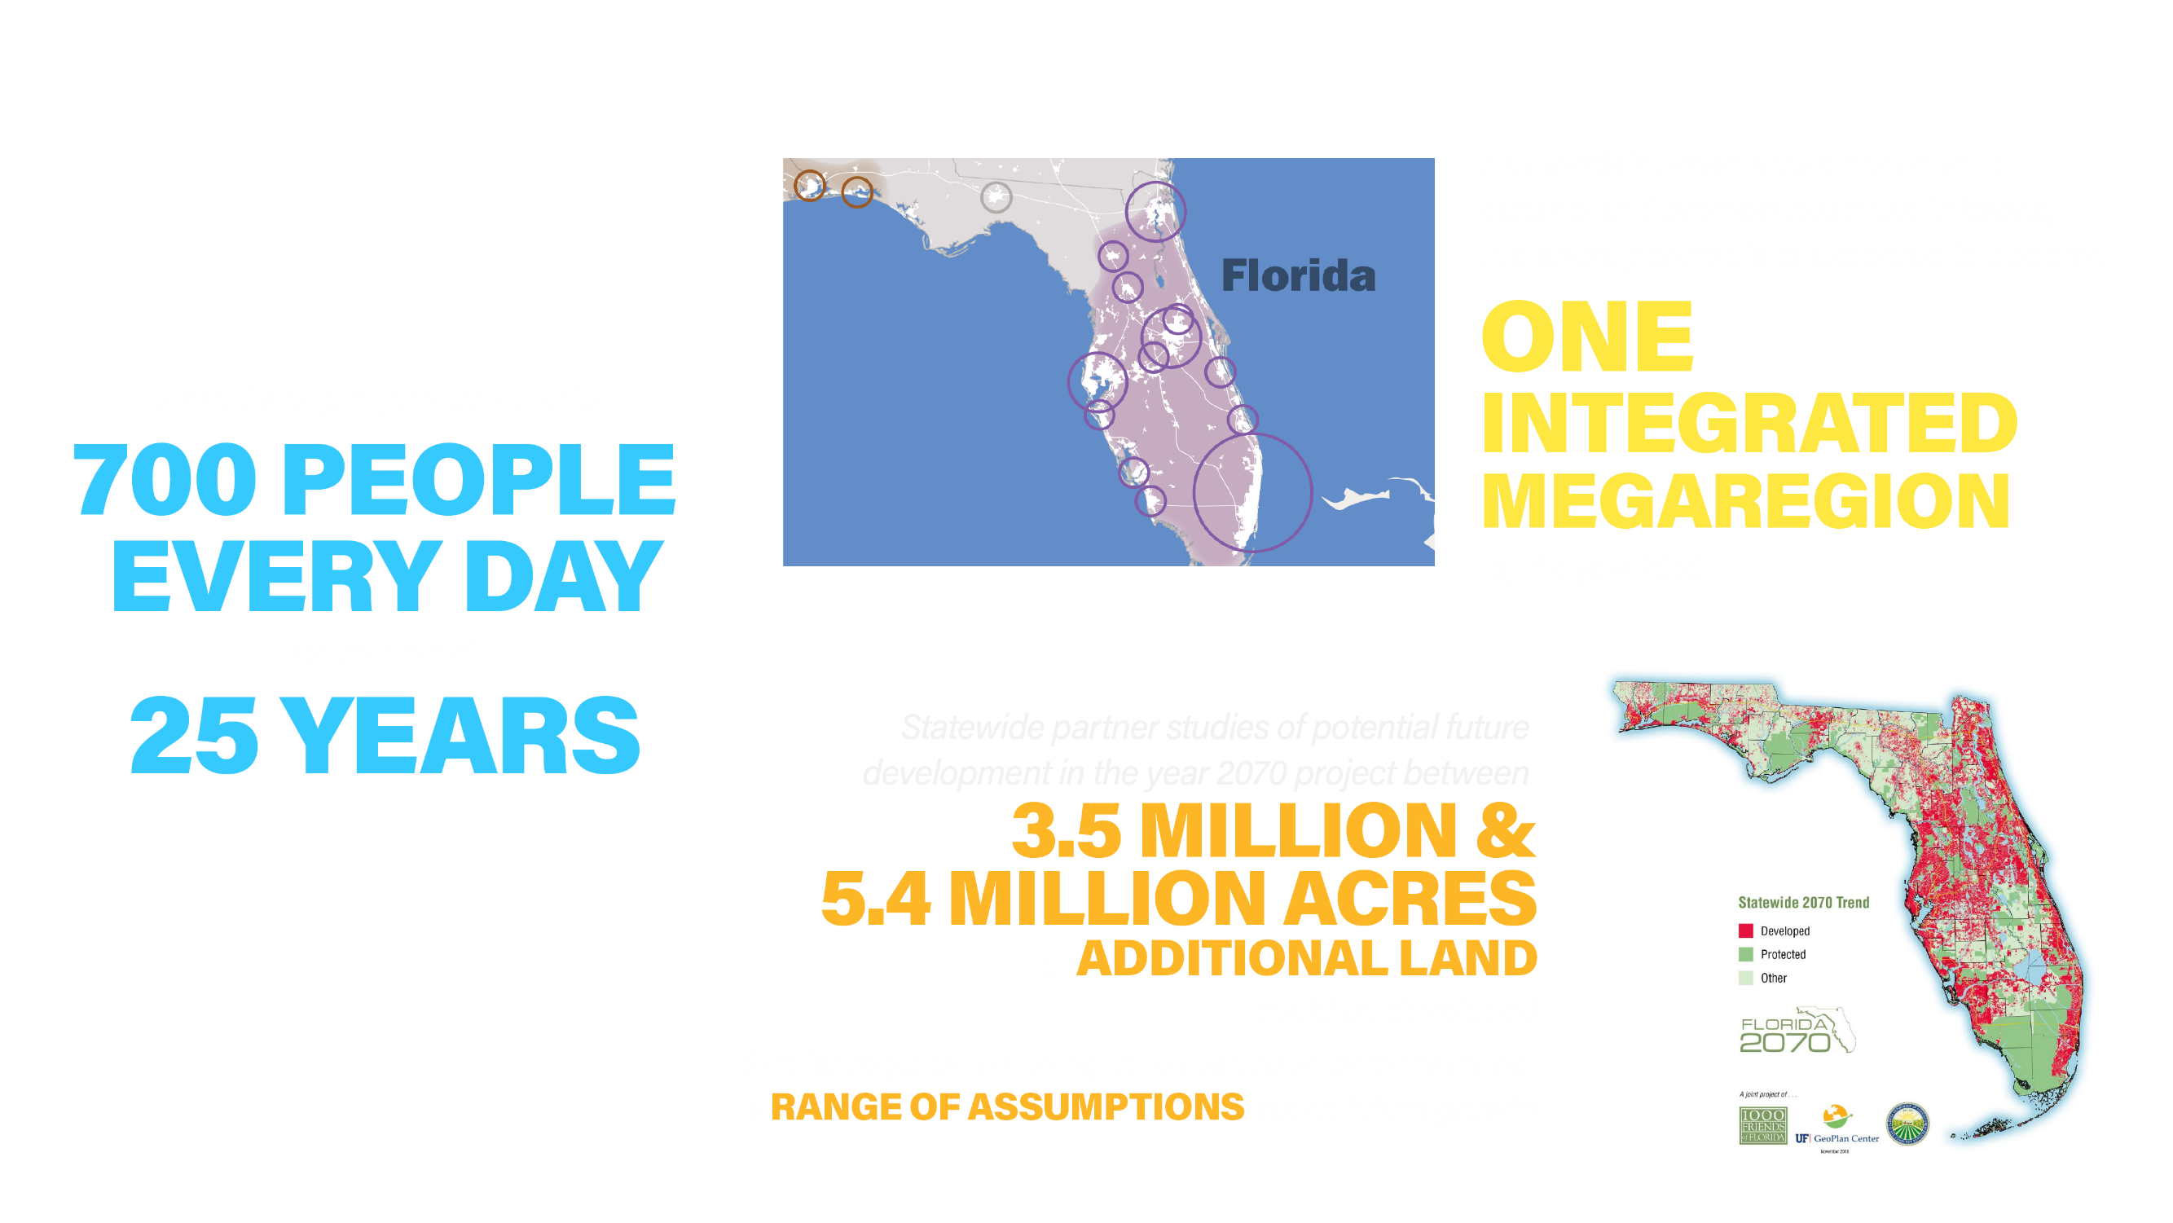
What’s Next?

Slide 10
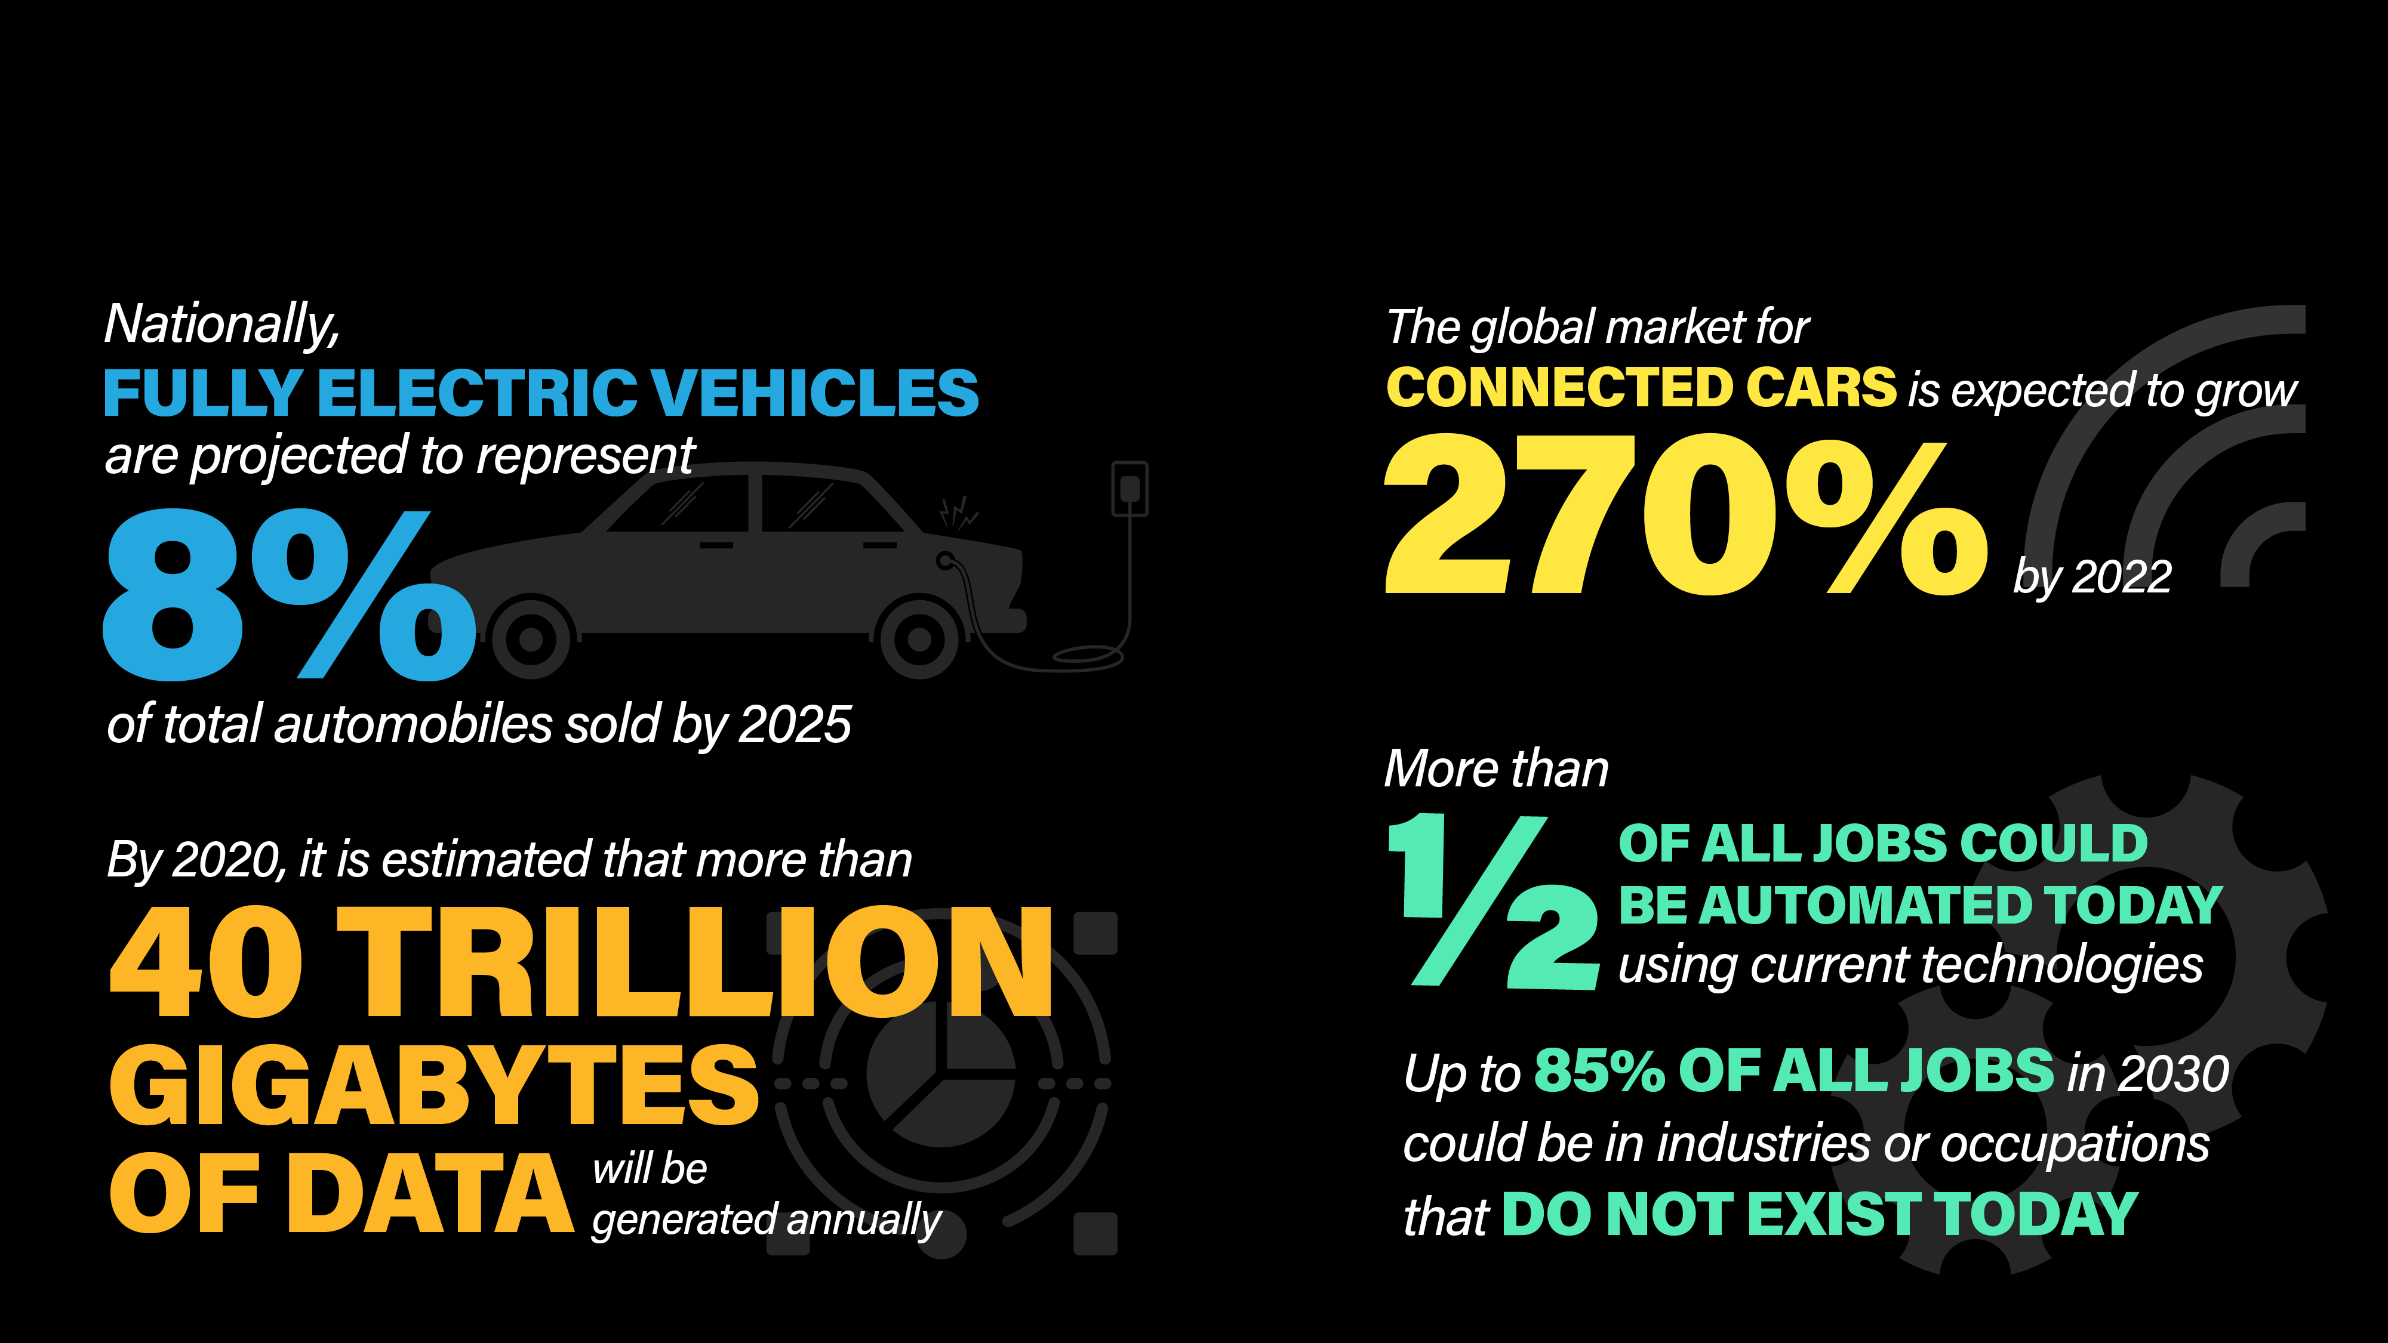
What’s Next?

Slide 11
FTP Goals
Refresh of existing FTP
Plan Crosswalk/Analysis
  MPO LRTPs
  Other FDOT plans
  Other State Agency plans
Trends Analysis
Long-Range Visioning Session
Steering Committee Discussion

Slide 12
What have we missed?

Slide 13
FTP/SIS Update Schedule Overview
FTP Kickoff in May 2019
Vision Element completed by December 2019
Policy Element completed by December 2020

Slide 14
Questions?
Dana Reiding
Office of Policy Planning
Florida Department of Transportation
Dana.Reiding@dot.state.fl.us
(850) 414-4719
www.fdot.gov/planning/policy

