Slide 1
The Gas Tax: Running On Empty
Potential Solutions to a Growing Problem
In Transportation Funding
Ed Regan
July 8, 2021

Slide 2
Overview of Today’s Discussion
An updated outlook on the viability of the motor fuel tax
  EIA release of its 2021 Annual Energy Outlook
  Probable partial restoration of enhanced CAFE standards
  Rapidly increasing shift to electric vehicles
A closer look at what it means to transportation funding in Florida
  How bad might it get?
  Some potential solutions
Increasing focus on Road User Charging (RUC)
  Likely Congressional support in Re-authorization proposals
  What’s happened to date and the challenges still to be overcome

Slide 3
Framing the Update
2021 EIA Fuel Forecast
  Projects U.S. fuel sales will never again reach levels seen in 2019
  Reflects reduced new car CAFE standards suggested in Trump Administration
  Assumes slight increase in electric vehicle penetration, but still well below other forecasts
Three alternative projection scenarios
  A: The 2021 EIA “Reference Case” forecast
  B: Alternative scenario assuming partial restoration of increased CAFE standards
  C: Alternative scenario assuming higher electric vehicle penetration

Slide 4
Comparison of Fuel Efficiency Assumptions by Scenario

Slide 5
Comparison of Electric Vehicle Penetration Assumptions

Slide 6
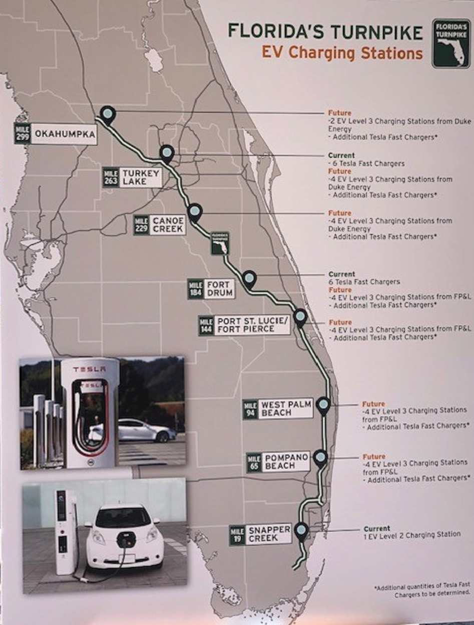
Shift to Electric Vehicles is Becoming a Lot More Real
GM projects it will only offer electric or plug in hybrid vehicles by 2035
Volvo has announced it will only offer EVs worldwide by around 2030
Ford recently introduced its new electric F 150 truck model “Lightning” with great interest
By 2035, all California new vehicle sales will be electric or other non-fossil fuel
Recent NY Times article estimates EVs will represent over 40% of the US light vehicle fleet by 2050

Slide 7
Updated U.S. Fuel Sales Forecast
Annual VMT
(Billions)
EIA 2021 AEO VMT Forecast
Estimated Fuel Sales if No Change in MPG
EIA Reference Case Fuel Sales Projections 2021 AEO
Annual US Fuel Sales (Billions)
Alternate Fuel Sales Projections With Restored CAFE standards
Adjusted Fuel Sales Projections With Higher EV Share (Bloomberg NEF)
Source: US Energy Information Administration.
Bloomberg New Energy Finance.

Slide 8
Estimated Annual Federal Motor Fuel Taxes
2021 Dollars – Assumes Current Federal Tax Rates
-$7.9B
(-19.4%)
-$12.1B
-28.4%
-$17.1B
(-38.6%)
-$21.3B
(-46.2%)
-$23.6B
(-49.4%)
With No Change MPG
2021 EIA Reference Case
With Restored CAFE Standards
Higher EV Penetration
Includes Federal tax on both gasoline and diesel fuels

Slide 9
Focusing on Florida
Like all states, travel in Florida was heavily impacted by Covid-19 in 2020
  Statewide VMT down over 13% vs 2019
  Fuel sales down about 10%
  Gas tax revenue also declined significantly
  Travel recovering well in 2021
Florida’s complex motor fuel tax
  Several components – some statewide, some vary at the county level
  Gasoline rate per gallon in 2021 ranges from $0.325 - $0.385 per gallon
  Statewide Diesel rate $0.332 per gallon
  Large part (about 2/3) of state gas and diesel tax indexed to inflation

Slide 10
Summary of Florida Travel and Fuel Sales Trends

Slide 11
Estimated Florida Travel and Fuel Consumption
Annual Florida VMT (Billions)
Estimated Fuel Sales if No Change in MPG
Florida VMT Forecast
Annual VMT (Billions)
Annual Fuel Consumption (Millions of Gallons)
Assuming ETA Ref. Case MPG
Annual Florida Fuel Sales (Millions)
Assuming Partially Restored CAFE Standards
Florida Fuel Sales Projections With Higher EV Share (Bloomberg NEF)
Source: US Energy Information Administration.
Bloomberg New Energy Finance.

Slide 12
To Be Clear: Florida Sees the Problem
FDOT and other Florida forecasters are also aware of the coming challenges facing the motor fuel tax
Semi-Annual REC projections of fuel sales are reflecting increasing fuel efficiency and declines in later years
FDOT has developed an Electric Vehicle Infrastructure Master Plan
  Considers Conservative, Moderate and Aggressive EV penetration scenarios
  By 2040, the Aggressive EV scenario assumes 35% of light vehicles would be BEV or PHEV, potential impacting gas tax revenue by 30% even after recognizing increasing fuel efficiency in ICE vehicles

Slide 13
Estimated Annual Florida Fuel Tax Revenue
-$4.5B
-55.4%
-$3.9B
-52.1%
-$2.9B
-43.9%
-$2.0B
-33.1%
-$1.3B
-24.0%
Assuming No Change in Current MPG
Assuming EIA 2021 Reference Case MPG
Assuming Partially Restored CAFE Standards
Assuming High Electric Vehicle Penetration
Future Year Dollars With Indexing
Assumes 2% Annual Rate Adjustment
Note: Includes both FL state level and local option fuel tax rates

Slide 14
Florida’s Bottom Line
Increasing fuel efficiency and the increasing usage of electric vehicles will negatively impact traditional gas tax revenue
  by about 33% by 2035
  by about 54% by 2050
Electric vehicle penetration will have the biggest impact
  All auto makers planning big shift to EV’s and PHEV’s in near future
Can we just offset these losses by increasing fuel tax rates?
  Probably not

Slide 15
Estimated Florida Tax Rates Per Gallon Needed to Offset
Fuel Efficiency Losses
Avg.
2021
Rate
No Change From
2021
EIA
Ref.
F’cast
Restored
CAFÉ
Stand.
With
High
EV Est.
No Change From
2021
EIA
Ref.
F’cast
Restored
CAFÉ
Stand.
With
High
EV Est.
2035 Fuel Efficiency Scenario
2050 Fuel Efficiency Scenario
(Assumes 2% Annual Increase in Indexed Portion of FL Gas Tax)
Note: Rates include both statewide and average county local option fuel tax components

Slide 16
States Are Looking for Funding New Solutions
PA Governor Tom Wolfe plans to phase out the state’s gas tax
  Appointed Task Force to identify new options by later this year
  State plans to fund reconstruction of several bridges by adding tolls
Several states are implementing special registration fees for electric and PHEV vehicles to replace lost gas tax revenue
  But this moves away from the critical “user fee” approach to transportation funding
  Some states introducing simplified RUC systems as an alternative for EVs
Interstate route tolling
  Several states have been looking at adding tolls to interstate highways
  Been a very “tough sell” at the state and local level
Broad Road User Charging (RUC) is the ultimate solution
  Shift from “per gallon” to “per mile” basis of charging that varies user charges based on how much a vehicle is driven

Slide 17
Road User Charging May Finally Be on the Way
Road User Charging is still “10 Years Away”
  Been saying that for 15-20 years… and it’s still 10 years away
  But with a coming 20% hit on the federal gas tax by 2030, the 10-year target is about to stop “sliding”
Expect action by Congress in the next Re-authorization
  Both houses targeting replacement bill in 2021
  Significant support for extending and expanding STFSA
  Big increase in the Federal share of funding probable
Increased focus on a national system
  Re-authorization proposals include proposals for developing a national system to replace the Federal gas tax and a large “national RUC pilot”
To be clear…
  Federal efforts to develop a national system to replace the Federal gas tax would NOT be a federal mandate on what states do with their own revenue systems
  But a national system should be designed to enable states to “tap in” should states elect to do so

Slide 18
Ultimate Road User Charging System of the Future
But ideally in the long term, while fully protecting motorist privacy, the ultimate RUC system of the future will:
  Tap into automaker telematics to offer the policy option for location, route and time of travel-based charging capability
  Providing aggregated charge information to jurisdictions while protecting motorist privacy
Factors driving the need for the ultimate, more sophisticated RUC system
  Travel between states
  Shifts toward more local transportation funding support
  More equitable funding support for transit
  Emergence of congestion pricing / variable time of day RUC pricing
  Expanded use of tolling – simplified toll collection methods

Slide 19
Thank you
Ed Regan
reganej@cdmsmith.com

