Slide 2
Key Supply Chain Challenges in Florida
Increases costs of last mile deliveries
Less reliability for JIT (just-in-time)
Increases the challenge of recruiting a skilled labor force
Congestion/ Bottlenecks
High traffic volumes congest key freight facilities/gateways
Few alternatives for outbound domestic shipments
Technology investments needed to optimize capacity
capacity / connectivity
Raises the cost of shipping (pay two-way rate for one-way shipment)
Raises the difficulty of accessing equipment
Lane Balance

Slide 3
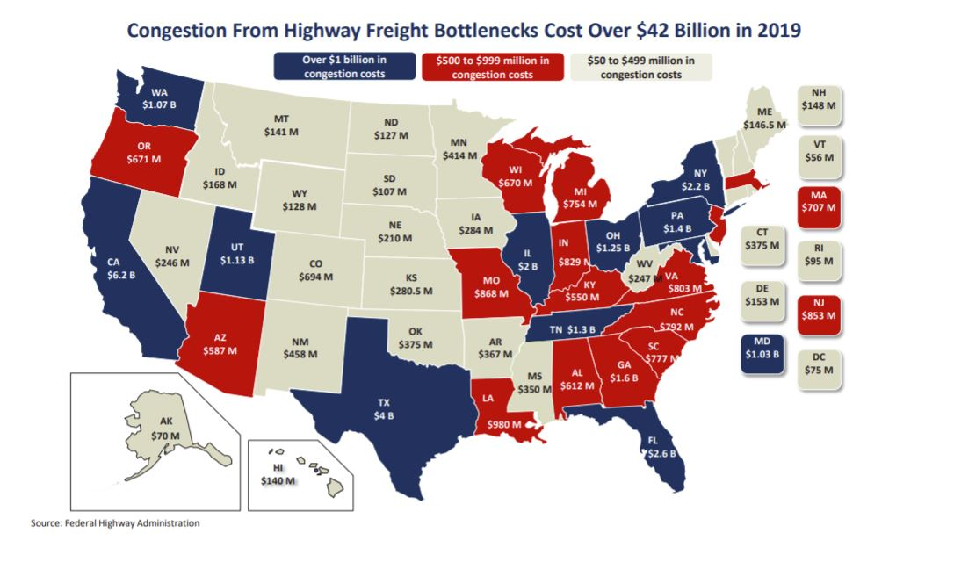

Slide 4
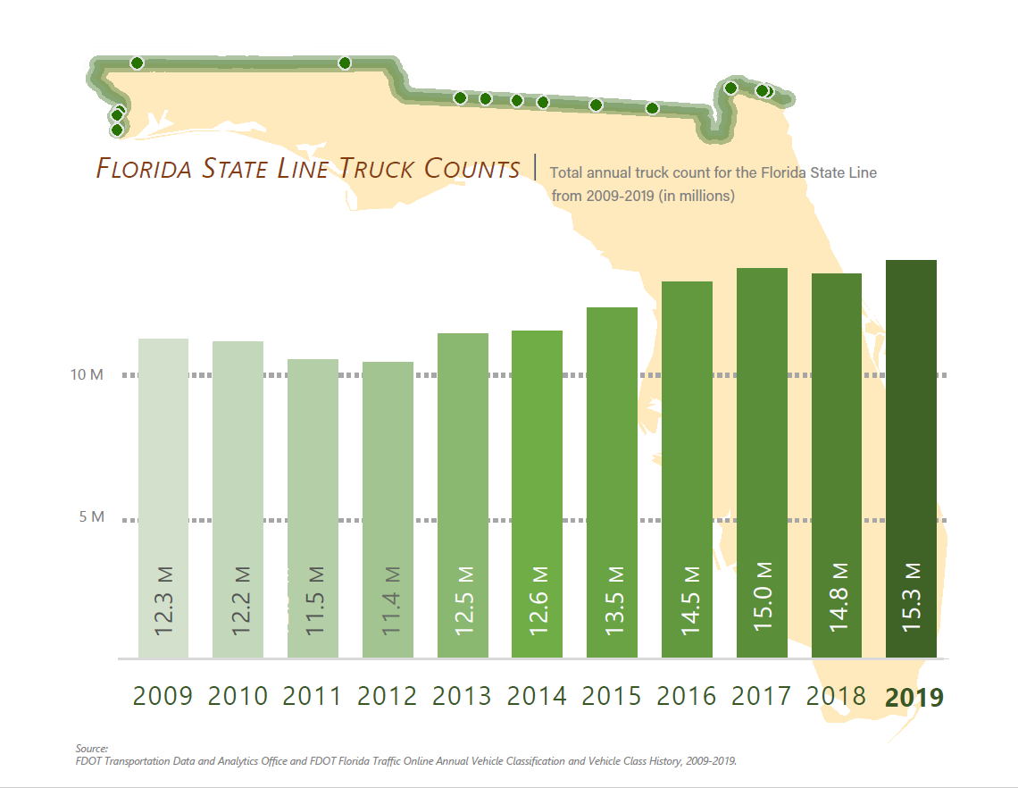

Slide 5
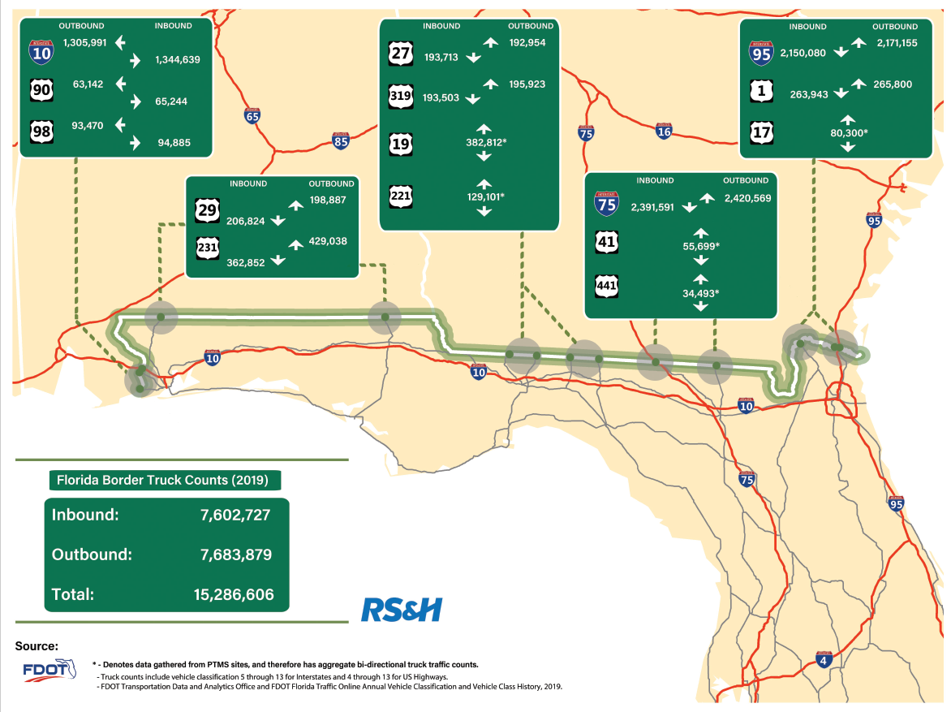

Slide 6
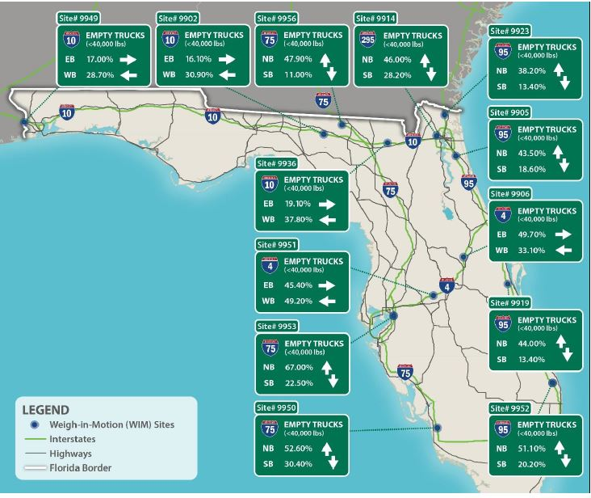
View as OPPORTUNITY NOT just a CHALLENGE

Slide 7
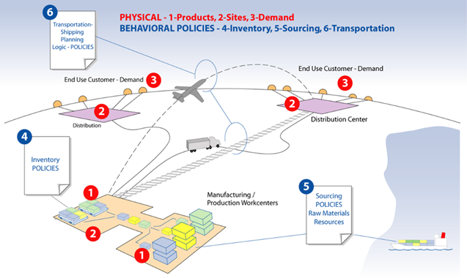
Optimization Objectives
Value Proposition to Industry…
Reduce transportation costs
Up to 80% of a products’ total landed cost is built-in to the supply chain network design
Optimization can also address:
Speed to market
Reliability
Resiliency
Industry workforce challenges
Driver shortages (national/state)
Economic Development
Turning challenges into opportunities
Empty backhaul
Diversified Infrastructure Investments
Notes:
May want to ask audience if anyone can explain “landed cost”

Slide 8
Top of the State offers freight alternatives Can mitigate driver shortages

Slide 9
After Model is Built: Test “What-If” Scenarios
Objective: Optimize networks to reduce supply chain costs
Test network changes/investments
Geography:
34 counties in Districts 2 & 3
Includes:
Locations (county level)
Market sizing / market opportunity for investment
Cost savings to private sector for network enhancements
Cost/Benefit and ROI analysis to support grants and financing
Notes:
Deleted the last bullet- use as a transition to the next slide
The Nebraska study scope includes 5 scenarios

Slide 10
FDOT Investments
Rail Improvements
Rail System Plan -short- & long-term needs identified
Grant Opportunities
Leverage federal funds for large projects
Partnerships
Model tests business case for unique needs that may lead to public private partnerships
~$60M available annually in Strategic Intermodal System (SIS) funding for eligible projects
Variety of programs can expand eligible project types – signals, safety, etc.
Industrial development, manufacturing support, etc.

