Slide 1
2021 Transportation Summer Camp “Building New Horizons in a Changing World”
Kevin J. Thibault, P.E. Florida Department of Transportation
July 8, 2021

Slide 2
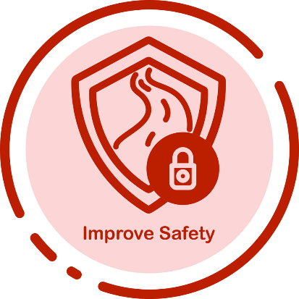
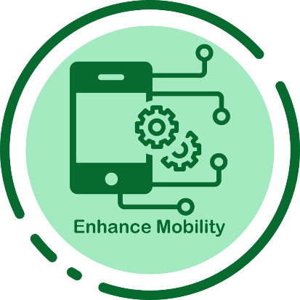
VITAL FEW – EVOLUTIONARY FOCUS
FOR FLORIDA TRANSPORTATION

Slide 3
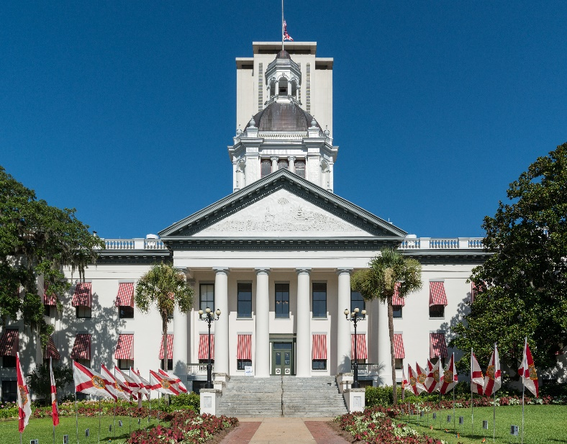
2021 LEGISLATIVE SESSION HIGHLIGHTS
Successful passage of FDOT’s bill (sponsored by Senator Harrell and Representative LaMarca)
$9.44 billion for the department’s Work Program
Transfer of $2 billion from federal COVID-19 relief funds to the State Transportation Trust Fund

Slide 4
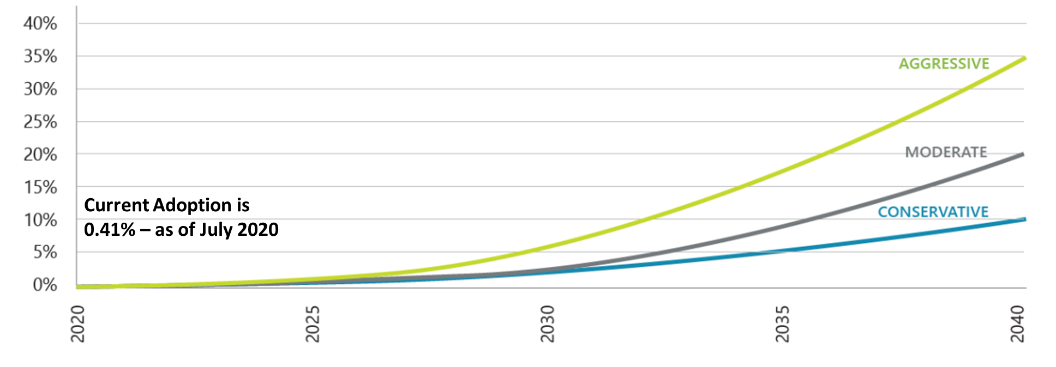
Preparing for a Funding Shift
ELECTRIFICATION OF VEHICLES
PROJECTED EV ADOPTION RATE IN FLORIDA

Slide 5
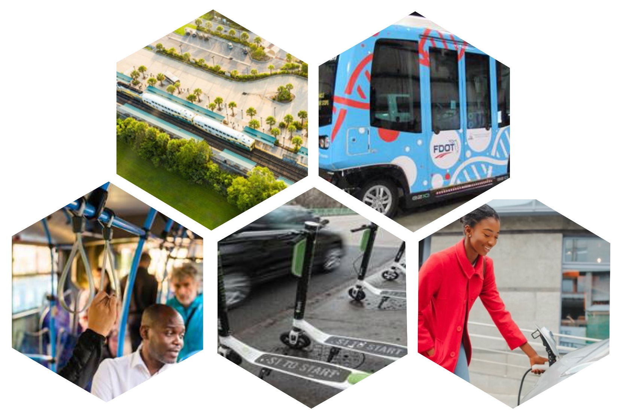
CHANGING NEEDS = NEW MOBILITY OPTIONS

Slide 6
FREIGHT MOBILITY
Explore innovative funding opportunities.
Develop new truck parking sites.
Expand truck parking availability systems.
Implement Freight Signal Priority projects.

Slide 7
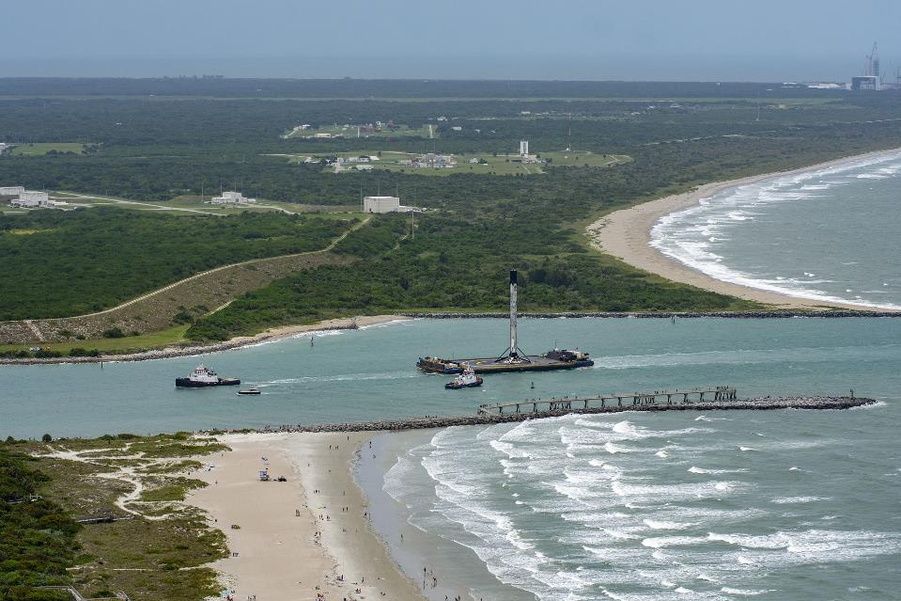
Linking Land, Air, Sea and Space connectivity across modes
Photo credit: Space Florida

Slide 8
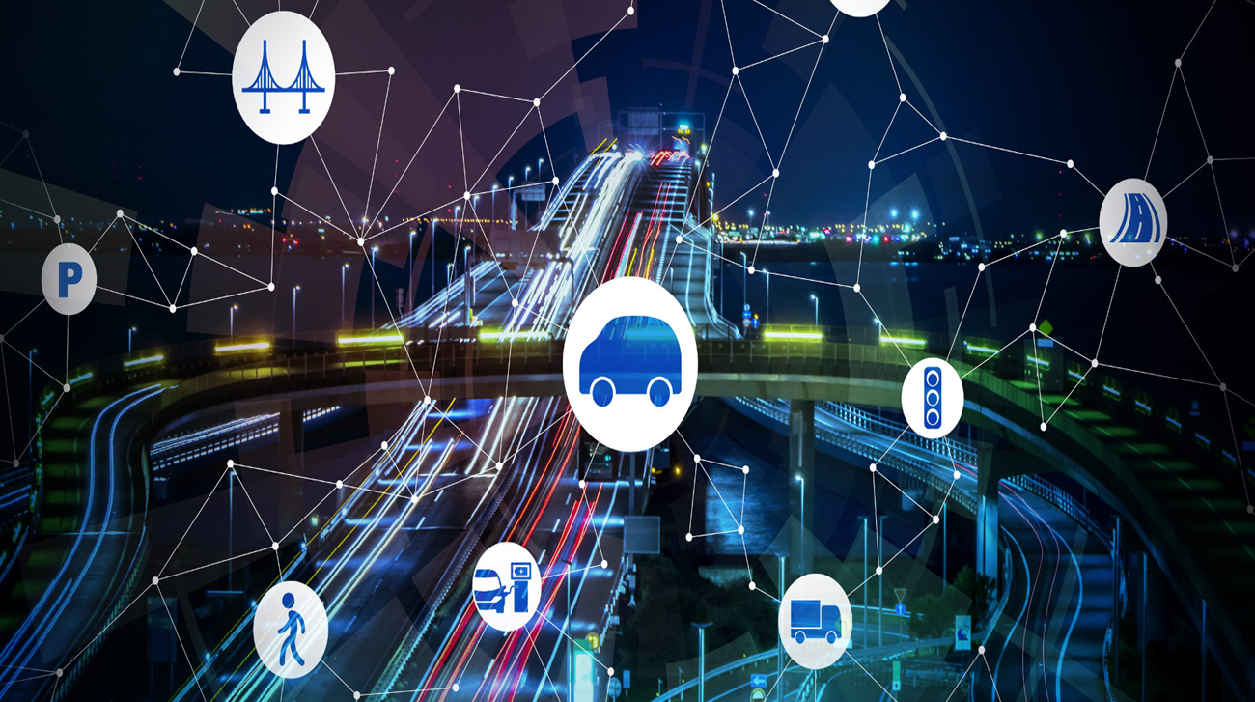
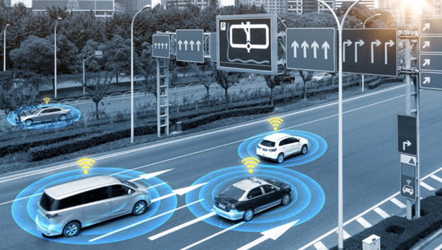
MODERNIZATION OF INFRASTRUCTURE
Advanced Traffic Management Systems
I-STREET Initiative
Intelligent Transportation Systems
Connected and Automated Vehicles Business Plan
V2X Data Exchange Platform

Slide 9
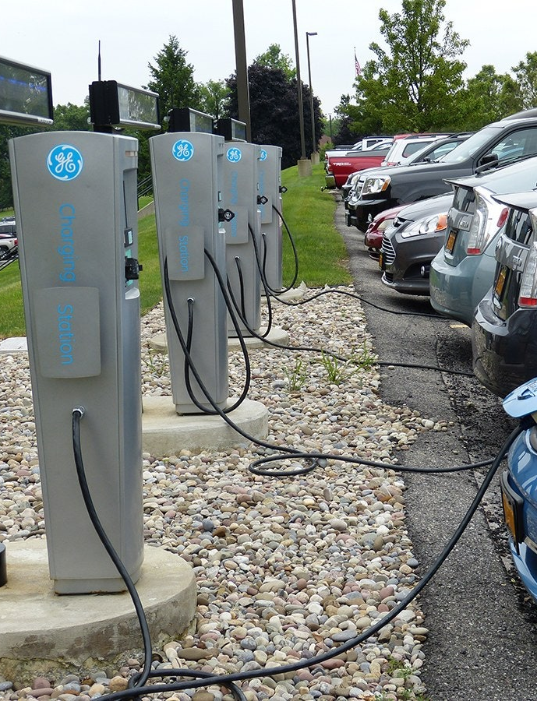
ELECTRIC VEHICLE Infrastructure MASTER PLAN
Adapt: Adapt transportation infrastructure to advance electrized mobility.
Facilitate: Facilitate the transition of next generation infrastructure through strategic investments and partnerships.
Educate: Provide resources to share information and knowledge that enhance educational and outreach efforts to support the state’s electrification goals.
Coordinate: Engage other states, communities, agencies and stakeholders to coordinate best practices on EV infrastructure deployment.

Slide 10
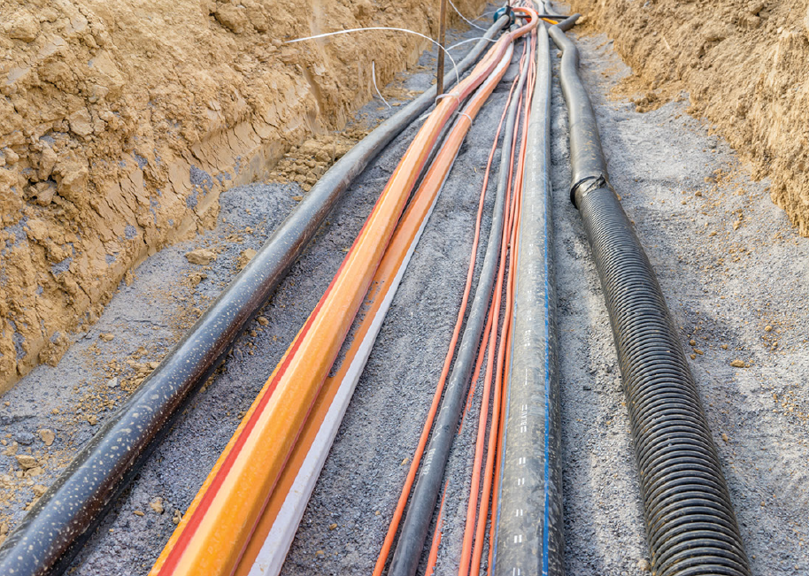
MORE THAN ROADS - BROADBAND INFRASTRUCTURE
Florida Transportation Plan Strategy
Expand Transportation Infostructure
Automated and connected vehicles rely on broadband service in roads, traffic signals, transit vehicles, and other systems to access data on roadway conditions, traffic volumes, and other critical factors that influence how they operate.

Slide 11
Role in Sustainability and resiliency
Reduce environmental impacts.
Increase efficiency in operations.
Realize economic outcomes.
Improve community relations.
Identify vulnerabilities on Florida’s Strategic Intermodal System (SIS) corridors to sea level rise, storm surge, inland flooding, extreme heat, and other risks and developing an action plan for improving resilience on the SIS.
Photo credit: Space Florida

Slide 12
Thank you!
Distracted driving is a rapidly growing problem as the use of handheld communication devices and other technologies continue to advance. The Florida Department of Transportation is committed to eliminating crashes that are attributable to distracted driving through the Put it Down campaign.

