Slide 1

Wireless Communications While Driving
The past, present and future …

Slide 2

Did you know …
Texting, posting and other phone distractions cause 1.6 million accidents per year, 11 teen deaths each day and nearly 1,200 injuries each day.
Reading a text message while driving distracts a driver for about 5 seconds. In five seconds, at 55 mph you will cover the length of a football field as if blindfolded.
Texting while driving makes you 23X more likely to have a crash and teen drivers are four times more likely than adults to crash while texting.
Texting and driving is the equivalent of driving after having had four beers and you are six more times likely to cause an accident than driving while drunk.
77 percent of adult drivers and 55 percent of teenage drivers say they can easily manage texting while driving.

Slide 3

The problem …
The average driver doesn’t care about the statistics
We are controlled by our wireless communications devices
We hear a “ding” and we reach for the device
After all, it could be an important message from our family or office
Or it could be …
  OMG - Cute puppy video or photo
  TMB

Slide 4
Texting While Driving
We have twenty-one million Florida drivers, 116 million yearly visitors, pedestrians and cyclists on our roads. Our goal is to deter offenders and change the culture around distracted driving, making it unacceptable just like drunk driving.
So how do we accomplish this goal?

Slide 5
The past …
Started working on this issue in 2012
  National Solid Waste Management Association (NSWMA) – now the National Waste & Recycling Association
  Employees were being injured by distracted drivers and the majority of them were hurt by people texting while driving
  Legislation filed but not heard in committees
  Time to create coalition to tackle this issue

Slide 6
FL DNT TXT N DRV Coalition
The FL DNT TXT+DRIVE COALITION , a broad based group consisting of law enforcement, local governments, businesses, trade associations, advocacy networks and the PTA
Started with approximately 20 members in 2013
Thanks to Senator Nancy Detert and Rep. Doug Holder, legislation was passed in 2013 that made texting while driving a secondary offense
Attempts were made from 2015 – 2018 to make texting while driving a primary offense

Slide 7


Never give up … never, never …
Thanks to Rep. Jackie Toledo and Rep. Emily Slosberg HB 107 relating to Wireless Communications While Driving was filed with 64 co-sponsors
Senator Wilton Simpson filed SB 76 relating to Texting While Driving with 11 co-sponsors
After a series of amendments and negotiations, HB 107 passed
  House – 108 to 7
  Senate – 33 to 5

Slide 8
New Law
CS/HB 107 (ch. 2019-44, L.O.F.) - Wireless Communications While Driving By: Transportation & Infrastructure Subcommittee; Toledo; Slosberg and others
Effective July 1, 2019, the bill changes enforcement of the existing texting while driving ban from a secondary offense to a primary offense. The bill does not change existing penalties and exceptions to the texting ban.

Slide 9
Handsfree
Effective October 1, 2019, the bill prohibits the use of a handheld wireless communications device while driving in a designated school crossing, school zone, or work zone area.
From October 1, 2019, to December 31, 2019, law enforcement officers may provide a verbal or written warning and beginning January 1, 2019, may issue a uniform traffic citation for a violation, which is punishable as a moving violation with three points assessed against the driver’s license.

Slide 10
HB 107 by Toledo, Slosberg & others
The bill prohibits a law enforcement officer from accessing a wireless communications device without a warrant and requires a law enforcement officer to record and report certain information when a citation is issued.
The Department of Highway Safety and Motor Vehicles (DHSMV), in consultation with the Department of Transportation, may implement a statewide awareness campaign on the texting while driving ban and the handheld prohibition.

Slide 11
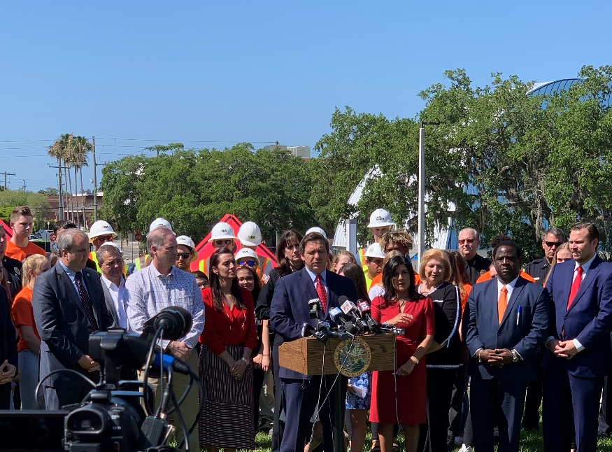
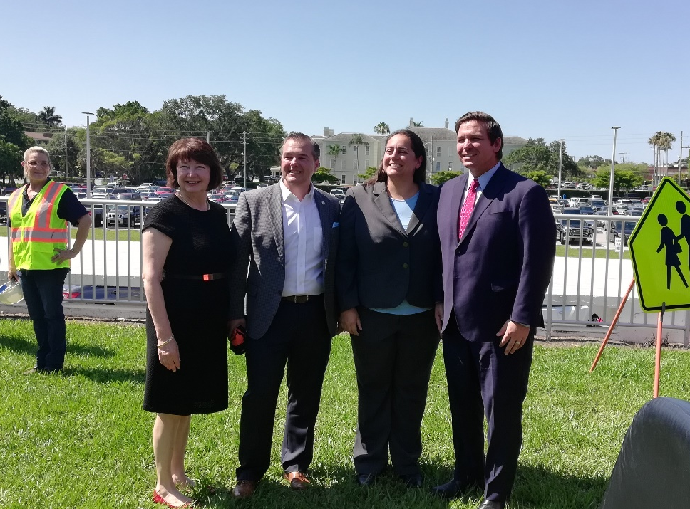
Governor DeSantis signs bill …
The bill became law on May 17, 2019, chapter 2019-44, Laws of Florida, and becomes effective July 1, 2019.

Slide 12
The present …
Thanks to the passage of HB 107
Texting While Driving – primary offense as of July 1
Education campaign being conducted by a variety of entities
FL DNT TXT N DRV Coalition continues to grow
Currently 88 members
Visit our Website at https://fldonttextanddrive.com/

Slide 13
The future …
No legislation during the 2020 session
Continue educational campaign – your organization can help spread the word
Look for handfree legislation to be filed in 2021

Slide 14

Thanks!
Keyna Cory
Public Affairs Consultants
730 East Park Avenue
Tallahassee, FL 32301
keynacory@paconsultants.com
www.paconsultants.com
Office 850-681-1065
Cell 850-566-9575

