Slide 1
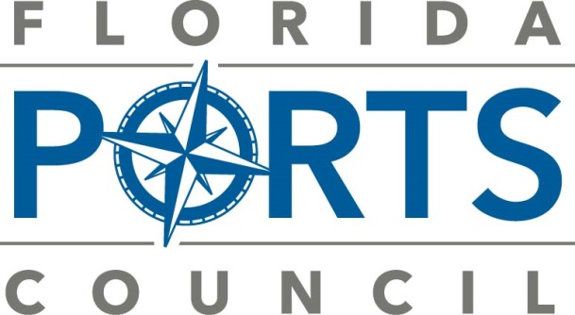

Florida’s Seaports
FBT Update
@floridaports
www.flaports.org

Slide 2
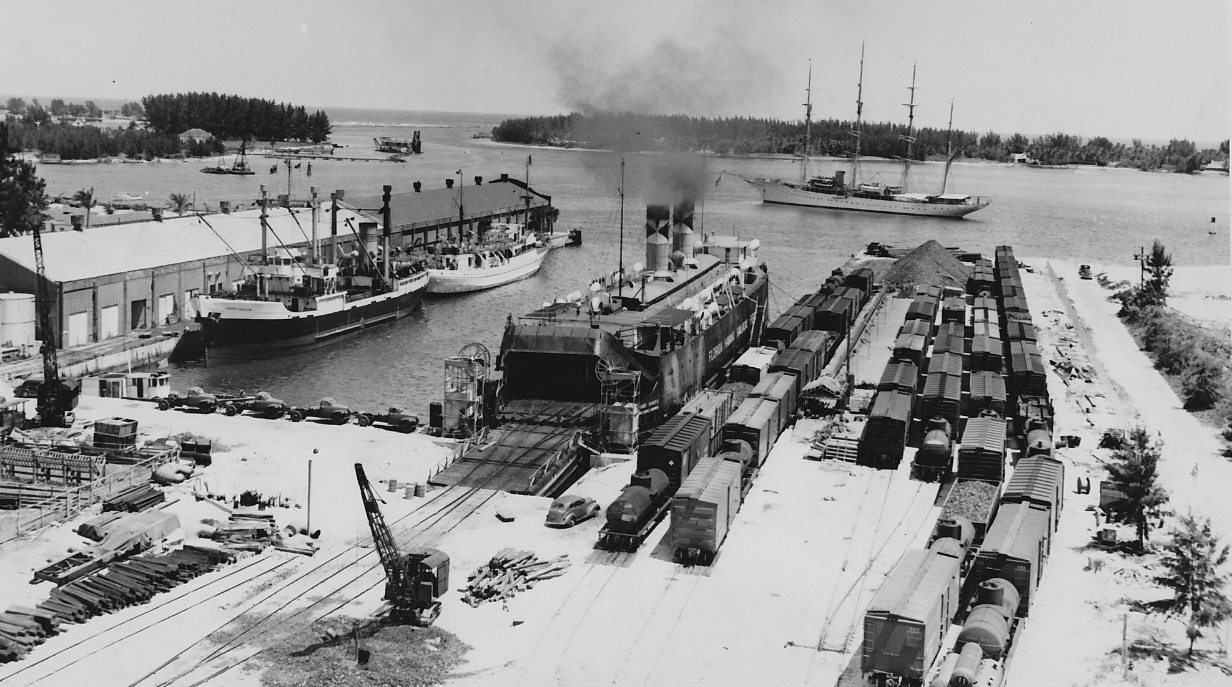
Florida’s Maritime History
1565
1824
1838
first act of international commerce
location of capital established in tallahassee
Florida Delegation Constitution Held
Port St. Joe

Slide 3
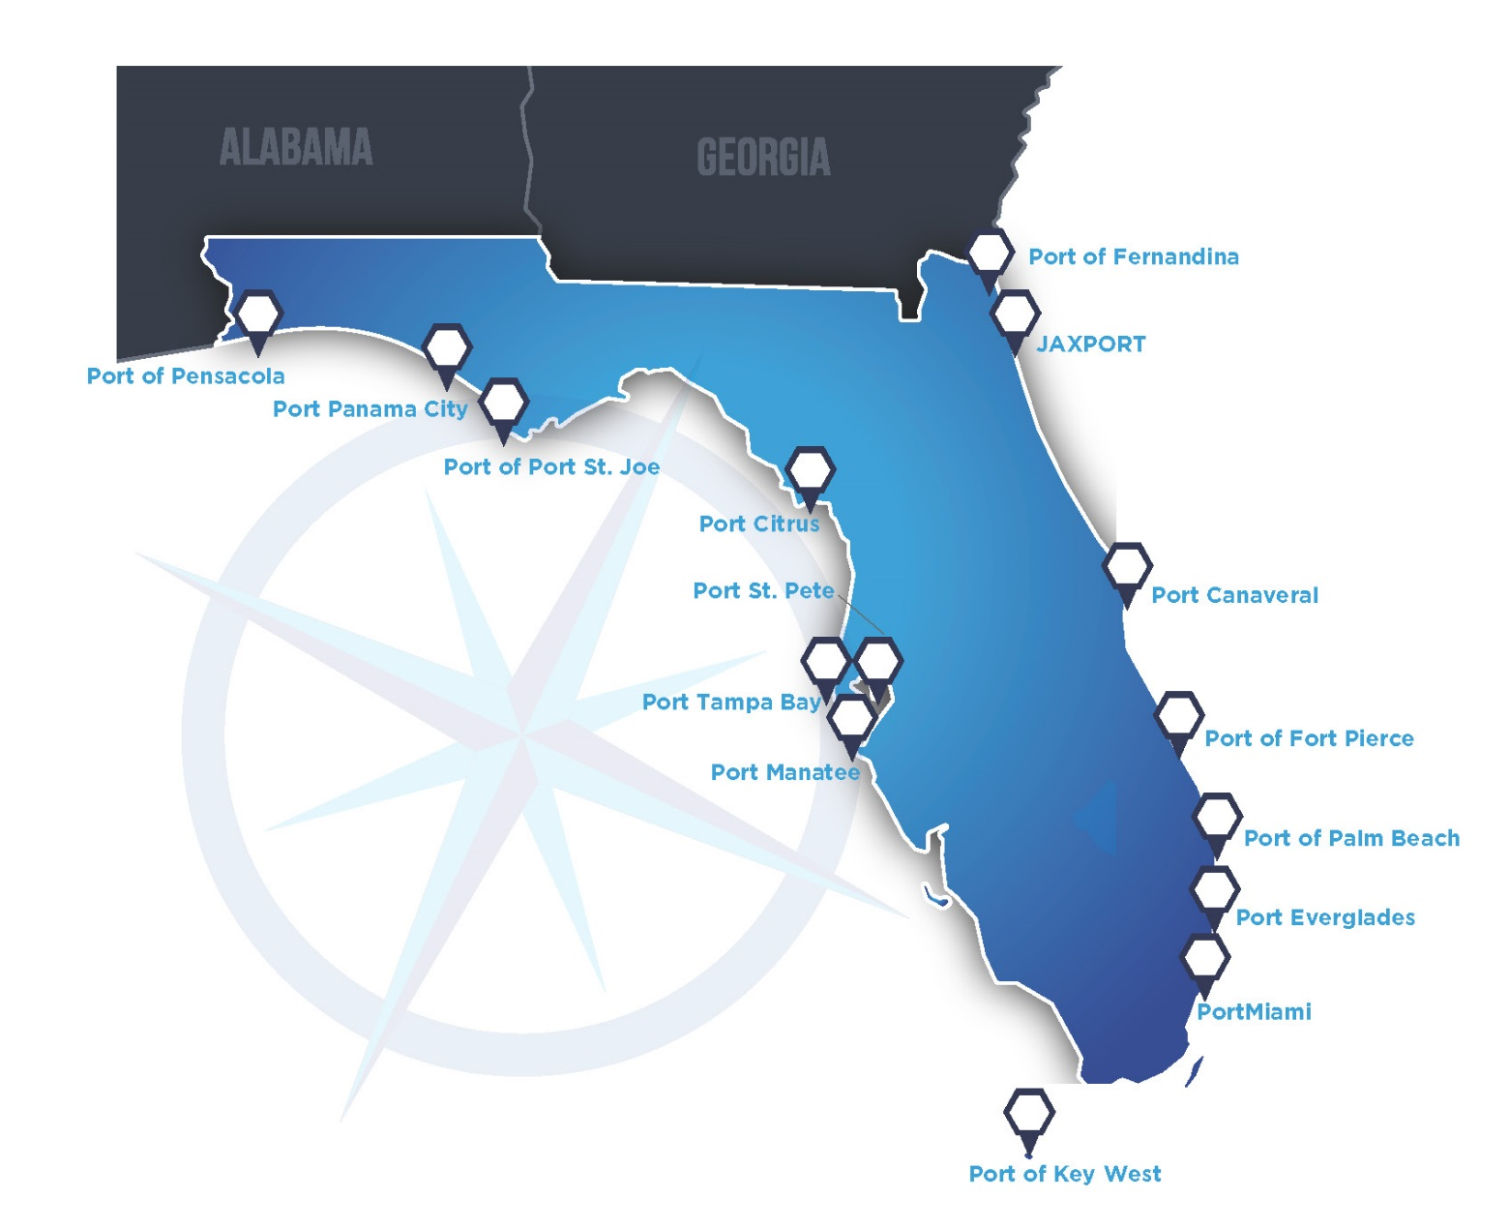
Florida Seaports

Slide 4

Seaport Governance Models
California (11 seaports), Louisiana (32 seaports), and Texas (19 seaports) follow a seaport governance structure that is almost identical to Florida: local government seaports with statewide advocacy and system development organizations.
Local government port authority structure is the most common one in every U.S. state with significant ocean access and lengthy shorelines.
department of city seaports | department of county seaports | dependent special district seaports | independent special district seaports
Port of Key West | Port Everglades | Port Citrus | Port Canaveral
Port St. Pete | PortMiami | Port of Ft. Pierce | Port of Fernandina
Port of Pensacola |  | Port Manatee | JAXPORT
 |  |  | Port of Palm Beach
 |  |  | Port Panama City
 |  |  | Port of Port St. Joe
 |  |  | Port Tampa Bay

Slide 5
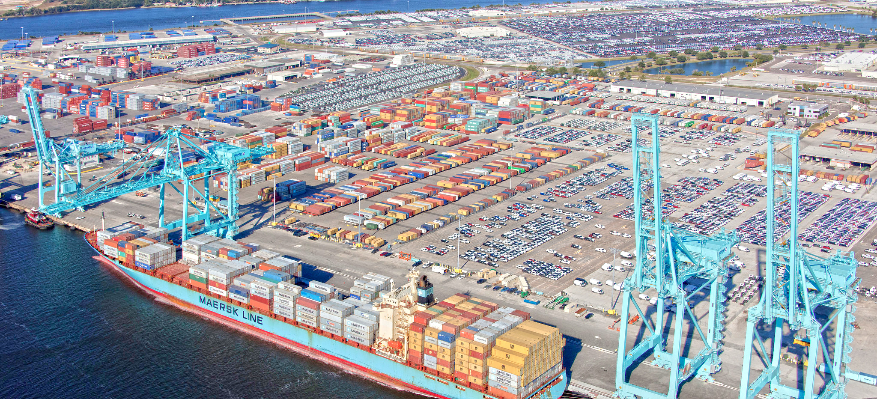
Florida Seaports Support …..
900,000
$40B
$117.6
$4.3B
direct and indirect jobs
in personal
income
in economic
value
in local and state tax revenue

Slide 6
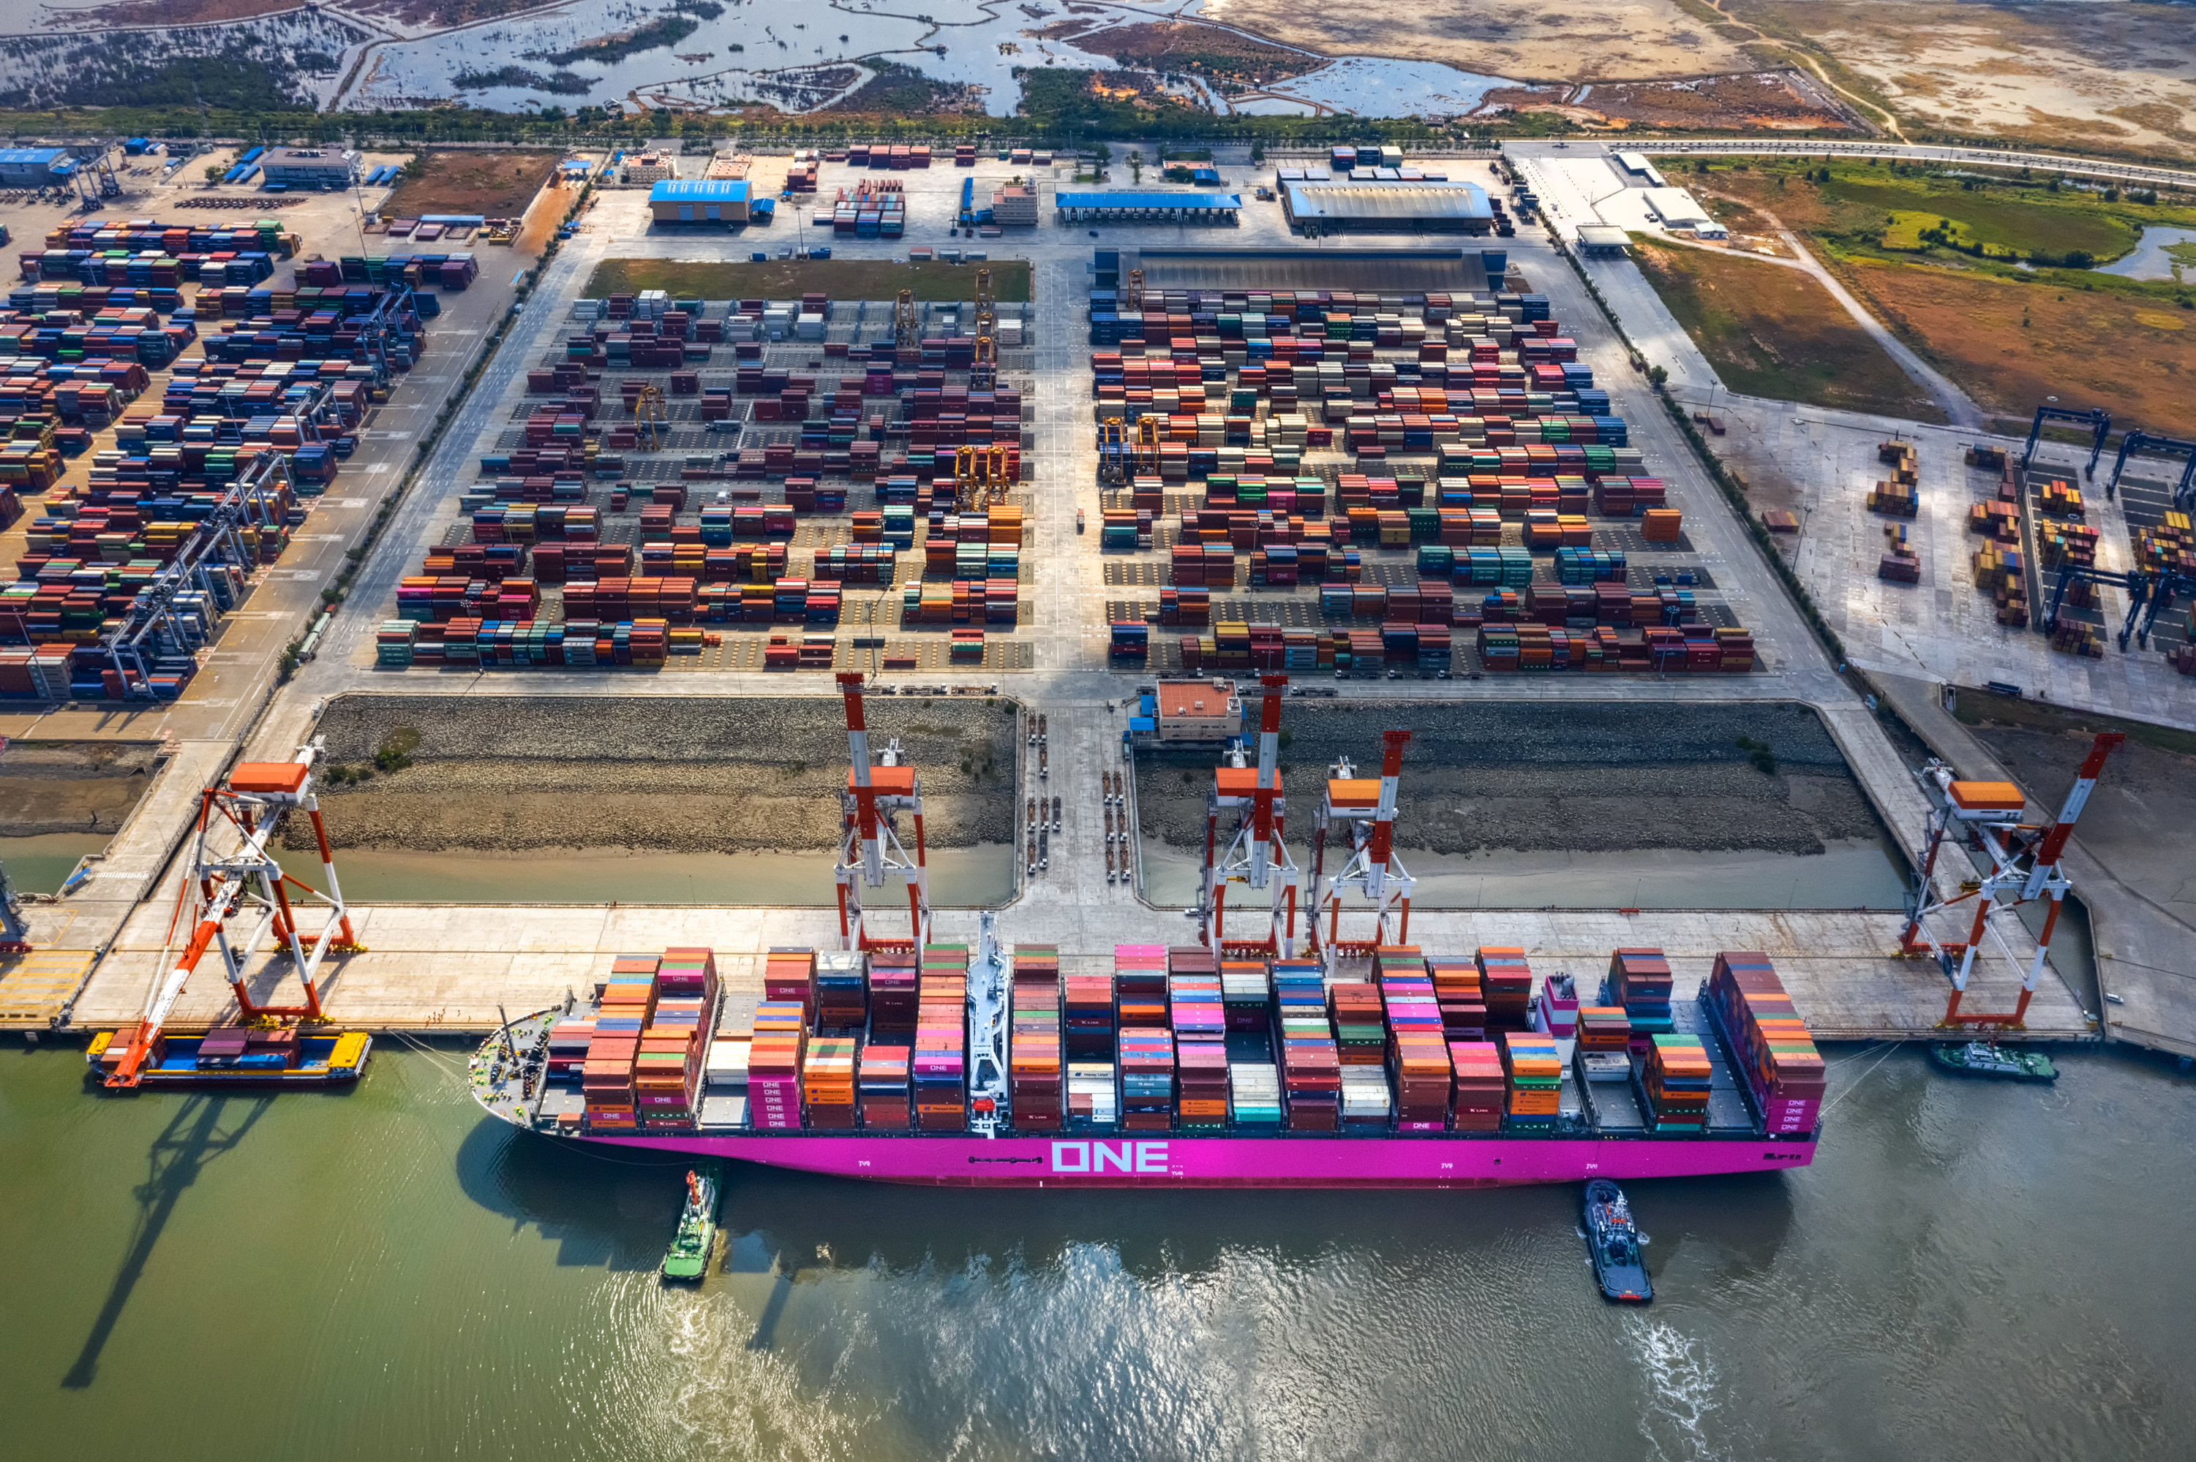
Cargo
$72.5B
102M
3.7M
200
in waterborne trade
tons of cargo
TEUs
Countries

Slide 7
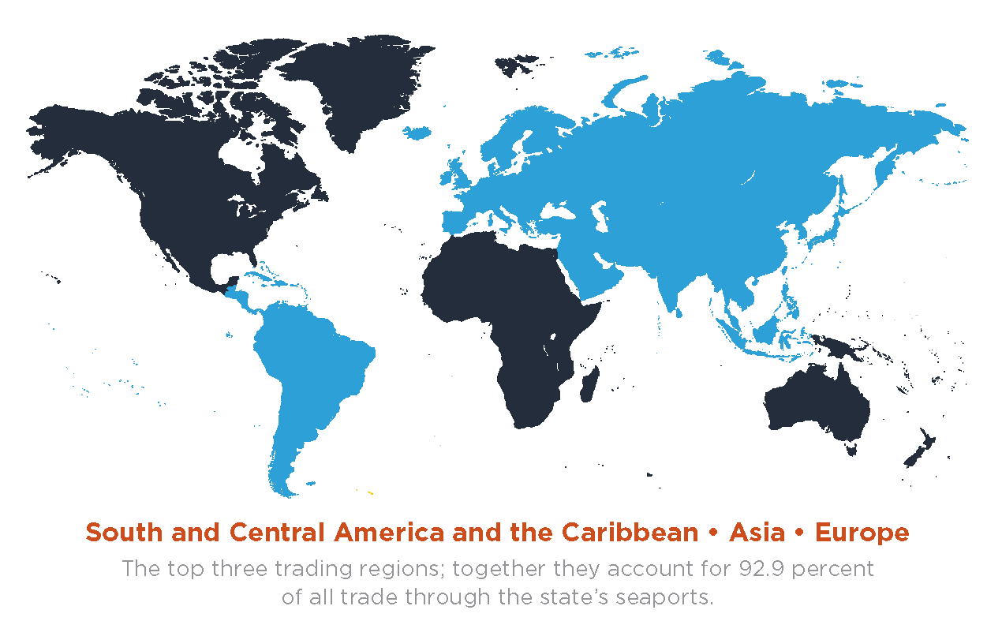
Florida’s Top 3 Trading Regions

Slide 8
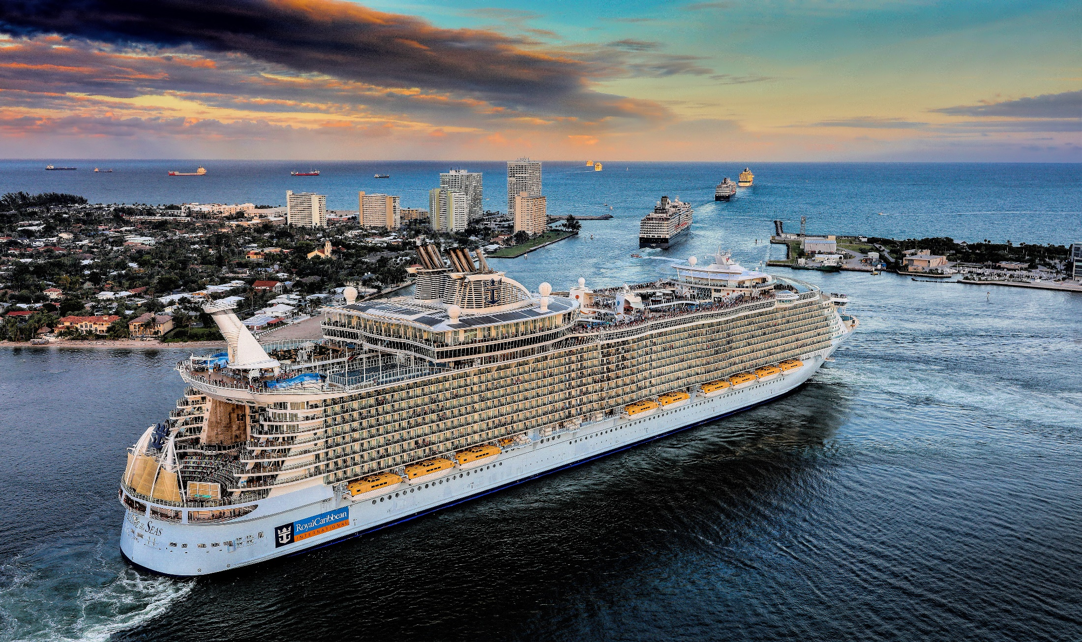
Cruise
60%
0
$0
Of us cruise activity
passenger
movements
in income
generated

Slide 9
COVID-19 Impacts on Florida Seaports
As a result of the pandemic, estimated losses through 2020 include:
  Nearly 169,000 Florida jobs supported by port activity
  $22 billion in economic impact (including more than $652 million in local purchases made by companies directly dependent on Florida ports)
  5.6 million tons of liquid bulk cargo
  1.6 million tons of dry bulk cargo
  More than 520,000 TEUs of containerized cargo
  4.9 million cruise passengers

Slide 10
Florida Seaports’ Future Investments
The combined five-year Capital Improvement Plan for Florida’s seaports totals $3.3 billion
Largest planned investments are for:
  Berth rehabilitation and repairs (26%)
  Cruse facilities (20%)
  Cargo terminals (19%)
  Channel and harbor deepening (9%)

Slide 11
Federal and State Legislative Issues
State FY 2022/2023 Appropriation Bill
Federal Infrastructure and Appropriation Bills
  WRDA – Army Corps funding for construction and operation and maintenance.
  President’s recommended budget – RAISE (BUILD), INFRA, PIDP, MTSERA.
Preemption and Foreign Products/Trade Bills?:
  Preemption of regulation, control and operations.
  Prohibition on the purchase of Chinese made products.
  Requirement to purchase U.S. made materials/products.

Slide 12

www.flaports.org
Find us on Facebook and Twitter!

