Slide 1
A New Approach to the Transition from Per-Gallon to Per-Mile
Robert Poole
Director of Transportation Policy
Reason Foundation

Slide 2
Implementing the transition to per-mile charging
Part 1: addressing the politics of per-mile charging
Part 2: starting the transition with Interstate highways

Slide 3
The problem:
MBUF/RUC is not popular
NCHRP Synthesis 487: average support by only 24% of population.
Media portrayal as “Big Brother in your car.”
Populist/taxpayer opposition to “yet another tax on driving.”
Focus on revenue shortfalls reinforces such concerns.
Complex and intrusive academic proposals to charge for all kinds of things.

Slide 4
We need a better value proposition
Fix all the fuel tax shortcomings, not just revenue shortfall.
Make it simple and user-friendly.
Solve a more tangible problem.

Slide 5
Better value proposition (1):
Fix all the fuel tax’s shortcomings
Not applicable to all vehicles
Not keeping pace with roadway needs
Not transparent
No effect on congestion
Not fully dedicated to user benefits
It’s a tax, not a real user fee

Slide 6
Tax or user fee?
Is it a “vehicle miles tax” or a charge per mile driven?
  A tax is paid by all and spent at government’s discretion.
  A user fee is paid by those who use a service and spent on the costs of providing that service.
  Long legal history of tax vs. user fee.
We should argue strongly for a user fee, not a “VMT tax.”

Slide 7
Better value proposition (2): make it customer-friendly
Simple and understandable—pay for roads
Replace fuel tax, not add to it
Make it fair to all road users
Make it transparent
Offer a choice of methods
Report only miles, not details
Include strict privacy protections

Slide 8
Who should lead: feds or states?
The case for state-led transition:
States own & operate the roadways.
States are more credible on roadway funding than Congress.
States are laboratories of democracy.
States pioneered fuel tax as highway user tax 35 years before feds.
Successful state projects will inspire others to do likewise.

Slide 9
The case for feds leading
Ensure nationwide interoperability.
Provide political cover for state officials.
Economies of scale for equipment.
Fix the under-funded Highway Trust Fund.

Slide 10
My assessment:
Doing federal MBUF first could set us back significantly.
Populist and anti-tax groups would mobilize against this.
Trucking industry would also mobilize, especially if trucks singled out to go first.
This risks serious politicization of MBUFs—and likely defeat.

Slide 11
Better value proposition (3): solve a more tangible problem
Aging Interstate highway system:
  Affects nearly all motorists.
  Affects most truckers.
  Congress not prioritizing this.
  ARTBA would love this.

Slide 12
Part 1 conclusions
Address all fuel-tax shortcomings
Customer-friendly approach
Replace, not add to, fuel taxes
State-led, not federally-led
Begin with tangible problem: fix the aging Interstates

Slide 14
Part 2: Why start with Interstates?
They are wearing out and need rebuilding.
They are easy to charge for, electronically.
The cost is $1 trillion, which Congress has ignored.

Slide 15
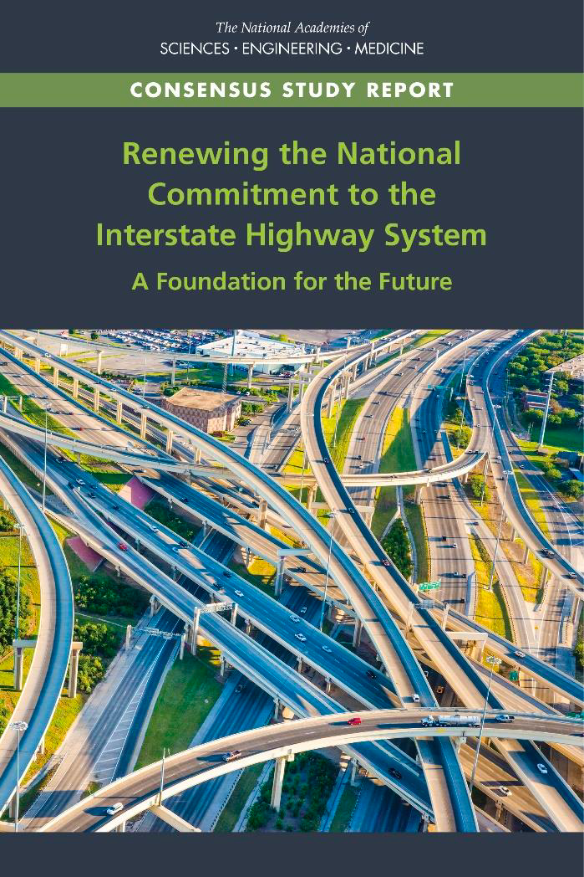

Slide 16
TRB Future Interstates Report
Interstates are wearing out; nearly all must be rebuilt over next 3 decades.
Many corridors also need widening.
Basic cost estimate: $57 billion/year for next two decades.
Proposes very large federal fuel tax increase, 90/10 split, pay-as-you-go funding from Congress.
We could do a lot better than this.

Slide 17
Huge federal fuel tax is not the answer
Huge increase (to yield $57B/year for 20 years) is fanciful.
Only a fraction would go to Interstates (102 programs get HTF money).
Pay-as-you-go is inferior to bonding.
Fuel tax needs replacing.

Slide 18
Tolling could address both funding and fuel-tax replacement
A per-mile electronic toll is a “mileage-based user fee.”
If used to rebuild Interstates, it could be charged instead of fuel taxes.
Toll revenue can be bonded, raising billions up-front to fund reconstruction and widening.
Toll bond buyers insist on proper, ongoing maintenance.
Tolled Interstates would free up remaining federal/state fuel taxes for all other highways during their transition to MBUF.

Slide 19
Reason’s alternative proposal
State-led effort, since tolling interest exists in at least six states.
Per-mile electronic tolling
Long-term financing, based on toll revenues
Voluntary option, open to all states (if Congress permits)

Slide 20
Customer-friendly tolling: key to feasibility (1)
Tolling exemption available only if state agrees to six provisions:
1. All-electronic and charged per mile
2. Charged instead of fuel tax, not in addition.
3. Revenues used only for capital and operating costs of Interstates

Slide 21
Customer-friendly tolling: key to feasibility (2)
4. Charge tolls only after a bridge or corridor is rebuilt and in operation.
5. Charge all vehicles, not just trucks
6. Charge same rates to in-state and out-of-state vehicles.

Slide 22
Value of pathfinder states
Would customer-friendly tolling get us to yes?
We’d find out, if Congress offered the option.
One or two state successes would be key.
Managed lanes spread this way, starting with SR 91 and I-15 in California.

Slide 23
Limited-access highways handle
34% of all VMT

Slide 25
Questions?
Contact information:
https://reason.org/topics/transportation
Bob.poole@reason.org

