Slide 1

Economic Outlook
Bonita Springs, FL
July 11th, 2019

Slide 2
Trump Administration
Tax reform
  Personal
    Lower tax rates
    Nearly doubles standard deduction
    Caps mortgage and SALT deductions
  Corporate
    Tax rate 35% to 21%
      Repatriation @ 15.5%
    Immediate expensing for small business
    Pass through income

Slide 3
Trump Administration
Regulatory relief in 1st year:
22 deregulatory actions for every 1 regulatory action
Agencies have:
  Withdrawn 653 regulations
  244 regulations made inactive
  700 regulations delayed

Slide 4
The Rules of the Game Matter
Federal Regulation and Aggregate Economic Growth
by John W. Dawson and John J. Seater
Journal of Economic Growth (2013) 18:137-177
Examined Economic Growth and Productivity 1949-2005

Slide 5

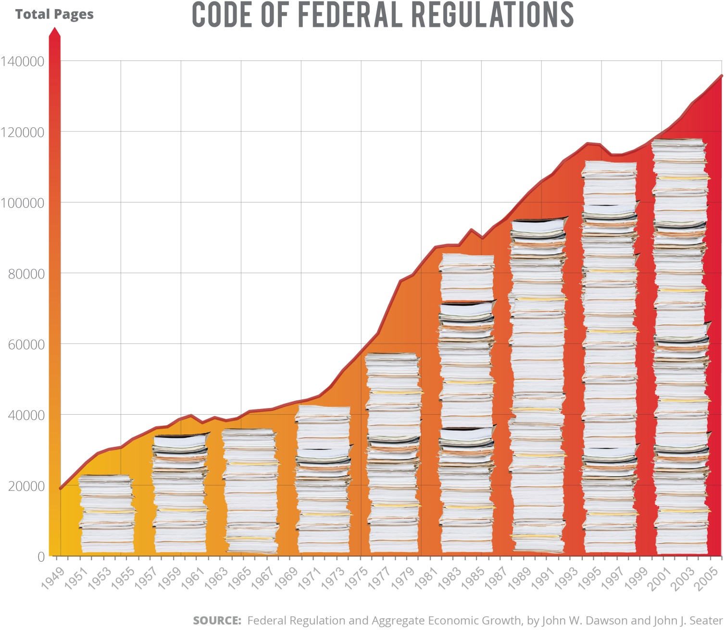

Slide 6
The Rules of the Game Matter
Results:
Regulations have reduced real GDP growth an average of 2% per year.
Real GDP in 2011 would have been $53.9 trillion instead of the $15.1 trillion

Slide 7
Trump Administration
Trade policy
Tariffs and other trade barriers in response to unfair trade practices and currency manipulation by China
  NAFTA – now USMCA

Slide 8
Trump Administration
Trump administration has thus far avoided SkyMall™ Policies
Sky Mall™ Policy:
  An Expensive Policy that Fails to Achieve its Desired Outcome

Slide 9

U.S. Forecast

Slide 10
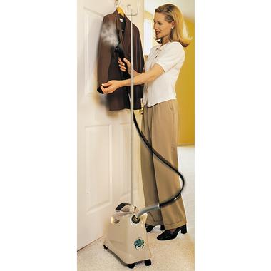
U.S. Forecast

Slide 11
U.S. Forecast
Sky Mall™ Policies:
  T.A.R.P.
  Foreclosure Prevention Act 2009
  ARRA of 2009
  Affordable Care Act
  Dodd-Frank

Slide 12

U.S. Forecast

Slide 13

U.S. Forecast

Slide 14

U.S. Forecast

Slide 15

U.S. Forecast

Slide 16

U.S. Forecast

Slide 17
U.S. Forecast

Slide 18
U.S. Forecast

Slide 19
U.S. Forecast
 | 2016 | 2017 | 2018 | 2019 | 2020
GDP % Change, Annual Rate | 1.5 | 2.4 | 3.0 | 3.1 | 2.8
Consumer Price Index % Change, Annual Rate | 1.3 | 2.1 | 2.5 | 2.4 | 2.6
Consumer Sentiment | 91.8 | 94.4 | 95.7 | 98.5 | 97.5
Consumption % Change, Annual Rate | 2.7 | 2.7 | 3.2 | 3.7 | 3.5

Slide 20
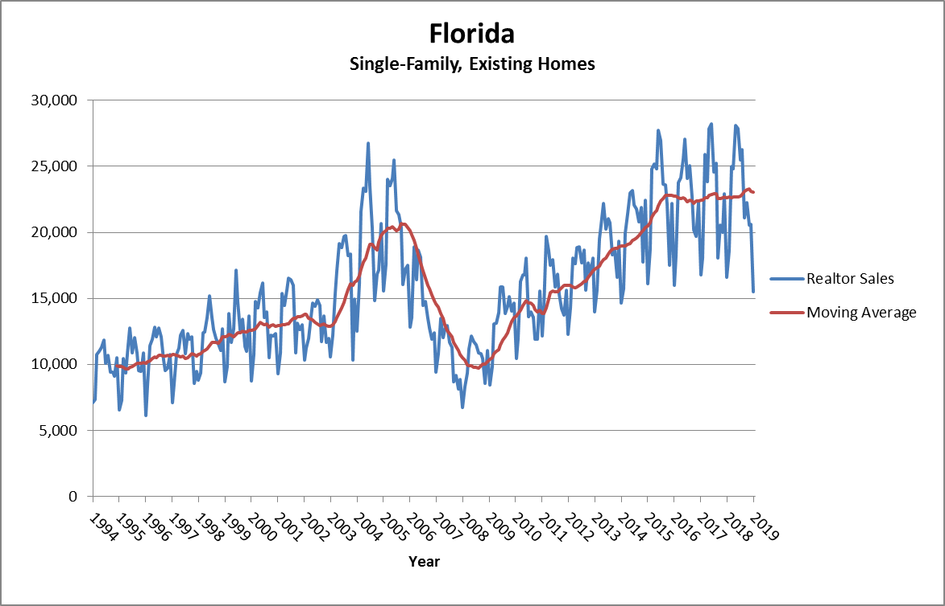
Florida Forecast

Slide 21
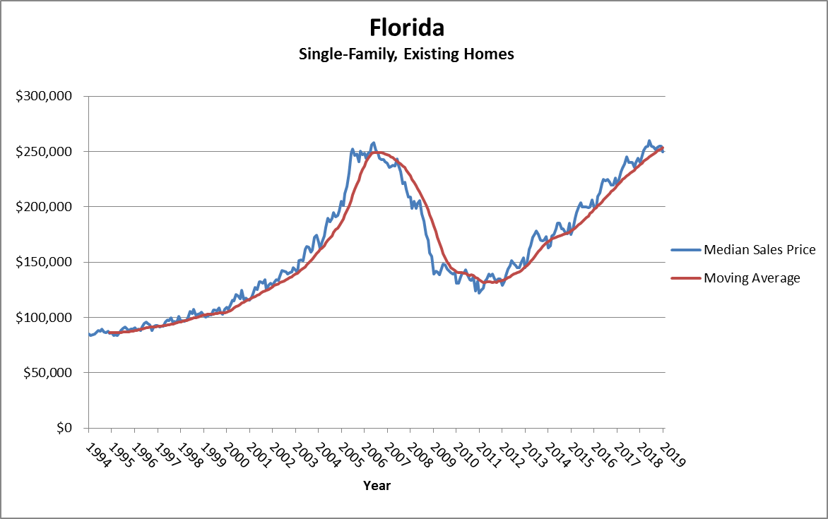
Florida Forecast

Slide 22
Florida Housing Market
 | April 2019 | April 2018 | Percent change
Closed Sales | 26,992 | 25,418 | 6.2%
Median Sale Price | $259,470 | $253,000 | 2.6%
Median Days on Market | 43 | 36 | 19.4%
Inventory (Months Supply) | 4.1 | 3.9 | 5.1%

Slide 23
Florida Forecast

Slide 24
Florida Forecast

Slide 25
Florida Forecast

Slide 26
Florida Forecast

Slide 27
Florida Forecast

Slide 28
Florida Forecast

Slide 29
Florida Forecast

Slide 30
Florida Forecast

Slide 31
Florida Forecast

Slide 32
2019-2022 Averages;
Q1 2019 Forecast
Florida
Sector | % Average Annual Growth
Construction | 4.7
Professional & Business Services | 4.0
Financial | 2.2
Leisure & Hospitality | 2.0
Education-Health Services | 1.7
Trade, Transportation & Utilities | 1.5
Federal Government | 1.1
State & Local Government | 0.9
Information | 0.2
Manufacturing | -0.5

Slide 33
2019-2022 Averages;
Q1 2019 Forecast
Region | Population Growth
 | Average % Chg | Rank
Florida | 1.3 | ---
Deltona | 1.3 | 7
Gainesville | 0.6 | 12
Jacksonville | 1.4 | 5
Lakeland | 1.8 | 3
Miami | 1.1 | 9
Naples | 1.9 | 1
Ocala | 1.5 | 4
Orlando | 1.8 | 2
Palm Bay | 1.4 | 6
Pensacola | 0.7 | 11
Tallahassee | 0.9 | 10
Tampa | 1.2 | 8

Slide 34
2019-2022 Averages;
Q1 2019 Forecast
Region | Employment Growth
 | Average % Chg | Rank
Florida | 1.8 | ---
Deltona | 1.1 | 11
Gainesville | 1.0 | 12
Jacksonville | 1.8 | 5
Lakeland | 1.6 | 8
Miami | 1.7 | 6
Naples | 2.7 | 1
Ocala | 2.1 | 3
Orlando | 2.5 | 2
Palm Bay | 1.8 | 4
Pensacola | 1.1 | 10
Tallahassee | 1.4 | 9
Tampa | 1.7 | 7

Slide 35


Quarterly Forecast Publications Available
Florida & Metro Forecast
U.S. Forecast
Download at:
WWW.IEC.UCF.EDU

Slide 36
Thank you
Sean M. Snaith, Ph.D.
Director
Institute for Economic Forecasting
(407) 823-1453
Sean@SeanSnaith.com
WWW.IEC.UCF.EDU
www.facebook.com/seansnaith
Twitter: @seansnaith

