Slide 1
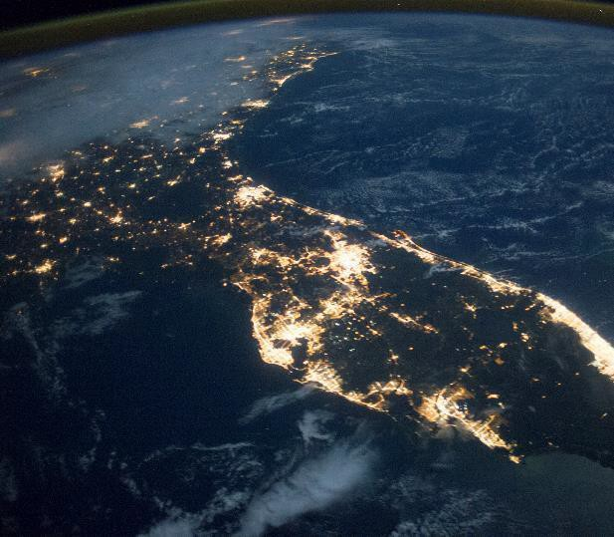
Florida on the Move Space Transportation
Todd Romberger,
SVP, Spaceports Business Unit
July 9, 2021

Slide 2
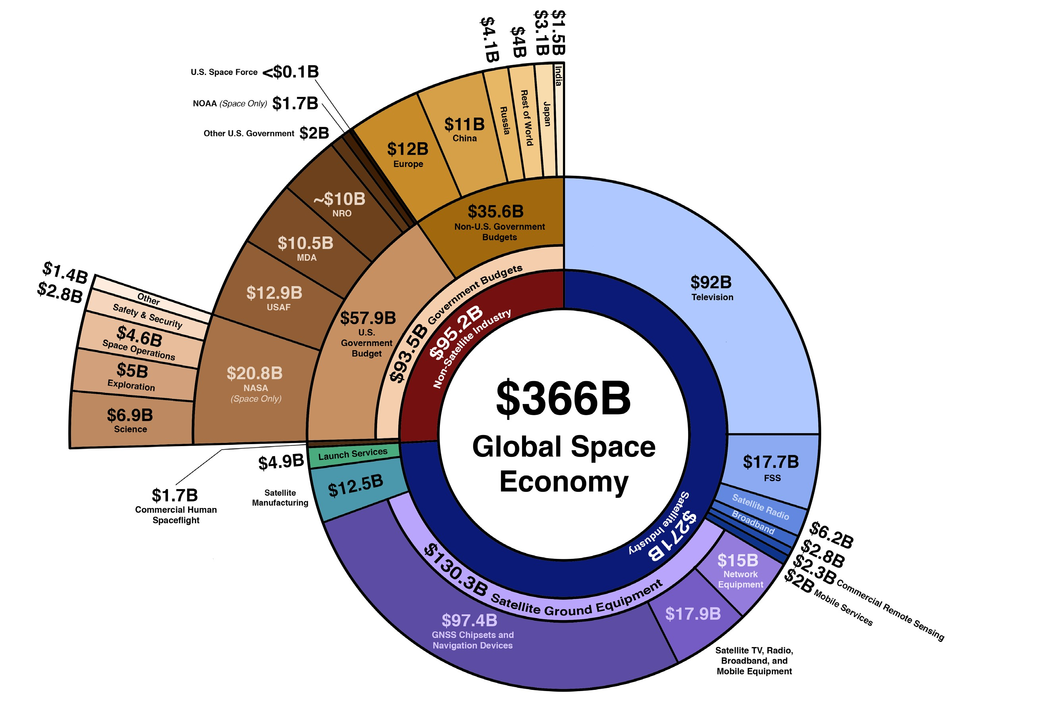
Global Space Economy
Sourc e: Bryce Space & Technology

Slide 3
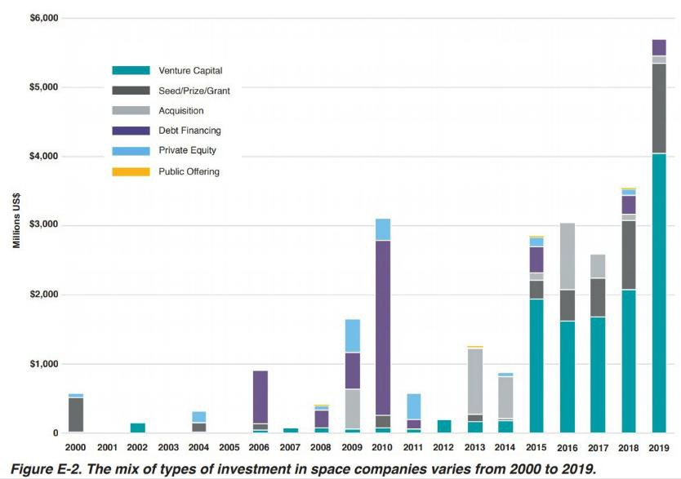
Private Investment in Space
Sourc e: Bryce Space & Technology

Slide 4
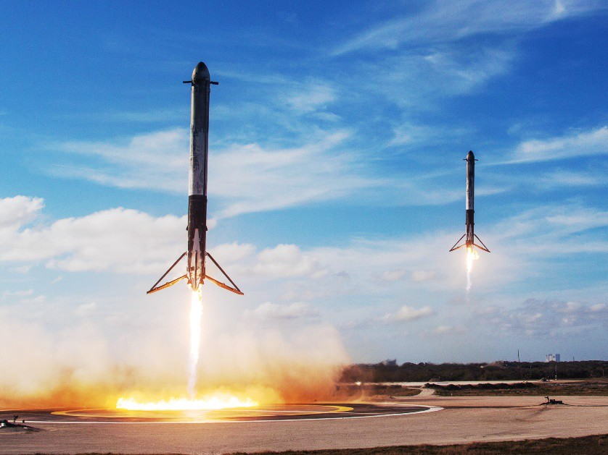
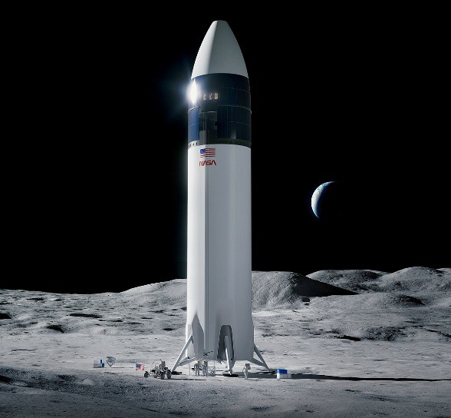
Trends & Drivers to Space Industry Growth
Ever-Increasing Demand for Bandwidth
Reusable Launch Vehicles
Volume
$ / kg
Cost-Plus
Fixed Price
Changes in
How the Government Buys Space
Buy the System
Buy the Service

Slide 5
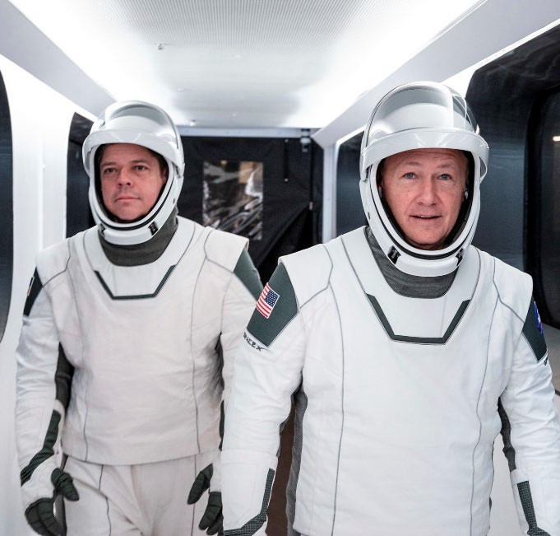
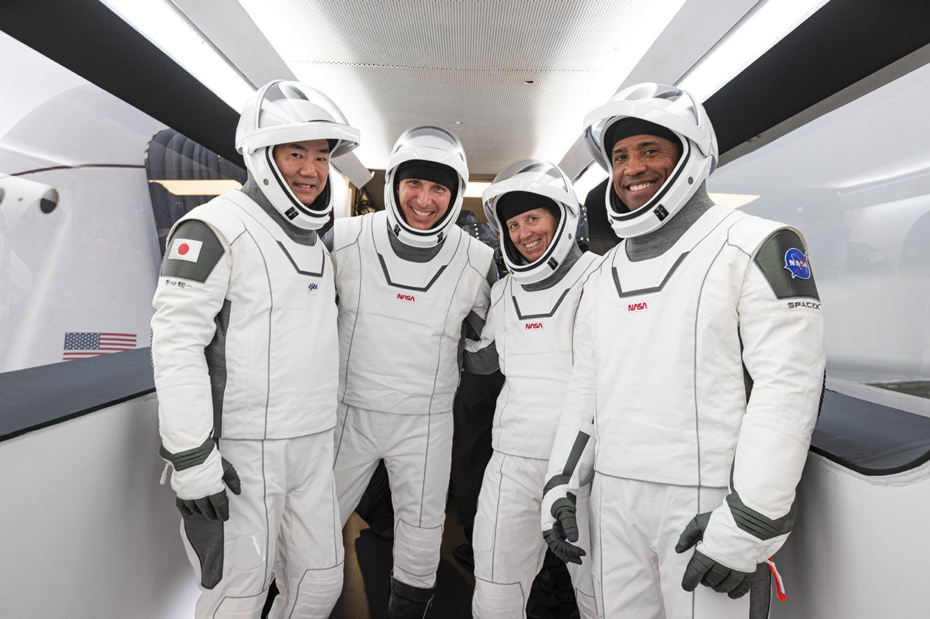
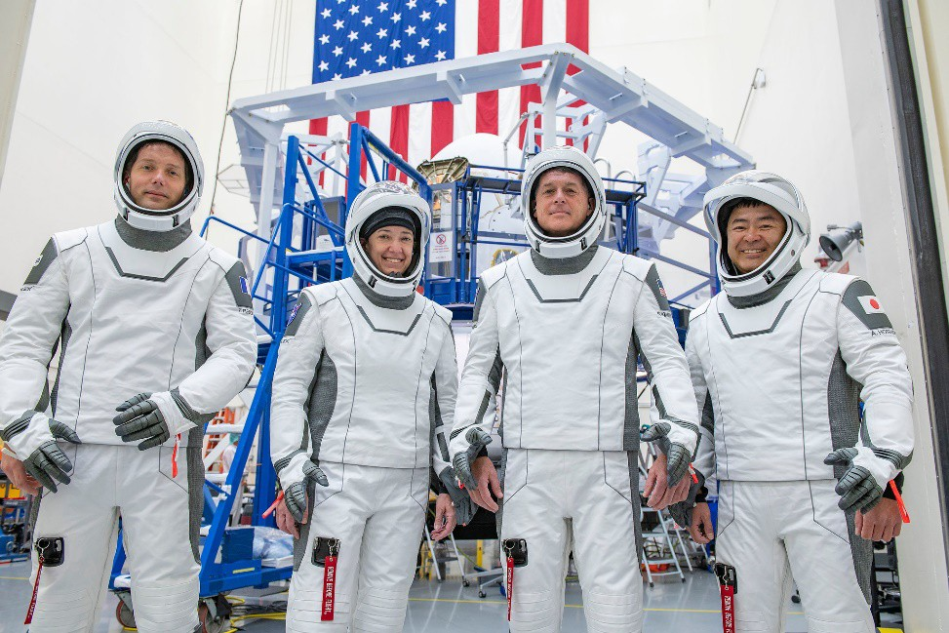
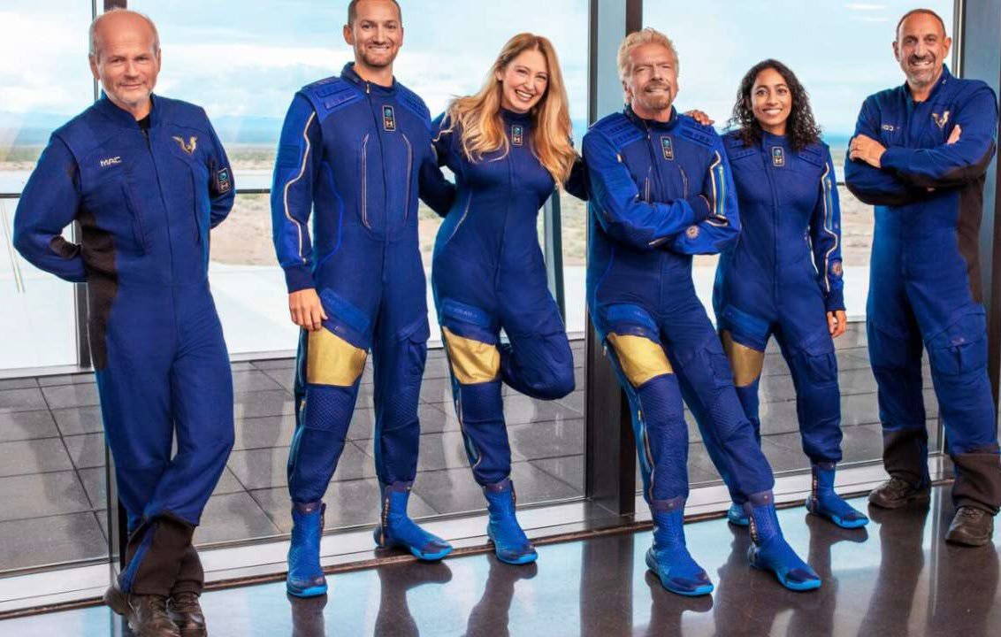
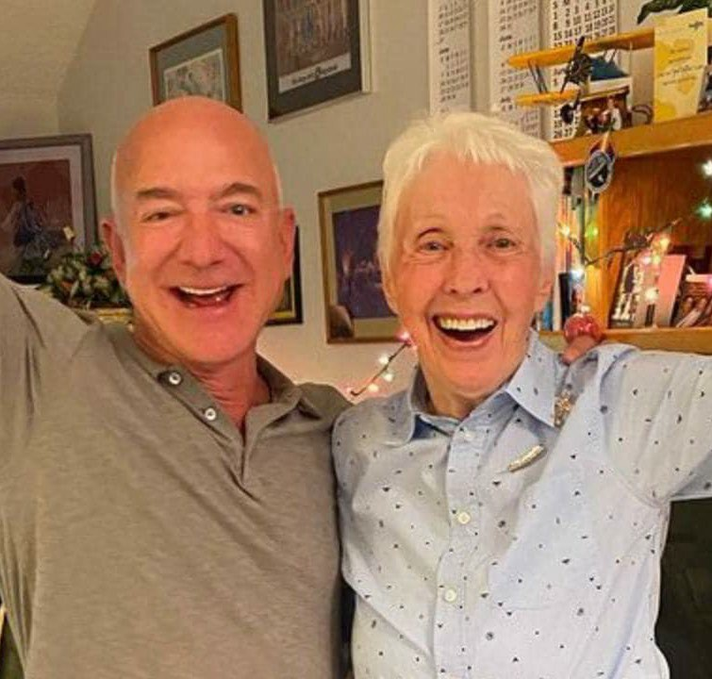
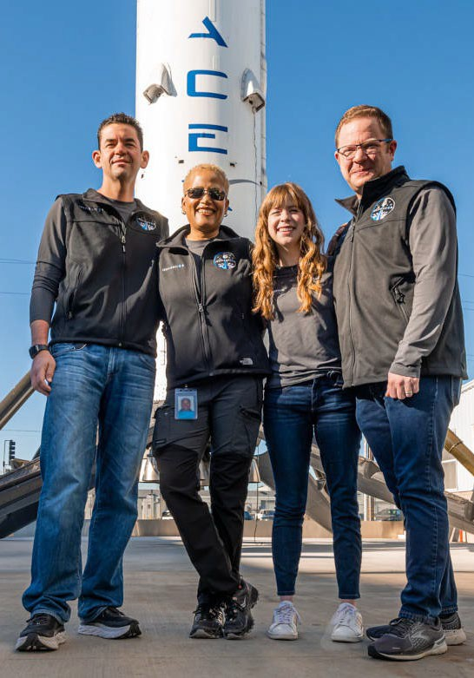
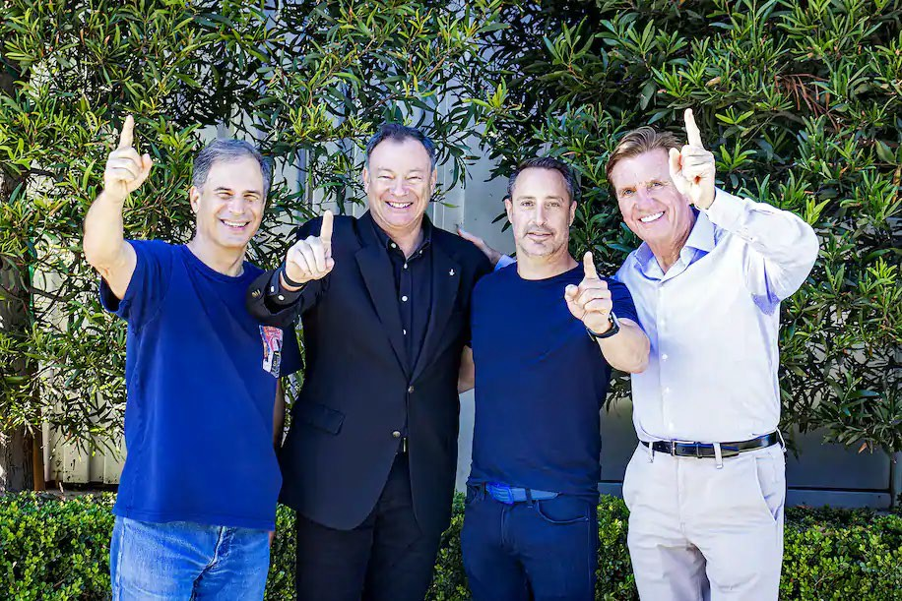
Growth of Human Spaceflight
May 2020 November 2020
April 2021
July 11, 2021
July 20, 2021
September 2021
January 2022

Slide 6
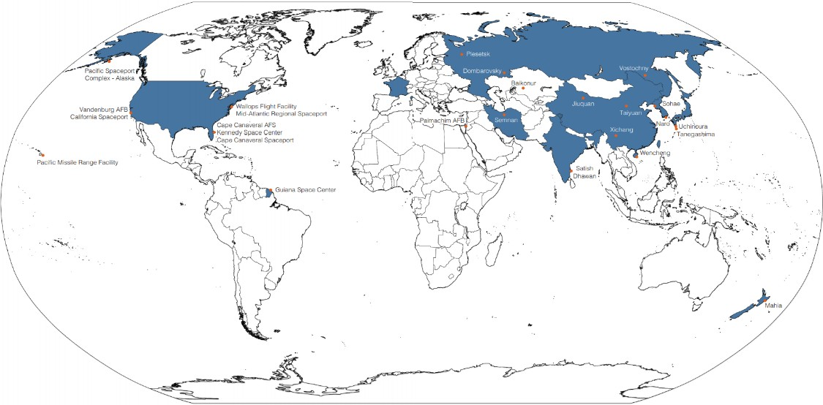
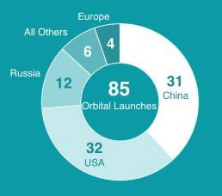
Global Spaceports- “We are not alone”
Source: Bryce Space & Technology
2020 Global Launches

Slide 7
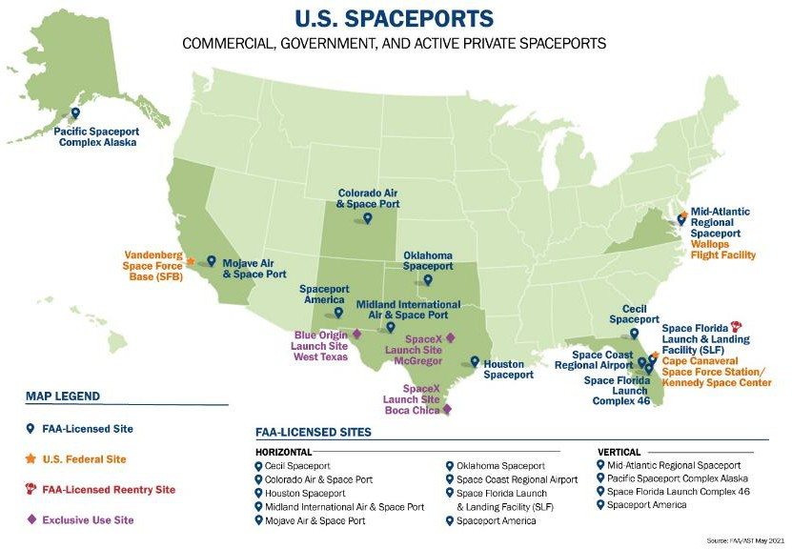
US Spaceports- A Growing & Competitive Landscape

Slide 8
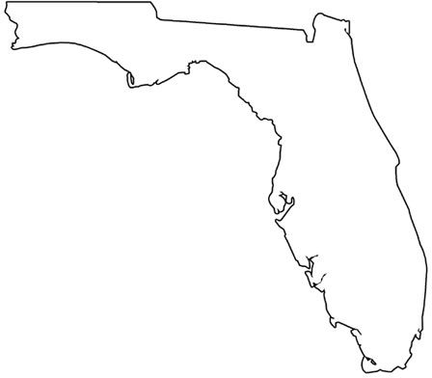
Florida’s Spaceport System
IN-SPACE PLAT FORMS
MANUFACTURING
MARAT IME ASSEMBLY
OFFSHORE LANDING
RANGE ASSET S
FREIGHT & LOGIST ICS
OFFSHORE RECOVERY
SPACEPORTS
SEAPORT S
OFFSHORE LAUNCH
SUPPLY CHAIN

Slide 9
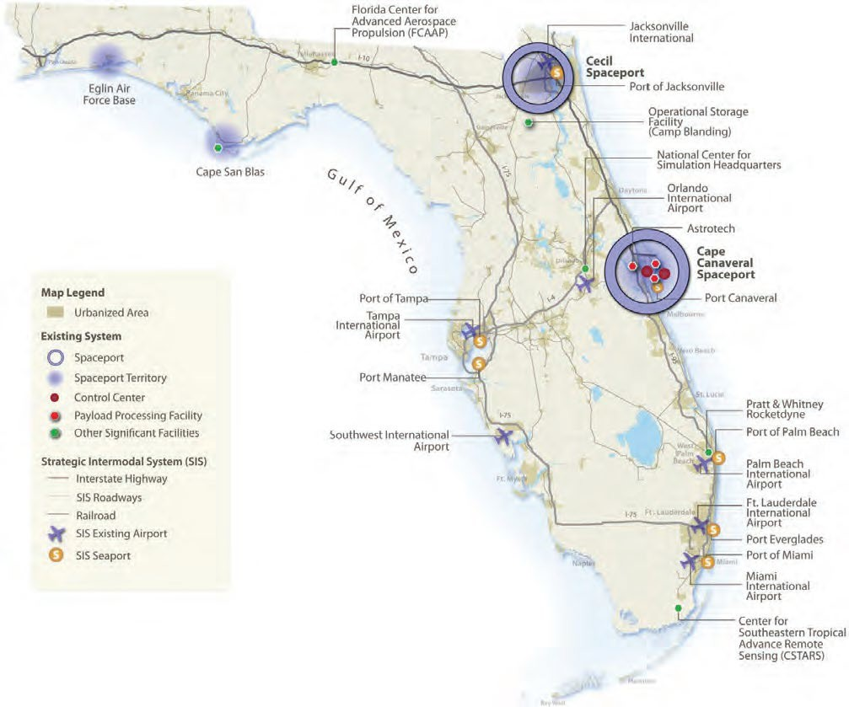
Florida’s Spaceport System- Spaceport Territories

Slide 10
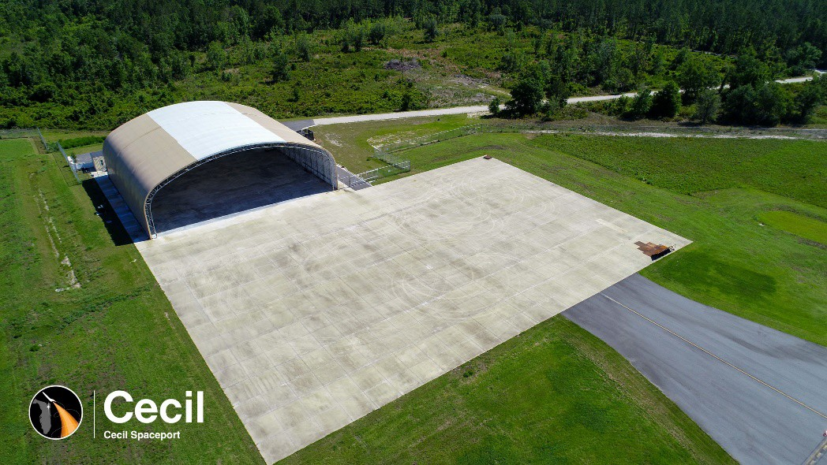
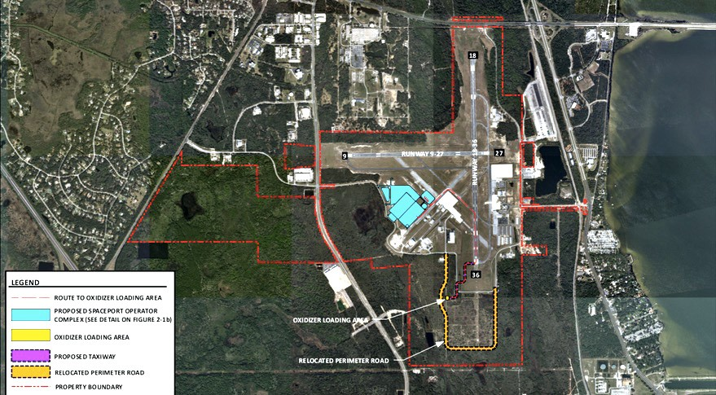
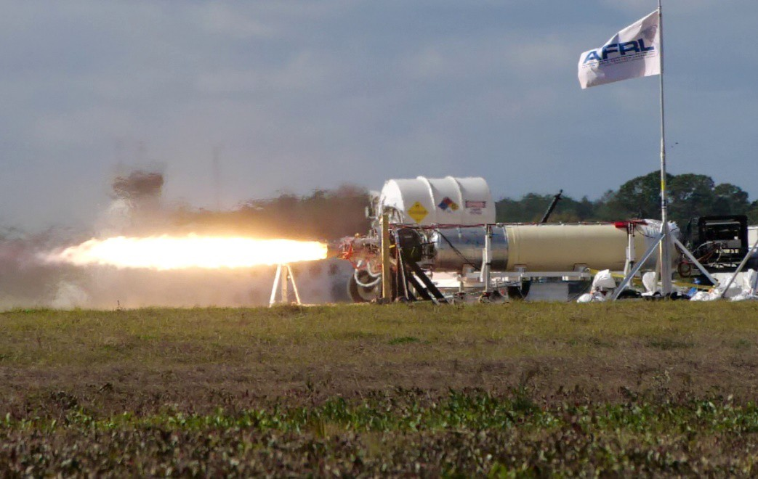
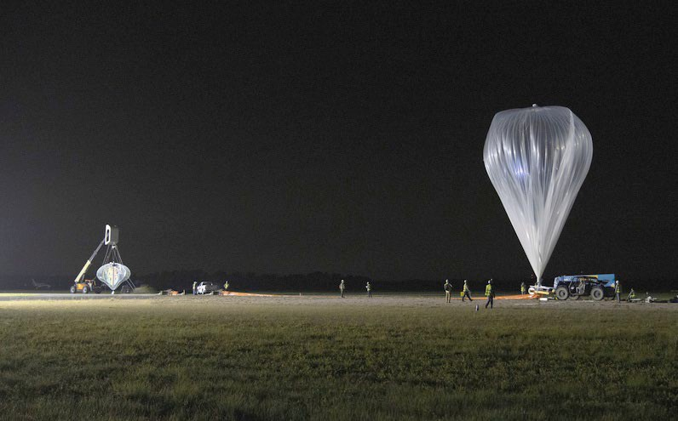
Florida’s Spaceport System
Cecil Spaceport, Jacksonville
Space Coast Air & Spaceport, Titusville

Slide 11
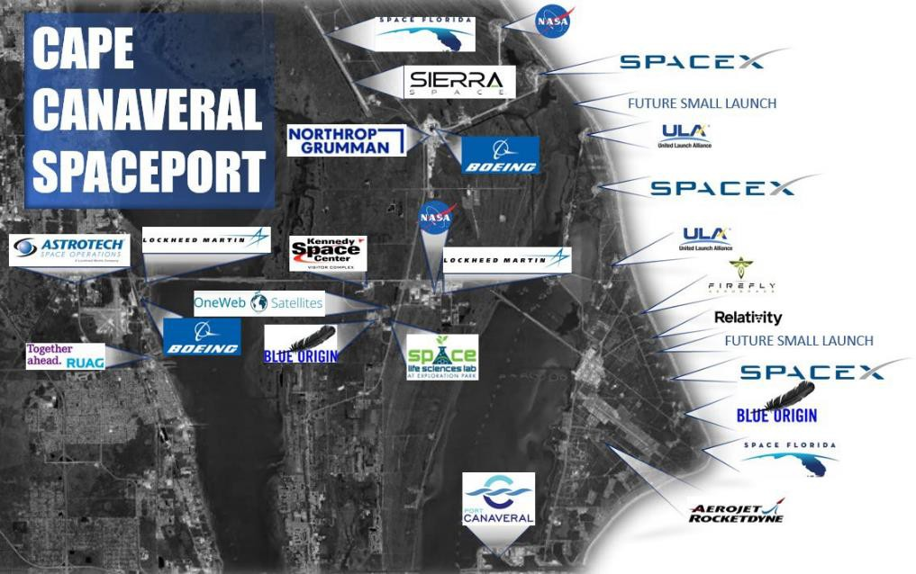
Growth of Commercial Activity

Slide 12
Enabling Growth with Spaceport Infrastructure
Spaceports Value Chain
Launch Platforms Services
Infrastructure to support Growth:
Launch Pads
Runways
Cargo / Payload processing
Passenger & Crew training & prep
Roads and Bridges
Commercial Utilities & Comm
Fuel / commodity distribution
Historical
Modern Spaceport
Enabling Infrastructure

Slide 13
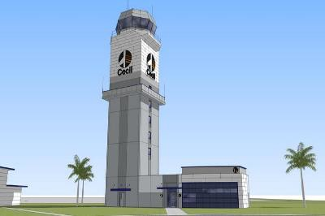
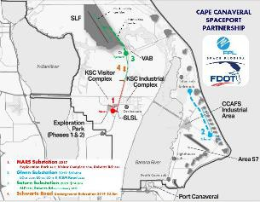
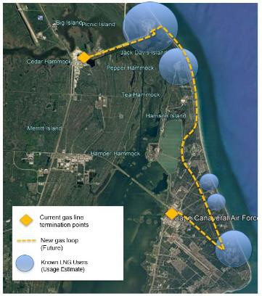
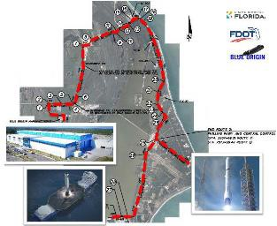
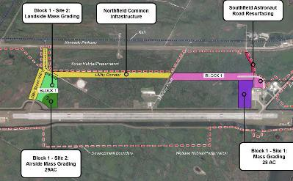
Enabling Growth with Spaceport Infrastructure
Cecil Spaceport Space Operations Center
Commercial Power Distribution
Natural Gas Distribution / LNG Production
Cape Canaveral Spaceport Roadway Widening
LLF Utility Corridor Development
Not Pictured:
Wastewater Capacity Expansion Helium Distribution
Commercial Communication Distribution LLF Runway Lighting
LLF Power & Comm

Slide 14
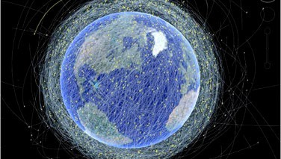
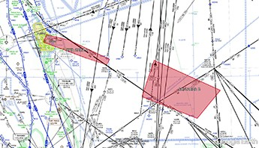
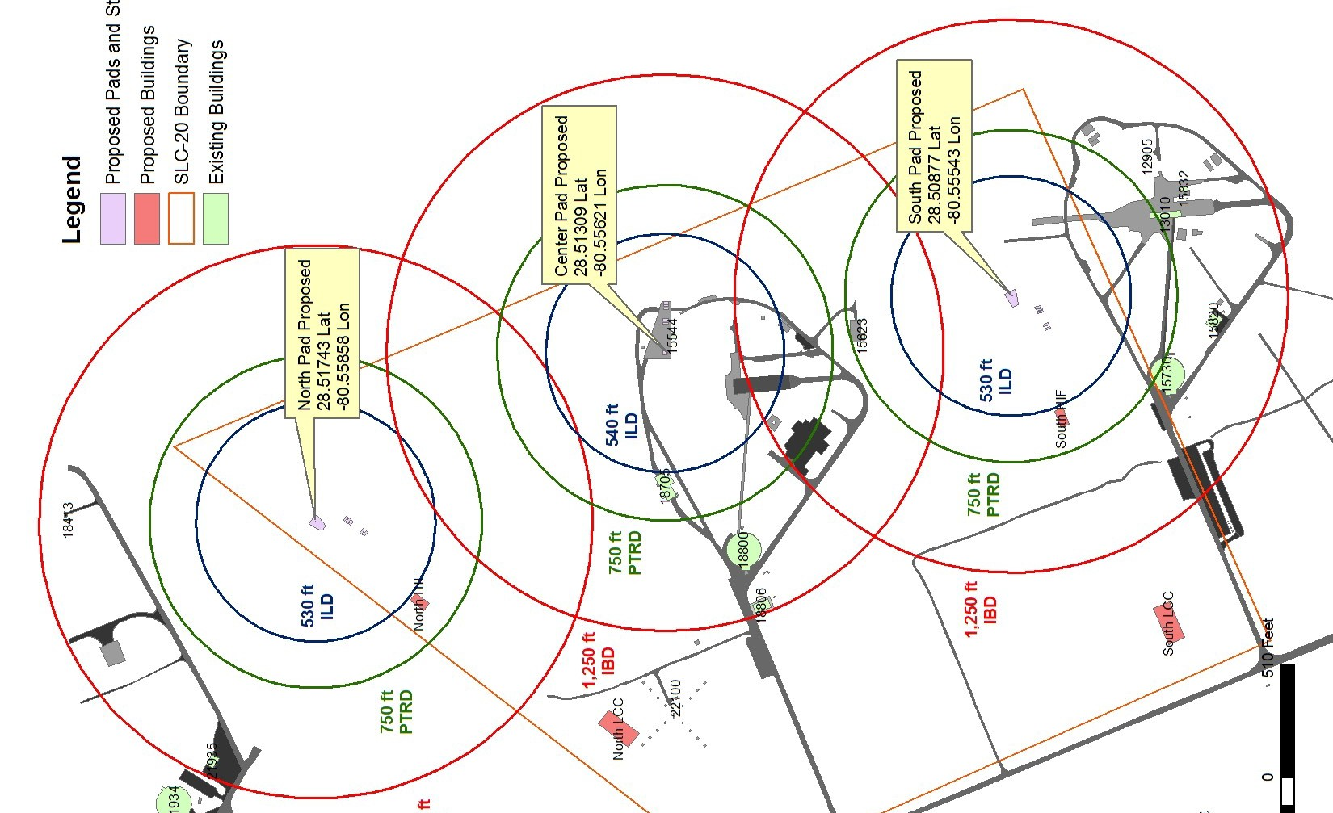
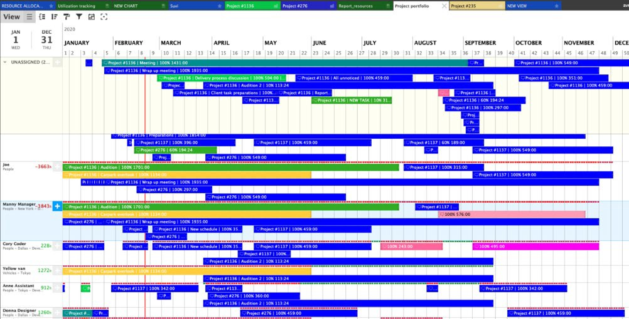
Growing Pains for a Growing Transportation Mode
Space Traffic Management
Airspace Integration
Operational Density
Schedule Certainty

Slide 15
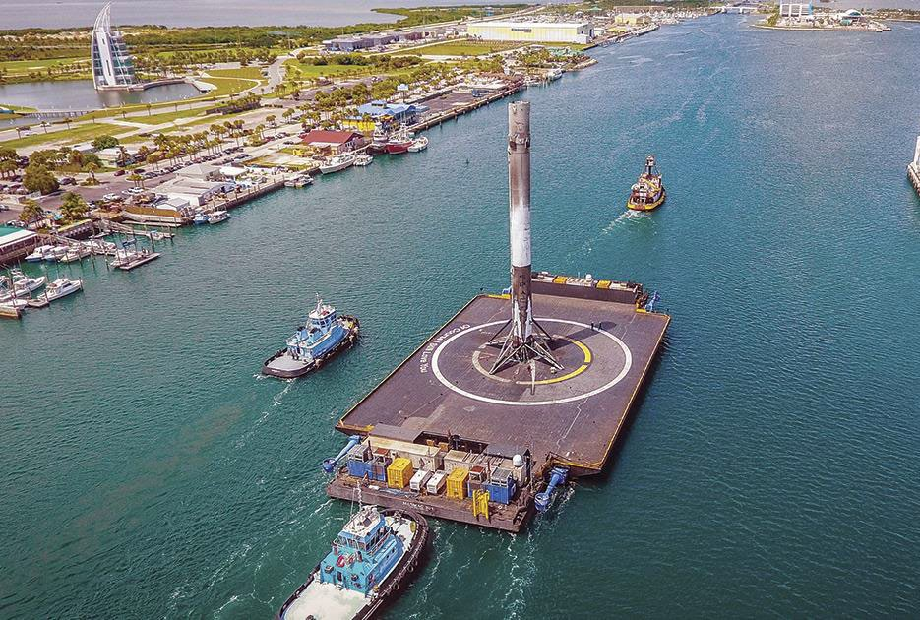
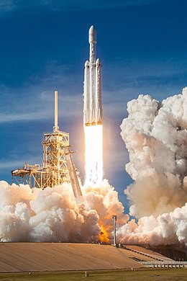
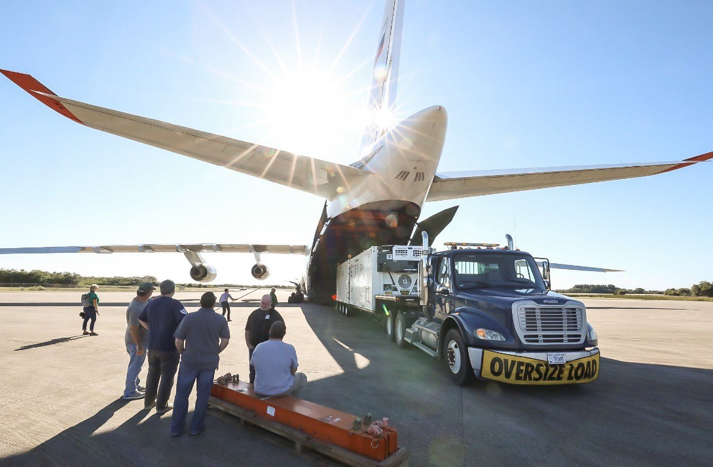
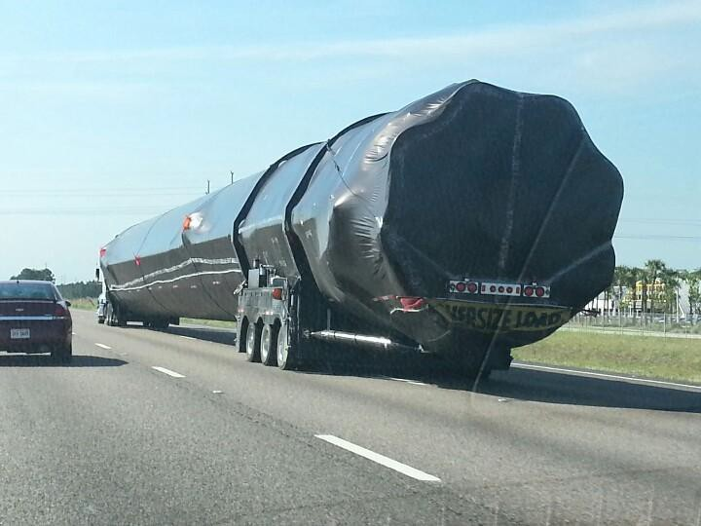
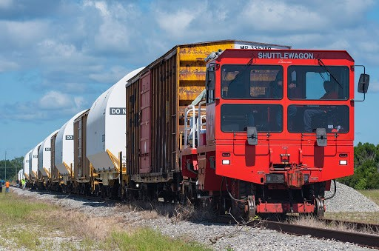
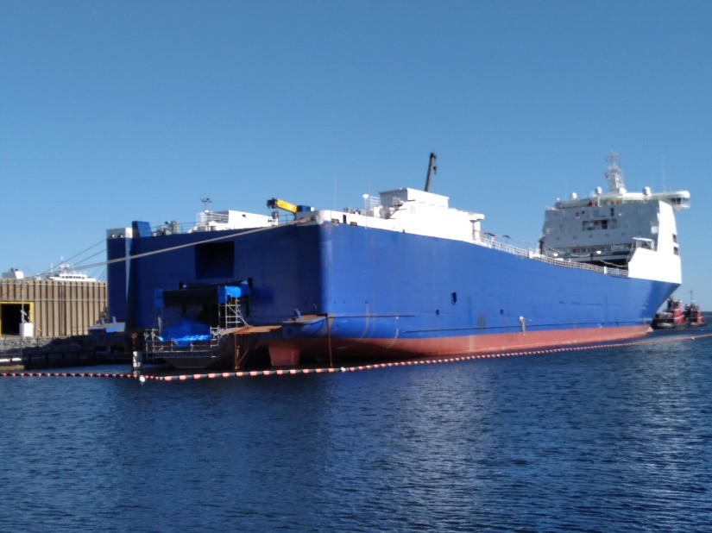
Space Is Multi-Modal

Slide 16
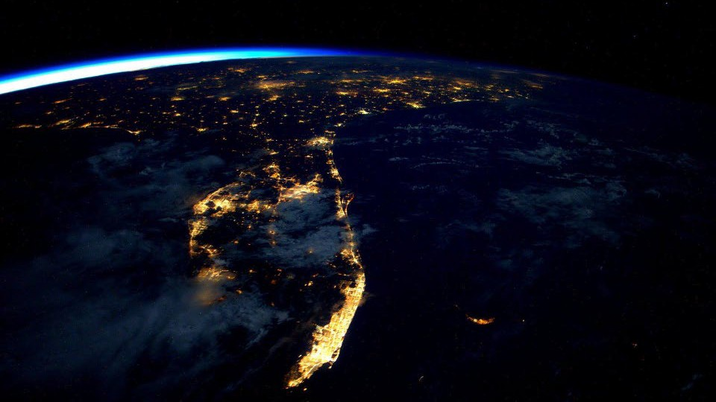
Thank You!

