Slide 1
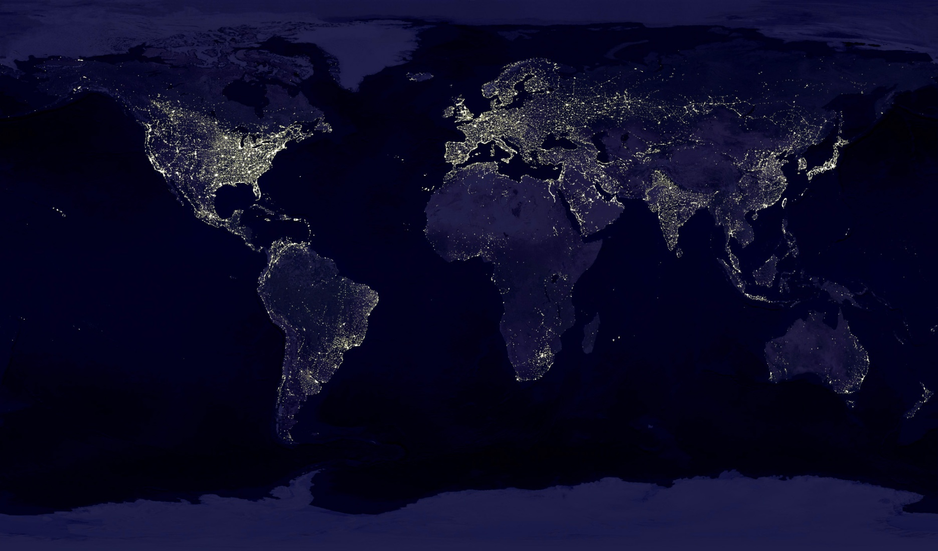
Florida 2030: A State in Transition
You Are Here
#FL2030 @FLChamberFdn
www.Florida2030.org
Tony Carvajal @WhatTonyCs
Florida Chamber Foundation

Slide 2
“Florida is changing. Our economics, our demographics and our politics are all changing and these changes are both opportunities and challenges.” – Mark Wilson

Slide 3
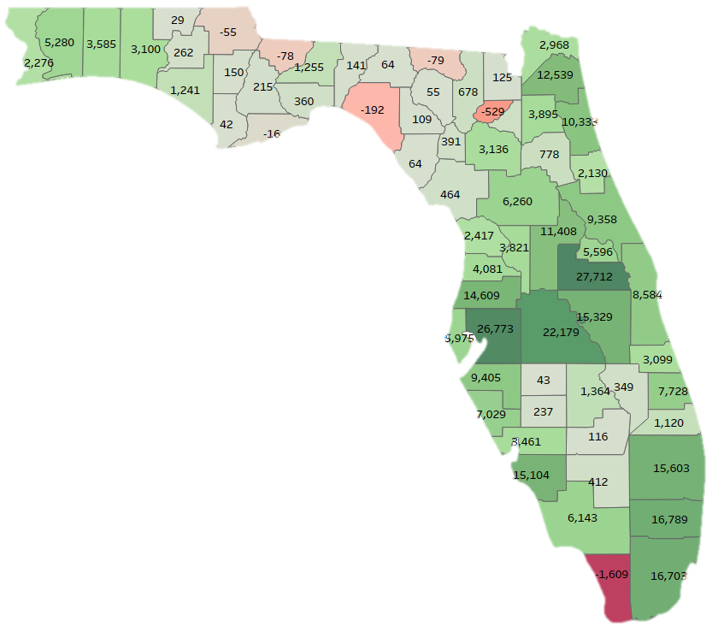
Population Change July 2017 to July 2018
Top Population Gains
Orange 27,712
Hillsborough 26,773
Polk 22,179
Broward 16,789
Miami-Dade 16,703
Palm Beach 15,603
Osceola 15,329
Lee 15,104
Pasco 14,609
Duval 12,539
6,713
7 Counties Lost Jobs
1. Monroe -1,609
2. Union -529
3. Taylor -192
4. Hamilton -79
5. Gadsden -78
6. Jackson -55
7. Franklin -16
Source: US Census Bureau

Slide 4
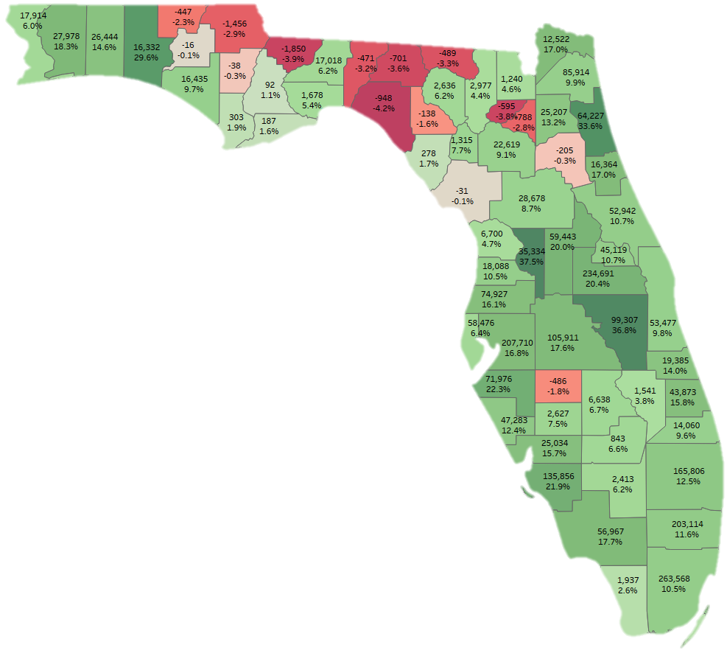
Population Change
2010 thru 2018
Florida Population Growth Rate 13.2%
Top Counties
1. Miami-Dade 263,568
2. Orange 234,691
3. Hillsborough 207,710
4. Broward 203,114
5. Palm Beach 165,806
Lee 135,856
Polk 105,911
Osceola 99,307
Duval 85,914
Pasco 74,927
Top Population Growth
Sumter 37.5%
Osceola 36.8%
St. Johns 33.6%
Walton 29.6%
Manatee 22.3%
Lee 21.9%
Orange 20.4%
Lake 20.0%
Santa Rosa 18.3%
Collier 17.7%
Source: US Census Bureau

Slide 5
Population Change
2010 thru 2018
15 Florida counties
lost population
between 2010 and 2018
Source: US Census Bureau

Slide 6
Growth
Change in Population by Source, 2010-2017 (millions)
Source: U.S. Census Bureau

Slide 7
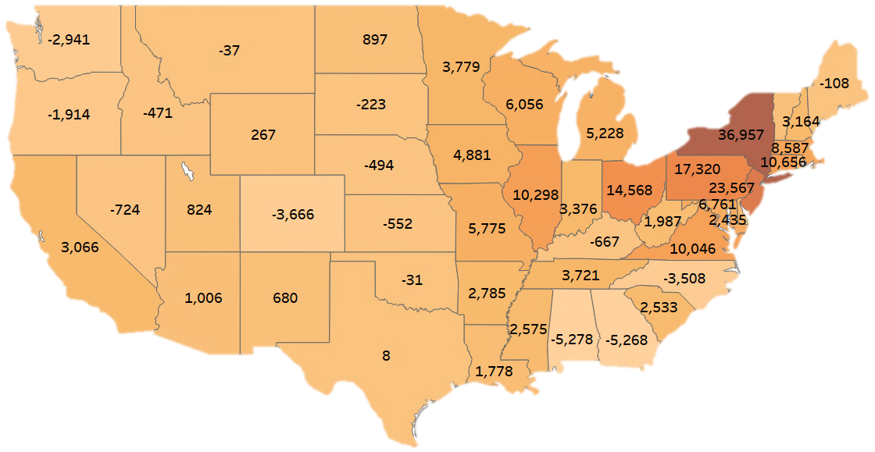
Top 10 States: Net People Moving to Florida
New York 36,957
New Jersey 23,567
Pennsylvania 17,320
Ohio 14,568
Connecticut 10,656
Illinois 10,298
Virginia 10,046 Massachusetts 8,587
Maryland 6,761
Wisconsin 6,056

Slide 8
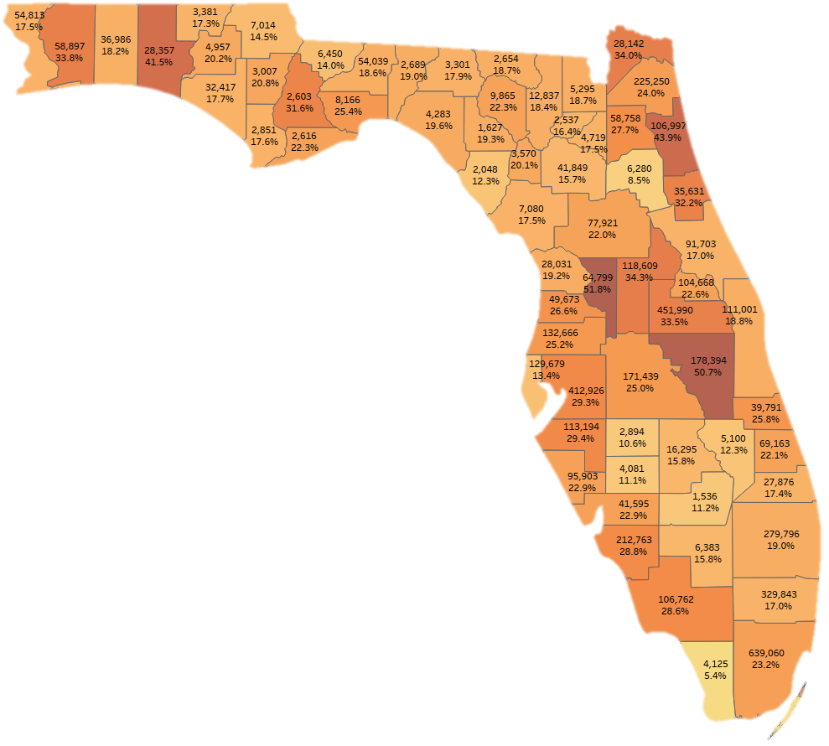
Florida’s Next
4.5 Million People
Top 10 Growth in People
Miami-Dade 639,060
Orange 451,990
Hillsborough 412,926
Broward 329,843
Palm Beach 279,976
Duval 225,250
Lee 212,763
Osceola 178,394
Polk 171,439
Pasco 129,769
Top 10 Growth in Percent
Sumter 51.8%
Osceola 50.7%
St. Johns 43.9%
Walton 41.5%
Lake 34.3%
Nassau 34.0%
Santa Rosa 33.8%
Orange 33.5%
Flagler 32.2%
Liberty 31.6%
Top 3 Counties = 33.4% of Growth
Top 6: 52.0%
Top 11: 70.3%
Top 13: 75.5%
Source: FL Demographic Estimating Conference & BEBR FL Population Studies

Slide 9
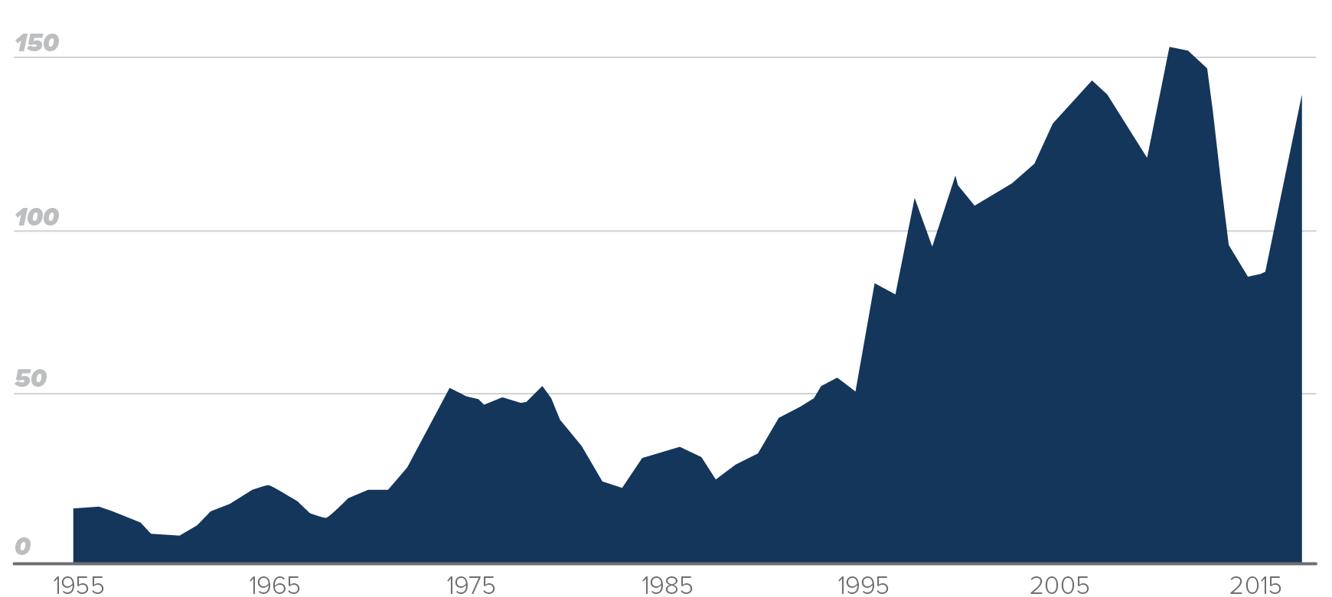
Risk & Resiliency
Category 3+ Hurricanes Near Florida, 1854-2017
Declared US. Disasters by Year
Source: National Oceanic and Atmospheric Administration; Federal Emergency Management Administration (three-year rolling average)

Slide 10
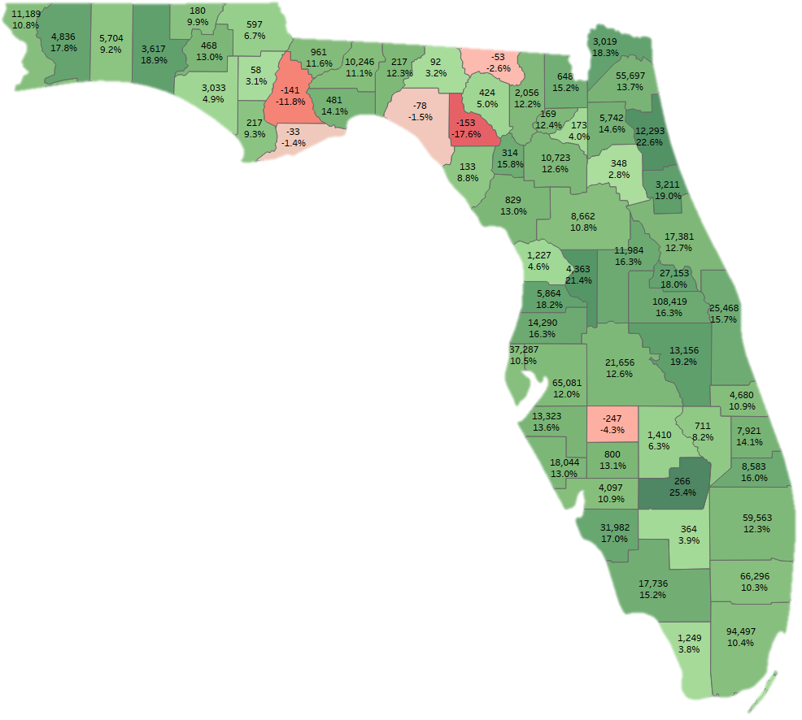
Job Creation
by County: 2014-18
U.S. Job Growth: 7.8%
Florida Job Growth: 13.4%
Top Counties for Jobs
Orange 108,419
Miami-Dade 94,497
Broward 66,296
Hillsborough 65,081
Palm Beach 59,563
Duval 55,697
Pinellas 37,287
Lee 31,982
Seminole 27,153
Brevard 25,468
Top Counties for Job Growth
Glades 25.4%
St. Johns 22.6%
Sumter 21.4%
Osceola 19.2%
Flagler 19.0%
Walton 18.9%
Nassau 18.3%
Hernando 18.2%
Seminole 18.0%
Santa Rosa 17.8%
6 Florida Counties Lost Jobs: Franklin, Taylor, Hamilton, Hardee, Liberty, Lafayette
Source: Quarterly Census of Employment & Wages, BLS

Slide 11
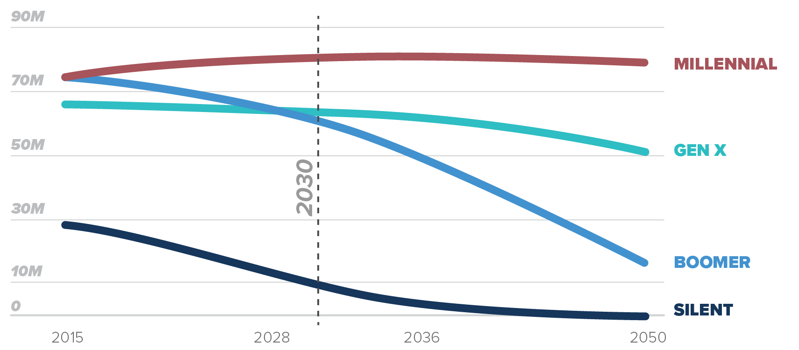
~̴Today
20-39
40-54
55-69
70+
Projected U.S. Population by Generation
Source: Pew Research Center tabulations of U.S. Census Bureau population projections

Slide 12
85+
% Growth to 2030 by Age Group
84-80
79-75
74-70
69-65
64-60
59-55
54-50
49-45
44-40
39-35
34-30
29-25
24-20
19-15
14-0
0%
20%
40%
60%
80%

Slide 13
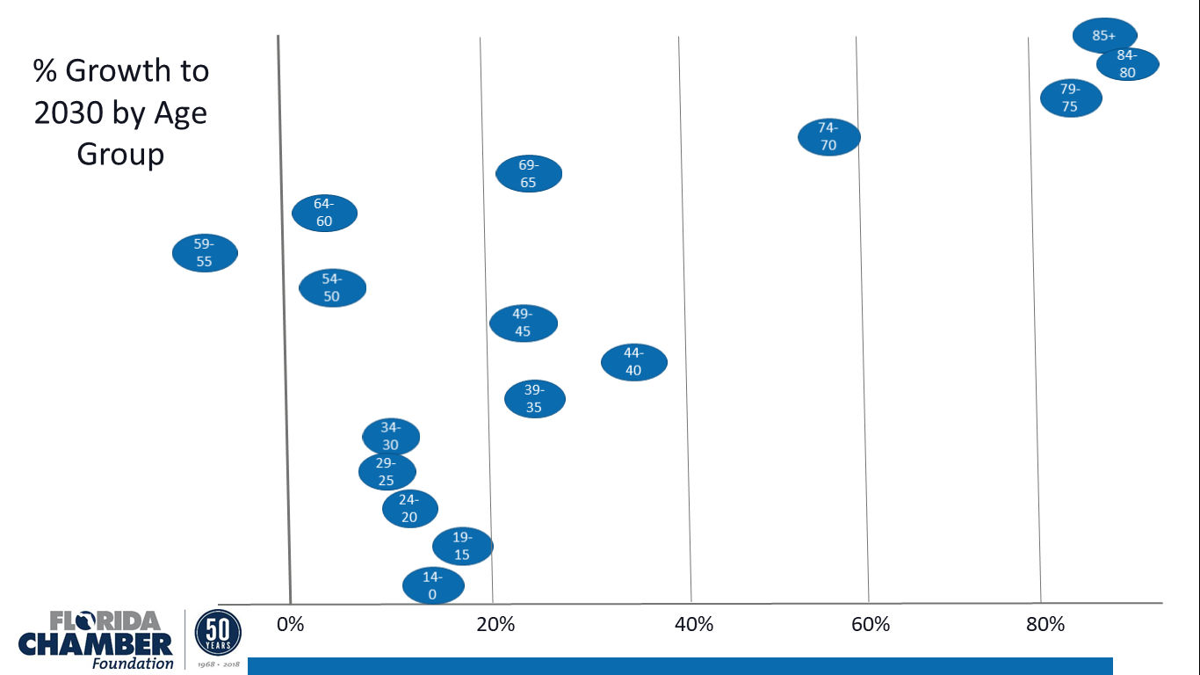
+ 2.4 Million Seniors
BUT
3 of 4 still < 65

Slide 14
New Voters Since 2010
Map Shaded by
New Voters/Total Voters
1 in 2 new voters
1 in 3 new voters
1 in 4 new voters
1 in 5+ new voters

Slide 15
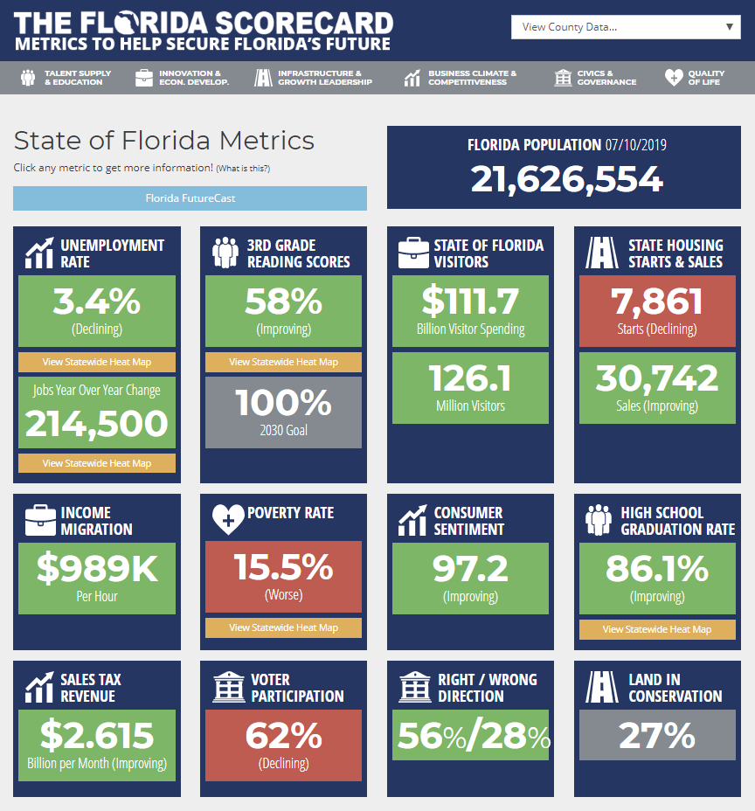
www.TheFloridaScorecard.org
Downloadable charts
Data is downloadable
Links to data sources
Free to use

Slide 16
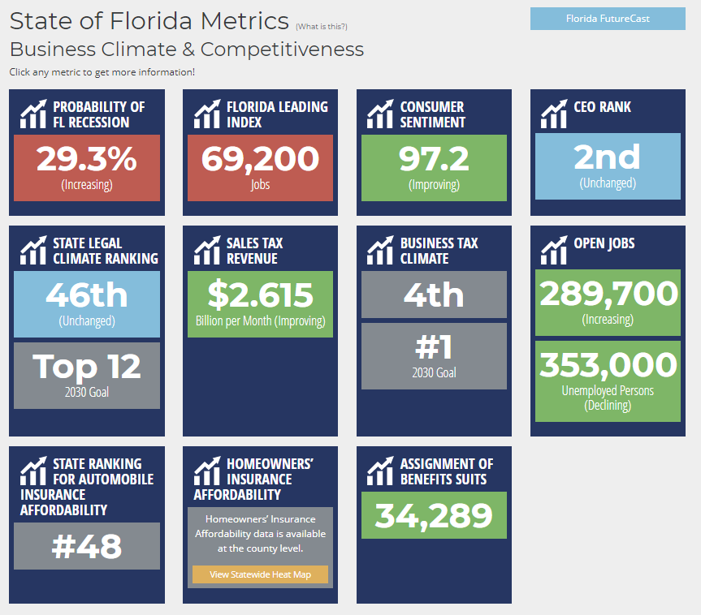
www.TheFloridaScorecard.org

Slide 17
www.TheFloridaScorecard.org
January 2018

Slide 18
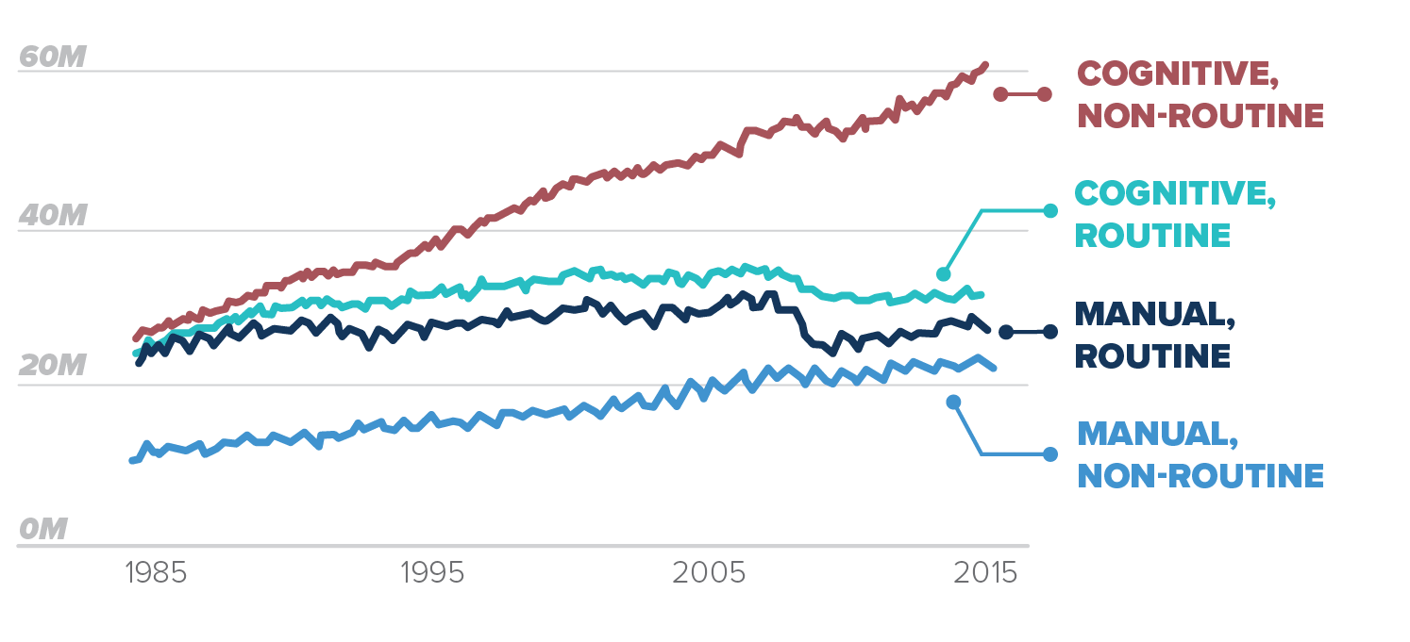
Nature of Work
Manager, computer tech, artist, etc.
Office & admin,
sales
Construction, manufacturing, production
Food prep., personal care, retail. Healthcare support
U.S. Employment by Job Type
Source: Federal Reserve Bank of St. Louis analysis of Bureau of Labor Statistics occupational data

Slide 19
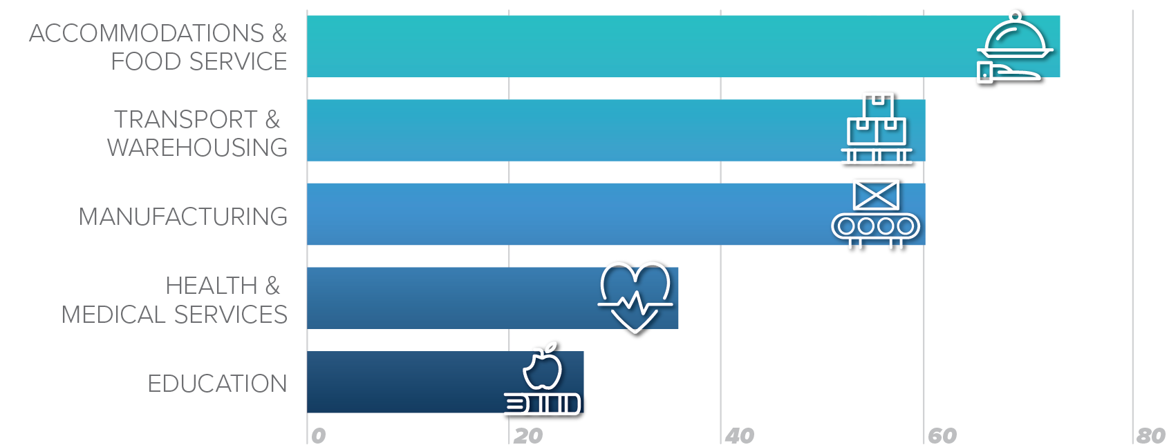
Nature of Work
Percent of Selected Jobs that Could be Automated Using Existing Technology
Source: McKinsey Global Institute, 2017.

Slide 20
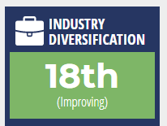
Florida’s $1 Trillion GDP by Industry – Q1 2018 ($Billion)
Source: Federal Reserve (FRED) Data

Slide 21
Florida’s $1 Trillion GDP by Industry – Q1 2018 ($Billion)
Technical Potential for DISRUPTION
Predictable Physical Work
Data Processing
Data Collection
Stakeholder Interactions
Managing Others
Non-Place Based Analysis/Transactions
Source: Federal Reserve (FRED) Data, Preliminary estimate using McKinsey Global Institute, Analysis for Jobs in the Americas

Slide 22
Source: McKinsey Quarterly, July 2016, Florida Chamber Foundation’s Florida Jobs 2030

Slide 23
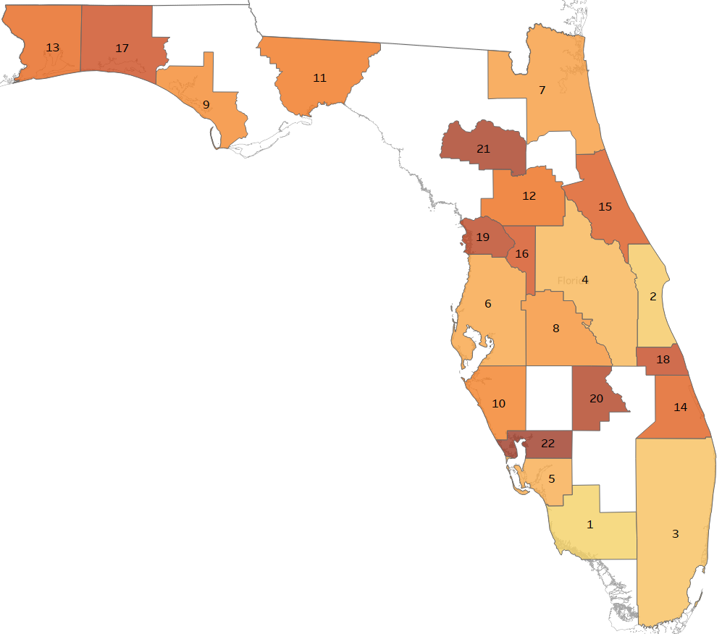
Florida
Industry Diversification by MSA
#1 Naples-Immokalee-Marco Island MSA
#2 Palm Bay-Melbourne-Titusville MSA
#3 Miami-Ft. Lauderdale-West Palm Beach MSA
#4 Orlando-Kissimmee-Sanford MSA
#5 Cape Coral-Ft. Myers MSA
#6 Tampa-St. Petersburg-Clearwater MSA
#7 Jacksonville
#8 Lakeland-Winter Haven
#9 Panama City
#10 North Port-Sarasota-Bradenton
Data Source: Florida Gulf Coast University, Regional Economic Research Institute. Q4 2018 data

Slide 24
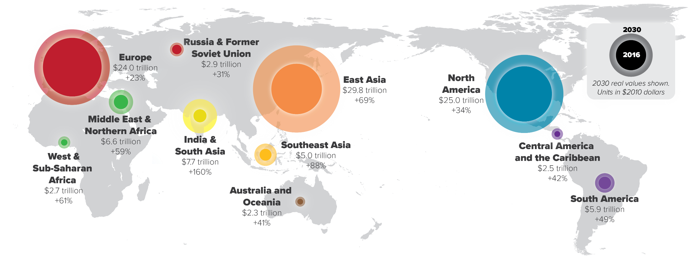
Global Markets
Projected Gross Domestic Product Growth by Region, 2016-2030
Source: U.S. Department of Agriculture, Economic Research Service, 2016

Slide 25
3B new Job Wars Global 500

Slide 26
Global Competition
(17th to 10th)
-----------------
Path to Prosperity
for every zip code in FL
-----------------
Vibrant & Resilient Communities
How do we plan better for the
next 5 million Floridians than
we did for the last 5 million?

Slide 28
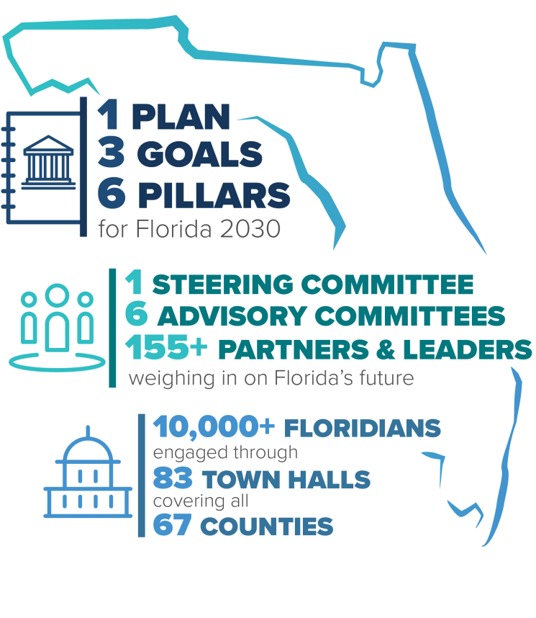

Slide 31
Coordinates

Slide 32
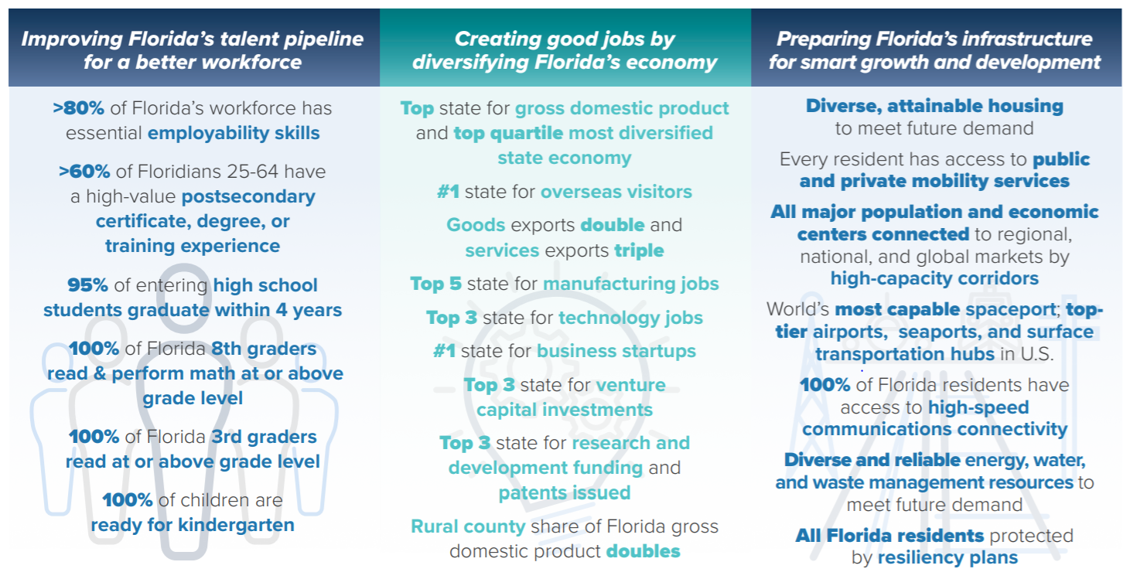
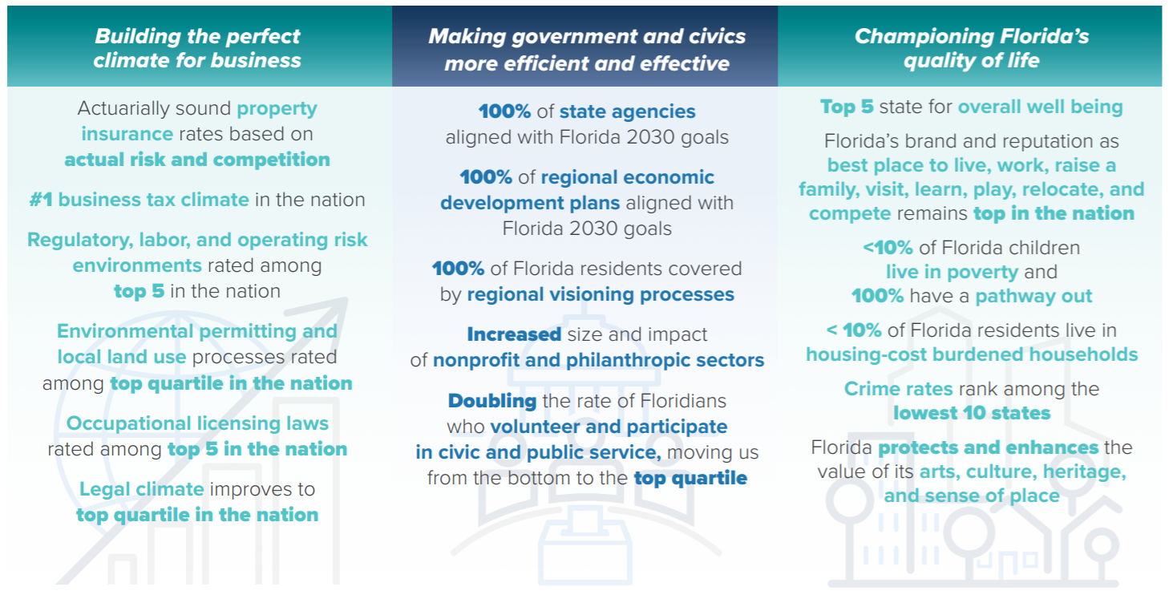

Slide 33
