Slide 1
Lessons Learned and Next Steps for Road Usage Charging
Floridians for Better Transportation
TEAMFL Focus Session
Travis P. Dunn
RUC Discipline Leader
July 8, 2021

Slide 2
Definition: Road Usage Charge (RUC)
A tax or fee collected from vehicle owners that is proportional to their consumption of the public roadway network.
Aliases:
Per-mile fee
Mileage tax
Mileage-based user fee (MBUF)
Distance-based fee
Road charge
Vehicle mileage tax (VMT)
RUC is different from tolls: While tolls are levied for access to a specific facility, RUC applies on all roads in a taxing jurisdiction (e.g., a state).

Slide 3
Explorations of RUC nationally
ME
WA
VT
MT
ND
NH
MA
OR
MN
NY
ID
WI
RI
SD
MI
CT
WY
PA
MD
NJ
IA
DE
NE
OH
NV
IL
IN
WV
VA
DC
CA
UT
CO
KY
KS
MO
NC
TN
SC
OK
AR
3
Enacted programs
AZ
NM
GA
MS
AL
10
Pilots/demonstrations
TX
LA
AK
FL
14
Research
HI

Slide 4
Issues raised during public presentations of RUC
Privacy protection
Data security
Exemptions and refunds
Out-of-state driving
Location-aware mileage reporting
Interoperability with other states, counties, federal
Compliance and enforcement
Scalability of systems
Flexibility for policy adaptation
Evolution of technology and business models
Equity by geography, vehicle type, income level
Cost of administration
Transition
Rate setting (including by weight, configuration)
Integration with tolling, congestion pricing
Fleet management
User experience
Organizational design
Constitutional issues (e.g., commerce clause)
Third party risk management
Impact of charging on environment, emissions

Slide 5

2011
2015
2016
2017
2018
2019
2020
  A state can develop a successful, innovative system from scratch.
Oregon
  Sustained legislative support is required to achieve long-term objectives.
  Privacy can be protected through system design and law.
  Building institutional knowledge is essential to success.
5
FBT 2021 TEAMFL Focus Group The Gas Tax: Running on Empty

Slide 6
2011
2015
2016
2017
2018
2019
2020
  Stretching the limits
California
  Expanding user choice
  Preserving the open market
  New mileage reporting methods
6
FBT 2021 TEAMFL Focus Group The Gas Tax: Running on Empty

Slide 7
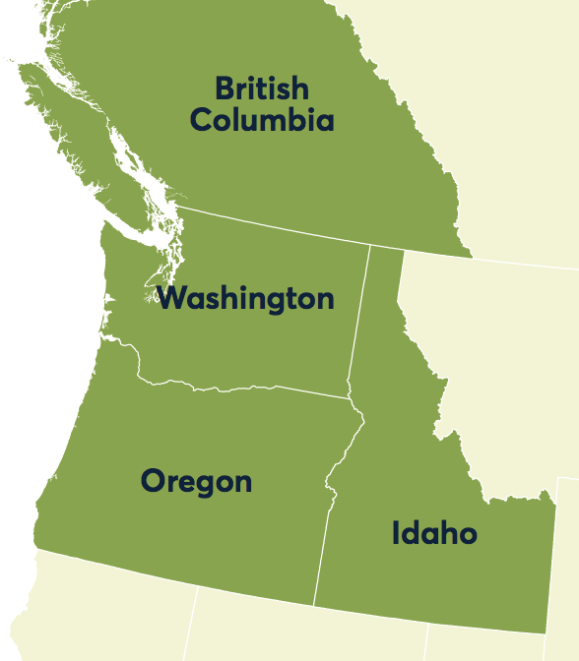
2011
2015
2016
2017
2018
2019
2020
  Participatory design to devise a smartphone mileage meter app
Washington
  Multiple jurisdictions using different vendors may participate in the same RUC system
  A shared interoperability hub (clearinghouse) may manage RUC data from multiple sources (vendors)
7
FBT 2021 TEAMFL Focus Group The Gas Tax: Running on Empty

Slide 8
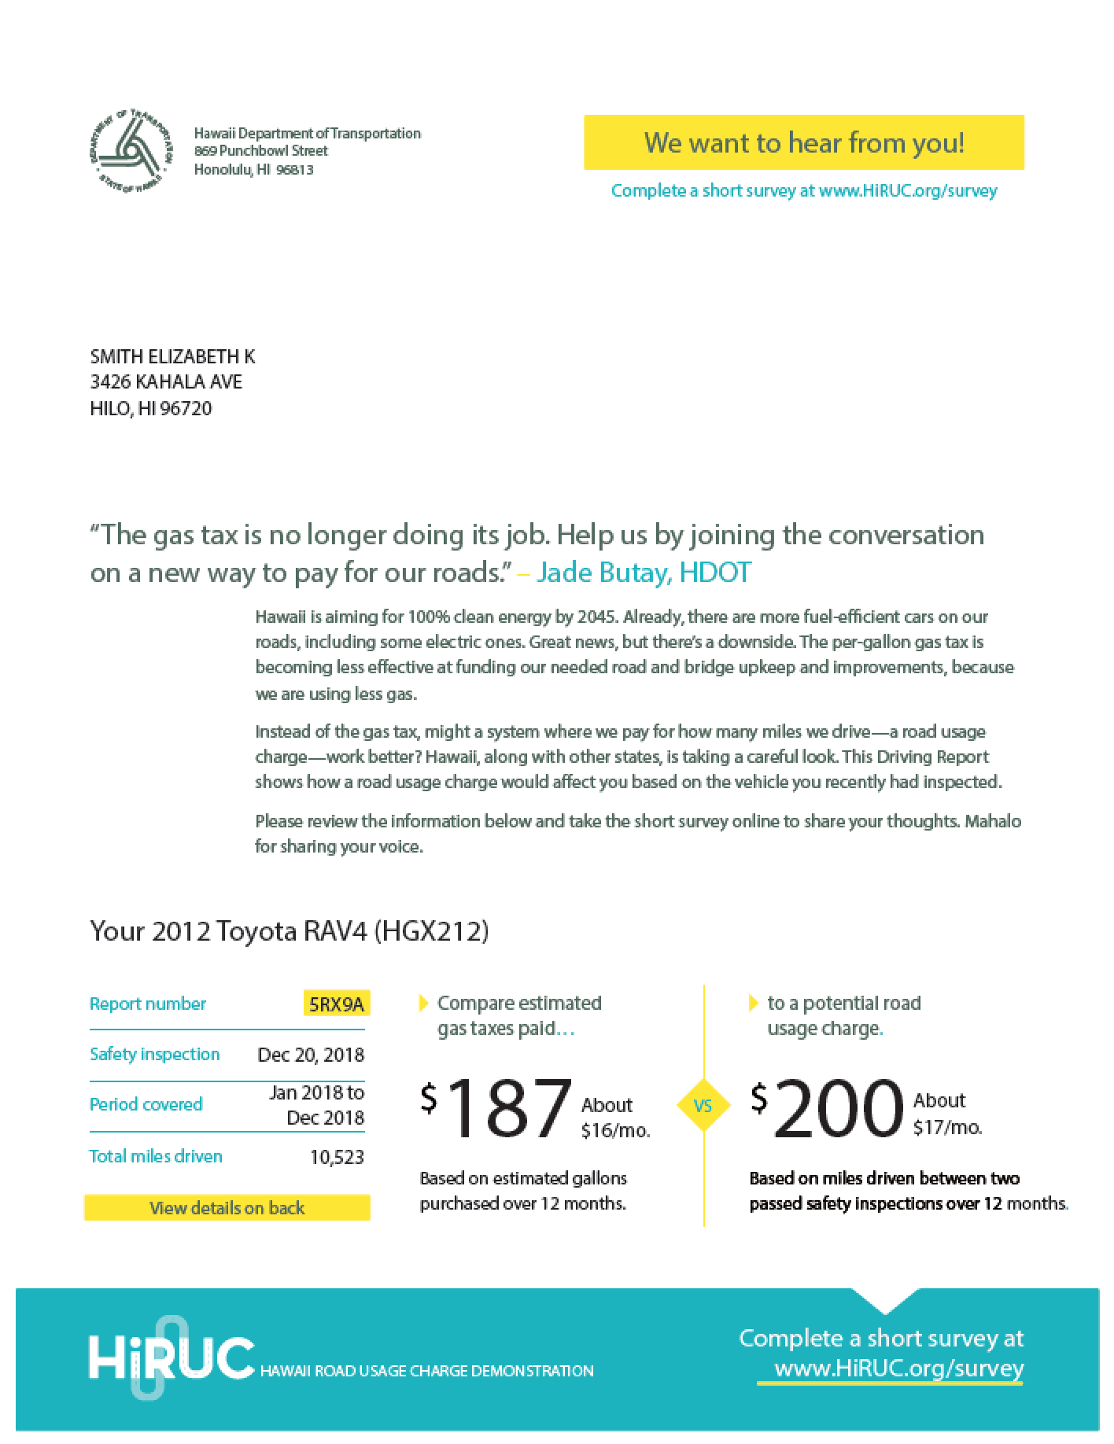
2011
2015
2016
2017
2018
2019
2020
Hawaii
  Safety check odometer-based charging is viable.
  Proactive public outreach accelerates ability to address key issues.
  Assessing fleets, especially rental cars, is challenging but critical for public acceptance.
  Invest in user experience and participant research.
8
FBT 2021 TEAMFL Focus Group The Gas Tax: Running on Empty

Slide 9
2011
2015
2016
2017
2018
2019
2020
Utah
  A state can launch a successful program in under two years with focused work by several dedicated staff with high program understanding.
  Business rule decisions have major impacts on the customer experience.
9
FBT 2021 TEAMFL Focus Group The Gas Tax: Running on Empty

Slide 10

The road forward
2011
2015
2016
2017
2018
2019
2020
2021
2022
  Rural, Midwest RUC: Prioritizing a human centered approach to understand the needs of rural communities in the Midwest.
  RUC for AVs: Leading with a stakeholder approach to understand Autonomous vehicle business models.
  Equity: Taking a deeper dive into equity to understand impacts on underrepresented communities
FORWARD DRIVE
10
FBT 2021 TEAMFL Focus Group The Gas Tax: Running on Empty

Slide 11
Critical issues hampering RUC enactment
Privacy protection
Equity by geography, vehicle type, income level
Cost of administration
Transition

Slide 12

Privacy
The Issue: Many drivers do not want to surrender their data to anyone, especially the government
The Context: Many drivers fear their data cannot be protected in a RUC system
The Truth: Americans give up their privacy in more serious ways every day through use of their phones, computers and in-vehicle telematics
Solutions:
  System design:
    Offer choice of alternatives for data reporting, including low-tech (manual) options
    Offer choice of account managers
    Design systems and technology to protect data
  Law:
    Restrict government access to the data
    Enact privacy and data protections into law

Slide 13


Equity by geography
The Issue: Rural and long-distance drivers object to RUC because of concerns RUC will unfairly burden them
The Context: The gas tax already unfairly burdens many of these drivers by requiring them to pay more per mile than urban drivers who tend to drive higher-MPG vehicles
The Truth: RUC may advantage driving low-MPG vehicles because these drivers pay more in gas tax today
Solutions:
  Better communication of the context and truth
  Adopt a RUC mandate that keeps low-MPG vehicles on the gas tax rather than paying RUC

Slide 14

Equity by vehicle type
The Issue: Advocates for zero-emission vehicles believe RUC will hamper sales and use
The Context: (1) RUC will replace the gas tax—a road tax, not an environmental tax; (2) Zero-emission vehicle operators currently do not pay their fair share in many states
The Truth: RUC represents a small fraction of vehicle operating costs regardless of engine type
Solutions:
  Better communication of the context and truth
  Address environmental priorities through parallel policies

Slide 15

Equity by income level
The Issue: Advocates for low-income drivers believe RUC will disadvantage them
The Context: All drivers currently pay the same tax rate for gasoline purchases no matter their income level
The Truth: The lowest-income drivers have the greatest mobility challenge when gas tax is increased and will be advantaged by RUC
Solutions:
  Better communications of context and truth
  Offer a tax rebate of some portion of RUC amount to low-income drivers or some other tax adjustment mechanism

Slide 16

Cost of administration
The Issue: Fear that the cost of operating a RUC system will be exorbitantly more expensive than the fuel tax.
The Context: The cost of operating the gas tax is extraordinarily low, but the cost of operating most other tax systems in the U.S. range from 5% to 20%.
The Truth: Experts believe the cost of RUC, at scale, will be less than 10 percent, like other common tax systems.
Solutions:
  Cost reduction analysis of high-cost elements of RUC collection like enforcement, customer service, enrollment, account management, procurement and certification.
  Interstate coordination on RUC systems.
  Access to in-vehicle automaker telematics for data reporting.

Slide 17

Transition
The Issue: How swiftly can governments shift from the gas tax to RUC without risking significant loss of revenue?
The Context: The revenues from the gas tax are waning and will continue to wane as more drivers shift to electric vehicles in great number later this decade.
The Truth: With care, a government can phase-in a RUC program without risking significant loss of revenue.
Solutions:
  Start with RUC for EVs as an option in lieu of high flat fees
  Start with RUC for high-MPG vehicles first, then low-MPG vehicles later.
  Phase in RUC for new high-MPG vehicles of a certain model year and newer.

Slide 18
Federal Support
Both House and Senate proposals for transportation re-authorization include extension and expansion of state RUC pilot funding
Increases overall funding
Increases Federal share of pilot cost from 50% to 70 or 80%
Over time funding priorities will shift from pilot testing to actual deployments

Slide 19
Thank you
Travis P. Dunn dunntp@cdmsmith.com

